Slide 1
MQXF Long Coil Fabrication Status and Plans at Fermilab
Fred Nobrega
HiLumi - LARP Collaboration Meeting
May 11-13, 2015
FNAL

Slide 2
Outline
Overview
Status
Wind & cure
Reaction/Impregnation
Fabrication Plan
Summary

Slide 3
Overview
Practice cable 1 → coil fab process at FNAL
Practice cable 1a → coil fab process at BNL
Long coil #2 → mirror magnet assembly at FNAL
Long coils #3-6 → 1st long magnet
All coil winding at FNAL
Coils 3 & 5, reaction & impregnation at BNL
Coils 4 & 6, reaction & impregnation at FNAL
Coil travelers updated and revised as needed.

Slide 4
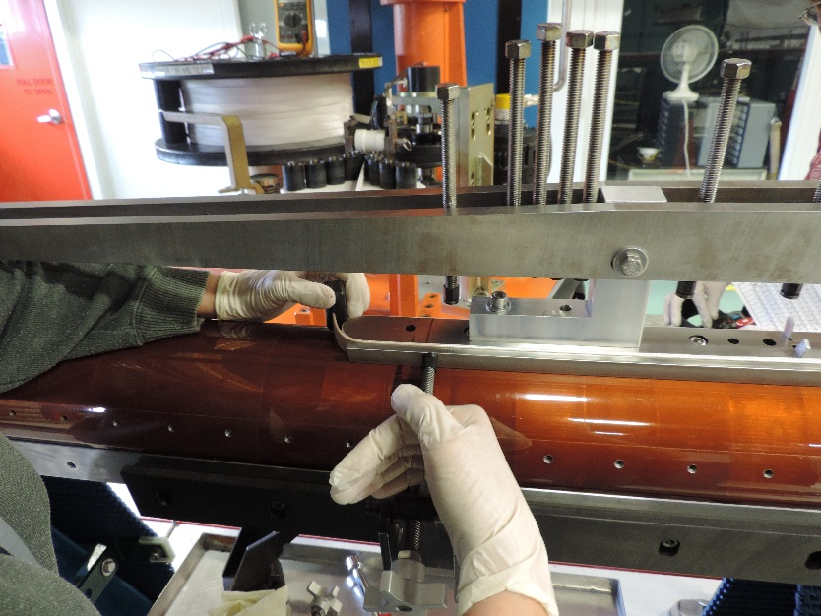
Fabrication Status, Wind & Cure
Long coil winding machine recently modernized and commissioned since last used in 2005 (ICB) for LHC IR Q2a/b coils.
Winding Machine designed for single layer coils, coil pairs spliced.
New curing mold complete & ready for introductory cure cycle.
All curing tooling is at FNAL, spacers, pushers, shells, etc. Curing shim at FNAL machine shop due May 19.
Coil winding of 1st practice coil with practice Nb₃Sn cable has begun.

Slide 5
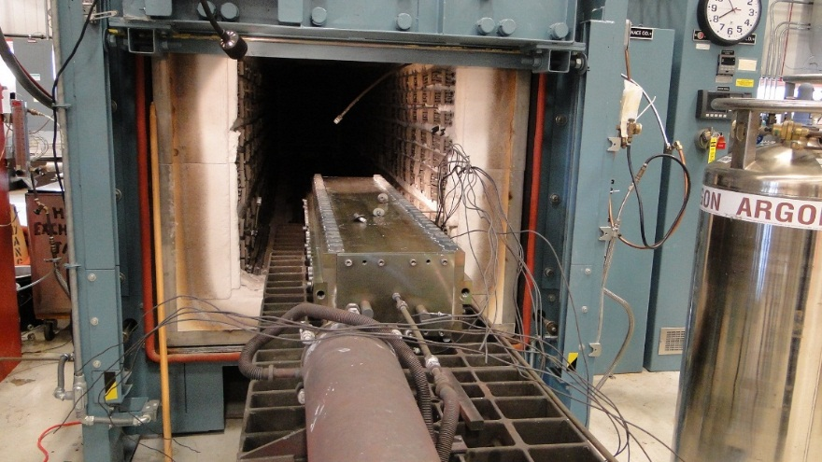
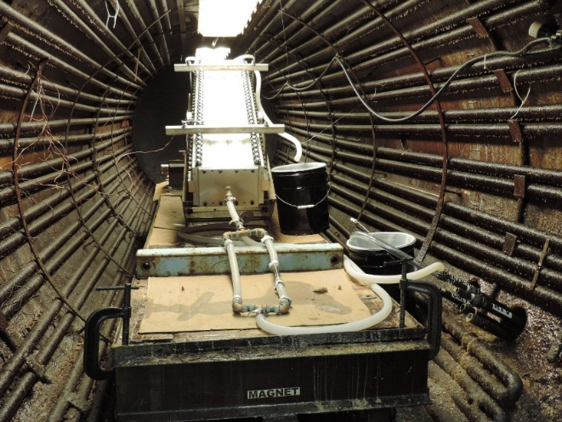
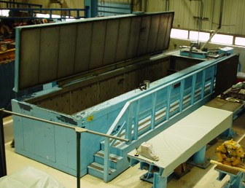
Fabrication Status, Reaction/Impregnation
2 sets of reaction and 2 sets of impregnation tooling were procured in Aug.
100 % of form blocks received by FNAL
~25% rejected and are being reworked or remade.
4.4 m long base plates and stiffener plates are 75% complete.
Two of each is expected at FNAL Thursday, May 15.
Upon inspection approval, there will be 1 complete reaction tooling assembly and 1 complete impregnation assembly
Remaining 2 sets of plates expected in about 3-4 weeks.
New/reworked form blocks expected in about 6 weeks.

Slide 6
Fabrication Plan
Practice coil #1 → 5/4/15 - 11/25/15
Practice coil #1a → 6/30/15 - 12/10/15
Long coil #2 → 9/2/15 - 3/1/16
Long coils #3-6 → 11/9/15 - 7/8/16
1st long magnet assembly → 10/3/16 - 2/10/17
Magnet test → 2/27/17 - 5/19/17

Slide 7
Summary
Long coil winding has begun.
Curing tooling is complete.
Reaction and impregnation tooling procurement is about 75% complete.
One complete set of reaction and impregnation tooling expected to available when the 1st practice coil winding and curing is complete.
Coil travelers being updated/revised as needed.

