Slide 1
QXF Long Coil Fabrication Status and Plans
J. Schmalzle
May 12, 2015

Slide 2
QXF Long Coils
Preparation for reaction & impregnation of 4 m coils.
Plans for winding and curing.
Plans for 4.2 m coils.

Slide 3
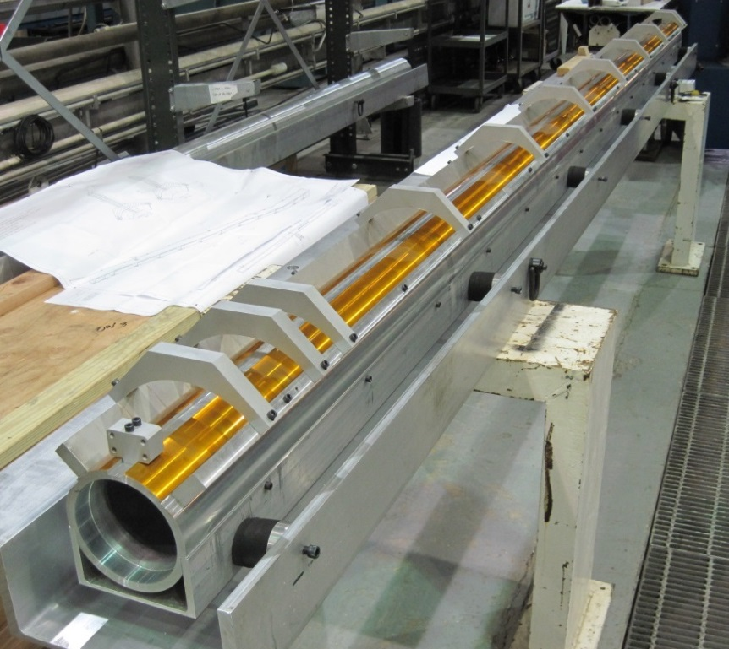
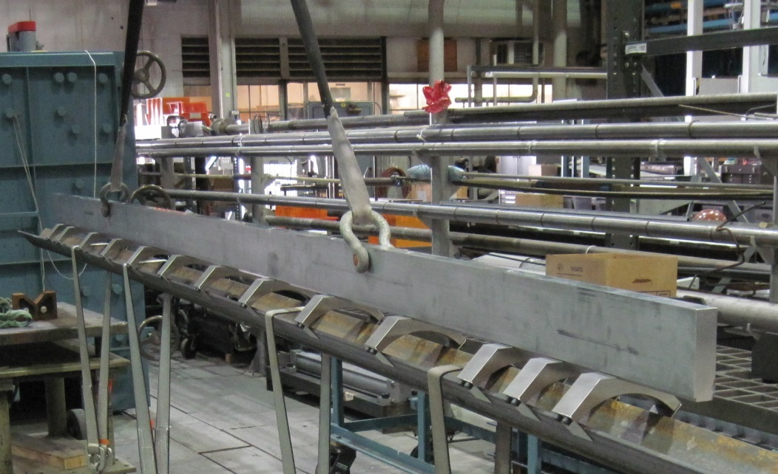
QXF Long Coils
Preparation for reaction / impregnation of 4 m coils:
Coil lifting fixture fabrication, assembly and load test complete – 3 sets.
Coil shipping fixtures – fabrication and assembly complete.
Fabrication of wooden crates also complete.
One shipping fixture and one lifting beam shipped to FNAL.
Reaction / Impregnation tooling to be supplied by FNAL.

Slide 4
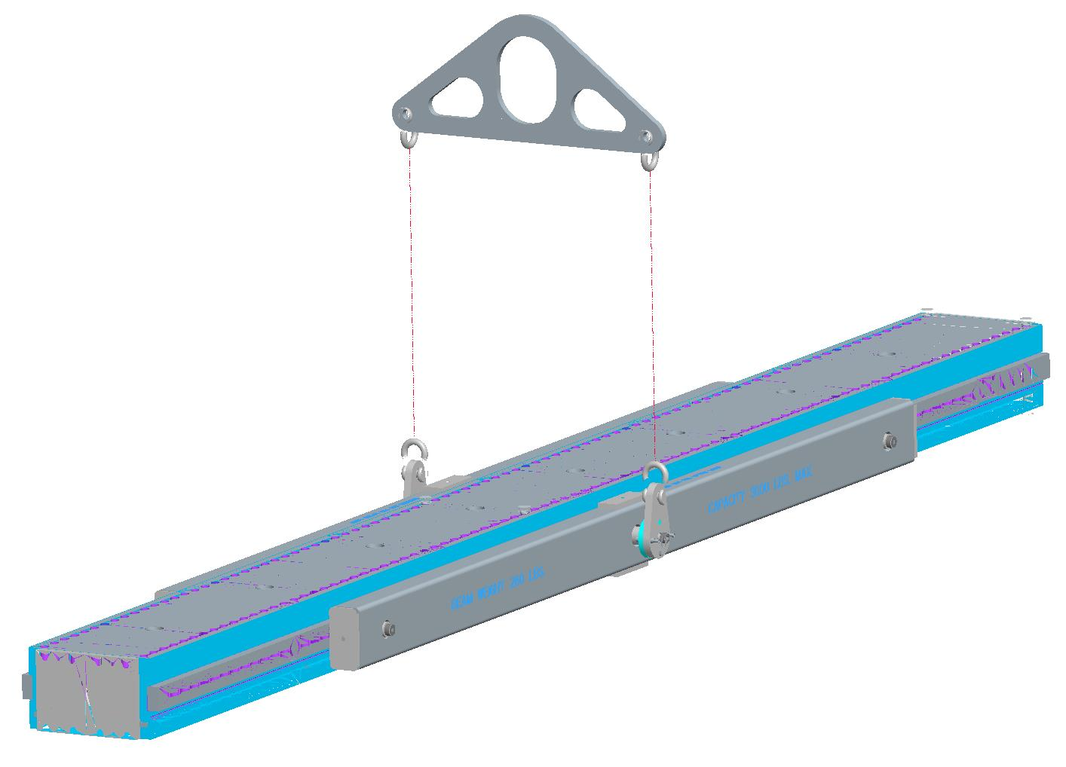
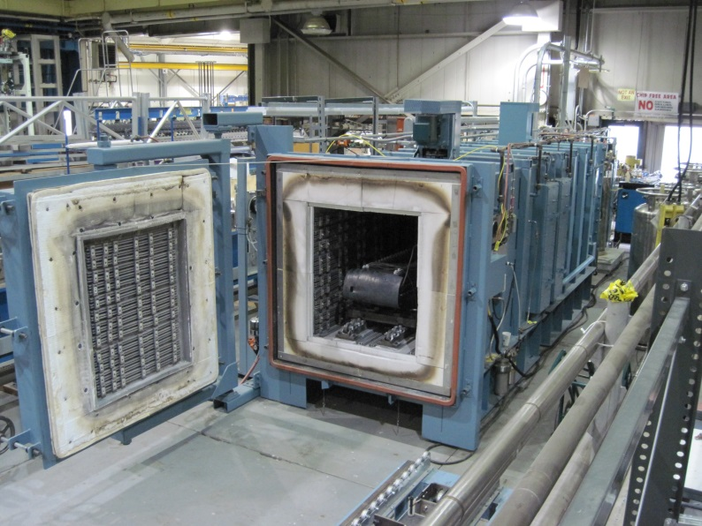
QXF Long Coils
Fixture lifting / rotating beams.
Fabrication complete.
Load testing planned for next week.
Reaction oven length is sufficient to accommodate 4 m coils.
Impregnation tank and top hat are suitable for long coils.
New impregnation fixture heaters purchased.

Slide 5
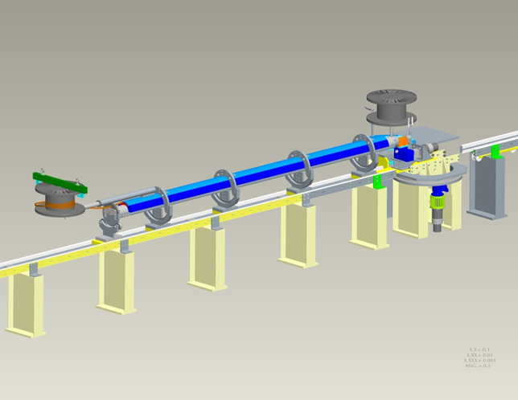
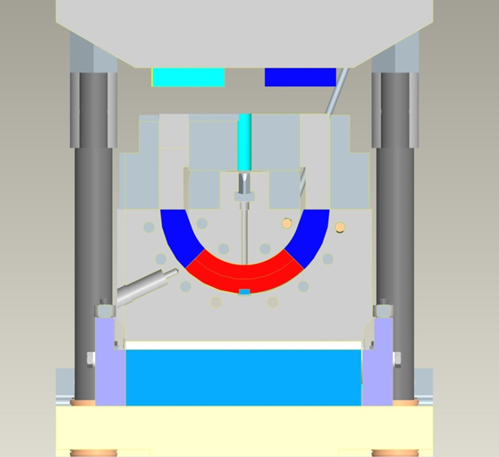
QXF Long Coils
Plans for winding and curing.
Winding machine and curing press existing.
QXF winding and curing tooling preliminary design complete.
Detailed W/C tooling design to start in June.
Funding for tooling fabrication expected in FY16.
Plans for 4.2 m coils.
Need to extend the reaction oven to accommodate the longer coils.
Looking at adding an extension of approximately 1 meter.
Working with oven vendor to come up with a detailed plan for fabrication and installation of oven extension.
Coil lifting and coil shipping fixtures will need to be modified / extended.

