Slide 1
Collimator materials for high-density energy deposition - report from WP 11
LARP HiLumi Meeting, Fermilab, 11 May 2015 Adriana Rossi on behalf of

Slide 2
ColMat-HDED collaboration and beyond
industrial,
extra-EU
ColMat-HDED partners: scientific,
NRC KI
Partnership agreement with CERN (KN2045)
Collaboration CERN with US-LARP
Notes:
Main founding to Kurchatov lab. From CERN Collimation Project
Complementarity with irradiation tests at BLN, different energies and additional materials tested .
Glidcop, Molybdenum, CuCD, MoGr
BNL Features:
Irradiation with proton beam at 200 MeV
Indirect water cooling and T~100°C (samples encapsulated with inert gas)
Thermo-physical and mechanical characterization for fluence up to 10²⁰ p/cm²
Possibility to irradiate with neutrons (simulate shower on secondary coll.)

Slide 3
Material studies
Requirements
Higher robustness (LHC beam energy density up to 15 GJ/mm2, 2-3 orders > other machines).
Lower impedance since collimators give, by far, the highest contribution to machine impedance, potentially leading to serious beam instabilities.
Larger resistance to radiation (1E16 p/y doses in LHC betatron cleaning insertion).
Higher absorption (clean efficiency for machine protection)
Experimental characterisation:
Irradiation
Beam impact
Thermo-mechanical tests
Thermo-mechanical and beam simulations
Radiation damage simulations

Slide 4
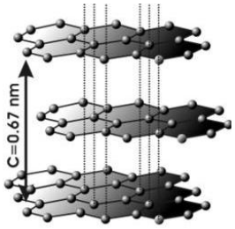
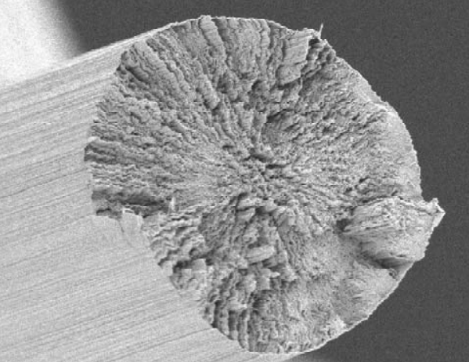
Some material science: MoGr Courtesy of M. Tomut (GSI)
Molybdenum-Graphite CF reinforced
Graphite crystallite is strongly anisotropic, having different physical properties for in-plane and transverse direction. If the graphite grains are correctly oriented along the planar direction, then in this direction the extraordinary properties can be realized.
Graphite and molybdenum have a chemically affinity for each other. The hexagonal Mo₂C can be formed when the powders of graphite and molybdenum are heated to 1000°C. During the process of the reaction, carbon atoms diffuse inside the molybdenum bcc lattice interstitials. When the amount of carbon reaches about 33%_{at} the molybdenum grain is totally transformed.
2Mo + C ↔ Mo₂C
In addition to MoGr, Carbon Fiber (CF) is also added. CF’s have been widely used as a reinforcing phase for the advanced composites due to their extraordinary physical and mechanical properties, such as high strength and high thermal conductivity.
As the amount of carbon further increases, the MoC carbide is formed. MoC carbide exhibits good mechanical properties if it can be finely dispersed inside the Mo₂C matrix, while the strength of the final composites can be reduced if MoC exists at the grain boundary. Therefore, it is essential to find an adequate temperature of the thermal treatment to ensure a fine dispersion of MoC inside the Mo₂C matrix.

Slide 5
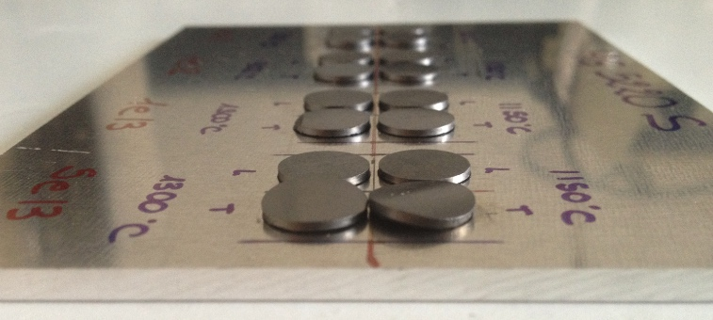
Experimental characterisation
GSI irradiation tests with swift heavy ions
In-plane and transverse MoGr samples irradiated at ≈ Bragg peak energy with Au U ions, with doses from 1E11 to 5E13 ions/cm².
All investigation methods (Laser Flash Method, Raman Spectroscopy, SEM, X-ray diffraction) show better stability if samples annealed prior exposure (so far 1150°C and 1300°C - 1800°C yet to be measured).
There seem to be a threshold dose for damage (to be understood).
Maximum irradiation dose should not be reached at LHC.
Irradiation above ion track formation.
At higher accumulated doses the transverse samples are deforming, whereas the in-plane samples experience no change of the shape. Optimization of radiation hardness of these samples has been done by pre-irradiation annealing.

Slide 6
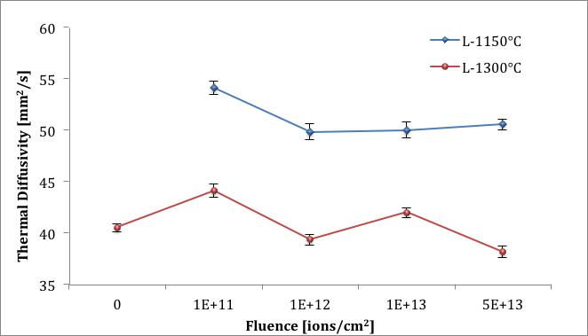
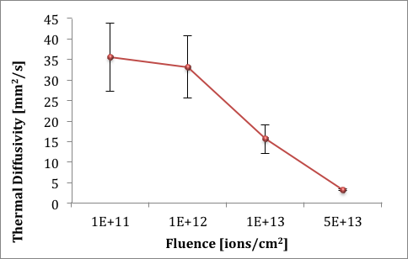
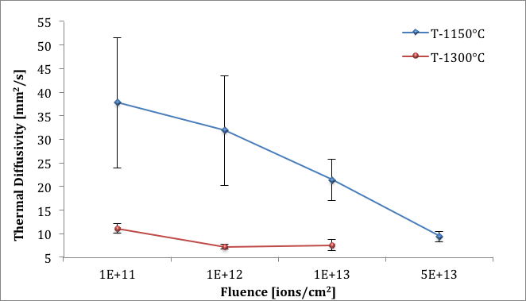
Results to be understood: LFA thermal diffusivity measurements
2 layers model
L = in-plane samples
T = transverse samples
1 layer model: as measured

Slide 7
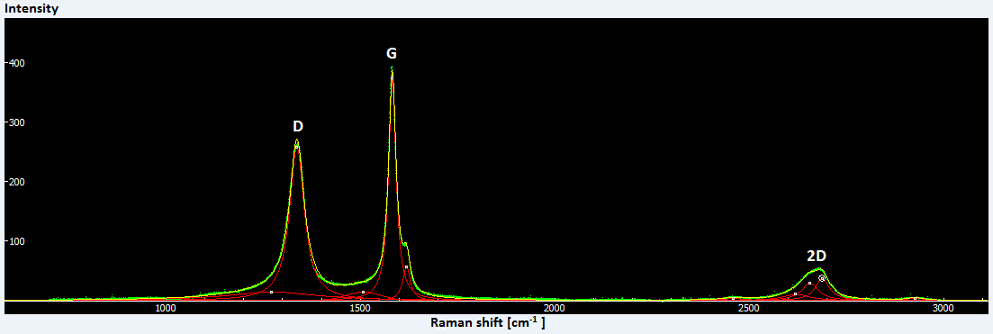
Parameters of the fist-order Raman spectrum
Look at the intensity ratio (I_{D}/I_{G}) and integrated area ratio (A_{D}/A_{G}) between D1 and G band as well as the broadening of G peak.
Most of the shown parameters are increasing with increasing ion dose which indicates the increasing disorder and the reduction of the in-plane grain size. These microscopic effects are the basic reason for the change of macroscopic property such as the thermal diffusivity. As above shown, the thermal diffusivity reduces with increasing ion implantation-induced disorder.
Raman spectrum of Mo-Gr sample “T-1150°C-5e13”

Slide 8
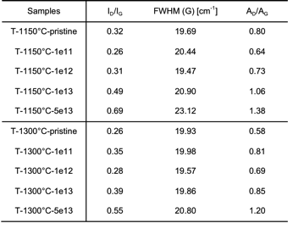
Parameters of the fist-order Raman spectrum
Change in first order of transversal samples for various fluences This table seems to point to a threshold effect: up to 1e12 no sign of degradation is evident, with even some indications of improved ordering at 1e11 …

Slide 9
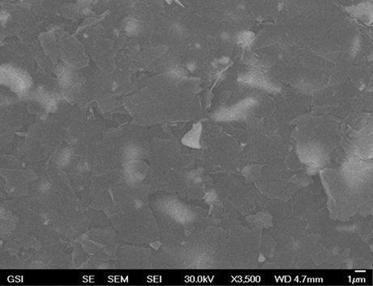
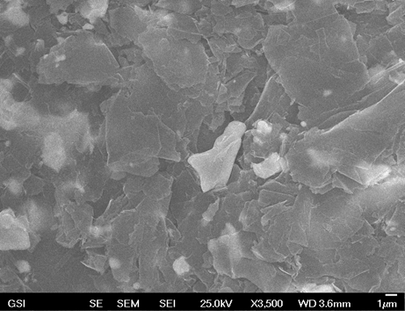
Microstructure with SEM
In-plane samples annealed at 1300°C for pristine (left) and irradiated with 1e12 ions/cm² (right)
By scanning electron microscopy (SEM) the radiation damage effects on microstructure can be observed. The white particles are molybdenum carbide, while the black area shows the graphite matrix.

Slide 10
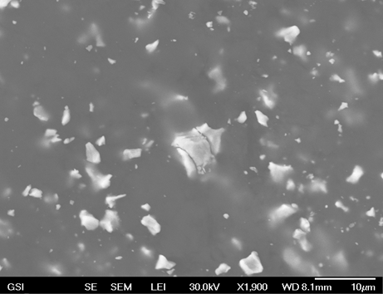
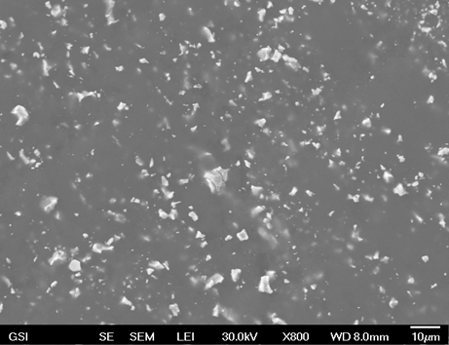
Microstructure with SEM
Transverse samples annealed at 1300°C irradiated with 5e13 ions/cm² with high (left) and low (right) magnification.
Under the LEI mode, which has a lower resolution, the carbide particles and their cracks can be more easily observed. The right image with low magnification shows more carbide particles but no other cracks.

Slide 11
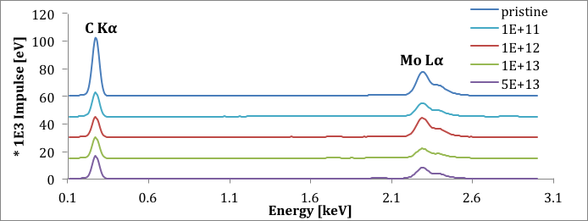
EDX spectrum
Different composition variations for different annealing temperature
How much the fact that samples come from different batch can affect the results?
T-1150°C
T-1300°C

Slide 12
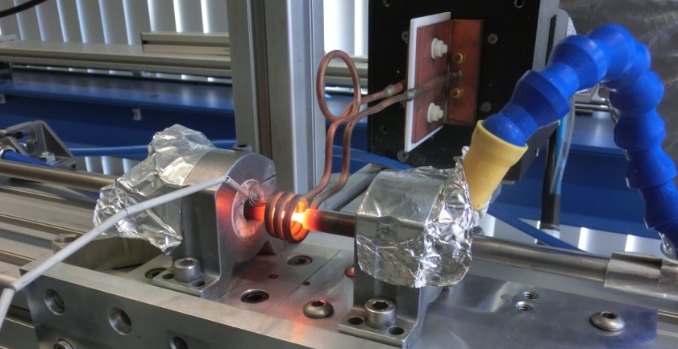
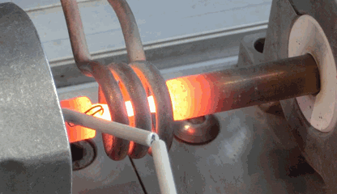
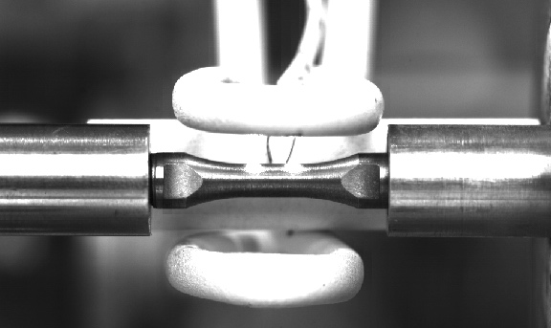
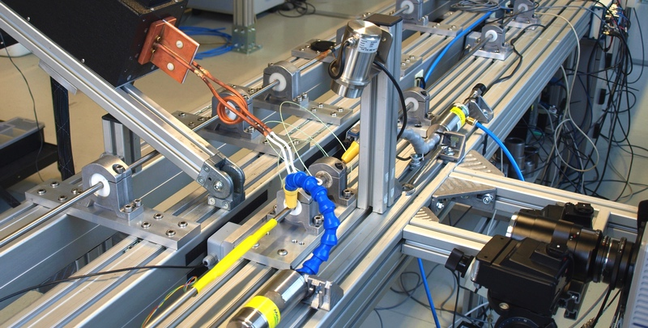
Experimental setup
SETUP 01
Induction heating system
Heating solenoid
Cooling jet
Thermocouple
Control thermocouple
SETUP 02
Induction heating system
Infrared pyrometer
Thermocouple
Heating solenoid
Fast camera
Pyrometer gage length
Infrared camera

Slide 13
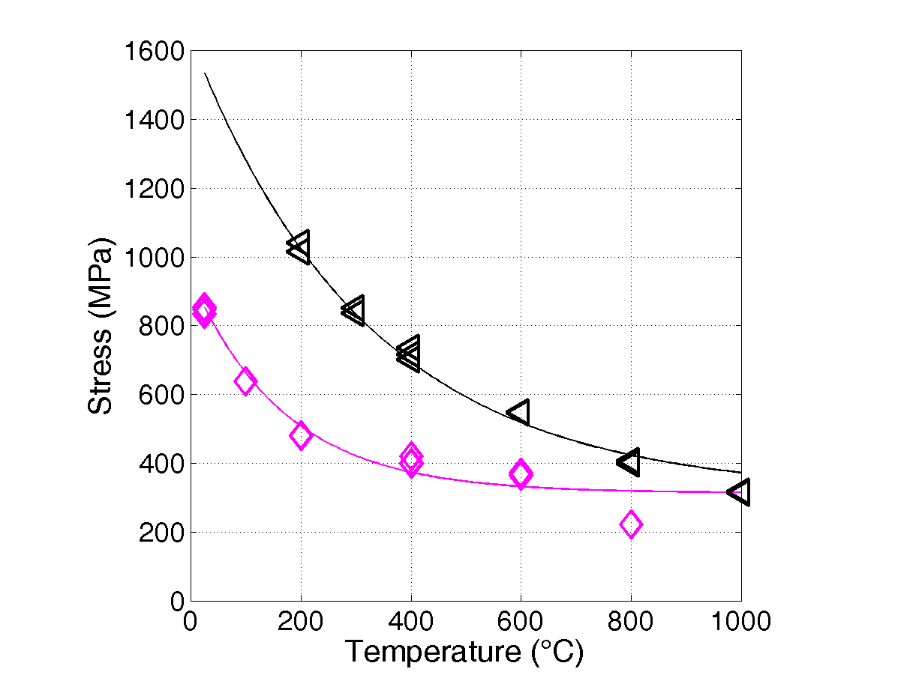
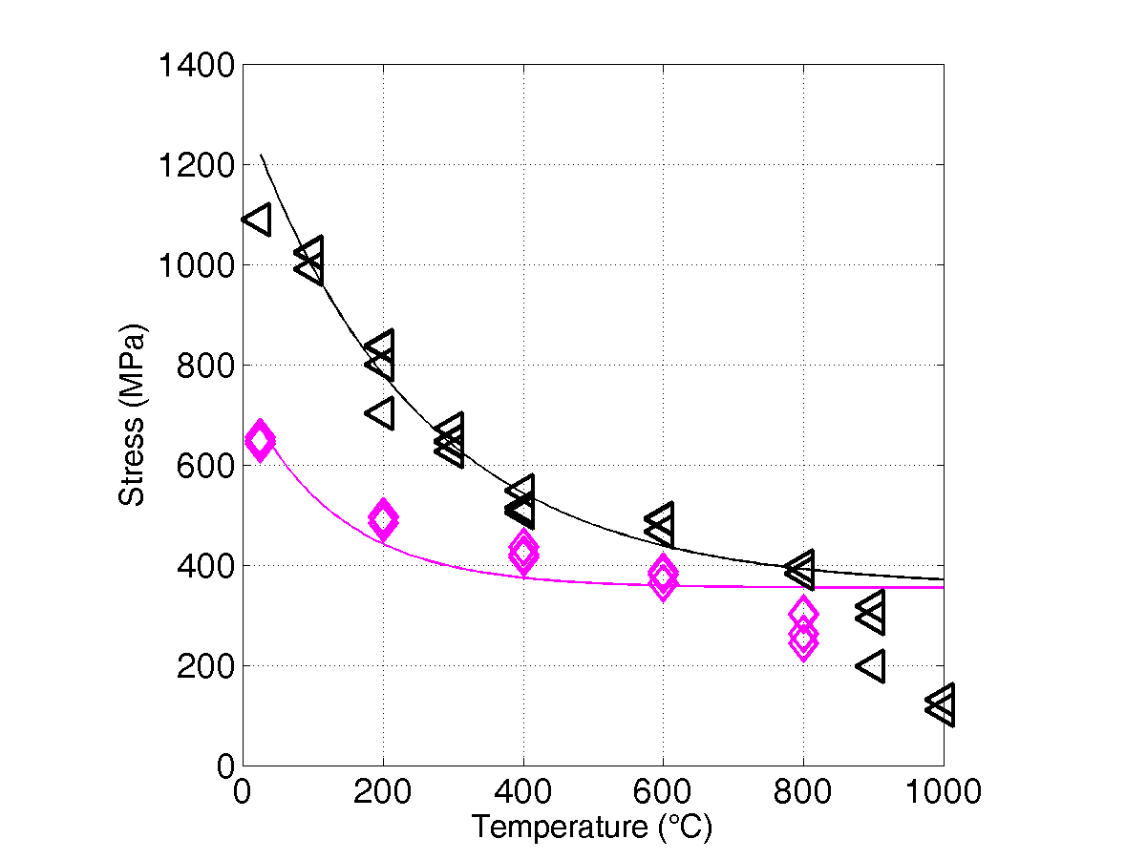
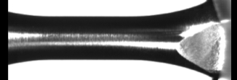
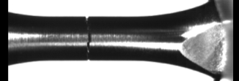
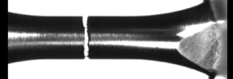
Mechanical characterization – Dynamic
At Politecnico di Torino, dynamic measurements performed to determine the effects of temperature and strain rate on the material behaviour
Characterization of metallic alloys with the Split-Hopkinson bar experimental setup:
Inermet180 (W-alloy) completed
Molybdenum (2 grades) completed
Densamet (W-alloy) ongoing
Inermet180
10³ s⁻¹
@5% max strain
Constitutive models to be used to predict material behaviour under extreme conditions (high strain rate, high temperature)
10⁻³ s⁻¹
Molybdenum grade1
A recent improvement in the setup allows the fast video recording of the test at high temperature and strain rates; a miniaturized setup was developed in order to reach strain-rates greater than 10⁴ s⁻¹
IT180
10³ s⁻¹
Mo
@5% max strain
10⁻³ s⁻¹

Slide 14
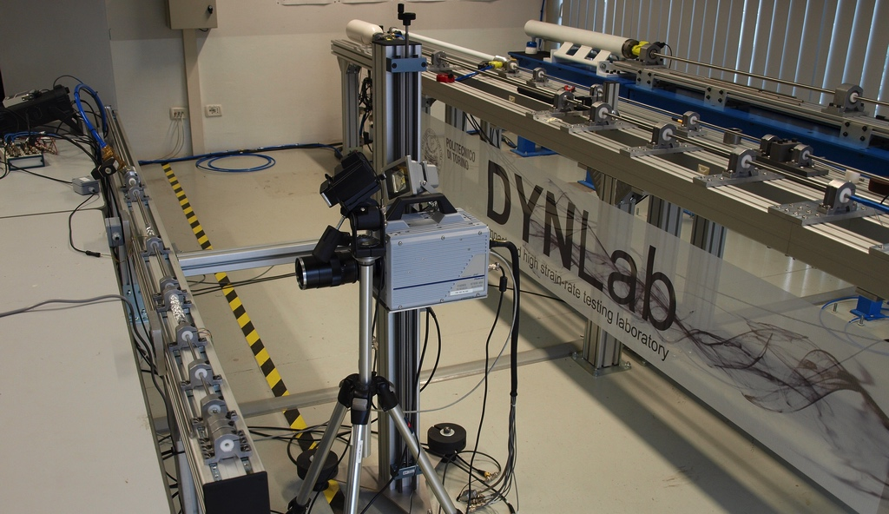
Mechanical characterization – Dynamic
Brittle materials are more difficult to evaluate, since the failure usually occurs in a tensile state
The dynamic tensile testing method developed for graphite in 2013 (presented at DAMAS conference) is not suitable for the novel composites because of size constraints
A Brazilian-Test setup is being prepared; it makes use of the Hopkinson bar as a striker for the specimen. OK for CuCD and MoGr testing!

Slide 15
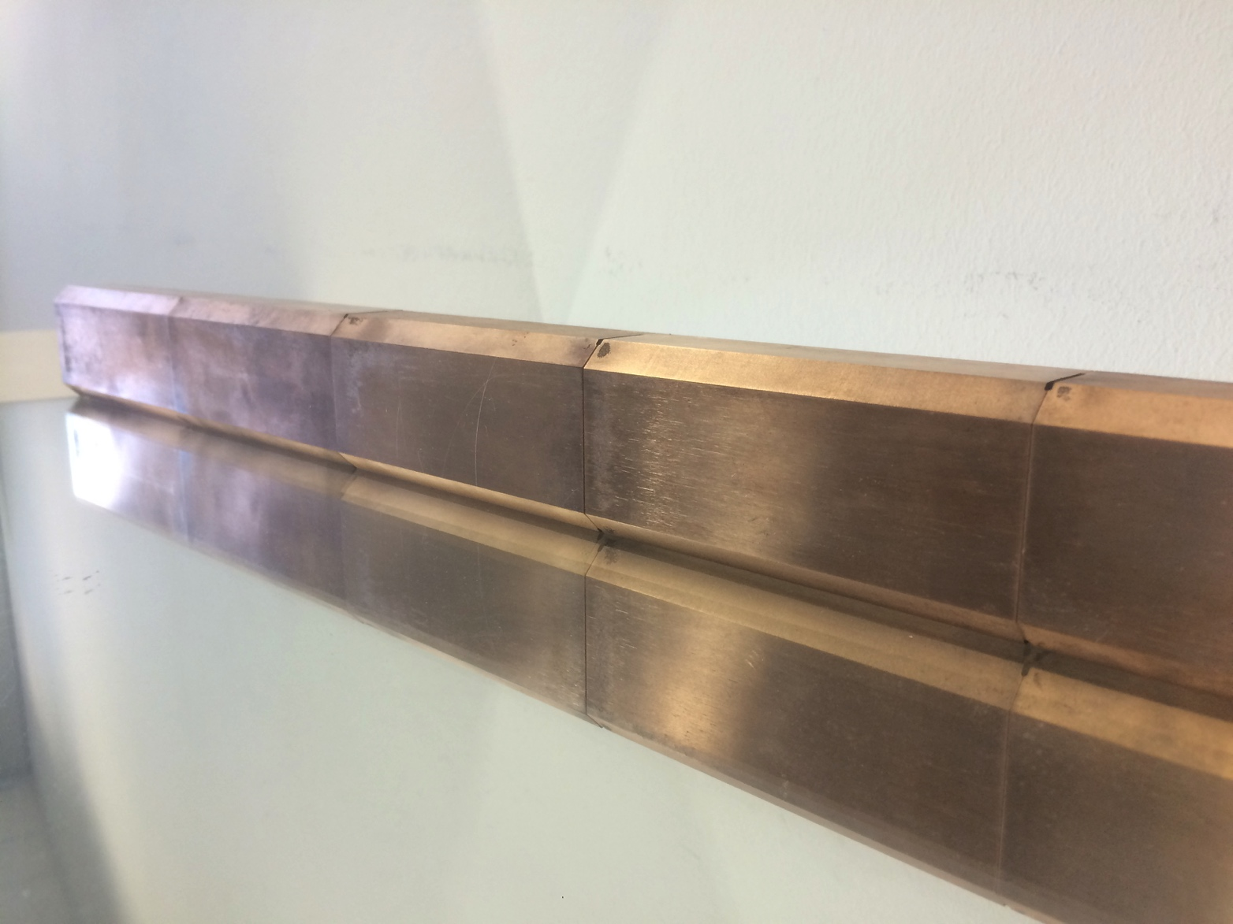
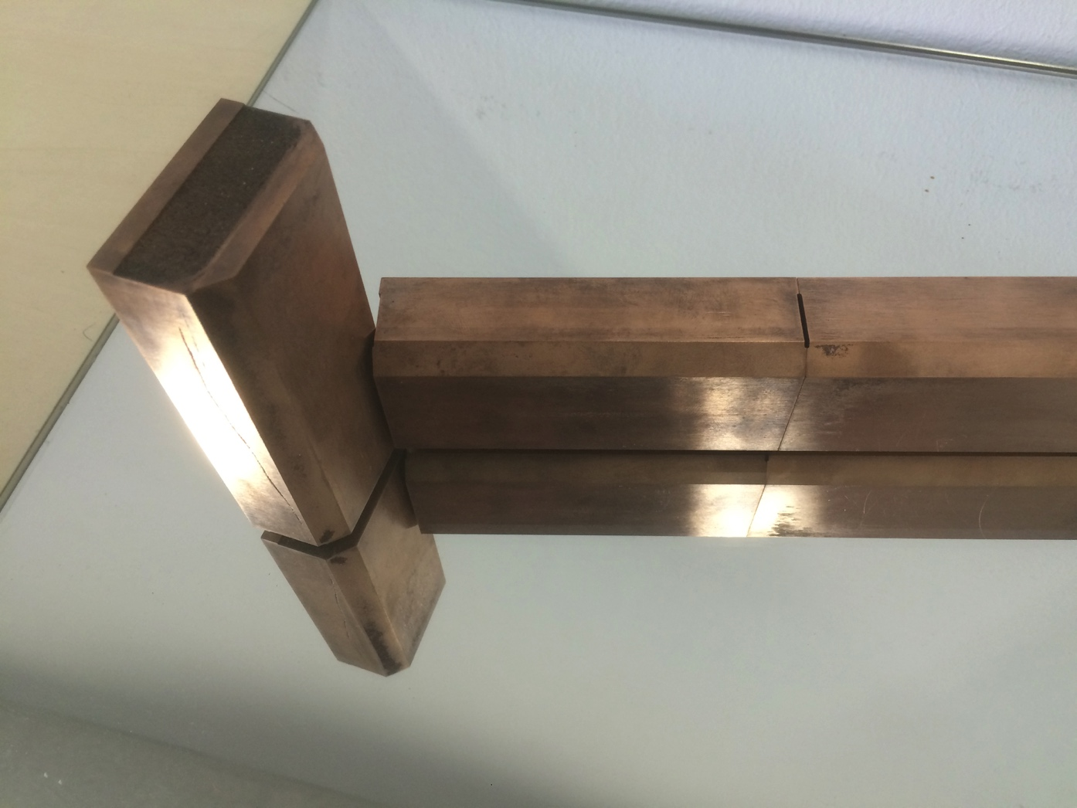
Contribution from industries
RHP : New samples for characterisation and large blocks of CuCD for a full scale collimator test.

Slide 16
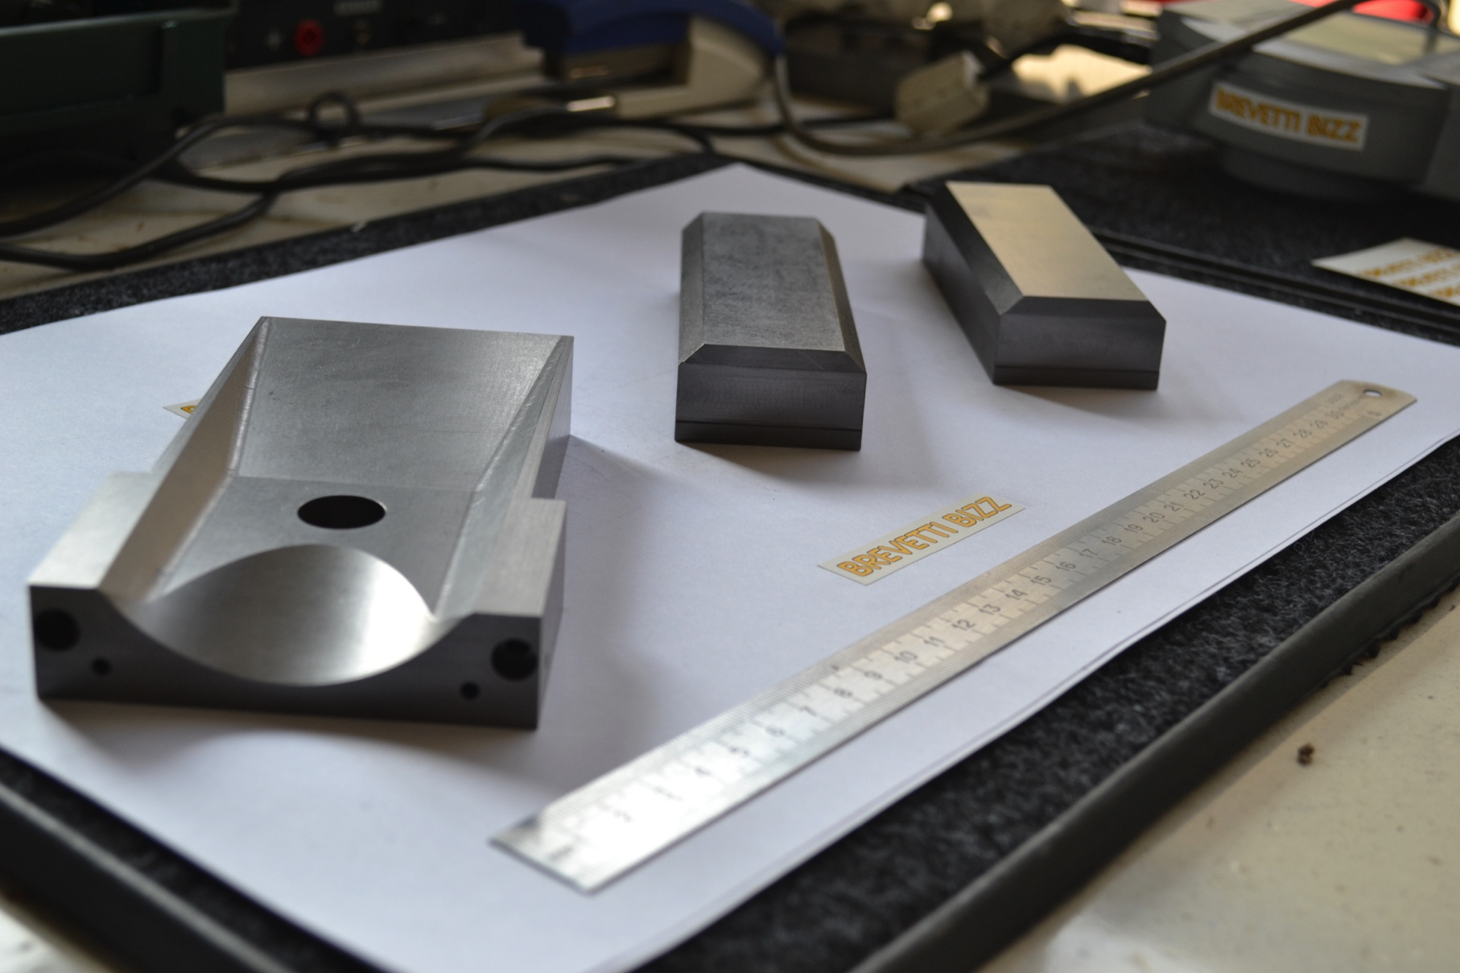
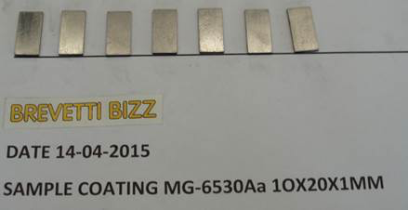
Contribution from industries
Improvement in MoGr production after irradiation tests feedback and in close collaborator with CERN.
Samples provided for TiN, TiB2 coating (light material, high conductivity)
Large blocks of MoGr for a full scale collimator tests.

Slide 17
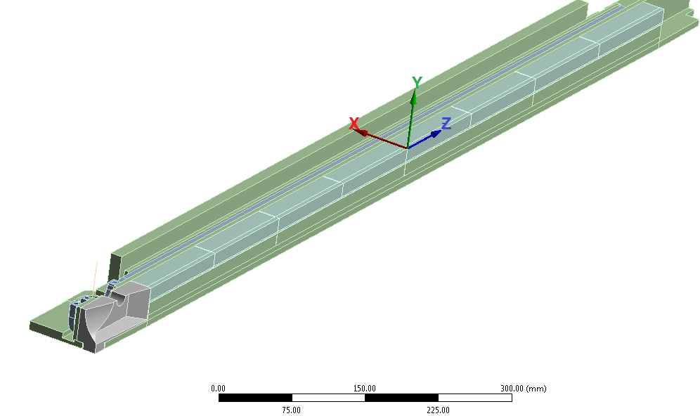
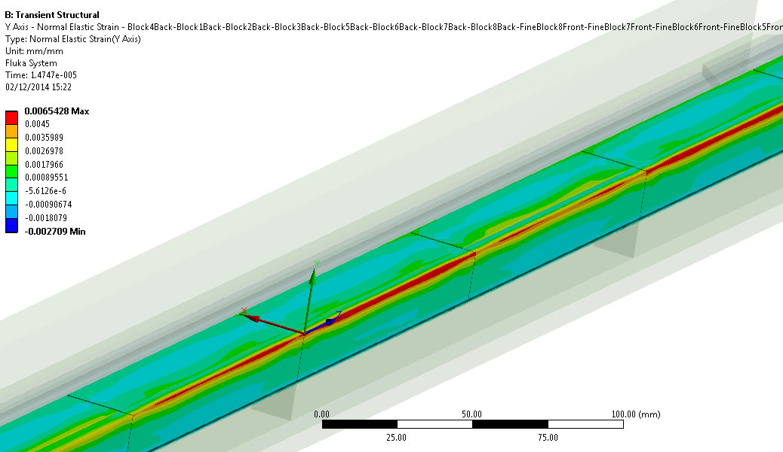
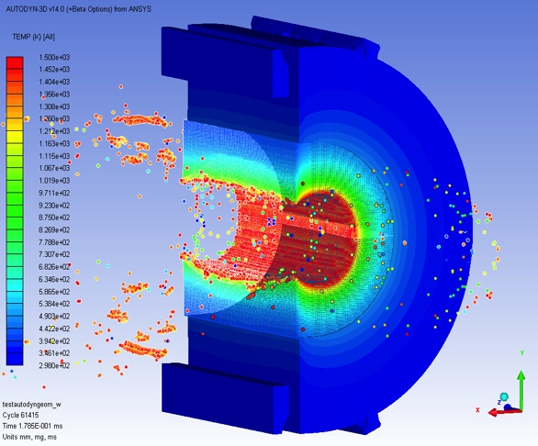
Numerical simulations at CERN
Numerical simulations (CERN)
Design of HL-LHC collimator (TCSPM)
MoGr and CuCD jaws simulated
Melting of CuCD is expected at HL-LHC beam parameters
Strains induced on MoGr are at the limits of the material resistance; possible local crack formation
Update of HRMT14 analyses (beam impact on samples – 2012)
After 2 ½ years cool down, HRMT14 test bench can be opened for sample extraction (May’15)
Non-destructive and destructive tests of specimens; results to be compared with refined FLUKA simulations (courtesy of T. Manousos and A. Lechner)
HL-LHC
secondary collimator
Much more with A. Bertarelli’s talk
72b @450GeV
on Inermet180
ε_{y} on MoGr jaw
ε_{y+}>4500
microstrain

Slide 18
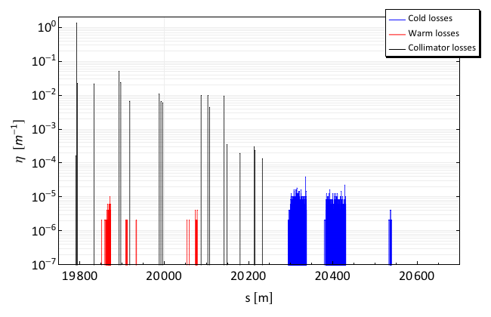
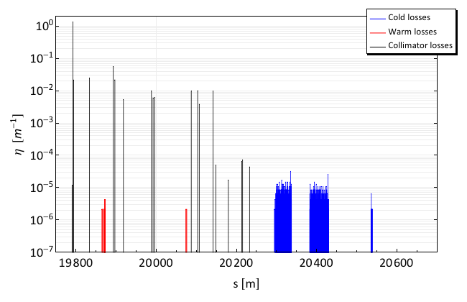
Halo cleaning simulations with advanced collimator materials
SixTrack material DB updated with new composites materials.
CFC
Main simulation parameters:
Energy: 7 TeV
Beam 1, Hor. halo
Statistics: 6.4 x 10⁶ SixTrack particles
Nominal 7 TeV optics and post LS1 LHC layout
All CFC secondary collimators in IR7 replaced by new materials: MoGr, CuCD, Inermet180.
Note: the high-Z Inermet180 is not part of any LHC upgrade plan, due to its limited robustness. It was included in the study for comparison.
CuCD
Collimator settings at 7 TeV [σ]
IR7 | TCP | 6
 | TCSG | 7
 | TCL | 10
IR6 | TCSG | 7.5
 | TCDQ | 8
IR3 | TCP | 15
 | TCSG | 18
 | TCL | 20
IR1/5 | TCT | 8.3
IR2/8 | TCT | 25
IR7 DS → highest loss location
Not largely affected by TCSG materials, losses dominated by single diffractive events in primary collimators.
Courtesy of E. Quaranta

Slide 19
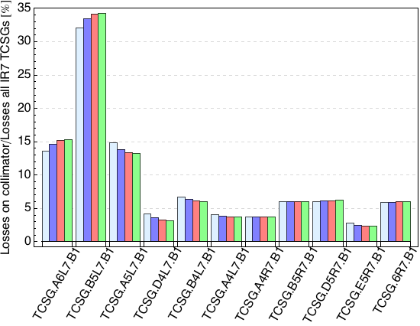
Simulated losses in TCSGs in IR7 (I)
First two TCSG more loaded than CFC case
(load as effective Z )
Distribution of losses in downstream TCSGs influenced by different scattering behavior of the different materials
Note: the high-Z Inermet180 is not part of any LHC upgrade plan, due to its limited robustness. It was included in the study for comparison.

Slide 20
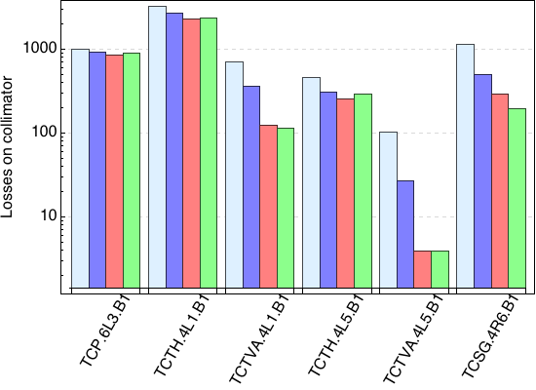
Losses in collimators in other LHC locations
Load significantly reduced further downstream (momentum cleaning, IR1/5 triplet protection, dump)
Comparison with other particle tracking codes foreseen

Slide 21
Radiation Damage (discussion at WP11 annual meeting ‘14)
Parameters to account for damage are:
Displacement Per Atom
He/H transmutation (especially for high energetic particles);
Electronic stopping (presently taken into account only as temperature increase, could produce damage – DPA – in non-metallic materials);
Damage correlation between different types of irradiations (projectile and energy) should take into account:
Primary recoil energy spectra;
Displacement dose rate, DPA/s;
Transmutation production rates, He/DPA and H/DPA;
Kinetics of irradiation-induced defect production and accumulation behaviour due to pulsed irradiation.
Production of single point defects and defect clusters.
Extrapolating from ion to high energetic protons challenging
Notes:
Main founding to Kurchatov lab. From CERN Collimation Project
Complementarity with irradiation tests at BLN, different energies and additional materials tested .
Glidcop, Molybdenum, CuCD, MoGr
BNL Features:
Irradiation with proton beam at 200 MeV
Indirect water cooling and T~100°C (samples encapsulated with inert gas)
Thermo-physical and mechanical characterization for fluence up to 10²⁰ p/cm²
Possibility to irradiate with neutrons (simulate shower on secondary coll.)

Slide 22
Radiation Damage (discussion at WP11 annual meeting ‘14)
Damage threshold for graphitic materials under proton irradiation ~ 0.2 DPA.
Threshold corresponds to ~ 30-40% degradation. Such degradation could be nevertheless relevant to LHC (electrical conductivity).
Is this threshold valid also for energetic protons, where He/H transmutation is relevant?
FLUKA estimates 0.3 DPA for HL-LHC (4000 fb⁻¹), H primary collimators.
Meeting outcome: how to judge a material
Graphite is a metal-like in the graphitic plane and an insulator in the perpendicular one. The electronic contribution to DPA should be taken into account.

Slide 23
WP11 Future work
Waiting from report on CuCD irradiation results from NRC KI.
Irradiation tests on going at BNL on MoGr, to be discussed at LARP meeting in May ‘15.
HiRadMat irradiation tests on CuCD and MoGr jaws.
Irradiation at GSI with light ions under tracking threshold.
Thermomechanical and beam simulations and characterisation.
Estimation of radiation effects (DPA, H/He transmutation, ion tracking) on material properties.
Further beam simulation and comparison with MERLIN.
Continuation of R&D on ceramic and metal matrix composites.

Slide 24
Back-up slides

Slide 25
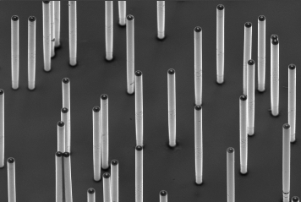
Ion tracking (Wikipedia)
Ion tracks are damage-trails created by swift heavy ions penetrating through solids, which may be sufficiently-contiguous for chemical etching in a variety of crystalline, glassy, and/or polymeric solids.
Swift heavy ion leave behind a trace of irregular and modified material confined to a cylinder of few nanometers in diameter. The energy transfer between the heavy projectile ion and the light target electrons occurs in binary collisions. The knocked-off primary electrons leave a charged region behind, inducing a secondary electron collision cascade. The remaining energy leads to atomic excitation and vibration, producing (heat).

