Slide 1
Report on Advanced Collimation Materials
Alessandro Bertarelli, CERN (EN/MME) on behalf of the Eucard2 WP11 collaborators
Joint HiLumi LHC-LARP Annual Meeting FNAL, Batavia, US – 11-13 May, 2015

Slide 2
Outline
Overview of Collimation Materials
Introduction and Motivations
Materials Requirements for LHC Collimators
Figures of Merit for Collimator Materials
Advanced Materials: R&D and Characterization
HL-LHC Collimator Design and Testing
Summary

Slide 3
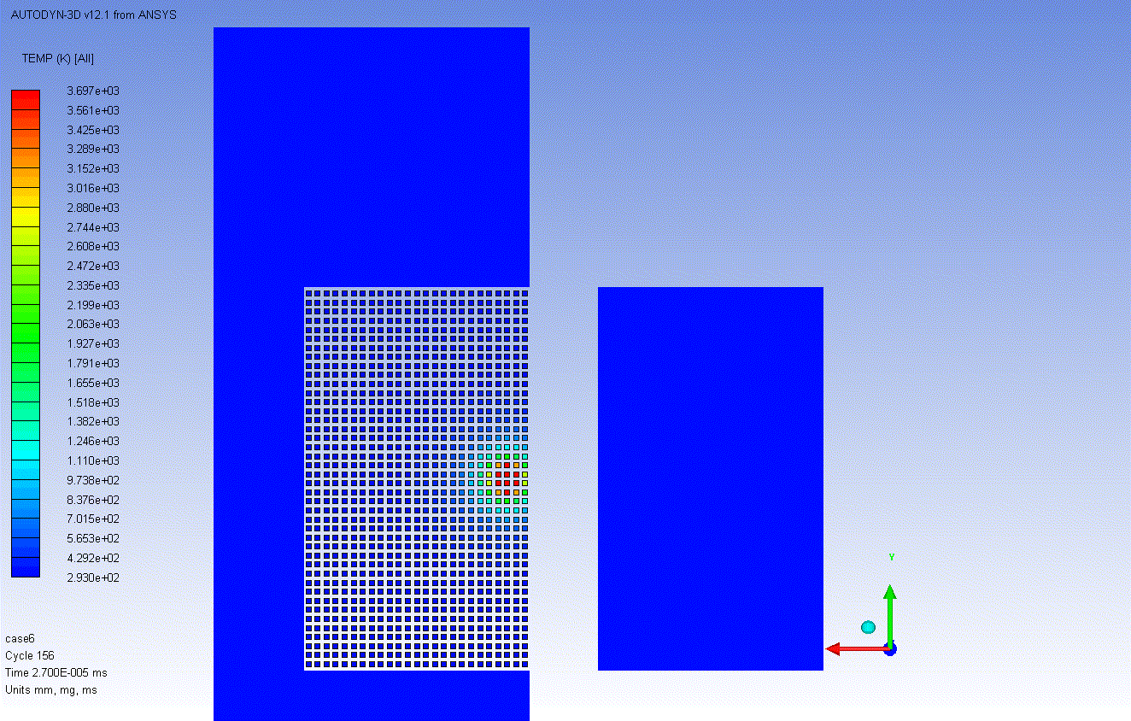
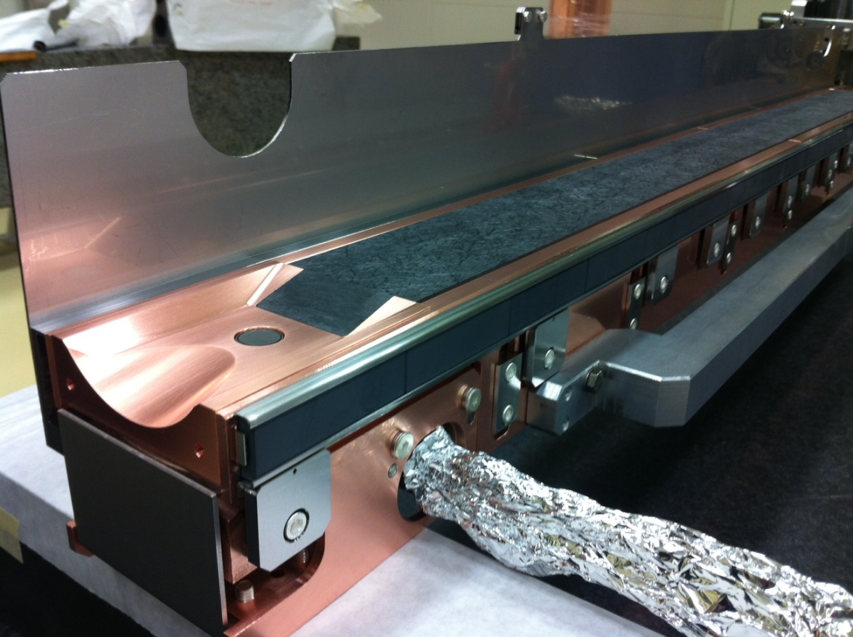
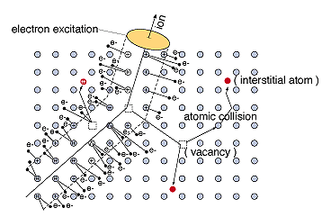
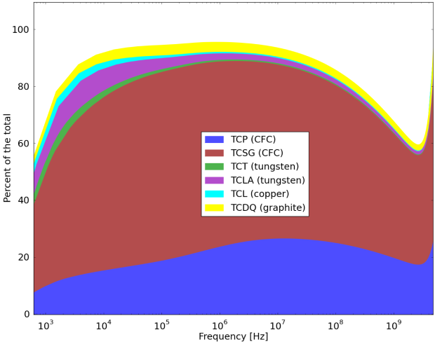
Materials Requirements for LHC Collimators
Introduction and Motivations
Collimators are required to survive the beam-induced accidents to which they are inherently exposed given their vicinity to the beam
They must possess extremely accurate jaw flatness to maintain their beam cleaning efficiency
The collimation system is, by far, the highest contributor to accelerator EM impedance which may significantly limit machine performances: they must possess the lowest possible electrical resistivity
Their lifetime and efficiency should be conserved under long-term particle irradiation
No existing material can simultaneously meet all requirements for HL-LHC!
Collimators impedance/ LHC Impedance

Slide 4
Figures Of Merit for Collimator Materials
Introduction and Motivation
How to find one’s way out of this maze of material requirements?
You need a good compass: Figures Of Merit (FoM)
Thermomechanical Robustness Index (TRI)
Related to the ability of a material to withstand the impact of a short particle pulse
Caution: FoMs are obtained from RT, averaged properties. They should only be taken for comparative purposes and not to anticipate material performances… !
Thermal Stability Index (TSI)
Index of the ability to maintain dimensional stability under beam slow losses
RF Impedance Index (RFI)
Index of the ability to minimize contributions to RF impedance
Radiation Damage Index (RDI)
Index of the ability to withstand radiation-induced damage

Slide 5
Outline
Materials R&D and Characterization
Introduction and Motivations
Advanced Materials: R&D and Characterization
Collimator Materials R&D Program
Mechanical Characterization
Thermo-physical Characterization
Materials Benchmarking
HL-LHC Collimator Design and Testing
Summary
Highlights on activities performed at CERN.
For additional research see Adriana Rossi’s talk …

Slide 6
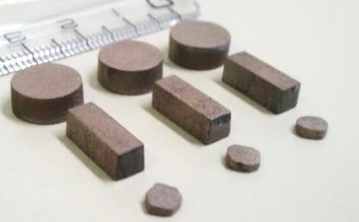
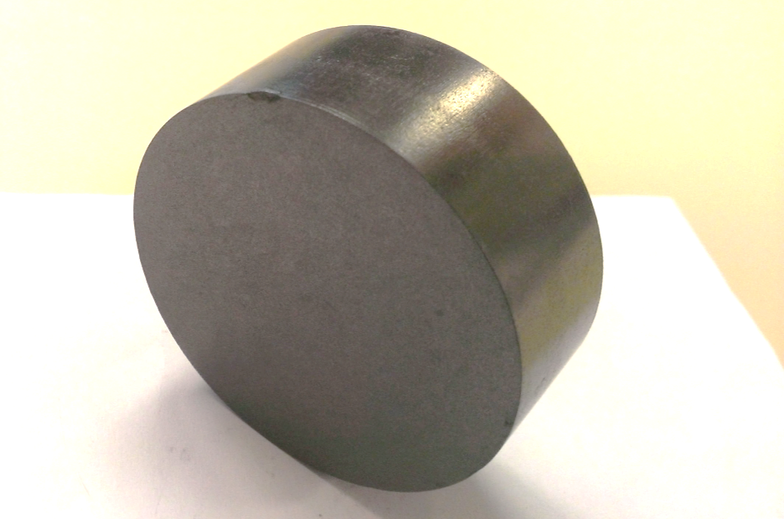
Collimator Materials R&D Program
Materials R&D and Characterization
EuCARD2 WP11 (tasks 2 & 3) main goal: review existing materials (e.g. Carbon-Carbon), develop, characterize, test, irradiate novel materials for high energy, high brightness accelerators (HL-LHC, LIU, FAIR, netrino facilities …)
Explore composites combining the properties of graphite or diamond (low ρ, high λ, low α) with those of metals and transition metal-based ceramics (high R_{M}, good γ)
Materials investigated are Molybdenum-Copper-Diamond (MoCuCD), Copper-Diamond (CuCD) developed by RHP-Technology, Molybdenum Carbide-Graphite (MoGr) co-developed by CERN and Brevetti Bizz.
Thermo-mechanical and irradiation tests at CERN, GSI (DE), BNL (US) , Kurchatov Institute (RU), Polito (IT)
Most promising for high energy applications (trade-off between robustness and low impedance) are CuCD and (especially) MoGr
MoGr internationally patented and to be tested by several firms for thermal management in electronics (AT&S, Heraeus and Intel)
CuCD
MoCuCD
MoGr

Slide 7
Copper – Diamond
Materials R&D and Characterization
Developed by RHP-Technology (Austria)
Composition :
60%_{v} diamonds (90% 100 µm, 10% 45 µm)
39%_{v} Cu powder (45 µm)
1%_{v} B powder (5 µm)
Composition and processing (Rapid Hot Pressing) did not change during R&D program
No diamond degradation
Thermal (~490 Wm⁻¹K⁻¹) and electrical conductivity (~12.6 MSm⁻¹)
No direct interface between Cu and CD (lack of affinity) impairs mechanical strength. Issue partly offset by limited bonding assured by Boron Carbides (~120 MPa).
Cu low melting point (1083 °C)
CTE increases significantly with T due to high Cu content (from ~6x10⁻⁶ K⁻¹ at RT up to ~12x10⁻⁶ K⁻¹ at 900 °C)
BC “bridge” stuck on CD surface.
No CD graphitization

Slide 8
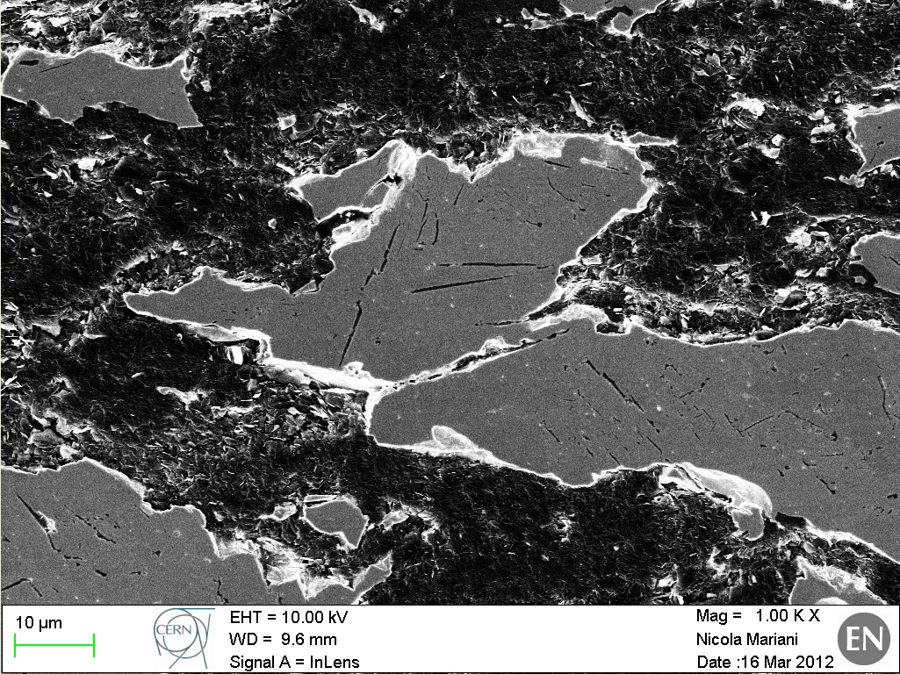
Molybdenum Carbide – Graphite
S
Co-developed by CERN and Brevetti Bizz (Italy)
Ceramic Composite based on Molybdenum (5÷ 50 μm) , Natural Graphite (~50 μm), Mesophase Pitch-based Carbon Fibers (0.3 ÷ 3 mm)
1st generation (2011- early ‘12): Mo – Graphite. Sintering Temp.: ~1700 °C. Density: ~ 5.3 gcm⁻³. Status: Used for HRTM-14 tests.
2nd generation (2012 – mid ‘13): Mo – Graphite – CF. Sint. Temp.: ~ 2200 °C. Density: ~3.8 gcm⁻³. Status: used for HRMT-14 tests.
3rd generation (mid 2013): Mo – Graphite – CF. Sint. Temp.: ~2400 °C. Density: ~3.7 gcm⁻³ Status: used for BNL tests.
4th generation (late ‘13 – mid ‘14): Mo – Graphite – CF. Sint. Temp.: ~ 2600 °C. Density: ~2.5÷2.7 gcm⁻³ Status: used for GSI tests (1st campaign).
5th generation (mid 2014) : Mo – Graphite – CF. Sint. Temp.: ~ 2600 °C. Post-processing annealing at 1150÷1300 °C Density: ~2.6 gcm⁻³ Status: used for GSI tests (2nd campaign).
6th generation (late ’14 – to date) : Mo – Graphite – CF. Sint. Temp.: ~ 2600 °C. Post-processing annealing at ~1900 °C Density: ~2.5 gcm⁻³ Status: used for GSI tests (3rd campaign). To be used for HRMT-23. Proposed for GSI 4th campaign and (hopefully) BNL 2nd campaign

Slide 9
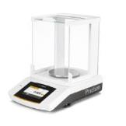
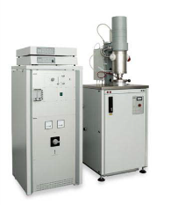
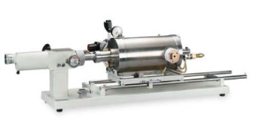
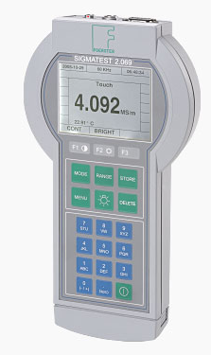
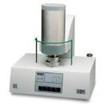
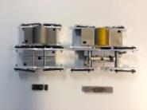
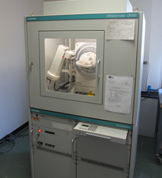
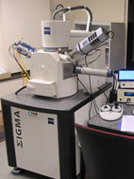
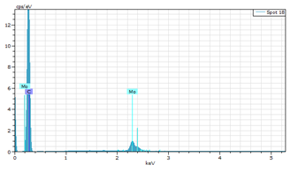
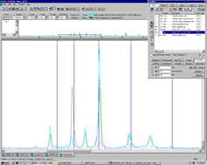
Materials Characterization at CERN
Materials R&D and Characterization
Thermophysical Analysis
Density
Thermal Expansion
Electrical Conductivity
Specific Heat
Thermal Diffusivity
Mechanical Testing
Elastic Constants
Flexural Strength
Compressive Strength
SEM
Microstructural Observations
XRD
Notes:
Characterised 11 grades of MG and one of CFC so far

Slide 10
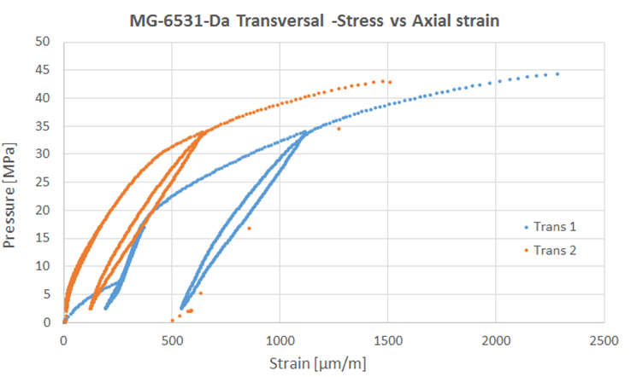
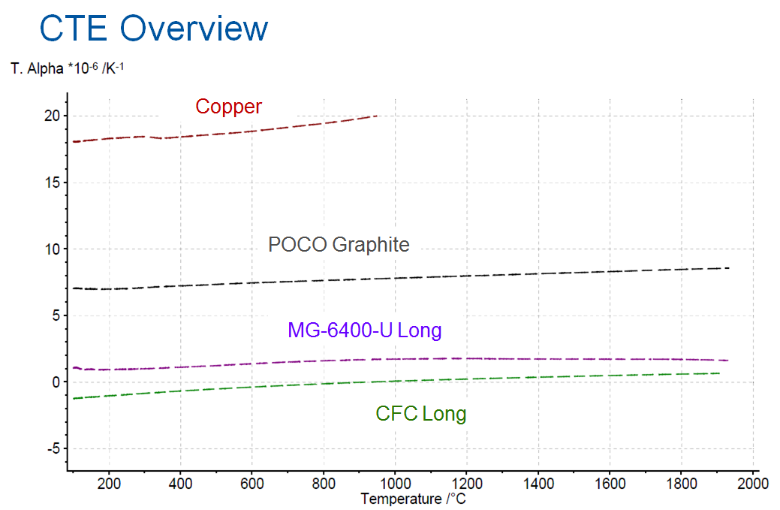
Molybdenum Carbide – Graphite Characterization
Materials R&D and Characterization
ρ [g/cm³] | 2.5
α// (RT to 1000° C) [10⁻⁶K⁻¹] | 1-1.8
α⊥ (RT to 1000° C) [10⁻⁶K⁻¹] | 12-15
λ// (RT) [Wm⁻¹K⁻¹] | 600 ÷ 770
λ⊥ (RT) [Wm⁻¹K⁻¹] | 85
γ// (RT) [MS/m] | 1÷18
γ⊥ (RT) [MS/m] | 0.3
E// [GPa] | 48÷74
R_{M//} [MPa] | 75÷85
MoGr can be Mo-coated to increase surface conductivity
Possibility of alternative lower-Z ceramic coatings being explored
Core:
1.0 MS/m
Carbide layer: 1.5 MS/m
Mo Coating:
18 MS/m

Slide 11
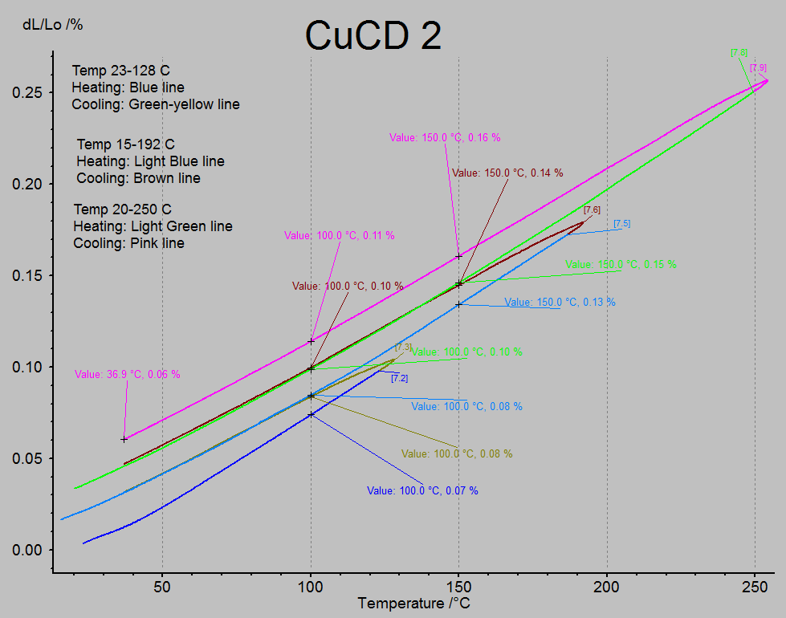
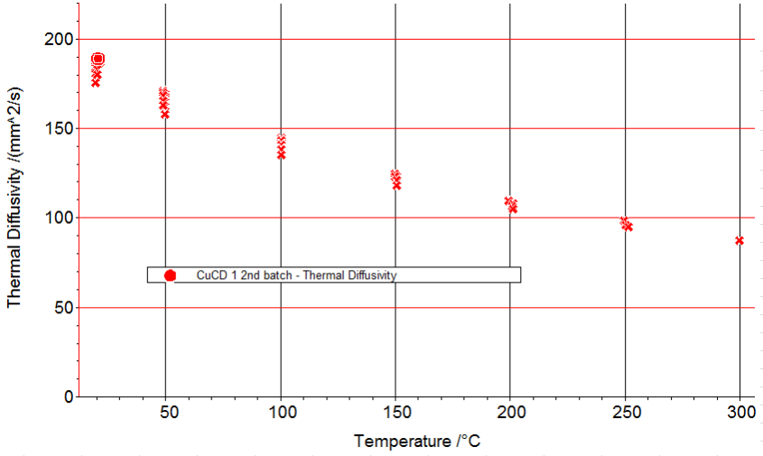
Copper – Diamond Characterization
Materials R&D and Characterization
ρ [g/cm³] | 5.3
α (RT to 250° C) [10⁻⁶K⁻¹] | 8
λ (RT) [Wm⁻¹K⁻¹] | 380
γ (RT) [MS/m] | 12.6
E [GPa] | 160
R_{M} [MPa] | 70
Time | 0h | 48 h | Loss in diffusivity
1st treatment | 192.0 mm²/s | 176.5 mm²/s | 8.8%
2nd treatment | 175.8 mm²/s | 168.6 mm²/s | 4.3%
3rd treatment | 158.0 mm²/s | 150.8 mm²/s | 4.8%
Moderate diffusivity degradation was observed after 48h cycles at 250˚C, simulating bake-out treatments.
CTE
Thermal Diffusivity

Slide 12
Materials Performances and Benchmarking
Materials for Beam Intercepting Devices
 | FOM for Existing Materials
 | Carbon- Carbon | Graphite | Cu (Glidcop) | Mo | W Alloy (IT180)
$Tm$ [°C] | 3650 | 3650 | 1083 | 2623 | ~1400
TRI [‒] | 800÷1200 | 800÷1100 | 5 | 6 | 0.5
TSI [-] | 45 | 10 | 0.8 | 0.7 | 0.1
RFI [-] | ~0.38 | ~0.27 | 7.33 | 4.38 | 2.93
FOM for Novel Materials
MoGr (uncoated) | CuCD
~2590 | ~1083
500÷800 | 7
70 | 10
~1 | 3.55
Indicative Required FOM for LHC Secondary Collimators
LHC (Nominal) | HL-LHC
300÷500 | 600÷1000
~20 | ~40
~0.4 | ~1
Required Robustness Index (TRI) derived from Injection Error scenarios (288 b at 450 GeV);
Required Stability Index (TSI) related to admissible jaw flatness under slow losses (1 hr beam lifetime)
Required RFI extrapolated for worst collimator settings (E. Metral LMC september 2014)
Carbon-based materials feature excellent TRI and TSI (to low-Z, low CTE, low density, high degradation temperature, high conductivity), but are penalized by low RFI ….
CuCD possesses very good RFI. Its limited robustness may be penalizing in case of highly energetic accidents.
In case EM impedance becomes an issue (e.g. for HL-LHC), MoGr appears the most appealing compromise. Coating can further improve MoGr performances.
Damage induced by long term irradiation and effects on materials lifetime is being assessed.

Slide 13
Outline
HL-LHC Collimator Design and Testing
Introduction and Motivations
Novel Materials for Collimators
HL-LHC Collimator Design and Testing
Preliminary Design of HL-LHC Collimator
Numerical Simulations for HL-LHC Collimators
HiRadMat Experimental Tests
Summary

Slide 14
Preliminary Design of HL-LHC Collimator
HL-LHC Collimators Design and Testing
A new modular design for HL-LHC Secondary Collimators is at an advanced stage of design. Work on-going to extend the range of embarked diagnostics.
The concept allows to install 8 or 10 jaw inserts made of either MoGr or CuCD
The BPM pickup end seat is lengthened to reduce RF perturbations
A full-scale prototype should be installed in the LHC for MD in first half of 2016
Screwed back stiffener
Housing
Bloc clamps
88
MoGr or CuCD blocks
Brazed cooling circuit

Slide 15
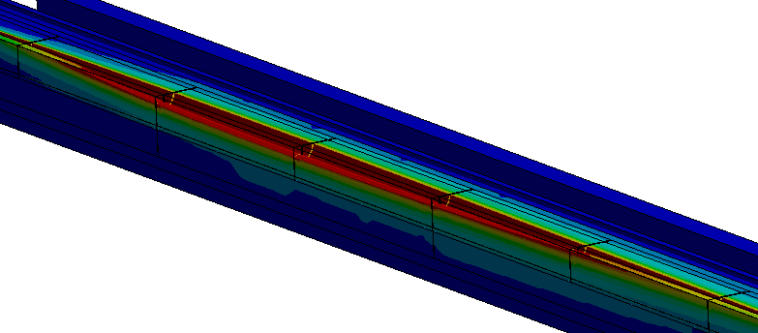
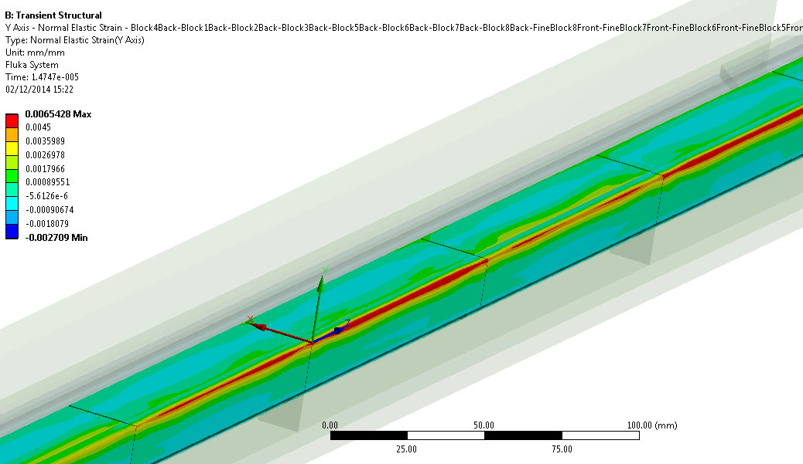
Numerical Simulations for HL-LHC Collimators
HL-LHC Collimator Design and Testing
Preliminary beam-impact simulations using HL-LHC parameters with CuCD and MoGr blocks
HL-LHC Injection error: 440 GeV, 288b, 6.4E13p, σ=1mm
High temperatures reached on CuCD: relevant molten volume
Simulations at lower intensities to determine CuCD damage threshold, results being analyzed
Maximum temperature on MoGr ~1200˚C (melting point~2590˚C): no melting of the jaw
Induced stresses and strains seem close or above the material limits. Local damage is possible
Limited plastic deformation of the Glidcop housing is expected
CuCD temperatures
Molten region
T_{max}>>T_{melt,Cu}
MoGr strains
ε_{y+}>4500
microstrains

Slide 16
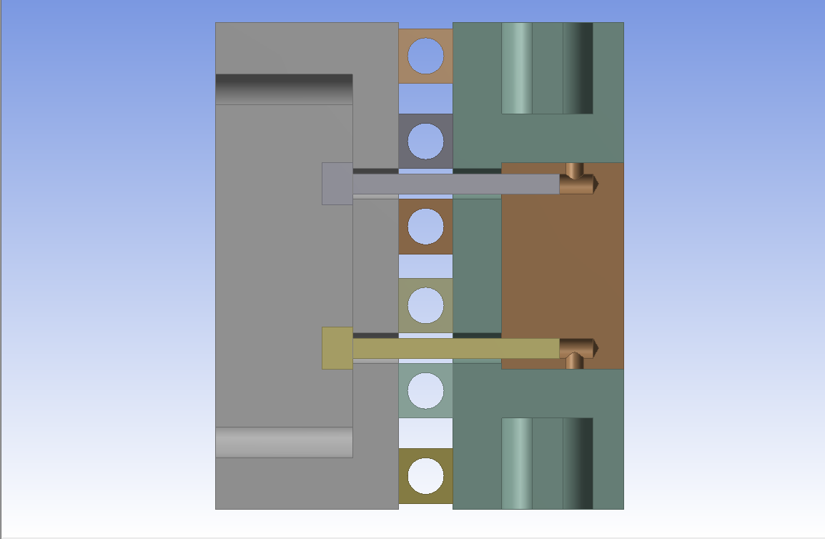
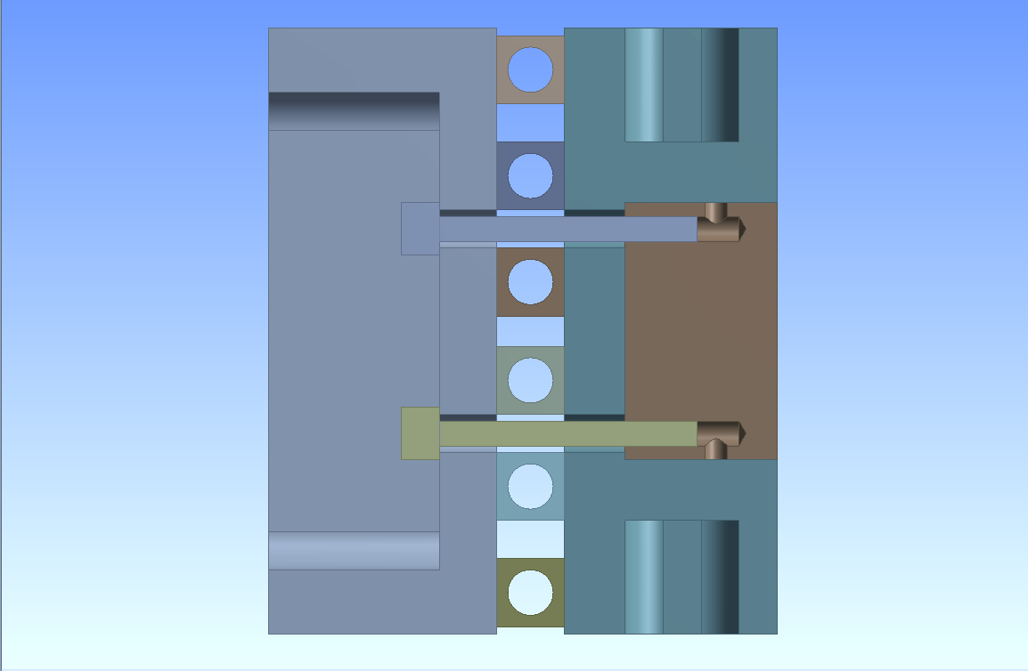
HRMT09 Experiment
HiRadMat Experiments
Experiment Goals
Integral test under SPS beam of 2 LHC Tertiary Collimator Jaws
Beam energy: 440 GeV
Impact depth: 2mm
Test 1
Test 2
Test 3
 | Test 1 | Test 2 | Test 3
Goal | Beam impact equivalent to 1 LHC bunch @ 7TeV | Identify onset of plastic damage | Induce severe damage on the collimator jaw
Impact location | Left jaw, up (+10 mm) | Left jaw, down (-8.3 mm) | Right jaw, down (-8.3 mm)
Pulse intensity [p] | 3.36 x 10¹² | 1.04 x 10¹² | 9.34 x 10¹²
Number of bunches | 24 | 6 | 72
Bunch spacing [ns] | 50 | 50 | 50
Beam size [σ_{x} - σ_{y} mm] | 0.53 x 0.36 | 0.53 x 0.36 | 0.53 x 0.36

Slide 17
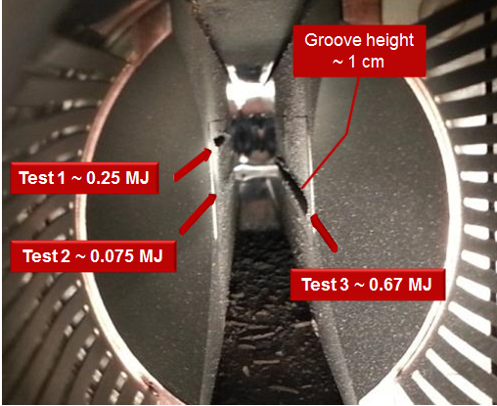
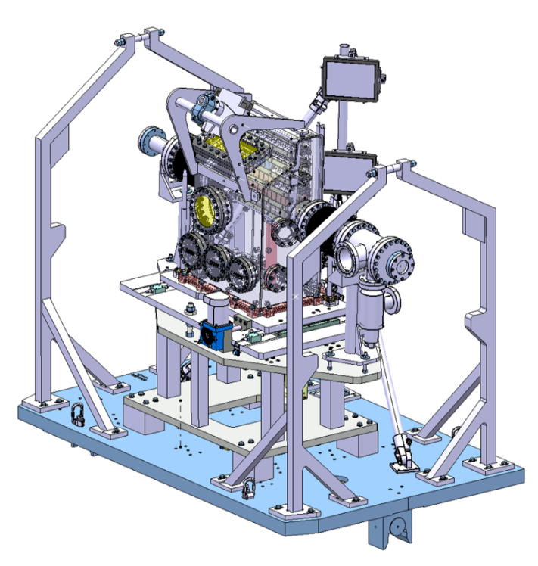
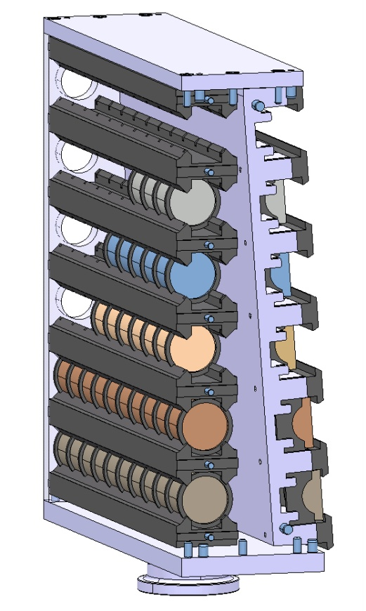
Update on HRMT09 and HRMT14 Experiments
HL-LHC Collimator Design and Testing
HRMT09: impact test on LHC tertiary collimator (Inermet180), SPS beam (450 GeV), 2 mm impact parameter, 3 intensities
HRMT14: impacts on samples of 6 different materials (Inermet 180, Molybdenum, Glidcop, MoCuCD, CuCD, MoGr), 2 shapes x material. Medium and high intensity tests.
Dose rate low enough to allow opening of the two tanks
Non-destructive and destructive observations coming soon.
HRMT09
HRMT14
Beam
Copper-Diamond, 1.3 MJ
Mo-Graphite (3 grades), 1.3 MJ
Tungsten Alloy, 0.65 MJ

Slide 18
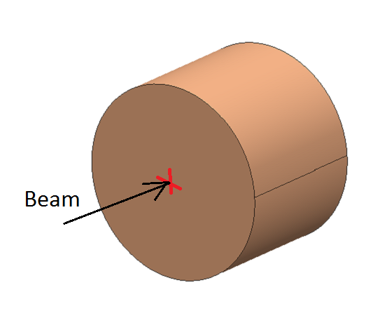
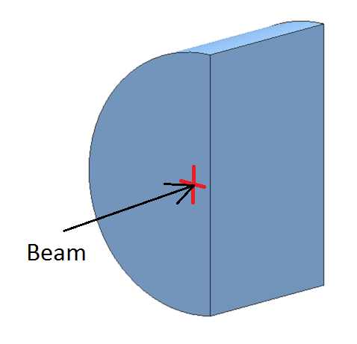
HRMT14 Experiment
Design and Testing for HL-LHC Collimators
HRMT14 (2012) Experiment Goals
Benchmark advanced numerical simulations and material constitutive models through extensive acquisition system
Characterize six existing and novel materials currently under development for future Collimators: Inermet180, Molybdenum, Glidcop, MoCuCD, CuCD, MoGr
Collect, primarily in real time, experimental data from different acquisition systems (Strain Gauges, Laser Doppler Vibrometer, High Speed video Camera, Temperature and Vacuum probes)
Beam Parameters
Beam energy | 440 GeV
Number of protons per bunch | 1.1e11
Bunch Spacing | 25 ns
High Intensity Tests:
Sample: half-moon;
Beam Offset 2 mm
Beam
Medium Intensity Tests:
Sample: Ø 40 mm , L30 mm

Slide 19
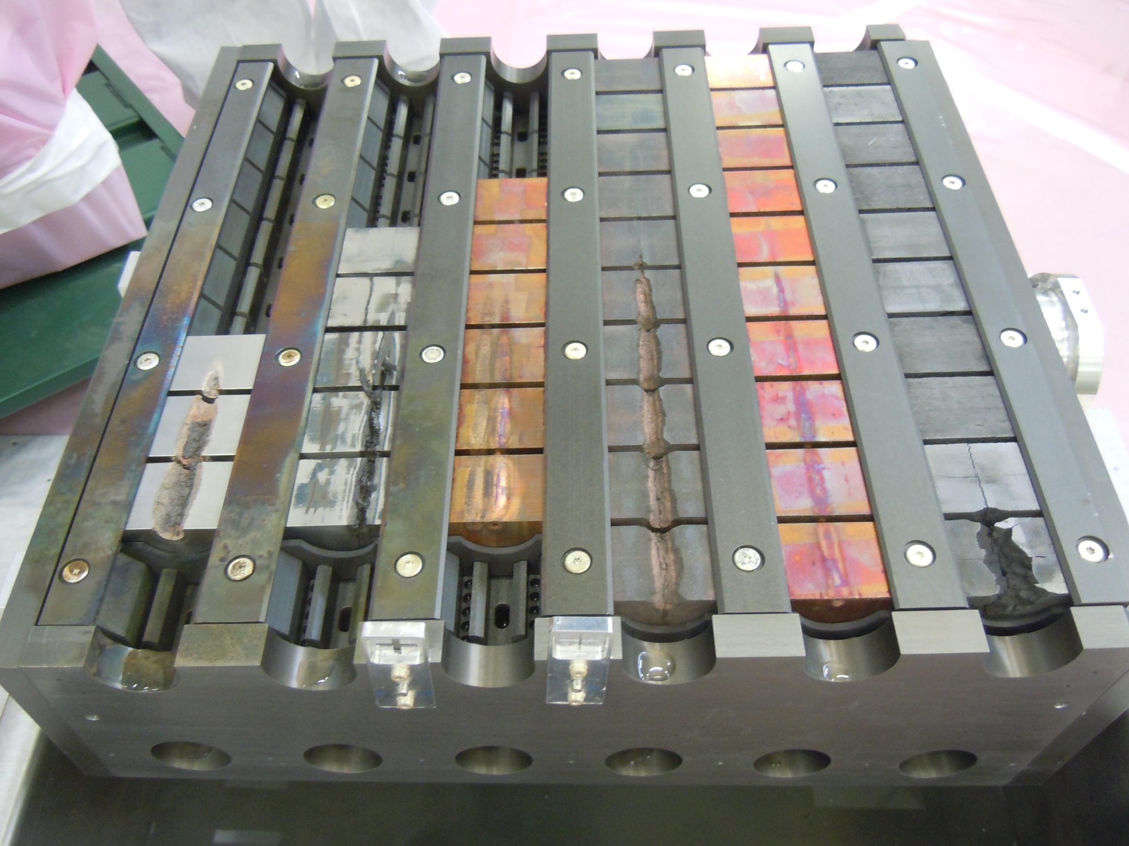
Update on HRMT09 and HRMT14 Experiments
HL-LHC Collimator Design and Testing
HRMT14
Dismounted sample holder (May 2015)
Inermet 180 0.65 MJ
Molybdenum 0.65 MJ and
1.3 MJ
Glidcop
0.65 MJ (twice)
MoCuCD
1.3 MJ
CuCD
1.3 MJ
MoGr
(3 grades)
1.3 MJ

Slide 20
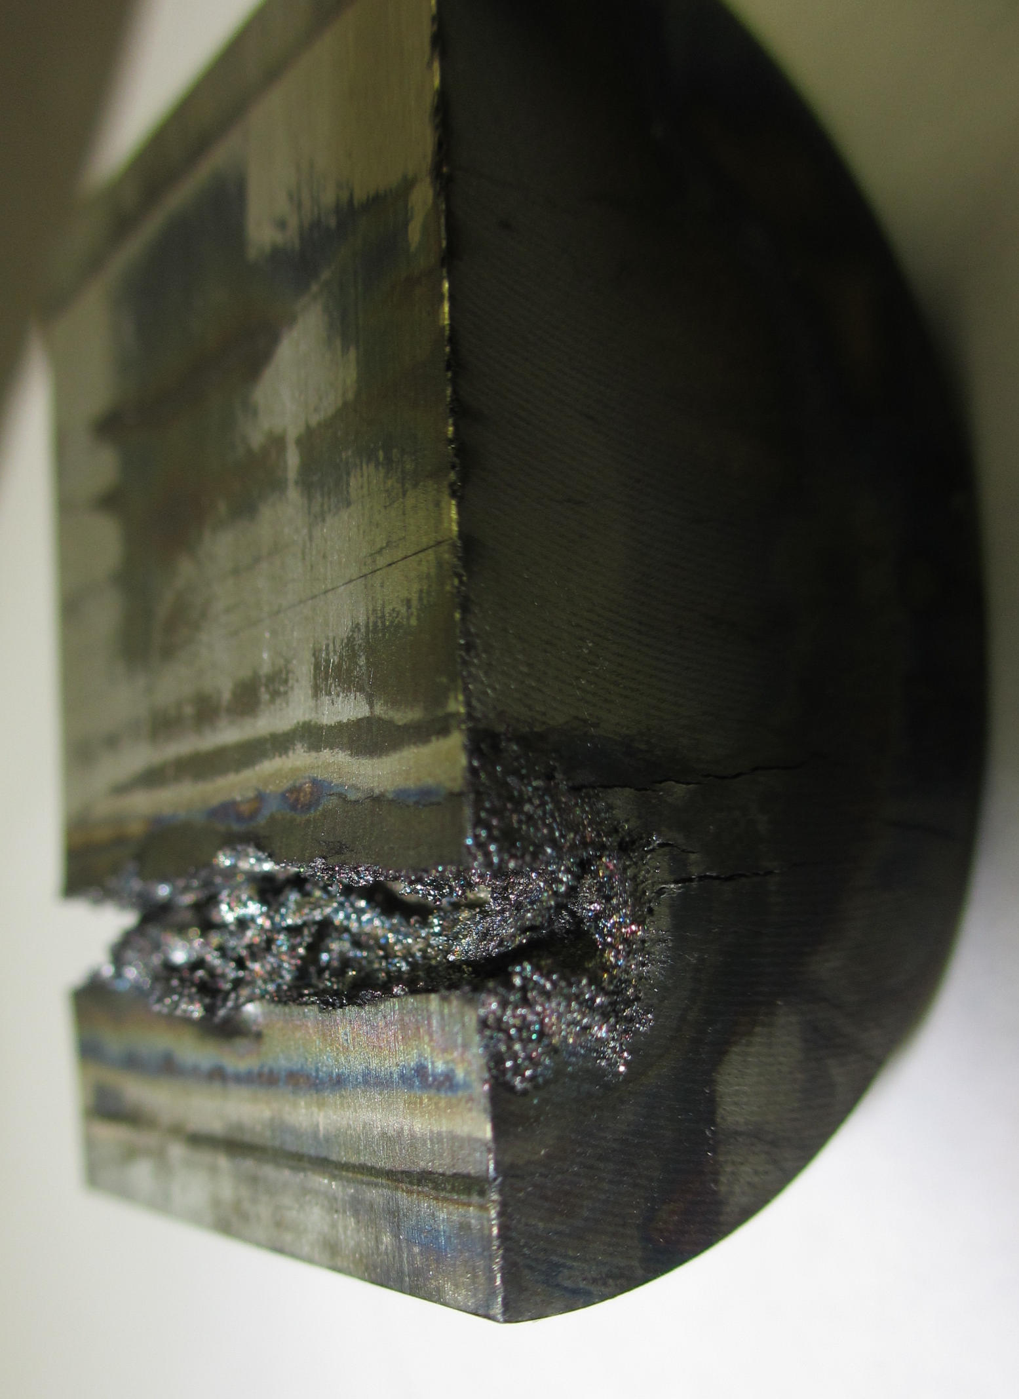
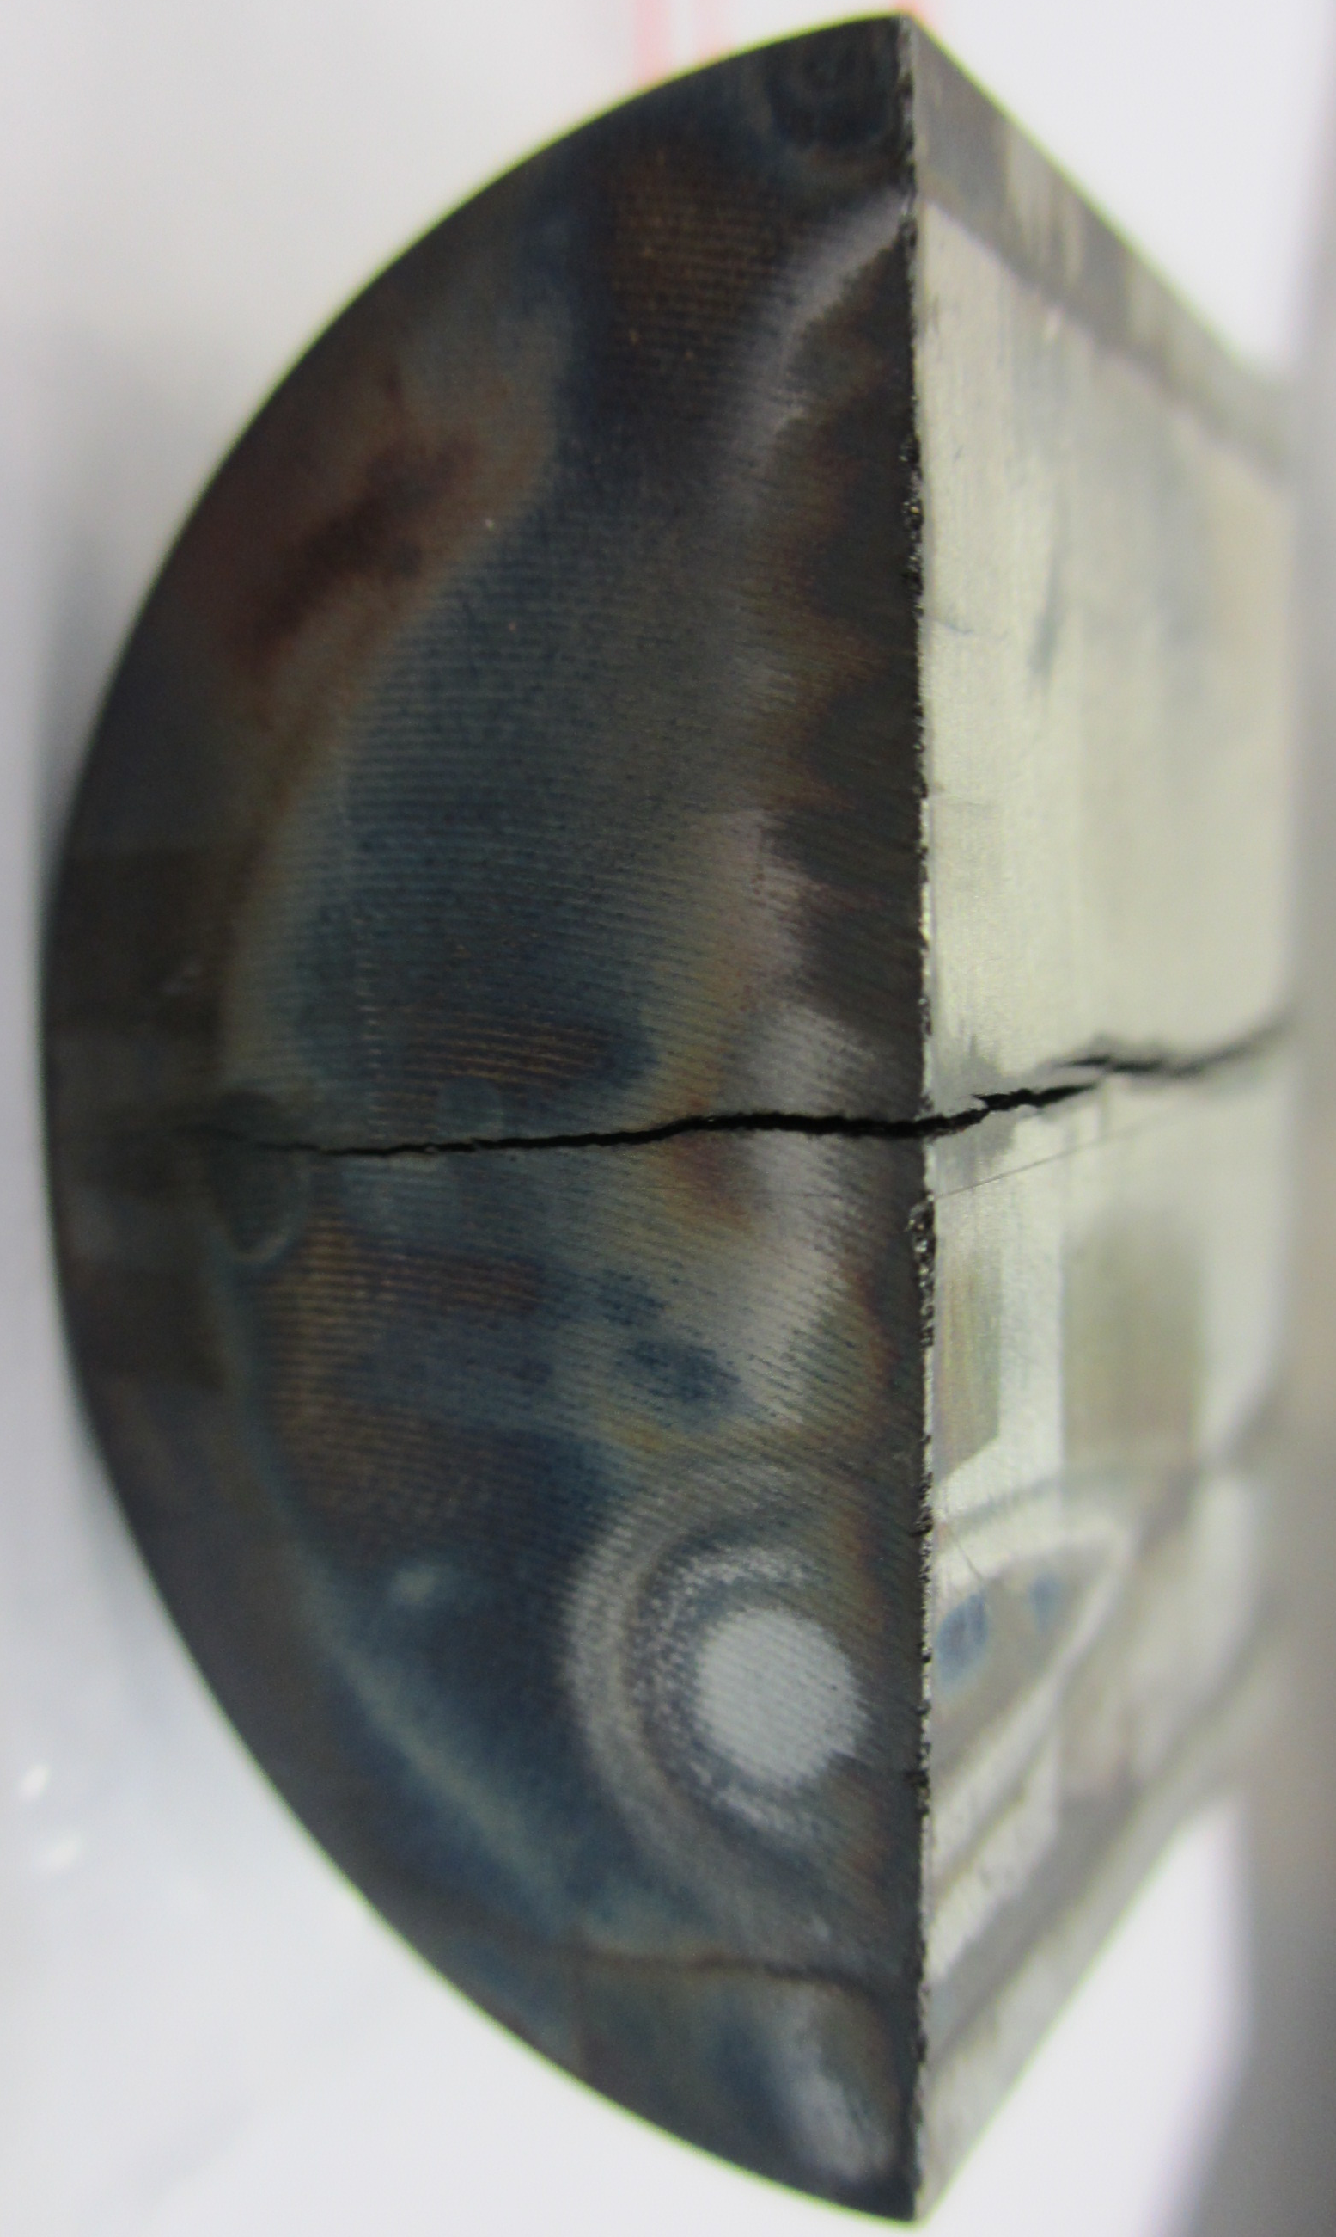
Update on HRMT09 and HRMT14 Experiments
HL-LHC Collimator Design and Testing
Molybdenum High intensity sample 2
Molybdenum High intensity sample 5
0.65 MJ
0.65 MJ
1.3 MJ
1.3 MJ

Slide 21
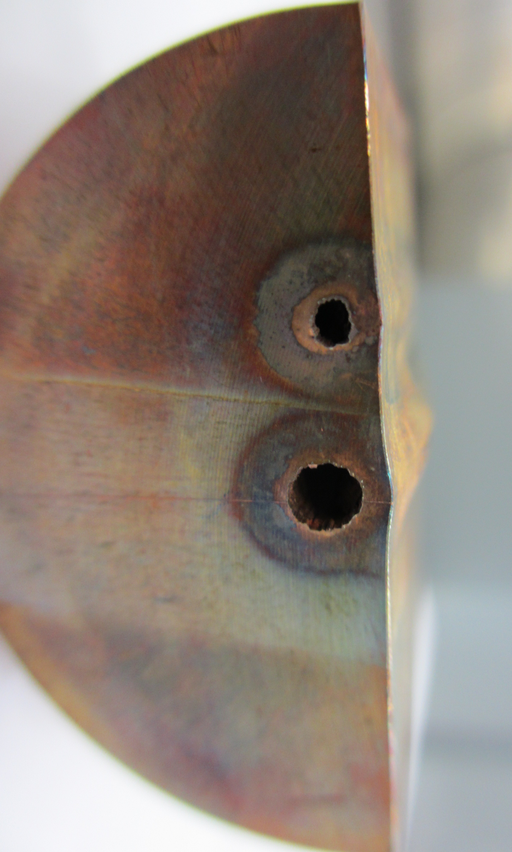
Update on HRMT09 and HRMT14 Experiments
HL-LHC Collimator Design and Testing
Glidcop High intensity Sample 6
Glidcop High intensity Sample 4
Molybdenum High intensity sample 5
0.65 MJ
0.65 MJ
0.65 MJ
1.3 MJ

Slide 22
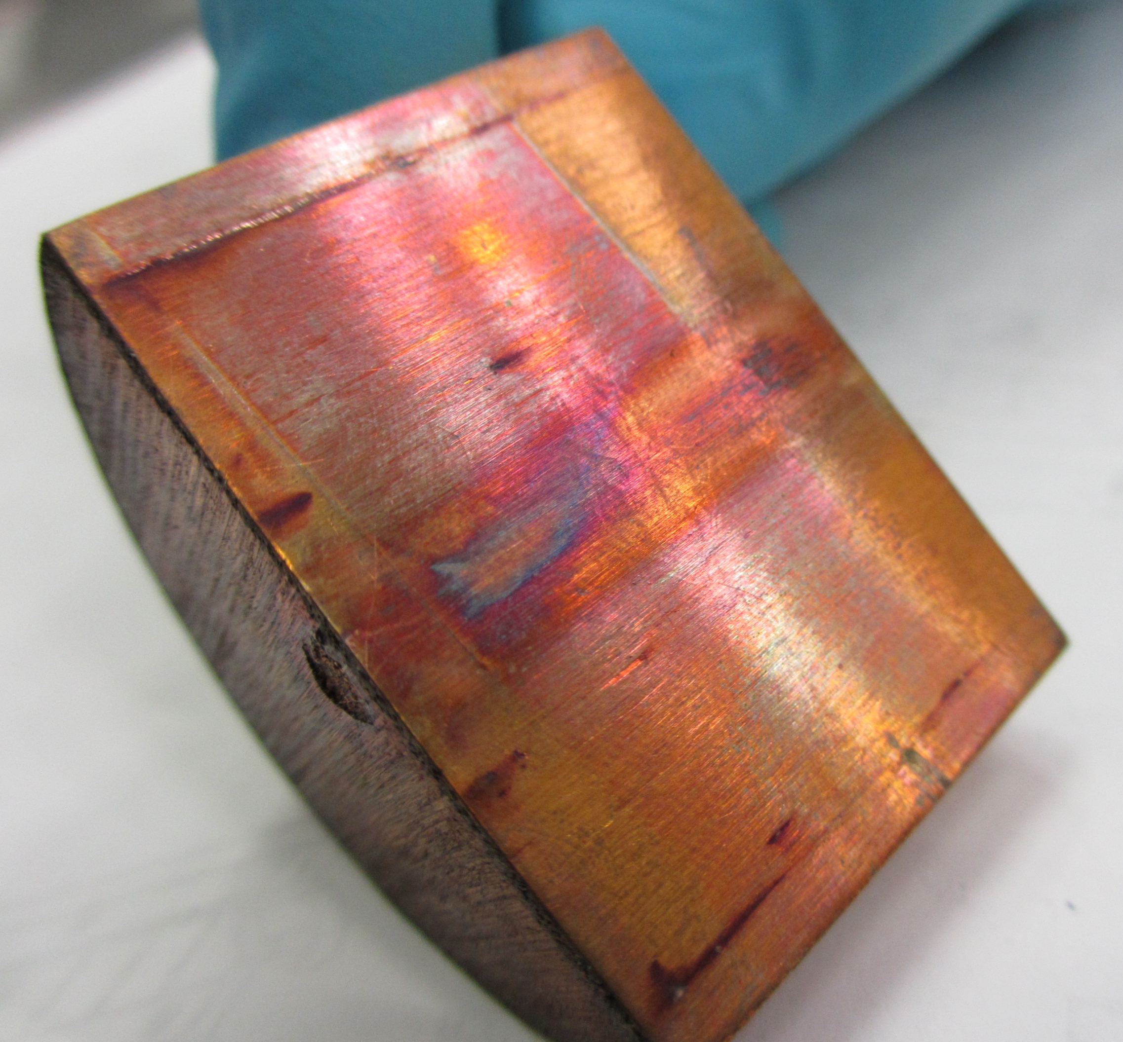
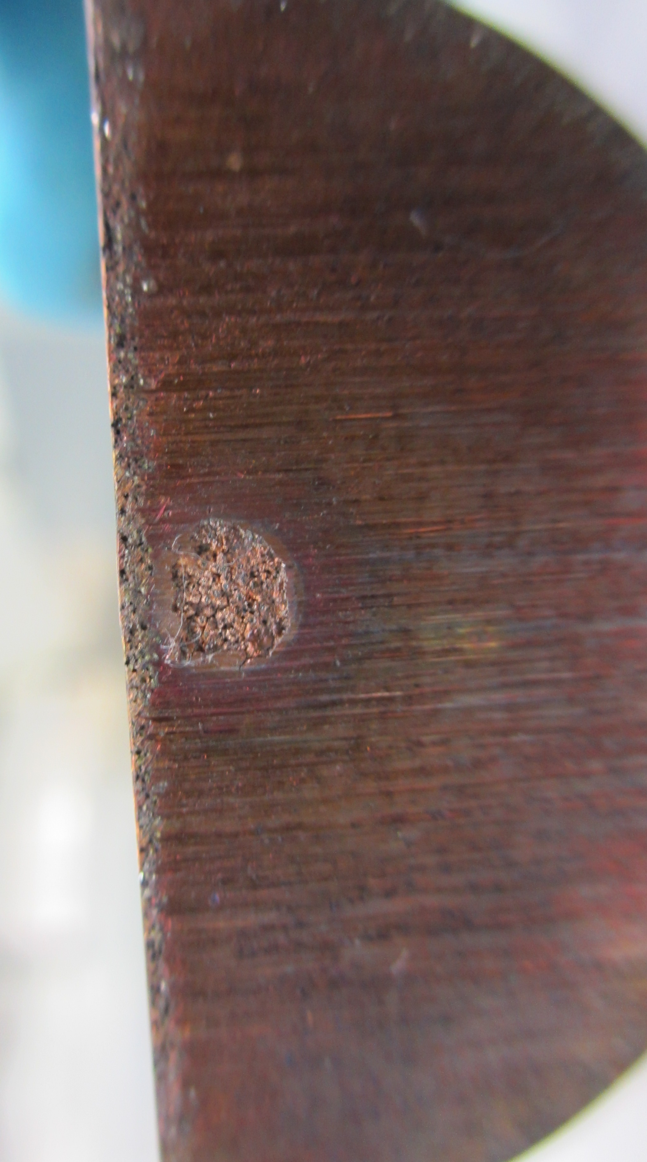
Update on HRMT09 and HRMT14 Experiments
HL-LHC Collimator Design and Testing
CuCD High intensity Sample 10
Glidcop High intensity Sample 4
1.3 MJ

Slide 23
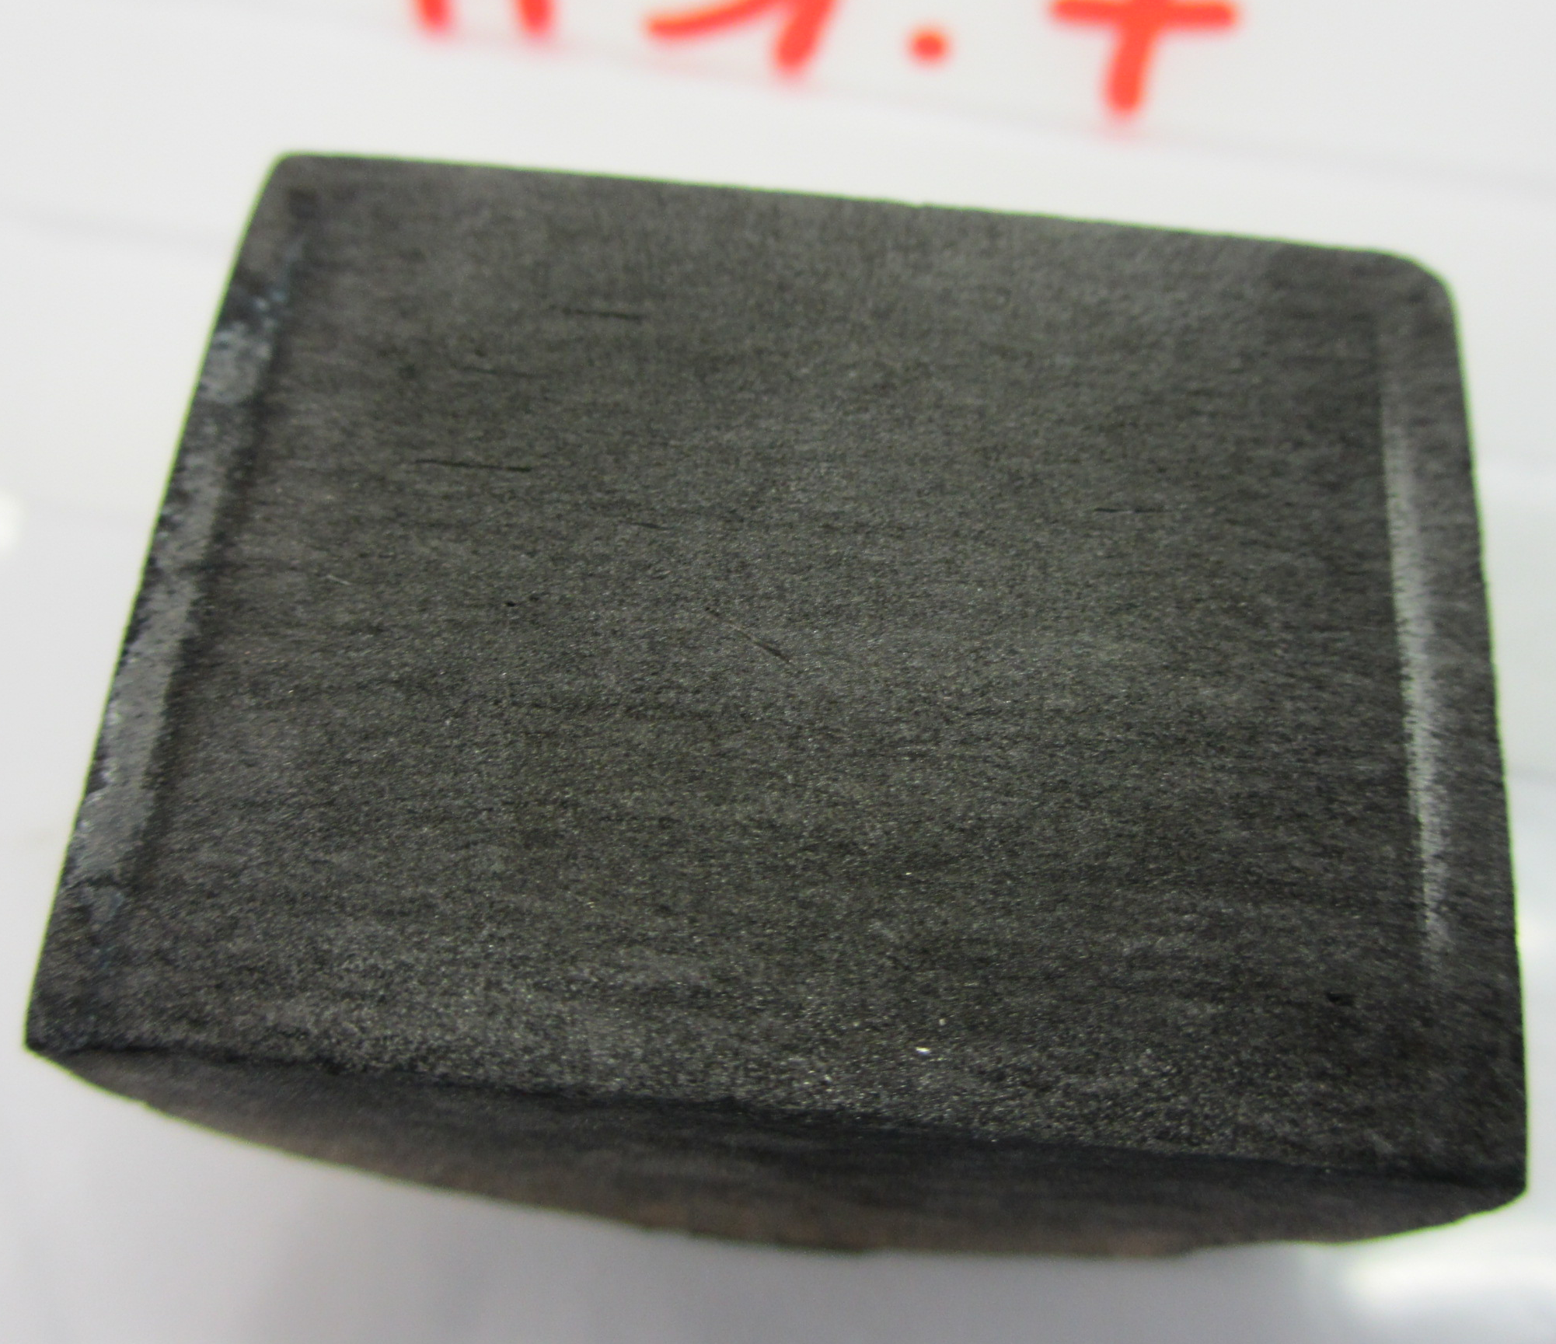
Update on HRMT09 and HRMT14 Experiments
HL-LHC Collimator Design and Testing
MoGr
Sample 8
Grade 2 (2nd Generation)
MoGr
Sample 7
Grade 3 (2nd Generation)

Slide 24
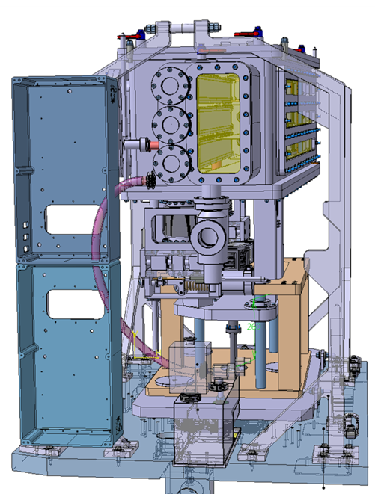
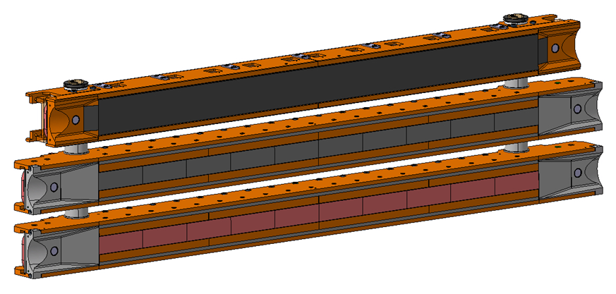
HiRadMat Experiment (HRMT-23)
HL-LHC Collimator Design and Testing
A new experiment (HRMT23) currently under manufacturing is planned for mid-2015 to simultaneously test 3 separate complete jaws extensively instrumented
Main goal is to qualify (or disqualify) jaws to be used in a full-scale HL-LHC prototype under highest and brightest 450 GeV beam available (e.g. 288 b x ~1.5e11 p/b) in view of LIU parameters
2 HL-LHC jaws (inserts in CuCD and MoGr)
1 LHC secondary collimator jaw (TCSP) …
System equipped with comprehensive set of online sensors (strains, displacement, structural damage, temperature …), viewports for optical acquisition (LDV, high-speed camera) and fast dismounting system for post-irradiation investigations

Slide 25
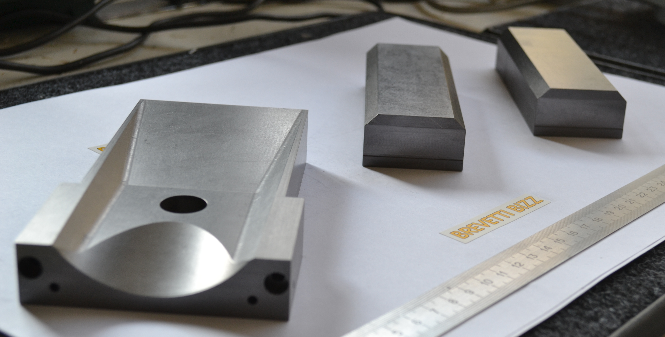
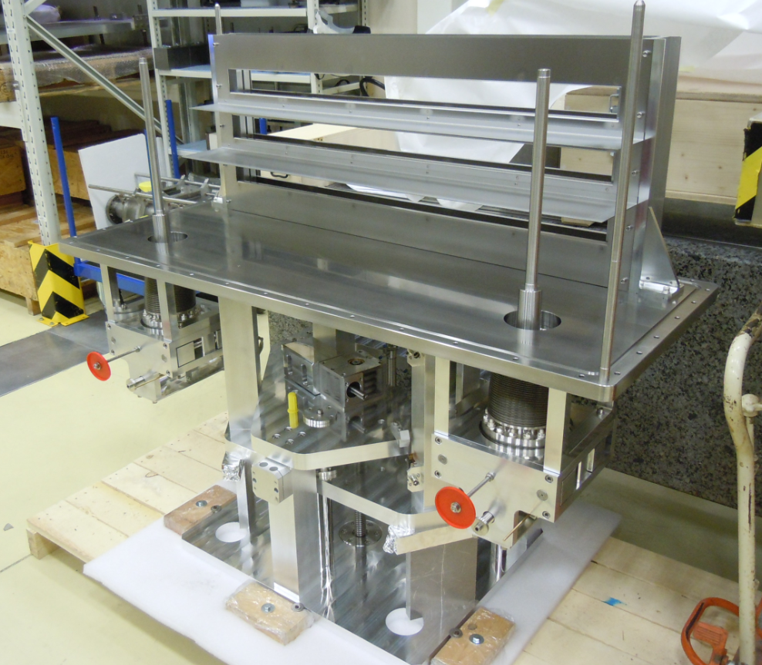
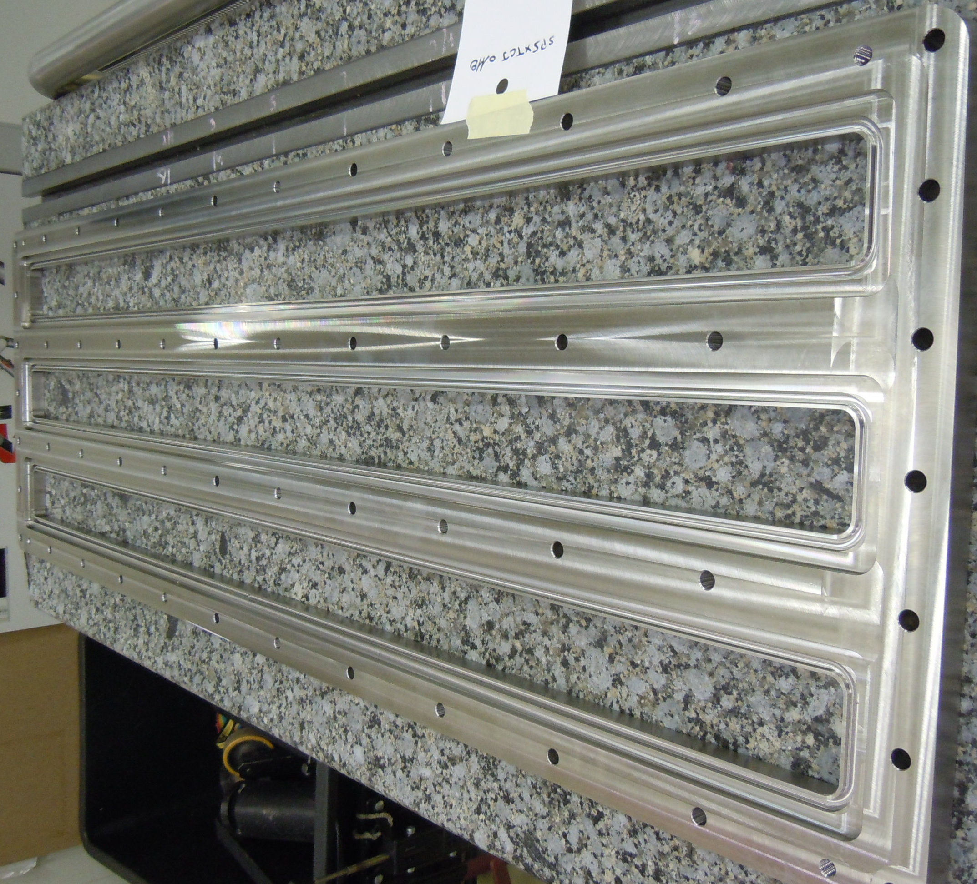
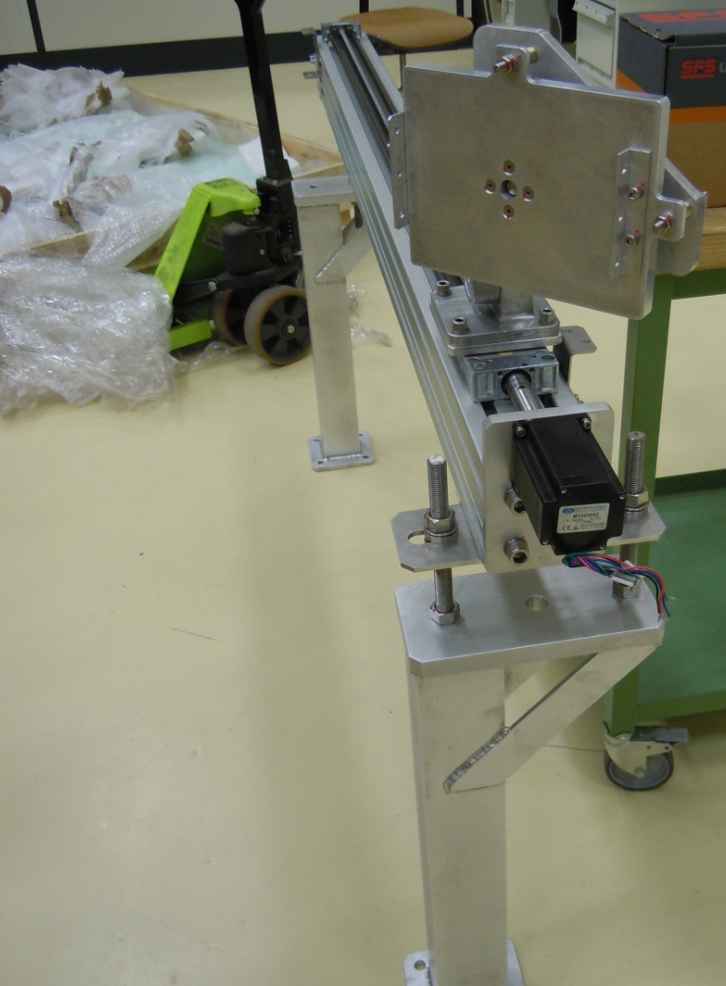
HiRadMat Experiment (HRMT-23)
HL-LHC Collimator Design and Testing
CuCD block
MoGr blocks and tapering
Supporting system
Window holders
Mirror supports

Slide 26
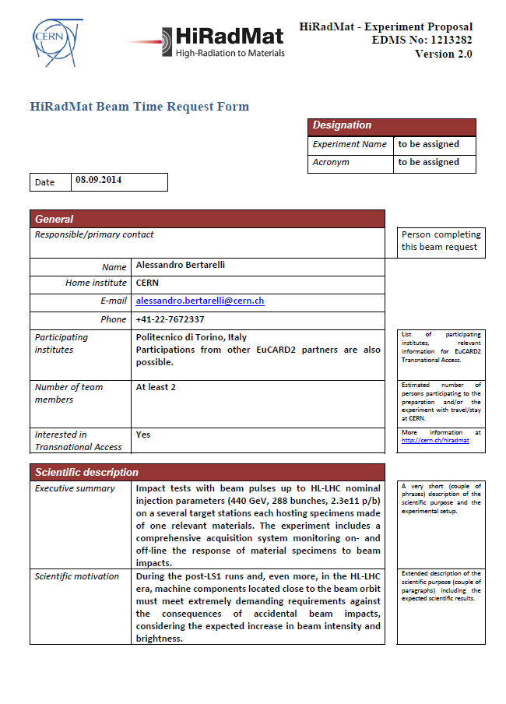
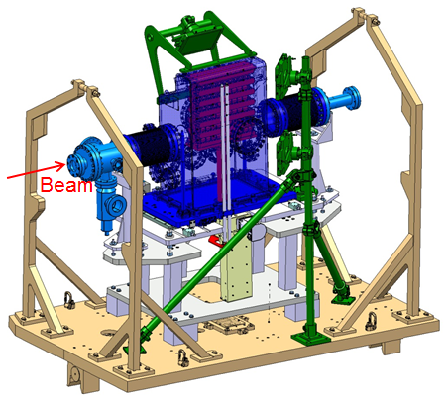
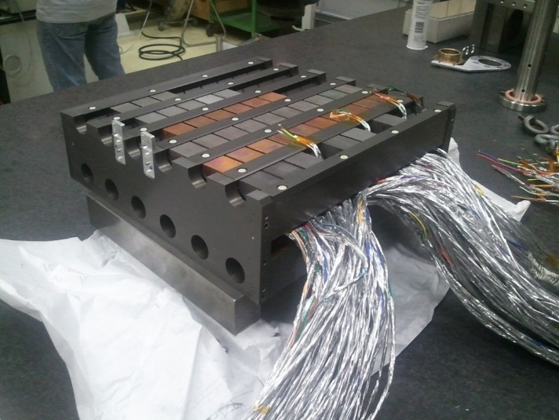
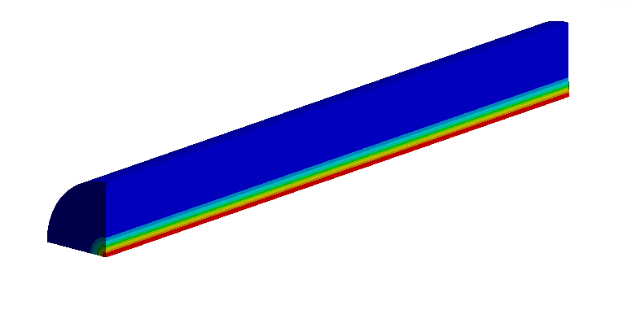
HiRadMat Experiment (MultiMat)
HL-LHC Collimator Design and Testing
After HRMT-23, an experiment on a broad range of materials is proposed in the HiRadMat facility (MultiMat)
Material specimens of simple shape of interest for collimators, injection and dump absorbers, protection devices for the HL-LHC era.
Possible materials: MoGr, CuCD, other Ceramic-Graphite composites, Carbon-Carbon (2D/3D), Graphite, BN, Glidcop, Mo, W-alloys (Inermet, W-Re, etc.)
Opportunity to join forces, optimize resources, create synergies between projects at CERN and elsewhere
Beam intensity up to 288 bunches, 1.7e11 p/b, beam size down to 0.3x0.3 mm²
Design and diversified instrumentation inspired by HRMT14 experiment. 12 target stations each hosting several specimens
∅=30 mm, L=40 mm

Slide 27
Summary
Overview of Collimation Materials
Getting to HL-LHC performances requires a new generation of collimators embarking advanced materials
The R&D, characterization, simulation, testing and irradiation program, part of WP11 Tasks 2 and 3, is well advanced focusing on a new generation of metal- and ceramic- matric composites: Copper – Diamond (CuCD) and Molybdenum Carbide – Graphite (MoGr)
Design of a new collimator concept embarking either CuCD or MoGr very advanced.
Disassebling and post-irradiation observations of HRMT-14 successfully started. HRMT-09 to start soon.
Qualification of the design and validation of advanced simulation methods and materials constitutive models expected in a HiRadMat experiment in Summer 2015.
Manufacturing of HiRadMat test-bench is in progress. Full scale CuCD and MoGr components successfully produced.
A full-scale prototype of the newly designed HL-LHC Collimator should be installed and tested in the LHC in 2016
MoGr about to be tested by a number of electronics manufacturers for efficient thermal management of components and systems.

Slide 28
Thank you for your attention!
The research leading to these results has received funding from the European Commission under the FP7 Research Infrastructures project EuCARD, Grant Agreement 227579, EuCARD-2 Grant Agreement 312453 and HiLumi Grant Agreement …
alessandro.bertarelli@cern.ch

Slide 29
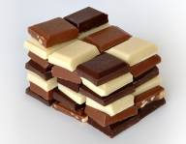
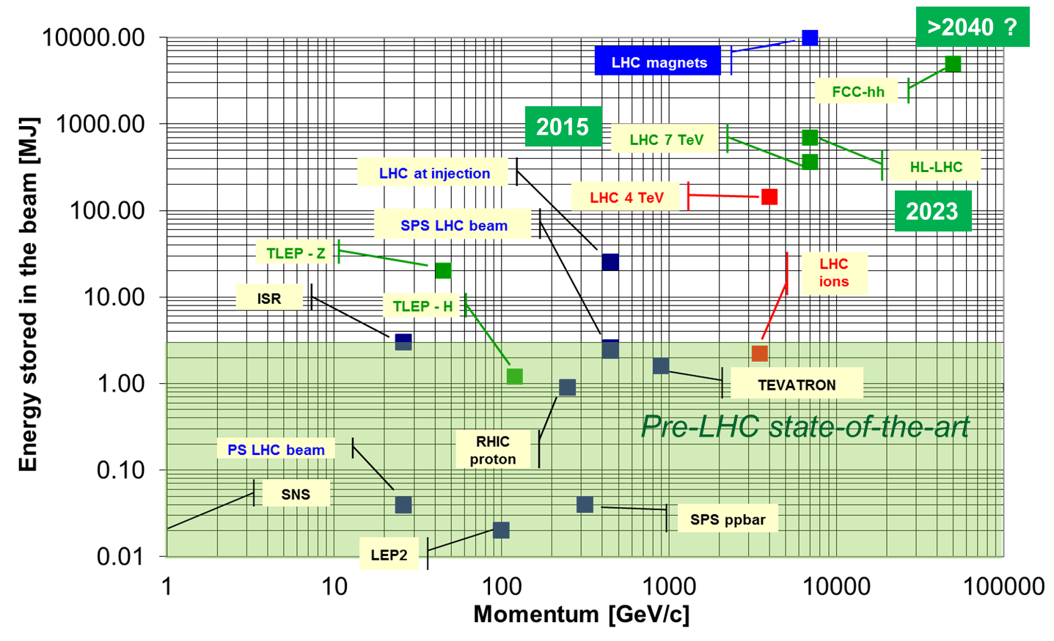
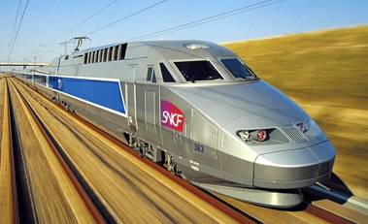
High Energy Particle Accelerators Challenges
Introduction and Motivations
Particle beams have reached unprecedented energy and energy density. This trend is set to continue for future accelerators (690 MJ for HL-LHC)
Beam-induced accidents, beam losses and beam stability represent one of the most relevant issues for high power particle accelerators!
Collimators are one of the most critical systems when these issues are of concern
What is HL-LHC Energy equivalent to?
v = 7 knots
30 kg Milk Chocolate
USS Harry S. Truman
v = 210 km/h
TGV
J. Wenninger (CERN)
160 kg TNT

Slide 30
LHC Collimation System
Introduction and Motivations
Collimation is one of the most critical systems for High Energy Accelerators (beam-induced accidents, beam losses, RF stability issues …)
Several types of collimators for multi-stage cleaning (primary, secondary, tertiary units) at multiple LHC locations (100+ Collimators).
Active part of jaws made of various materials (C-C, Graphite, Copper, Tungsten Heavy Alloy...)
Jaw Assembly (1.2 m long)
Jaw Block (Carbon-Carbon)
Vacuum Vessel
Particle Beam
Jaw Cooling system
Actuation system
LHC Secondary Collimator (TCSG) Cutaway
Notes:
30

Slide 31
Radiation Damage Index
Introduction and Motivations
Proposed during the 2nd Eucard2 ColMat-HDED Annual Meeting (GSI, 4-5 December 2014)
It takes into account three different contributions to radiation damage:
Displacement Per Atom
Gas production (Hydrogen and Helium)
Damage induced by Ion Tracks
Studies ongoing to asses RDI for collimator materials!

Slide 32
Mechanical Characterization: Elastic Constants
Novel Materials: R&D and Characterization
Method to derive the elastic constants of transversely isotropic and orthotropic materials (MoGr, C-C); can be extended to isotropic materials (CuCD)!
Developed by M. Borg (University of Malta, CERN), the method combines resonance measurement of the first natural frequencies (flexural and torsional) and ultra-sound testing assessing speed of sound.
The problem is 3D: numerical benchmarking (ANSYS) to derive the material parameters once the frequencies are known (reverse engineering)
Exp. test-bench
1st Flexural mode

Slide 33
Measurement of elastic constants
Material | Young’s and Shear Moduli [GPa]
 | E_{y} | E_{z} | E_{x} | G_{xy} | G_{xz} | G_{yz}
MoGr 6530-Aa | 74 | 74 | 7.1 | 4.3 | 4.3 | 31
CuCD | 160 | 160 | 160 | 75 | 75 | 75
CFC | 58 | 104 | 2.4 | 2.2 | 3.7 | 14
Material | Poisson’s Ratios
 | n_{xy} | n_{yz} | n_{xz}
MoGr 6530-Aa | 0.10 | 0.20 | 0.10
CuCD | 0.07 | 0.07 | 0.07
CFC | tbd | tbd | tbd
Reference System
Poisson’s ratio of CFC not yet measured because of the strong signal attenuation in the material

