Slide 1
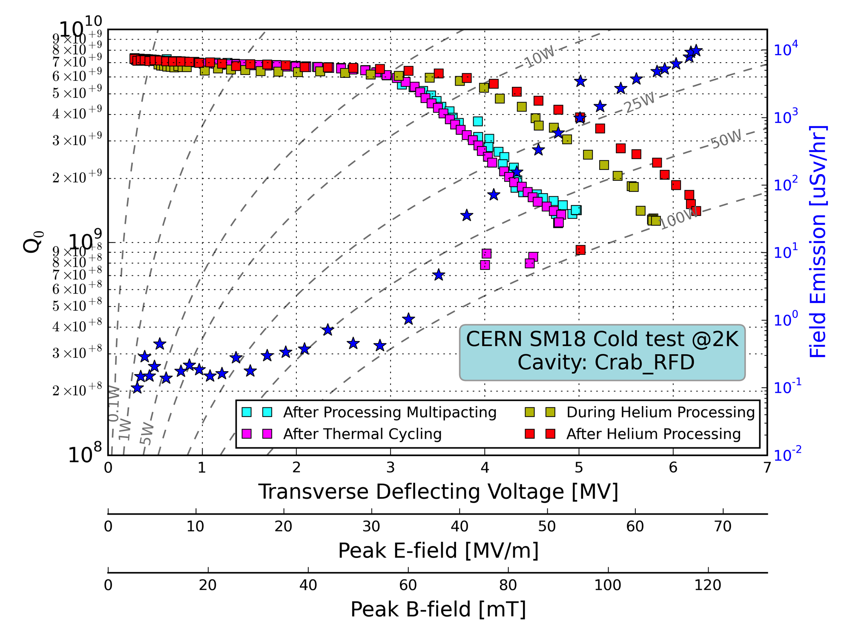
RFD Cold Test
Cavity Test at 2K:
Cavity sent under vacuum
Cavity not vented at CERN.
Performance @ CERN
Q0 = 7.5 x10⁹
RResidual = 16 nOhm
Max VT = 6.2 MV
Performance @ ODU/JLAB
Q0 = 1.25 x 10¹⁰
RResidual = 9.5 nOhm
Max VT = 7.0 MV
Comments
Multipacting processable
No issues
300 K
~10 days
0 K
Thermal cycle to 15 K

Slide 2
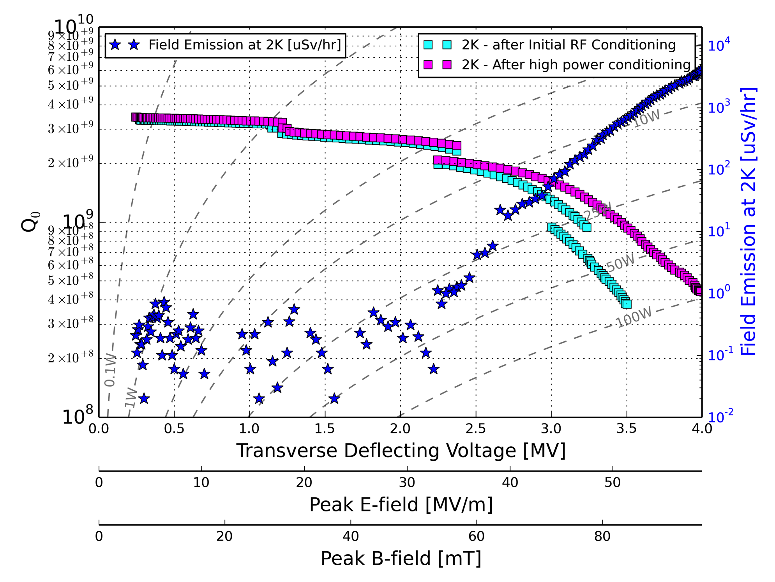
DQW Cold Test
300 K
Cavity Test at 2K:
RF surface contaminated
HPR required before test
Performance @ CERN
Q0 = 3.5 x10⁹
RResidual = 24 nOhm
Max VT = 4.0 MV
Performance @ BNL
Q0 = 4.5 x 10⁹
RResidual = 18.3 nOhm
Max VT = 4.5 MV
Comments
Results compromised by cable breakdown on input power cable in cryostat
=> retesting obligatory
~10 days
0 K

Slide 3
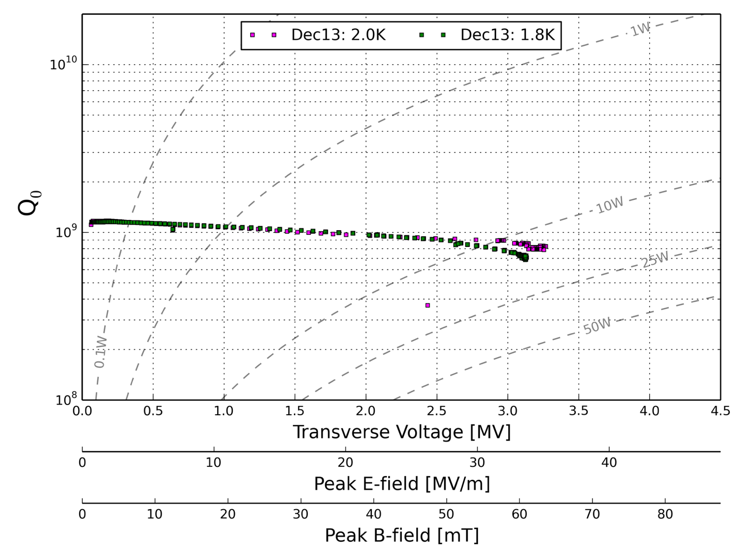
UK-4Rod Cold Test
Cavity Tests at 4K, 2K & 1.8K
Issues with the cavity
Bad Cavity Vacuum at all temperatures
NbTi Flanges with very poor knife edges
Niobium porosity on weld at base of rods at 2K
Insufficient HPR at time of test
Performance @ CERN
Q0 = ~1.0 x10⁹
RResidual = 38 nOhm
Max VT = 3.3 MV
Comments
Cavity flanges needed repair

Slide 4
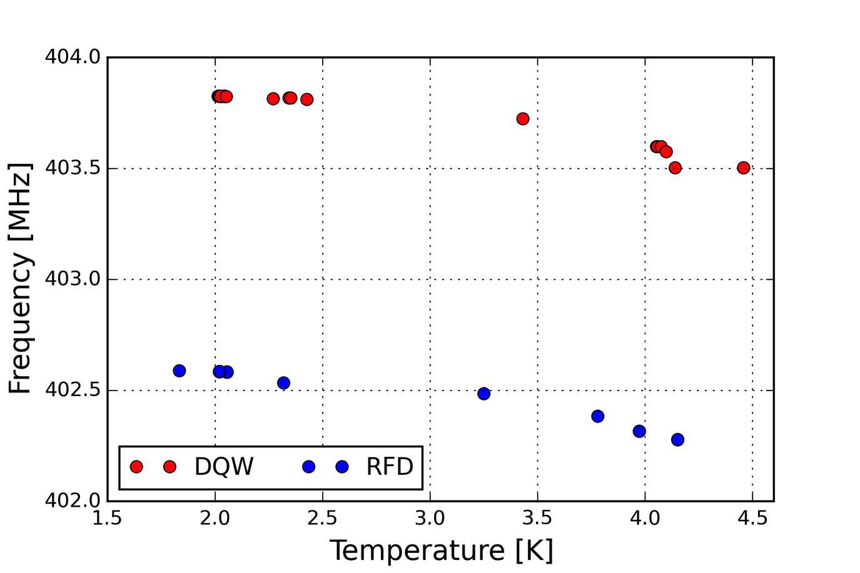
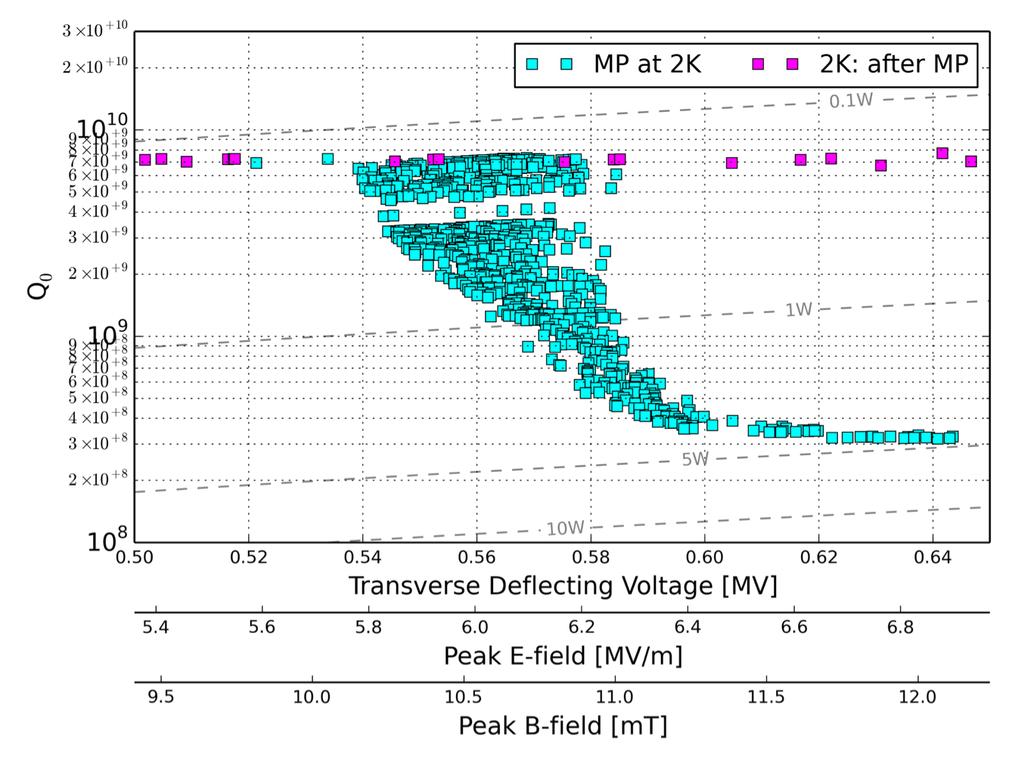
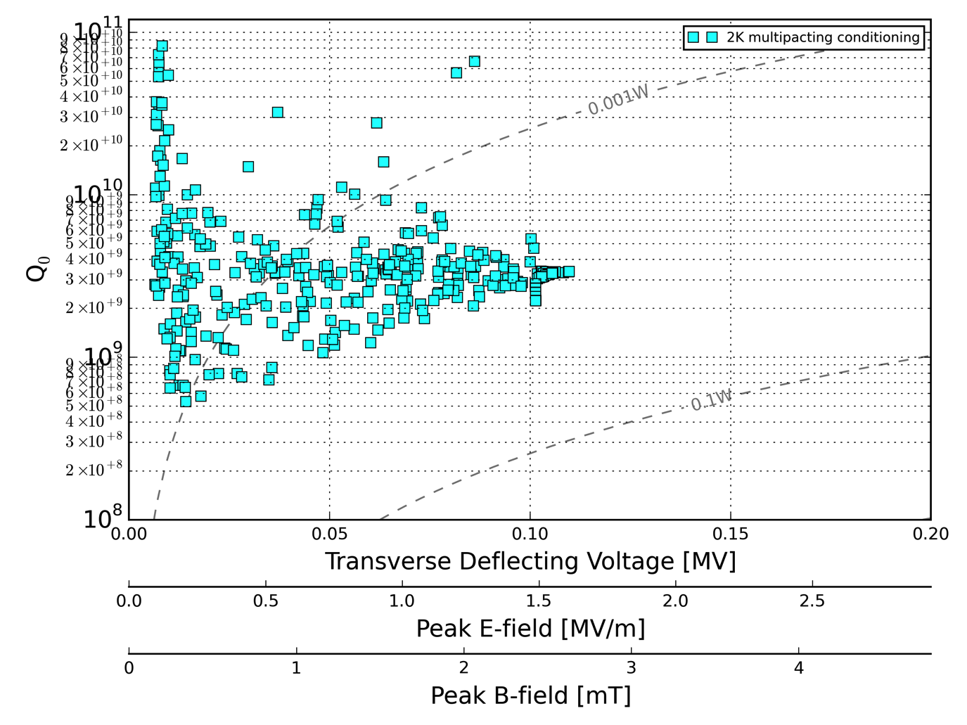
Other observations
Frequency change with temperature
DQW:
Δf = 323 kHz from 4.5 το 2.0K
RFD:
Δf = 311 kHz from 4.1 το 2.0K
Low field Multipacting
Easily processable
RFD @ 0.54- 0.6 MV
DQW @ 0.01 -0.1 MV
RFD
DQW

Slide 5
Crab Present Status
SM18 Tests stand:
SM18_V3 operational & shared between Crab and High Gradient programs
New insert required for DQW + tuner test: presently under manufacture
Tests slot availability dictated by compensatory measures for radiation protection, cryogenics availability, and clean room availability/readiness
RFD:
PoP Cavity returned to ODU without venting.
DQW:
PoP Cavity vented, welds etc checked with X-rays + ultrasound
PoP Cavity: Prepared for light BCP -> 1st available slot = week 21
Repeat test of PoP Cavity: HPR on week 22, cold test on weeks 23-24
Cold test with tuner: High Priority -> Awaiting new insert -> Aim for testing in July
UK-4Rod
Beam port flanges replaced. BCP on week 22, then await test slot
SM18 Horizontal Bunker
Preparations for horizontal test starting: Cryo distribution box for M7 bunker now under design study, with initial planning estimate expected beginning of June.

Slide 6
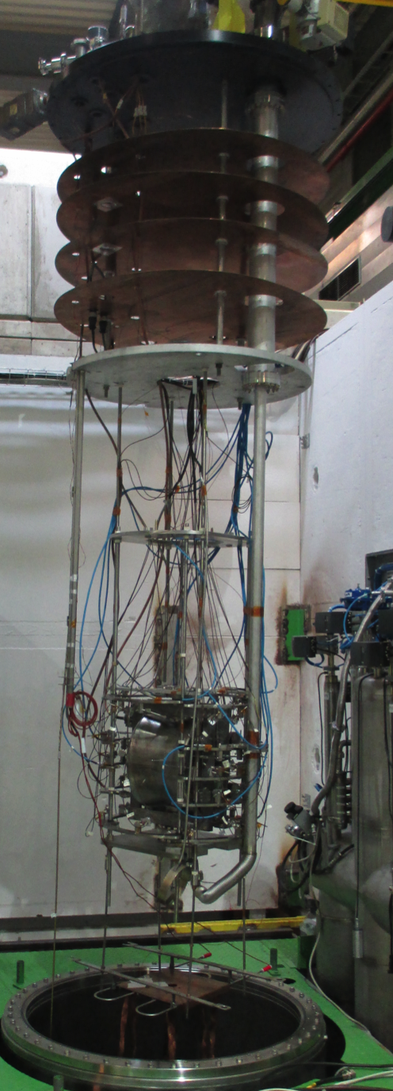
SM18_V3 Insert
Upgrade of insert needed for DQW +tuner test
Required changes: Tuner motor integration, resized rupture disks, insert load balance, improved pumping line connection
Existing Insert
Bare Cavity
Cavity + Tuner

