Slide 1
Hollow Electron Lens Update
A. Bertarelli, R. Bruce, A. Rossi, D. Perini, S. Redaelli, B. Salvachua – CERN, Geneva, Switzerland
G. Stancari, A. Valishev – FNAL, Batavia, IL, USA
Research supported by FP7 HiLumi LHC, Grant Agreement 284404 and by the US DOE through the US-LARP program. Fermilab is operated by Fermi Research Alliance, LLC under Contract DE-AC02-07CH11359 with the US DOE.
Main canvas from R. Bruce, 2015.05.06, presented at IPAC’15
1
Notes:
1
1
1540 -> 1609

Slide 2
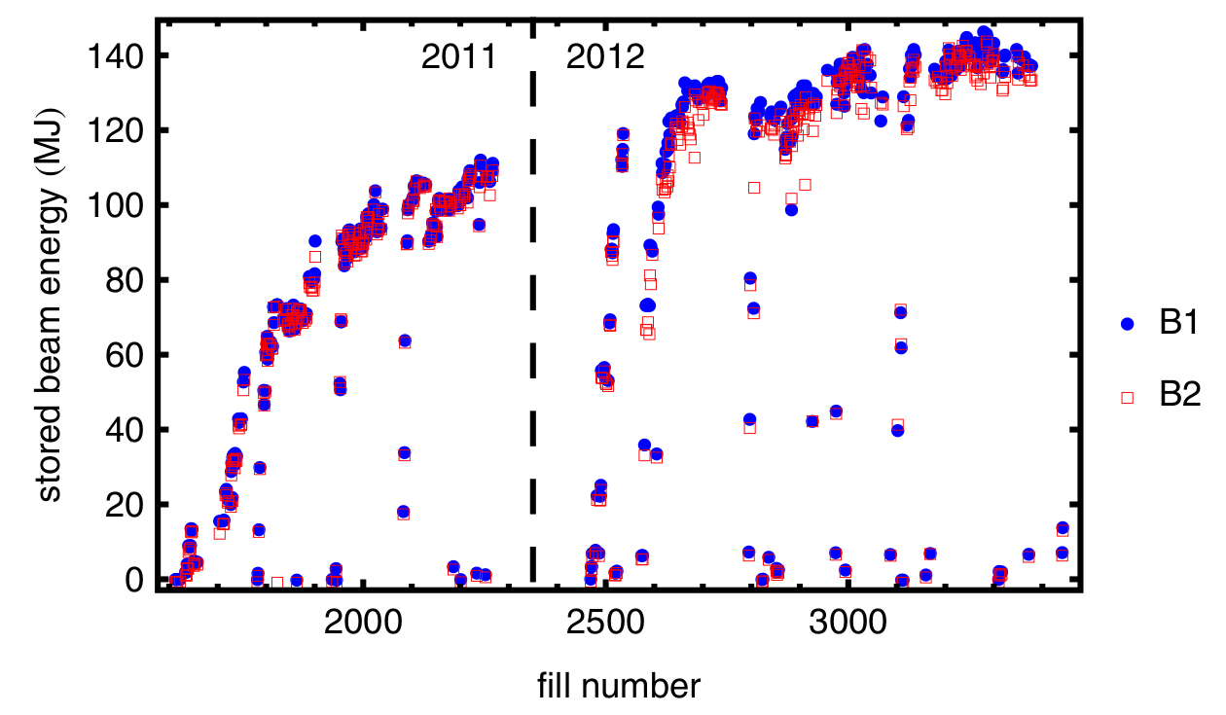
Stored energy in Run 1
LHC collimation worked very well in Run I at 4 TeV (2010-2013) with routinely stored ~140 MJ beams over hours without accidental quenches

Slide 3
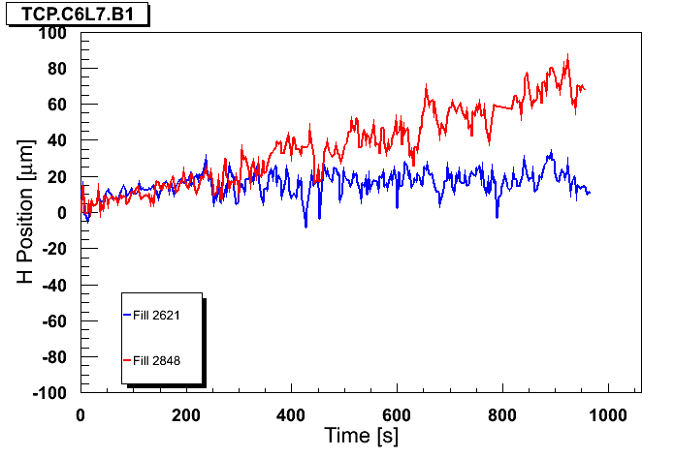
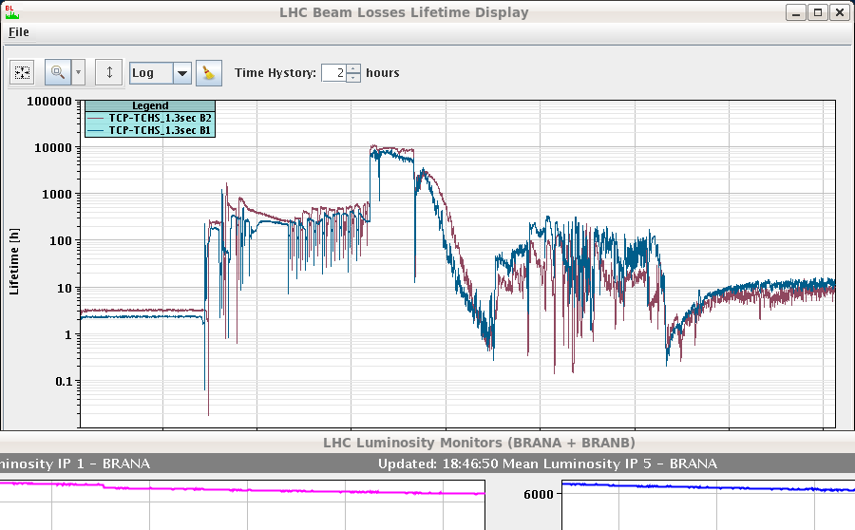
Stored energy in Run 1
Orbit at primary collimator
Courtesy of J. Wenninger
LHC collimation worked very well in Run I at 4 TeV (2010-2013) with routinely stored ~140 MJ beams over hours without accidental quenches
However, operation sometimes perturbed by sudden losses correlated to fast orbit movements => beam dumps
Huge stored beam energy per beam : 362 MJ for nominal LHC configuration, 675 MJ for planned upgrade HL-LHC
HL-LHC: phase failure of crab cavity => beam gets a ~1-σ kick which causes scraping
Possible mitigation: limit peak losses by actively depleting halo in a controlled way
Injection
Ramp
Squeeze
Adjust
Physics

Slide 4
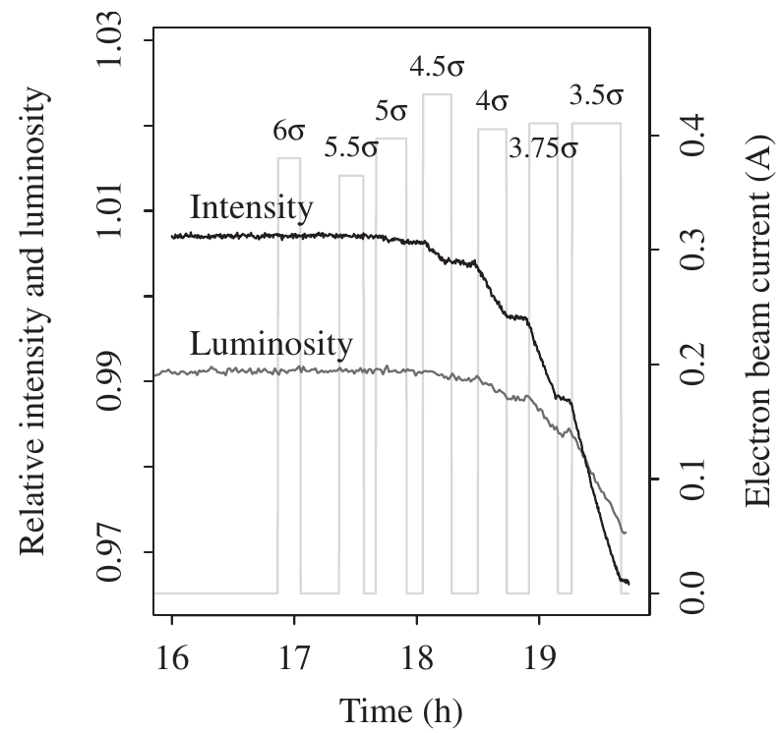
Methods for halo scraping
Hollow electron lens
Solid experimental proof of principle at Tevatron
Requires new hardware
Advantage : closer to beam without impedance
Alternatives under parallel study:
Put halo on resonance using a tune ripple or transverse damper
Relies on very good knowledge of tune and detuning with amplitude – not evident!
Does not require new hardware and shall be tested in the LHC
Stancari et al., Phys. Rev. Lett. 107, 084802 (2011)
See also
Shiltsev, BEAM06, CERN-2007-002
Shiltsev et al., EPAC08
Shiltsev et al., Phys. Rev. STAB11, 103501 (2008)

Slide 5
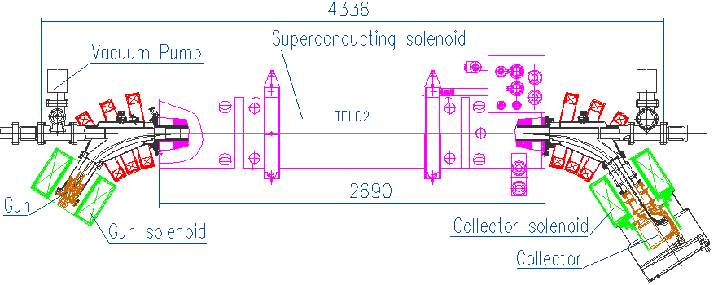
Tevatron electron lens layout
Pulsed, magnetically confined, low-energy electron beam
Tunable transverse halo kicks ~0.1 μrad
6 m total length
superconducting solenoid
1–6 T
protons
electrons
antiprotons
3-m overlap region
collector
Tevatron electron lens
5-kV, 1-A electron gun
thermionic cathode
200-ns rise time
conventional solenoids
0.1–0.4 T
Shiltsev et al., Phys. Rev. ST Accel. Beams 11, 103501 (2008)

Slide 6
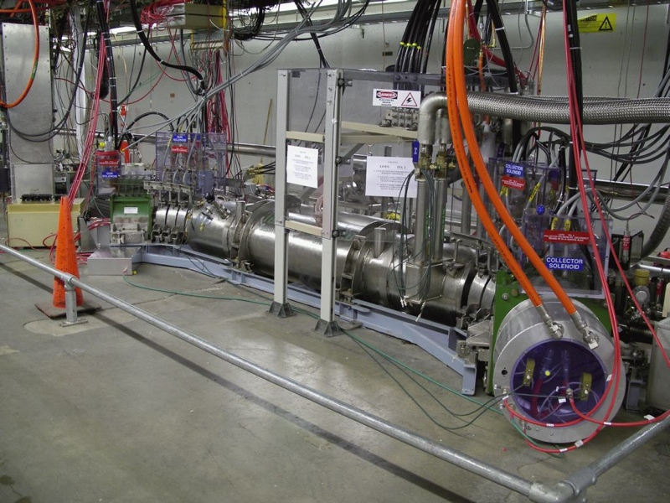
Electron gun
Superconducting solenoid
Collector
Electron lens (TEL-2) in the Tevatron tunnel`

Slide 7
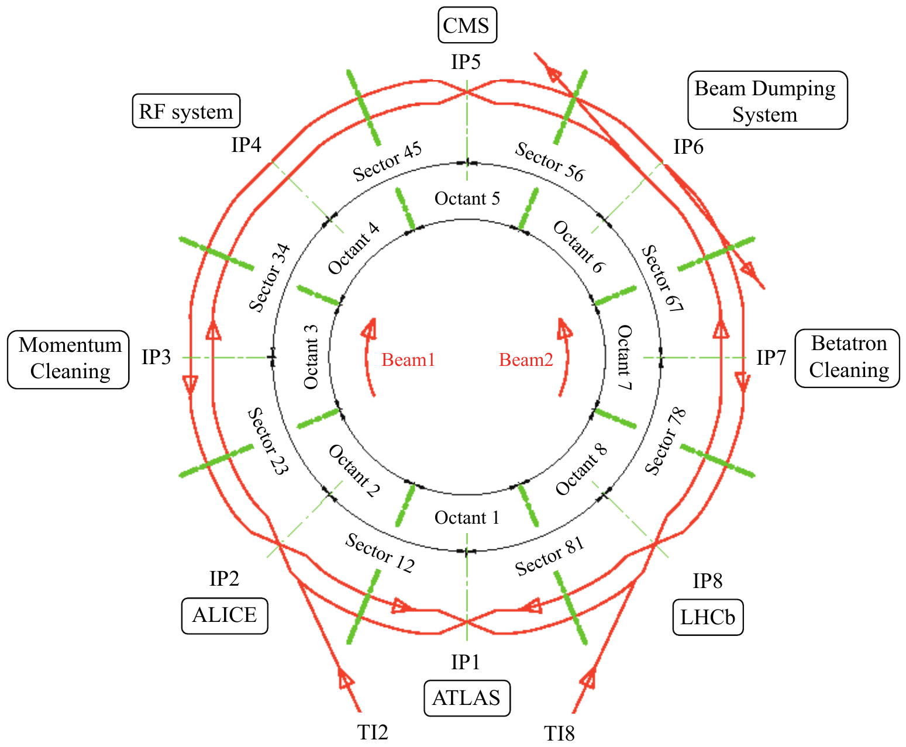
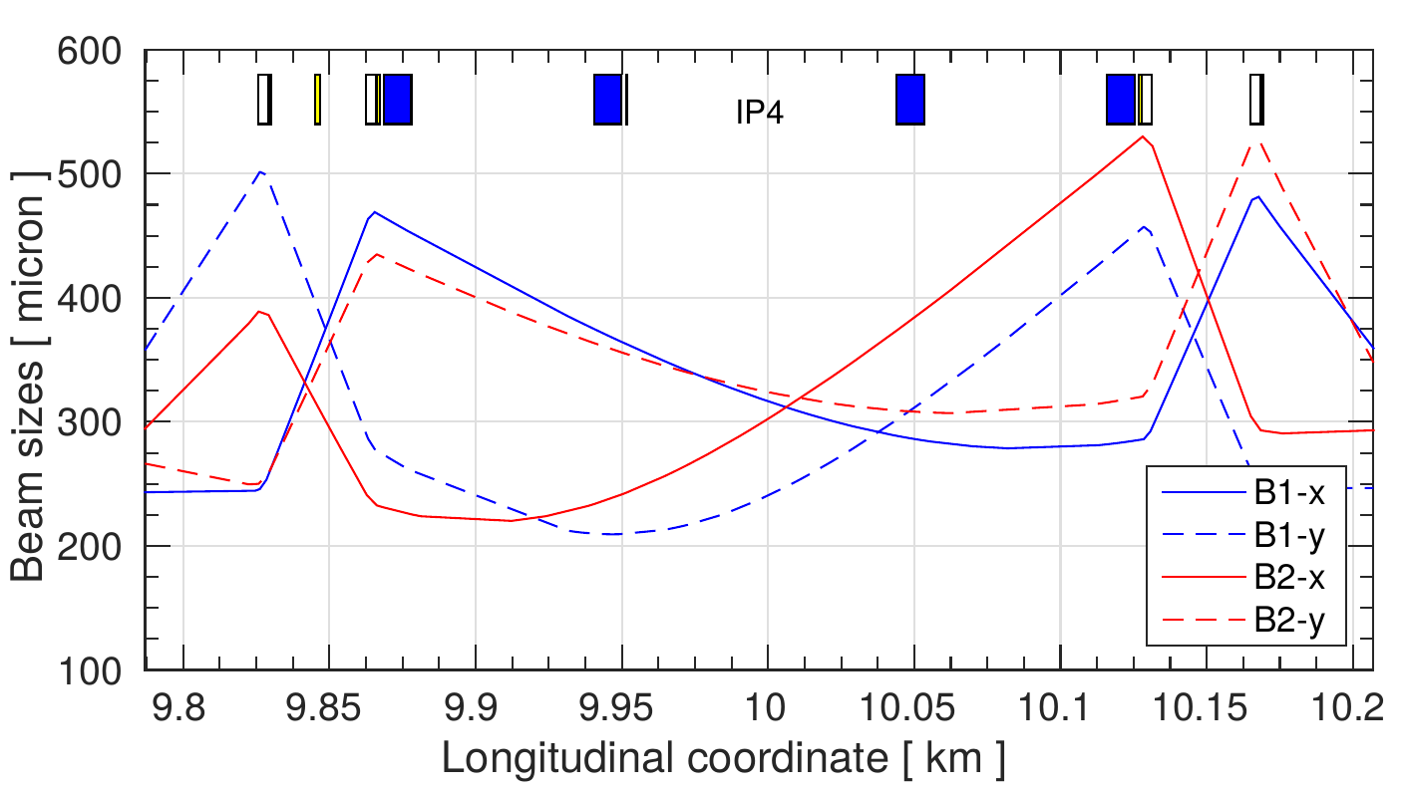
Proposed location in the LHC
Best place IR4:
Large intra beam distance (420 mm)
β_{x} ≈ β_{y}
cryogenics

Slide 8
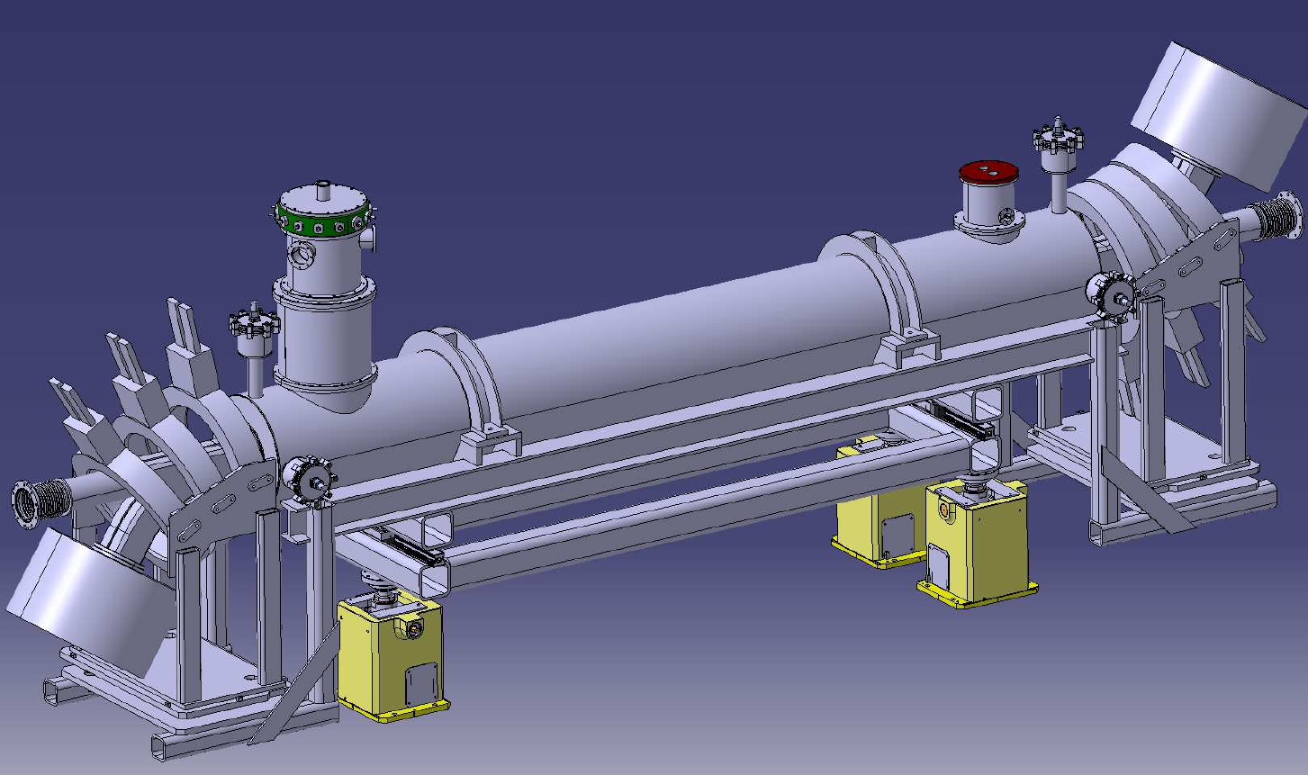
Technical design (CERN)
S-shaped to compensate for the asymmetric electron beam distributions seen by the main beam
Gun and collector stick out in vertical plane to fit in LHC tunnel
Heat loads (at 4.5 K for 1m long cryostat + anti cryostat)
Current leads (~250 A) 1 W
Supports 0.5 W
Thermal radiation 0.5 W / m (with superinsulation)
Diego Perini

Slide 9
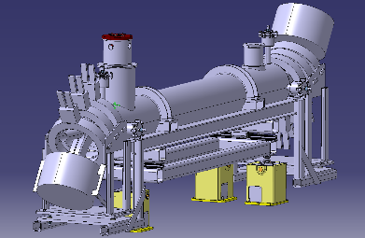
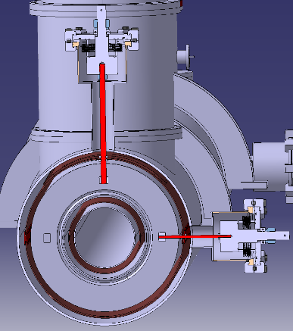
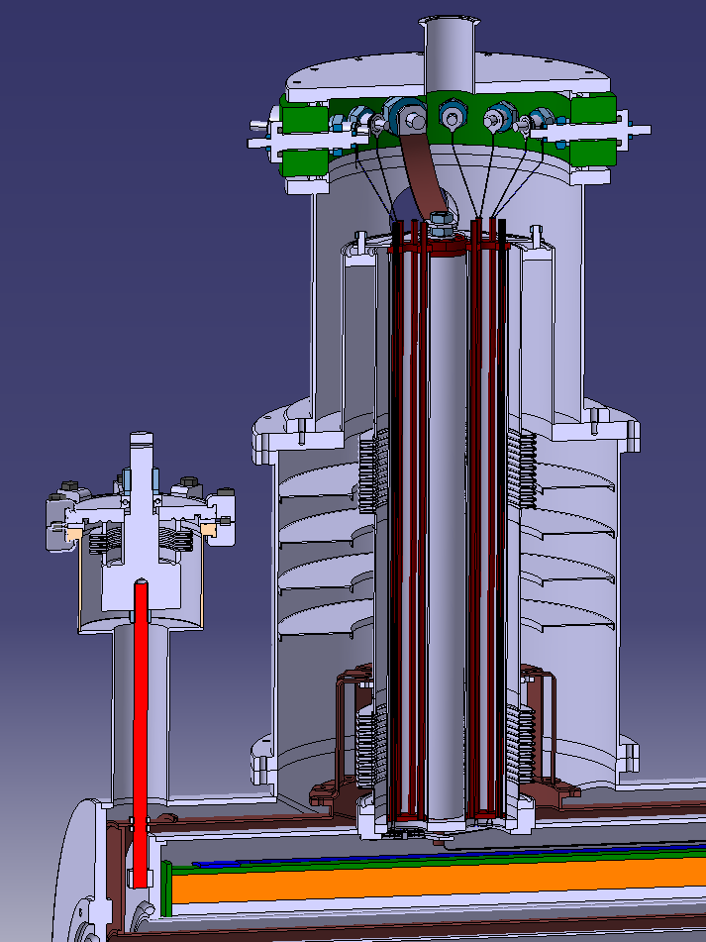
3D design ready to go into production drawings

Slide 10
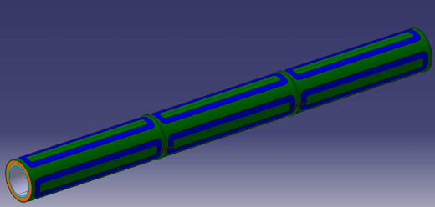
Superconducting solenoid (CERN)
3 x 1 m long, 250 A current, 5T field, cooled with He to 4.2 K
Includes 6 correction coils for alignment of electron beam
Includes (not in the figure) the quench protection system
1 m magnet could be used for test bench
Overall design may evolve with the integration of instrumentation
see
H. Schmickler’s
talk

Slide 11
Summary of main parameters
Going from Conceptual Design Report
(CERN-ACC-2014-0248, FERMILAB-TM-2572-APC and arXiv:1405.2033 – written in collaboration between US LHC Accelerator Research Program (LARP), LHC collimation team, and HL-LHC Project )
to Technical Design Report

Slide 12
Required parameters
Kick given by electron lens
Keeping the Tevatron hardware, kicks given to protons would be factor ~7 less from magnetic rigidity
Increase electron current to compensate (or length – less attractive)
Halo removal rate depends not only on kick but also on lattice non-linearities
Simulations (LifeTrack and SixTrack) demonstrate desired halo depletion with 5A current and stochastic excitation mode
A. Valishev, FERMILAB-TM-2584-AP (2014)

Slide 13
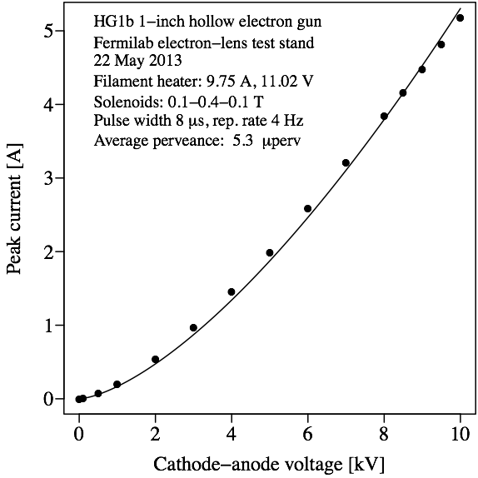
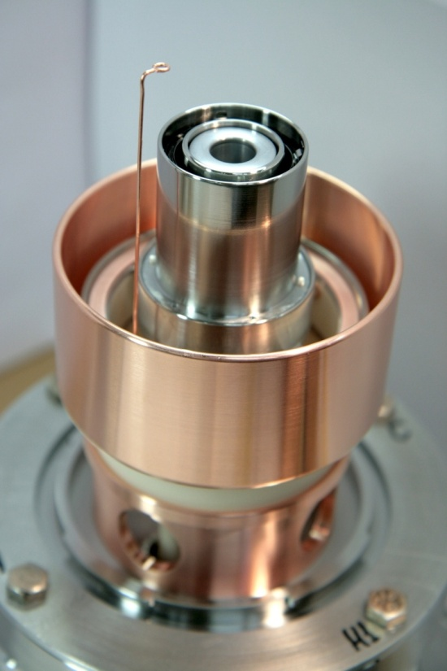
Hollow electron gun (1)
New gun needed for higher current and adjusted electron beam size
First prototype designed, built and tested at Fermilab can provide 5A.
Tungsten dispenser cathode with BaO:CaO:Al2O3 impregnant, 1400 K
First prototype of hollow cathode
Prototype yields 5 A at 10 kV

Slide 14
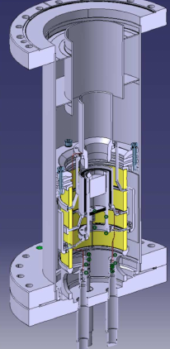
Hollow electron gun (2)
Next gun with slightly reviewed design w.r.t. FNAL one to be built at CERN
Test stand planned to be set up at CERN (SM18) but initial tests at FNAL (LARP)
Powering
10 kV modulator used to power the gun
If we want to act on a subset of bunches: Need very fast rise time
200 ns allows to switch on and off between bunch trains
Cathode: one student to increase current
Present cathode design

Slide 15
Instrumentation
Need to monitor position of electron beam and proton beam
Requirement: About 20 µm accuracy (0.1 σ of proton beam), time resolution of 1 ns (protons) and 100 ns (electrons).
Need to monitor electron current at cathode and collector
Need to monitor electron beam profile
Sensitive loss monitors can be placed downstream
In addition: need halo monitor for the LHC proton beam to study population in various scenarios, independently of e-lens
Detailed design of instrumentation not yet started

Slide 16
Timeline
Collimation needs can only be defined in detail after gaining operational experience at 6.5 TeV (end of 2015)
Uncertainties: cleaning efficiency, beam lifetime, quench limits, impedance
Final decision on installation to be taken based on Run II experience but Hollow Electron Lens already considered for HL-LHC baseline
Meanwhile, proceed with design of 2 devices (1 per beam)
Estimated time needed: about 3 years
If technical design is finalized in 2015, could aim at installation during long shutdown in 2018 (LS2)

Slide 17
CERN/FNAL studies
CERN/FNAL: PhD student (Frankfurt U) will start in July with joint supervision. Work on simulations e-lens related, continuing work of A. Valishev and V. Previtali
FNAL: Toohig student would be very useful for tests and simulations on halo diffusion
CERN: students working on designing the test bench solenoid (production drawings)
CERN: Master student (Darmstadt U) on material science to start in October improving e-gun to extract higher current

Slide 18
Main conclusions
2 Hollow Electron Lenses for collimation are being proposed as baseline for the HL-LHC
New electron gun will built at CERN and first tested at FNAL
3D main design of solenoid magnet is ready to be used for 2D production drawings
1m prototype solenoid will be used in the test bench (ready in about 12 months + design completion)
Results on instrumentation (overlap monitor) may bring to some modifications to the overall design
Design will be used later on for LRBB compensation E-lens
Studies in collaboration between CERN/FNAL ongoing

