Slide 1
BBLR Compensation at HL-LHC
A.Valishev (Fermilab/US LARP), S.Fartoukh (CERN), D.Shatilov (BINP)
Thanks to: C.Milardi, Y.Papaphilippou, H.Schmickler, G.Stancari, M.Zobov
24th LARP Collaboration Meeting, May 12, 2015

Slide 2
Motivation for BBLR in HL-LHC
Flat optics + wires
          (S. Fartoukh, 5th HL-LHC coordination meeting, 2013)
HL-LHC Plan B without crab cavities
Implication of flat optics – no mutual compensation of long-range collisions at IP1,5 requires large crossing angle to create 16-17 σ separation.
Current wires can be used to allow reducing crossing angle and recover geometrical luminosity loss.

Slide 3
Motivation for BBLR in HL-LHC
V-V crossing scheme (S. Fartoukh, F.Cerutti – WP10)
allows strong mitigation of the heat load from the debris produced at the IP and arriving in D2/Q4
  Same as 1 – no mutual compensation of long-range collisions at IP1,5 requires large crossing angle to create 16-17 σ separation.
  Current wires can be used to allow reducing crossing angle and preserve the crab cavity voltage.
  For full flexibility, do we then need to foresee 8 wires per IR (one in each transverse plane, per beam, and per IP side)?

Slide 4
Motivation for BBLR in HL-LHC
Flexible tool for overcoming intensity limitations (S. Fartoukh)
wires allow to restore full freedom in the choice of octupole polarity
  minimize the octupole strength and preserve the DA which otherwise may be limited in the ATS (M.Fitterer, 19 Nov.).

Slide 5
Motivation for BBLR in HL-LHC
Crab-Kissing scheme (S. Fartoukh, Phys. Rev. ST Accel. Beams 17, 111001, 2014)
Together with crab cavities and flat optics, wires are a key ingredient allowing to reduce the pile-up.
  CK requires crab cavities in two planes.

Slide 6
Workplan
First, consider the range of parameters where BBLR might be useful
Evaluate beam-beam performance with/without wires
Evaluate limitations of technical solutions

Slide 7
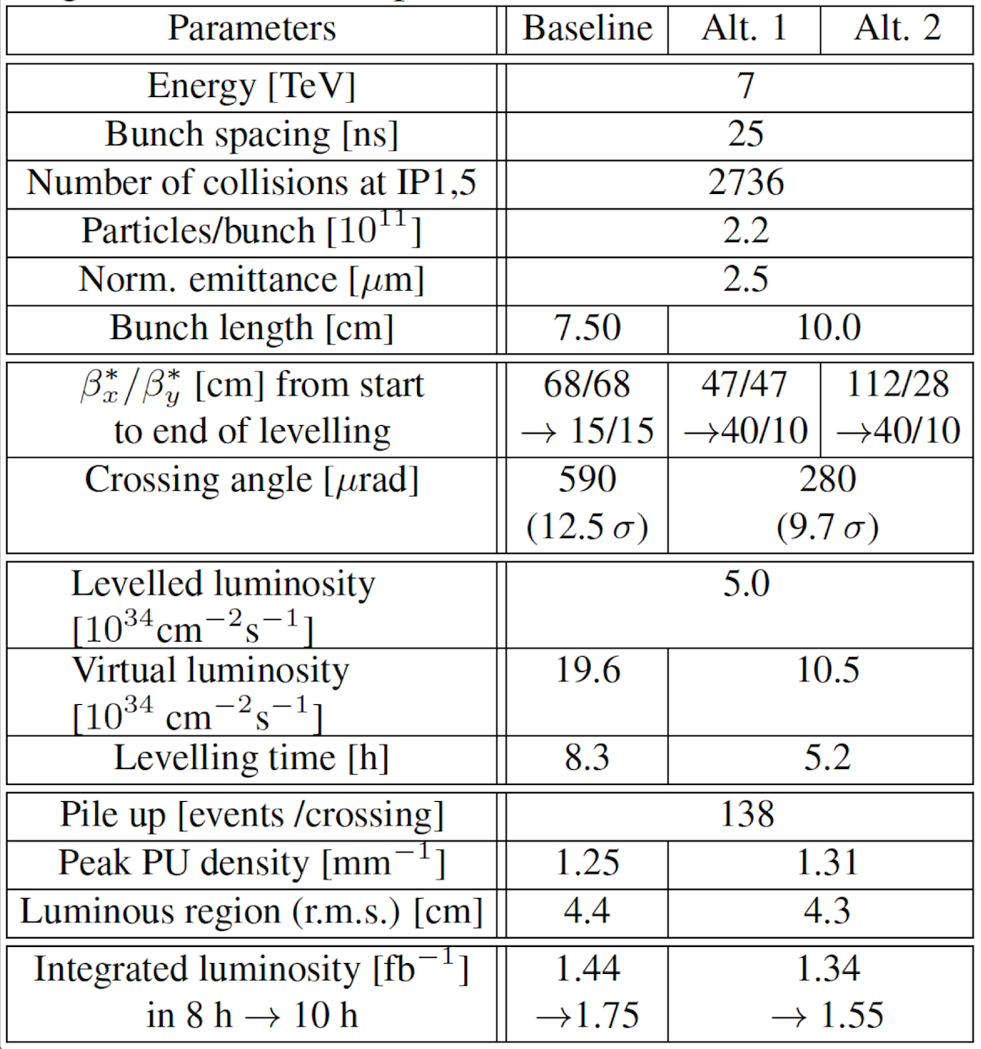
Luminosity Leveling at 5×10³⁴ baseline vs. alternative scenarios

Slide 8
Luminosity Leveling at 5×10³⁴ baseline vs. alternative scenarios

Slide 9
Luminosity Leveling at 5×10³⁴ baseline vs. alternative scenarios

Slide 10
Luminosity Leveling at 5×10³⁴ baseline vs. alternative scenarios

Slide 11
Luminosity Leveling at 5×10³⁴ baseline vs. alternative scenarios

Slide 12
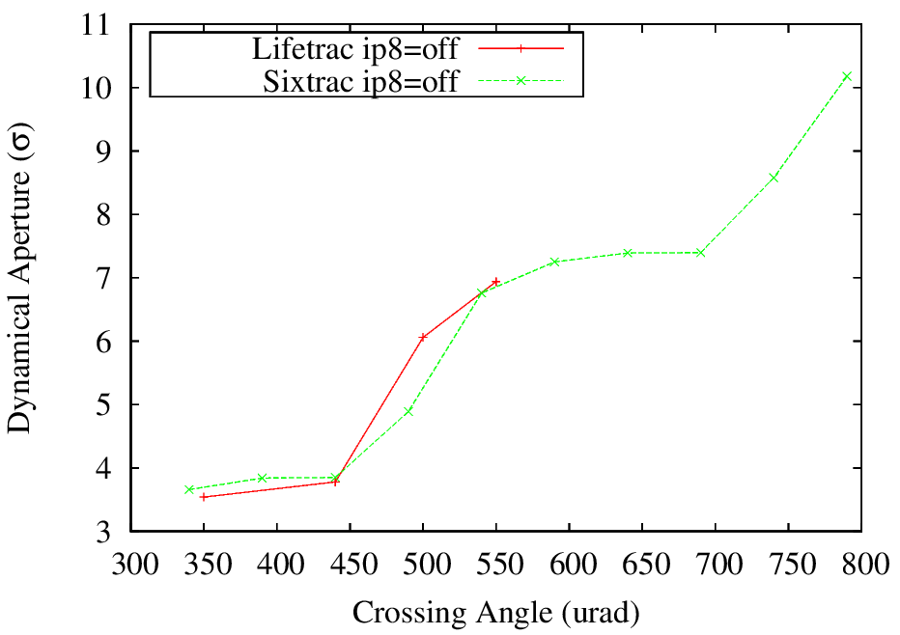
Flat Optics SLHCV3.1b 30/7.5 cm
DA benchmarking with Sixtrack and Lifetrac:
Flat optics requires 16-17σ separation
at Np=2.2E11

Slide 13
Code Benchmarking

Slide 14
Computer code validation against DAΦNE data
In 2005, simulations with Lifetrac were used to justify the wire installation and qualitatively predict performance
We used the latest version with the full account of machine detail and the latest simulation tools to reproduce the experimental data quantitatively

Slide 15
DAFNE Lifetime Optimization with BBLR
C. Milardi, D. Alesini, M.A. Preger, P. Raimondi, M. Zobov, D. Shatilov, http://arxiv.org/abs/0803.1544 (2008)
  … During the operation for the KLOE experiment two such wires have been installed at both ends of the interaction region. They produced a relevant improvement in the lifetime of the weak beam (positrons) at the maximum current of the strong one (electrons) without luminosity loss, in agreement with the numerical predictions.
  The only demonstration of long-range compensation with wires in collider operations.

Slide 16
Slide courtesy C.Milardi
Parasitic Crossings in the DAΦNE IR1
In the DAFNE IRs the beams experience 24 Long Range Beam Beam interactions
IP1
IP1
IP1

Slide 17
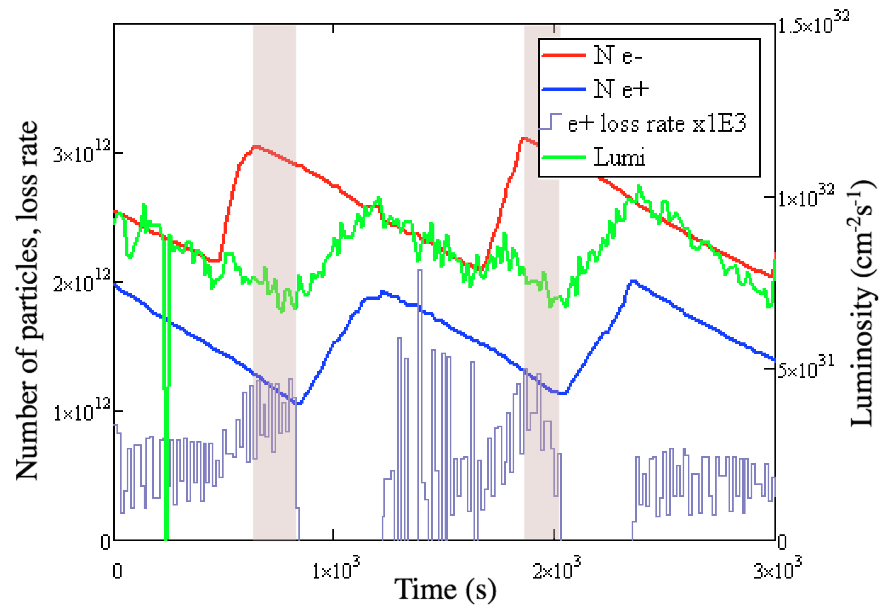

Reduction of Experimental Data
WIRES OFF τ_{BB}=1,200 ±175 s

Slide 18
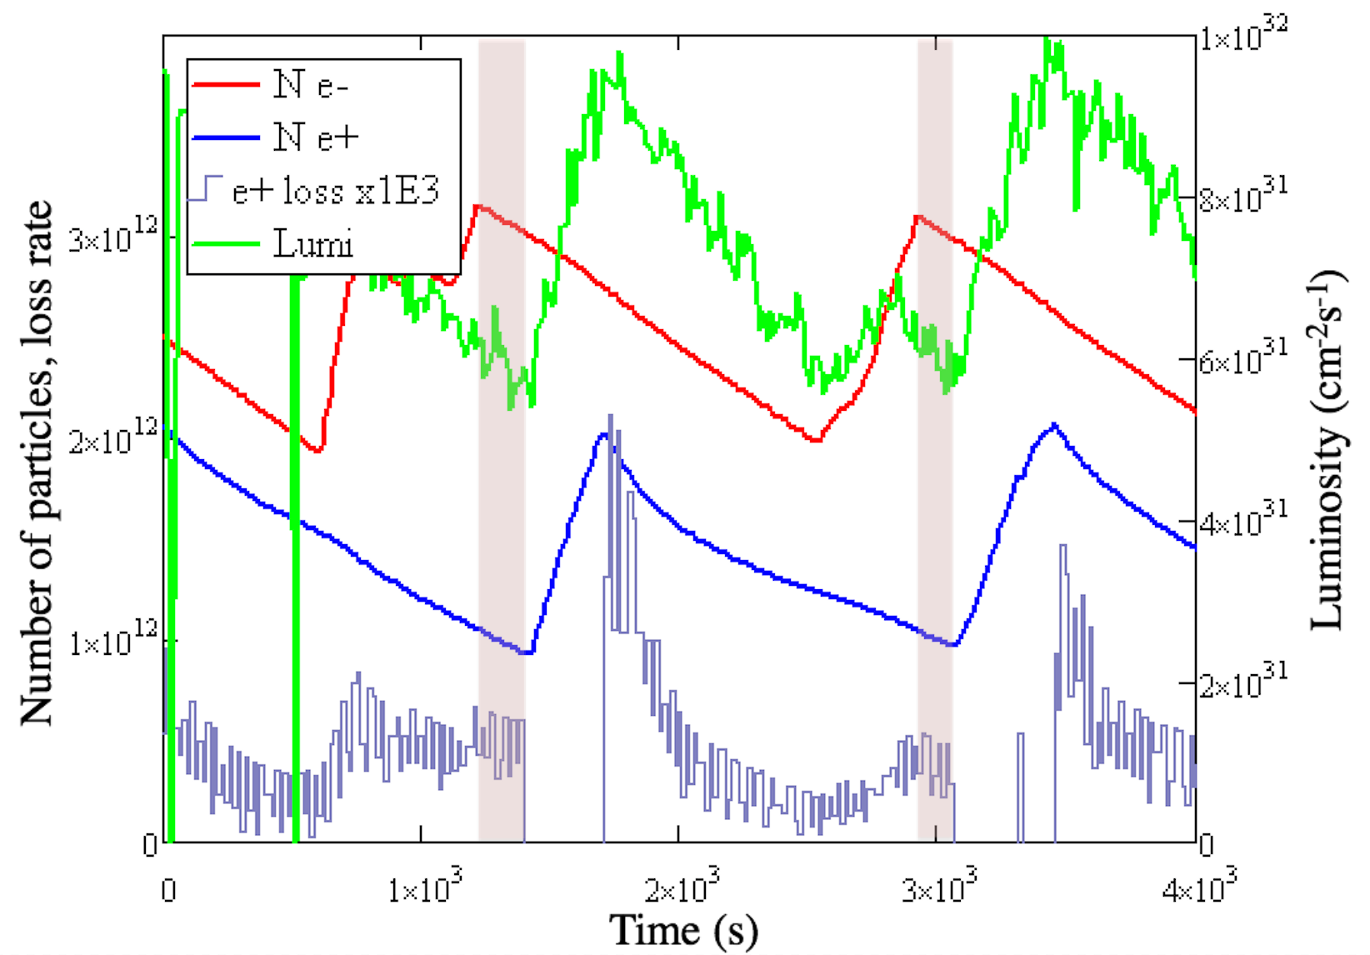
Reduction of Experimental Data
WIRES ON τ_{BB}=2,000±360 s

Slide 19
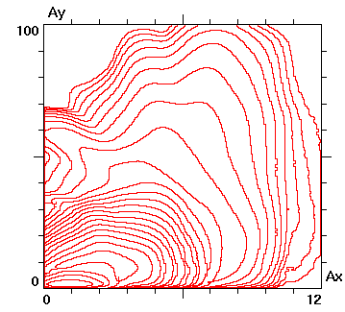
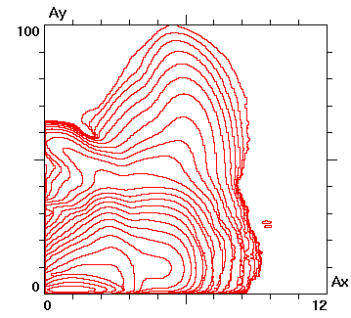
Simulation Results
WIRES OFF
H Aperture 12σ
WIRES ON

Slide 20
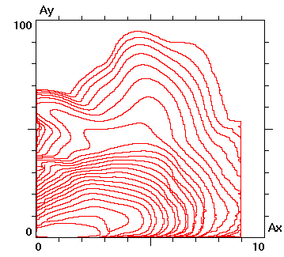
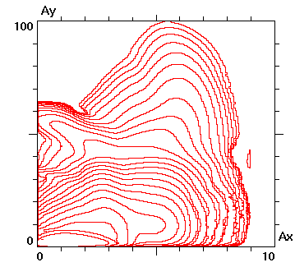
Simulation Results
WIRES OFF
H Aperture 9σ
WIRES ON

Slide 21
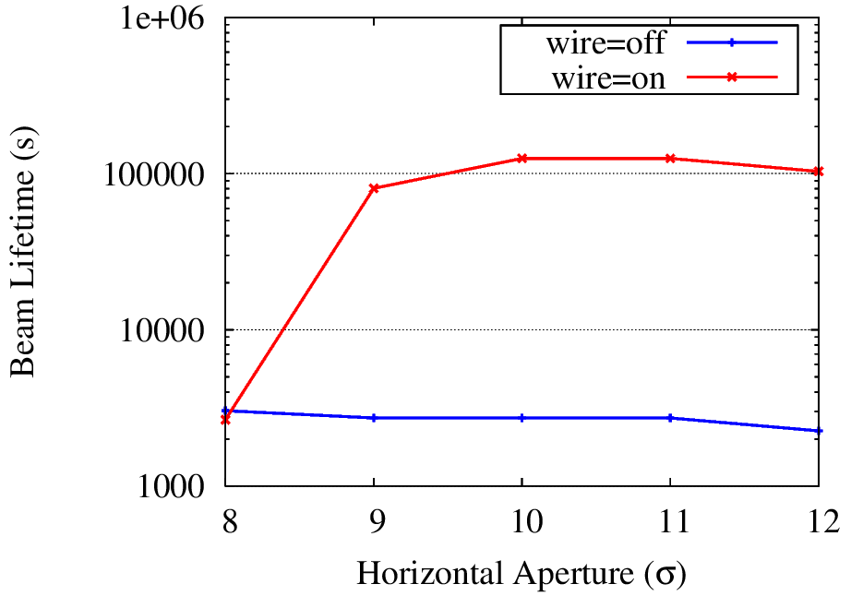
Simulation Results
WIRES OFF τ_{BB}=2000 s

Slide 22
Lifetrac Simulation Summary
The general conclusions of 2005-2006 campaign have been reproduced
Full machine detail does not change the results
  in particular strong coupling in the IR due to experimental solenoid
  sextupoles
No effect on specific luminosity from BBLR – in quantitative agreement with experiment
Aperture model implemented and lifetime effect reproduced quantitatively
In April 2015, Lifetrac simulation was used to guide machine development, which resulted in performance increase
(M.Zobov et al., IPAC-2015)

Slide 23
Simulations for alternative scenarios

Slide 24
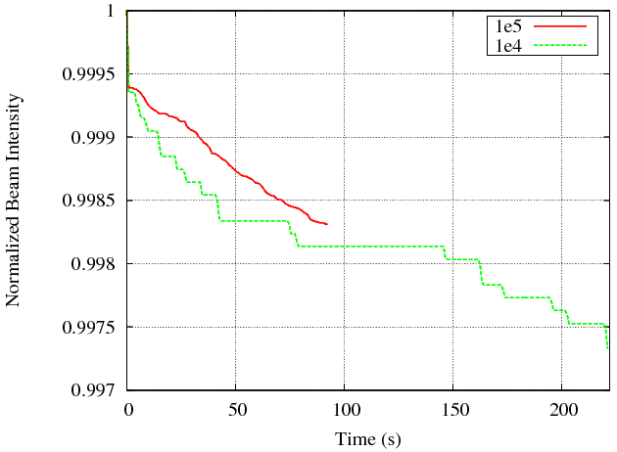
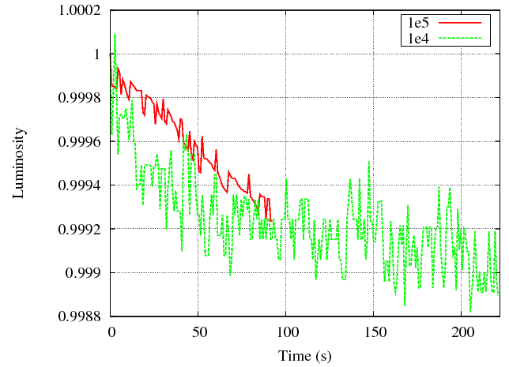
Macroscopic Beam Parameters
End of Leveling at 5×10³⁴
β* = 40/10cm, x=280 urad
IP8=on, CC=off
τ_{L} ~15 hr
τ_{L} ~34 hr

Slide 25
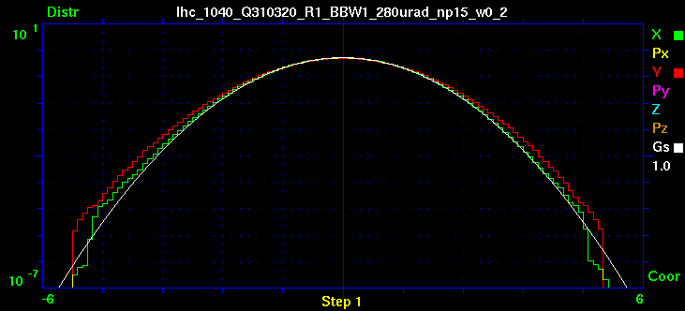
Evolution of Tails, 1E5 particles
β* = 40/10cm, x=280 urad
IP8=on, CC=off

Slide 26
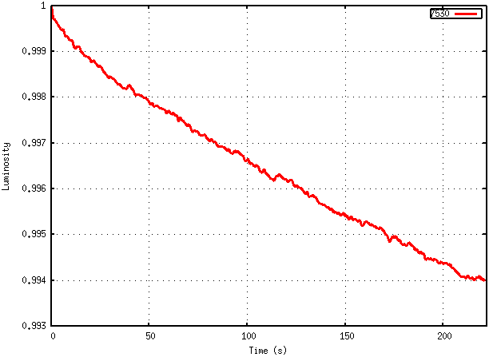
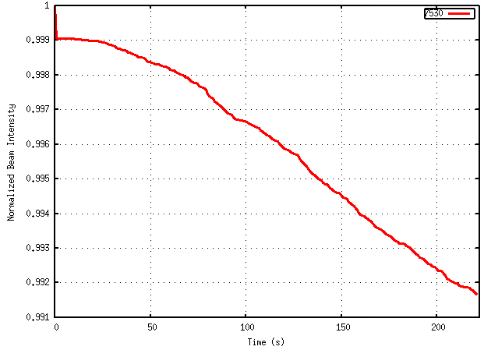
Macroscopic Beam Parameters
End of Leveling at 5×10³⁴
β* = 30/7.5cm, x=320 urad
IP8=on, CC=off
τ_{L} ~10 hr
τ_{L} ~7 hr

Slide 27
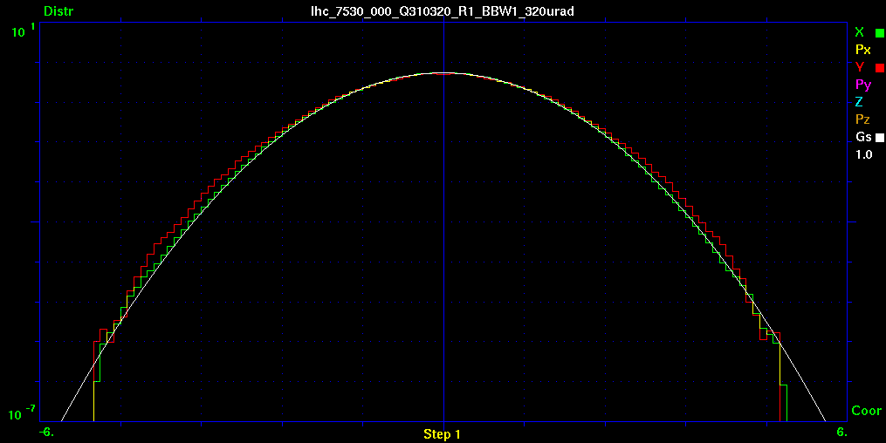
Evolution of Tails
β* = 30/7.5cm, x=320 urad
IP8=on, CC=off

Slide 28
Enter the wires
Significant degradation of luminosity lifetime (τ~10 hr) and DA (3σ) at end of leveling, significant tail growth (1-2 orders of magnitude)

Slide 29
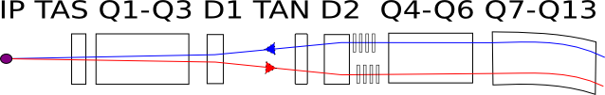
Wire configuration
BBLR
Distance from IR 150 m (replaces CC)
Adjust
  distance to beam
  current

Slide 30
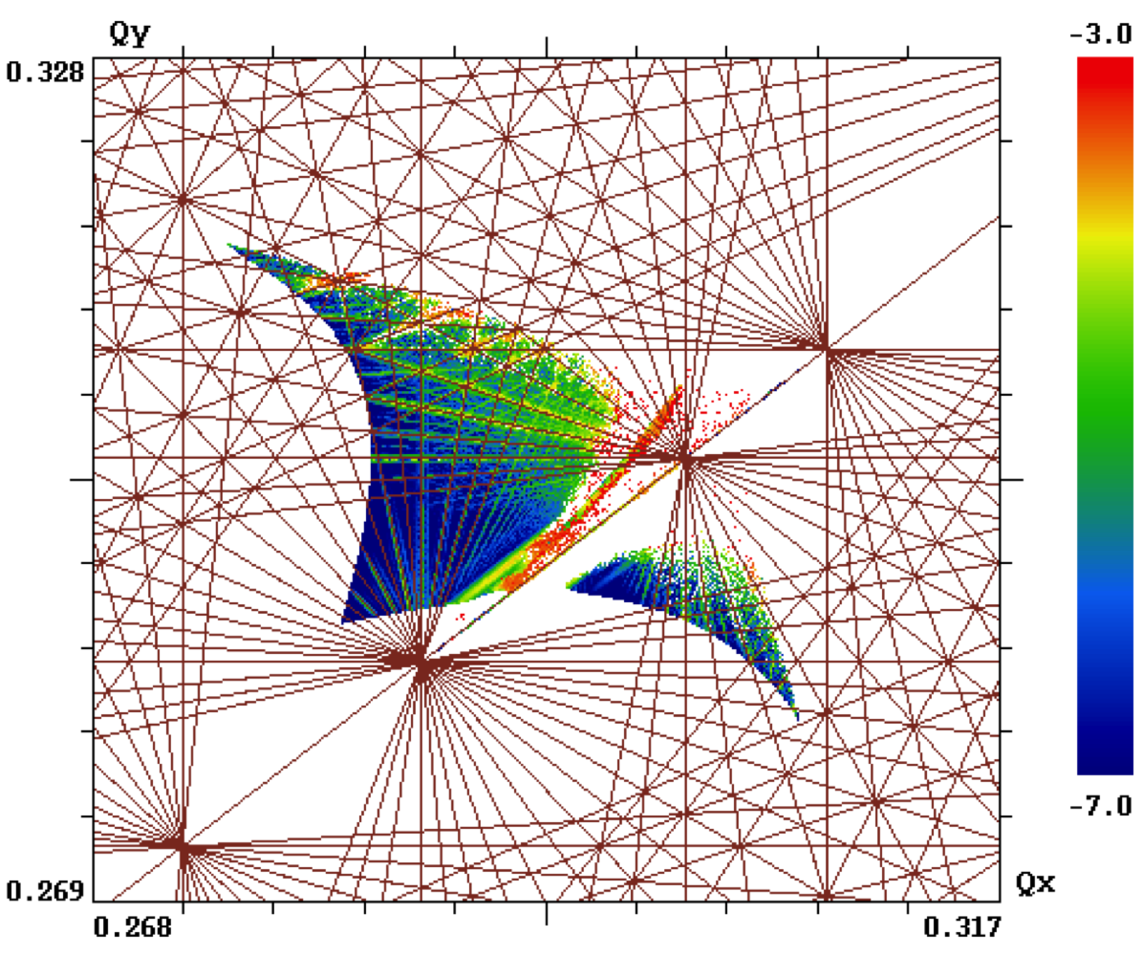
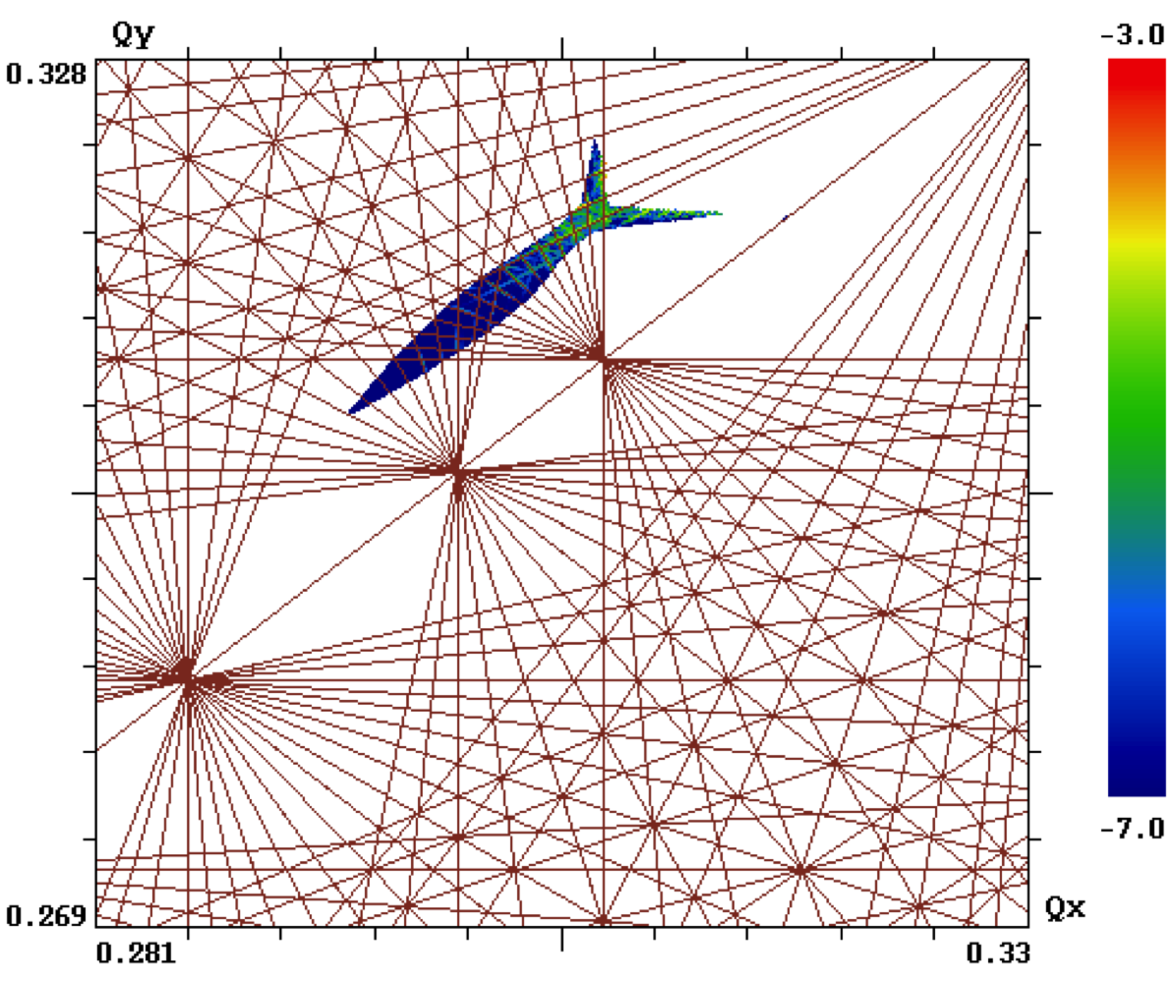
FMA Flat Optics β*=40/10cm, 280urad, Np=1.5×10¹¹
BBLR=off
BBLR=on

Slide 31
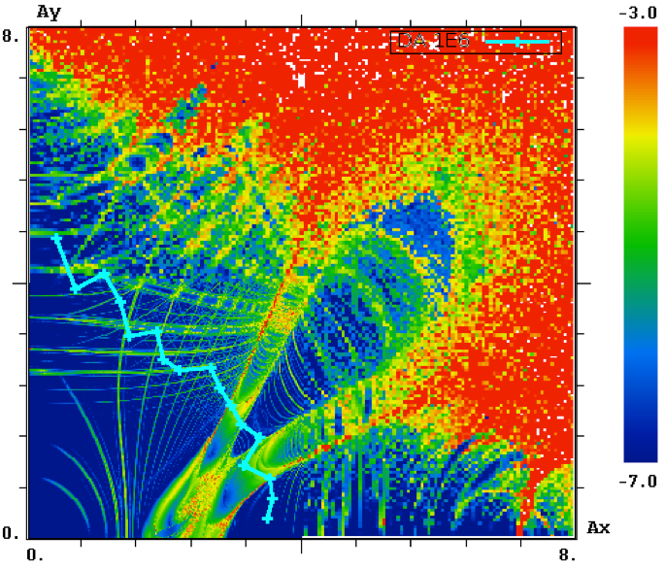
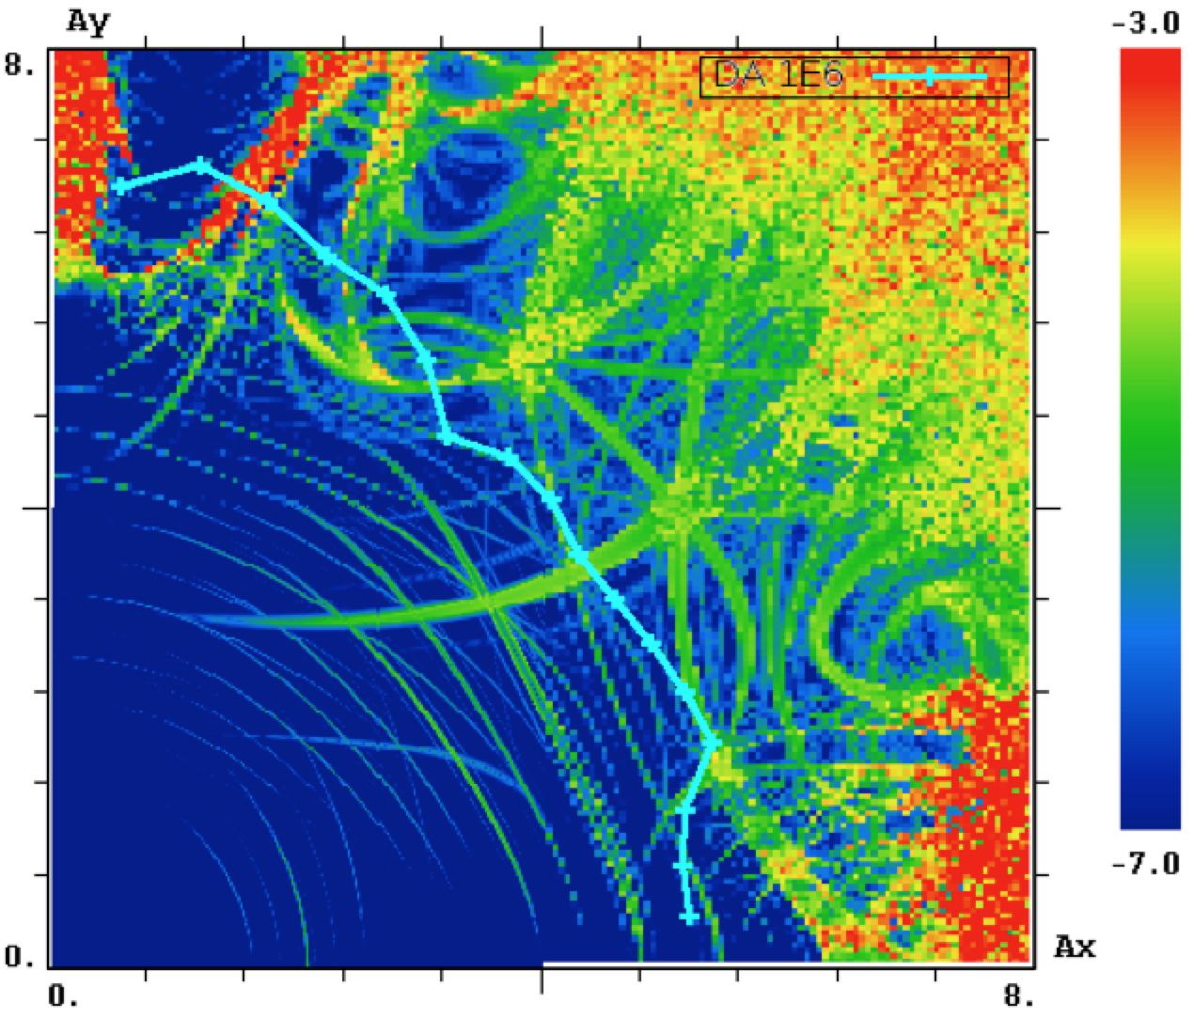
FMA/DA Flat Optics β*=40/10cm, 280urad, Np=1.5×10¹¹ – end of leveling
BBLR=off, DA=3.2
BBLR=on, DA=5.4
Wire at optimal* distance 9.3σ, current 250 A×m

Slide 32
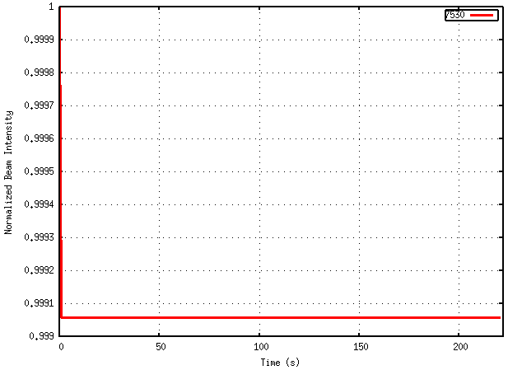
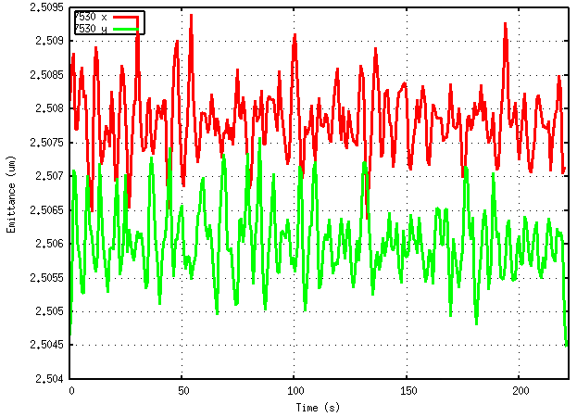
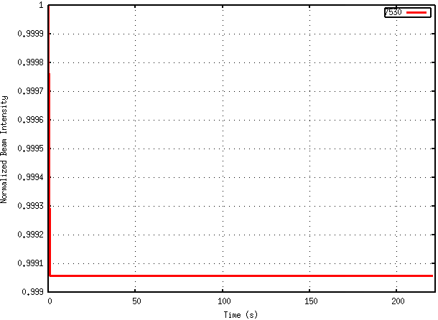
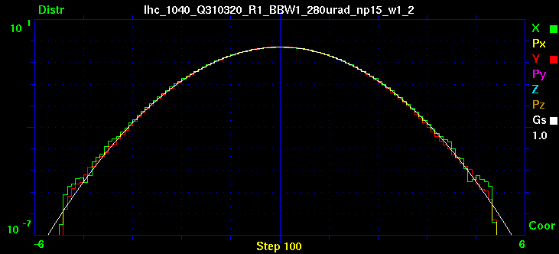
Macroscopic Beam Parameters
End of Leveling at 5×10³⁴
β* = 40/10cm, x=280 urad
IP8=on, CC=off, BBLR=on

Slide 33
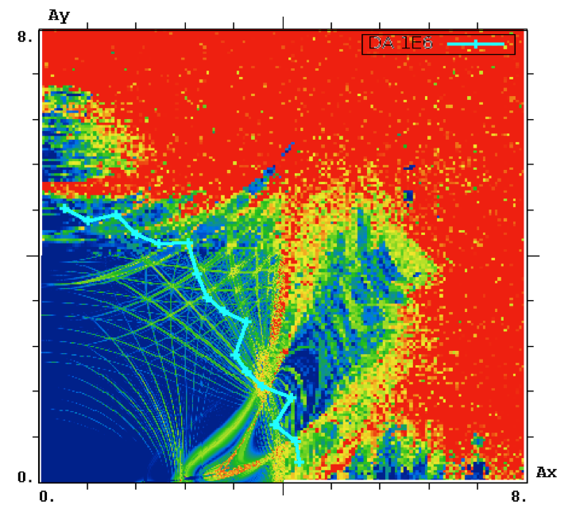
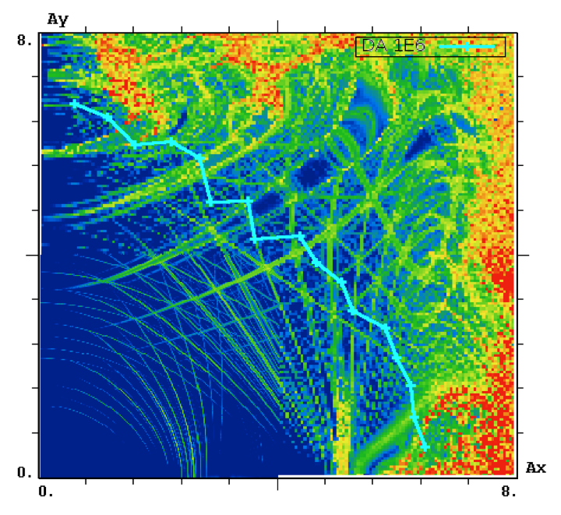
FMA/DA Flat Optics β*=40/40cm, 280urad, Np=2.2×10¹¹ – beginning of leveling
BBLR=off, DA=3.9
BBLR=on, DA=5.8
Wire at optimal* distance 10.3σ, PARTIAL COMPENSATION current 250 A×m

Slide 34
Questions
In the found solution, wire is at 9.3 σ beam = 7.4 mm
For wire embedded in TCT, wire-jaw=3mm, +10-11σ beam = total distance 14-15σ
  Can wire be effective at larger distance?
    Could not find a satisfactory solution at 14σ
  Can parameter optimization (WP, RDT’s) improve DA?
    Tune scans, alternative wire positions, and compensation of different sets of RDT’s tried – min DA still at 5.5-5.8σ

Slide 35
Summary
Alternative HL-LHC scenario with reduced crossing angle and flat optics to restore performance without CC is feasible with long-range beam-beam compensation
Wires restore DA from 3 to almost 6 sigma at smallest separation of 9.4 at end of fill (worst case). Macroscopic parameter evolution is unaffected by beam-beam
Wires need to be at 9.3 sigma, a solution with larger distance has not been found
Since wires need to be turned on towards the end of fill, the required current is 250 A×m – good for immaterial wire with E-Lens, would require 42 A×m EL
At beginning of fill, partial compensation with 250 A×m works

