Slide 1
WP2 summary
G. Arduini for WP2
Acknowledgments: WP2 Task Leaders and Members, Speakers and Conveners of the WP2 Sessions, Colleagues from other WPs

Slide 2
Updated layout
R. De Maria
New triplet layout and optics needed due to lower gradient (< 132.6 T/m)
New triplet magnetic lengths: 4.2 m and 7.15 m.
On-going integration studies (with WP8/12/13/15) to determine
Final L*: option of L*=23 m being studied
BPM position optimization (to be far from BB LR encounters)
Nominal
*
New triplet L*=23 m
*
Ideal bpm positions
Forbidden areas ±60 cm

Slide 3
Powering Schemes HL-LHC
Baseline powering scheme (PDR)
PC1 17.4 kA
HL-LHC | rms((Q_{z}-Q_{z0})) [10⁻⁴] | ΔQ/ΔQ(Baseline)
Baseline | 1.37 | x1.0
Q1-Q2-Q3 | 0.67 | x0.5
Q1-Q2a Q2b-Q3 | 0.54 | x0.4
Q1
Q2a
Q2b
Q3
PC3 ±0.2 kA
PC4 ±2.0 kA
PC2 17.4 kA
Inner Triplet powering:
class 1 (1ppm) leads to ≈ 10⁻⁴ rms tune shift
➔ further reduction needed (10⁻⁵ for k-mod.)
Q1-Q2-Q3 features a small tune shift in the current and voltage control regime
Separation dipoles:
class 1 PC preferable, less critical than IT and Q4
Q4:
class 1 PC needed
Q1-Q2a Q2b-Q3 (S. Fartoukh):
PC1 17.4 kA
PC2 17.4 kA
Q1
Q2a
Q2b
Q3
PC3 ±2.0 kA
PC4 ±2.0 kA
Q1-Q2-Q3
PC1 17.4 kA
Q1
Q2a
Q2b
Q3
PC2 ±2.0 kA
PC3 ±0.2 kA
PC4 ±2.0 kA

Slide 4
Operational scenario
E. Metral
Machine and beam parameters defined for each cycle phase (injection, ramp, pre-squeeze, collision, stable beams)
Common reference for all simulations!
https://espace.cern.ch/HiLumi/WP2/task4/Shared%20Documents/HLLHC-OperationalScenarios-FinalVersion_06-05-2015_EM.pdf

Slide 5
Field quality
Dynamic aperture dependence during cycle phases, dependence on machine settings (e.g. octupoles, chromaticity)
Need margin for that but also need to test sensitivity to field errors also for these configurations
Y. Nosochkov

Slide 6
Field quality
Field quality has an impact on dynamic aperture even in the presence of beam-beam ➔ We have not plenty of margin (note that we are using beam sigmas here)
Analysis of the sensitivity to field errors that are might be difficult to control ongoing.
T. Pieloni

Slide 7
Field quality
S. Izquierdo Bermudez
First estimates of the expected fringe field effects for the triplets presented
Need to cross-check once more synchronization among WP2/3 field error specification tables in the iterative process between magnet and accelerator physics experts

Slide 8
Aperture
R. De Maria
Critical areas:
TAXS @ 54 mm:
No margin
Need to quantify the maximum aperture acceptable consistently with experiment protection ➔ WP8
Need to know from experiments whether transverse collision offsets are required.
Q2&Q3:
No margin
Need to know tolerances on the beam screen dimensions
Collimator settings/tolerances to be reviewed

Slide 9
Stability: Impedance (collimators)
Low impedance collimators to replace present CFC collimators are needed to cope with higher HL-LHC bunch population
Low impedance collimators only in IR7 ➔ Partial loss of stability margin can be recovered by opening partially the collimators in IR3
N. Biancacci
Notes:
Which chromaticity?

Slide 10
Stability: impedance (crab cavities)
More realistic model of the crab cavity impedance taking into account possible distribution of HOM frequencies of the various cavities (similar approach to magnet field errors)
N. Biancacci

Slide 11
Impedance crab cavities
Good progress and discussions.
Single bunch regime:
Crab cavities increase the instability growth rate by a factor 1.5 (even assuming distribution of HOM ➔ error bar being estimated)
Need to halve the total R_{s}/Q for both BNL and SLAC designs
Coupled bunch regime:
BNL design: 927 MHz, 1.86 GHz and 1.92 GHz modes to be reduced by a factor 3. Mode 1.75 GHz to be reduced by more than 2 orders of magnitude.
SLAC design: mode at 1.6 GHz should be decreased by a factor 2.
But progress has already been done by the HOM designers recently ➔ need to update
N. Biancacci
Notes:
Does stronger damper helps?

Slide 12
Crab cavity tests in SPS
Expect no visible impedance effects with HOM damping
Ideally, we should profit of the tests to:
Benchmarking of the codes (although these provide convergent results)
Check the stability/reproducibility of the modes
Possible ideas emerged during the discussion:
“Undamping” of some of the modes
Detuning to overlap the undamped modes with beam spectral lines
Local increase of the beta functions at the crab cavities
Adjust working point
B. Salvant

Slide 13
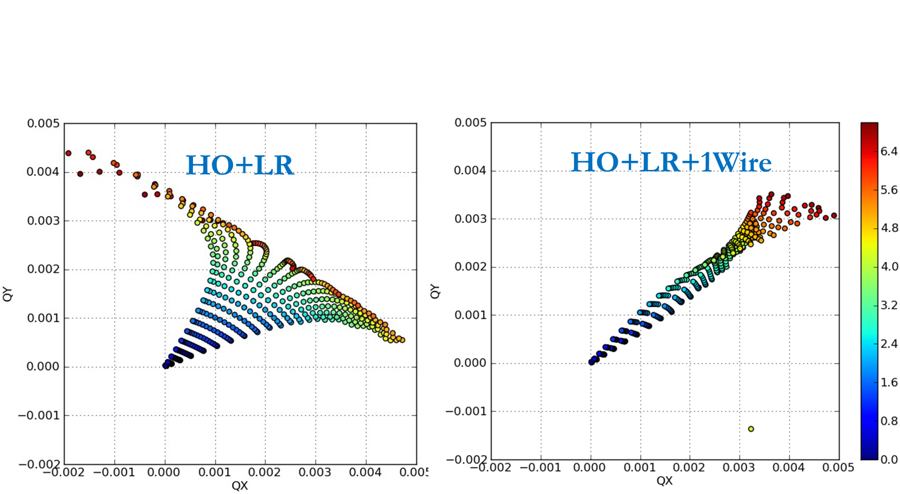
BBLR compensation–LHC
Y. Papaphilippou
Wire model made available in Sixtrack
We have now the tools for conducting systematic simulations and define plans and tests both in the LHC and SPS and to include all the effects of the different machine parameters. Too small spread might not be what we necessarily want

Slide 14
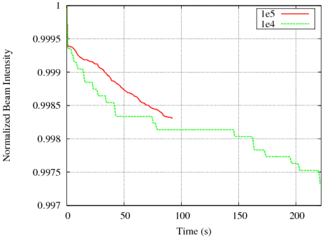
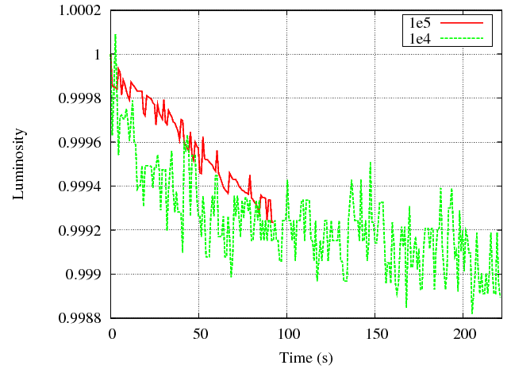
BBLR Compensation HL-LHC
τ_{L} ~15 hr
τ_{L} ~34 hr
Lifetrac simulations
Sixtrack should be able to provide similar information in the future
β* = 40/10cm, x=280 urad (9.5 σ)
IP8=on, CC=off, BBLR=OFF
A. Valishev

Slide 15
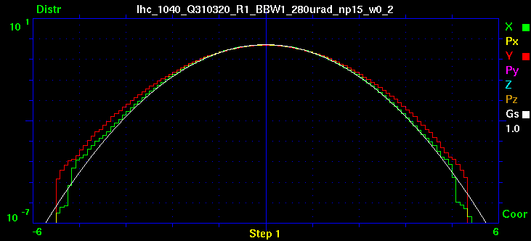
BBLR Compensation HL-LHC
A. Valishev
β* = 40/10cm, x=280 urad (9.5 σ)
IP8=on, CC=off, BBLR=OFF

Slide 16
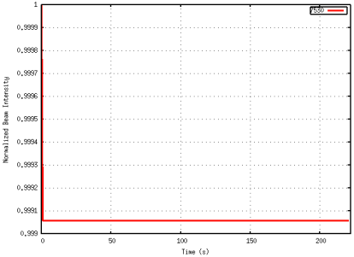
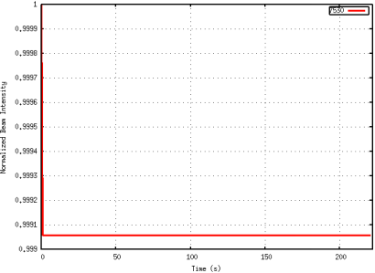
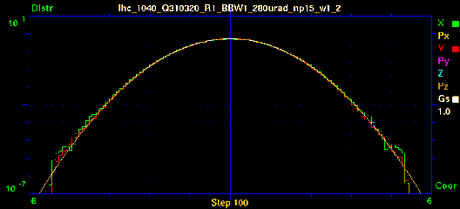
BBLR Compensation HL-LHC
A. Valishev
β* = 40/10cm, x=280 urad (9.5 σ)
IP8=on, CC=off, BBLR=ON @ 9.3 σ
Wire at 250 A×m or electron lens at 42 A×m

Slide 17
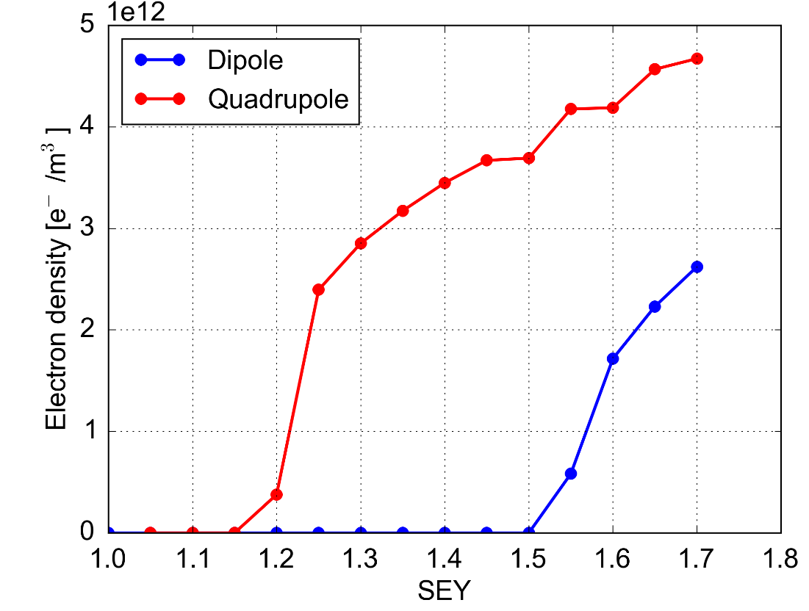
Electron Cloud effects
Operation with 25 ns beam relies on beam induced scrubbing
Full e-cloud suppression should be possible for the arc dipoles but seems unlikely for the quadrupoles
Heat loads should be within the cryo cooling capacity but impact on beam quality/stability needs to be assessed
PyECLOUD buildup simulations – 2.3e11 ppb
G. Iadarola

Slide 18
Electron Cloud effects
Important development work carried out in the latest year to allow the simulation of this scenario
After scrubbing (SEY < 1.3) e-cloud should not drive the beam unstable at injection and even more at 7 TeV… (at least considering main quadrupoles and dipoles)
… but still important forces on the beam → tune spread to be taken into account for interplay with other phenomena
G. Iadarola

Slide 19
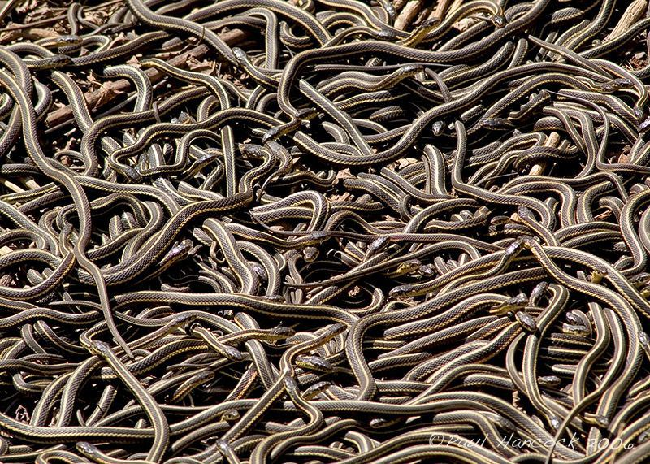
Accelerator Physics in the Snake Pit
From Wikipedia: “Snake pits are places of horror, torture and even death in European legends and fairy tales”
Is this a subliminal message?

