Slide 1
WP5 Summary with Emphasis and Common LARP & HL-LHC Activities
US LHC Accelerator Research Program
BNL - FNAL- LBNL - SLAC
13 May 2015
LARP CM24/HL-LHC
Fermilab
T. Markiewicz/SLAC

Slide 2
Summary
Examination and preliminary analysis of BNL irradiated samples of next-generation collimation materials (low impedance yet robust) have yielded first results:
  Favored materials (Moly-graphite) do not fare well under ~1 DPA doses received
  Next generation versions of MoGr should be tested in a 2016 run
  Continued support of BNL BLIP beam time, new test samples and continued CERN-provided effort for X-Ray, SEM analysis of samples at BNL must be arranged. FNAL & EUCARD studies to understand expected doses at LHC & relation to test beam doses should continue.
The Hollow Electron Beam Collimator is steadily moving from an interesting possible option to a part of the HL-LHC Baseline
It is a pity that these activities cannot receive the support they deserve.

Slide 3
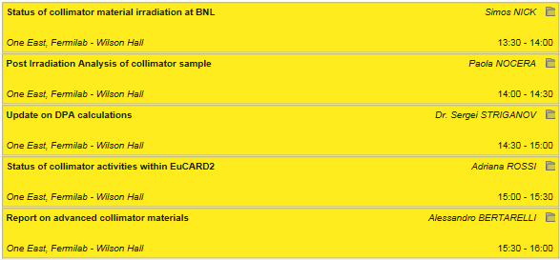

Material in WP5
Collimator Material Study
Hollow Electron Lens Scraper
General Layout
& Elena Quaranta
Adriana Rossi

Slide 4
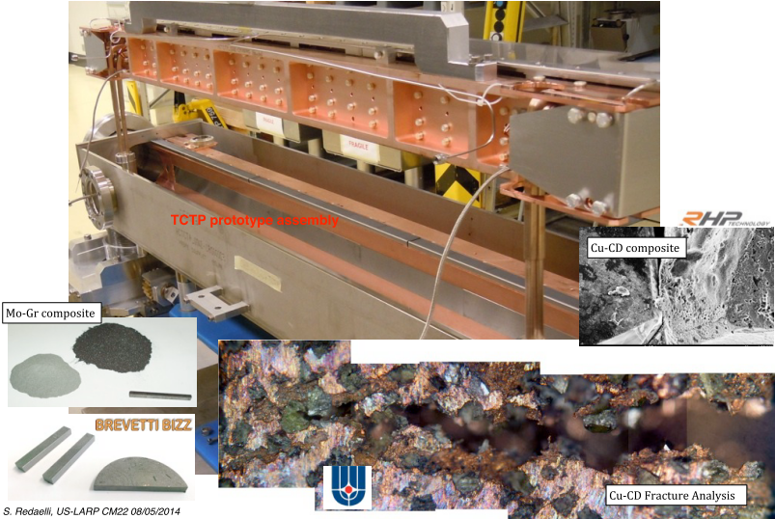
Low Impedance Robust Secondary Collimator Design Project
CM22 2014 Slide
Focus is on Mo-Graphite Composite: BNL Irradiation Test Results Needed
PLAN: Build a prototype for installation in the 2015 Xmas stop
Based on post-LS1, prepare to replace IR7 secondary collimators in LS2

Slide 5
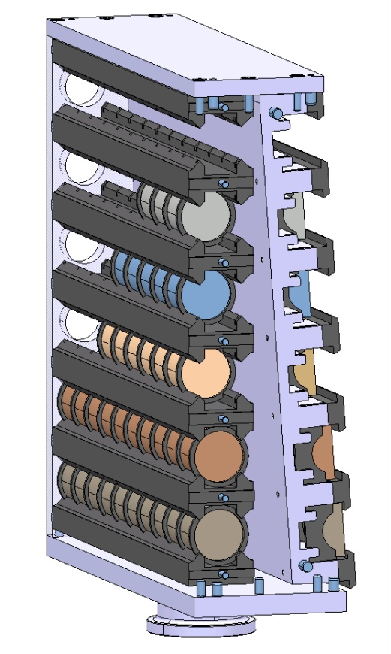
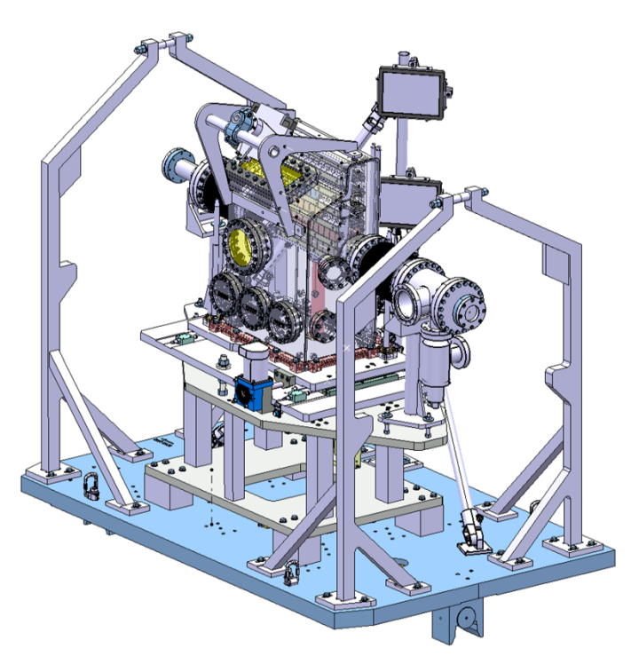
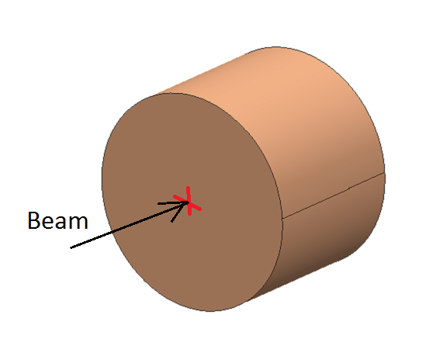
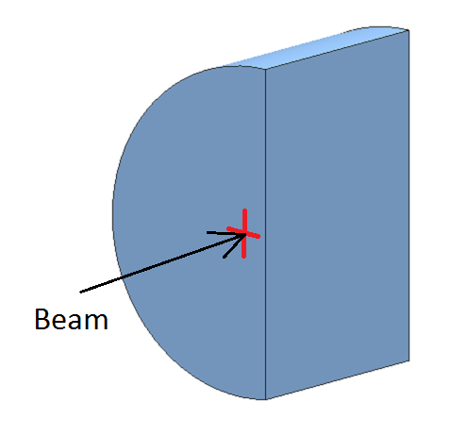
HRMT14 Experiment
Design and Testing for HL-LHC Collimators
HRMT14 (2012) Experiment Goals
  Benchmark advanced numerical simulations and material constitutive models through extensive acquisition system
  Characterize six existing and novel materials currently under development for future Collimators: Inermet180, Molybdenum, Glidcop, MoCuCD, CuCD, MoGr
  Collect, primarily in real time, experimental data from different acquisition systems (Strain Gauges, Laser Doppler Vibrometer, High Speed video Camera, Temperature and Vacuum probes)
Beam Parameters
Beam energy | 440 GeV
Number of protons per bunch | 1.1e11
Bunch Spacing | 25 ns
High Intensity Tests:
Sample: half-moon;
Beam Offset 2 mm
Beam
Medium Intensity Tests:
Sample: Ø 40 mm , L30 mm

Slide 6
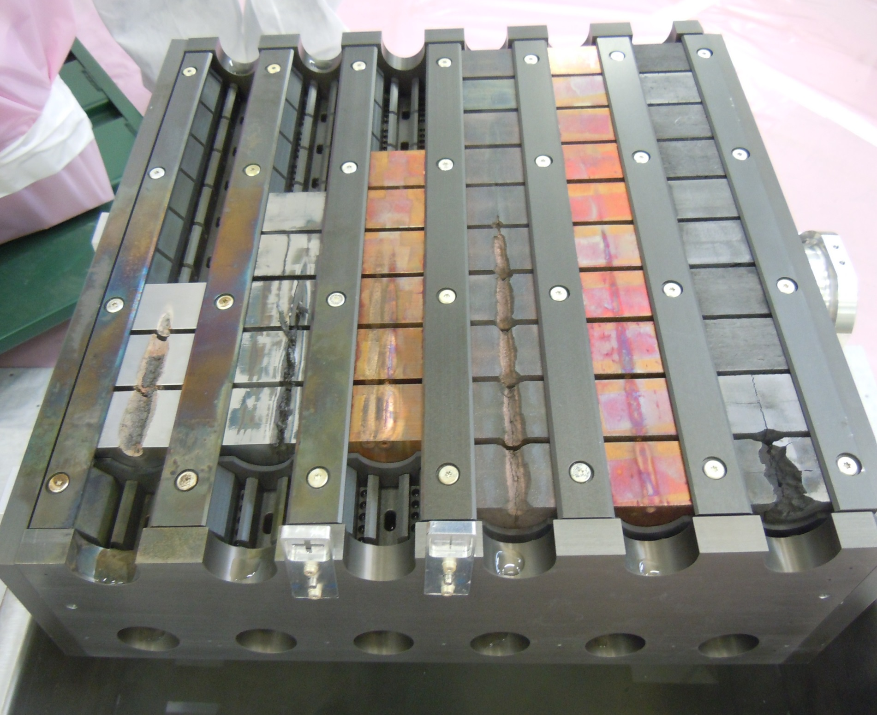
Update on HRMT09 and HRMT14 Experiments
HL-LHC Collimator Design and Testing
HRMT14
Dismounted sample holder (May 2015)
1
2
3
4
5
6
7
8
9
    Molybdenum 0.65 MJ and
    1.3 MJ
    Inermet 180 0.65 MJ
    Glidcop
    0.65 MJ (twice)
    MoCuCD
    1.3 MJ
    CuCD
    1.3 MJ
    MoGr
    (3 grades)
    1.3 MJ

Slide 7
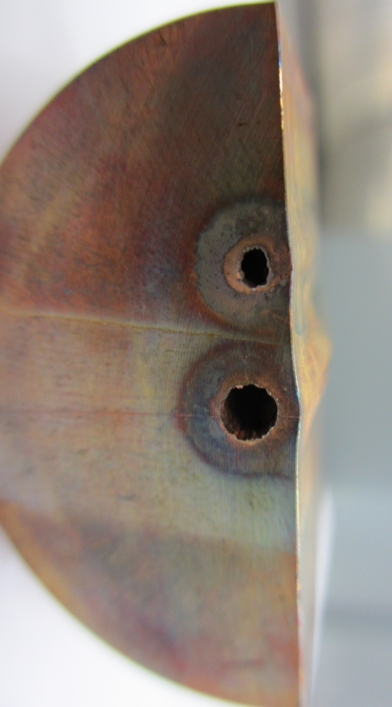
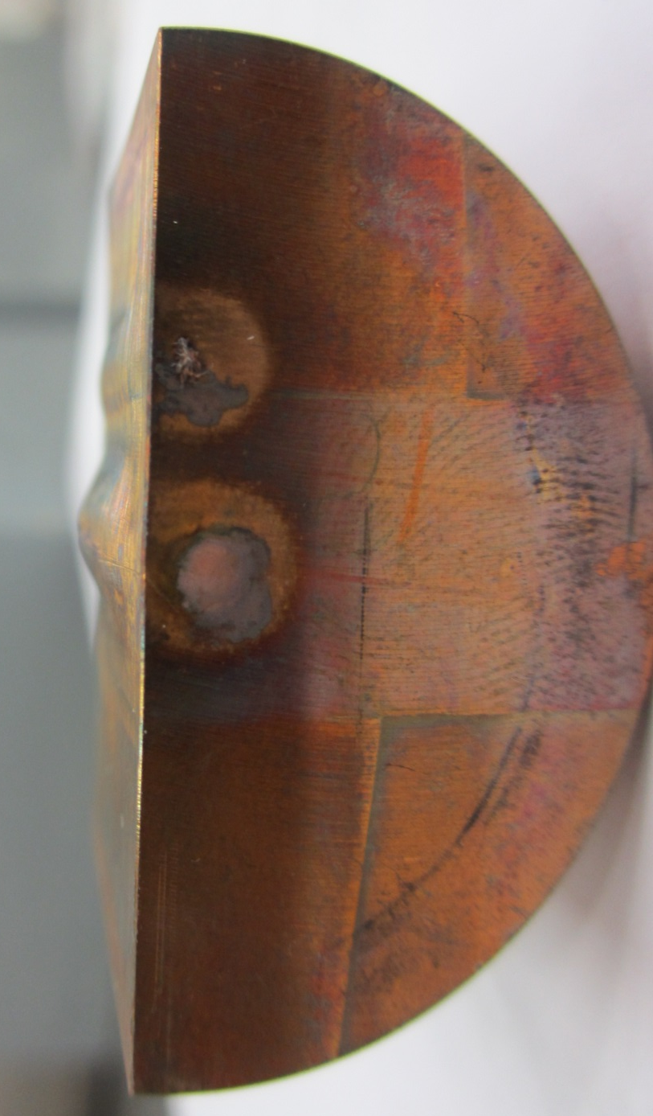
Update on HRMT09 and HRMT14 Experiments
HL-LHC Collimator Design and Testing
    Glidcop
    High intensity Sample 6
    Glidcop
    High intensity Sample 4
    Molybdenum
    High intensity sample 5
0.65 MJ
0.65 MJ
0.65 MJ
1.3 MJ

Slide 8
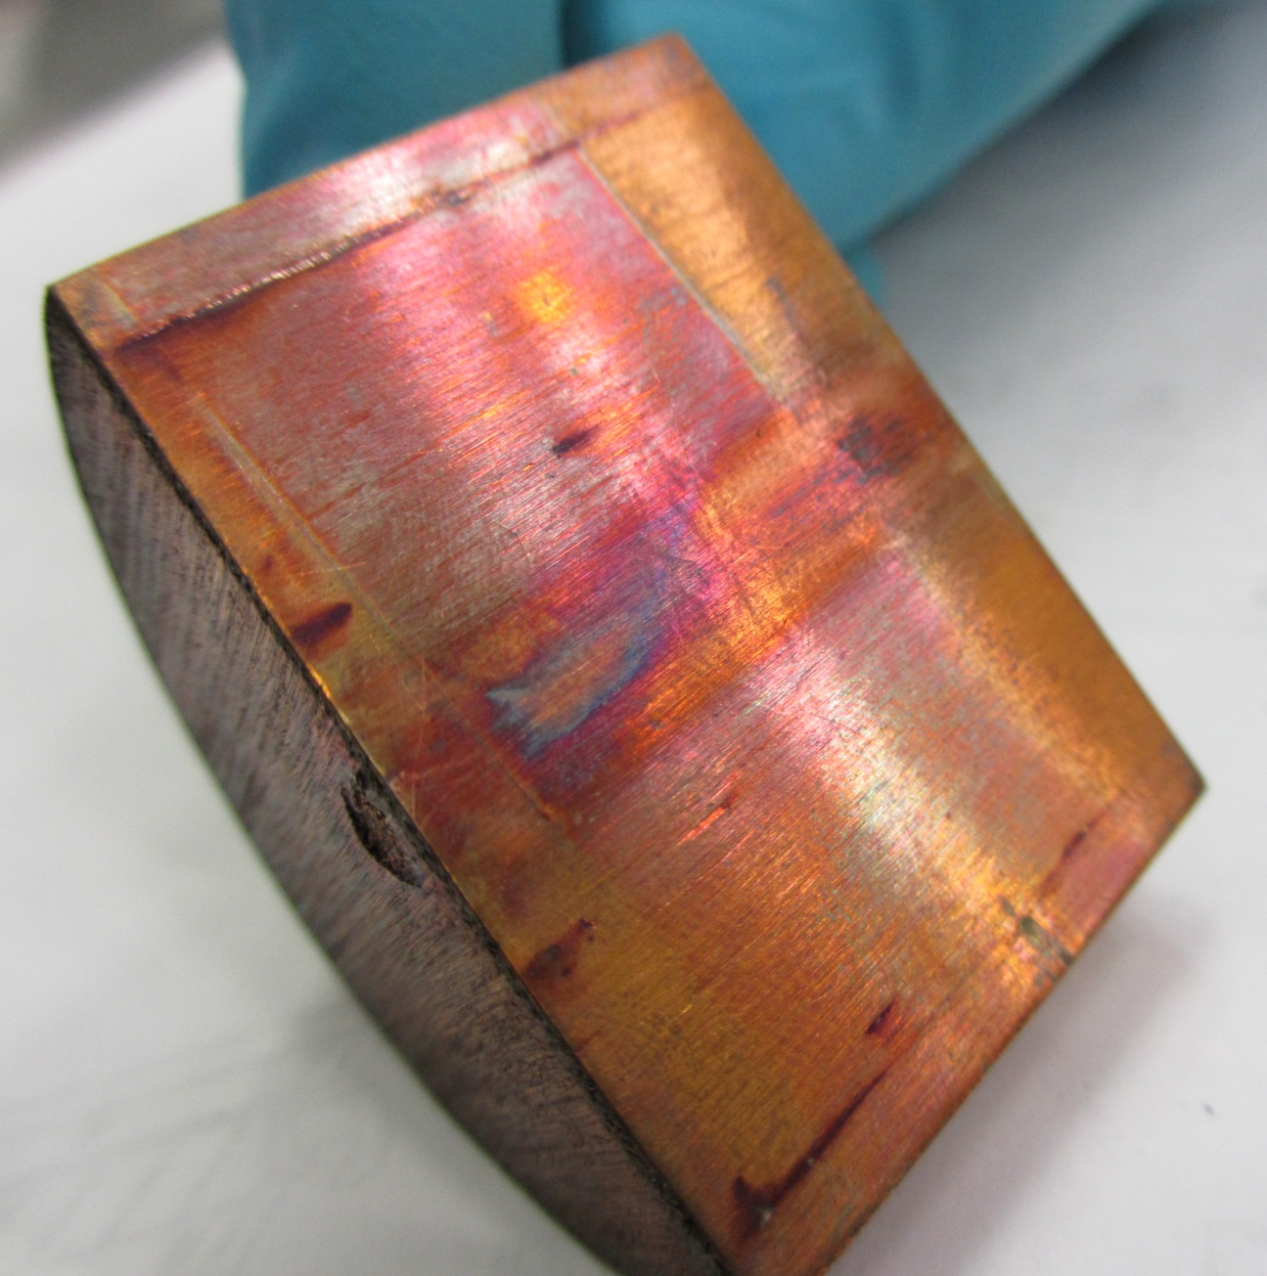
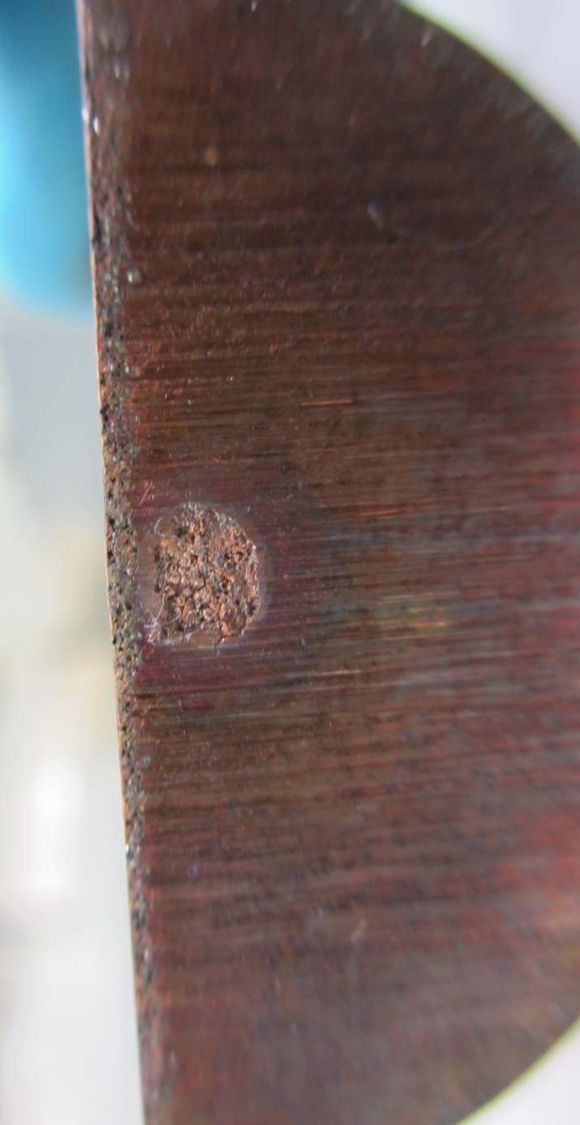
Update on HRMT09 and HRMT14 Experiments
HL-LHC Collimator Design and Testing
    CuCD
    High intensity Sample 10
    Glidcop
    High intensity Sample 4
1.3 MJ

Slide 9
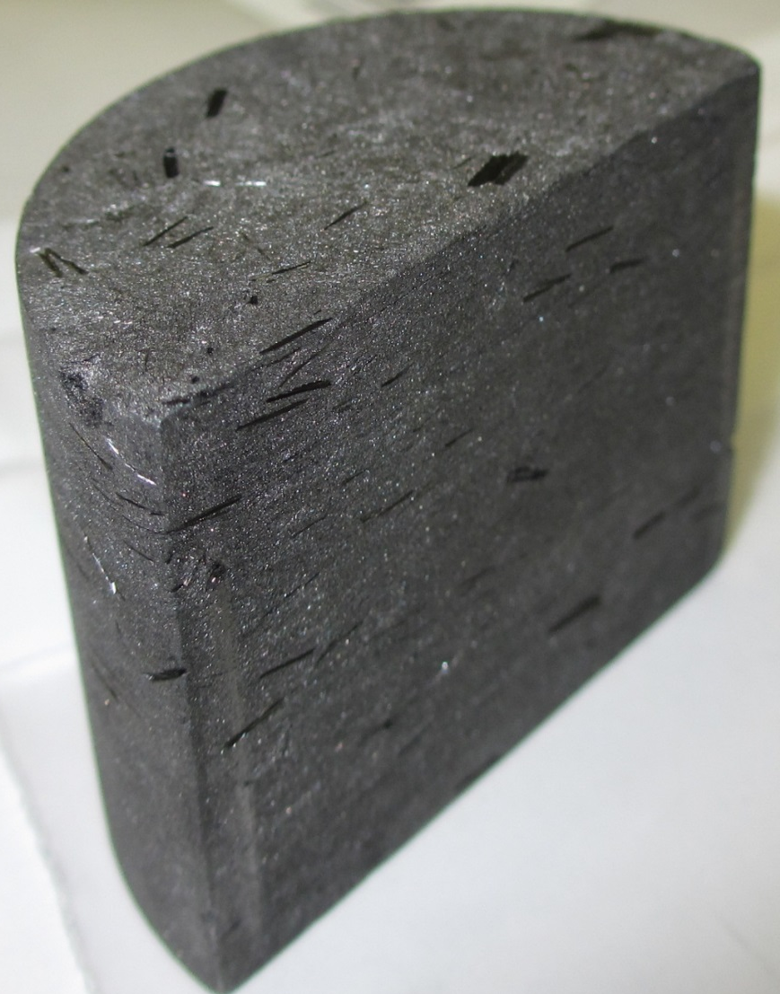
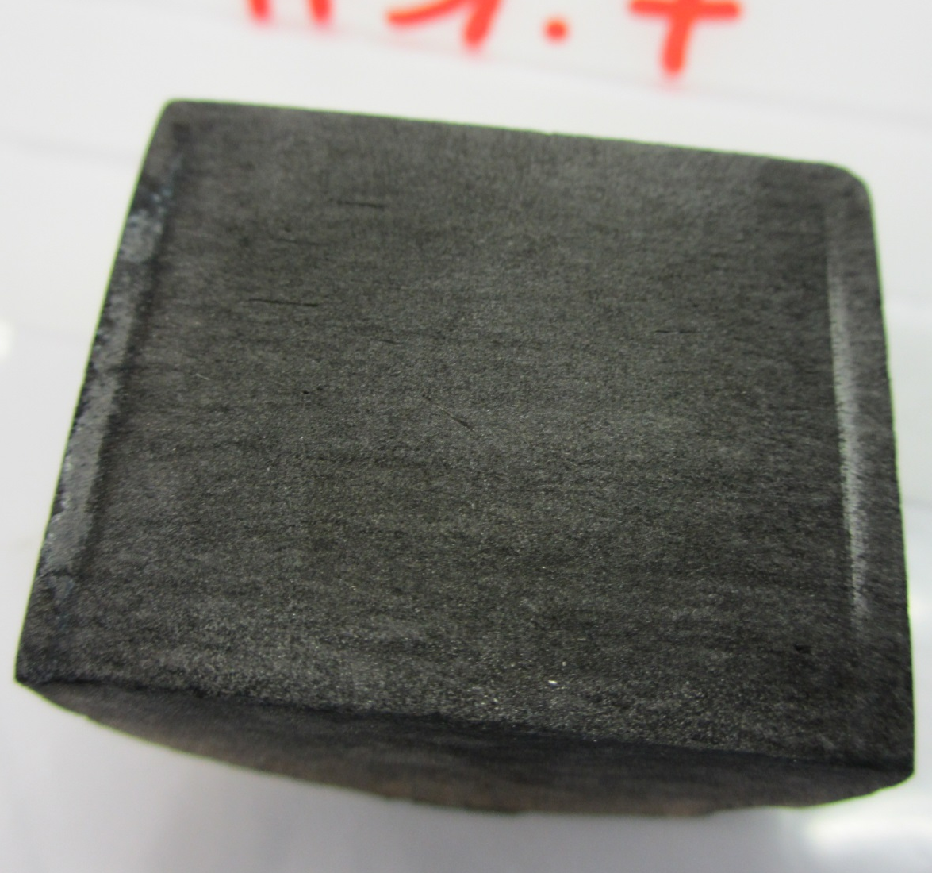
Update on HRMT09 and HRMT14 Experiments
HL-LHC Collimator Design and Testing
    MoGr
    Sample 8
    Grade 2
    (2nd Generation)
    MoGr
    Sample 7
    Grade 3
    (2nd Generation)

Slide 10
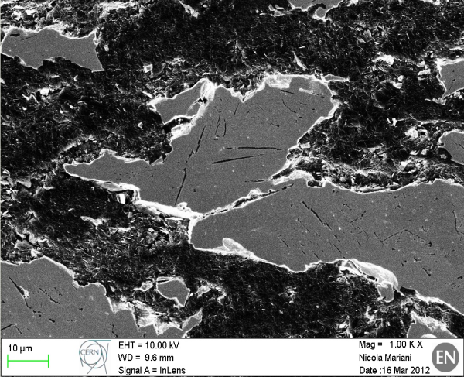
Molybdenum Carbide – Graphite
S
Co-developed by CERN and Brevetti Bizz (Italy)
Ceramic Composite based on Molybdenum (5÷ 50 μm) , Natural Graphite
(~50 μm), Mesophase Pitch-based Carbon Fibers (0.3 ÷ 3 mm)
1st generation (2011- early ‘12): Mo – Graphite. Sintering Temp.: ~1700 °C.
Density: ~ 5.3 gcm⁻³. Status: Used for HRTM-14 tests.
2nd generation (2012 – mid ‘13): Mo – Graphite – CF. Sint. Temp.: ~ 2200 °C.
Density: ~3.8 gcm⁻³. Status: used for HRMT-14 tests.
3rd generation (mid 2013): Mo – Graphite – CF. Sint. Temp.: ~2400 °C.
Density: ~3.7 gcm⁻³ Status: used for BNL tests.
4th generation (late ‘13 – mid ‘14): Mo – Graphite – CF. Sint. Temp.: ~ 2600 °C.
Density: ~2.5÷2.7 gcm⁻³ Status: used for GSI tests (1st campaign).
5th generation (mid 2014) : Mo – Graphite – CF. Sint. Temp.: ~ 2600 °C.
Post-processing annealing at 1150÷1300 °C
Density: ~2.6 gcm⁻³ Status: used for GSI tests (2nd campaign).
6th generation (late ’14 – to date) : Mo – Graphite – CF. Sint. Temp.: ~ 2600 °C.
Post-processing annealing at ~1900 °C
Density: ~2.5 gcm⁻³ Status: used for GSI tests (3rd campaign). To be used for HRMT-23. Proposed for GSI 4th campaign and (hopefully) BNL 2nd campaign

Slide 11
Questions
Molybdenum-Graphite with tuned recipe for (% Mo)/(% Graphite) (net density), sintering temperature and annealing process remains preferred candidate
What are results of BNL irradiation campaign?
  Are the results a function of the radiation dose (as characterized by “Displacement per Atom” (DPA) or of the temperature (1000-1100 C) experienced during the irradiation or of He/H transmutation as nuclei are fractured?
How does the dose received by the BNL samples compare with the doses expected for 4000 fb⁻¹ Hi-Lumi run collimator by collimator and by location within each collimator?
How does the dose received via 7 TeV proton showers compare to the 200 MeV protons from the BNL Ion Production Facility (BLIP) and the 28 MeV protons from the BNL Tandem Van der Graf

Slide 12
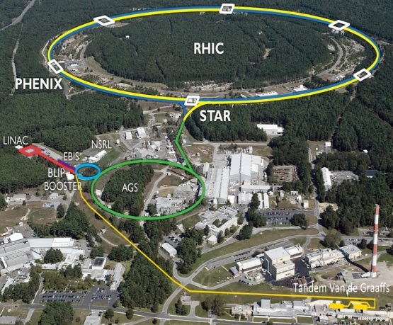
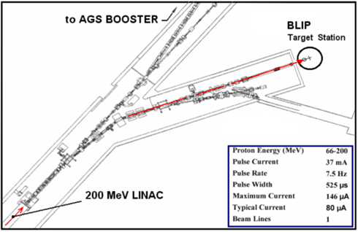
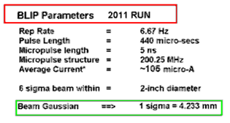
BNL Accelerator Complex
BLIP & Tandem Facilities
2013 & 2014 RUNS
Average Current ~ 110 uA

Slide 13
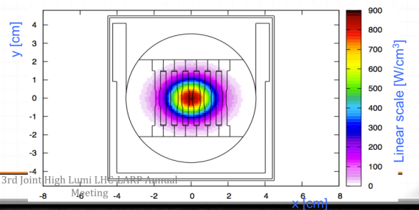
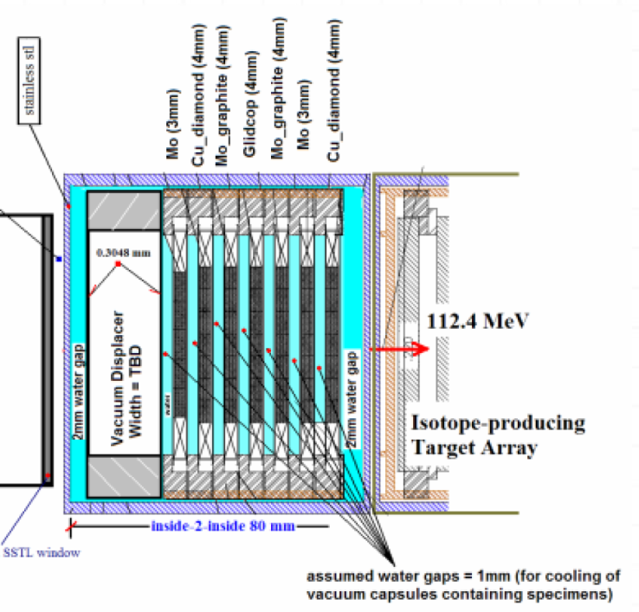
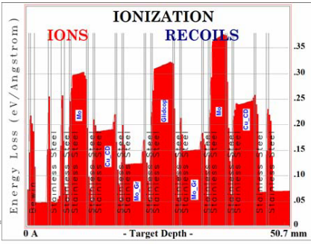
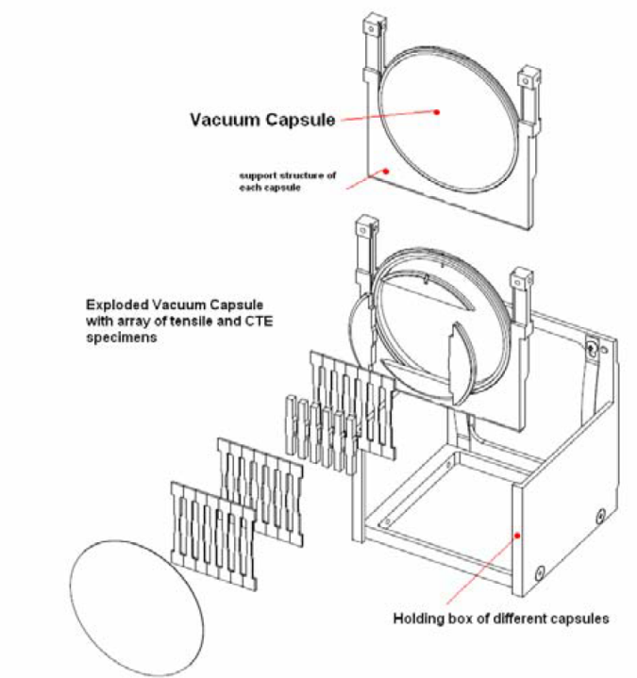
BLIP + Hot Cell + Analysis of LHC Collimator Materials
CERN provided materials & mechanics & FLUKA study
Nick Simos/BNL: calculations, approvals, running, testing
Samples Studied:
Molybdenum
Glidcop
Cu-CD
Mo-GrCF
200 MeV p+ from Linac
Features:
Irradiation w/ 200MEV p+
Indirect water cooling of vacuum encapsulated samples
Sample degradation vs. dpa
Thermo-physical & mechanical characterization of irradiated samples for fluence up to 10²⁰ p/cm²
Irradiation w/neutrons to simulate showers on secondary collimators
As of CM22 (5/2014): “Final 3.5 week irradiation BLIP NOW underway. After cool down, post irradiation study of physical properties

Slide 14
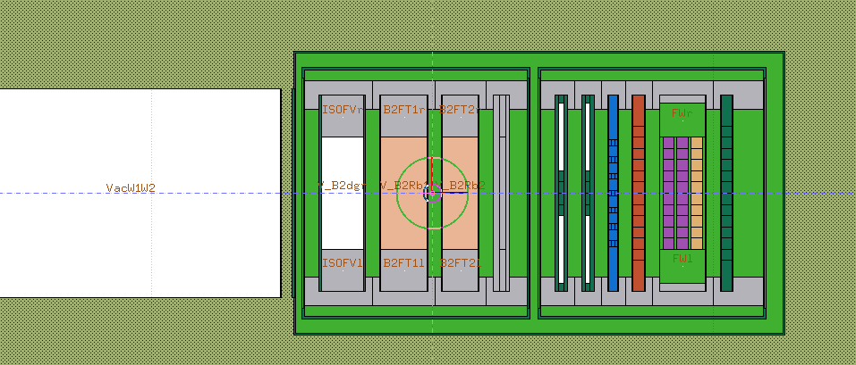
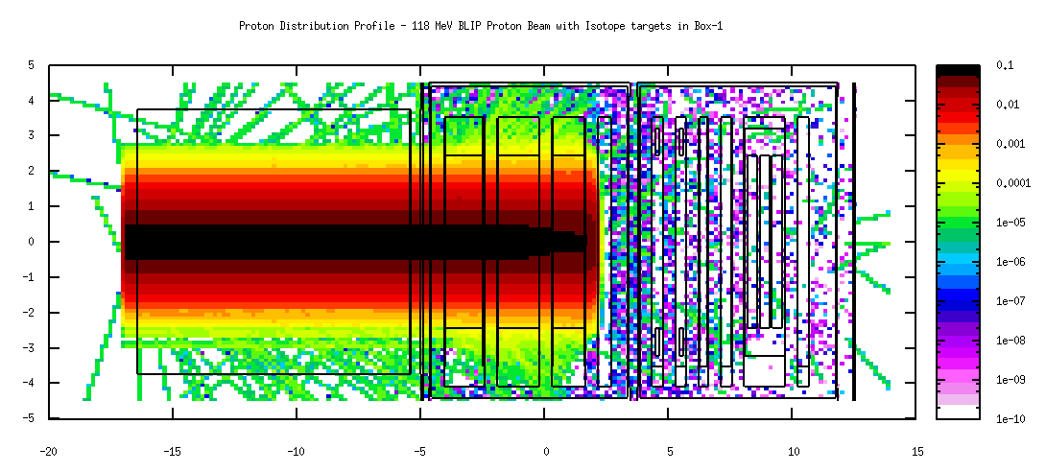
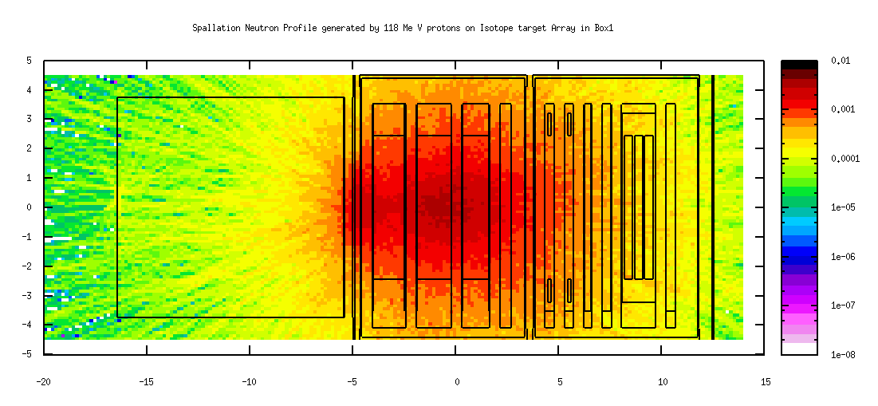
Spallation Neutron Irradiation at BLIP
In-beam since March 7, 2014; Will run until July 31st 2014
Followed by multi-faceted post-irradiation analysis

Slide 15
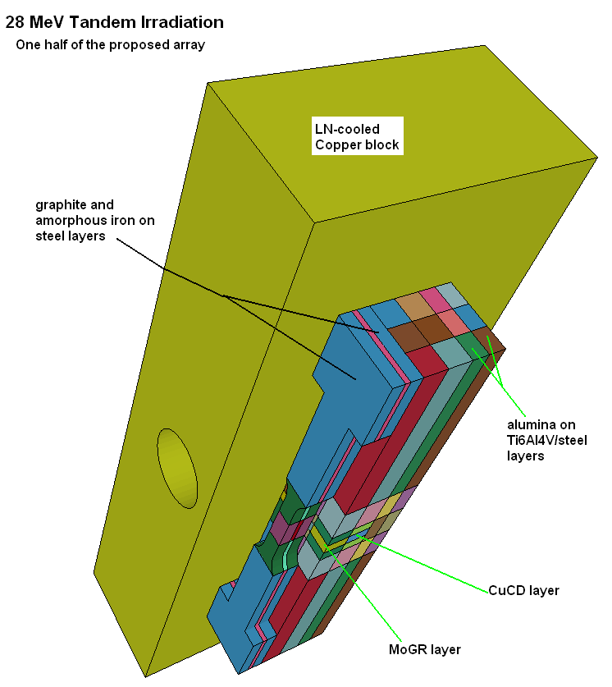
28 MeV Proton Irradiation at Tandem

Slide 16
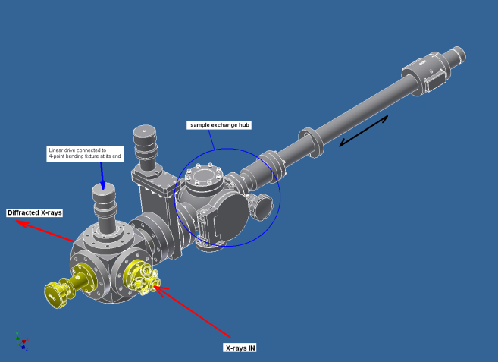
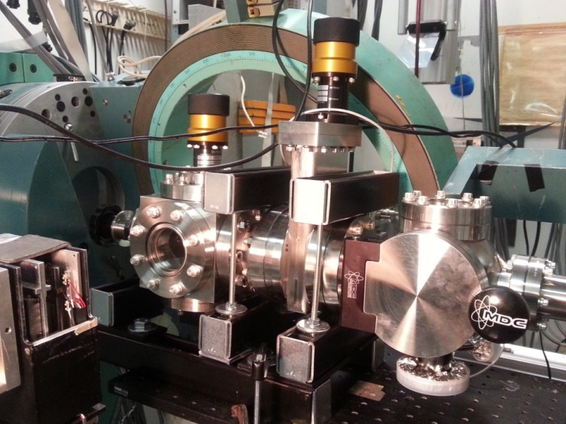
EDXRD at the National Synchrotron
(Energy Dispersive X-Ray Diffraction)
Diffraction Studies on Irradiated materials (including LHC Collimators)
Experimental stage at X17B1 Beamline (100-200 KeV x-rays)
Example of Structural Change after Irradiation

Slide 17
Experimental Results & Observations to-date
Mo-GR (the prime candidate faired poorly!
Mo (experienced temperatures 1000-1100 C) faired very WELL
indications of impurities in the structure
Cu-CD performance TBD
Glidcop Survived the high irradiation temperature (900-1000C)

Slide 18
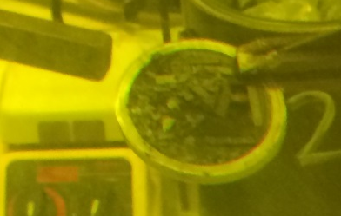
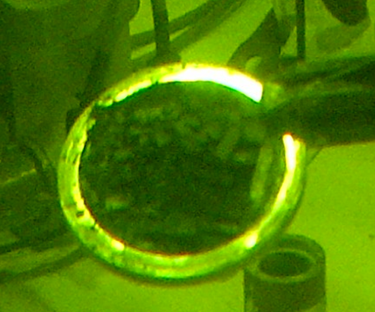
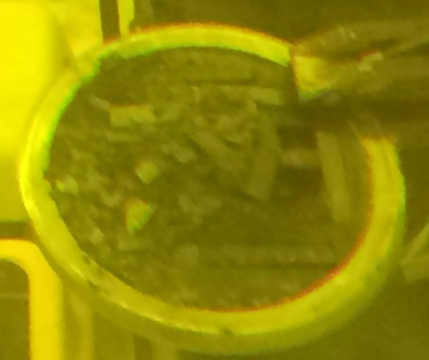
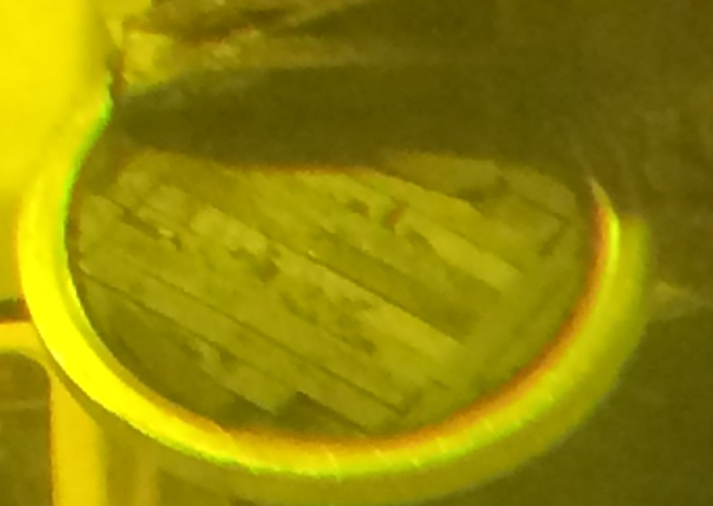
State of Mo-GR after 1.1 10²¹ p/cm² FLUENCE !!!!
After 2.8 10¹⁸ p/cm²

Slide 19

It should not have happened !
But why?
Irradiation under vacuum and elevated temperature
Dominant Graphite component should be undergoing annealing of damage at these temperatures
X-ray diffraction revealed the presence of several Mo_{x}C_{y}, are they to blame? Or
It is the FLUENCE threshold of high energy proton damage experienced by graphite or other carbon-based structures?
Revealed at BNL studies and correlated with other experiments during Phase I irradiation of 2D C/C
Irradiated samples at 2+ sigma survived (sort-of) and are being post-irradiation analyzed
2006-07-see next slide

Slide 20

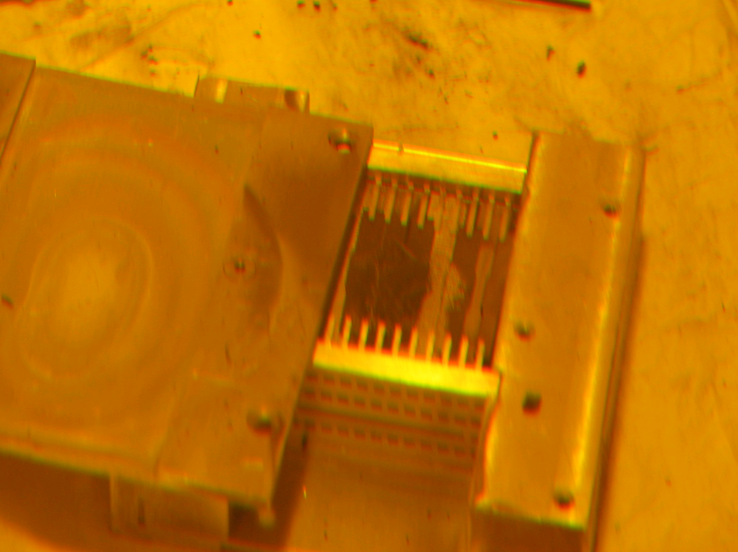
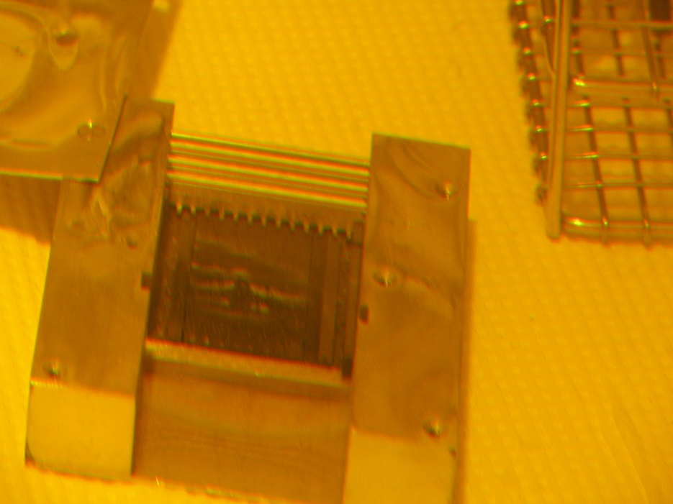
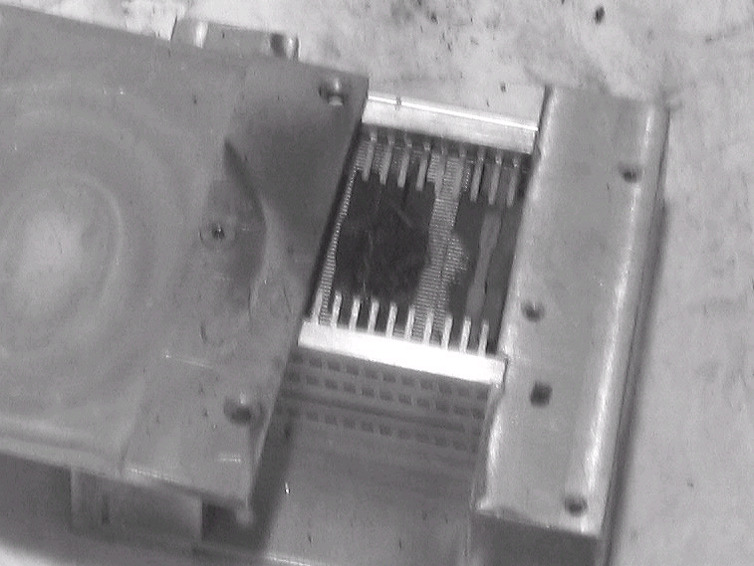
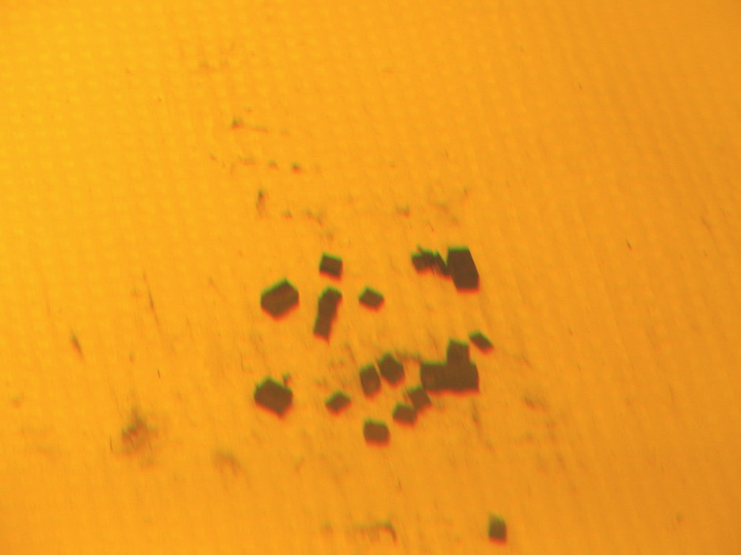
Start of Post Irradiation Study
3D Carbon-Carbon issues
Oct 2006 LARP CM
3D CC
2D CC

Slide 21
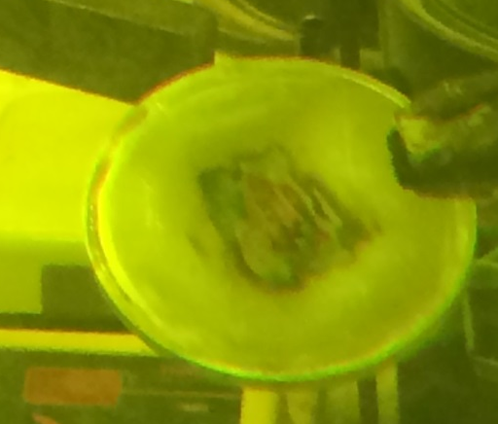
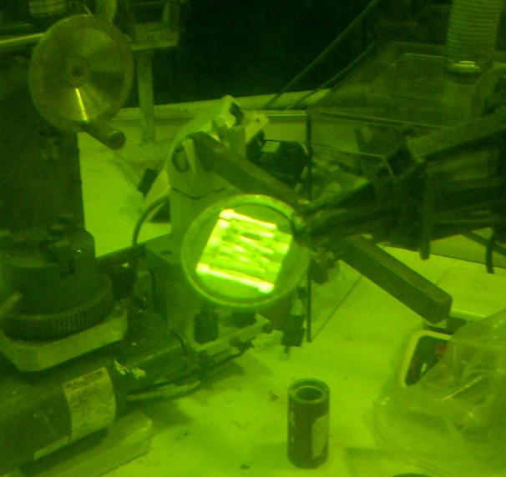
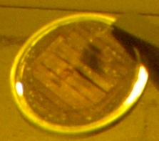
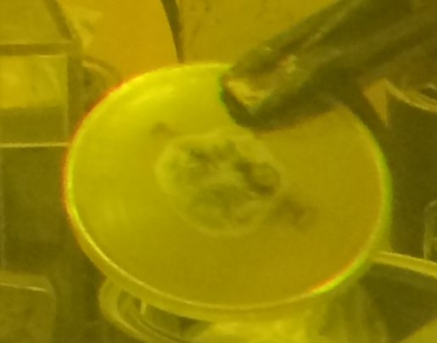
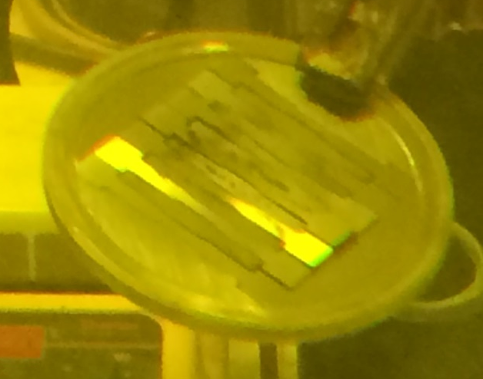
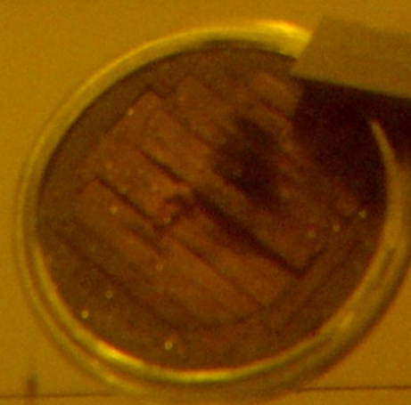
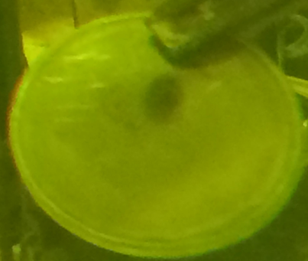
Capsule windows
Mo state
Cu-CD state

Slide 22
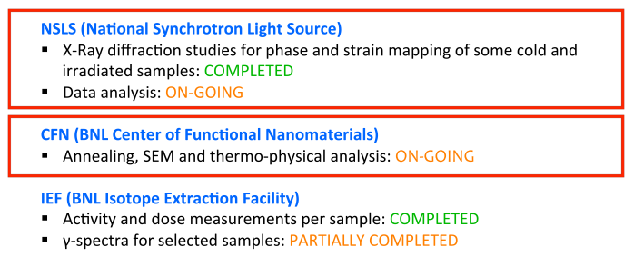
SEM and X-Ray Studies at BNL by Paola Nocera and Elena Quaranta

Slide 23
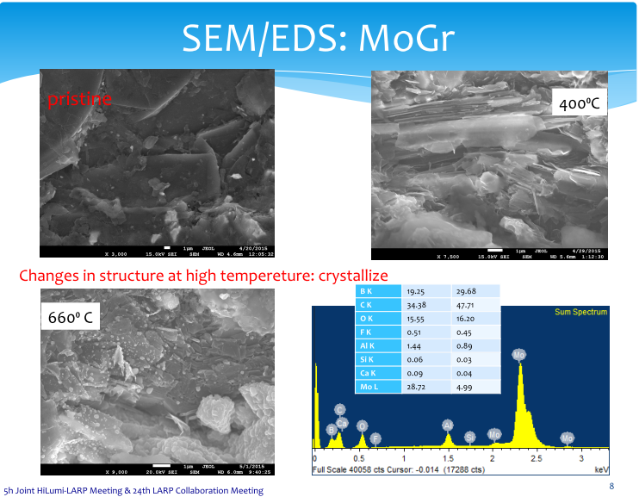
Example

Slide 24
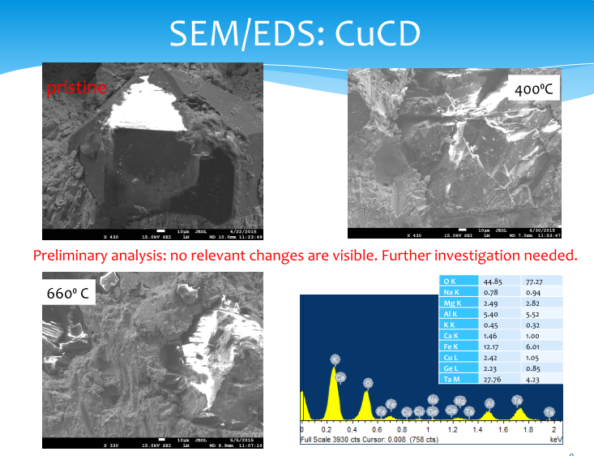
Example

Slide 25
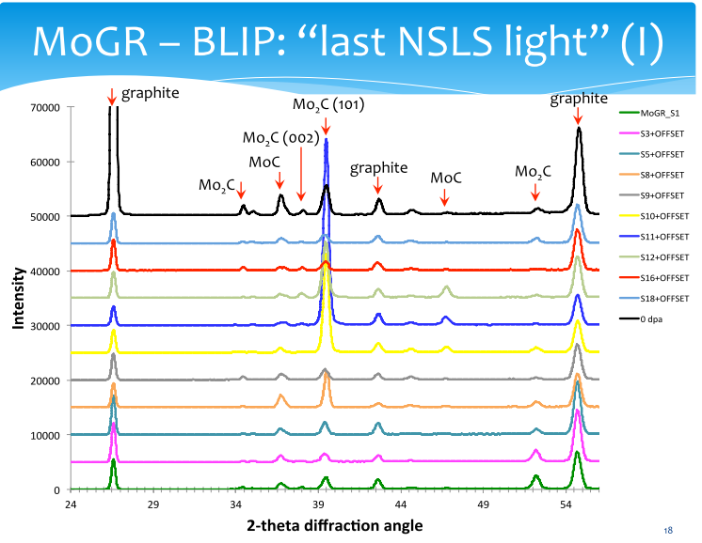
Example of X-Ray Scan Along sample

Slide 26
Next Steps
Apparent need to support a second irradiation campaign at BNL
  Focus on MoGr
    Acquire 6th generation samples
    Plan for January 2016 BLIP run
    First results Summer 2016
  Revisit the C-C samples tested in 2006 irradiation
  Lower doses
Decisions needed to match into
  Production of prototype collimators for HiRadMat testing
  Series production of IR7 collimators for LS2 installation
Continued analysis/simulations to understand interplay of DPA, temperature, beam energy, expected dose, etc.

Slide 27
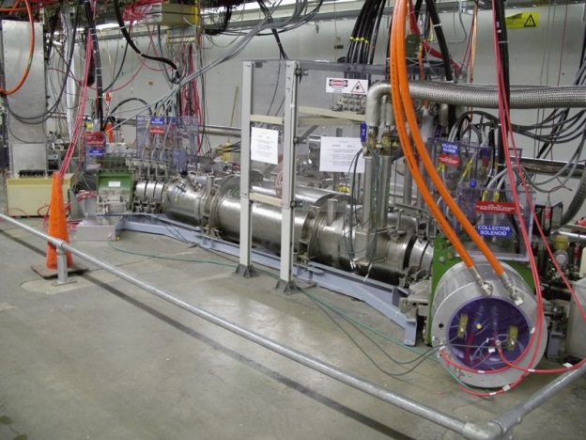
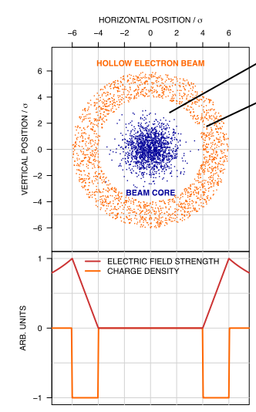
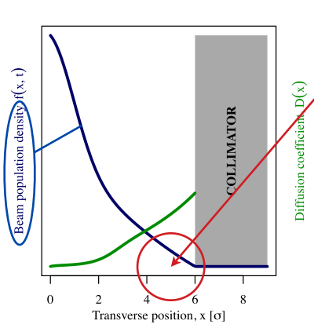
Fermilab Electron Lenses:
Hollow Beam Scraper: Stancari et al
Need to measure and monitor the halo, and to remove it at controllable rates

Slide 28
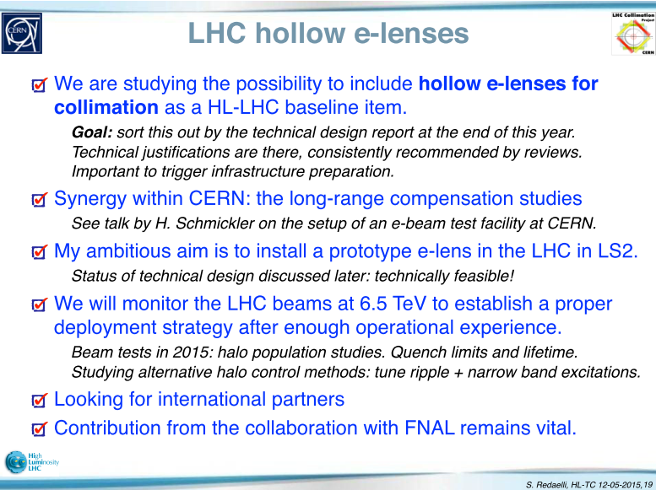
Stefano:

Slide 29


Proposed location in the LHC
Best place IR4:
  Large intra beam distance (420 mm)
  β_{x} ≈ β_{y}
  cryogenics

Slide 30

Technical design (CERN)
S-shaped to compensate for the asymmetric electron beam distributions seen by the main beam
Gun and collector stick out in vertical plane to fit in LHC tunnel
Diego Perini

Slide 31



3D design ready to go into
production drawings

Slide 32

Superconducting solenoid (CERN)
3 x 1 m long, 250 A current, 5T field, cooled with He to 4.2 K
Includes 6 correction coils for alignment of electron beam
Includes (not in the figure) the quench protection system
1 m magnet could be used for test bench
Overall design may evolve with the integration of instrumentation
see
H. Schmickler’s
talk

Slide 33


Hollow electron gun (1)
New gun needed for higher current and adjusted electron beam size
First prototype designed, built and tested at Fermilab can provide 5A.
Tungsten dispenser cathode with BaO:CaO:Al2O3 impregnant, 1400 K
First prototype of
hollow cathode
Prototype yields
5 A at 10 kV

Slide 34

Hollow electron gun (2)
Next gun with slightly reviewed design w.r.t. FNAL one to be built at CERN
  Test stand planned to be set up at CERN (SM18) but initial tests at FNAL (LARP)
Powering
  10 kV modulator used to power the gun
  If we want to act on a subset of bunches: Need very fast rise time
  200 ns allows to switch on and off between bunch trains
Cathode: one student to increase current
Present cathode design

Slide 35
Timeline
Collimation needs can only be defined in detail after gaining operational experience at 6.5 TeV (end of 2015)
  Uncertainties: cleaning efficiency, beam lifetime, quench limits, impedance
  Final decision on installation to be taken based on Run II experience
  but Hollow Electron Lens already considered for HL-LHC baseline
Meanwhile, proceed with design of 2 devices (1 per beam)
  Estimated time needed: about 3 years
  If technical design is finalized in 2015, could aim at installation during long shutdown in 2018 (LS2)

Slide 36


LARP Rotatable Collimator

