Slide 1
READINESS AND BOTTLENECKS FOR QXF MAGNETS
FNAL, LARP and HL LHC meeting
12th May 2015
G. Ambrosio, P. Ferracin, E. Todesco
CERN, Geneva Switzerland

Slide 2
CONTENTS
Technical risks
Schedule risk

Slide 3
TECHNICAL RISKS
Nearly all design features tested on HQ
This is strongly reducing the risk of the QXF project
Missing: adding the SS shell - to be done in 2nd or 3rd short QXF
Margin increased from 19% to 23%
This gives some more relax on quench performance, quench protection, stress and prestress, … [see G. Ambrosio talk]
Recent decision of using 108/127, which is the strand layout mostly used by LARP [see P. Ferracin summary, A. Ghosh, B. Bordini]
Risk and cost reduction
CERN will produce short models with 132/169, than go to 108/127 for prototypes according to present plan
108 gives twice amplitude flux jumps at low energy (variable thresholds for protection already in the baseline)

Slide 4
SCHEDULE OUTLOOK
Color codes
Orange: coil fabrication (excluding practice etc.)
Light Green: horizontal test
Light Blue: cold mass welding
Deep Blue: cryostating
Dark Green: horizontal test

Slide 5
TECHNICAL RISKS: LENGTH
The length issue is the most critical
LARP had three 3.4-m-long coils, CERN starts from scratch (or better from 11T 5.5-m-long coils that will come soon)
First 4-m-long in LARP at the end of 2016
First 7-m-long in CERN tested at the beginning of 2018
Very short period between first and second long CERN prototype

Slide 6
TECHNICAL RISKS: STRAND
It takes more than 1 year to order strand
Test of the short can give feedback on the strand order for the series
Test of the long cannot give feedback on the strand order for the series for CERN (and it is at the limit for US hilumi)

Slide 7
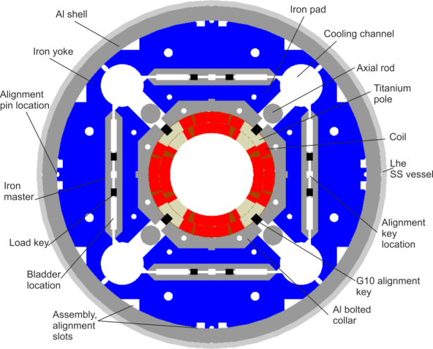
TECHNICAL RISKS: LAMINATED STRUCTURE
We are considering a laminated structure for the iron yoke
Two pieces, blue parts in the figure
Allows a strong reduction of the cost (from 75 kchf/m to 30 kchf/m), so 7 M total
This will be tested on a short model (possibly 2nd or 3rd)
I think we should have this option tested on short on both sides of the ocean
In principle one test is enough, but I think it is a risk to have a new long structure assembled for the first proto

Slide 8
TECHNICAL RISKS: PROTECTION
Protection is still a major concern to me
Outer layer quench heaters only do not provide adequate protection
We are working with a very large T_{max} (350 K)
Inner layer can be a viable option to provide redundancy and lower the hotspot
Visual signs of degradation, but no evidence of longer delays
[talk by G. Ambrosio]
My favourite option since it is independent of the length – results will be available already with short models
CLIQ is an interesting technique [talk by E. Ravaioli]
Codes are reliable , but final validation only with prototypes
Possibility of having the triplet on one circuit is being studied

Slide 9
TECHNICAL RISKS: FIELD QUALITY
Iteration on the cross-section takes 1.5 years
We just went to cross-section II (without testing yet the first one)
But in this way we have midplane and pole shims allowing tune b₆ over a wide range
No change of cross-section is foreseen (unless major unexpected events)
If b₁₀ or b₁₄ are a problem, we will add correctors and not change the cross-section
Magnetic shimming can take care of two large non allowed multipoles
Corrects ±5 units of b₃, ±5 units of a₃, ±3 units of b₄
Only ±1 unit of a₄
Evidence of large b₅, a₆, b₇
Difficult to act on these multipoles
Consider increasing strength of correctors (b₅, a₆) or add correctors b₇

Slide 10
TECHNICAL RISKS: SCHEDULE
US Hilumi schedule was at the edge
Last magnets ready for cryostat at the end 2023, plus preparation etc
With one year slipping schedule looks more relaxed
But no contingency, no failures accounted for
1.5 year between first test prototype and first winding of series coil

Slide 11
TECHNICAL RISKS: SCHEDULE
CERN schedule more relaxed, but
Only few months between test first prototype and first winding of the series coil (really too little)
Assume a smooth series production for a 7-m-long coil (unrealistic)
There is a considerable contingency (two years, with new schedule)

Slide 12
CONTENTS
THANKS !

