Slide 1
The US-HiLumi Project
Ruben Carcagno
May 13, 2015

Slide 2
What is US-HiLumi?
“US-HiLumi” refers to the anticipated U.S. DOE project for High Luminosity LHC (HL-LHC) deliverables
  Must follow DOE Order 413.3B for capital projects above $50M
It is separate from LARP, which is an R&D program not regulated by DOE Order 413.3B
US-HiLumi assumes all prototyping will be completed under the LARP program. US-HiLumi only deals with series production of U.S. deliverables for HL-LHC.
US-HiLumi assumes some long-lead items will be acquired under LARP (e.g., initial conductor, tooling, and initial coil parts)

Slide 3
US-HiLumi Scope
20 MQXFA magnets for Q1 and Q3, installed as a pair in 10 LQXA/B Cold Mass Assemblies
40 dressed crab cavities with HOM couplers and Tuners
Wideband Feedback System
Electron Lenses
Items in Blue have higher confidence to be part of US-HiLumi project. Items in Gray have more uncertainty, depend on final CERN-DOE collaboration agreement. DOE has stated that items in Light Red are highly unlikely (Feb’ 15 discussions at DOE Headquarters). Some of these maybe carried out as a possible continuation of LARP (LARP2?)

Slide 4
US-HiLumi Status
The US-HiLumi Project will officially start after DOE approves Critical Decision 0 (CD-0).
  CERN and DOE are actively working on agreements (cooperation-signed May 7 2015, protocol, collaboration)
  CD-0 expected to be approved after protocol agreement is signed (in summer 2015?)
    DOE indicated CD-0 within the year
  DOE may change the official project name

Slide 5
Critical US-HiLumi Milestones
CD-0: Mission Need Approved. Project Starts.
  Expected within the year
CD-1/2: Consolidated CD-1 and CD-2 milestones. Project Performance Baseline Approved.
  Expected April 2017
CD-3: Start of Fabrication Approved
  Expected January 2018
  Earlier CD-3a approval may allow procurement of long-lead items
CD-4: Deliverables accepted by CERN. Project Completion.
US-HiLumi must be completed at CD-4 within the original approved performance baseline at CD-2

Slide 6
Main Project Planning Documents
(Must have for CD-1/2 review)
: Started
Mission Need Statement (MNS)
Project Management Plan (PMP)
Functional Requirements Specification (FRS)
Performance Baseline (PB)
Risk Management Plan (RMP)
Scope Baseline
Acquisition Strategy (AS)
Design: Reports (CDR, PDR, FDR) Drawings, Specifications, etc.
KPPs, WBS, WBS Dictionary
Quality Assurance Plan (QAP)
Cost and Schedule Range, Key Milestones
Schedule Baseline
Value Engineering
Alternatives and Risk Analysis
Change Control Management Plan
BOEs, RLS, Milestones, Constraints, Contingency
Manufacturing: Manufacturing Plan (MP), Procedures, etc.
Project Execution Plan (PEP)
Procurement Management Plan
Cost Baseline
Procurement: Procurement Plan (PP), etc.
Key Assumptions, KPPs, Baseline, Funding Profile, PM Strategy
Integrated Safety Management Plan
BOEs, Time-Phased, Escalation, Contingency
Risk Registry (RR), Risk Analysis
OBS, RAM, CAMs

Slide 7
Preliminary Roadmap to CD-2
Independent Director’s CD reviews are held before a DOE CD review
  Director’s CD-2 review requires monthly internal EVMS reporting for 6 months
  Project Performance Measurement Baseline must be frozen prior to EVMS reporting staring
    From there on, changes are only possible through Change Control Board approval
  After DOE CD-2 approval, monthly external EVMS reporting into the DOE system immediately starts
Independent Director’s Design reviews are held before DOE CD reviews
An Independent Cost Estimate (ICE) by the DOE Office of Acquisition and Project Management (APM) is required by DOE O 413.3B prior to CD-2 for projects with TPC > $100M
May/June 2016
July 2016
January 2017
April 2017
Performance Baseline Frozen
EVMS Reporting
6 months
Director’s CD-1/2 Review
3 months
Director’s Independent
Design Review
DOE CD-2 Review
DOE Independent Cost Estimate Review

Slide 8
Project Phasing?
Potential issue: magnets CD-2 readiness expected earlier than crab cavities CD-2 readiness
  Different levels of project definition and maturity
    A firm project performance baseline is approved at CD-2
Possible solution: use DOE O 413.3B method of “Phasing” CDs:
  For example, obtain CD-0 and CD-1 approvals for magnets plus cavities collectively and simultaneously, but subsequently magnets and cavities will have their own CD-2, CD-3, CD-4.

Slide 9
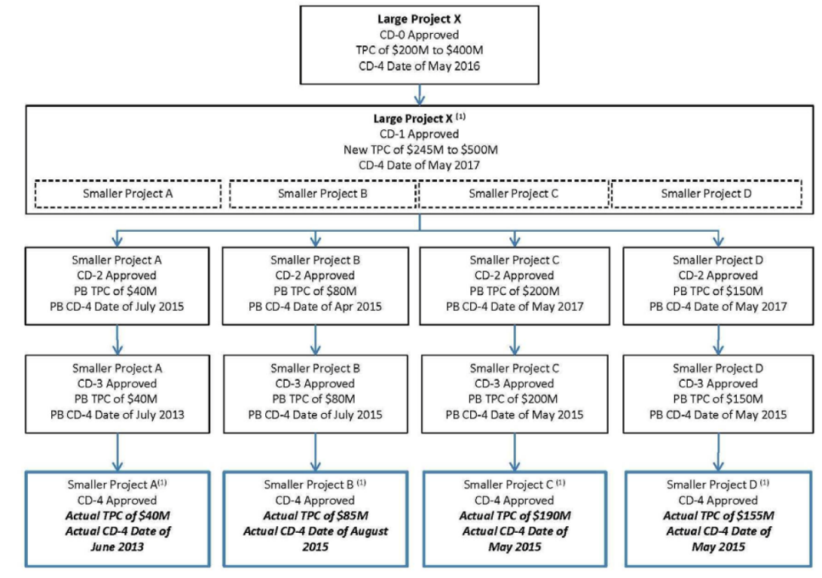
Phasing of a Large Project
(from DOE O 413.3B)
Cavities
Magnets
Figure source: DOE O 413.3B, 11-29-2010, Page C-23, Figure 4: Phasing of a Large Project

Slide 10
US-HiLumi Magnets Timeline
Tentative plan:
  Assumes Q1 and Q3 tunnel installation in CY-2024
  Provides 3.5 years for CERN Q1 and Q3 scope (cryostating, test, etc)
  Production Coil winding must start in January 2018 (U.S. Critical Decision 3 DOE approval, CD-3)
  Two years of preparations needed for strand and series production tooling procurements, start cable fabrication, etc.
  Production throughput based on June 2013 MQXF fabrication plan (being updated)

Slide 11
Preliminary Delivery Schedule
Roughly based on production throughput estimates from 2013 fabrication plan
This delivery schedule was used for the 2015 Cost Estimate

Slide 12
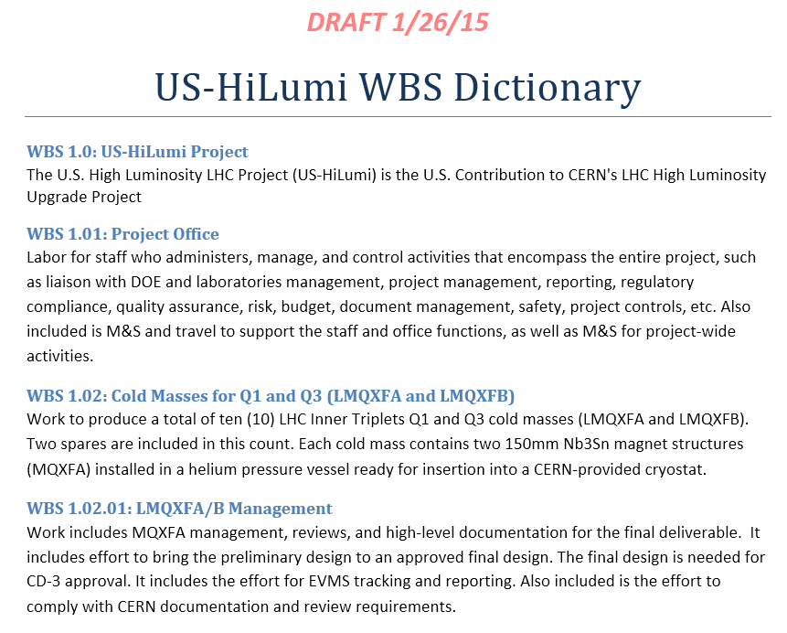
US-HiLumi Preliminary WBS
Preliminary WBS and WBS Dictionary
  Created for Magnets, Crab Cavities, Electron Lenses, and Wideband Feedback System
  Responsibilities assigned down to Level 3 (L3s)
  Used to generate a preliminary bottoms-up cost estimate

Slide 13
US-HiLumi Cost
U.S. Total Project Cost (TPC) = Base Cost + Contingency + Escalation
  Base Cost: Labor + Materials and Services (M&S)
    Labor = Salary, Wages, and Fringes (SWF) + Overhead
      Unit of labor: Full Time Equivalent (FTE)
        1 FTE-year = 1,768 hours (85% of annual working hours)
    M&S = Direct Cost + Overhead
  Contingency: Uncertainty Contingency + Risk Contingency
    Uncertainty Contingency: estimate uncertainty, e.g., cost of poles
    Risk Contingency: for threat (negative impact) or opportunities (positive impact) of events that may or may not happen, e.g., more (or less) coils fail than assumed yield
    Unused contingency may be used to increase project scope during execution (with DOE approval)
  Escalation: Assumes year to year escalation rate
    The TPC is the cost at completion (in then dollars), not the present value (in today’s dollars).

Slide 14
Preliminary Cost Estimate
Includes all activities defined in WBS - Series production only – No prototypes
Bottoms-up estimate for magnets and project office (70% of the cost)
  Parametric and analogous estimates for Crab Cavities and Electron Lenses
Based on more than 135 Basis of Estimates (BOEs) in a standard BOE template
Includes institutional labor rates and overheads for FNAL, BNL, LBNL, and SLAC; uncertainty contingency; and escalation cost. Risk contingency not yet included.
  For reference, risk contingency for mu2e solenoids is $3.5M on a TPC of $110M
Total Activities Cost Estimate (TAC) = $236M
Two funding sources (details next):
1. Funded by LARP (FY16-17) = $14M
2. Funded by DOE 413.3B Project (FY18-24) = $222M
413.3B Project TPC = $222M + Risk Contingency
413.3B Total Project Cost (TPC):
  All scope: $222M + Risk Contingency
  Magnets + Cavities: $198M + RC
  Magnets: $151M + RC

Slide 15
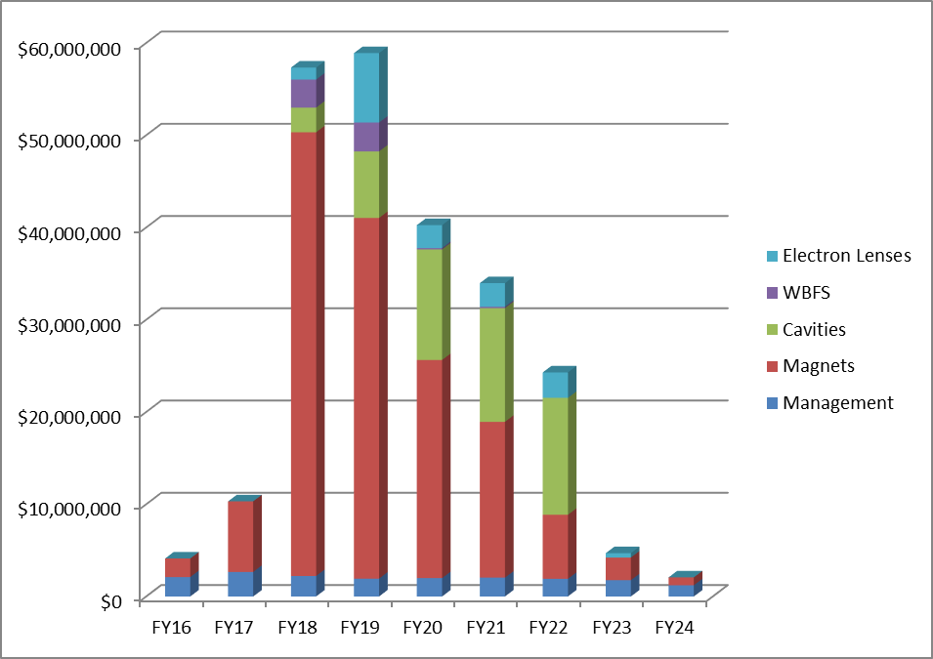
Preliminary time-phased cost
Activity BOEs were generated for this tentative baseline and allocated by FY according to the anticipated quantities and timeline
Assumes FY16-17 Nb3Sn strand (~ $7.7M direct M&S) delivered by CERN, and then project procures strand for CERN in FY18-19
Sharp cost rise in FY18, primarily driven by start of magnets production
Presented to DOE on February 2015. Feedback:
  A much more gradual funding ramp-up should be expected
  WBFS and Electron Lenses unlikely to be included on project
DOE provided US-HiLumi funding guidance on May 7 2015 (next slide)
LARP
($14.4M)
413.3B Project
($222M)

Slide 16
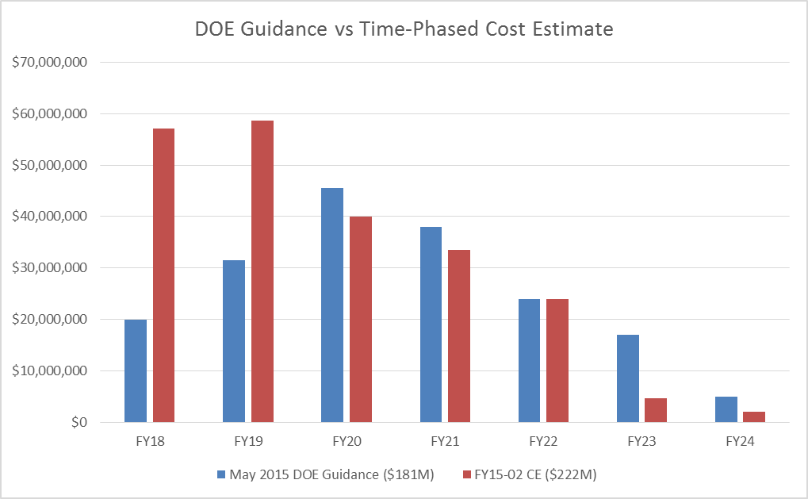
DOE Funding Guidance
Presented by Bruce Strauss on May 11, 2015:

Slide 17
FY18 Details - Magnets
A large portion of the FY18 strand procurement is to return strand procured by CERN for US-HiLumi in FY16-17
These FY18 activities are needed to support the baseline delivery schedule:

Slide 18
Options to match funding profile
A more gradual funding profile rise (for magnets) could be accomplished (in principle) by:
  Reducing Scope
    Total quantities are fixed by CERN’s needs (20 MQXFAs, 10 LMQXFA/B)
  Stretching the Schedule
    Driven by CERN’s needs. U.S. Deliverables must support present LS3 schedule, however there are indications of a possible 1-year delay.
  Keeping scope and schedule the same, start production slower, and then ramp up to higher throughput than estimate baseline
    Is this feasible? What is the risk?
Launched a detailed production manufacturing planning effort in April 2015 to quantify and analyze alternatives, evaluate risk, and document the manufacturing process

Slide 19
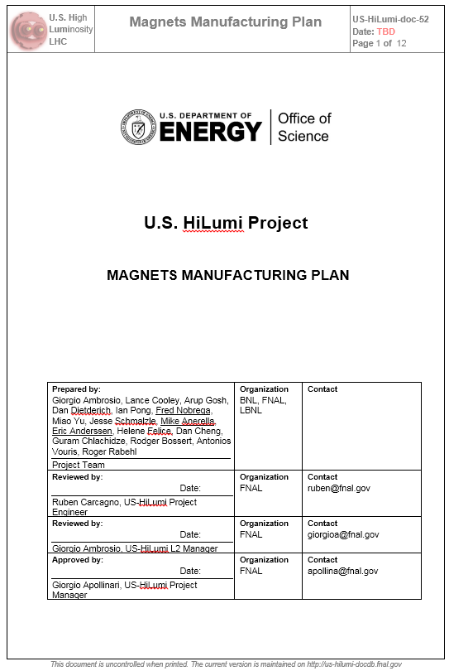
Magnets Manufacturing Plan
First goal: production throughput scenarios, determine peak throughput and resources to support

Slide 20
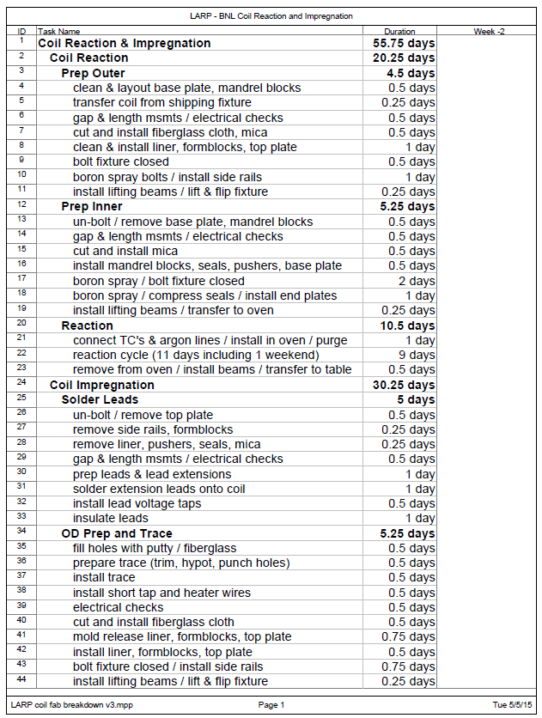
Example: Coils Fabrication
(This is Work in Progress)
FNAL Steps Breakdown
BNL Steps Breakdown
BNL, FNAL working towards agreement of basic steps, grouping, durations, and technician crew
Will consolidate and converge on the same steps breakdown logic and estimates
Summary Status:

Slide 21
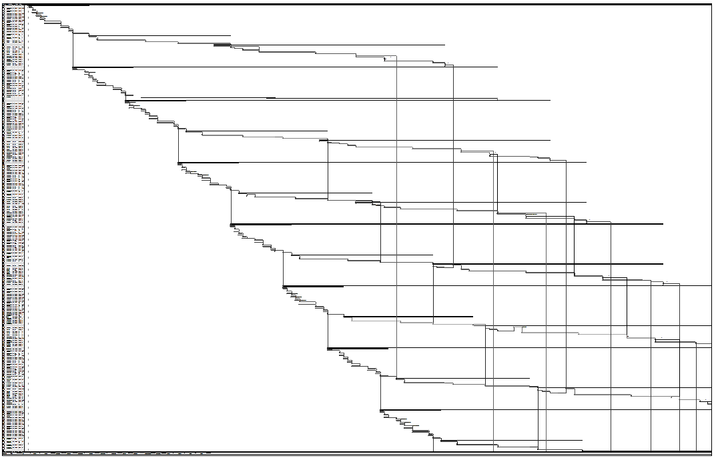
Coil Peak Throughput
(This is Work In Progress)
Criteria: one reaction oven, fully utilized (no idle time)
  Reaction time is “incompressible”
FNAL Resource-loaded schedule analysis (390 tasks)
  Tasks are defined by the steps (previous slide) of multiple coils fabricated concurrently
  Technician crew fully utilized
Result: 1 coil every 11 working days (per line)
Requires (per line):
  1 Reaction Oven
  2 Mandrels
  6 Reaction Tooling
  4 Impregnation Tooling
  Two Shifts for Winding and Curing
  18 Technicians
    4 W&C
    4 Reaction
    8 Impregnation
    2 QC

Slide 22
Coil Throughput Comparison
(This is Work in Progress)
Throughput is for steady production, after learning curve.
Estimates will be updated as MQXFA Long Prototype fabrication experience becomes available
A difference of 5.6 days translates in a duration of one year (50 work weeks) per line
  Each line is assumed to produce a total of 45 coils

Slide 23
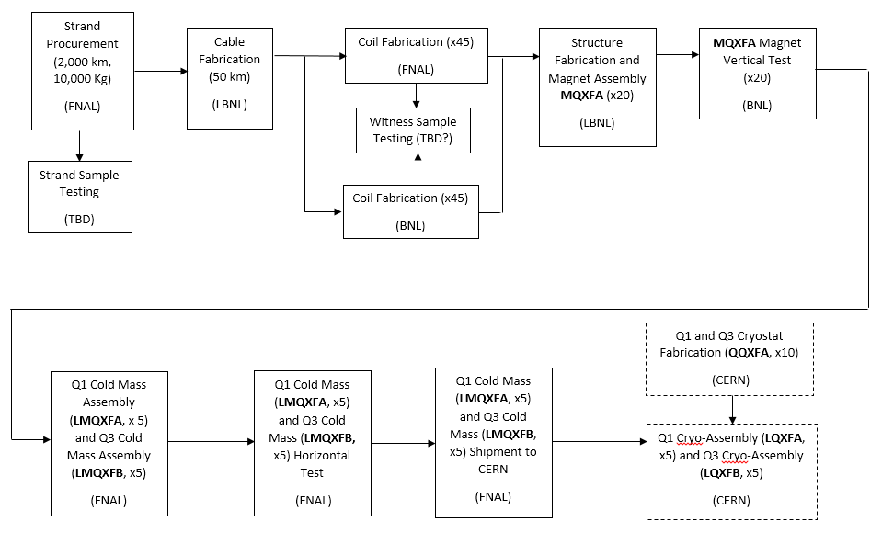
Throughput Matching
Similar peak throughput analysis is being conducted for other processes in the manufacturing chain (e.g., structure fabrication and magnet assembly, testing, etc.)

Slide 24
Summary
The US-HiLumi will be a DOE 413.3B project for the series production of US contributions to HL-LHC.
  CD-0 anticipated within the year, CD-1/2 April 2017, and CD-3 January 2018
    Project CD Phasing may be needed for cavities after CD-1, with CD-2 and CD-3 for cavities coming later than magnets
  Exact scope will be known after the final CERN-DOE collaboration agreement is signed (early 2016?)
    DOE: WBFS and Electron Lenses will most likely NOT be part of US-HiLumi scope
Preliminary US-HiLumi cost and schedule estimates were completed, requiring an unlikely funding profile sharp rise in FY18 driven by the start of magnets production
  DOE Provided funding guidance on May 11, 2015: much slower ramp-up, less TPC ($181M vs. $222M)
A US-HiLumi detailed Magnets Manufacturing Plan effort was launched. Throughput scenarios and risks are being analyzed and will attempt to match the newly provided DOE funding profile
Project baseline must be established and frozen approximately one year from now to support the CD review process

