Slide 1
Feedback From Magnet Assemblies and Their Application Toward the MQXF Structure
Dan Cheng, Helene Felice
5/12/2015

Slide 2
Outline
Introduction
Feedback from prior magnets
Observations from the MQXFSD1 assembly
Summary

Slide 3
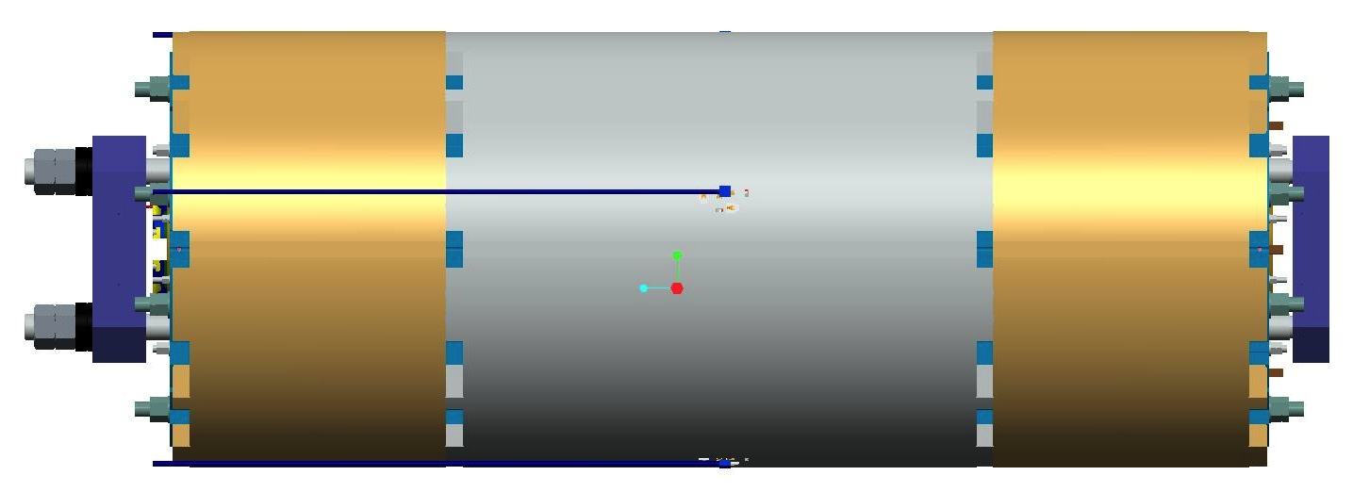
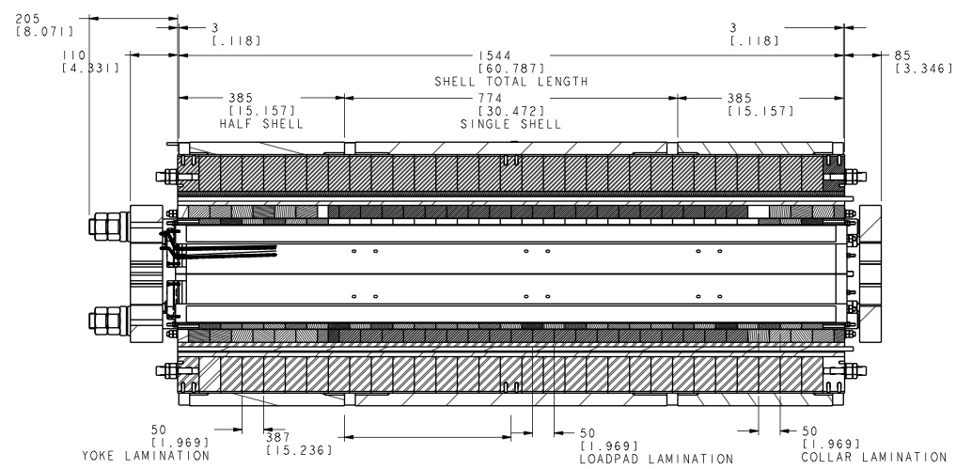
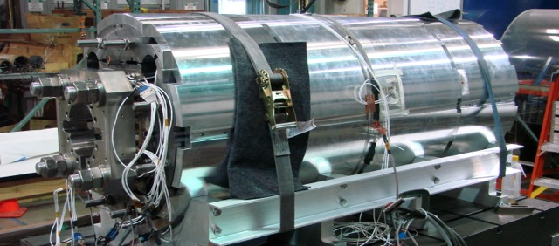
Introduction – The Design Cycle
Parts Design
Fabrication
Feedback
Feedback
Prior magnets (LQ, HQ, etc.)
Assembly

Slide 4
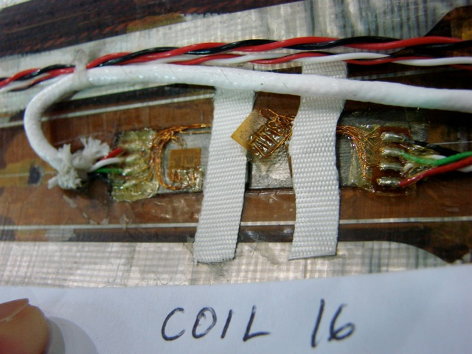
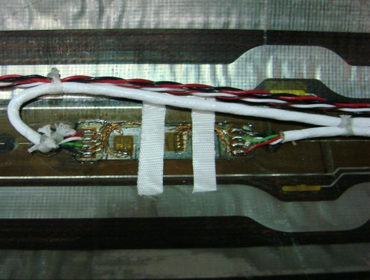
HQ02b Strain Gauges
LQ & HQ had some history of “losing” strain gauges upon cooldown
Adhesive could not be cured to manufacturer specified temperatures—we were not able to control adequately
Somewhat inconclusive, though, because shell gauges still performed…
Tape securing thermal compensators was also causing these gauges to be lost
Pre-Test
Post-Test

Slide 5
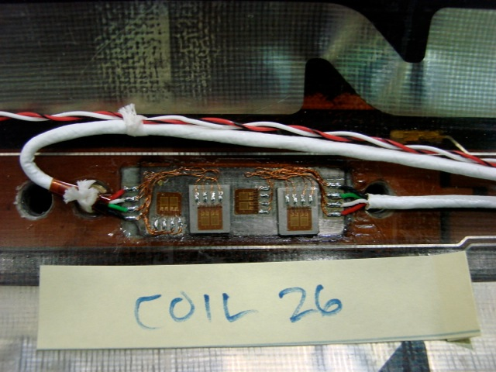
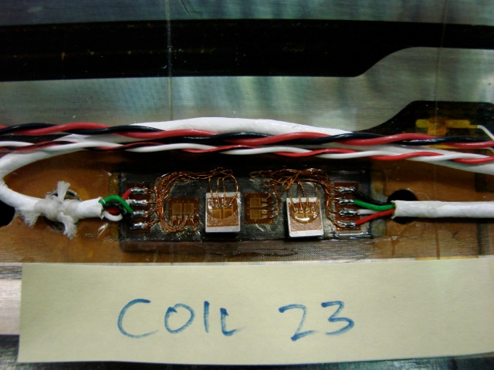
HQ03a Strain Gauges: An Improvement
New procedures developed for HQ03a gauges:
SGs using new bonding procedures performed well; epoxy was able to cure at RT and remained intact when cold
SGs using old-style procedures in Coil 23 were lost on cooldown
SGs using new procedures
SGs using old-style procedures

Slide 6
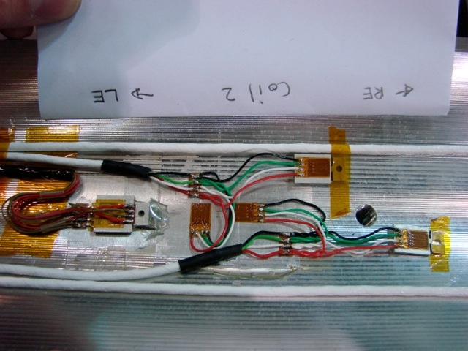
MQXFSD1 Strain Gauges: A Promising Result
Used the new procedures, new gauges, and compensators
No gauges were lost during cooldown test
Full examination to follow after disassembly

Slide 7
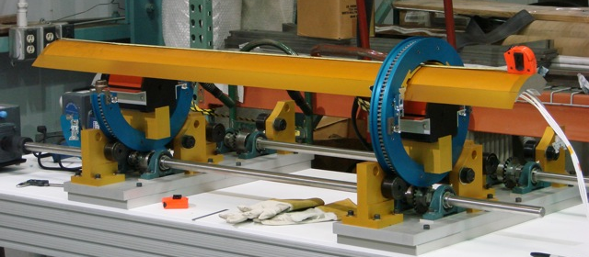
Application of MQXFSD Coil GPI
Did not actually use our coil rotating tooling yet
Modifications to support mandrels need to be implemented before real coils can be placed and assembled
Kapton with B-stage layer has been ordered to the correct width; no additional trimming is necessary

Slide 8
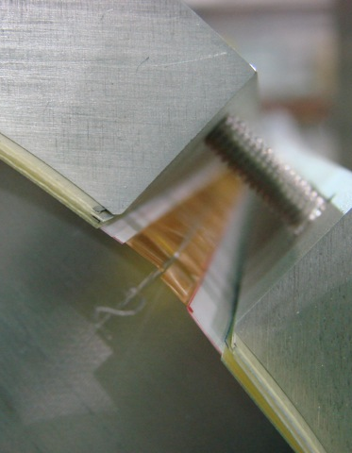
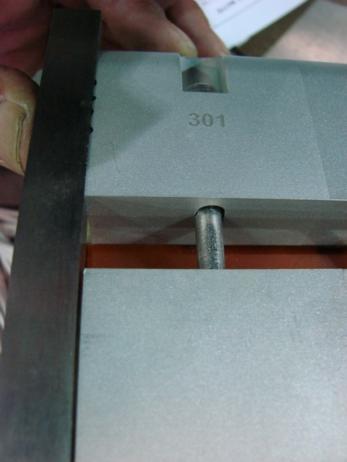
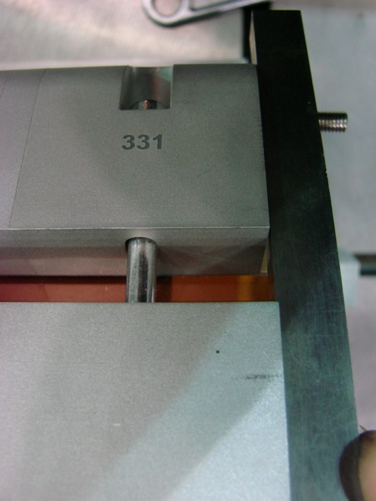
MQXFSD1 Collars and Load Pads
Collar required ~0.057 (~1.5 mm) thick of shim (G10), not including GPI layers
We will adjust collar radius in long model to use less shim (and less labor)
Collar laminations were not uniform in thickness
Resulted in offset in the holes from end to end when stacks assembled together

Slide 9
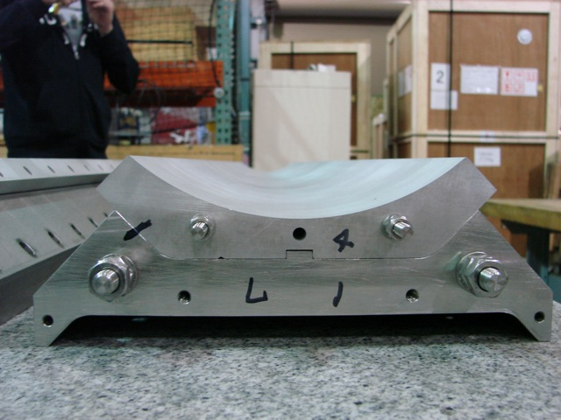
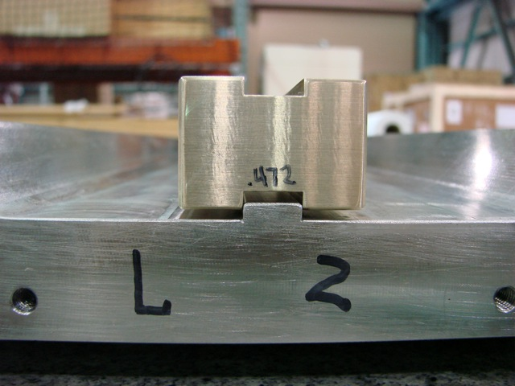
MQXFSD1 Collars and Load Pads
Load Pad Key feature
Load pad key feature on two pad assemblies (with slot features) did not fit the collar key slot
Fabricated a “go, no-go” gauge and dressed the key on the pads in order to fit them in the collars

Slide 10
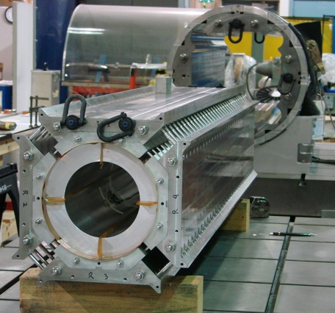
MQXFSD1 Coil Pack Builds
Tapped holes in collars also did not appear to be fully chased
A few aluminum metal chips were found on Kapton GPI after collar pack build was complete
Fortunately we are not powering this structure…
A few tapped holes in load pads needed chasing as well

Slide 11
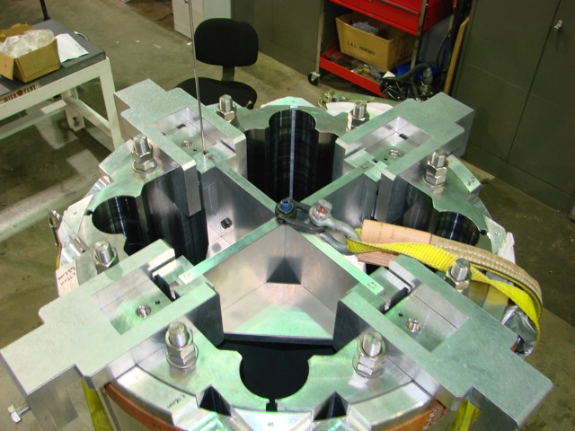
MQXFSD1 Yoke-Shell Subassembly
High bladder pressures (6,000 - 7,000 psi/40 – 48 MPa) were required for the initial assembly
Encountered some bladder failures after reaching these pressures
=> We plan to redesign tooling to incorporate 8 bladder slots instead of 4 in this initial tooling design (CERN is also exploring this as well)

Slide 12
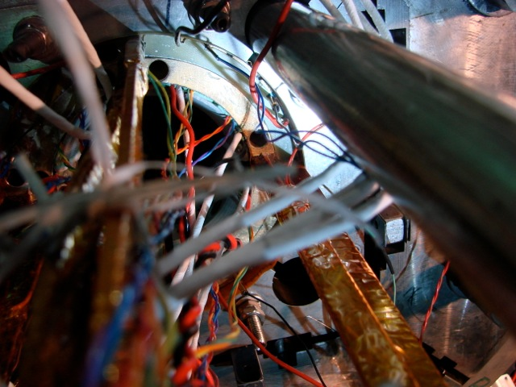
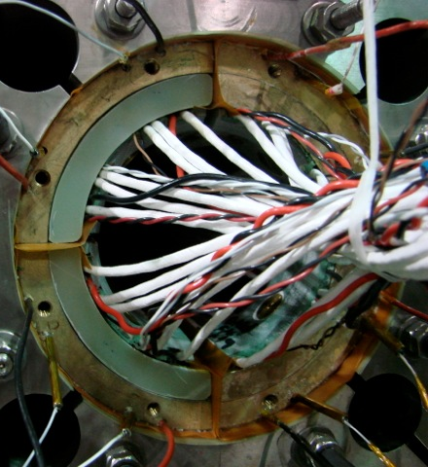
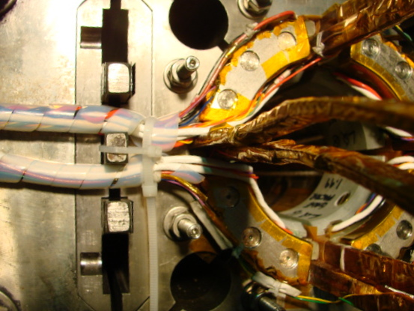
LQ Wire Routing
Wiring was typically a “rat’s nest”
Wires were bundled around bullets and pushers
Pinched or broken wires still resulted
LQ, Lead End
LQ, Return End

Slide 13
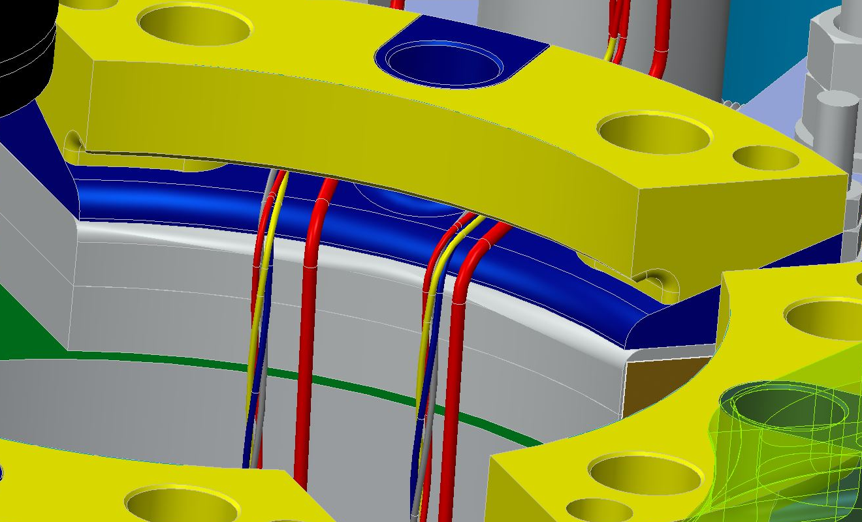
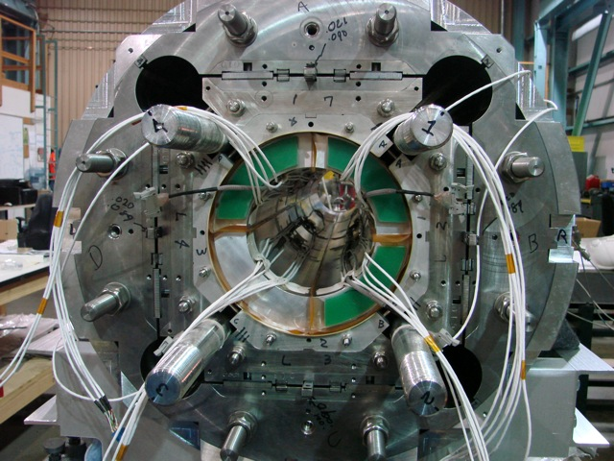
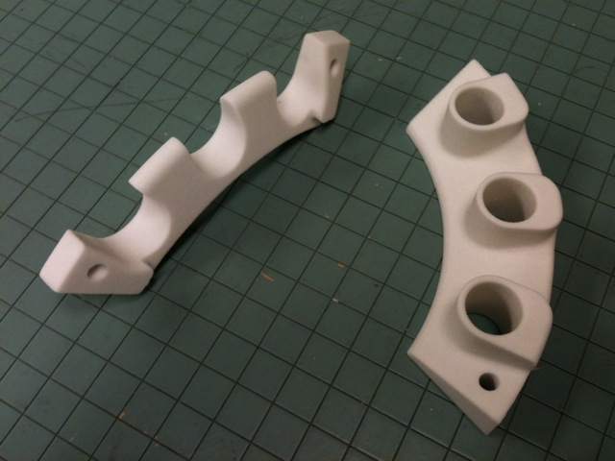
MQXFSD1 Wire Routing
IL wiring (including SGs)
Initial design called for IL signal wires to pass through bore opening (OL would pass around endplate)
Did not have wire guides ready in time for the cooldown test. Will implement in MQXFS1

Slide 14
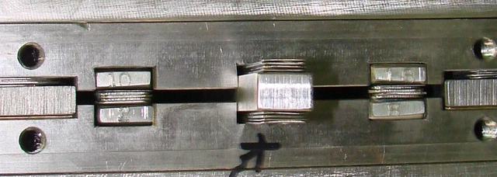
MQXFSD1 Master Key Shims
Alignment and load keys required many shims in nominal dimensions
Each load key required 0.120” (~3 mm) thick worth of shims to start
Alignment keys required ~2 mm per side of shims (still with clearance)
=> We plan to increase nominal thickness of these keys to reduce shims needed
Load keys
Mild steel on mild steel master key surfaces seemed to gall (even with Moly dry lubricant)

Slide 15
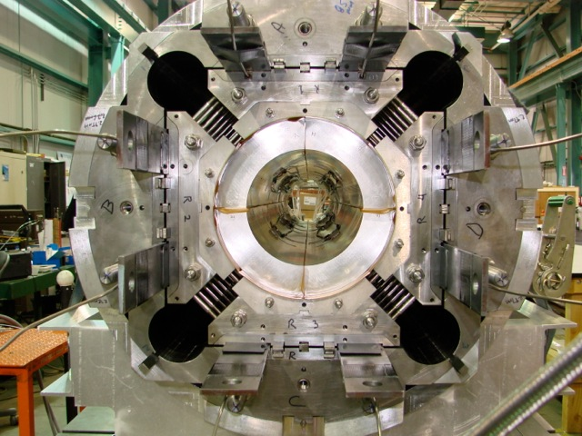
MQXFSD1 Alignment Observations
MQXFSD assembly appears to be mechanically well centered
All alignment keys were loose after the bladder operations (keys are not being loaded in shear)
Question:
What are the specifications/requirements for the assembly (center, twist, etc.)?

Slide 16
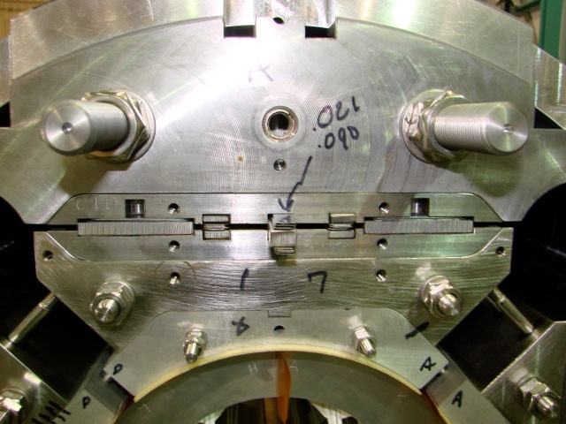
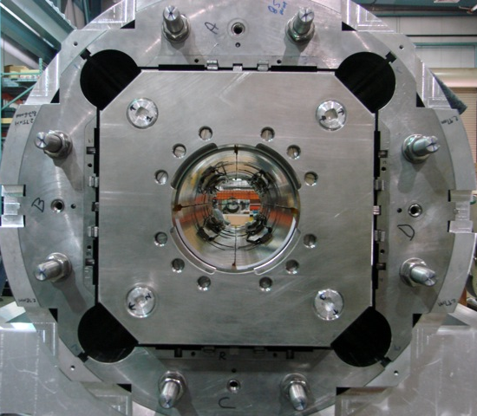
So, What About Mechanical Measurements?
To date, no specifications on the mechanical center have been specified, nor guidance on mech. measurements provided
Fiducial features must be accessible after magnet has been assembled, as conceptualized here
Collar targets defined to the center (single fiducial is not sufficient for twist)
Yoke features
remain accessible after axial
endplates are installed
Yoke targets and flats features
defined to collar targets

Slide 17
Summary
Prior magnets experience (HQ, LQ, etc.) revealed areas for improvements
Feedback helped improved strain gauge reliability
Instrumentation wires will be better routed and protected
MQXFSD1 assembly provided good feedback as well
Rollover tooling will be improved for use with real coils
Fabrication issues were observed for the load pads and collar stacks at coilpack assembly
What still needs to be implemented
Short-term:
Revisit keys design to reduce amount of shim required
Route and protect instrumentation wires
Longer-term:
Reduce collar radii to reduce shim
New tooling for assembling shell & yoke subassemblies
Specifications for defining fiducial targets and mechanical measurements will require further discussion

Slide 18
Thank you for your attention!

