Slide 2
MQXFB Prototype structure and plans at CERN
J.C Perez
On behalf on MQXF collaboration team
Joint HiLumi-LARP Meeting & 24th LARP Collaboration Meeting
11-14 May 2015 Fermilab- Wilson Hall

Slide 3
OUTLINE
Production of MQXFB prototype structure components
  Cost comparison for component fabrication techniques
  MQXFSD0 Vs MQXFSD3 mechanical structure
  Components fabrication for MQXFS3 and MQXFB
Assembly concepts for long magnets
LMF preparation for long magnets production
Production plans
Summary

Slide 4
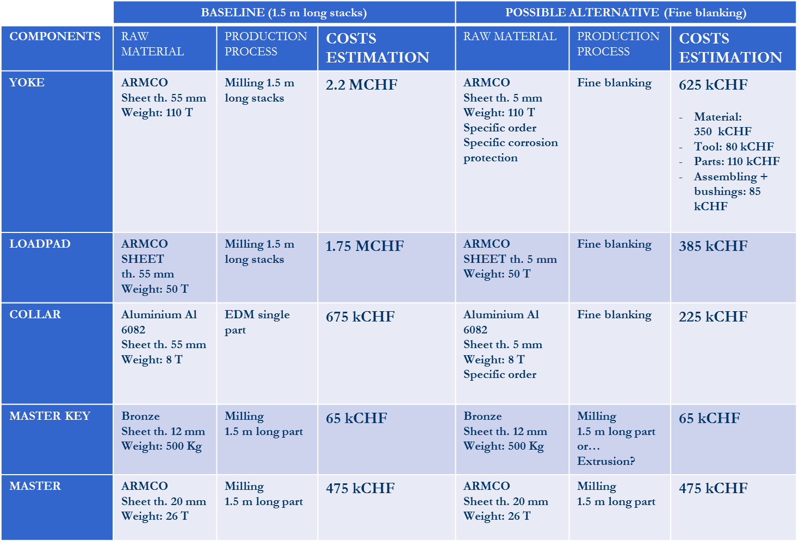
Cost comparison for 10 MQXFB
Courtesy of Pierre Moyret

Slide 5
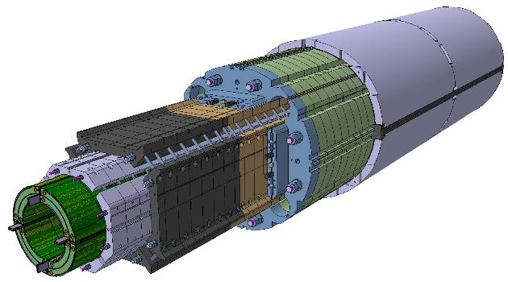
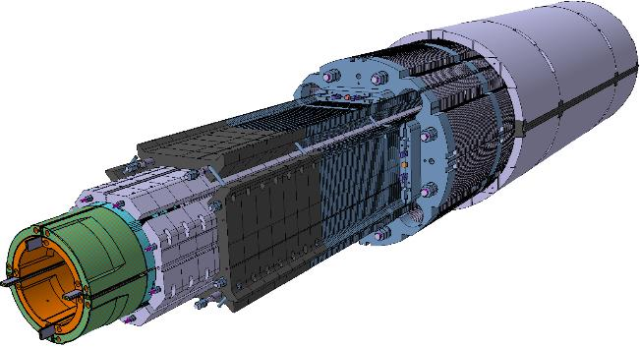
MQXFS1 Vs MQXFS2 mechanical structure
MQXFSD0
MQXFSD3
Component | MQXFSD0 | MQXFSD3
Aluminum collars | 50 mm EDM single part | 50 mm EDM single part
Pads | Milling 1.5 m long stacks (50 mm Armco and St. Steel plates) | Laser/EDM single part (50 mm St. St plates and 5.8 mm “Magnetil” LHC type iron sheets)
Masters | Milling 1.5 m single piece (Armco) | Milling 1.5 m single piece (Armco)
Yokes | Milling 1.5 m stack (Armco & St. Steel) | Laser/EDM single part (50 mm stainless steel and 5.8 mm “Magnetil” LHC type iron sheets)
Aluminum shells | 2 forged/rolled cylinders (lathing and milling) | 3 forged/rolled cylinders (lathing and milling)
MQXFSD3 will be used to validate components fabrication methods and assembly procedures for MQXFB magnets construction
3D views courtesy of Bruno Favrat

Slide 6
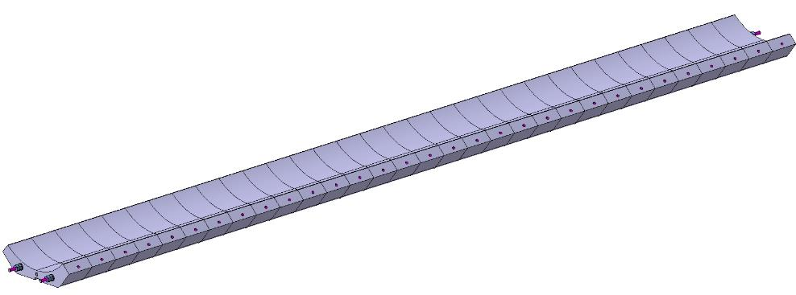
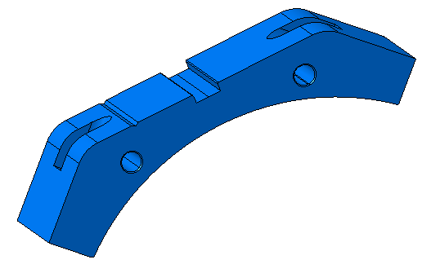
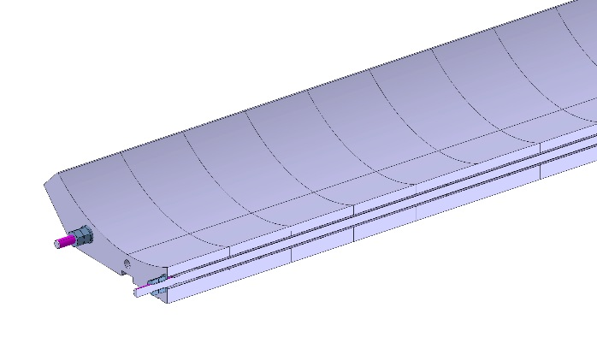
Aluminum collars fabrication
MQXFSD0 collar assembly
  Collars to be produced by EDM/milling machining as a single part:
    Cut the Al6082 T6 plate 160x400 mm, thickness 55 mm,
    Milling both surfaces to thickness 50.3 mm
    Drilling the holes for the wire erosion
    Grinding to the final thickness
    EDM wire cutting. Single step is enough to reach the required tolerance
    Milling the radial holes
The same technique will be used to machine collars for MQXFB prototype magnet

Slide 7
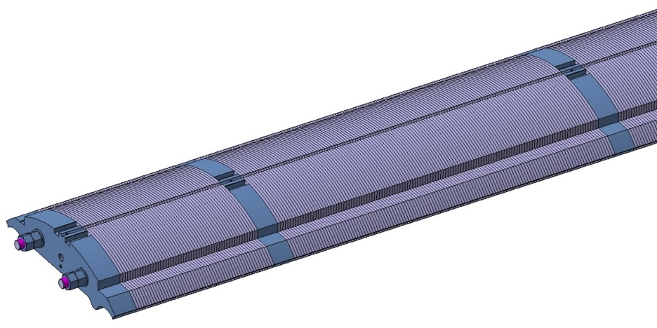
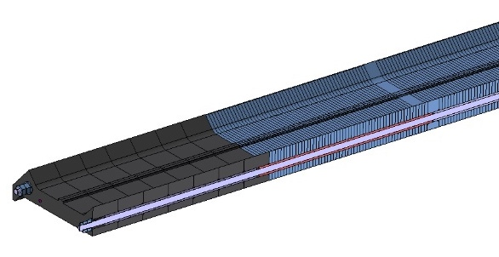
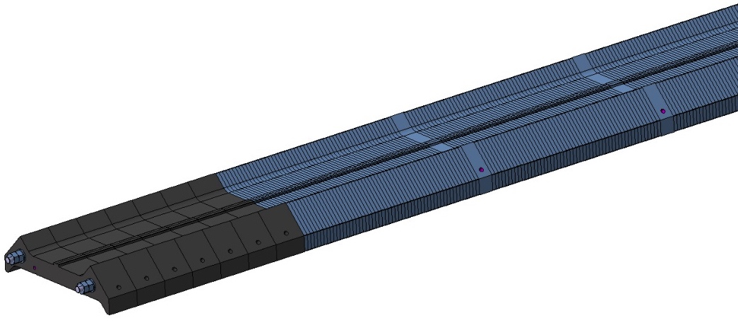
Yoke and Pads fabrication
Yoke and pads laminations will be machined by Laser/EDM as a single part (50 mm stainless steel or Armco plates and 5.8 mm “Magnetil” LHC type iron sheets) for MQXFSD3 model structure
For MQXFB magnets:
  The same technique will be applied to machine 50 mm thick laminations
  5.8 mm thick “Magnetil” plates will be obtained by fine blanking

Slide 8
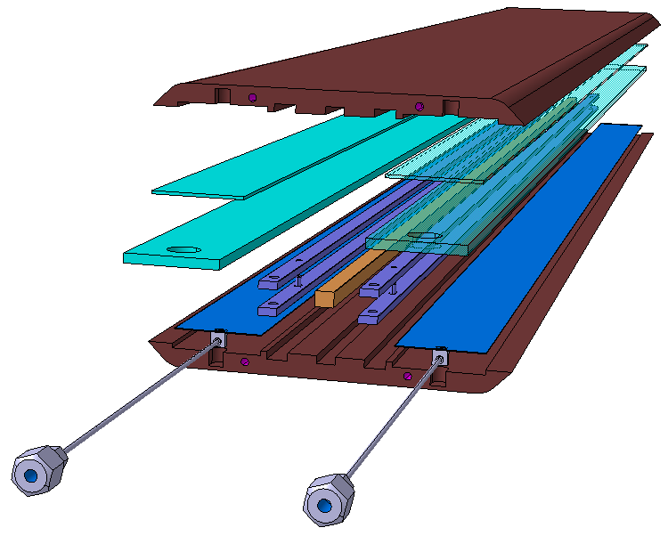
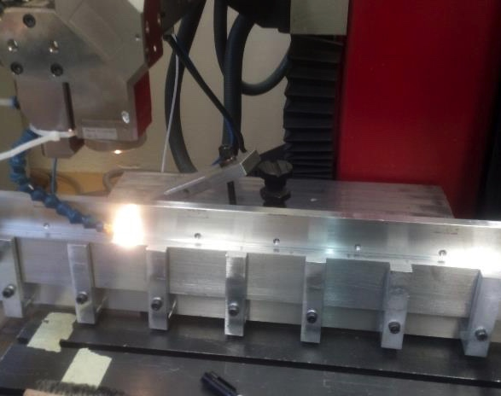
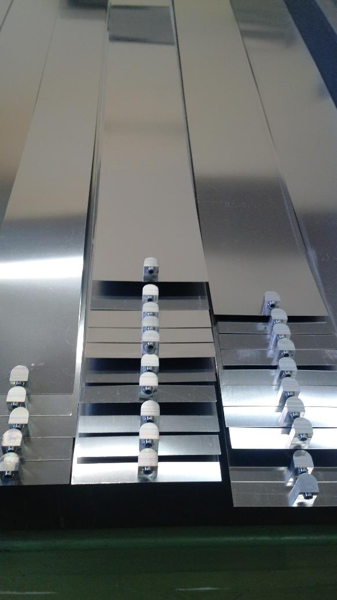
Master and bladders
MQXFB masters will be produced using milling technique
Armco 1.5 m long pieces have been already machined for MQXFSD mechanical models within the required tolerances
The possibility to machine 3.6 m long single pieces for MQXFB magnets is being investigated
The fabrication of ≈ 3.5 m long bladder prototypes using 0.5 mm SS sheets, will be launched at CERN during 2nd ½ 2015.
No show stoppers have been identify until now
The production of 3 different lengths will be required for MQXFB assembly process

Slide 9
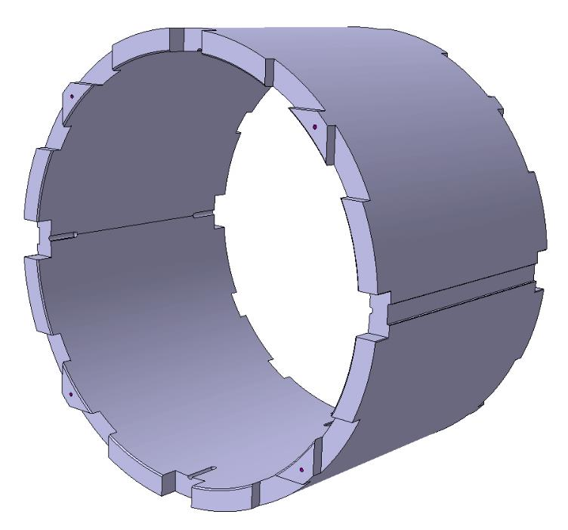
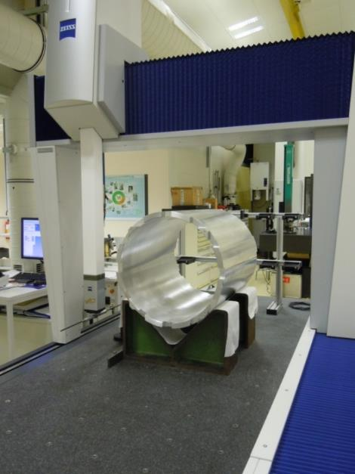
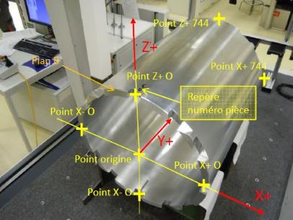
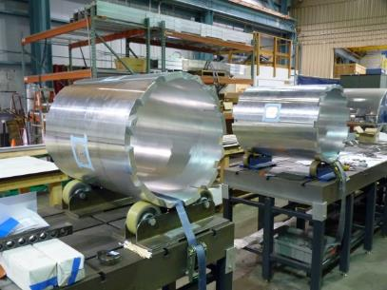
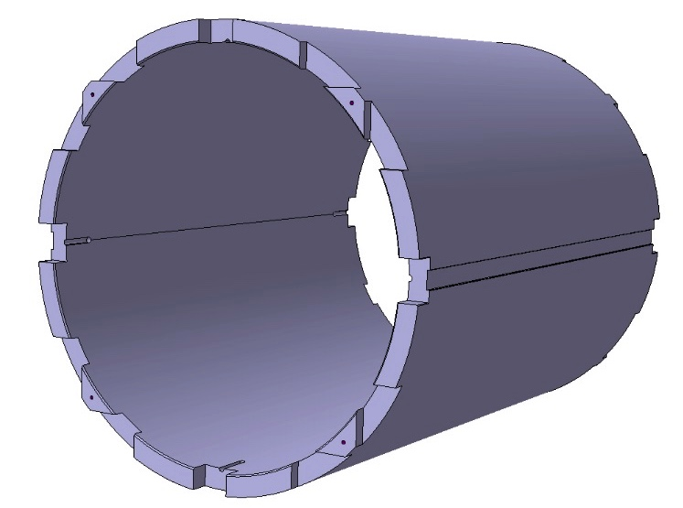
Aluminum shells for MQXFB
AA7175 aluminum alloy rolled rough machined tubes (Ø 620*545, L 800 mm long) will be produced
Best compromise to get reasonable prices for series production (3800 €/_{cylinder} + 3000 € for machining)
Two different shell length to be machined ( ≈342 mm and ≈ 683 mm)

Slide 10
OUTLINE
Production of MQXFB prototype structure components
  Cost comparison for component fabrication techniques
  MQXFSD0 Vs MQXFSD3 mechanical structure
  Components fabrication for MQXFS3 and MQXFB
Assembly concepts for long magnets
LMF preparation for long magnets production
Production plans
Summary

Slide 11
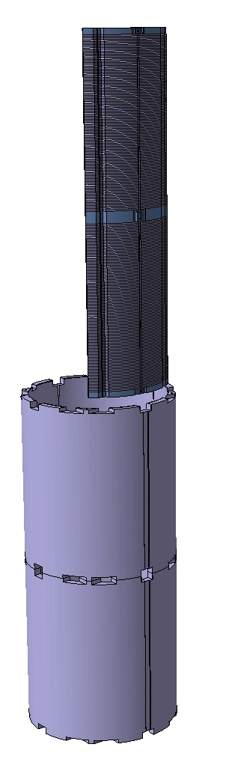
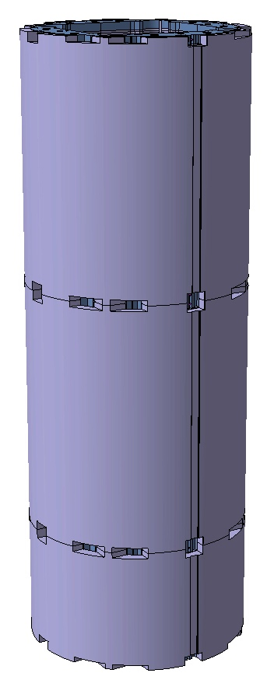
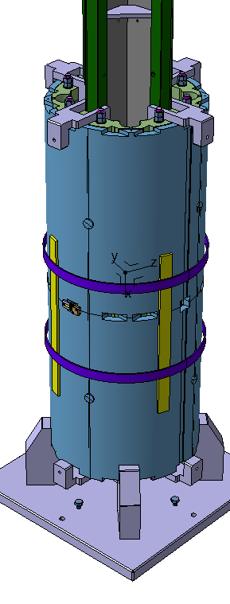
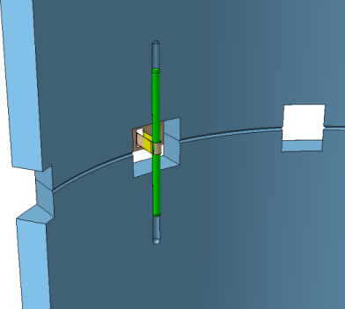
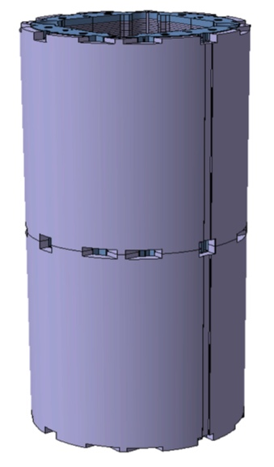
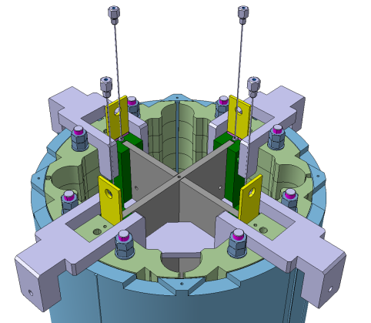
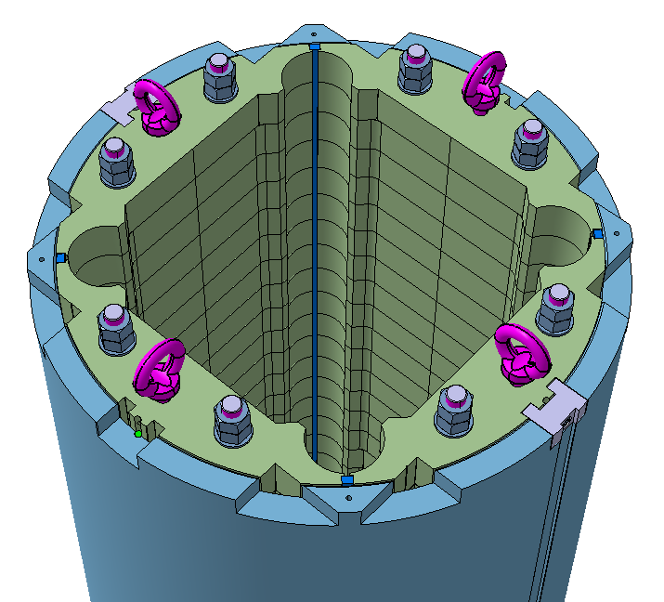
Yoke and shells modules assembly
Two different modules configuration to be assembled in vertical position and then rotated for transport and magnet structure assembly
Assembly method developed and improved during models fabrication

Slide 12
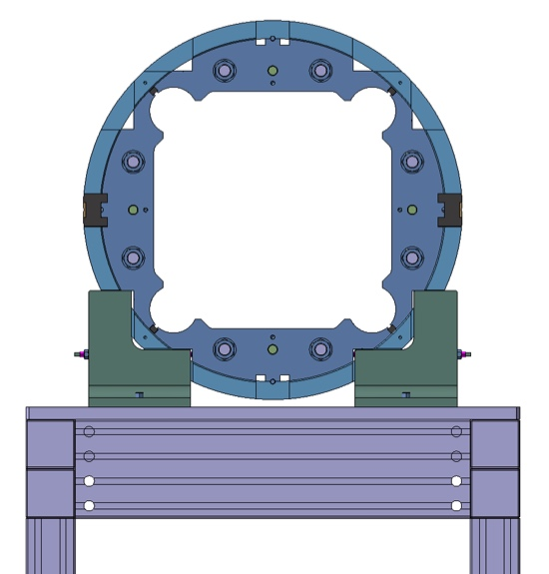
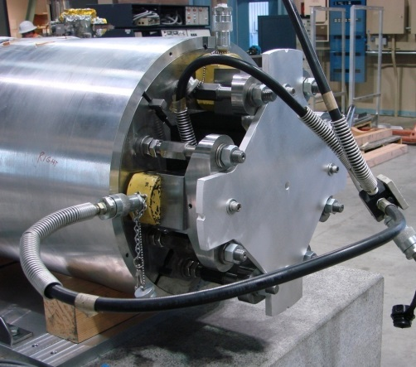
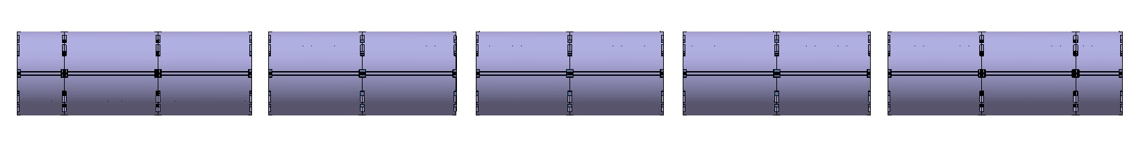
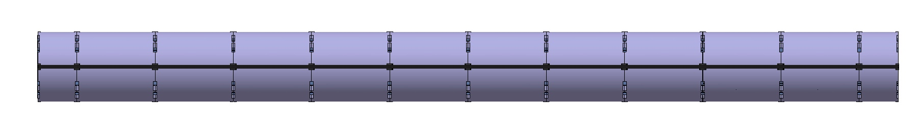
Yoke and shells assembly
¼ yokes are aligned in the shells by dowel-pins
The 2 vertical iron yokes will be taken as reference during yoke and shells modules assembly
Hydraulic cylinders will be used to compress the 7 modules with ≈7.5 m rods.

Slide 13
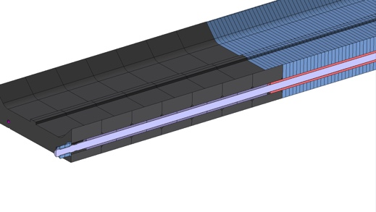
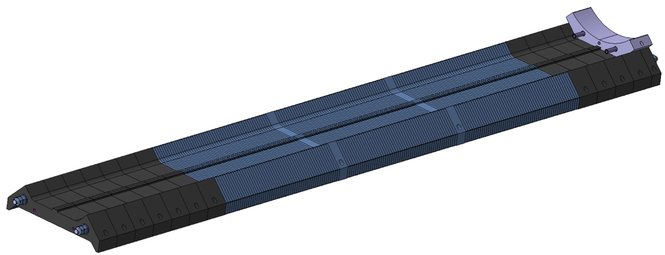
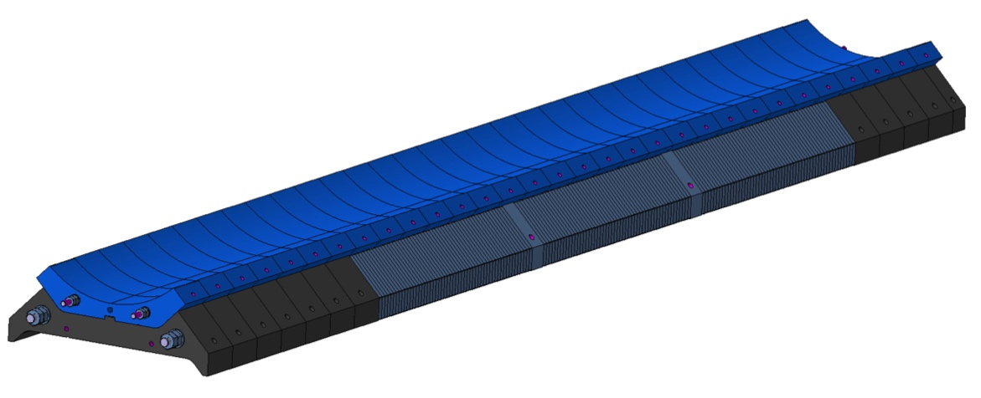
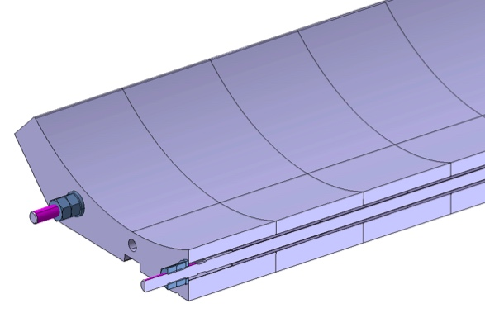
Collars and pads assembly
Pads assembly will be performed on a reference table using bushes to guarantee the alignment between pieces
Longitudinal rods will compress the assembly
The assembled pad will then be used to align and clamp the aluminum collars

Slide 14
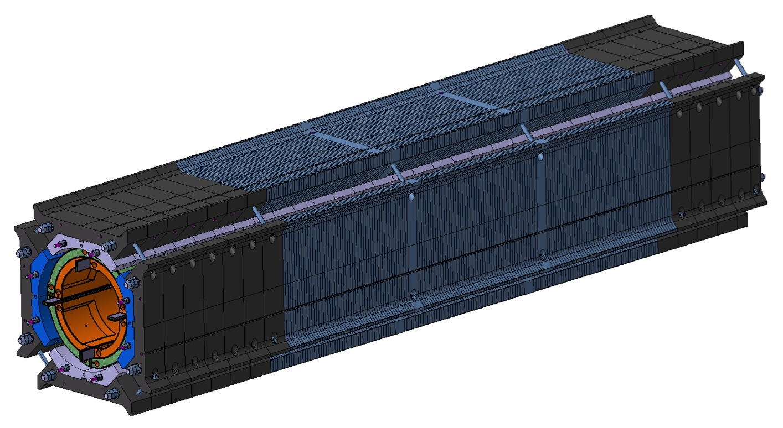
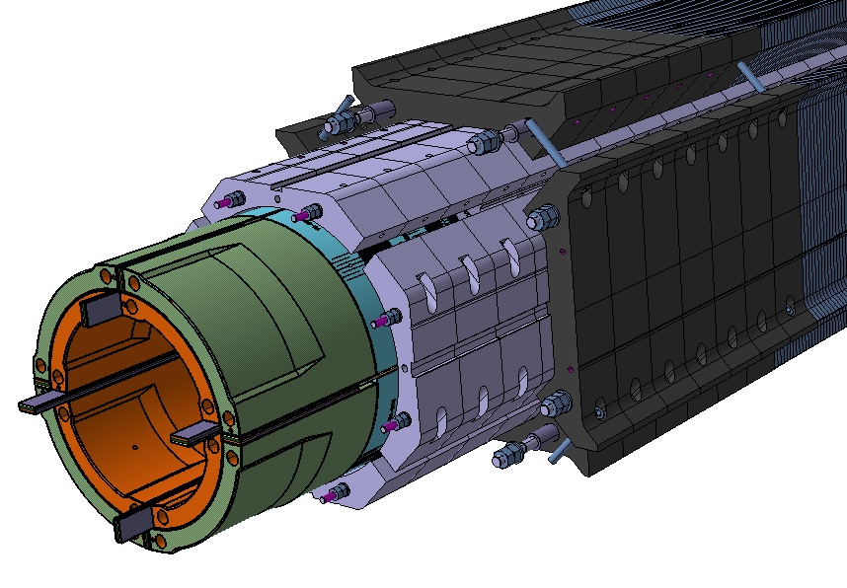
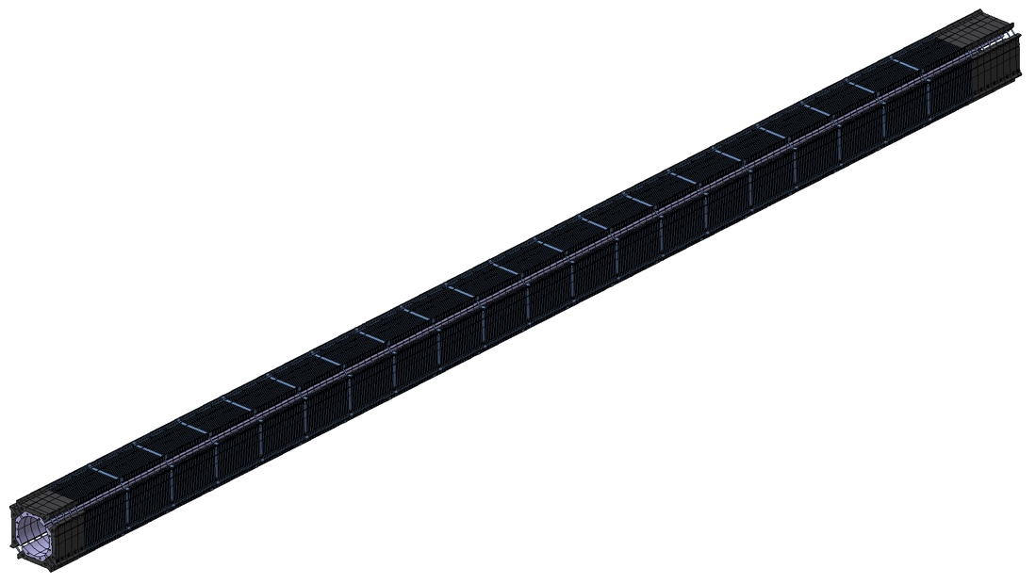
New coil-pack assembly concept
MQXFSD3 coil-pack
MQXFB coil-pack assembly
Aluminum collars will not be bolted. Collar and pad will be treated as a single element during assembly
Only few bolts will link the pads together to allow coil pack insertion into the yoke aperture
Components for MQXFS_D3 will be delivered end of Q3-2015
First cool-down test to 77K scheduled for Q4_2015
Coil pack assembly method applied on MQXFSD3 to be scaled-up for MQXFB

Slide 15
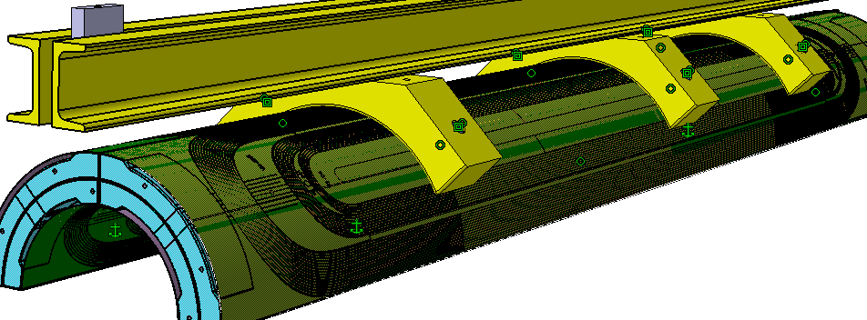
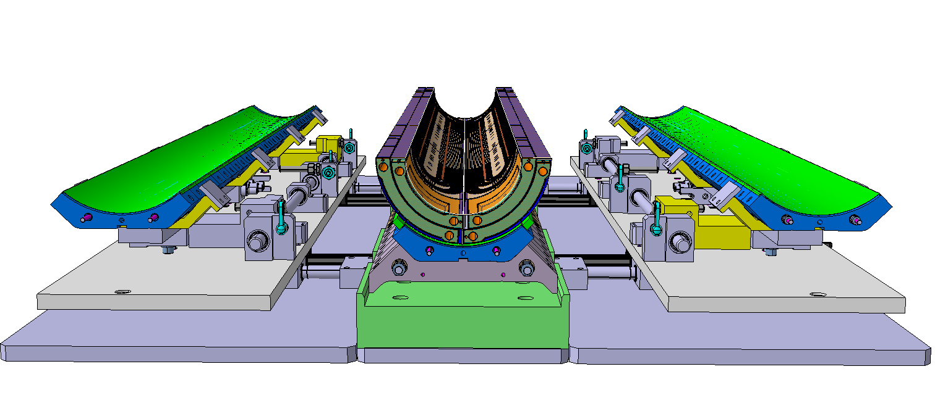
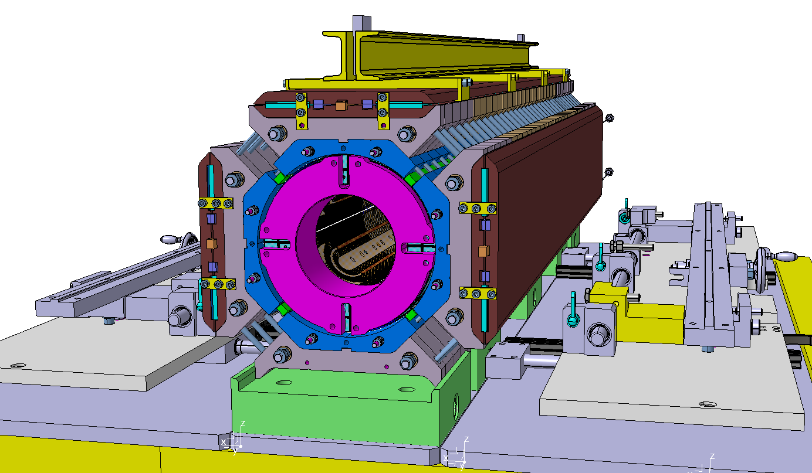
Coil pack assembly and lifting tooling for MQXFB
The assembly concepts and procedures developed during models construction will be adapted for long magnets
Assembly and lifting tools will be scaled-up (Coil lifting beam will be adapted from 11T Dipole project)
Detailed tooling design will be launched 2nd half 2015
Notes:
Mettre photo banc02 sans le coilpack a l’interieur
Manque photo yoke and shell sans gap
Manque photo detail depasse de la plaque d’extremite

Slide 16
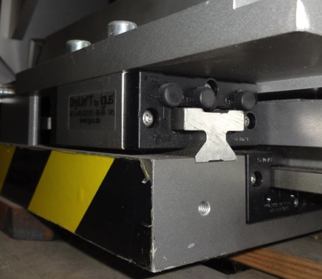
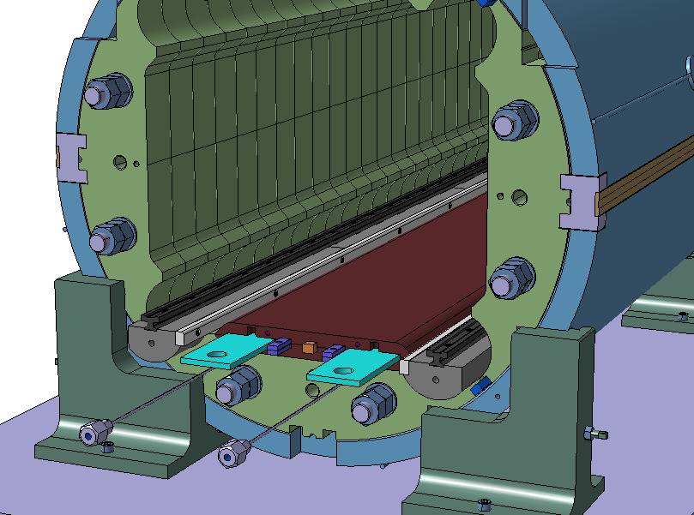
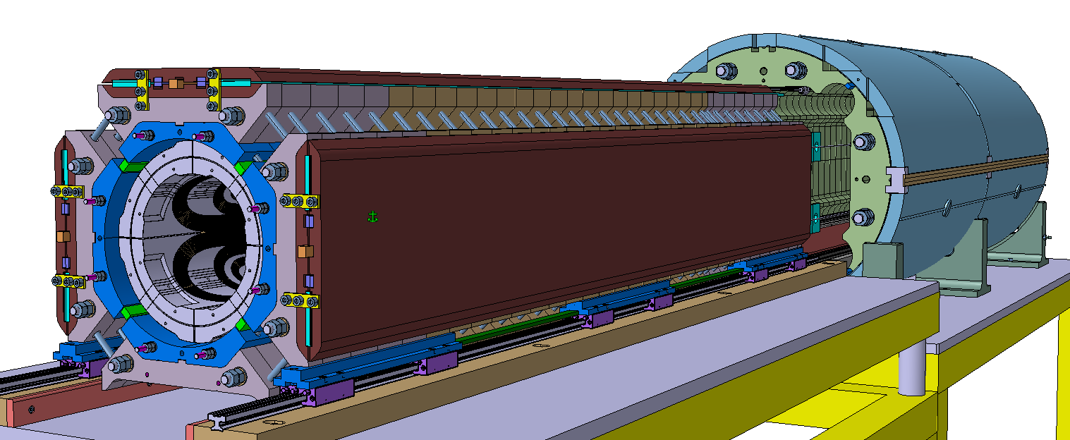
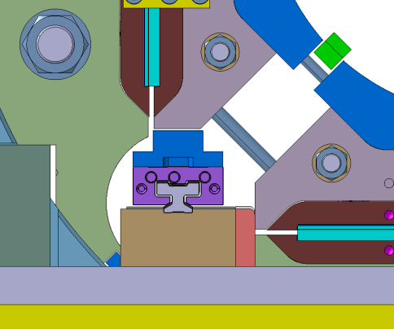
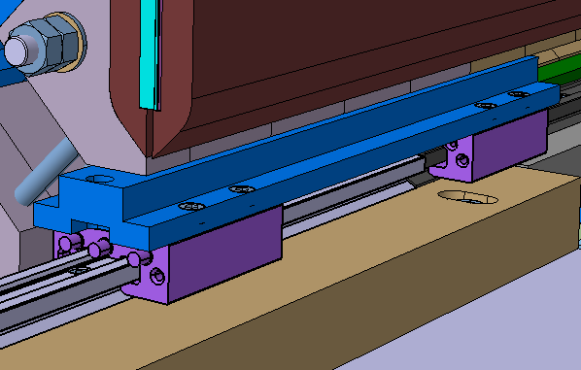
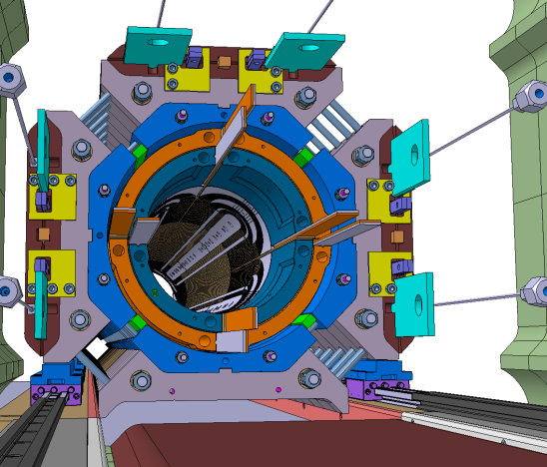
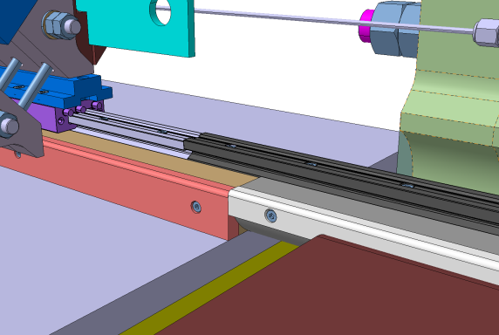
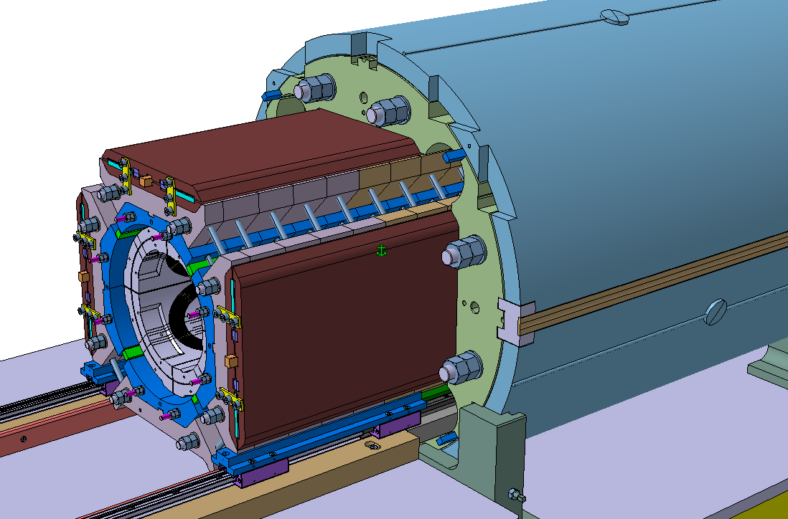
Coil pack insertion tooling concept for MQXFB
Linear guides will be used to slide the coil-pack into the yoke cavity. The heat exchanger holes are used to support and align the linear guides rails
Aluminum profile interface to align the rail into the heat exchanger hole
Linear guides and rails
Detailed tooling design will be launched 2nd half 2015
J.C. Perez
16

Slide 17
OUTLINE
Production of MQXFB prototype structure components
  Cost comparison for component fabrication techniques
  MQXFSD0 Vs MQXFSD3 mechanical structure
  Components fabrication for MQXFS3 and MQXFB
Assembly concepts for long magnets
LMF preparation for long magnets production
Production plans
Summary

Slide 18
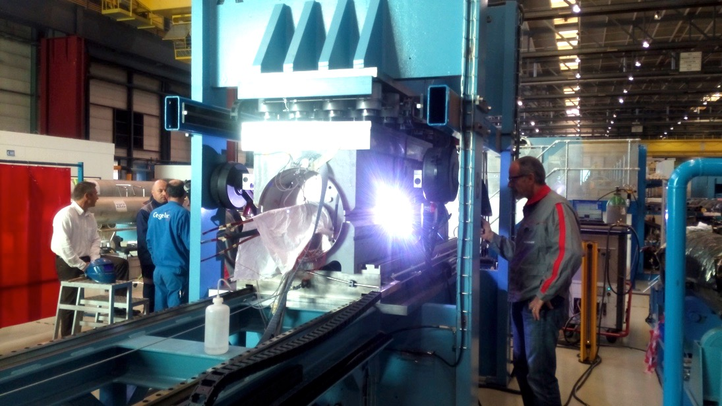
LMF - Welding press
Contract for new TIG based welding system was launched in April 2015.
Equipment will allow to weld on the short prototype and on the large welding press
Hydraulic modifications on large welding press are ongoing (sectoring)
Full compatibility with the LHC welding system is mandatory
Hydraulic sectoring will allow to weld magnets from 4 m to 15 m
The upgrade will be finalized by end of 2015
Price enquiry for first batch of shells to be used on model magnets launched in Mai (delivery end 2015)
Market survey for long shells and welding cradles for MQXFB to be triggered after summer 2015 (around 1 year delivery time expected for the long shells)

Slide 19
OUTLINE
Production of MQXFB prototype structure components
  Cost comparison for component fabrication techniques
  MQXFSD0 Vs MQXFSD3 mechanical structure
  Components fabrication for MQXFD3 and MQXFB
Assembly concepts for long magnets
LMF preparation for long magnets production
Production plans
Summary

Slide 20
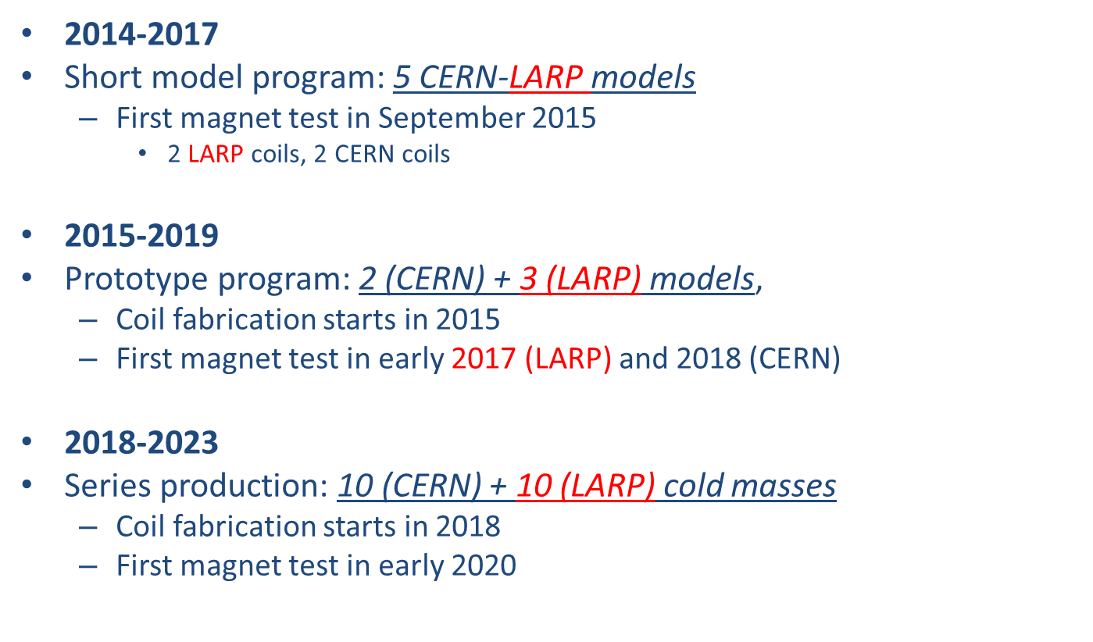
MQXF project schedule and milestones

Slide 21
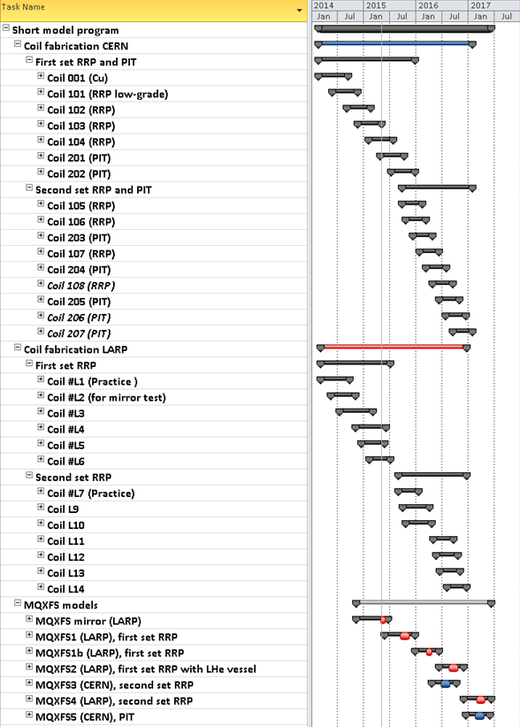
Short model program
Exchangeable coils CERN-LARP and identical structures
23 coils and 5 models (2014-2017)
  MQXFS1-2
    Test of 1st generation RRP coils and stainless steel shell by LARP
    8 coils by CERN+LARP
  MQXFS3-4
    Test of 2nd generation RRP coils by CERN and by LARP (reproducibility)
    10 coils by CERN+LARP
  MQXFS5
    Test of PIT coils at CERN
    5 coils by CERN

Slide 22
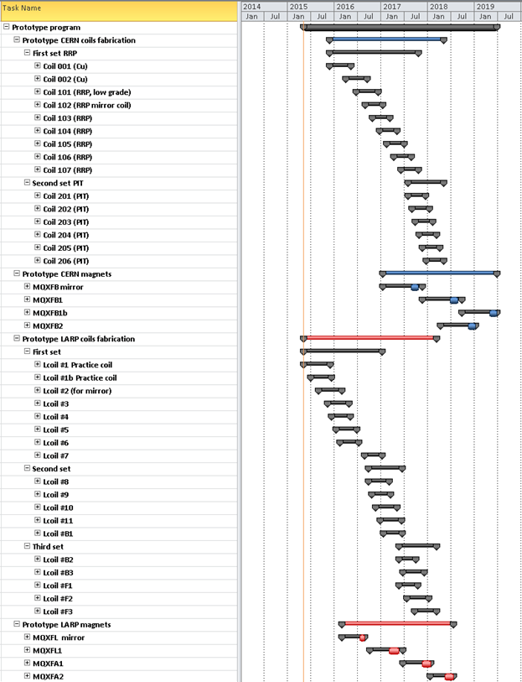

Prototype program

Slide 23
Summary
A new design for MQXFSD3 mechanical structure is ready, accommodating components design modifications in view of series magnets fabrication
MQXFSD2,the second version of first CERN mechanical structure, using 3 shells configuration and thick laminations, will be assembled and tested during summer 2015
The second CERN mechanical structure MQXFSD3, including 3 shells configuration and new components design will be assembled and tested by end 2015
Components fabrication methods have been identified and chosen for long magnets
Changes induced on MQXFS assembly procedure by new components configuration will be tested on MQXFS3 and extrapolated for MQXFB
Design activities on assembly and lifting tooling for MQXFB should start second half of 2015
Welding press modifications started (price enquiry for welding cradles to be triggered second half 2015)
A market survey will certainly be required to order the shells for the series
Preparation work for MQXFB production started in LMF

Slide 24


Thank you for your attention
The HiLumi LHC Design Study is included in the High Luminosity LHC project and is partly funded by the European Commission within the Framework Programme 7 Capacities Specific Programme, Grant Agreement 284404.

