Slide 1


Status of MQXF Conductor
LARP Update
Arup. K. Ghosh
Dan Dietderich, Lance Cooley, Ian Pong
LARP/HiLumi Collaboration Meeting CM-24
FNAL
May 11-13, 2015

Slide 2
Outline
Introduction
RRP® 108/127 Strand
  OST strand production
RRR Control
Recent MQXF strand RRP® 132/169 and 144/169
Strand Procurement Plan
Cable
Insulation
Summary

Slide 3
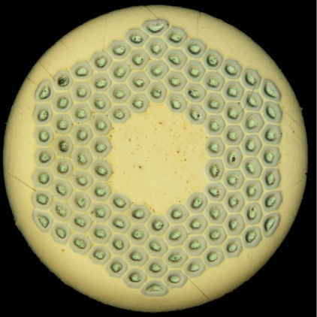

Introduction
The 150 mm aperture MQXF magnet program in LARP is presently using the RRP 108/127 Ti-Ternary strand.
Strand specification
Strand Diameter, mm 0.85
J_{c}(12 T) at 4.2 K, A/mm² > 2650
  I_{c}, A > 684
J_{c}(15 T) at 4.2 K, A/mm² > 1400
  I_{c}, A > 361
d_{s}, µm (nominal) < 60
Cu-fraction, % > 53
  Cu/non-Cu > 1.13
RRR > 150
Piece length > 750 m

Slide 4
Ti-Ternary RRP® 108/127 Wire
Oxford Superconducting Technology delivered 400 kg of wire ~ 13 billets (2012-2013)
Vendor Data provided at 0.778 mm
Wire initially held at 1.04 mm
Final wire delivered at 0.85 mm
Two types of billets
  Standard Sn content : Nb/Sn=3.4, 6 billets
  5% lower Sn content : Nb/Sn=3.6, 7 billets
Wire Reaction schedule
210 ºC/48h + 400 ºC/48h + 650 ºC/50h

Slide 5
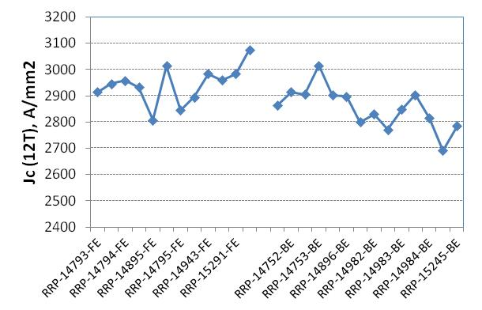
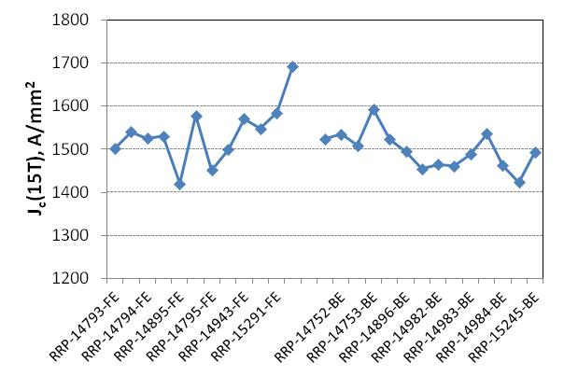
J_{c} of 108/127 wire – 13 billets
Standard-Sn
Reduced-Sn
Standard-Sn
Reduced-Sn
J_{c} of “reduced-Sn” billets are somewhat lower than the standard-Sn billets

Slide 6
RRR of 108/127 wire
Reduced-Sn
Standard-Sn
    Reduced-Sn billets show marked increase in RRR

Slide 7
OST Data for 0. 778 mm wire
Jc (4.2 K, 15T) vs. RRR
5 % Reduced-Sn
At. Nb/Sn = 3.6
Standard-Sn
At. Nb/Sn = 3.4
210 ºC/48h + 400 ºC/48h + 650 ºC/50h

Slide 8
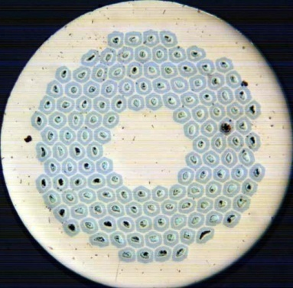
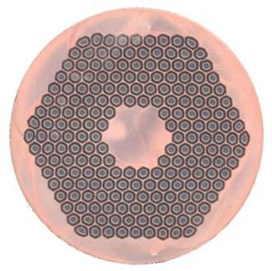
Ti-Ternary RRP® Wire
More recently, Oxford Superconducting Technology has also delivered
55 Km (380 Kg) of 0.85 mm wire ⇨ 9 billets
  Design 132/169
  “5% Reduced-Sn” : Nb/Sn=3.6
  Exception taken to Ic(15 T) specification ➢ Ic (15 T) > 350 A
38 Km (185 Kg) of 0.85 mm wire ⇨ 6 billets
  20 Km (LARP), 18 Km (CDP: Conductor Development Program)
  Design 144/169
  “2.5% Reduced-Sn”: Nb/Sn=3.5
  Exception taken to Cu/Non-Cu ratio
    set to 1.05 ± 0.10
  All wire qualified using the wire reaction schedule
210 ºC/48h + 400 ºC/48h + 650 ºC/50h

Slide 9
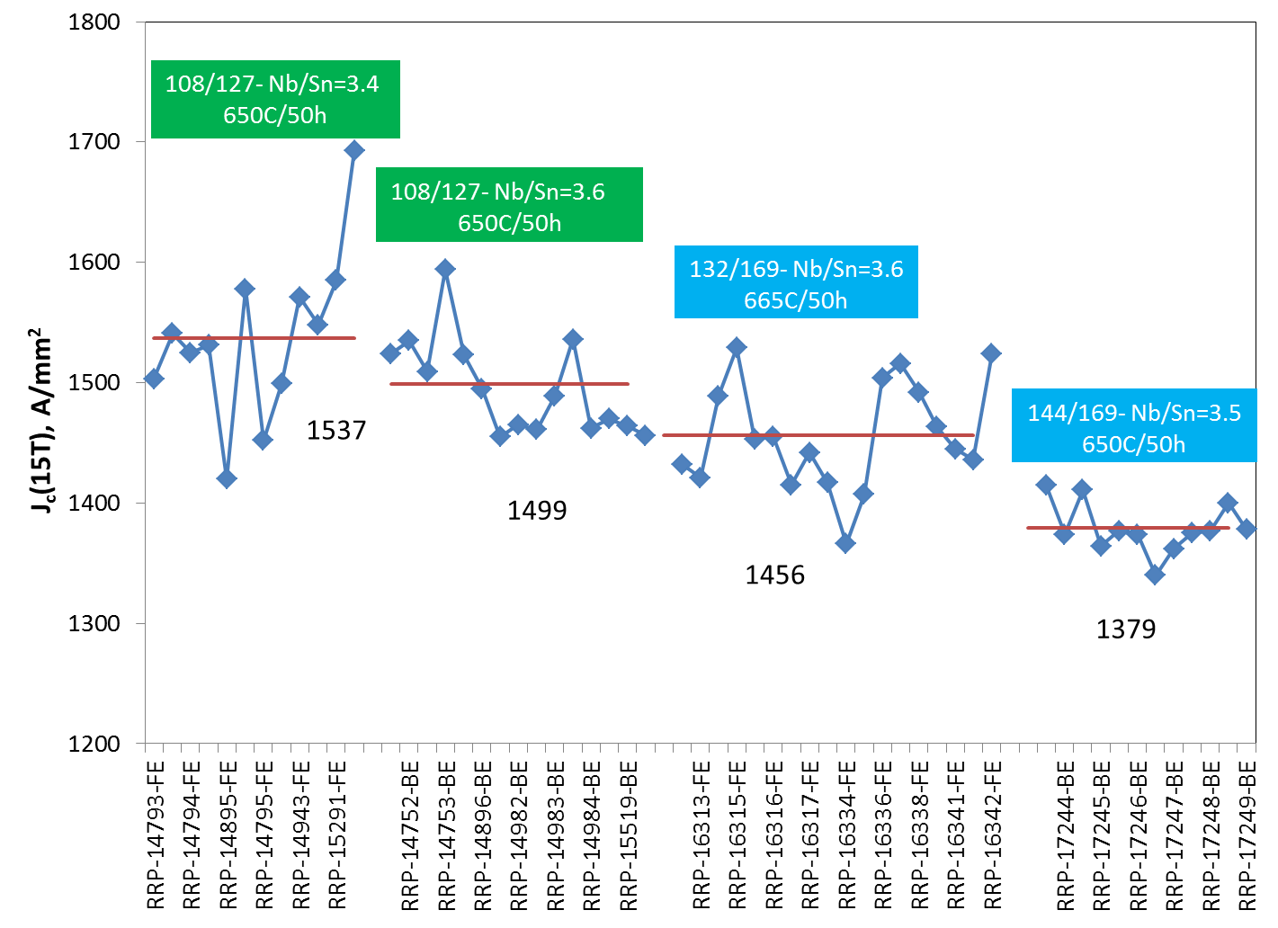
Jc (15 T) – A comparison
144/169- Nb/Sn=3.5
650C/50h

Slide 10
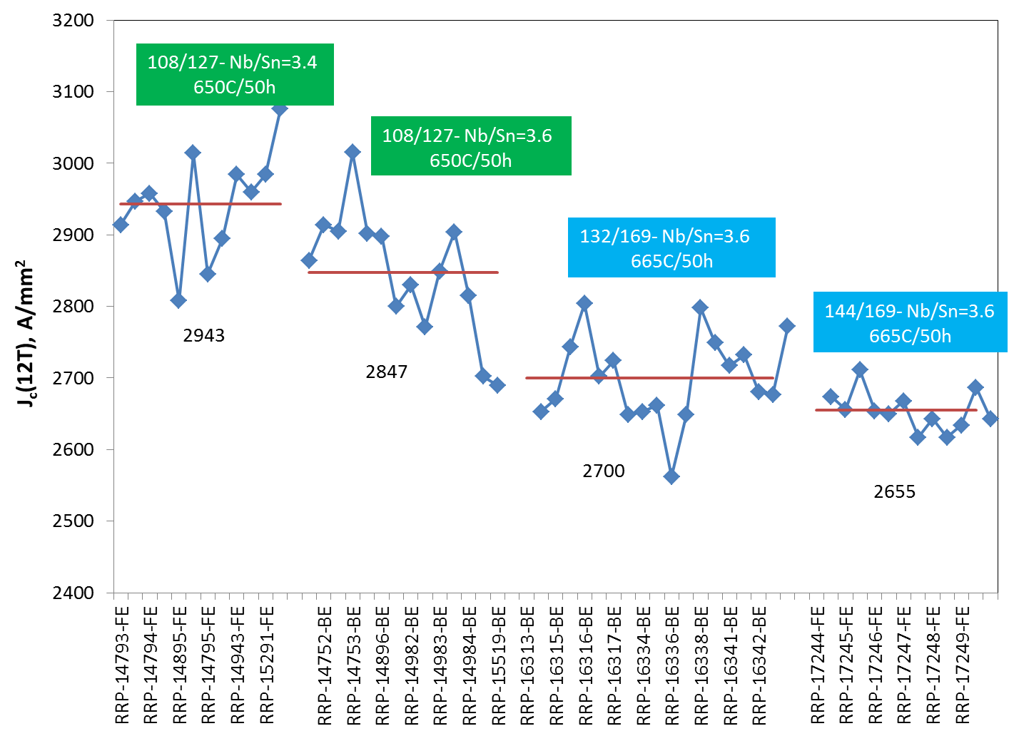
Jc (12 T) – A comparison
144/169- Nb/Sn=3.5
650C/50h

Slide 11
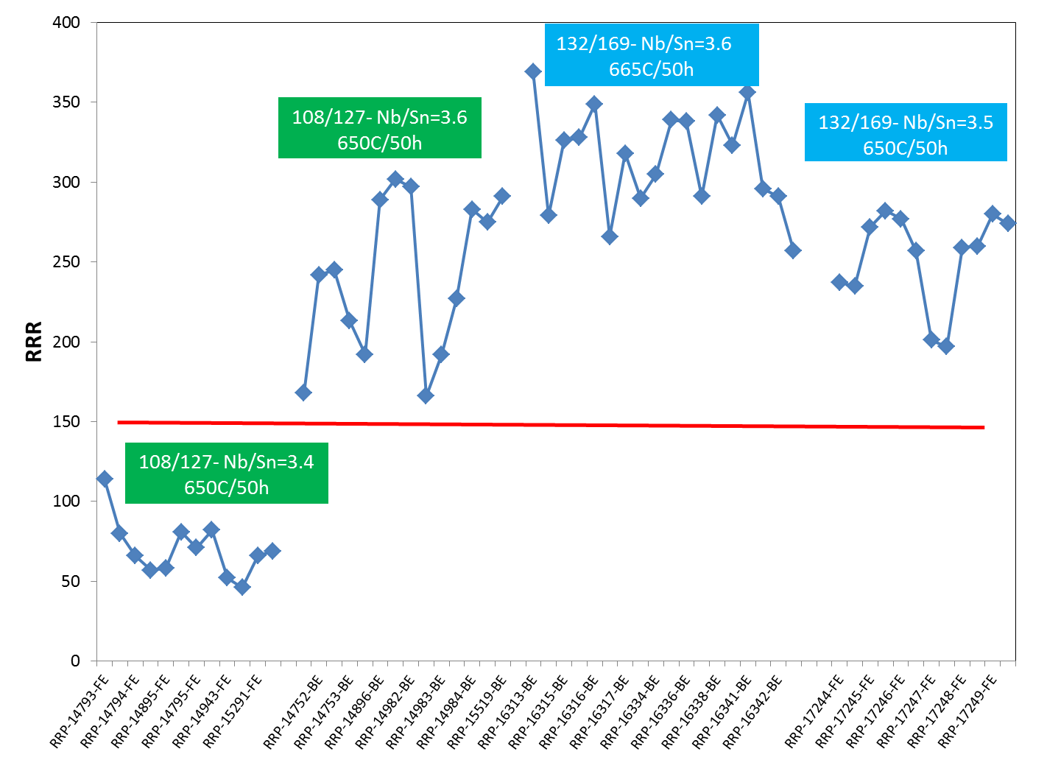
RRR– A comparison
144/169- Nb/Sn=3.5
650C/50h

Slide 12
Statistics for 108/127, 132/169 and 144/169
7 Billets | Ic(12T) | Ic(15T) | Jc(12T) | Jc(15T) | Non_Cu% | RRR | Cu/Non_Cu | Cu%
AVG | 743 | 390 | 2853 | 1497 | 0.459 | 224 | 1.179 | 0.541
σ | 20 | 10 | 80 | 44 | 0.006 | 54 | 0.027 | 0.006
MIN | 707 | 374 | 2691 | 1423 | 0.447 | 143 | 1.141 | 0.533
MAX | 775 | 409 | 3015 | 1594 | 0.467 | 302 | 1.237 | 0.553
AVG-3σ | 682 | 358 | 2615 | 1366 | 0.442 | 62 | 1.098 | 0.524
9 Billets | Ic(12T) | Ic(15T) | Jc(12T) | Jc(15T) | Non_Cu% | RRR | Cu/Non_Cu | Cu%
AVG | 691 | 372 | 2692 | 1452 | 0.452 | 312 | 1.214 | 0.548
σ | 19 | 13 | 65 | 49 | 0.007 | 29 | 0.033 | 0.007
MIN | 664 | 354 | 2562 | 1366 | 0.444 | 257 | 1.151 | 0.535
MAX | 730 | 388 | 2798 | 1524 | 0.465 | 356 | 1.252 | 0.556
AVG-3σ | 634 | 334 | 2497 | 1306 | 0.431 | 226 | 1.114 | 0.528
7 Billets | Ic(12T) | Ic(15T) | Jc(12T) | Jc(15T) | Non_Cu% | RRR | Cu/Non_Cu | Cu%
AVG | 724 | 376 | 2655 | 1379 | 0.481 | 253 | 1.078 | 0.519
σ | 10 | 7 | 28 | 21 | 0.004 | 29 | 0.017 | 0.004
MIN | 711 | 364 | 2617 | 1340 | 0.475 | 197 | 1.045 | 0.511
MAX | 738 | 390 | 2711 | 1415 | 0.489 | 282 | 1.105 | 0.525
AVG-3σ | 693 | 354 | 2572 | 1316 | 0.470 | 165 | 1.029 | 0.507

Slide 13
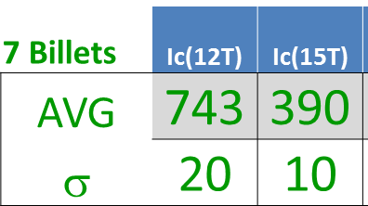
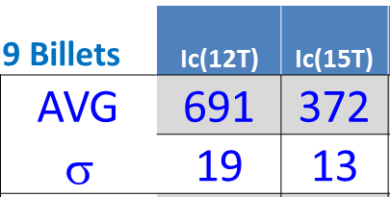
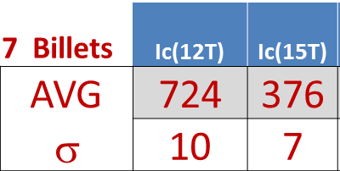
I_{c} Statistics for 108/127, 132/169 and 144/169
Production should be within ± 3 σ
108/127 Min Ic (15 T) = 358 A
132/169 Min Ic (15 T) = 334 A
144/169 Min Ic (15 T) = 354 A

Slide 14
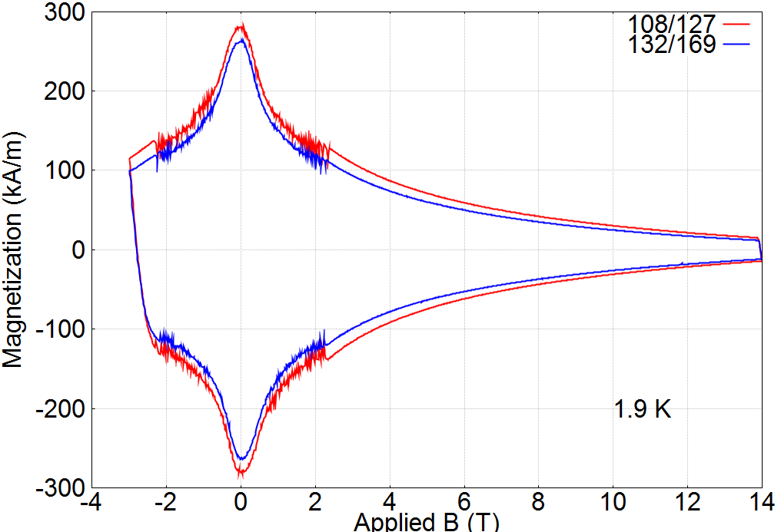
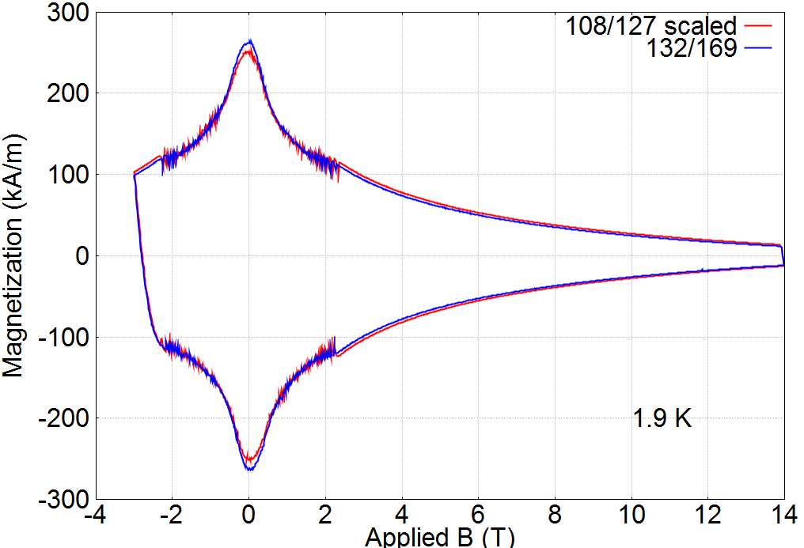
Magnetization of 0.85 mm,108/127 and 132/169 at 1.9 K
Strands have same Jc and Cu/Sc ratio
108/127 Scaled by 89%
X. Wang
Measurements performed at OSU
By M. Sumption and X. Xu
Magnetization scales with filament diameter

Slide 15
RRP strand for MQXF coils
Present inventory of wire at LARP is the following:
  38 Km of 144/169
  43 Km of 132/169
  11 Km of 108/127
This wire will be used to fabricate cables for 3 short coils and 3 long coils.
Unit length of a short coil is 170 m and that for the long coil is 450 m.

Slide 16
Strand Specification for the HiLumi Project
Very recently within a Conductor Working Group with members from CERN and LARP we agreed on a set of requirements for the strand and cable
Within LARP the strand Specification is being released under the following document:
  “U.S. HiLumi Project
  SPECIFICATION FOR QUADRUPOLE MAGNET CONDUCTOR
  US-HiLumi-doc.40
  Rev. No. Original Release
  Date: 05-May-2015”

Slide 17
Specification for MQXF Strand
Parameter or characteristic | Value | Unit
Superconductor composition | Ti-alloyed Nb₃Sn
Strand Diameter | 0.850 ± 0.003 | mm
Critical current at 4.2 K and 12 T | > 632 | A
Critical current at 4.2 K and 15 T | > 331 | A
n-value at 15 T | > 30
Count of sub-elements (Equivalent sub-element diameter) | ≥ 108 (≤ 55) | (µm)
Cu : Non-Cu volume Ratio Variation around mean | ≥ 1.2 ± 0.1
Residual Resistance Ratio RRR for reacted final-size strand | ≥ 150
Magnetization* at 3 T, 4.2 K | < 256 (< 320) | kA m⁻¹ (mT)
Twist Pitch | 19.0 ± 3.0 | mm
Twist Direction | Right-hand screw
Strand Spring Back | < 720 | arc degrees
Minimum piece length | 550 | m
High temperature HT duration | ≥ 40 | Hours
Total heat treatment duration from start of ramp to power off and furnace cool | ≤ 240 | Hours
Heat treatment heating ramp rate | ≤ 50 | °C per hour
Rolled strand (0.765 mm thk.) critical current at 4.2 K and 12 T | > 600 | A
Rolled strand critical current at 4.2 K and 15 T | > 314 | A
Rolled strand RRR after reaction | > 100
0.85 mm Ti-Ternary
I_{c} (12 T)>632 A, J_{c}(12 T)> 2450 A/mm²
I_{c} (15 T)>331 A, J_{c}(15 T)> 1250 A/mm²
108/127
Cu % > 53 %
RRR >150
Nb/Sn > 3.5

Slide 18
Procurement Plan for MQXF magnets
MQXFS and MQXFL
MQXF Production for Q1/Q3
Require ~ 300 Km of wire to complete the short model program (4 additional coils) and fabricate 12 long coils for the long prototype program.
Place an order for 70 km in FY’15 and 130 Km in FY’16
100 Km will be made available from CERN in CY16 to help the MQXFL magnet schedule of the LARP program.
Require 90 coils with each coil using ~ 20 Km of wire.
Total procurement is for ~ 1,800 Km (9 tonnes)
The procurement plan is incorporated in US-HiLumi doc-37 V.5
“Advanced Acquisition Plan for Quadrupole Magnet conductor”
- by Lance Cooley

Slide 19
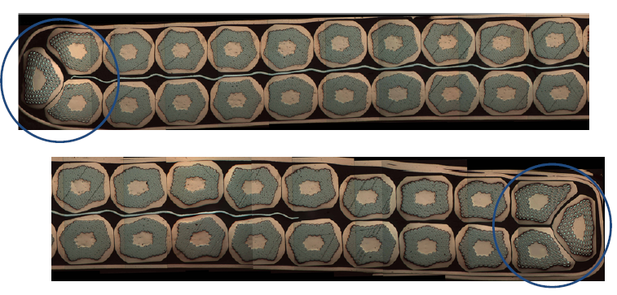
18 mm wide 40 strand QXF cable
- An example of a developmental cable
SS Core to reduce Eddy Current losses
Thick
edge
Thin
Edge
Width = 17.95 mm
Thickness = 1.50 mm
Keystone Angle = 0.62 Deg.

Slide 20
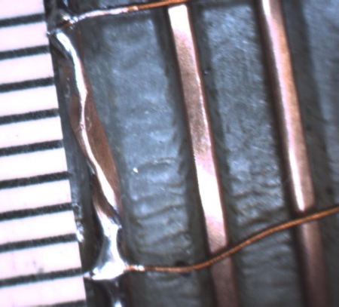
Example of sub-element shearing and barrier rupture
These damage lead to mostly RRR degradation of the copper stabilizer at the edges of the cable. Low RRR can lead to conductor instability due to “magnetization” and “self-field” effects. Target is to maintain RRR > 100 at the “kinks” – cable edges.
V-tap configuration to measure RRR at edges
20

Slide 21
Cabling Trade-offs
Minimize the amount of strand damage
  Less compaction
  Can lead to mechanically unstable cable for coil winding
Increase mechanical stability of cable
  More compaction and deformation of strands
  More strand damage - Reduced critical current and RRR (Sub-element shear leading to barrier thinning and barrier breakage causing Sn leak into copper and reducing RRR)
  To reduce cabling damage, the keystone angle has been reduced from 0.55 to 0.4 degrees

Slide 22
Specification for MQXF Cable
2nd Generation
Number of strands 40
Mid-thickness 1.525 mm +/- 0.010 mm
Width 18.15 mm +/- 0.050 mm
K.S. angle 0.40 deg. +/- 0.10 deg.
Pitch Length 109 mm +/- 3 mm
Core Material Annealed 316L SS
Core Width 12 mm (biased to major edge)
Core thickness 0.025 mm
  The only change made from the 1st generation cable design is to reduce the Keystone angle from 0.55 to 0.40 deg.

Slide 23
1st and 2nd Gen cable using the same Cable Map
Cable | 1056-A | 1056-7
 | 1st Gen. | 2nd Gen.
Avg. THICKNESS mm | 1.524 | 1.522
Avg. WIDTH mm | 18.14 | 18.19
Avg. ANGLE deg. | 0.58 | 0.38
Extracted Strand Tests from a trial run of 2nd Gen
Cable Description | Ic (12 T) Degradation | Ic (15 T) Degradation | RRR Extr.
1st Gen. Cable | 2.6% | 3.4% | 250
2nd Gen Cable | 2.2% | 2.7% | 234

Slide 24
RRR at the edges of the cable V_{tap} ~ 10 mm
Comparison of 0.38 and 0.58 Deg. Keystone
Wires are from two billets 15950 and 15953 with round wire RRR of 307 (15950) and 205 (15953)

Slide 25
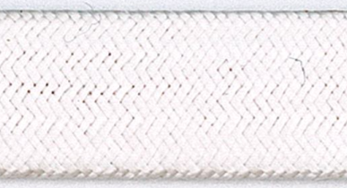
Cable Insulation
Insulation is braided directly on cable
  New England Wire Technology (NEWT)
Using S-2® glass (from AGY) with 933 Silane sizing
  2 ply yarn
Several lengths of QXF cable has been insulated
  Using braiding parameters to yield target specification of 0.145 ± 0.005 mm thickness
  10-stack measurements at 5 MPa are used to determine insulation thickness
  Thickness can be readily adjusted to meet any change to present specification.

Slide 26
Cable Insulation
 | Measurement at 5 Mpa
 | mm
 | Ist Cycle | 2nd Cycle | 3rd Cycle
Average | 0.146 | 0.144 | 0.143
s | 0.003 | 0.003 | 0.002
MIN | 0.142 | 0.140 | 0.138
MAX | 0.154 | 0.149 | 0.147

Slide 27
Summary
The “reduced-Sn” design change increases RRR control with minimal loss of J_{c}.
  Implemented for all billets in process and future procurements.
RRP® 108/127 is going to used for all future procurements
  There is sufficient manufacturing margin in I_{c} in the specification. RRR margin is ensured by proper control of Nb/Sn content of the sub-element. However, production uniformity has to be emphasized in the control of “raw” materials, and in ensuring proper QA/QC procedures in wire fabrication and in the testing at the vendor.
Strand procurement has been planned to meet cable manufacture and coil winding schedule.
We have a 2nd iteration of the cable parameters which reduces the keystone angle and thereby the possibility of sub-element shear in the wire at the cable edges
Specification and Production QA plan is being finalized this fiscal year for strand, cable and insulation

Slide 28
End of Presentation

