Slide 1



FermiLab – 12th May 2015
Status of the MQXF Conductor
at CERN
B. Bordini, A. Ballarino, L. Oberli, D. Richter
Joint HiLumi-LARP Meeting

Slide 2
Outline
Wire specifications
Magnet Margin
Cable Specification and performance
Wire procurement
Conclusions

Slide 3
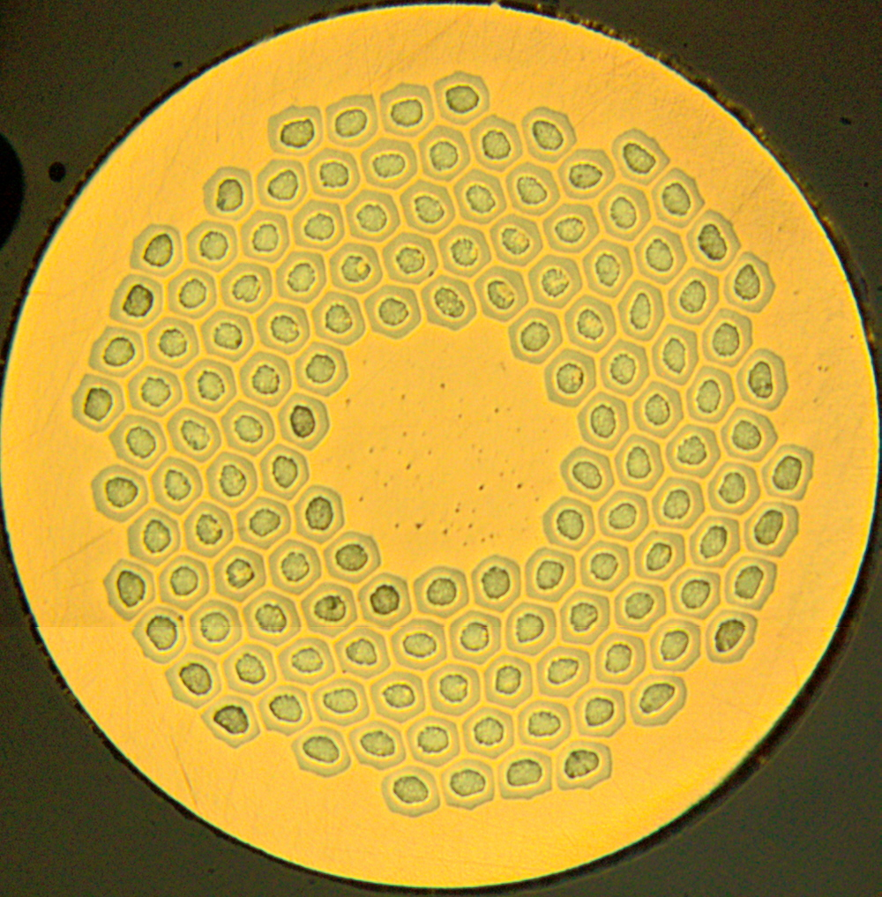
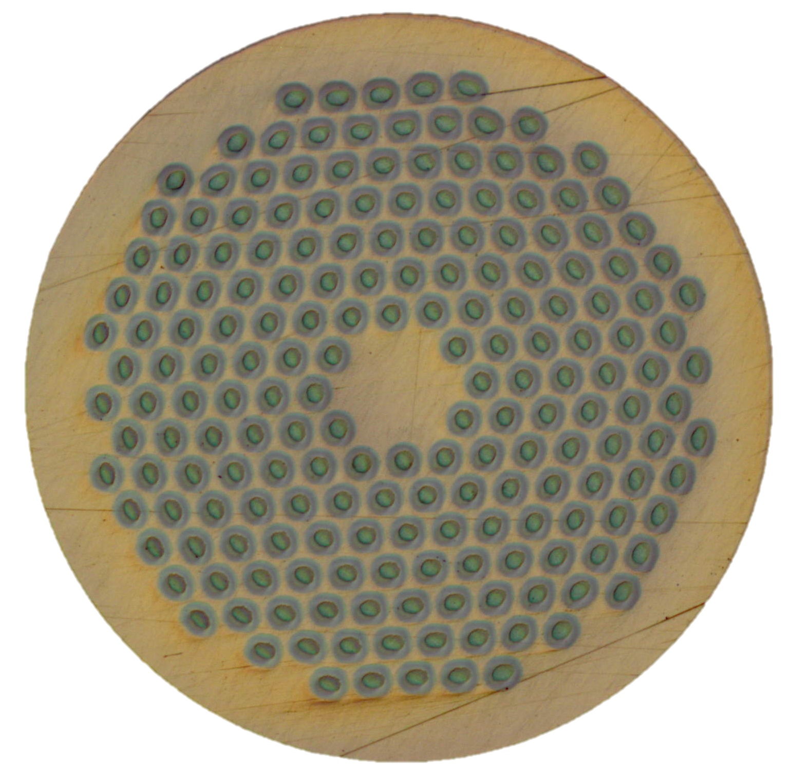
MQXF Wire Specifications
November-December 2014
Main wire specifications presented at the international reviews held at CERN in November (Conductor Review) and in December (Magnet Review) 2014
RRP 132/169
PIT 192

Slide 4
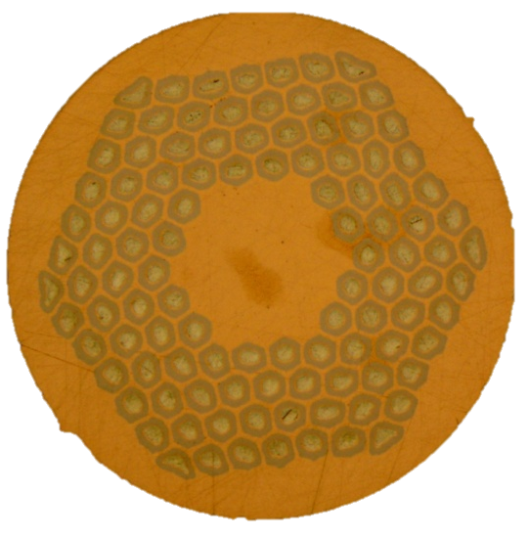
MQXF Wire Specifications
Present
Bruker EAS
OST
132/169
108/127
192
^{Work in Progress}

Slide 5
MQXF Wire Specifications
Reasons of the Evolution
Following the suggestions of Reviewers, it was decided to increase the margin of the magnet by decreasing its field gradient (and increasing the magnet length to maintain the same focusing strength)
  The reduced peak field allowed to release the wire performance still having a sufficient margin for the magnet
Releasing the I_{c} specification at 15 T (about 8%) and the sub-elements dimensions (about 10 %) had a significant impact on the reduction of the conductor price
It was estimated that the greater sub-element dimensions will not increase significantly the risk of a magnet failure

Slide 6
Margin of the ‘long’ Magnet
RRP wire fulfilling the November specs
I_{c}(15 T, 4.22 K)= 361 A
B_{c2}(4.22 K)= 24.4 T
Margin on the load-line → 24 %
Temperature Margin → 5.2 K
Enthalpy Margin → 14 mJ/cm³

Slide 7
Margin of the ‘long’ Magnet
RRP wire – margin vs I_{c}
I_{c}(4.22 K, 15 T) = 361 A
I_{c}(4.22 K, 15 T) = 331 A
Reducing the I_{c}(4.22 K, 15 T) by 8.3% reduces the Enthalpy margin by 13 %

Slide 8
Comparison between ‘short’ and ‘long’ magnet
Reference Critical Current I_{c}(4.22 K, 15 T) = 361 A
Short magnet
Long magnet
The enthalpy margin of the long magnet based on conductor with a current reduced by 8.3 % - strand I_{c}(4.22 K, 15 T) = 331 A instead of 361 A - is 22 % larger than the margin of the short magnet based on a RRP conductor with I_{c}(4.22 K, 15 T) = 361 A

Slide 9
Margin of the ‘long’ Magnet
Present Specification
Assuming B_{c2}(4.22K)=24.4T + I_{c}(15T, 4.22K)=331A → I_{c}(12T, 4.22K)=632A
Margin on the load-line → 22.6 %
Temperature Margin → 4.9 K
Enthalpy Margin → 12.4 mJ/cm³

Slide 10
Status of PIT Conductor
Today the PIT wire has a critical current about 1-9 % lower than specs with a RRR around 150
Bruker-EAS is collaborating with CERN to further improve the PIT conductor
A modification, which should bring the wire to specs with a limited impact to the wire layout and production, has been identified and Bruker-EAS has already started to implement it
By the end of June, CERN is expected to receive the first results

Slide 11
MQXF Cable Parameters
Width | mm | 18.15 | 18.15
Keystone | deg | 0.55 | 0.4
Thin Edge | mm | 1.438 | 1.462
Thick Edge | mm | 1.612 | 1.588
Mid Thickness | mm | 1.525 | 1.525
ε_Thin Edge | % | 15.4 | 14
Packing factor | % | 86 | 86.5
Cable 1st iteration
Cable 2nd iteration
PIT I_{c} degradation from 7 % to less than 2 %, local RRR from 30 to 100; also RRP conductor benefits from it
In February it was decided that the second iteration cable will be the baseline for HiLumi

Slide 12
2nd Iteration Cable
I_{c} Degradation of the 132/169
Last December last, LBNL sent to CERN and to BNL, several strands extracted from the first 2nd iteration cable that they had manufactured
These extracted samples were shipped together with round wire samples that were adjacent to the extracted ones
Five couples of extracted and round wires were mounted on VAMAS barrels, heat treated and measured at CERN
The average I_{c} degradation at 4.3 K and 12 T was very limited 2.1 % (range: 1.2 % - 4.3 %)
An analogues exercise was done with four extracted samples take from a cable produced at CERN: average I_{c} degradation 2.3 % (range: 1.2 % - 3.4 %)

Slide 13
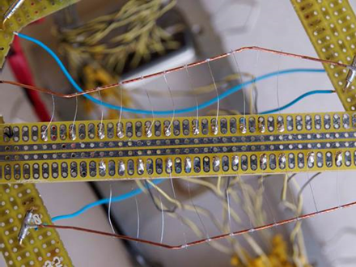
2nd Iteration Cable
Local RRR of the 132/169 - 1/3
thin edge
thick edge
RRR virgin wire ≈ 220
Max value local RRR compatible with virgin wire
Min value local RRR ≈ 100

Slide 14
2nd Iteration Cable
Local RRR of the 132/169 - 2/3
Four extracted strand samples from the LARP 2nd iteration cable were reacted and tested at CERN together with four extracted strand samples from the LARP 1st iteration cable – the two cables were done with the same wire billets
Even the RRP conductor benefits from the 2nd iteration cable

Slide 15
2nd Iteration Cable
Local RRR of the 132/169 - 3/3
Six extracted strand samples from the CERN 2nd iteration cable where also reacted and tested at CERN
Even if the CERN cable was based on round wires with lower RRR and the keystone angle was larger, the average minimum local RRR was still above 100

Slide 16
Procurement
Procured
RRP 132/169
  5 Km for cabling trials
  7 km (low grade) + 35 km + 20 km for short model coils
    Four (one low grade) 150 m-long first-iteration cables were delivered
    About 24 km in stock for three 150 m-long second-iteration cables
PIT 192
  5 Km for cabling trials
  7 km + 35 km for short model coils
    Two 110 m-long RMC cables (rectangular) were delivered
    Two 150 m-long first-iteration cables were delivered
  20 km for short model coil expected by the end of the month
    To be used with the remaining in stock for three 150 m-long second-iteration cables

Slide 17
Procurement
Next Orders
RRP 108/127
  250 km (840 m and 190 m unit lengths)+ 110 km (550 m unit length) mainly for prototype coils
  Contract planned to be signed by end of next June
  First deliveries by march 2016
PIT
  The order for the prototypes (about 200 km) is planned to be signed by the end of the year

Slide 18
Conclusions
The wire specification is finalized and agreed between CERN and LARP → RRP 108/127
The wire order for the RRP prototype magnets is planned to be signed by the end of next month and the first delivery is expected by march 2016
Bruker-EAS is working on a promising wire design that should bring the wire to specs with a limited impact to the wire layout – first results by end of next month
The second generation cable has a low I_{c} degradation both for the PIT and the RRP conductor furthermore the minimum local RRR is sufficiently large (around 100)

Slide 19
Conclusions
The wire specification is finalized and agreed between CERN and LARP → RRP 108/127
The wire order for the RRP prototype magnets is planned to be signed by the end of next month and the first delivery is expected by march 2016
Bruker-EAS is working on a promising wire design that should bring the wire to specs with a limited impact to the wire layout – first results by end of next month
The second generation cable has a low I_{c} degradation both for the PIT and the RRP conductor furthermore the minimum local RRR is sufficiently large (around 100)

