Slide 1
Structure Session Outline
From HQ to MQXFD1 Hélène Felice
Lessons learned at LBNL Dan Cheng
Experience from MQXFD0 Mariusz Juchno
Preliminary Target for MQXFS1 assembly Hélène Felice

Slide 2
From HQ to MQXFD
H. Felice – D. Cheng – M. Juchno – P. Ferracin

Slide 3
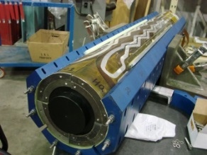
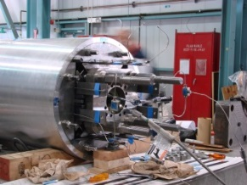
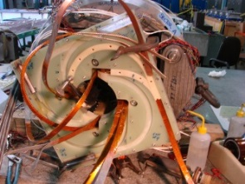
Outline
HQ01 to HQ03
Preload history
MQXFD1 assembly and cool-down
Structure validation
Recommendation toward MQXFS1
2010
2011
2012
2013
2014
2015
HQ01a-b-c
HQ01d-e
HQ02a-b
HQ03

Slide 4
Preload Challenges
Objective 1
Preload the magnet to avoid coil/pole detachment at operating condition
While remaining conservative
Safe azimuthal stress range defined by TQS03 study
Objective 2
Maximize alignment
Pole key to collar gap
Al alloy bolted collars
Yoke master
Pad master to yoke master
Pad
master

Slide 5
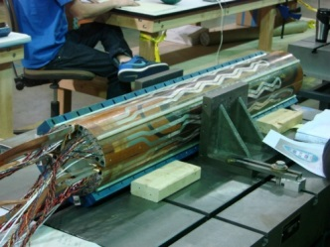
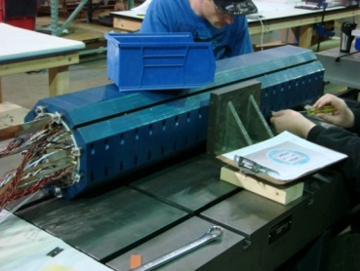
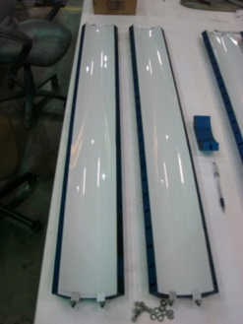
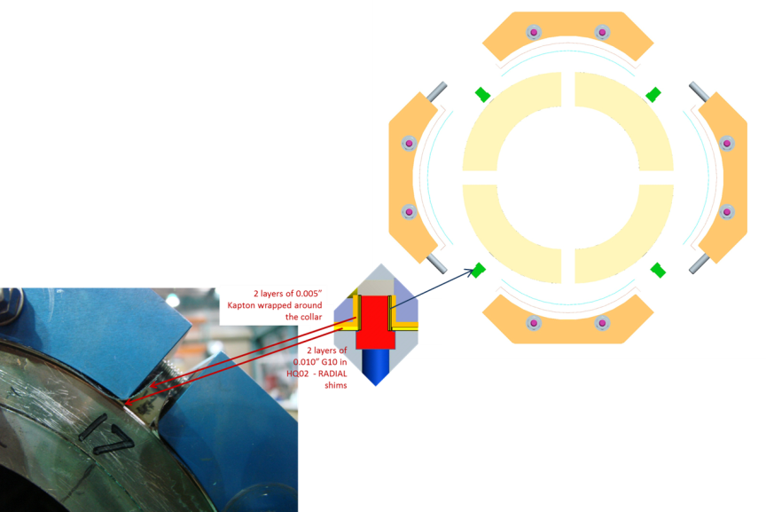
Typical Assembly steps
Ground plane insulation layout
Coil CMM measurements
Actual coil OD
Nominal Radial shims
Actual radial shims
Assembly with Fuji paper
No shimming of the pole key
Nominal pole key shims
Actual pole key shims
Measurement of pole gap dimensions along the length using measurement pins
Fuji paper inspection
Kapton
OK
G10

Slide 6
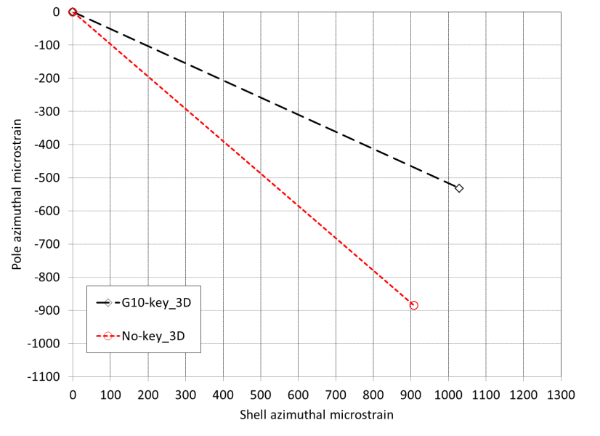
Typical Assembly steps
Ground plane insulation layout
Coil CMM measurements
Actual coil OD
Nominal Radial shims
Actual radial shims
Assembly with actual G10 and Kapton radial shims
Nominal pole key shims
Actual pole key shims
Pole shims
2 possible regimes:
Pole key to collar contact or no contact
Measurement of pole gap dimensions along the length using measurement pins and feeler gages
Assembly

Slide 7
HQ Preload overview
 | HQ01a/b | HQ01c | HQ01d | HQ01e | HQ02a-a2
Target preload to |  | 219 T/m | 200 T/m |  | 200 T/m
εθ shell target (300/4.2K) |  | 1028/2086 με | 863/1905 με |  | 863/1905 με
εθ pole target (300/4.2K) |  | -536/-828 με | -450/-720 με |  | -450/-720 με
Coil generation |  | 1 overcompacted | 1 overcompacted |  | 2
Comment |  | Mid-plane quenches | Pole unloading in one coil
Likely related to coil fab
Lack of magnet performance
prevents from checking other coil preload
Axial preload:
σz rod = 60 / 160 MPa
εz rod = 880 με / 2000 με
Axial preload was never an issue in HQ
HQ01 disregarded
HQ02: reference magnet

Slide 8
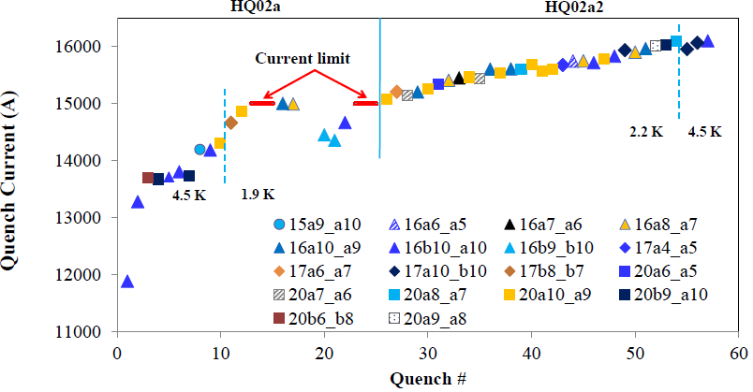
HQ02a Behavior
Test performed at FNAL, Guram Chlachidze
Training slows down at 15 kA = 170 T/m
A possible explanation:
Lack of preload starts at 15 kA => more interception than predicted by model
Coil SG behavior unreliable during test (See Dan Cheng’s talk)
Preload increase for HQ02b was based on shell SG measurement and training performance

Slide 9
HQ Preload overview
 | HQ01a/b | HQ01c | HQ01d | HQ01e | HQ02a-a2 | HQ02b
Target preload to |  | 219 T/m | 200 T/m |  | 200 T/m
εθ shell target (300/4.2K) |  | 1028/2086 με | 863/1905 με |  | 863/1905 με | 1300/2300 με
εθ pole target (300/4.2K) |  | -536/-828 με | -450/-720 με |  | -450/-720 με | -675 με
Coil generation |  | 1 overcompacted | 1 overcompacted |  | 2 | 2
Comment |  | Mid-plane quenches | Pole unloading in one coil |  | Pole unloading | Reached 95% Iss
Likely related to coil fab
Lack of magnet performance
prevents from checking other coil preload
Starting at 15 kA (170 T/m)
More force interception?
Lack of SG at cold prevents comparison with model
Preload adjusted based on test performance
Sufficient to 95% at 1.9 K
Axial preload:
σz rod = 60 / 160 MPa
εz rod = 880 με / 2000 με
Axial preload was never an issue in HQ

Slide 10
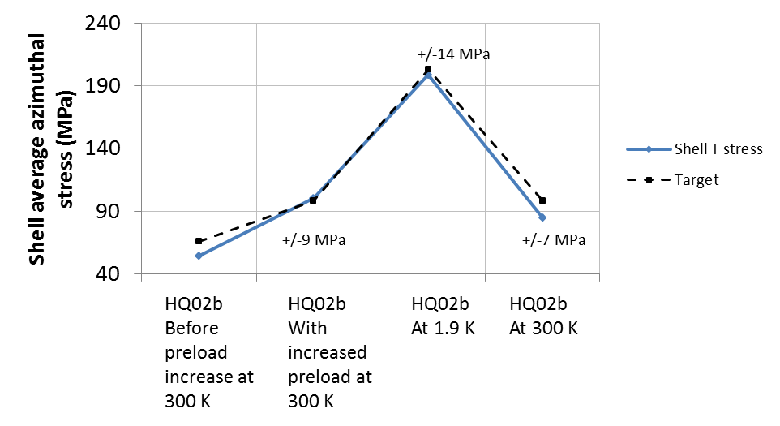
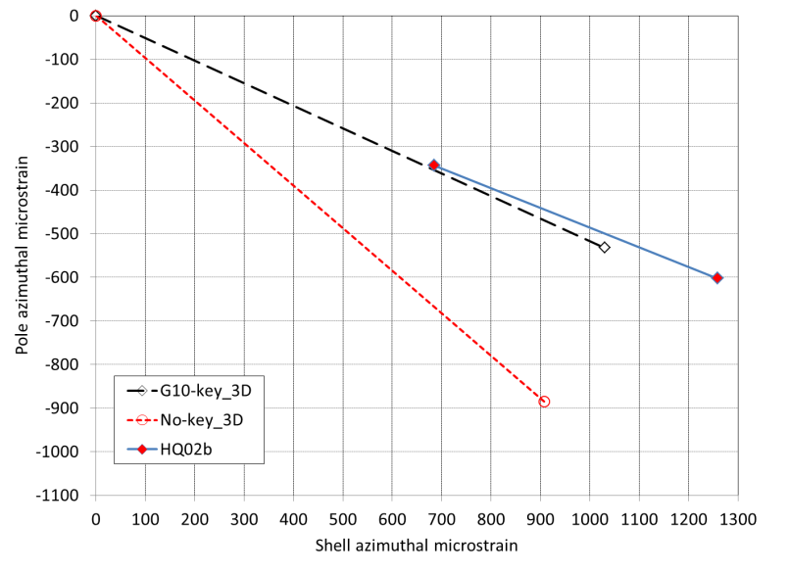
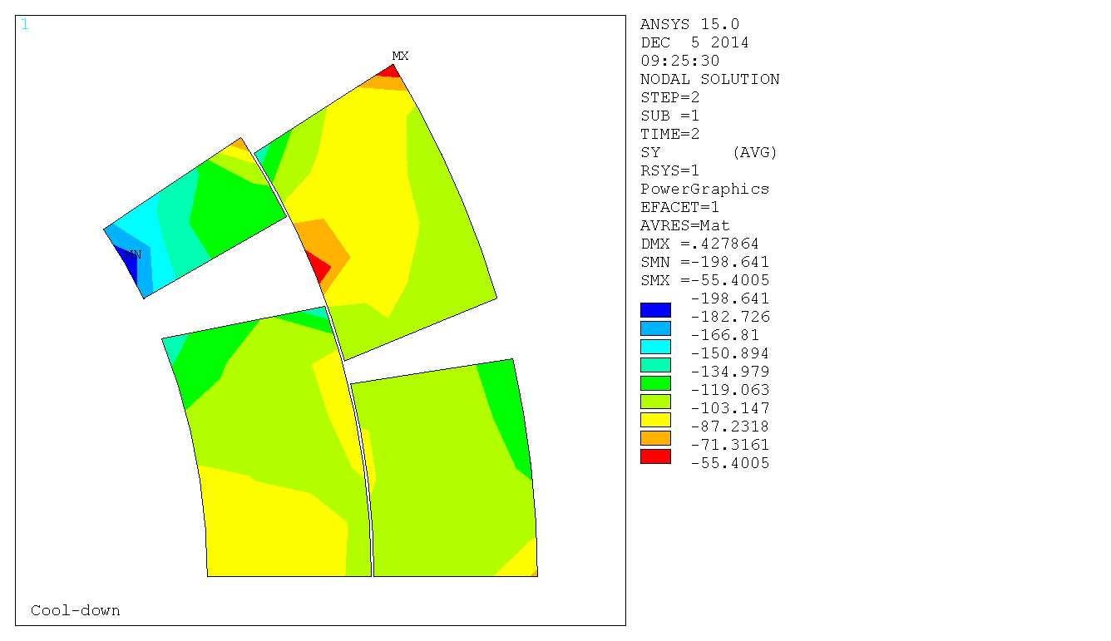
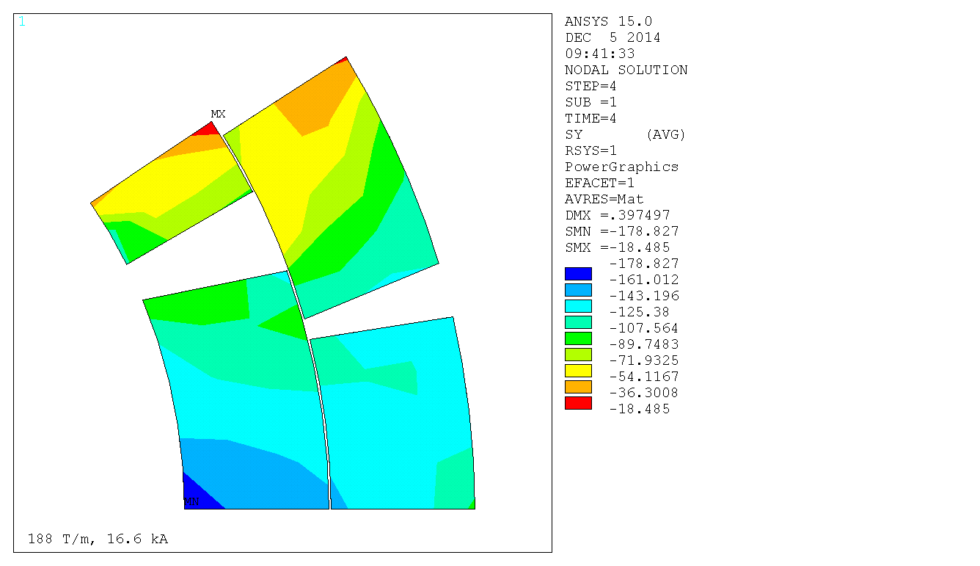
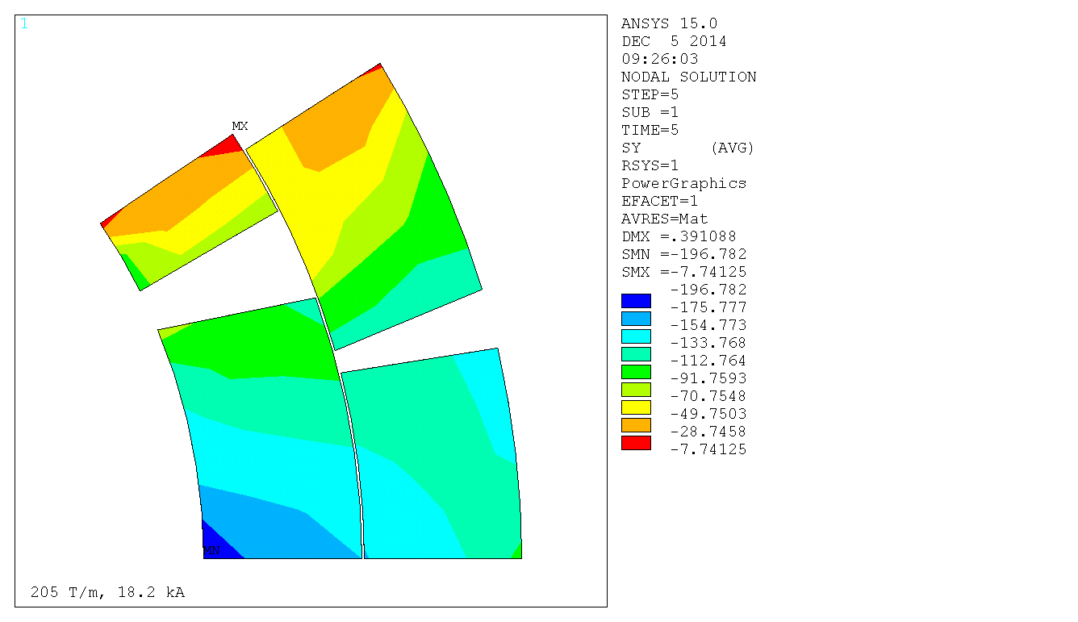
HQ02b Preload and stress summary
Coil SG at room T
Shell SG
Azimuthal stress (MPa)
4.2 K
Azimuthal stress (MPa)
188 T/m – 16.6 kA – 4.2 K HQ02 Iss
Azimuthal stress (MPa)
205 T/m – 18.2 kA – 1.9 K HQ02 Iss

Slide 11
HQ02b performance
Test performed at CERN
95% Iss – 195 T/m
Top-head limit
Preload increase => Improved training rate in HQ02b
Azimuthal stress range: 180-200 MPa

Slide 12
HQ Preload overview
 | HQ01a/b | HQ01c | HQ01d | HQ01e | HQ02a | HQ02b | HQ03
Target preload to |  | 219 T/m | 200 T/m |  | 200 T/m |  | HQ02b
εθ shell target (300/4.2K) |  | 1028/2086 με | 863/1905 με |  | 863/1905 με | 1300/2300 με | 1300/2300 με
εθ pole target (300/4.2K) |  | -536/-828 με | -450/-720 με |  | -450/-720 με | -675 με | -675 με
Coil generation |  | 1 overcompacted | 1 overcompacted |  | 2 | 2 | 2
Comment |  | Mid-plane quenches | Pole unloading in one coil |  | Pole unloading | Reached 95% Iss
Likely related to coil fab
Lack of magnet performance
prevents from checking other coil preload
Starting at 15 kA (170 T/m)
More force interception?
Lack of SG at cold prevents comparison with model
Preload adjusted based on test performance
Sufficient to 95% at 1.9 K
Axial preload:
σz rod = 60 / 160 MPa
εz rod = 880 με / 2000 με
Axial preload was never an issue in HQ

Slide 13
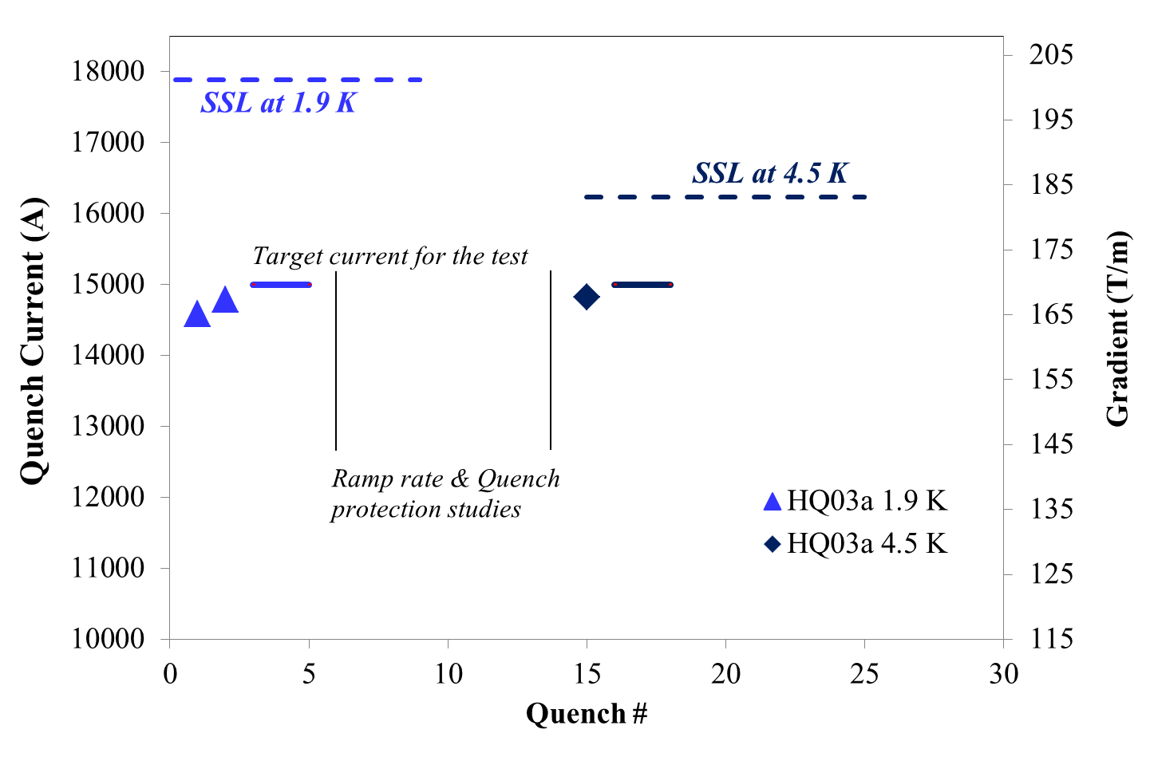
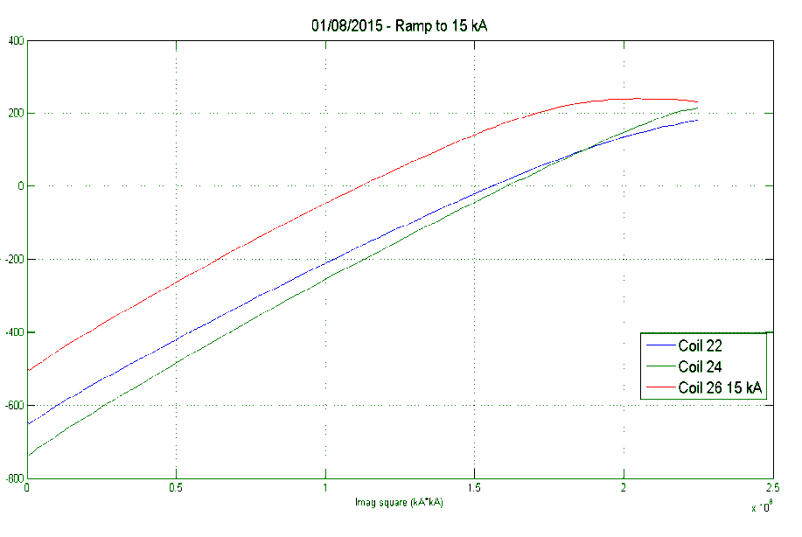
HQ03
Test performed at FNAL, Guram Chlachidze
Same preload condition as HQ02b
Same expected stress distribution as HQ02b
SG procedure was fixed => 3 out of 4 coils
Coil EpsT (με)
Rate of unloading
measured~ 450-500 με/10⁸ kA²
ANSYS ~ 400 με/10⁸ kA²
I²
1st quench at 81.5 % at 1.9 K
Possible start of unloading in coil 26 uncorrelated to quench to be confirmed in HQ03a2

Slide 14
Coil overall dimensions F. Borgnolutti (CM22 – May 2014)
+50 μm
+250 μm
-50 μm
Coil 23
Coil 22
Coil 20
Coil 17
Coil 16
-250 μm
All measurements performed with Zeiss
Bowed coils
Mid-plane under or oversized
Mid-plane consistency along the length
Lead End
Absolute position
Lead End
Aligned on OD

Slide 15
Summary – part 1
From HQ:
HQ02 and HQ03: coils consistent in terms of size
HQ02 and 3 showed contact between collar and pole key
HQ02 showed low preload potentially due to larger interception by the pole key
Range of safe azimuthal stress reached in the HQ02b and HQ03: 180-200 MPa
Appropriate level of preload to improve training

Slide 16
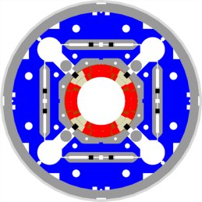
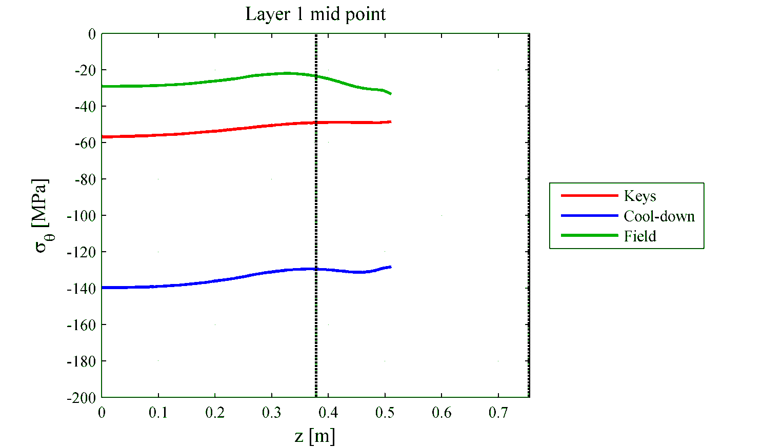
MQXFD1
385 mm
775 mm
Motivation for ½ +1+ ½
Minimize the stress variation
along the coil: +/- 5 Mpa
Implemented in MQXFD1
385 mm
45 mm pin slot
25 mm welding block gap
25 mm tool block
76 mm pin slot
M. Juchno

Slide 17
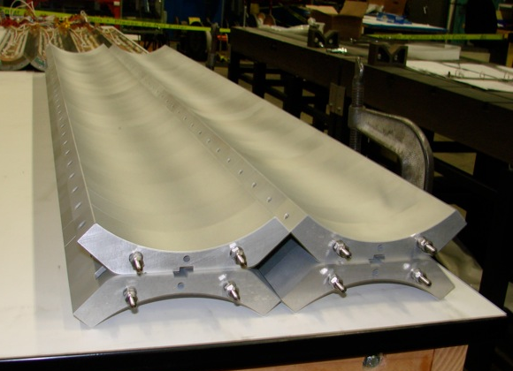
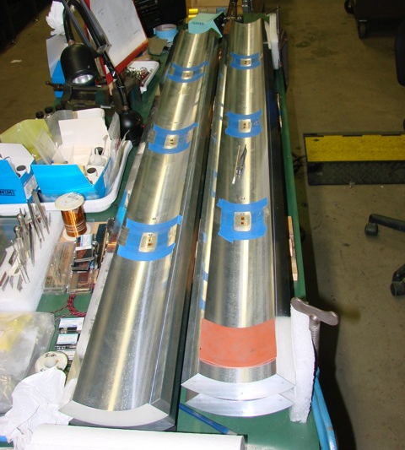
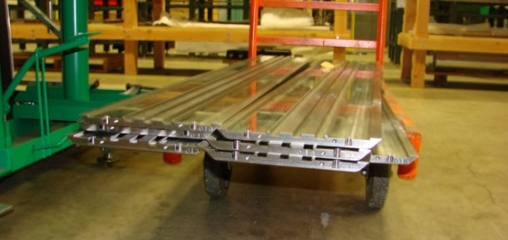
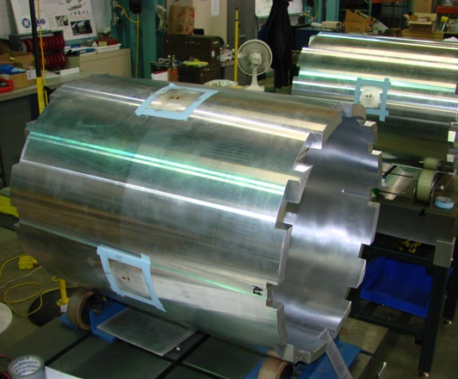
MQXFS structure procurement
2 structures procured by CERN
MQXFD0 used at CERN
MQXFD1 shipped to LBNL
Shell 1 + 1 initially
Cut at LBNL ½ + 1 + ½

Slide 18
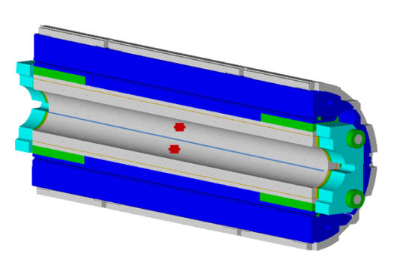
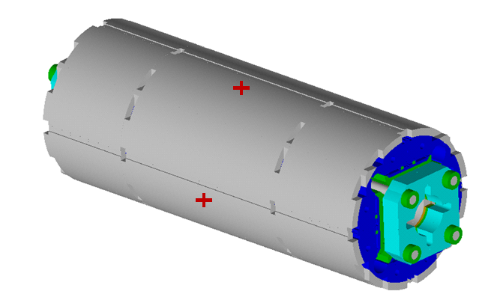
Strain gauges
Station 1
Station 2
LBNL+CERN
Station 3
LBNL + CERN
LBNL SG instrumentation
On shell and dummy coils: Vishay Type WK-13-125PC-350/W
DC current powered
k factor variation not characterized on Vishay SG
CERN SG instrumentation
On shell: HBM 1-LC11-6/350 (uniaxial)
On dummy coils: HBM 1-XC11-3/350 (biaxial)
AC voltage powered
SG characterized at cold => k factor variation by 6.5 % from RT to 77 K and 8 % to 4.2 K
(Report from Thibault Dijoud, CERN)
In collaboration with M. Guinchard, P. GrosClaude, CERN,
EN/MME/Mechanical meas. Lab.

Slide 19
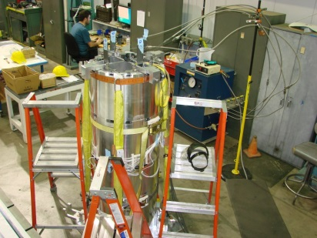
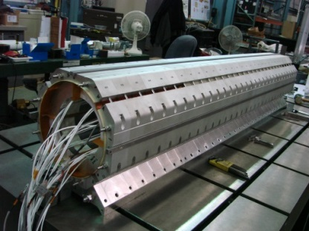
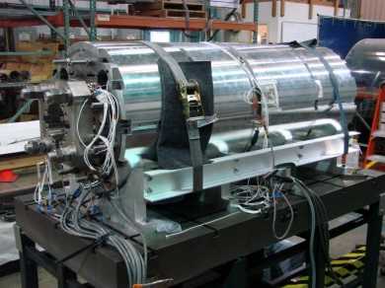
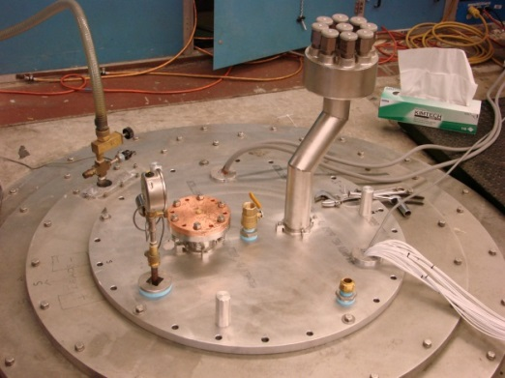
MQXFD1 timeline
Feb 1st 2015
Yoke-shell subassembly completed
March 1st 2015
Collar pack with Fuji paper completed
Final coil pack completed
April 1st 2015
MQXFD1 Preload completed
May 1st 2015
MQXFD1 77K test completed

Slide 20
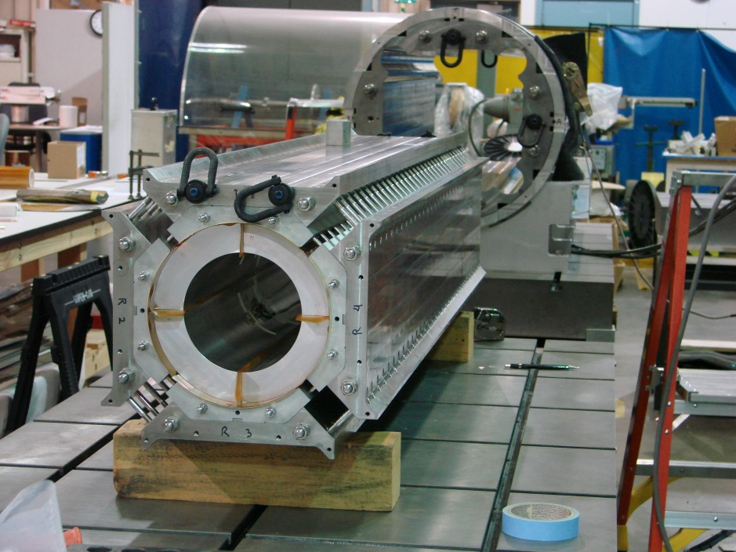
Coil pack assembly
Radial shim: 1.57 mm (1.62 mm target)
Pole key gaps: none except one quadrant 230 μm
~60 μm per quadrant
Nominal pack size: 319 mm
Actual pack smaller than nominal by about 150 μm per side
Actual coil pack size wider at the bottom
1
4
2
3
Zposition RE to LE | 1290 | 980 | 680 | 380 | AVG | AVG (mm)
Height side 1-2 | 12.539” | 12.545” | 12.547” | 12.54” | 12.54275” | 318.59
Height side 4-3 | 12.545” | 12.544” | 12.547” | 12.548” | 12.546” | 318.67
Width side 1-4 | 12.541” | 12.55” | 12.553” | 12.541” | 12.54625” | 318.67
Width side 2-3 | 12.556” | 12.553” | 12.563 | 12.553” | 12.55625” | 318.92

Slide 21
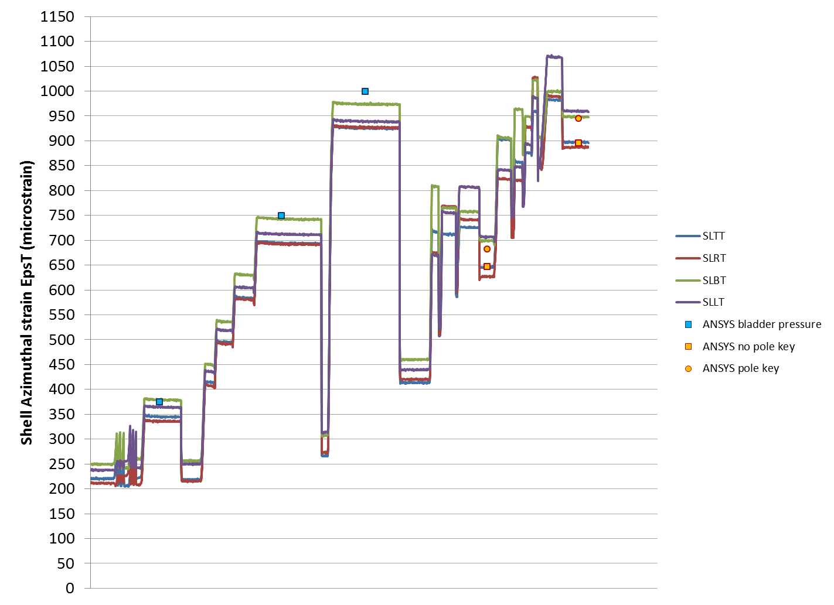
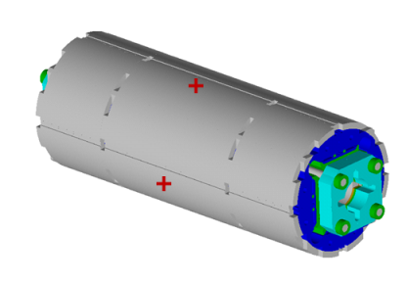
Shell εθ versus time (LBNL SG data)
Gap keys tight
Effective shim: 460 μm
Load keys: 13.556 mm
Average strain: 923 +/- 35 με
Bladder pressure by quadrant
Max: 4000 psi (27.6 MPa)
All bladders at 1500 psi (10.3 MPa)
All bladders at 3000 psi (20.6 MPa)
All bladders at 4000 psi (27.6 MPa)

Slide 22
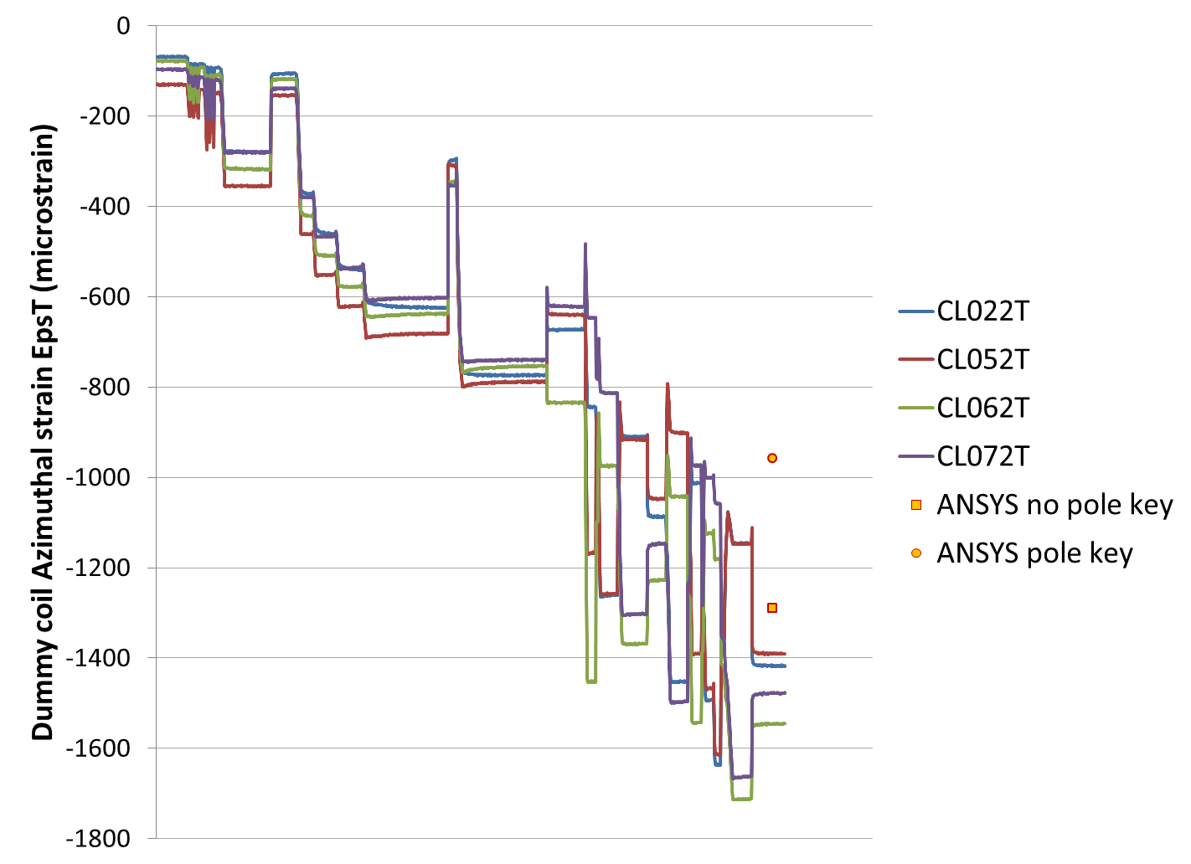
Coil station 2 εθ versus time (LBNL data)
Average azimuthal strain
-1457 +/- 58 με

Slide 23
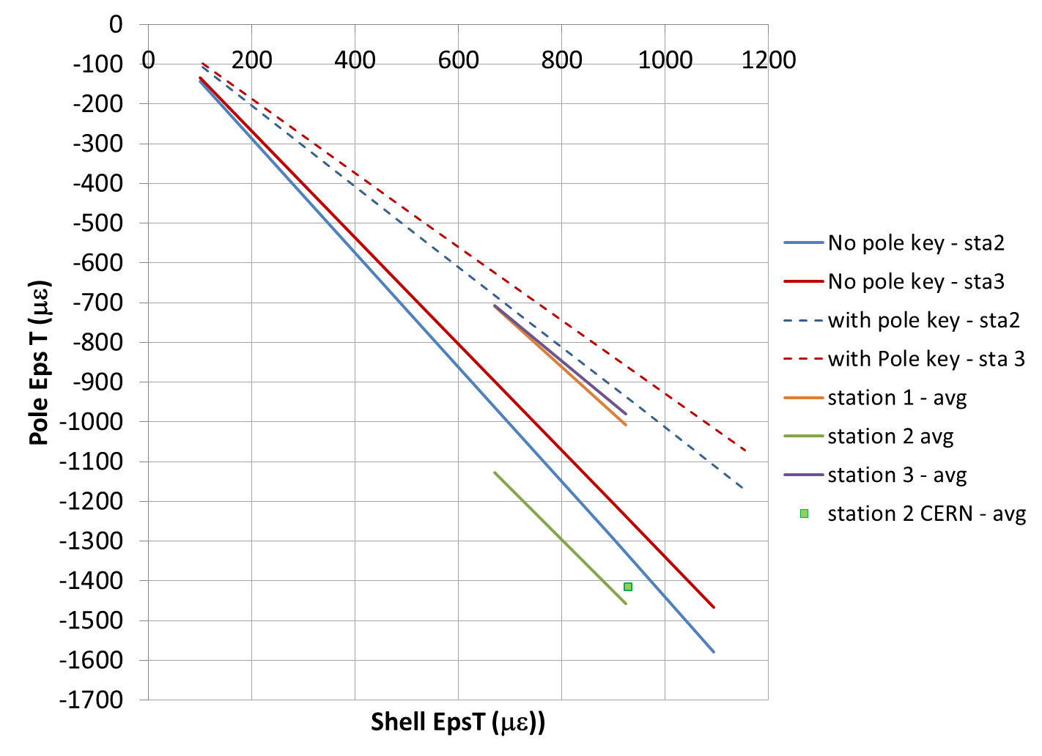
MQXF Loading Transfer function LBNL and CERN data
Station 1
Station 2
Station 3
Coil preload consistent with a “no-pole key” case
Alignment within 60 microns
-1457 +/- 58 με
CERN -1416 +/- 92 με

Slide 24
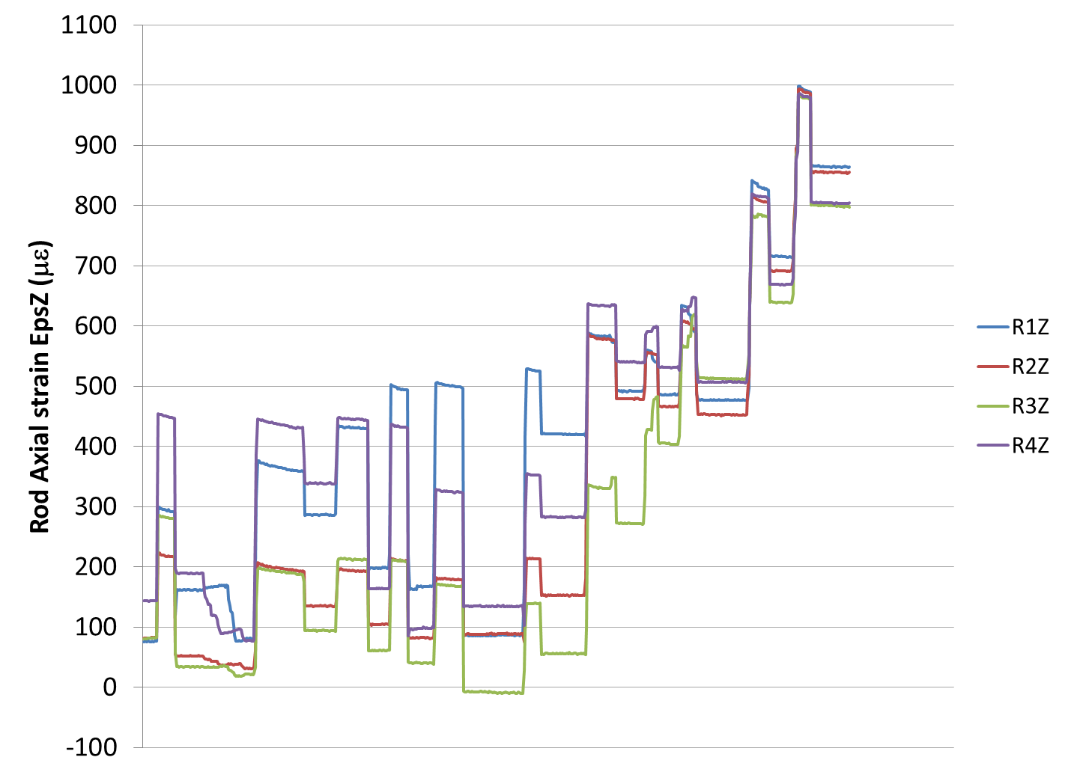
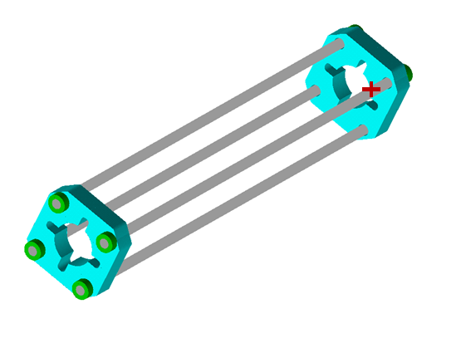
Axial Preload
Average axial strain
830 +/- 34 με
Rods Adjustment

Slide 25
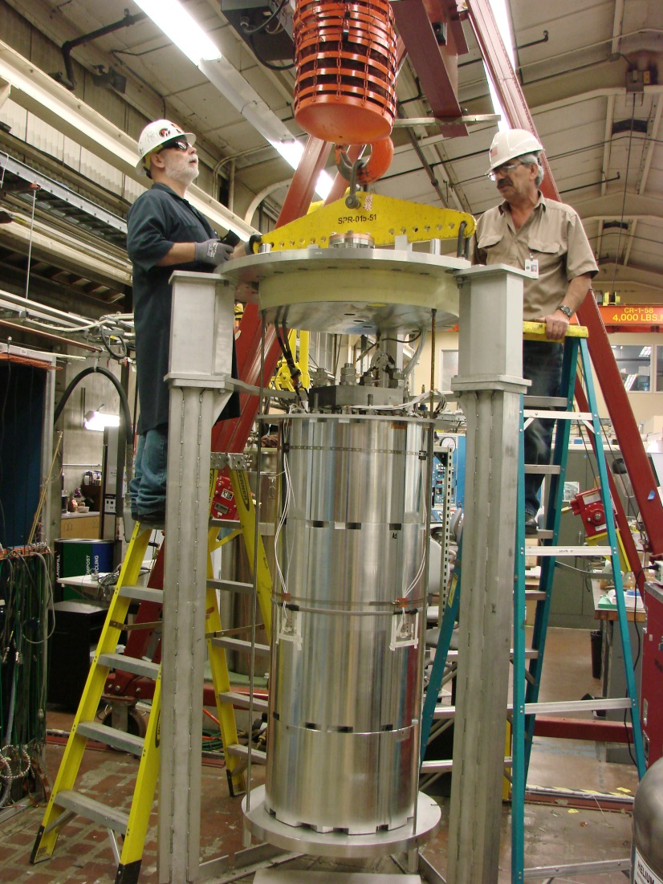
MQXFD1 preparation for cool-down

Slide 26
Shell Strain
Good consistency between LARP and CERN Strain gauge data
ANSYS Model: f=0.3
Some inconsistency axially
0.2 < f < 0.3

Slide 27
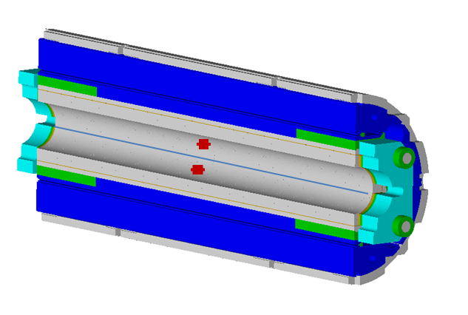
Coil Strain
Good consistency between LARP and CERN Strain gauge data
Model: f=0.3
Good consistency overall

Slide 28
Shell Stress
Model: f=0.3
Axial stress below model computation
Optimal friction coefficient in the model being investigated

Slide 29
Coil Stress
Model: f=0.3
Axial stress showing some inconsistency
Also seen in MQXFD0
Optimal friction coefficient in the model being investigated

Slide 30
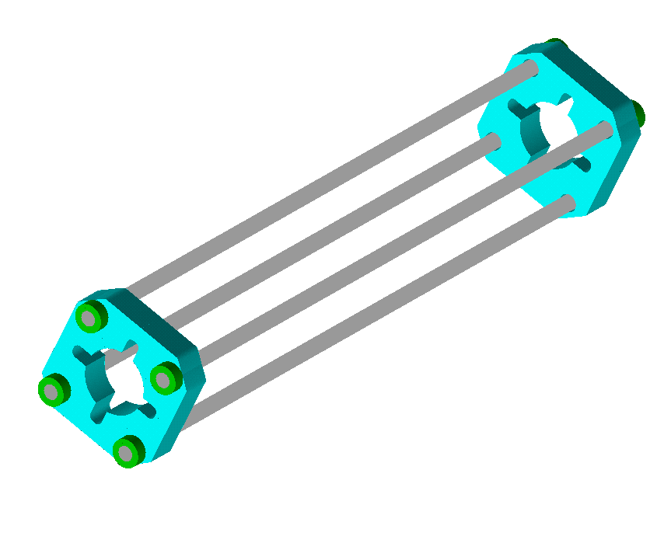
Rod axial Stress
Model: f=0.3
Good consistency between model and SG data

Slide 31
Summary
From HQ:
HQ02 and HQ03: coils consistent in terms of size
HQ02 and 3 showed contact between collar and pole key
HQ02 showed low preload potentially due to larger interception by the pole key
Range of safe azimuthal stress reached in the HQ02b and HQ03: 180-200 MPa
Appropriate level of preload to improve training
From MQXFD1
Mechanical model assembled and cooled-down at 77 K
Alignment coil to structure achieved within 60 μm
Consistency between LARP and CERN strain gauges measurements at warm and cold
Consistency between Strain gages measurements and ANSYS model
Fine tuning of the friction coefficient between 0.2 and 0.3 is required
The friction coefficient affects marginally the coil preload
The stage is set for MQXFS1 assembly

Slide 32
Back-up slides

Slide 33
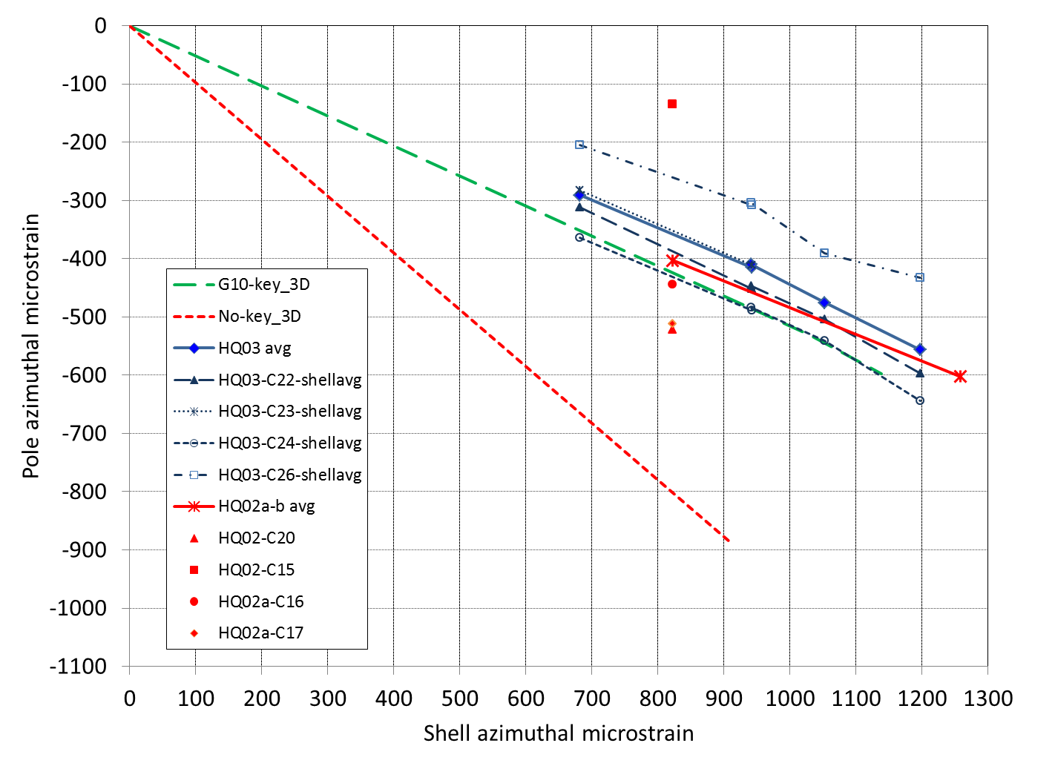
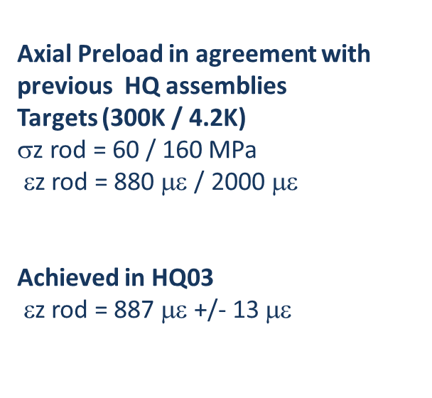
HQ03a preload summary Comparison with HQ02 Azimuthal preload
HQ03
εθ shell avg meas= 1197+/-78 με
εθ coil avg meas =-556 +/-91 με
HQ02b
εθ shell avg meas= 1270+/-107 με
εθ coil avg meas ~-600με

Slide 34
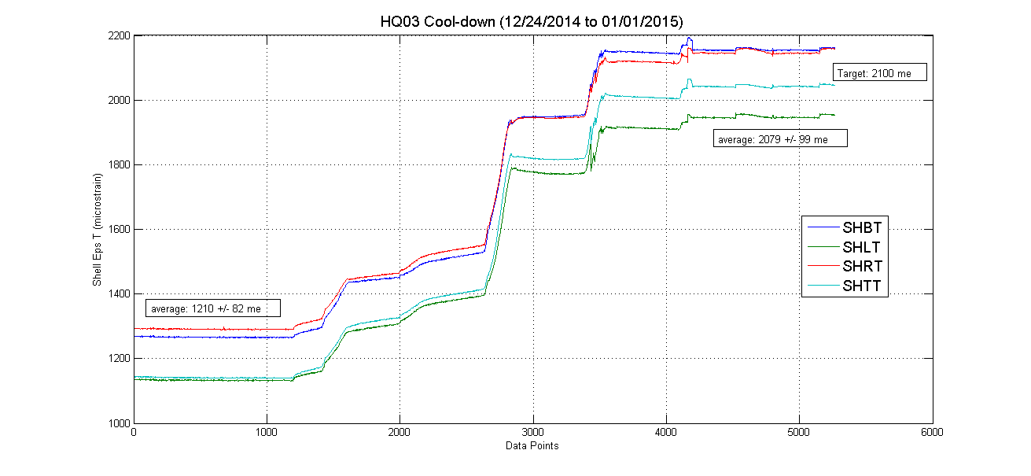
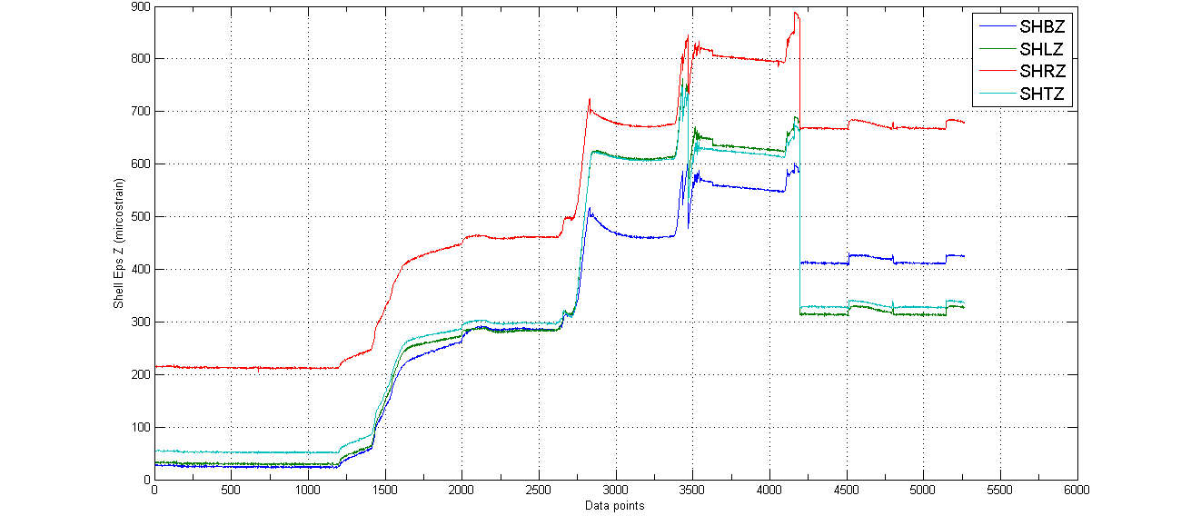
HQ03a Cool-down Shell
Average reached: 2079 με
Target: 2100 με
Axial slippage

Slide 35
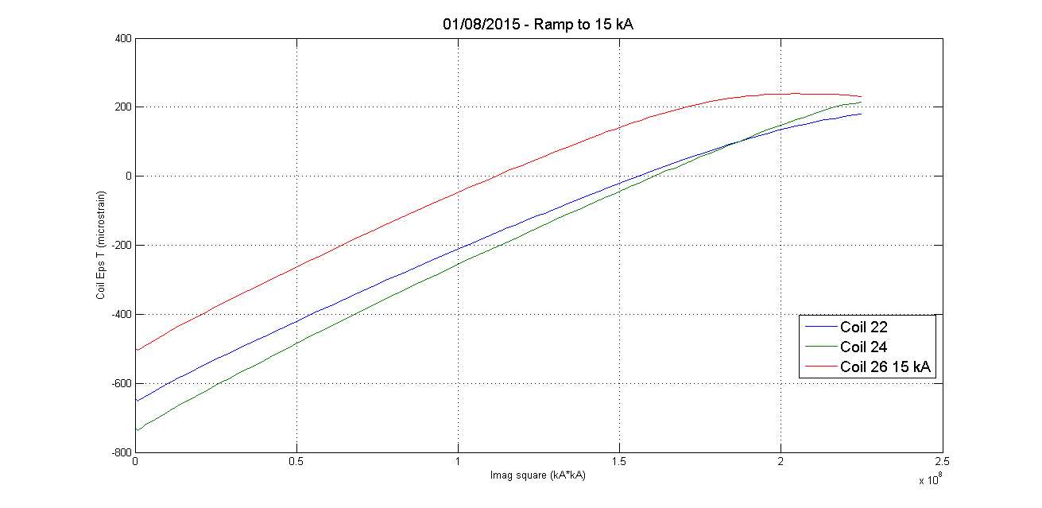
Ramp to 15 kA 01/08/2015
Coil EpsT (με)
Rate of unloading
measured~ 450-500 με/10⁸ kA²
ANSYS ~ 400 με/10⁸ kA²
I²
Signs of unloading in coil 26 => not quenching so far
SG Coil 23Z lost after cool-down
SG coil 23T lost during excitation

Slide 36
Coil pack insertion and master shimming
Load keys nominal: 13 mm (2x5+3)
Shimming calculated based on our coil-pack measurements:
Load keys: 0.120” = 3.05 mm
Bladders : 0.080” = 2.03 mm
Actual
Bottom master => calculated
Other masters
=> load keys shims: 0.100”
=> bladder shims: 0.060”
1st step of bladder => bring load keys shimming to nominal shimming

Slide 37
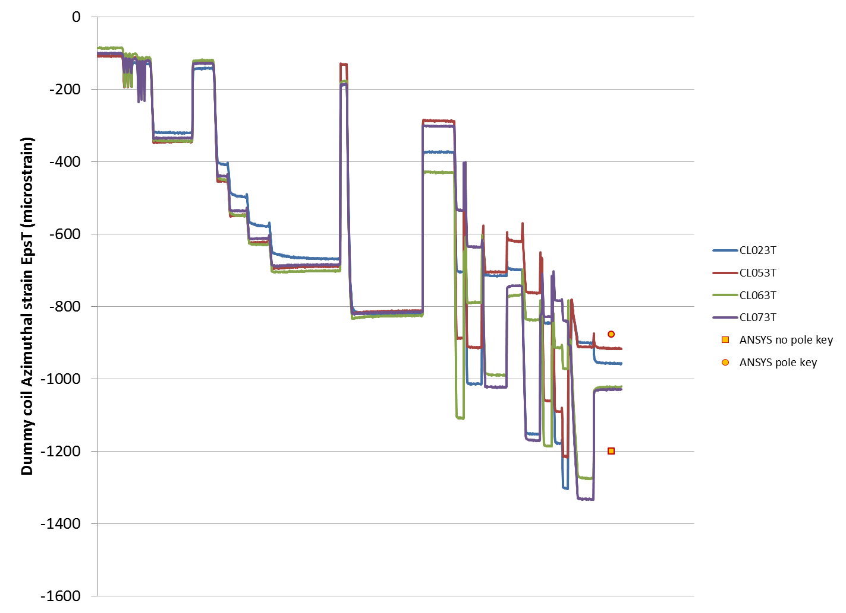
Coil station 3 εθ versus time (LBNL data)

Slide 38
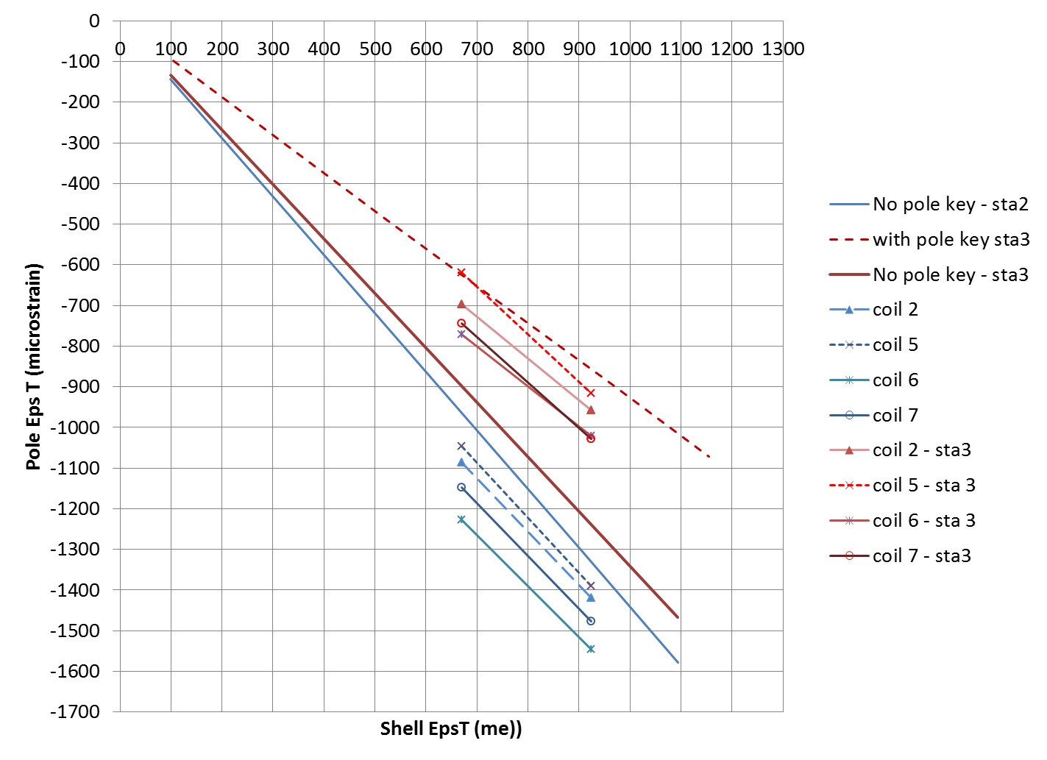
MQXF Loading Transfer function LBNL data per coil
Station 1
Station 2
Station 3

Slide 39
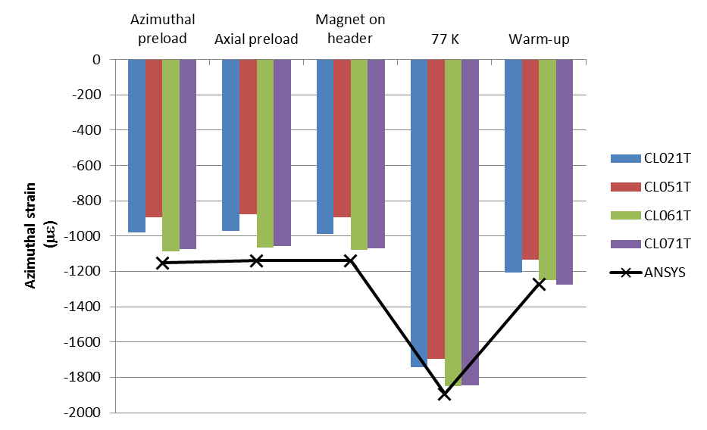
Coil station 1 azimuthal strain

Slide 40
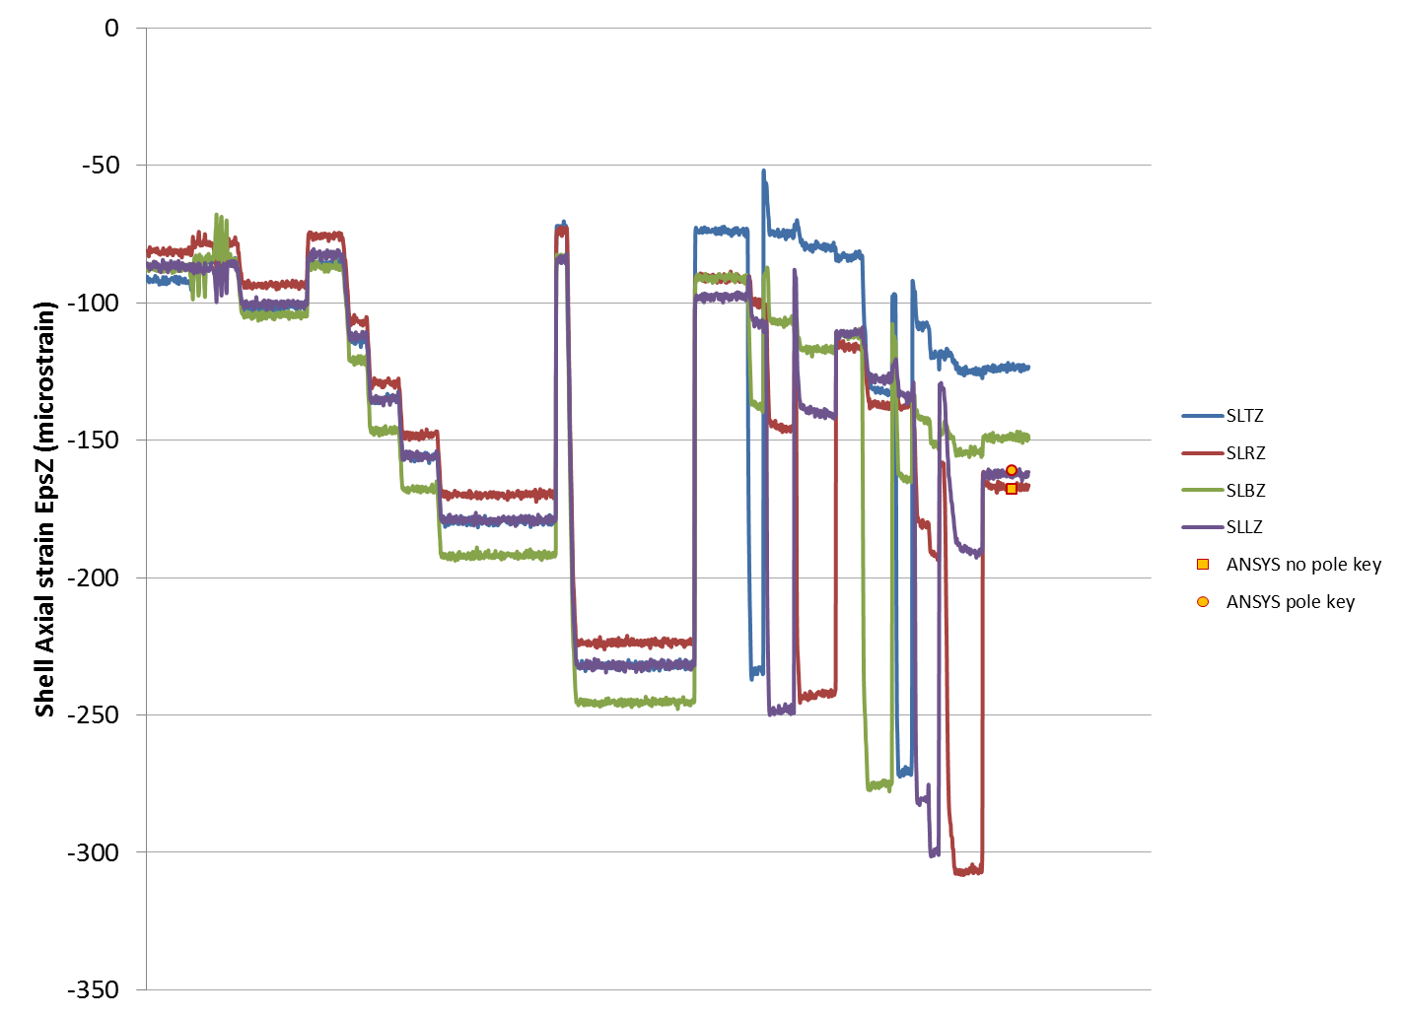
Shell εz (LBNL data)

