Slide 1
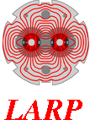
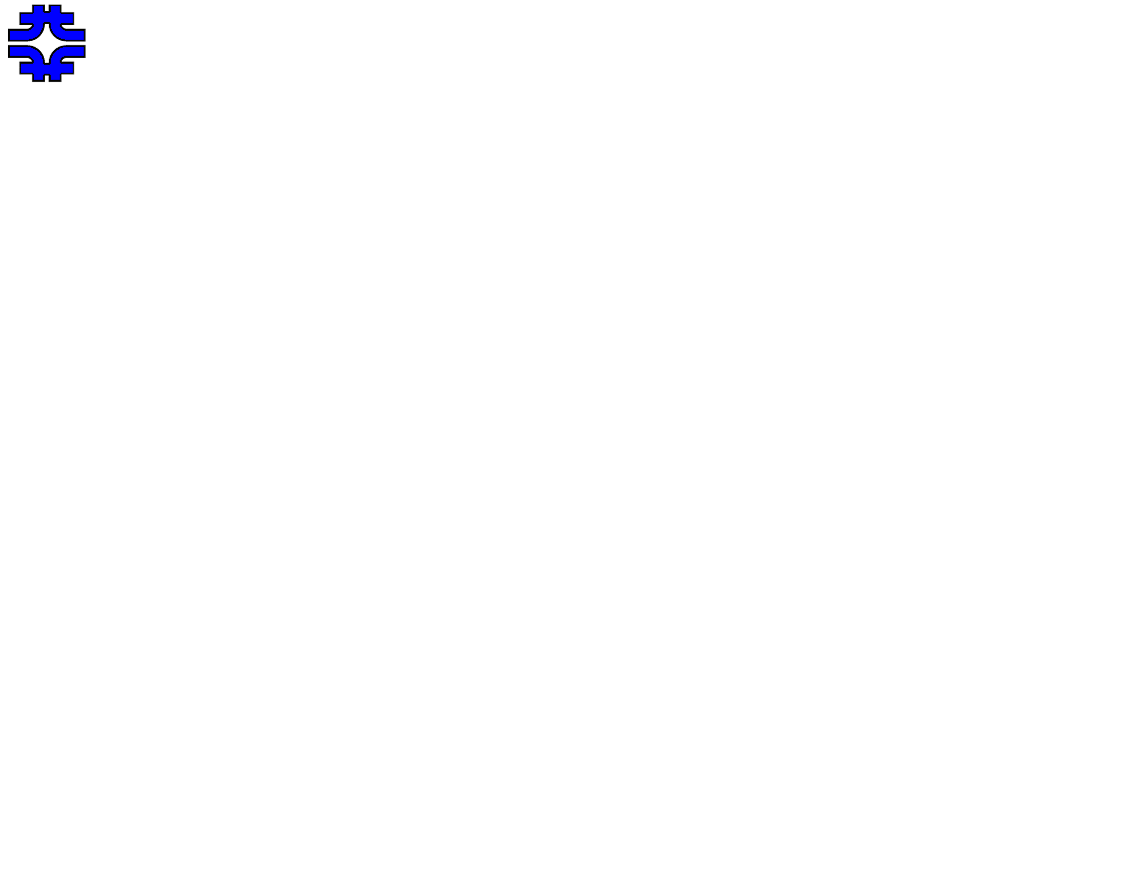

MQXFS Mirror Fabrication
R. Bossert, G. Chlachidze, S. Stoynev
HiLumi-LARP Collaboration Meeting
May 11-13, 2015
FNAL

Slide 2
Outline
Mirror Concept and Design
Instrumentation
Preload during Fabrication Steps
Axial Strain during Fabrication.

Slide 3
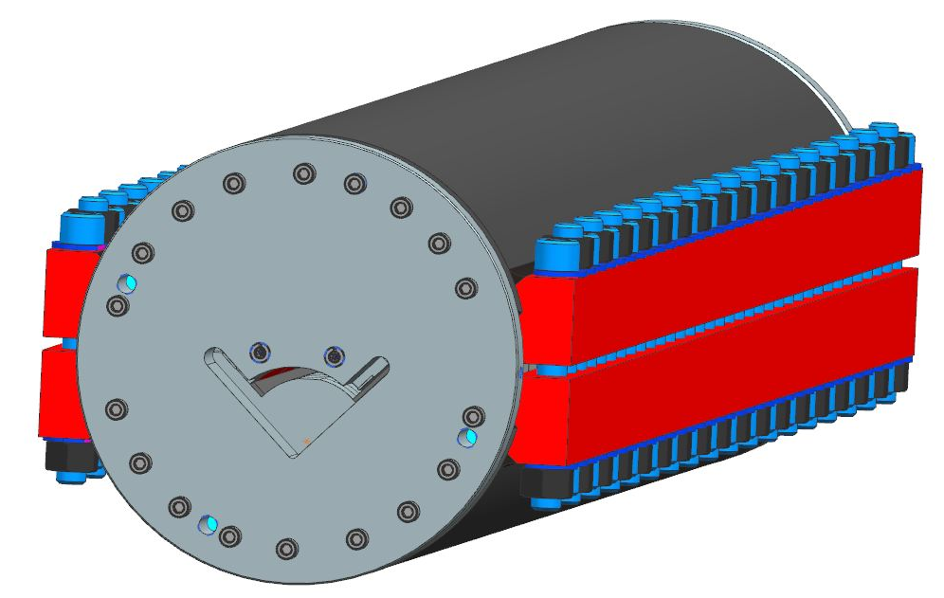
SQXF Mirror Design
Tests single SQXF coil in traditional Fermilab yoke with stainless steel bolt-on skin.
Coil Protective Shell
Yoke (EDM’d blocks)
Bolt on skin
Aluminum Side Clamp
Coil Midplane shim

Slide 4
SQXF Mirror Design is derived from previous Mirrors built at Fermlab.
TQ mirror
HQ mirror
HFM Dipole Mirror
SQXF Mirror

Slide 5
Preload is adjusted by altering shims within the cross section.

Slide 6
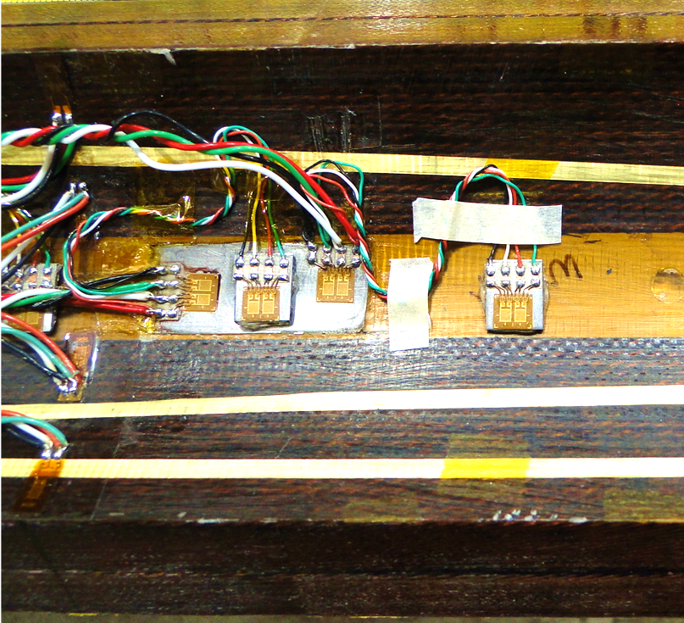
Strain Gauges
Strain gauge system, standard for short mirror:
1 set of full bridges on inner titanium pole, one azimuthal bridge, one longitudinal bridge.
4 quarter bridges bonded to inside surface of inner coil, used during construction only.
Gauges bonded to coil

Slide 7
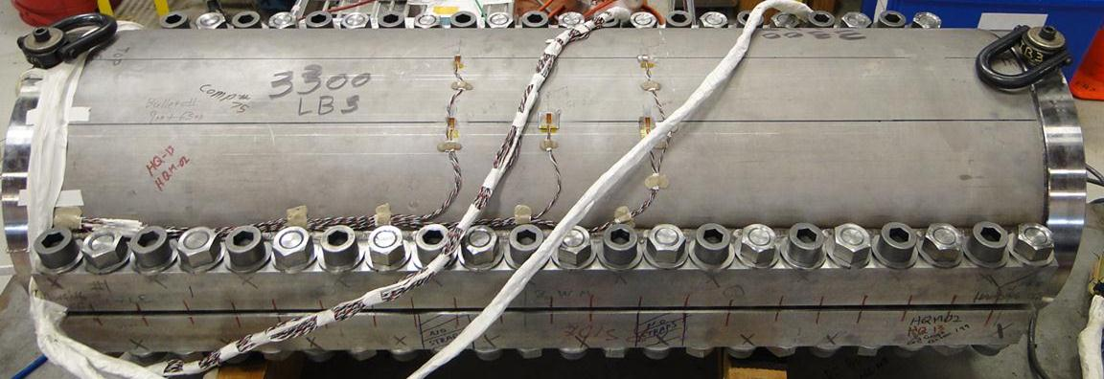
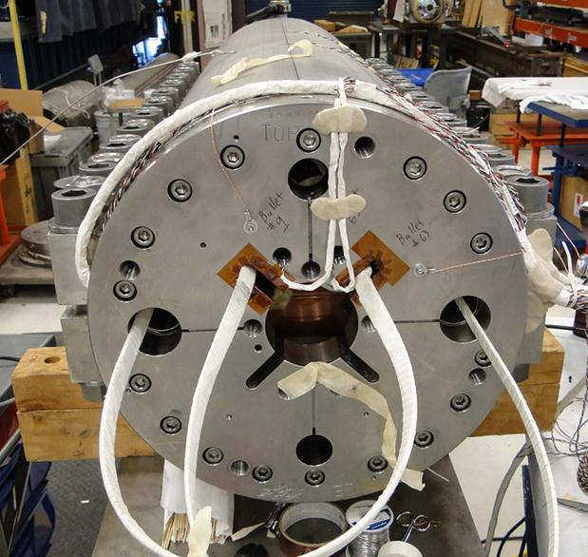
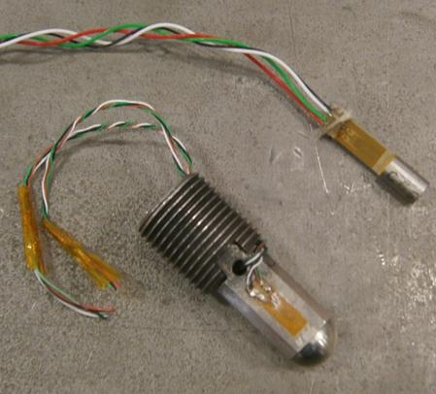
Strain Gauges
Array of gauges on skin at 60 and 90 degrees from midplane (HQ shell shown).
Strain gauges bonded to end preload bolts.

Slide 8
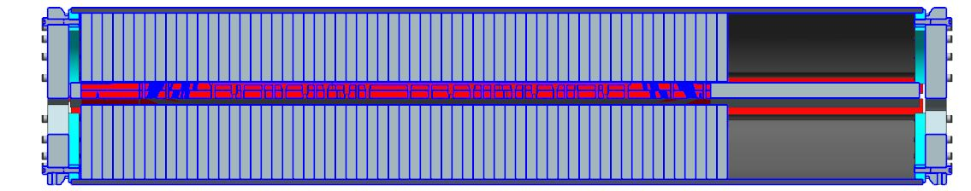
Side View
Bolt-on skin is 2 meters long, while coil is 1.6 meters long. Coil is placed with Lead End at one end of structure, allowing leads to be terminated in a conventional way. Remainder of structure was filled with filler packs.
End Load
Similar to HQ mirrors. 2 preload bolts on each end, each applying 7 kN (1500 pounds) of force from the 50mm thick end plate, for a total of 14 kN (3000 pounds) at each end.

Slide 9
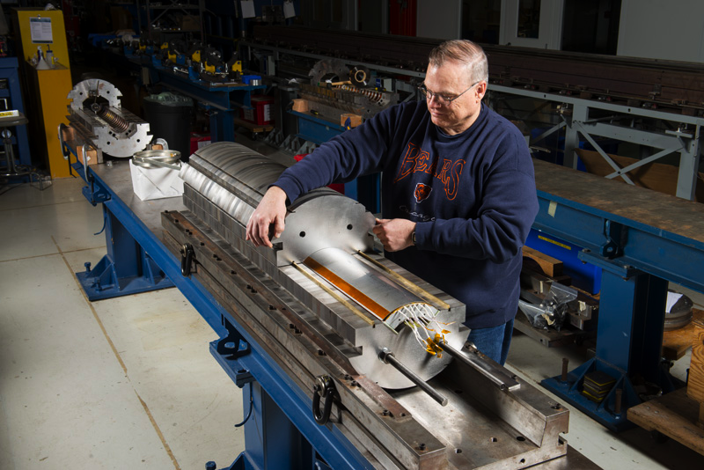
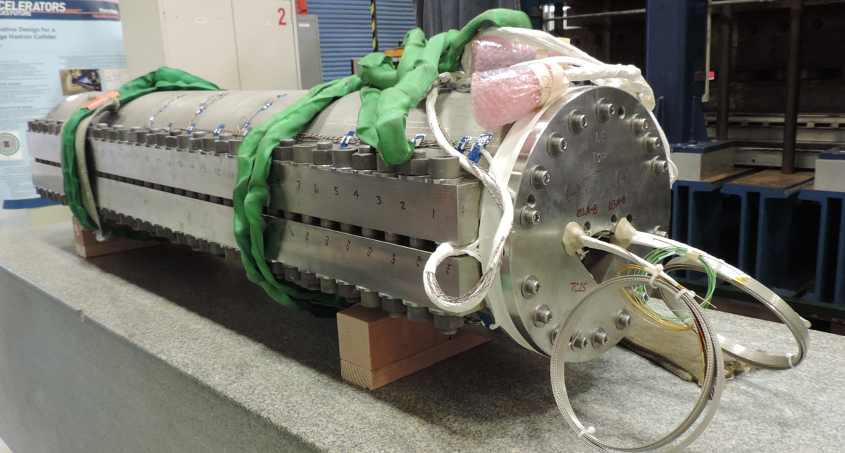
QXFSM1

Slide 10
Assembly Steps – Planned and Actual
Press to 80 MPa azimuthal stress in press without skin or clamps.
Actual – 79 MPa azimuthal stress
480 µS longitudinal strain
Drive in side clamps, increasing azimuthal preload to 90 MPa
Actual – 89 MPa azimuthal stress
530 µS longitudinal strain

Slide 11
Assembly Steps
3. Remove press pressure, clamps deflect, azimuthal preload is 50 MPa.
Actual – 66 MPa azimuthal stress
460 µS longitudinal strain
Install skin, return to press, press to azimuthal preload of 90 MPa.
Actual – 89 MPa azimuthal stress
310 µS longitudinal strain
Bolt skin and release press. Final average azimuthal coil preload of 70 MPa.
Actual – 77 MPa azimuthal stress
270 µS longitudinal strain

Slide 12
Longitudinal Strain in Pole during Construction
Positive longitudinal strain in the titanium pole is typical of mirrors during construction.
QXFSM1 strain was slightly higher than seen in any previous mirrors.
The highest strain during final pressing in QXFSM1 was 530 µS (.053%). During a pre-pressing step, a slightly higher strain of 550 µS was reached.
Nb₃Sn strand has been tested to determine the maximum amount of longitudinal strain that can be withstood before damage occurs.
For tantalum doped Nb₃Sn strand, tests showed that the maximum amount of strain before damage was found 1500 µS (.15%).
However, this test was for a straight strand, not a spiral would cable. Also, the strain measured here is in the titanium pole at center, not the coil itself.
For comparison, the highest strain during construction in past mirrors was:
HQM04 – 420 µS
HQM02 – 350 µS
HQM01 – 283 µS
LHQM01 – 305 µS
LQM01 – 295 µS
TQM05 – 310 µS
TQM04 – 490 µS

Slide 13
Summary
Mirror design is based on and similar to previous HFM, TQ and HQ mirrors.
Fabrication went according to plan.
Slightly higher axial strain than seen in past.

Slide 14
Backup Slides

Slide 15
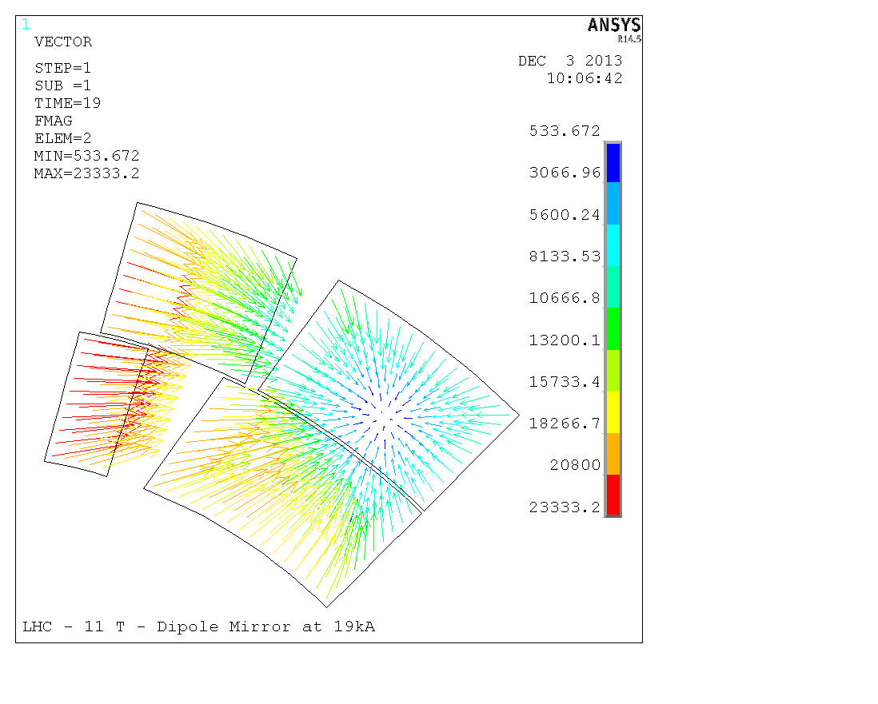
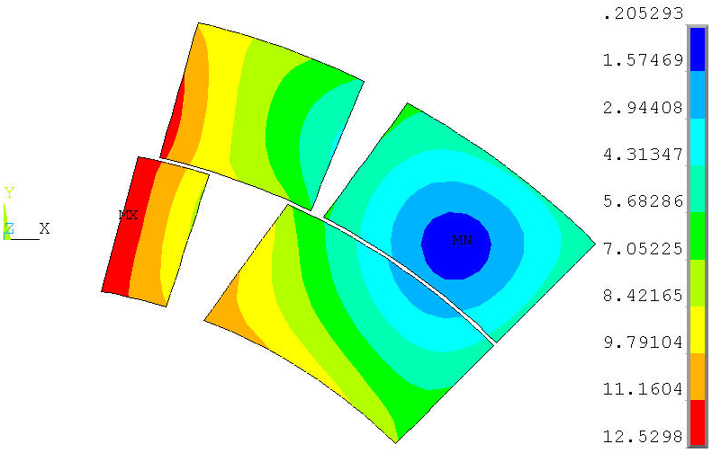
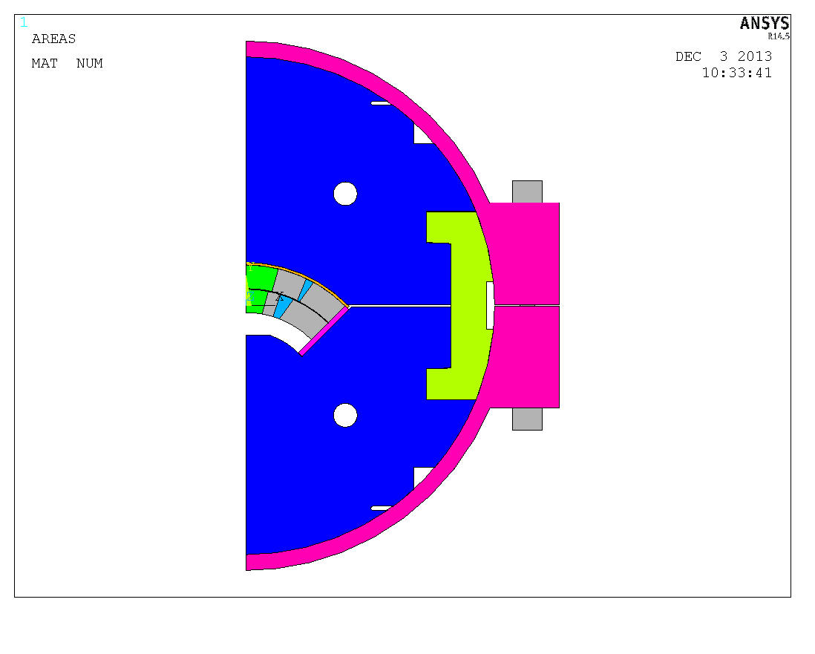
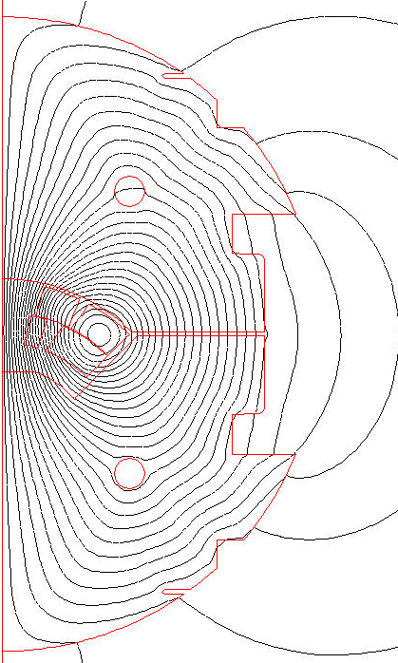
SQXF Mirror Magnetic Field at 19 kA

Slide 16
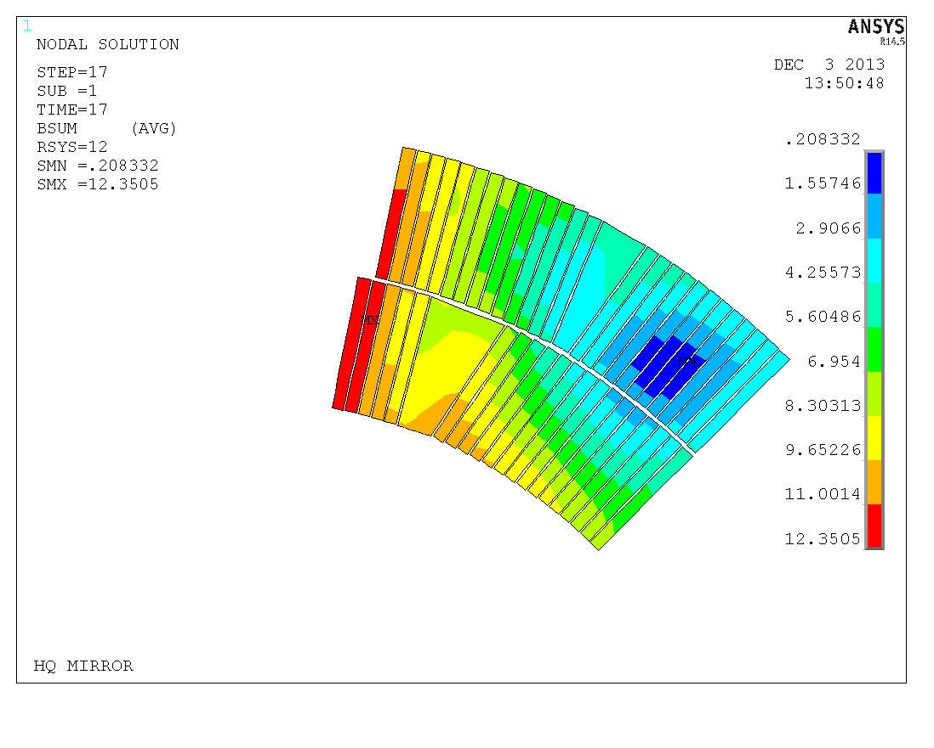
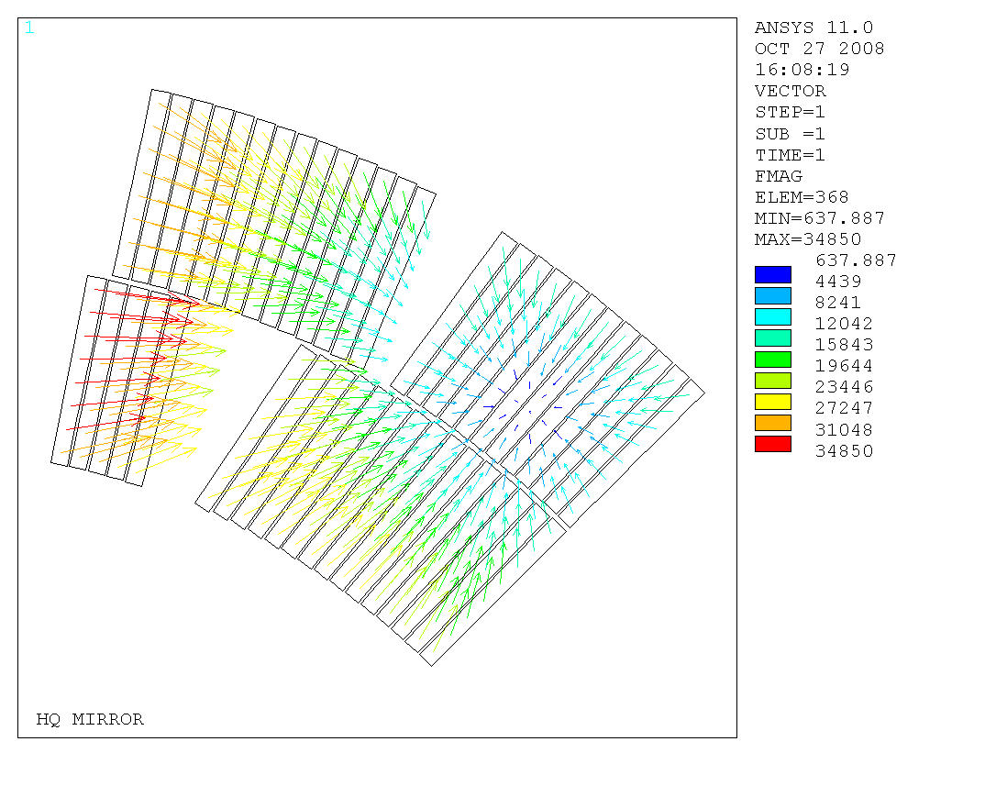
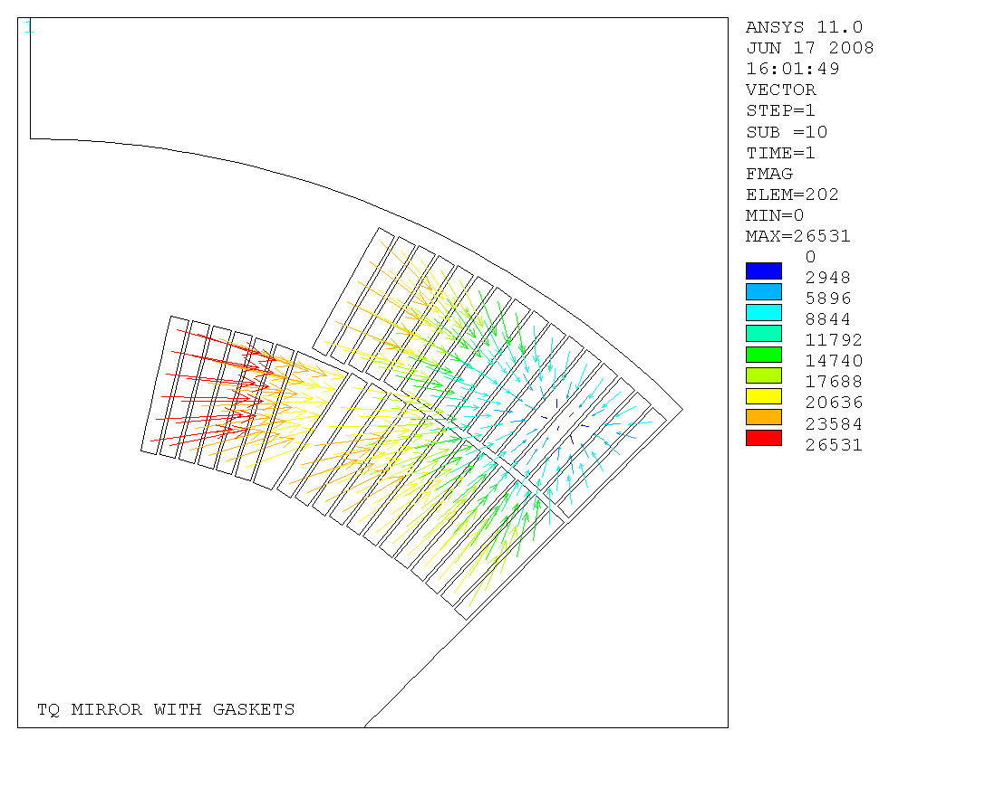
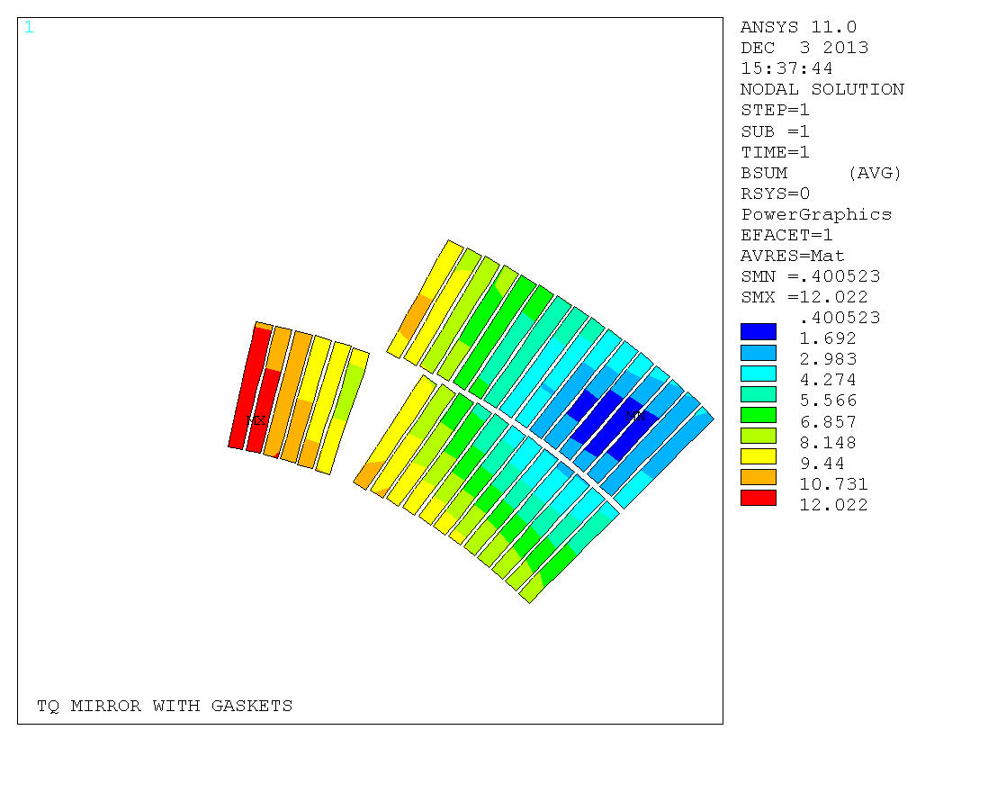
HQ and TQ Mirror Magnetic Field (for reference)
HQM at 17 kA
TQM at 14 kA

Slide 17
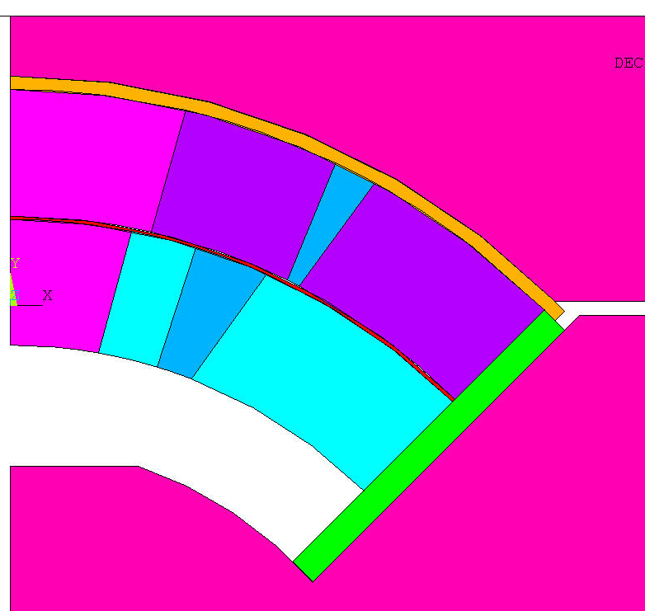
FEA Structural Model
Steel
E(293K) = 213 GPa
E(4.2K) = 224 GPa
α= 1.97/(1000*293)
Titanium alloy
E(293K) = 130 GPa
E(4.2K) = 130 GPa
α= 1.74/(1000*293)
St. Steel
E(293K) = 193 GPa
E(4.2K) = 210 GPa
α= 2.84/(1000*293)
St. Steel
E(293K) = 193 GPa
E(4.2K) = 210 GPa
α= 2.84/(1000*293)
Insulation
E(293K) = 30 GPa (x)/30 GPa (y)
E(4.2K) = 30 GPa (x)/30 GPa (y)
αx= 7.06/(1000*293)
αy= 7.06/(1000*293)
AL Bronze
E(293K) = 110 GPa
E(4.2K) = 120 GPa
α= 3.12/(1000*293)
Steel
E(293K) = 213 GPa
E(4.2K) = 224 GPa
α= 1.97/(1000*293)
Cable Composite
E(293K) = 52 GPa (r)/44 GPa (θ)
E(4.2K) = 52 GPa (r)/44 GPa (θ)
αr= 3.08/(1000*293)
αθ= 3.36/(1000*293)

Slide 18
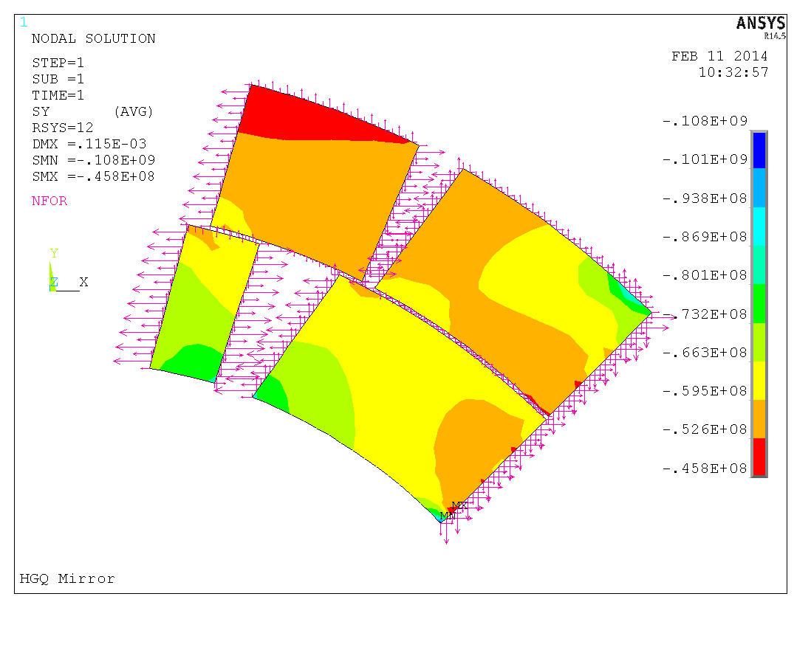
300K
Saz, Pa
Radial Shim=0.1mm

Slide 19
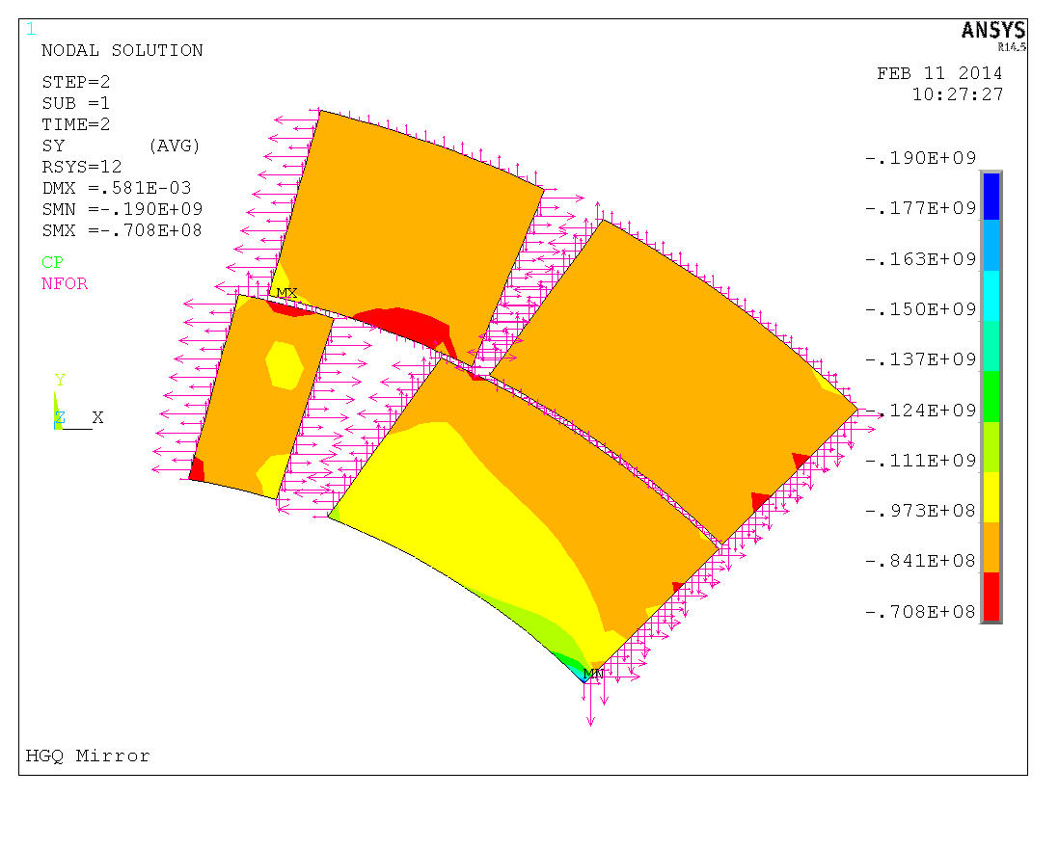
4K
Saz, Pa
At quench current the azimuthal Lorentz force in the mirror is ~30% lower than in the quadrupole model => lower coil prestress needed.

Slide 20
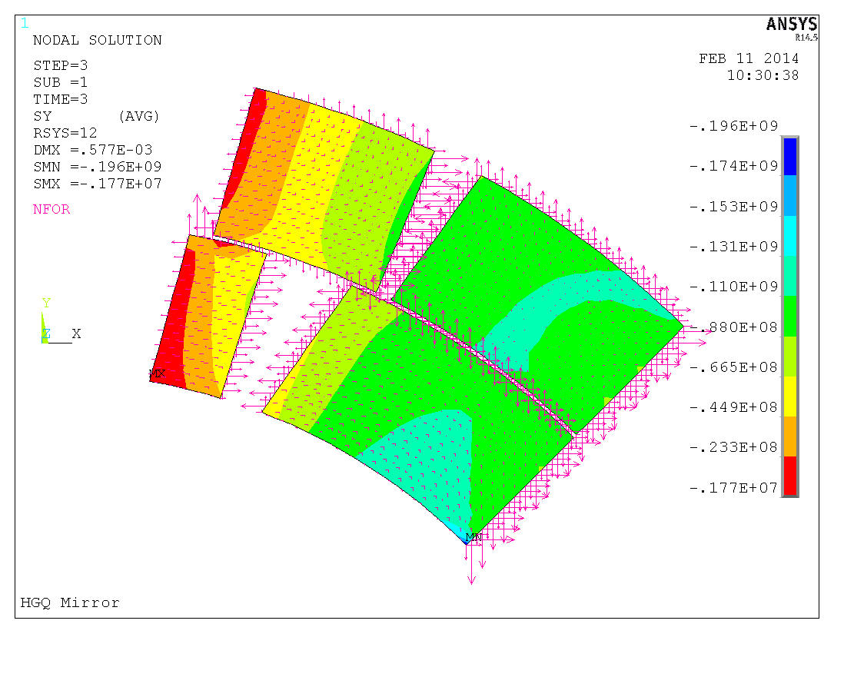
4K 11.9T 18kA
Saz, Pa
Radial Shim=0.1mm

Slide 21
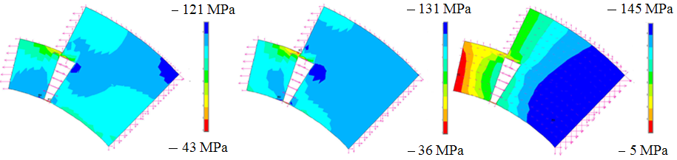
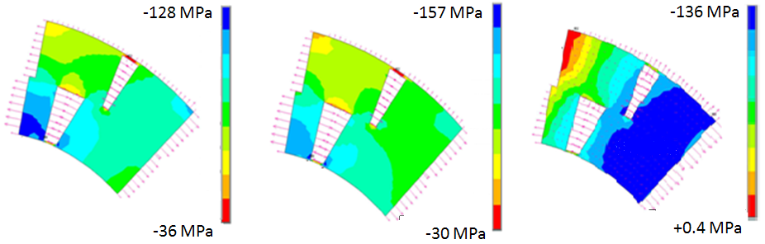
Coil Stress in TQ and HQ mirrors (for reference)
300 K
4 K
4 K, 14 kA, 17 kA
90 mm
120 mm

