Slide 1
MQXFS Test in a Mirror Structure
R. Bossert, G. Chlachidze, S. Stoynev for the Magnet Test Group at Fermilab
HiLumi-LARP Collaboration Meeting
FNAL, May 11-13, 2015

Slide 2
Outline
Introduction
Mirror magnet assembly details presented by Rodger Bossert
SSL estimates
Magnet Instrumentation
Cold Test Results
Summary

Slide 3
Introduction
The first test of a 150-mm diameter Nb₃Sn coil based on 0.85 mm diameter RRP 108/127 strand
Short model - 1.5 m long coil in a quadrupole-mirror structure
New header assembly constructed for testing 150-mm diameter MQXFS magnets at VMTF
New top plate, new lambda plate with insert components, new instrumentation wiring feed-through and various cryogenic components
Old vapor-cooled power leads utilized
Thanks to the Test & Instrumentation department members: M. Tartaglia, C. Sylvester, D. Orris, F. Lewis, R. Rabehl, W. Mumper, S. Johnson, B. Andrews..
3 CLIQ power leads could be instrumented with this header assembly
Anti-cryostat for magnetic measurements will be ready before the next MQXFS magnet test

Slide 4
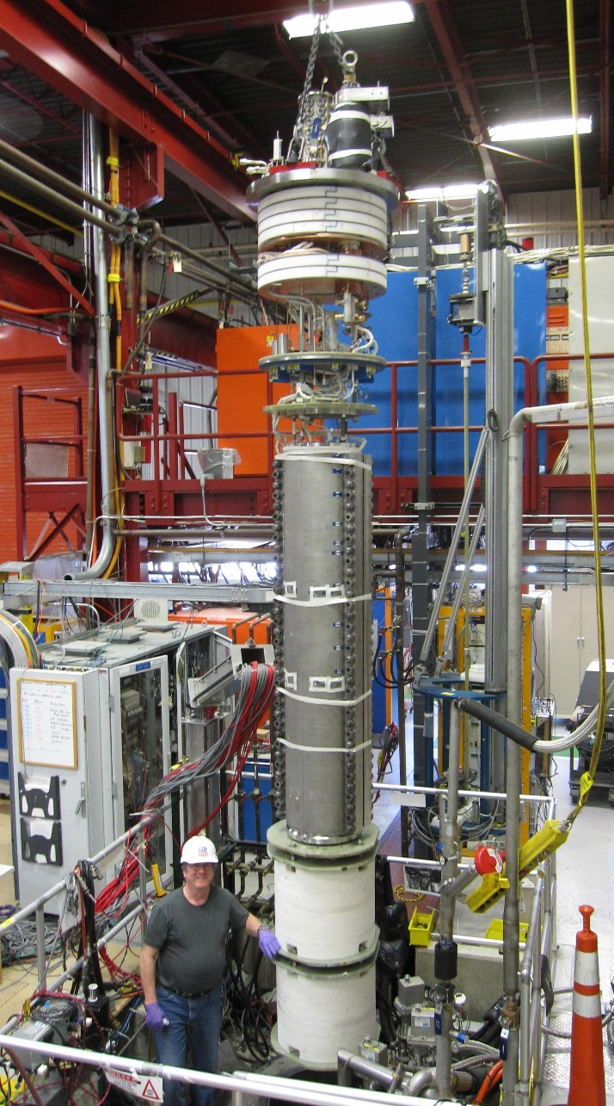
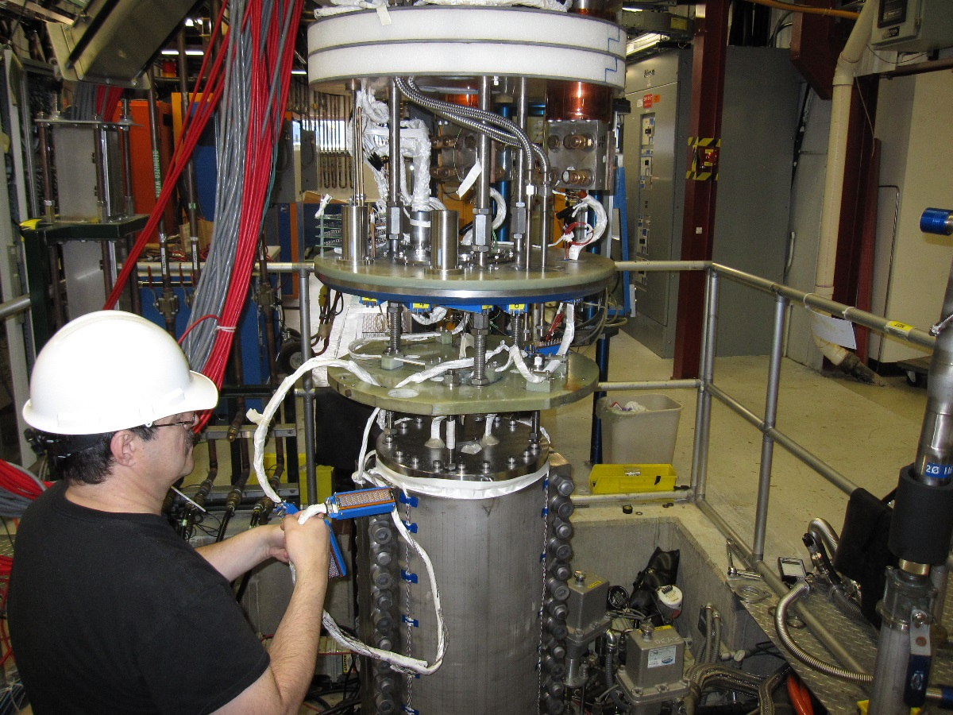
First test with the new header
The very first cool down with the new header assembly was successful: 1.7 K was reached

Slide 5
Cable properties & SSL Estimates
SSL estimated for the mirror configuration
(load line for the mirror structure)
Cable width, mm |  | 18.094
Cable mid. thickness, mm |  | 1.529
Keystone angle, degree |  | 0.518
Twistpitch, mm |  | 109
Number of strands |  | 40
Core |  | 316 SS
T [K] | Bpeak_SS [T] | Icable_SS [A]
4.5 | 13.20 | 18734
1.9 | 14.49 | 21065
Arup Ghosh, Dan Dietderich

Slide 6
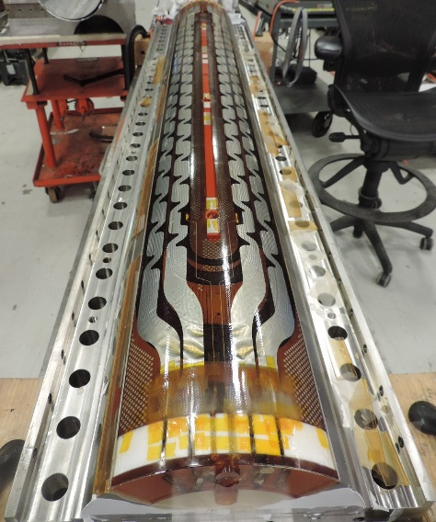
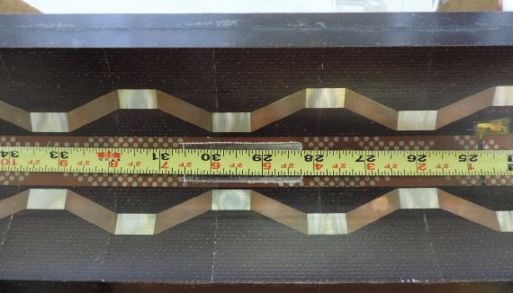
Magnet Instrumentation
Standard magnet instrumentation:
Voltage taps on the inner and outer layers
Strain gauges
Temperature sensors
Quench antenna with 5 PCB coils
OL Heaters
IL Heaters

Slide 7
Quench Training
Quench training started at 1.9 K:
20 A/s ramp rate
b5_b4 and b7_b6 are straight sections of the OL pole turn
82.2% SSL
19.2 kA, 91.3% SSL
16.5 kA
78.3% SSL

Slide 8
More tests
Quench ramp rate dependence
at 1.9 K:
Quench location in a3_a4
No quench in ramp down from
18 kA (>85% SSL) at 300 A/s
Temperature dependence study
at 20 A/s
90% of SSL both at 1.9 K and
4.5 K
Holding current tests:
4.5 K: no quench for 2 hours
at 16.5 kA (88% SSL)
1.9 K: no quench for 2 hours at
17.8 kA (~85% SSL). Longer test is possible

Slide 9
Quench Locations
No quenches in low field area.
Few quenches in the OL pole-turn
segments
Established pattern of a quench
Plateau:
Simultaneous start in a3_a4 and
a4_a5 segments, QA signals originate
mostly in segments #1 and #2
Data analysis in progress
VT A08
VT A04
VT A03

Slide 10
Brief Summary
MQXFS coil test in a mirror structure still in progress
Quench protection study expected this week, few more training quenches at the end
MQXFS coil #2 in a “mirror” configuration reached 16.5 kA in 3 quenches and 17.3 kA or 82.2% of SSL in 5 quenches. Currently magnet is at 90% of SSL
Ramp rate dependence is consistent with performance of coil with a cored cable. No quench occurred in ramp down from 18 kA at 300 A/s
Temperature dependence study demonstrated similar performance (~90% of SSL) at all temperatures
No “holding” quenches after 2 hours both at 4.5 K (16.5 kA or 88% of SSL) and 1.9 K (17.8 kA or 84.5% SSL)
Comprehensive data analysis still to be done

Slide 11
Backup Slides

Slide 12
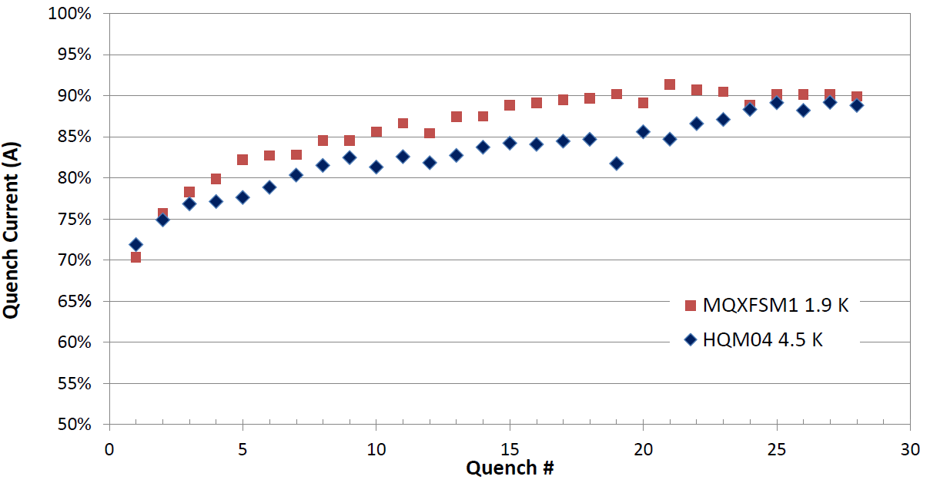
MQXFSM1 Quench Training

