Slide 1
MQXFS1 Target Proposal
H. Felice – M. Juchno – P. Ferracin

Slide 2
MQXFS1 Target Rational
From HQ
Tendency of more force interception than expected
Training clearly improved toward “high” preload
Range of azimuthal stress estimated and safe in HQ: 180-200 MPa
From MQXFD0 and MQXFD1
In absence of contact between pole key and collar good correlation of ANSYS and SG data => structure is validated
MQXFS1 preload:
Baseline case: contact between collar and pole key
Operating Gradient target: 133 T/m

Slide 3
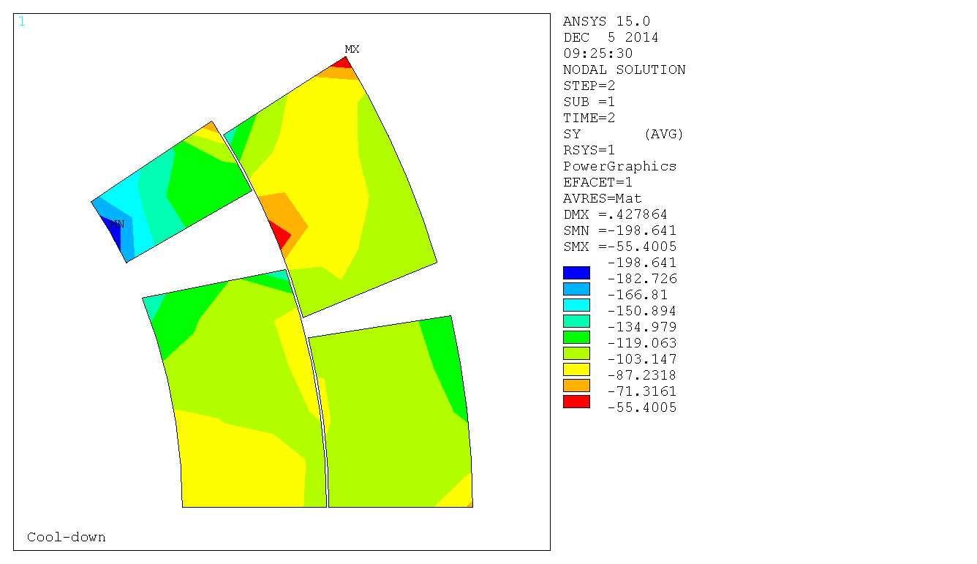
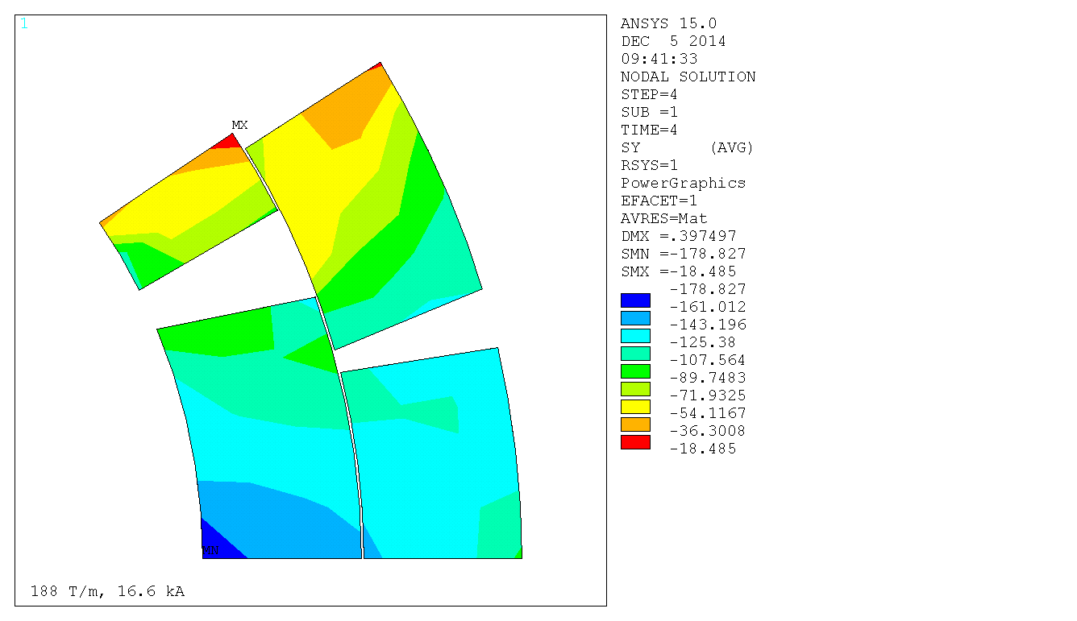
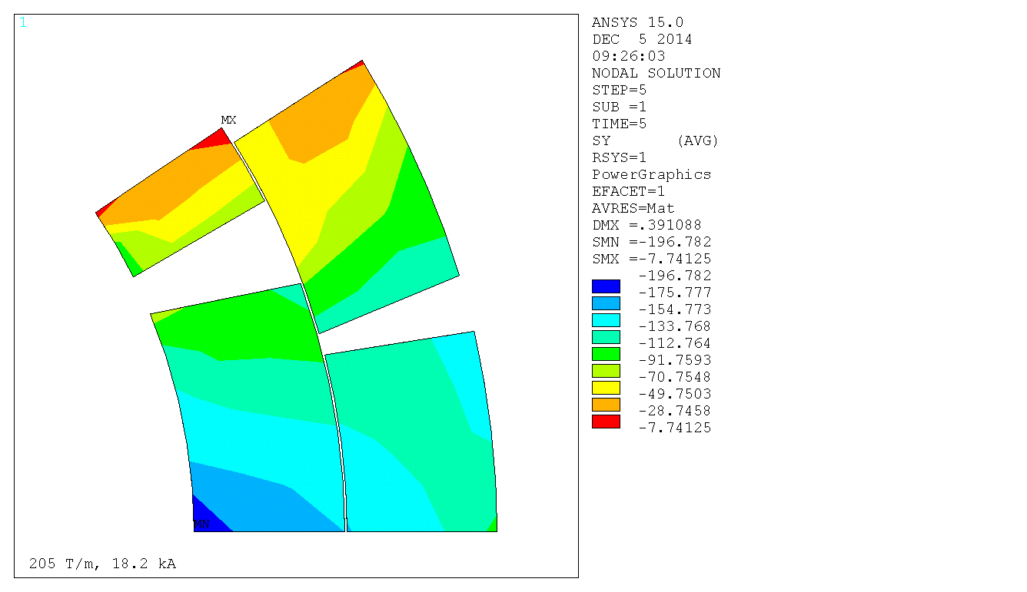
Context and Figure of merits
Compression of the pole turn at operating gradient 133 T/m
Structure validated in previous reviews and meeting, we will focus on coil stress and contact pressure
Safe stress distribution in the coil
HQ02b-HQ03 used as the upper bound
Azimuthal stress (MPa)
4.2 K
Azimuthal stress (MPa)
188 T/m – 16.6 kA – 4.2 K HQ02 Iss
Azimuthal stress (MPa)
205 T/m – 18.2 kA – 1.9 K HQ02 Iss

Slide 4
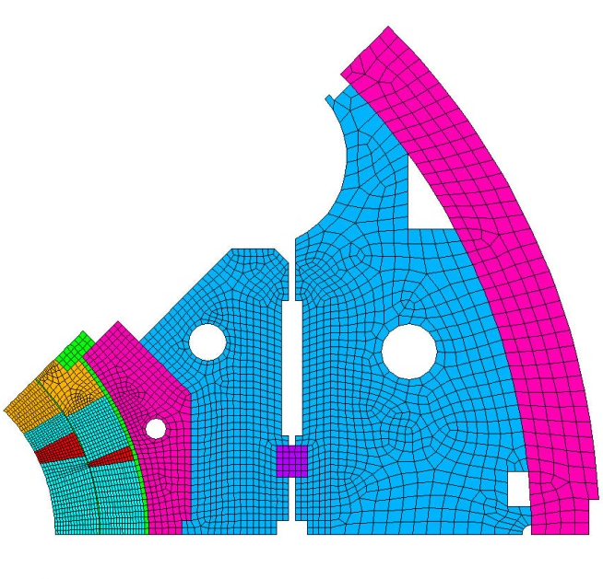
Model
2D model results are shown today
3D model results for the assembly readiness review
MQXFS1: No LHe vessel
Friction coefficient set at 0.3 based on mechanical model feedback
=> some results might differ slightly from results presented at the MQXF review
Shimming of the load key: 550 μm

Slide 5
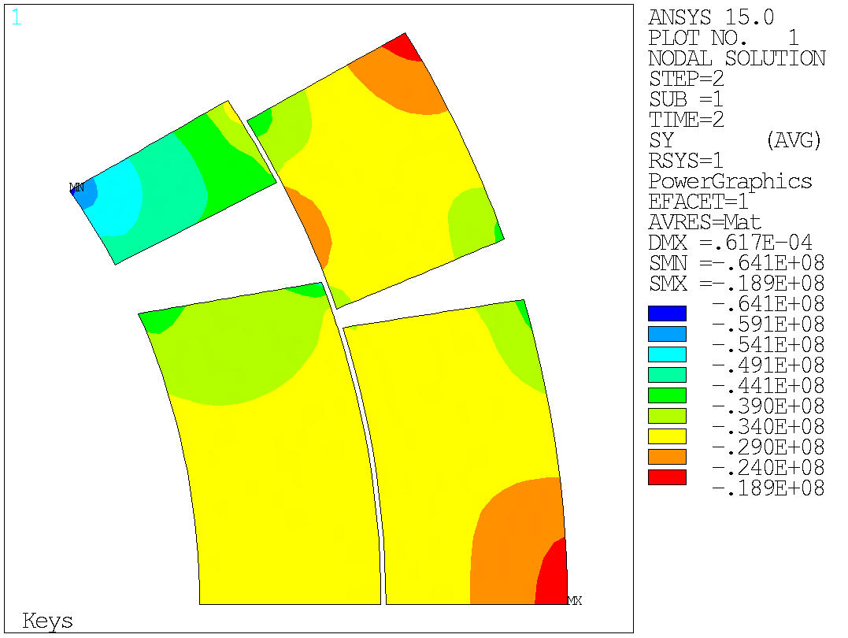
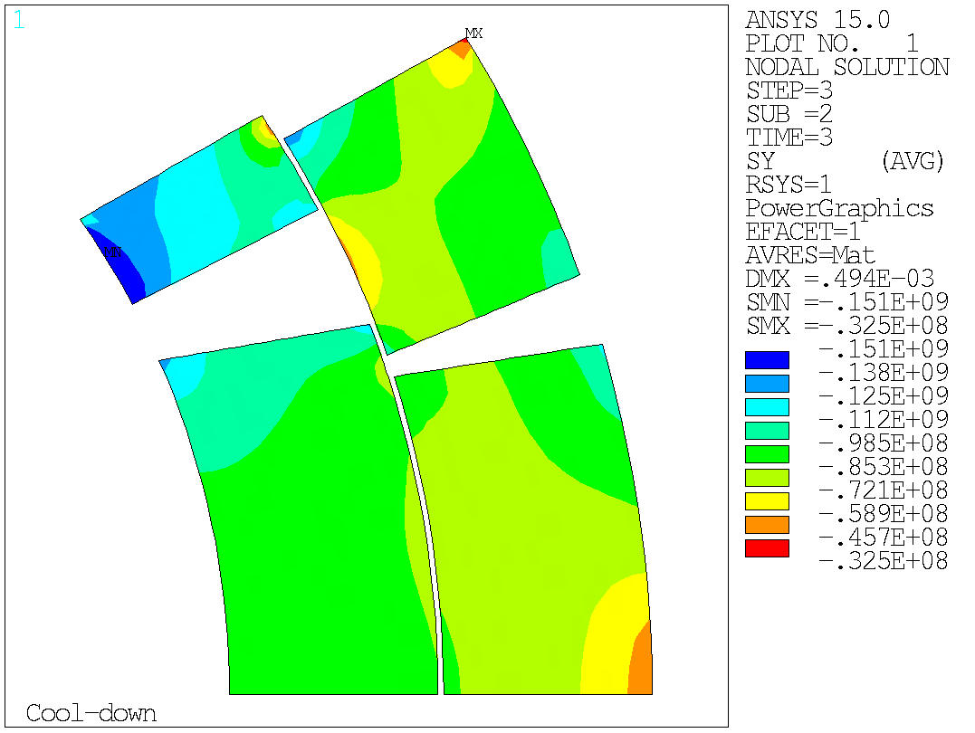
Baseline case Azimuthal Stress distribution in coil
Shimming
4.2 K

Slide 6
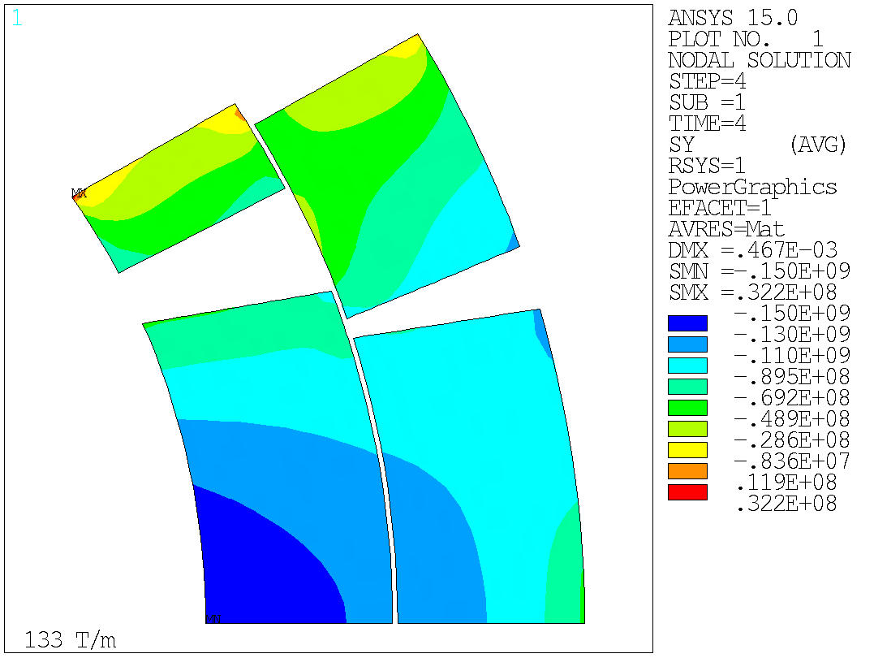
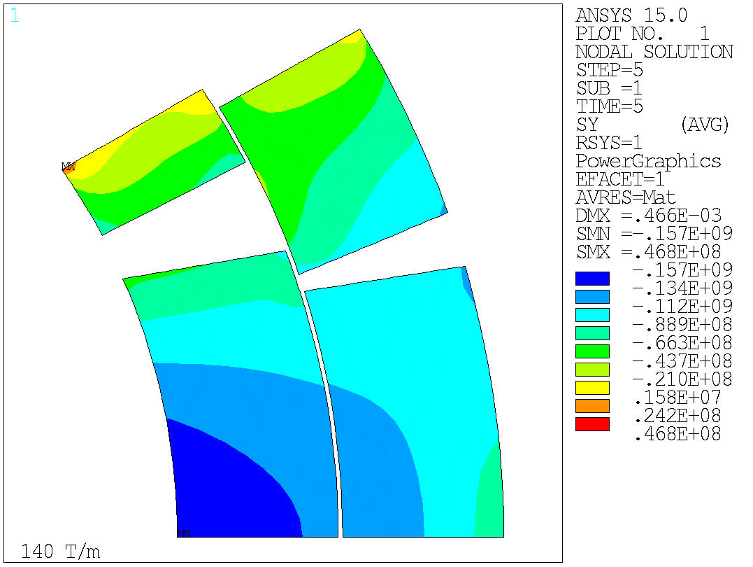
Baseline case Azimuthal Stress distribution in coil
133 T/m
140 T/m

Slide 7
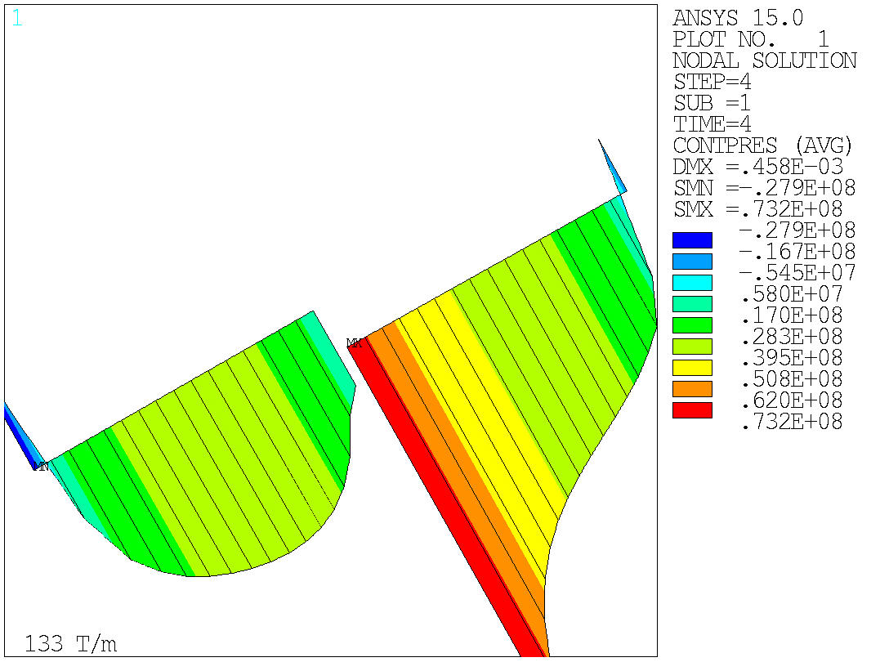
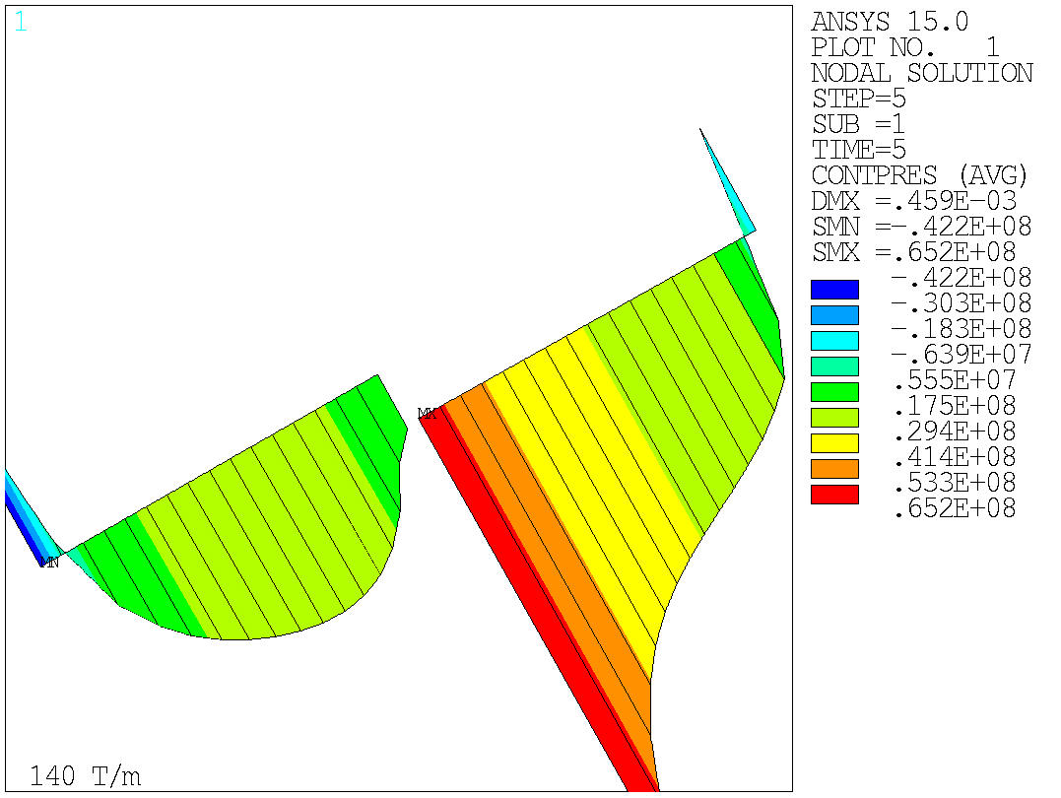
Baseline case Contact pressure coil to pole
133 T/m
140 T/m

Slide 8
Summary
Operating Gradient target: 133 T/m
550 microns interference
Stress distribution < HQ stress distribution
Compression of the pole turn provided beyond 140 T/m

Slide 9
Back up

Slide 10
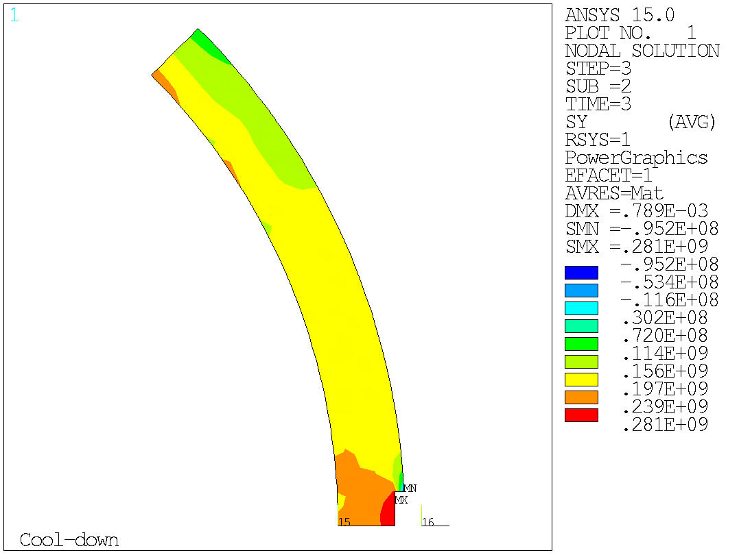
Baseline case azimuthal stress in shell
4.2 K
133 T/m

