Slide 1
MQXFS Coil V1 Fabrication Status -Winding and Curing
Miao Yu
2015-05-12

Slide 2
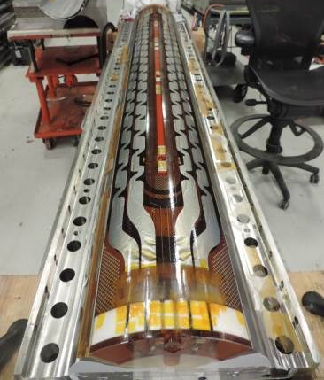
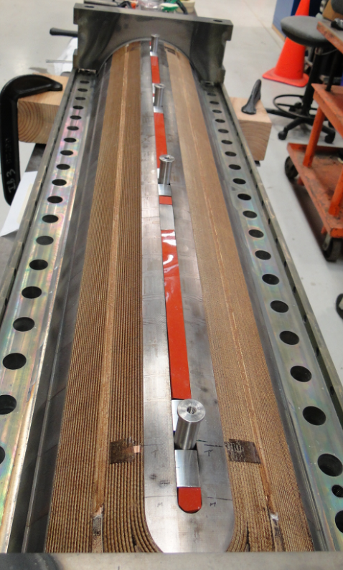
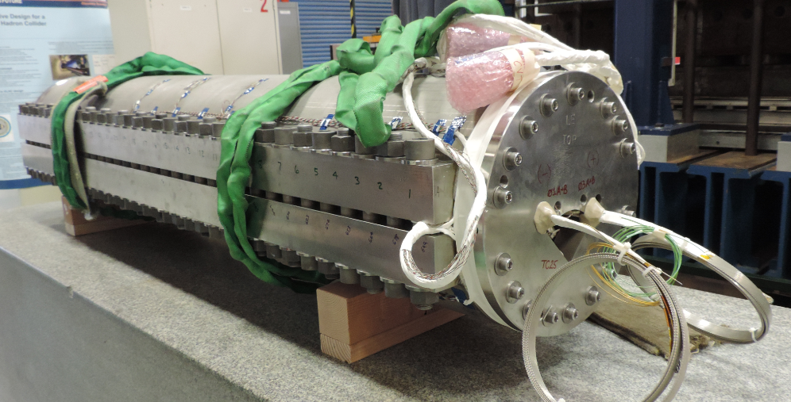
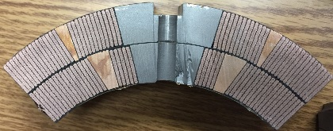
Coil fabrication status
LARP have wound and cured 6 coils at FNAL
MQXFS Coil 01
MQXFS Coil 02
MQXFS Coil 03&05
MQXFS Coil 04&06
R&I at BNL
Cut and inspected
R&I at FNAL
Being tested in a Mirror structure
R&I at BNL
Shipped to BNL for magnet assembly
Coil 04 prep. for I at LBNL
Coil 06 prep. for I at FNAL
Both will be ready in June

Slide 3
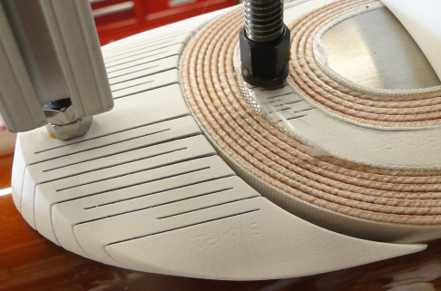
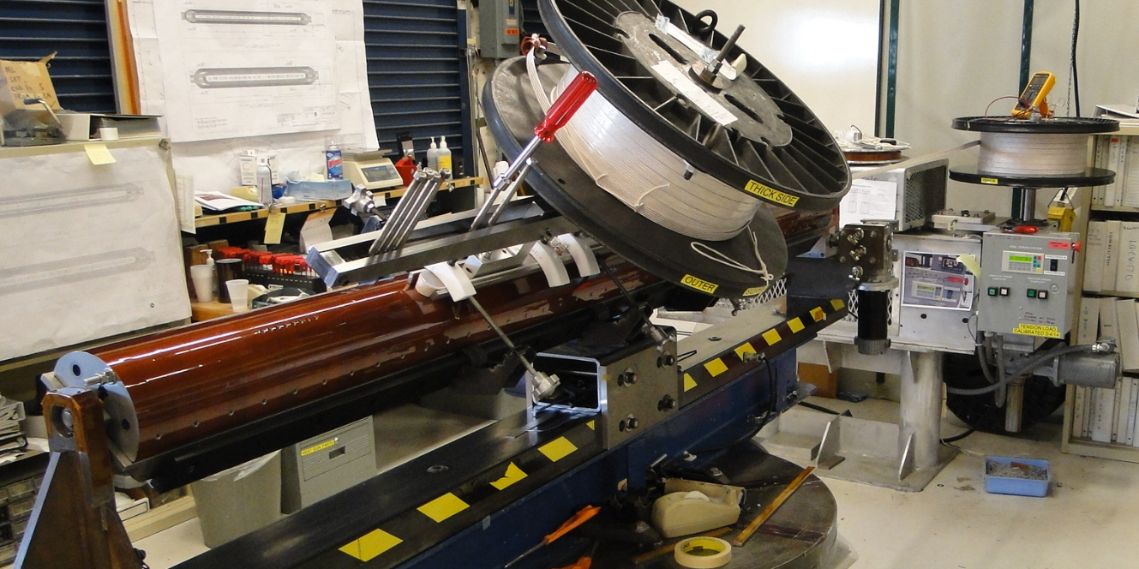
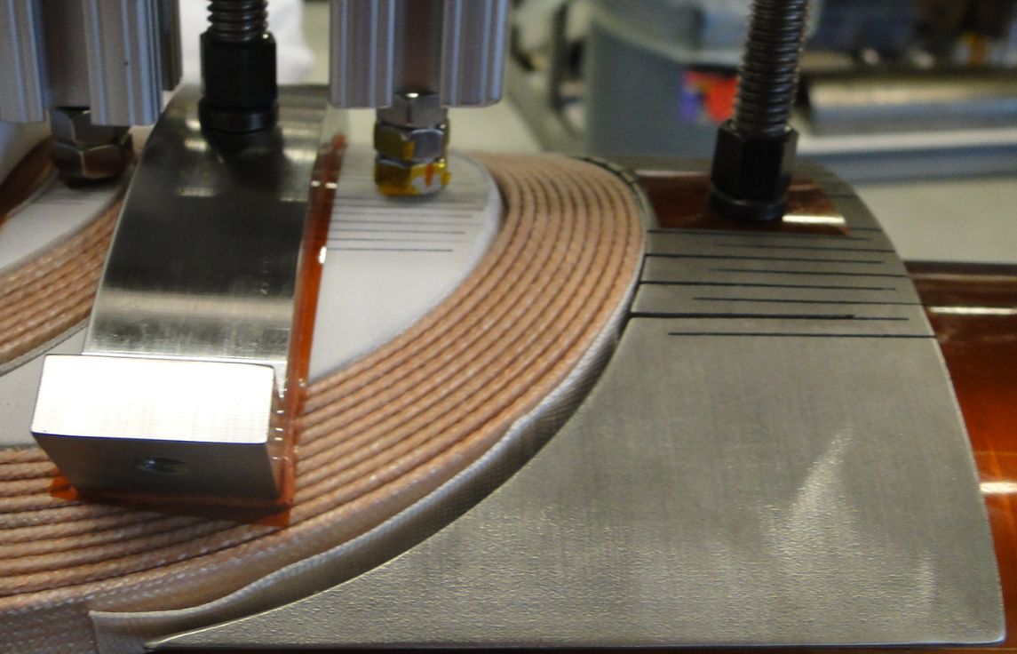
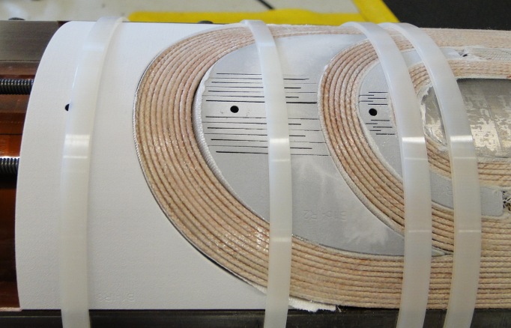
Winding
Winding tension: 9 kg for 1st turn, and then increase to 25 kg
Wind the coil with the tool and the binder (No popped strands, observed from coil 01 cross-section)
End parts fit before/after curing

Slide 4
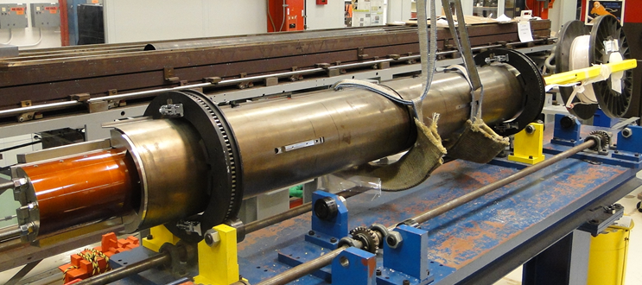
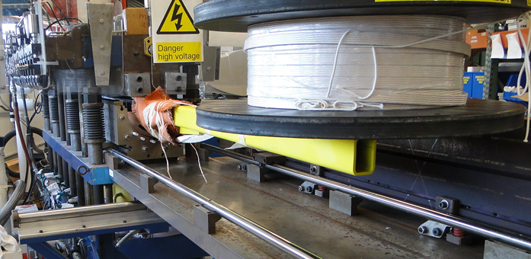
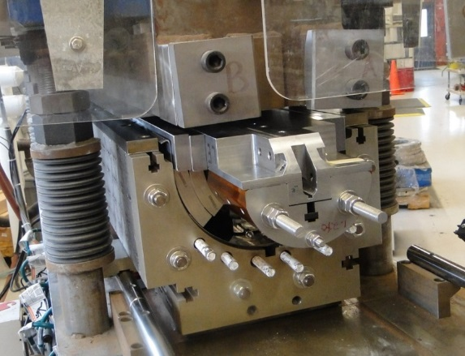
Curing
Apply 90 grams Ceramic Matrix Binder (CTD-1202X) to L1, and 120 grams to L2. (~0.5 gram per meter of cable)
L1 Curing
L2 Curing

Slide 5
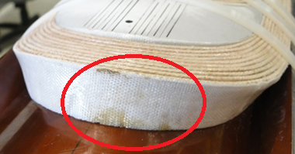
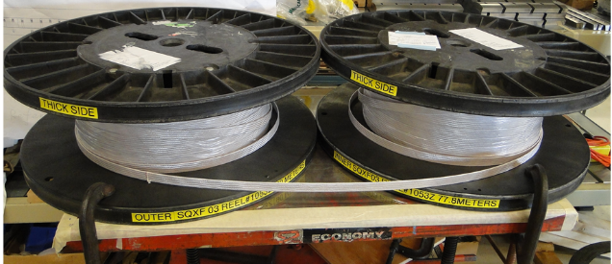
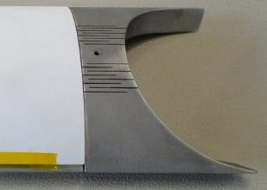
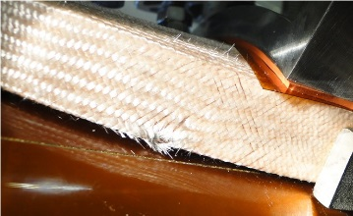
Main Issue and Solution
Coil 01, 02 & 03-L1:
Oil like fluid contaminate the insulation, found after curing.
Cause: The laser sintered part is porous and machine oil can be trapped during slits cut, leaking out during curing.
Solution: Clean the parts before coating (alcohol soak and ultrasonic in water.)
Coil 03:
1. Cable Reverse bending
Cause: not carefully verify the cable orientation on the spool and swapped L1 spool and L2 spool.
Solution: detail description in the traveler to prepare the cable.
2. Insulation damage
Cause: Install L1 LE saddle without removing the connecting screws to the splice block. The saddle was not flexible and cut the insulation during installation. The cable looked OK under magnifier.
Solution: read through each step in the traveler.
Coil 03
Coil 03

Slide 6
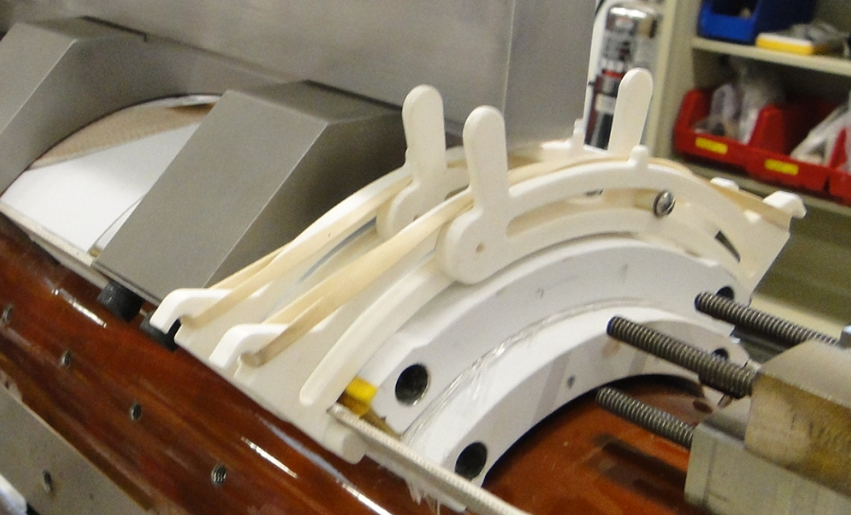
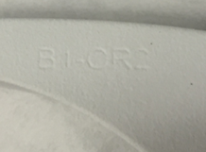
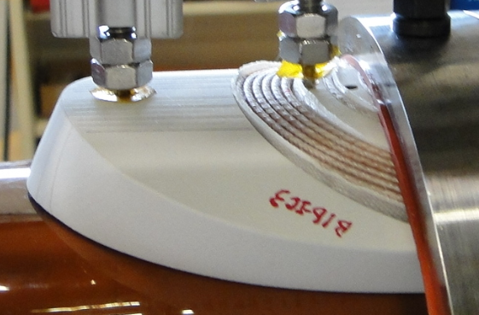
Main Issue and Solution (Cont.)
Coil 04:
L1 LE and RE spacers were swapped, so L1 shifted toward LE by ~10 mm.
Cause: After coating, the identification becomes fuzzy.
Solution: All the parts go through QC carefully and highlight the ID using red marker.
Coil 05: No main issue.
Coil 06:
Plasma coating came off the L2 Splice block
Cause: G10 shim was 1 mm thicker than nominal 3.8 mm, so over compress Nb3Sn lead during curing. During winding, we measure the step size between the saddle and the splice block (usually larger than the nominal due to the flexible saddle).
Solution: Use the nominal size shim
Coil 04
Coil 06
 | Coil 02 | Coil 03 | Coil 04 | Coil 05 | Coil 06
L1 | 4.1 | 4.4 | 4.1 | 3.8 | 4.3
L2 | 4.0 | 4.4 | 4.1 | 3.8 | 4.8

Slide 7
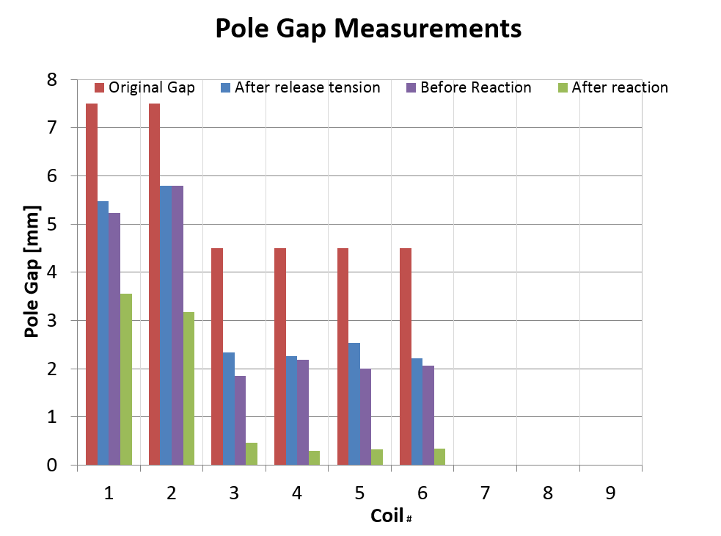
Pole Gap
Due to winding tension and thermal contraction during reaction, pole gap is required to release the strain energy.
After reaction, the target for the pole gap is 0.

Slide 8
Summary
6 MQXF short coils have been wound and cured.
Tooling for winding and curing were checked.
Coil parts were check and fit well in the coil.
Coil 03 insulation damaged during winding, and the cable should be OK.
Coil 04 has 10 mm shift between L1 and L2 due to parts swap.
Coil 05 have no major issue in winding and curing
Coil 06 over compress the L2 lead during curing

