Slide 1
Coil fabrication experience for the 1st generation SQXF coils
Susana Izquierdo Bermudez, Juan Carlos Perez, Eugenio Cavanna, Paolo Ferracin
Joint HiLumi LHC-LARP Annual Meeting/24th LARP Collaboration Meeting
12th May, 2015

Slide 2
Outline
SQXF overview coil design & manufacturing process
SQXF coils production summary
Destructive inspection of coil 101
  Acknowledgments
TE/MSC
E. Cavanna, N. Bourcey, P. Ferracin, R. Gauthier, L. Lambert, J. Mazet, N. Perey, E. Rochepault, J. C. Perez, F-O. Pincot, M. Semeraro and S. Tavares.
EN/MME
B. Favrat, J. Parrilla, T. Sahner

Slide 3
Outline
SQXF overview coil design & manufacturing process
SQXF coils production summary
Destructive inspection of coil 101

Slide 4
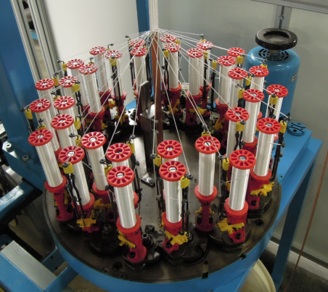
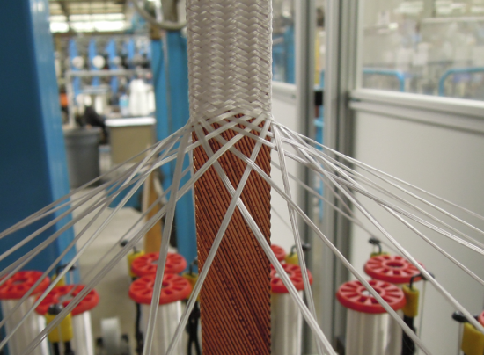
Cable Insulation
AGY S2-glass fibers
  66 tex with 933 silane sizing
32 bobbins
Variables: # of yarn per coil and of picks/inch
Target: 145 μm ± 5 μm per side
Measured insulation thickness within specifications
Samples | Insulation thickness – Sample S1 (µm) | Insulation thickness – Sample S2 (µm) | Insulation thickness – Sample S3 (µm)
Coil 001 | 152 | 144 | 150
Coil 101 | 143 | - | 143
Coil 102 | 145 | 144 | 146
Coil 103 | 147 | 147 | 147
Coil 104 | 142 | 145 | 143

Slide 5
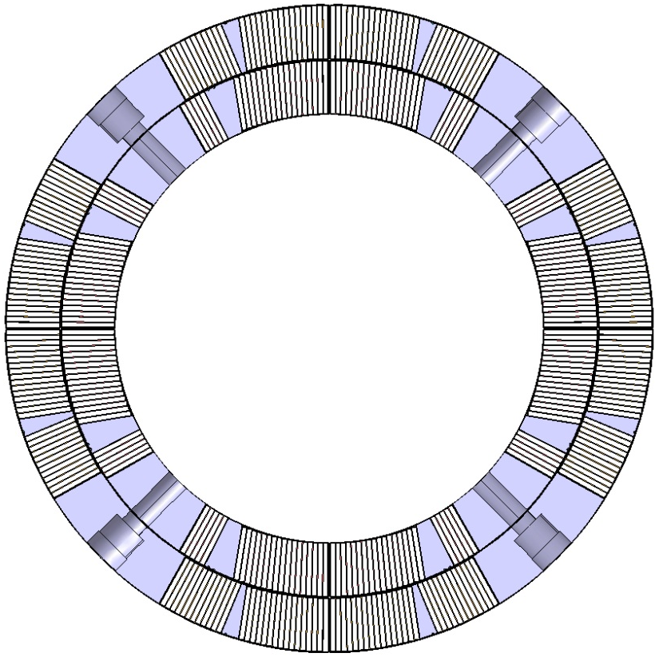
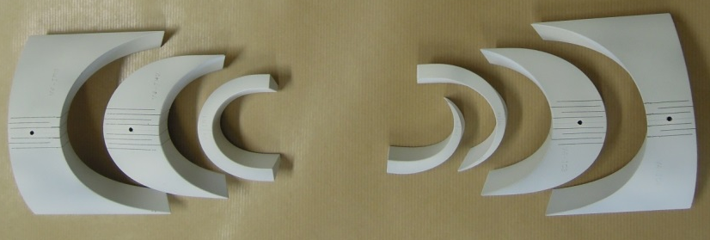
Coil Insulation
2 x 0.175 mm S2 glass around winding pole
0.125 mm S2 glass sleeve around wedges
0.5 mm S2 glass inter-layer insulation
0.125 G11 + 0.125 polymide mid-plan shim (per quadrant)
250 µm coating on end parts
175 µm S2 glass between end parts and the cable

Slide 6
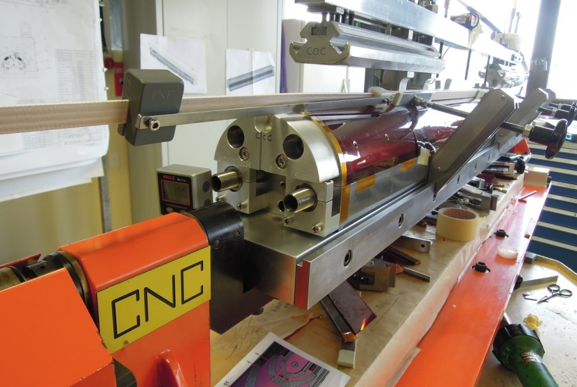
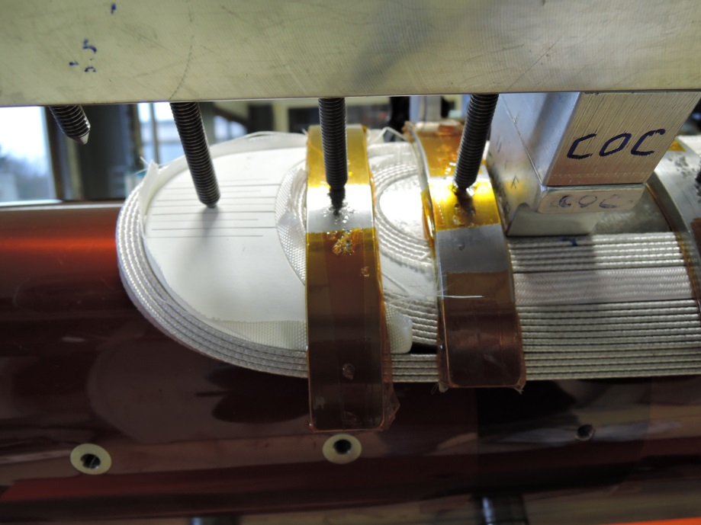
Winding
Winding tension:
25 kg
Winding Direction Inner Layer
favourable (clockwise)
Winding Direction Outer Layer
unfavourable (anti-clockwise)
Winding Technique
winding tool used systematically
no binder applied on the ends
no twist applied on the cable
End parts
produced by SLS (mat. 316L).
slits to make parts flexible
coated using Al2O3
Wedges
two wedges per side and per layer, insulated using a 0.125 mm sleeve
(the two wedge segments are insulated in a unique sleeve)
No particular problems during winding

Slide 7
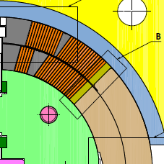
Curing
Curing cavity designed considering the cable dimensions after heat treatment
Assumed growth during HT :4.5% (thickness), 2% (width)
  Bare width x thickness before reaction: 18.150 x 1.525 mm
  Bare width x thickness after reaction: 18.513 x 1.594 mm
Azimuthal additional room per side:
1.5 mm for the inner layer
1.9 mm for the outer layer
Quantity of ceramic binder:
Central part = 33 g (per layer)
Coil ends = 12 g (per end)
Curing cycle parameters:
Pressure to close the mould = 40 bars
Curing temperature = 150°C (2 hours)
Curing pressure
  60 bars for inner layer
  80 bars for outer layer

Slide 8
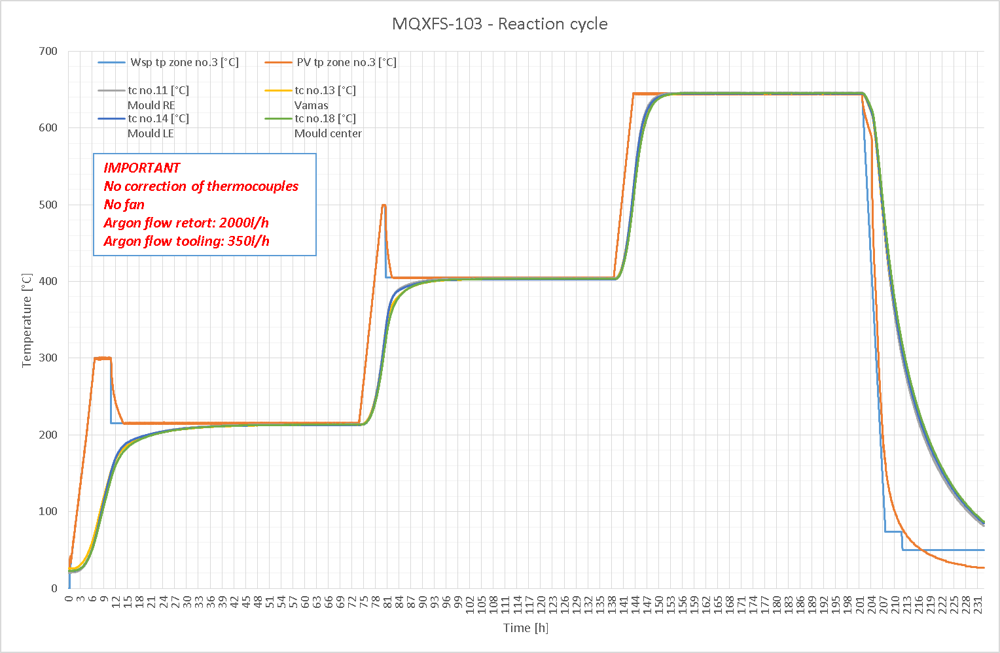
Reaction
Take 103
Coil 101 (practice coil, low grade Nb3Sn) was reacted three times to optimze the reaction oven parameters
  First full heat treatment
  2nd heat treatment done with short plateaus
  3rd heat treatment done only with first plateau
Step | Type | From temp [°C] | To temp [°C] | Rate [°C/h] | Duration [h] | Comments
1 | Ramp | 20 | 300 | 50
2 | Dwell | 300 | 300 | 0 | 4.5
3 | Cool-down | 300 | 210-215
4 | Dwell | 210 | 210 | 0 | 48+15 | As requested by SCD
5 | Ramp | 215 | 500 | 50
6 | Dwell | 500 | 500 | 0 | 1.5
7 | Cool-down | 500 | 400
8 | Dwell | 400 | 400 |  | 48+3.5 | As requested by SCD
9 | Ramp | 400 | 640-665 | 50
10 | Dwell | 640 | 640 | 0 | 50+12 | As requested by SCD
11 | Cool-down | 640 | 20

Slide 9
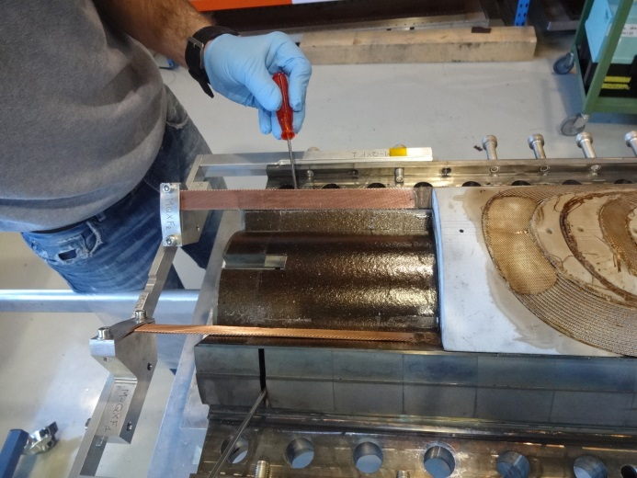
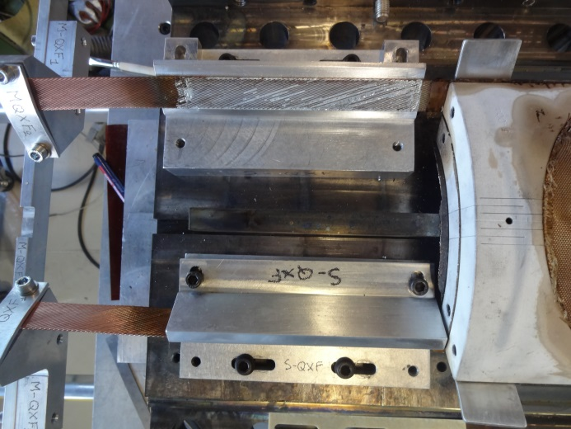
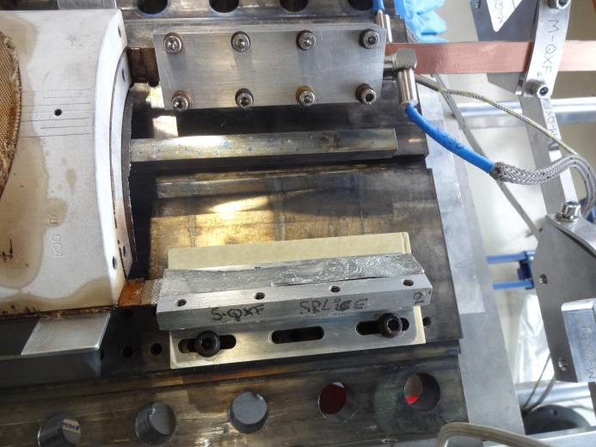
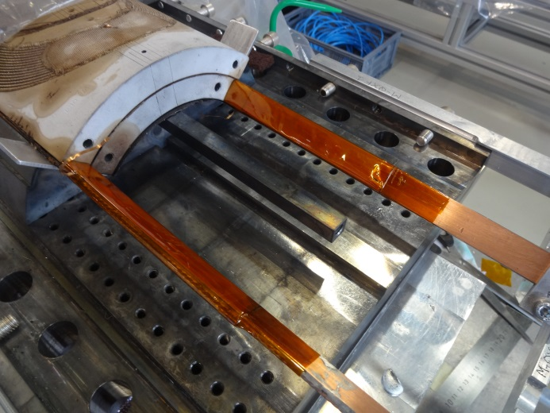
Splicing
Soldering alloy: Sn96Ag4
Soldering flux: MOB39 (non activated)
  Access to both sides of the Nb3Sn cable during splice operation to remove oxidation
Copper stabilizer in the NbTi connection lead

Slide 10
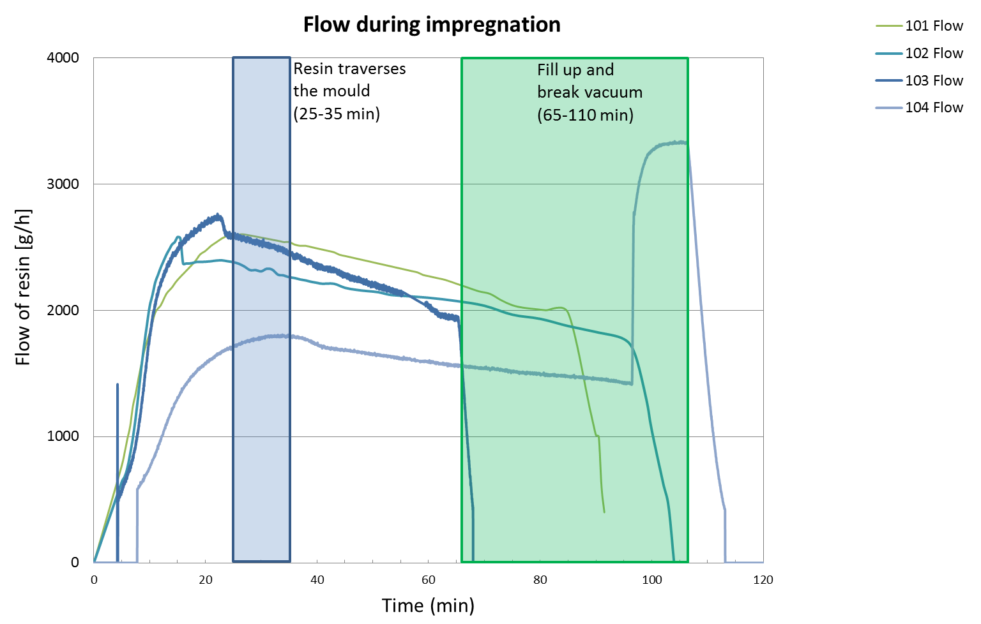
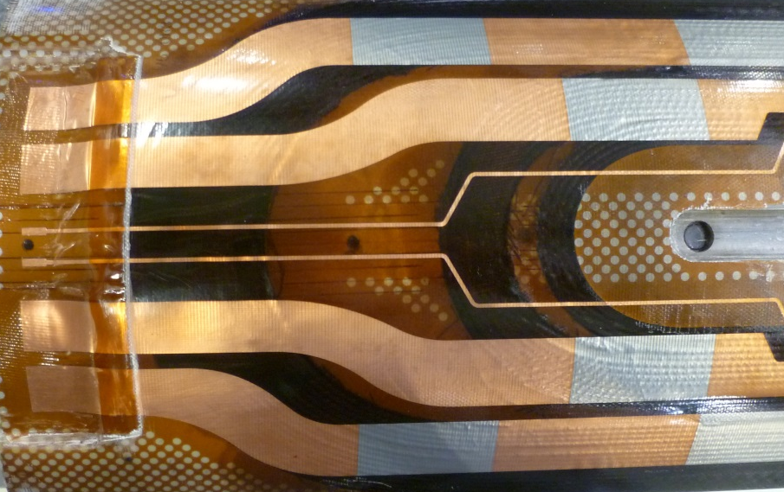
Impregnation
Epoxy CTD 101 K | Temp [C°] | Time | Press. [mbar]
Bake out | 60 | 48 h (minimum) | ~10⁻³
Agitated Degas | 55-60 | 60 min | ~7.5x10⁻²
VPI (ΔP) | 60 | 25-35 min resin across mould 65-110 min in total | ~10⁻³ (chamber) 10⁻² - 5x10⁻² (mould) 500-800 (reservoir)
Gel |  | 3 h | ~10⁻³
Cure | 3 h ramp, 6 h at 110° C, 1 h ramp, 16 h at 125° C
In general, the quality of the impregnation is good

Slide 11
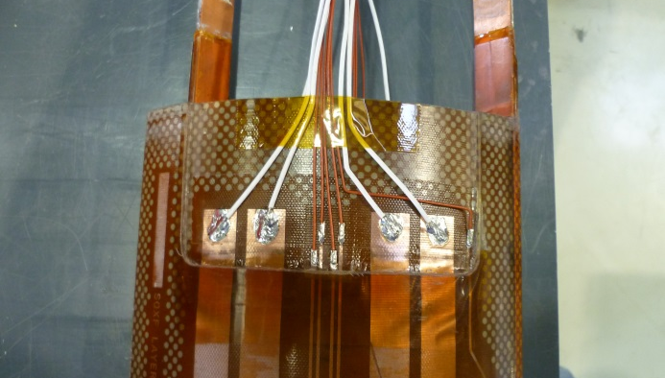
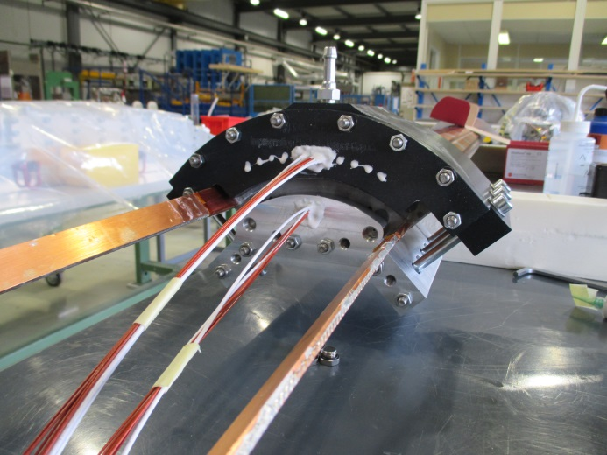
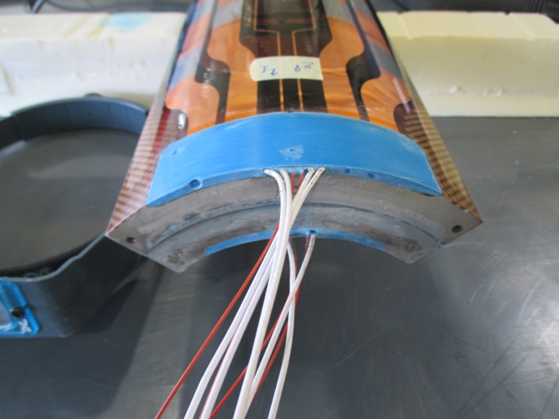
Post-impregnation
After impregnation, quench heater and voltage taps wires are soldered to the pads.
The connection box is then impregnated with Ecobond (same material as the one used broadly in the LHC)

Slide 12
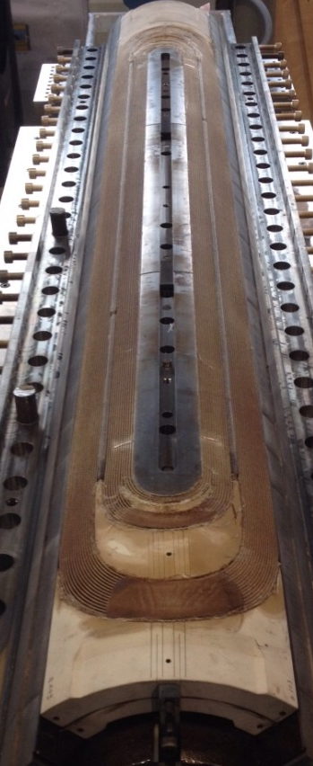
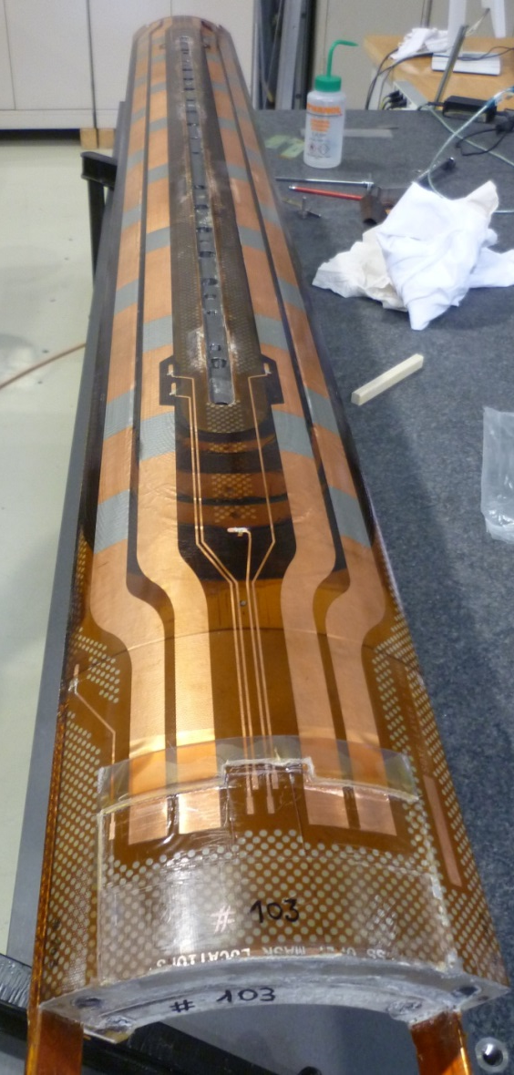
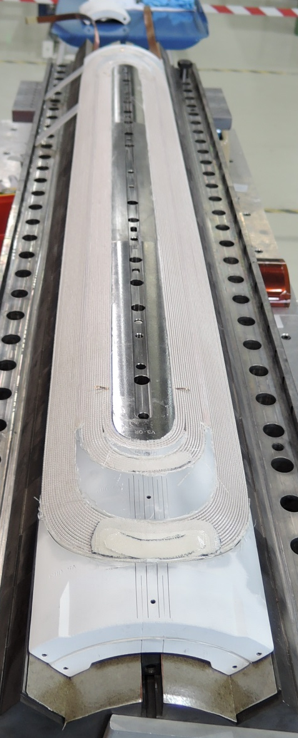
Coils at different manufacturing stages
After curing
After reaction
After impregnation

Slide 13
Outline
SQXF overview coil design & manufacturing process
SQXF coils production summary
Destructive inspection of coil 101

Slide 14
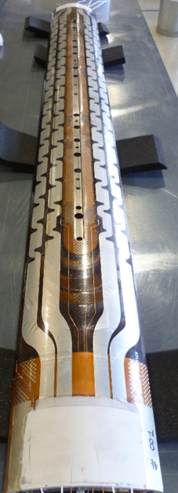
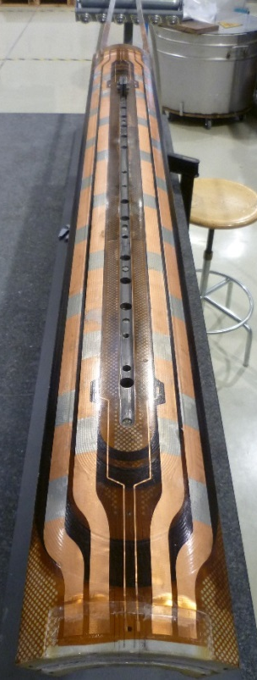
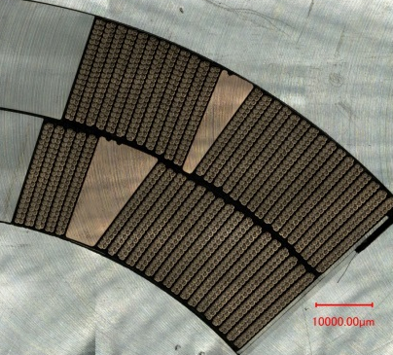
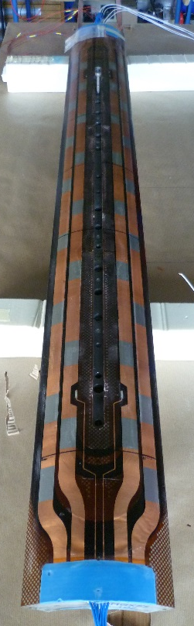
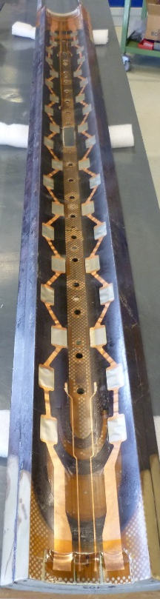
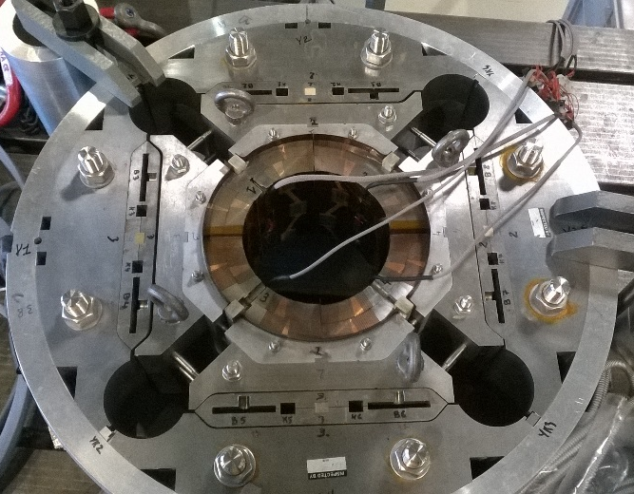
SQXF coils production summary
Coil 001 | Coil 101 | Coil 102 | Coil 103 | Coil 104
Copper | Nb3Sn low grade | Nb3Sn | Nb3Sn | Nb3Sn
Practice coil | Practice coil | Spare coil | Coil for SQXF1 | Coil for SQXF1
Aim of the coil: Development manufacturing process Tooling Commissioning Electrical QA limits | Aim of the coil: Study of conductor position Coil ends validation Mechanical mock-up Electrical QA limits | Issues during production? Overshoot on the VAMAS during reaction treatment Problem on the splice | Issues during production? No | Issues during production? No
Coils for the first short model

Slide 15
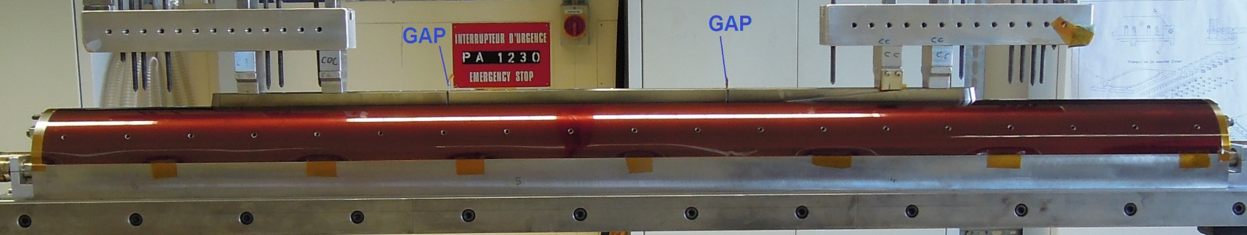
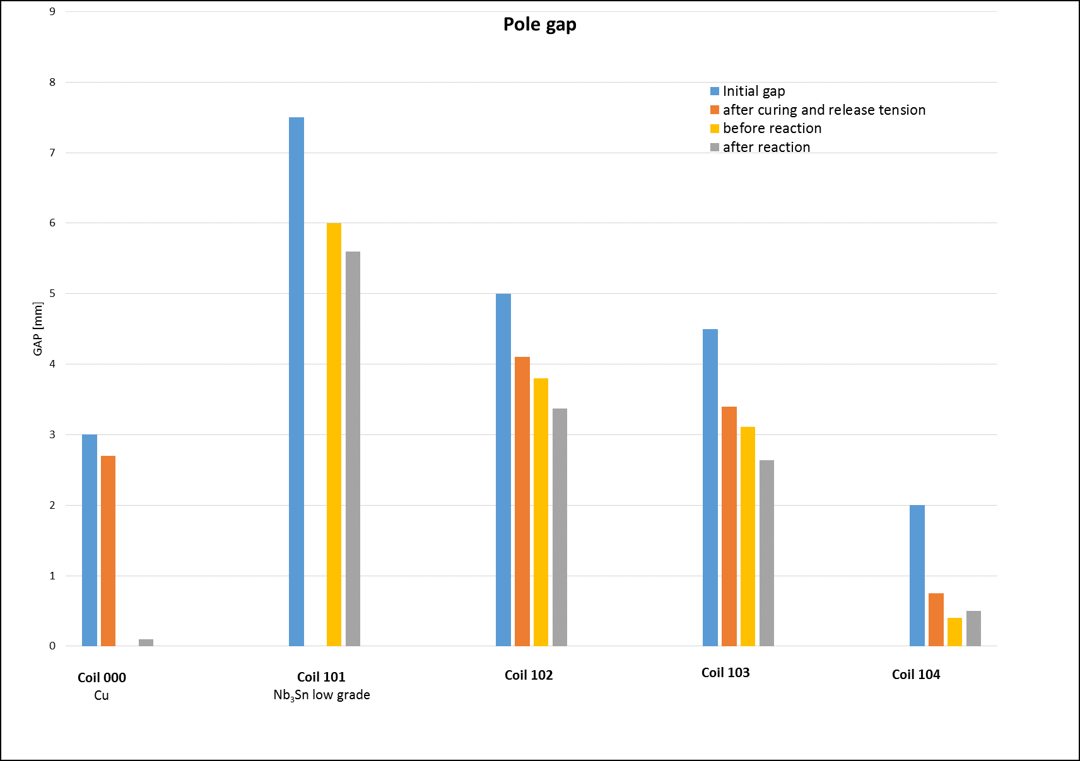
Pole gap
Gap reduces by 1.2 to 1.6 mm when releasing the winding tension.
During heat treatment, longituindal coil contraction 0.4 – 0.5 mm
For coil 104, no contraction of gap during heat treatment
Coil # | Initial [mm] | After curing [mm] | Before HT [mm] | After HT [mm]
001 | 3 | 2.7 |  | 0.1
101 | 7.5 |  | 6 | 5.6
102 | 5 | 4.1 | 3.8 | 3.37
103 | 4.5 | 3.4 | 3.11 | 2.64
104 | 2 | 0.75 | 0.4 | 0.5

Slide 16
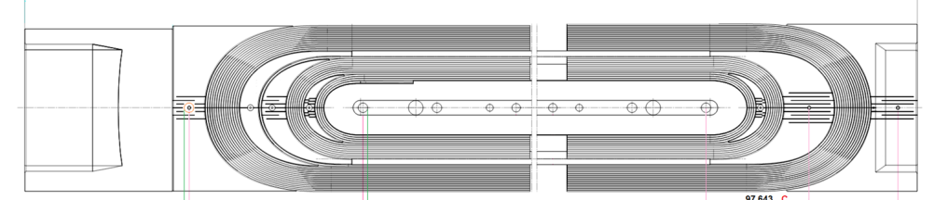
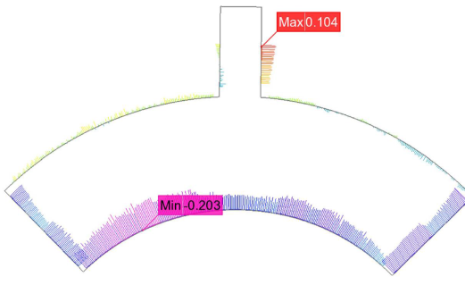
Overall coil dimensions
Coils are 2 – 5 mm longer than nominal
Coil overlength (mm)
mm | Inner layer | Inner layer assuming pole gap =0 | Outer layer | Outer layer assuming pole gap =0
101
102 | -- | -- | 5.4 | 2.03
103 | -- | -- | 9 | 6.36
104 | 4.65 | 3.9 | 5.16 | 4.66
Coils are typically 100 µm smaller than nominal in the radial direction and about 200 µm smaller in the azimuthal direction
Average azimuthal deviation ~100 µm
Average deviation from nominal radial thickness ~100 µm
Average azimuthal deviation ~100 µm

Slide 17
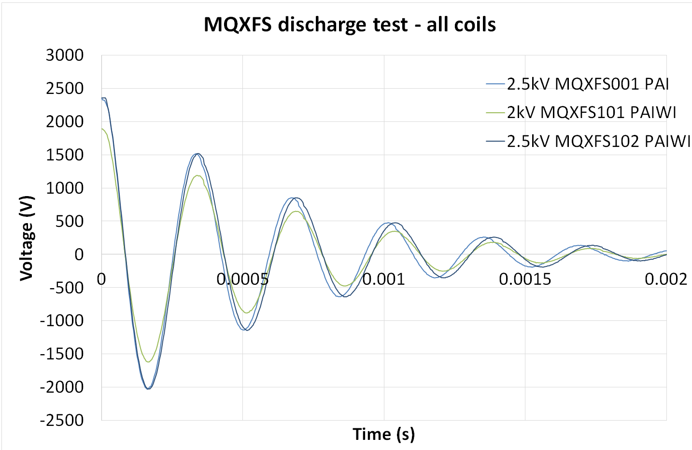
Electrical QA
Coils 001 and 101 have been used to check the limits in terms of coil electrical integrity.
  Discharge test coil 001~ 3.5 kV
  Discharge test coil 101> 5 kV
From coil 102, standard electrical tests
  Coil 102 passed all the tests (only a weak point on the insulation QH to end shoe)
  Coils 103 and 104 to be tested in the coming days
MQXF Set-point test
MQXFS_102 | coil
All QHs | 2500 / 2500 | All QHs
Endshoe CS | 1000 / 1000 | 2500/ 2500
Endshoe NCS | 1000/ 1000 | 2500/ 2000
Central post | 500 / 500
U1 / U2 = MQXF Target (V) / measured (V)

Slide 18
Outline
SQXF overview coil design & manufacturing process
SQXF coils production summary
Destructive inspection of coil 101

Slide 19
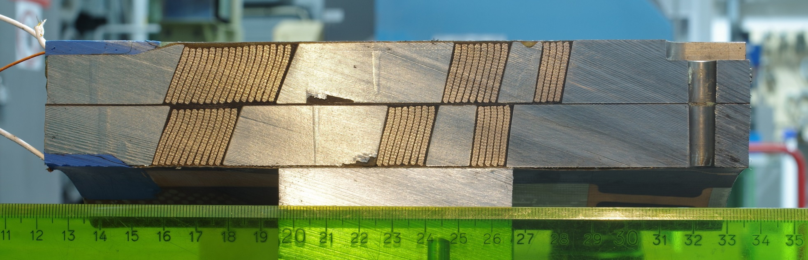
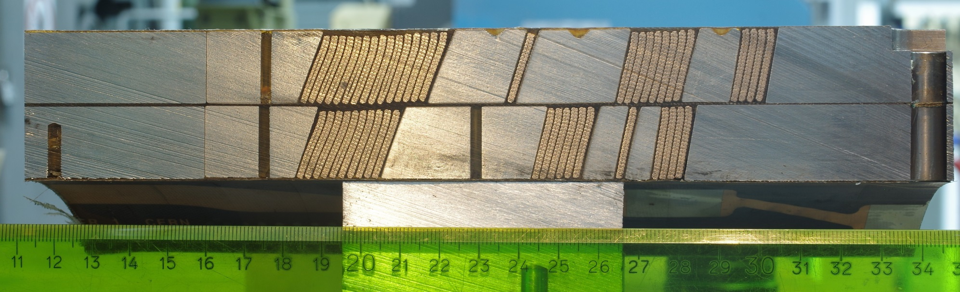
Coil Ends – Coil 101

Slide 20
Coil Ends – Coil 101
Comparison to nominal conductor position shows good agreement
(only small deviation in the last blocks)

Slide 21
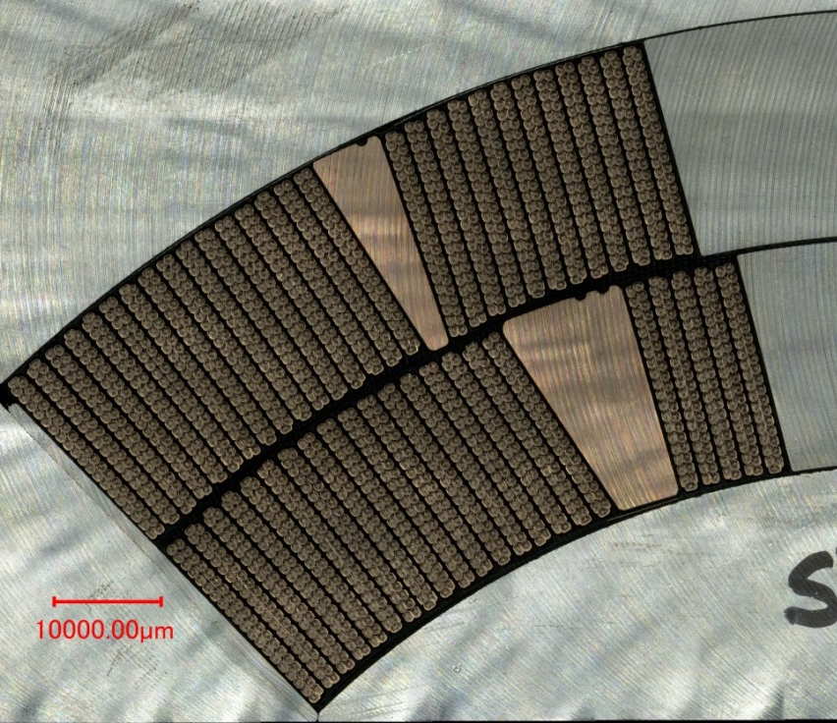
Coil cross section – Coil 101
Radially, there is ~ 600 µm of free space filled by epoxy (due to the overestimation on conductor expansion due to heat treatment). Conductor are aligned in the outer diameter.
Pole turns and mid-plane are well aligned, but conductors in between are tilted (up to ~ 500 µm) when compared to the nominal conductor position

Slide 22
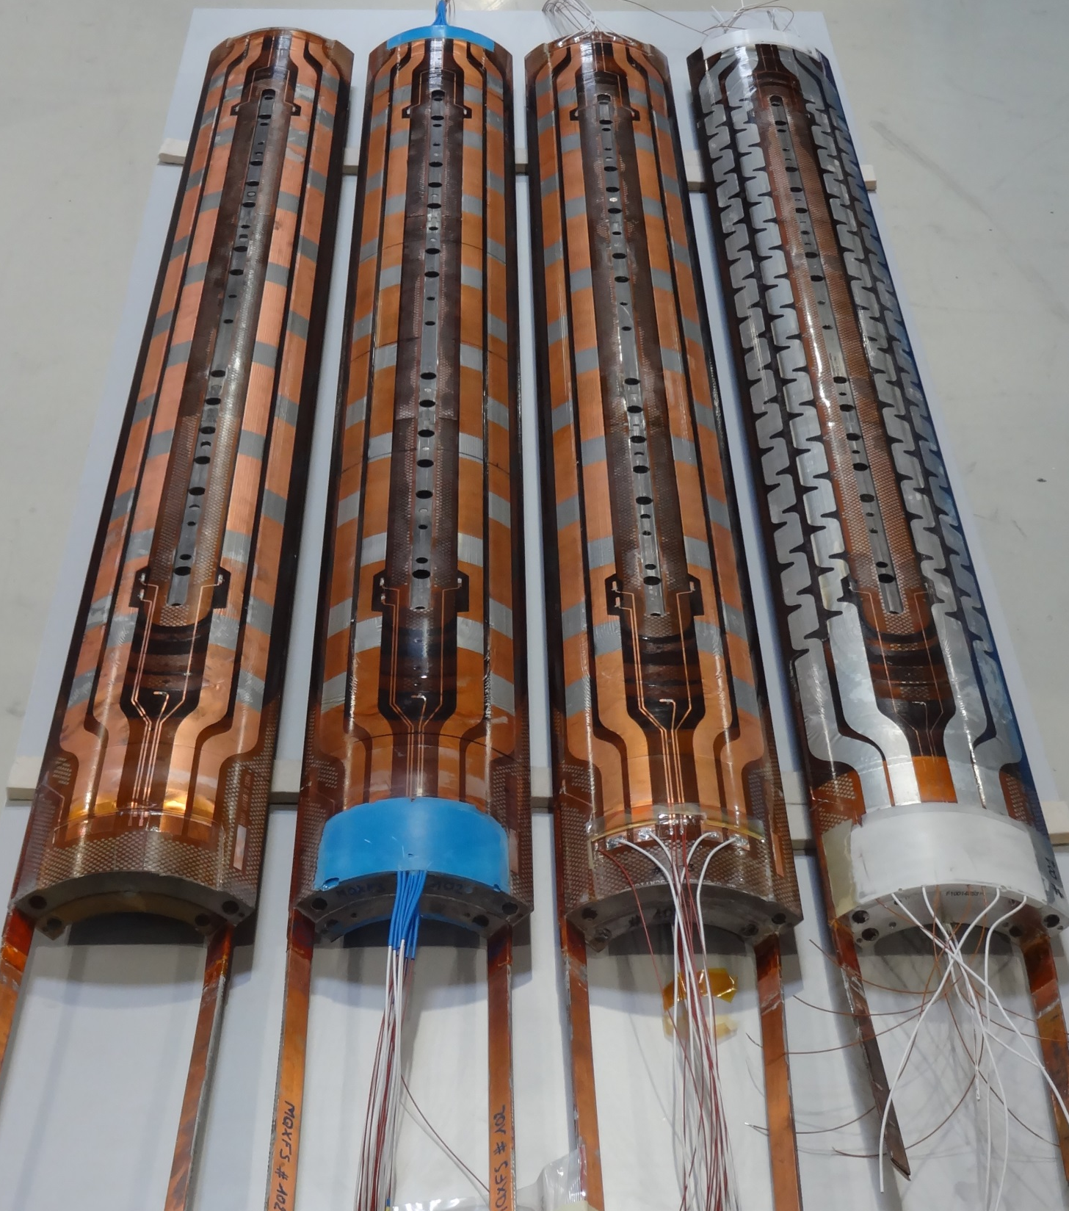
Summary
Coil 001 (Copper) and coil 101 (Low Grade RRP Nb₃Sn) have been used to validate the manufacturing process/tooling
The splice region of coil 102 (RRP) is partially damage, but is potentially a good coil to be tested in a mirror structure.
Coil 103 (RRP) and 104 (RRP) will be used in the first MQXFS1 short model if electrical checks are OK.
Two additional practice coils for the first generation MQXF design will be produced using PIT conductor.

Slide 23
Additional slides

Slide 24

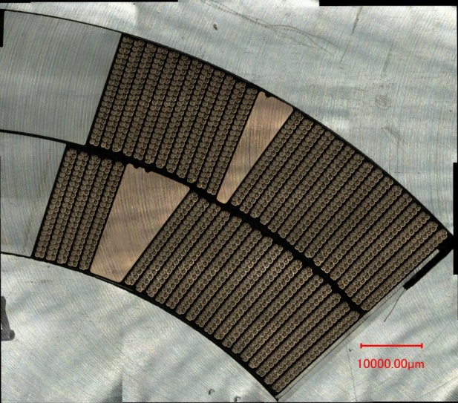
Coil cross section – Coil 101
AZIMUTHAL ALIGNMENT

Slide 25
Coil cross section – Coil 101
RADIAL ALIGNMENT

Slide 26

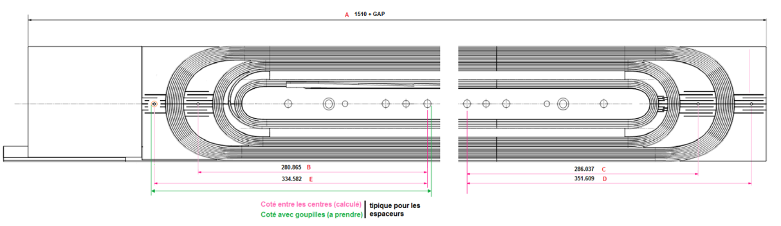
Coil compaction
Difference (mm) in coil compaction return end with respect to nominal:
(>0 means ends less compacted than nominal)
mm | IL after curing | IL after reaction | OL after curing | OL after reaction
101
102 | -0.75 | -- | -0.43 | 0.95
103 | 1.94 | -- | 2.55 | 3.06
104 | 0.79 | 1.15 | 0.72 | 1.53
IL RE
OL RE
Difference (mm) in coil compaction lead end with respect to nominal
(>0 means ends less compacted than nominal)
mm | IL after curing | IL after reaction | OL after curing | OL after reaction
101
102 | 1.15 | -- | 1.4 | 1.37
103 | 3.12 | -- | 3.38 | 3.94
104 | 1.44 | 2.17 | 2.4 | 2.92
IL LE
OL LE

Slide 27
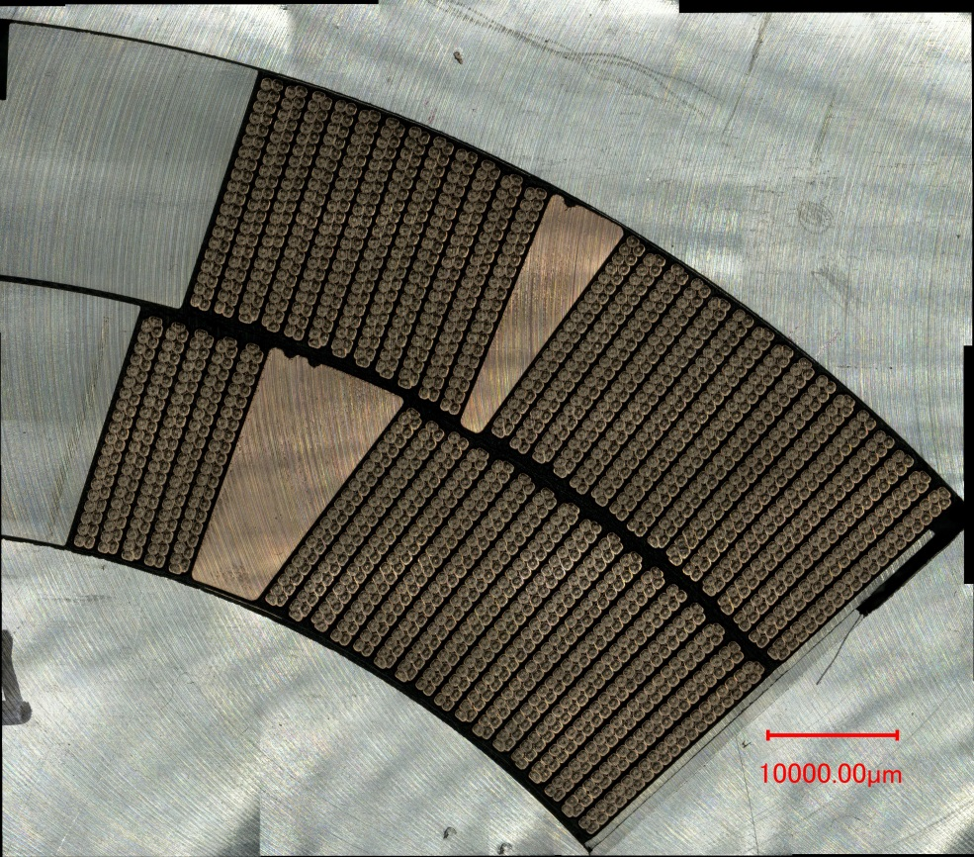
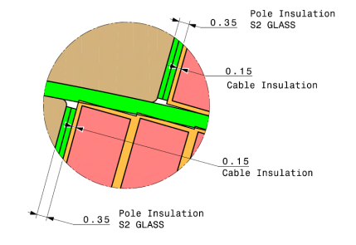
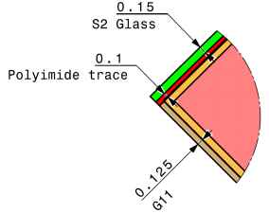
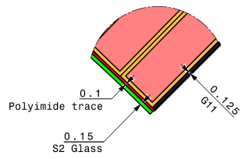
Coil insulation – Coil 101
3
# |  | Nominal (µm) | Measured (µm) | Δ (µm)
1 | IL IR pole | 250 | 200 | -50
2 | IL OL pole | 500 | 460 | -40
3 | OL OR pole | 250 | 250 | 0
4 | IL PT | 500 | 445 | -55
5 | OL PT | 500 | 480 | -20
6 | MP IL | 275 | 290 | 15
7 | MP OL | 275 | 260 | -15
8 | IL IR MP | 400 | 900 | 500
9 | IL OL MP | 800 | 930 | 130
10 | OL OR MP | 400 | 350-590
5
2
A
4
B
10
1
9
7
6
8
C
A
B
C

Slide 28
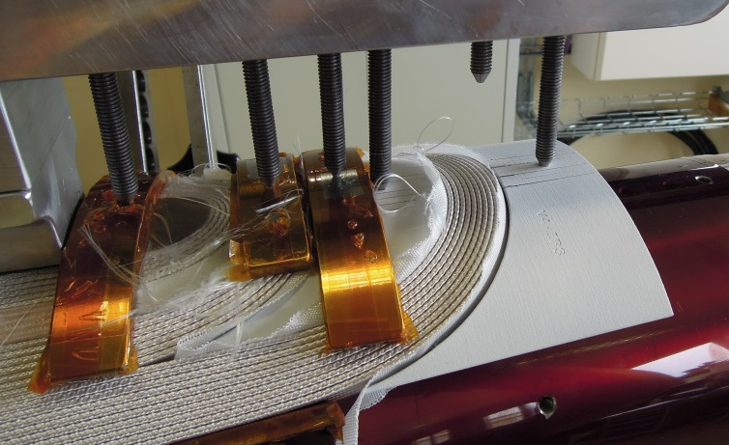
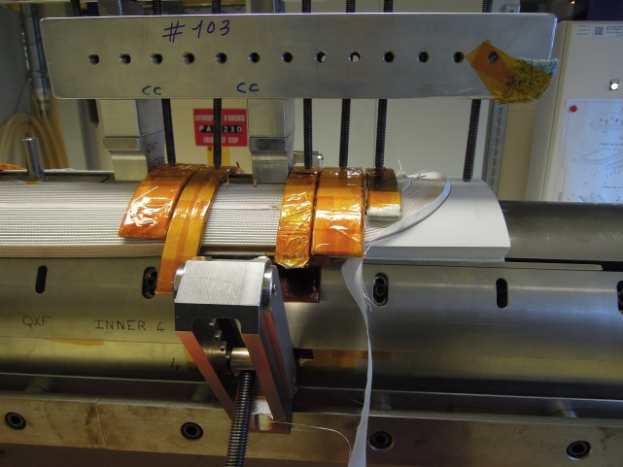
Coil Ends
In general, good fitting of coil end parts.
Position and inclination of the conductors in the end regions during winding and compared to the nominal turn location.
The measurements are usually within give number (I think is about 0.5 mm)

Slide 29
Electrical QA – Coil 001 - Limits
MQXFS Dielectrique measurement
equipment : | Megger
Time : | 30s | insulation (GOhm)
 | 5min | current leakage (nA)
U1 / U2 / U3 = LHC quality standard (V) / max setpoint tested (V) / Breakdown voltage (V)
MQXFS_001
 | coil | QH inner | QH outer | Endshoe inner CS | Endshoe inner NCS
QH inner | 2350 / 4000 / 5000
QH outer | 2350 / 5000 / 5500
Endshoe inner CS |  | 2350 / 2000 / xxxx
Endshoe outer CS |  |  | 2350 / 2000 / xxxx | xxxx / 1000 / 2000
Endshoe inner NCS |  | 2350 / 2000 / xxxx
Endshoe outer NCS |  |  | 2350 / 2000 / xxxx |  | xxxx / 1000 / 1500
Central post | xxxx / 500 / 1000
Remarks :
LHC quality standard
Vq = 1000 | Vq maximal voltage in the coil during quench
Vtest between QH and coil around 2350V
Vtest between coil and ground around 3500V

Slide 30
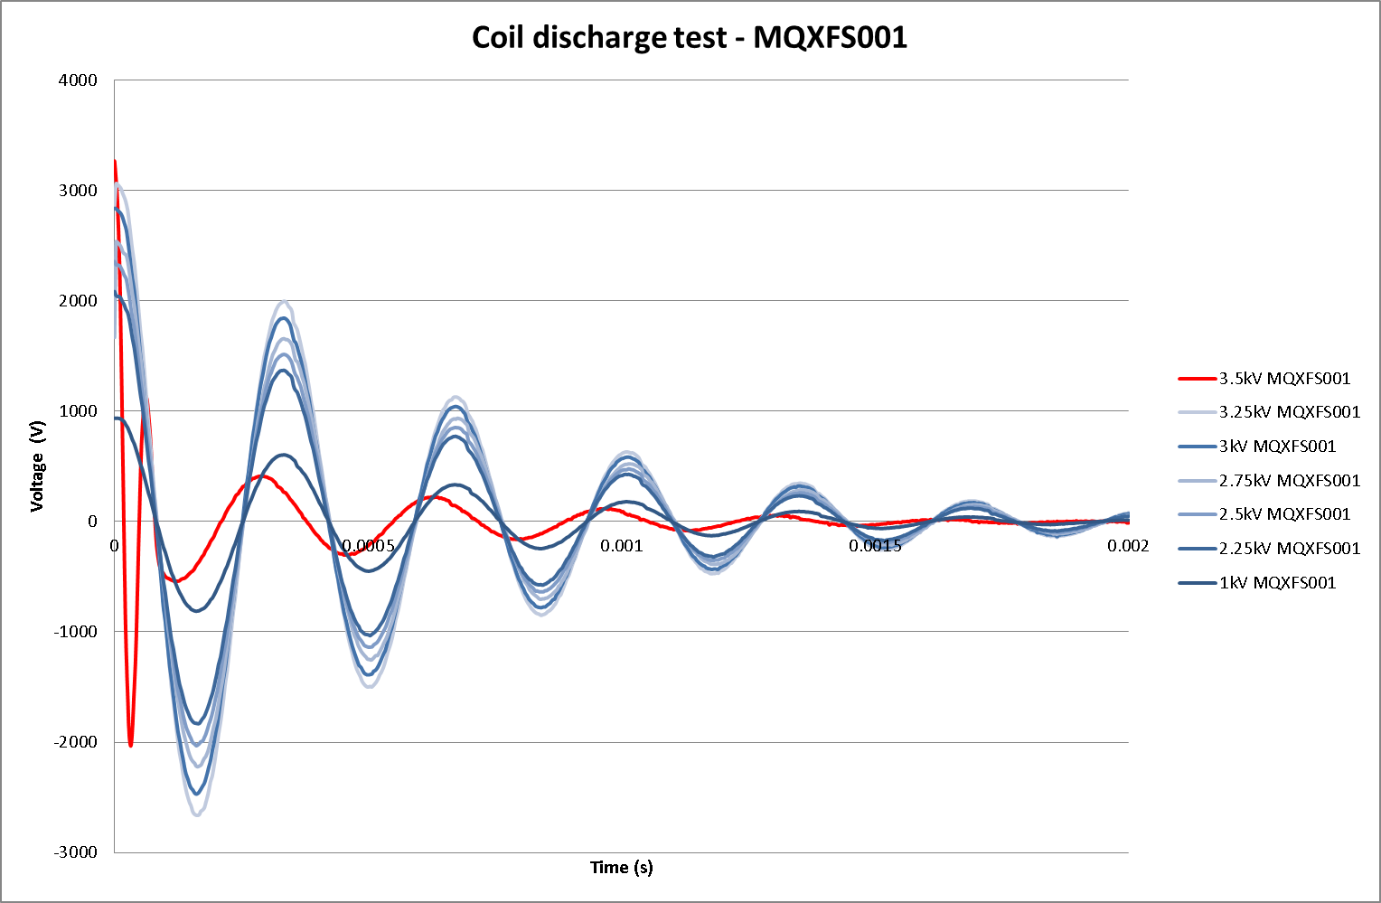
Coil 001 – Discharge test

Slide 31
Electrical QA – Coil 101 - Limits
MQXFS Dielectrique measurement
equipment : | Megger
Time : | 30s | insulation (GOhm)
 | 5min | current leakage (nA)
U1 / U2 / U3 = LHC quality standard (V) / max setpoint tested (V) / Breakdown voltage (V)
MQXFS_101
 | coil | QH inner | QH outer | Endshoe inner CS | Endshoe inner NCS
QH inner | 2350 / 2000 / 3000
QH outer | 2350 / 5000 / 6000
Endshoe inner CS | xxxx / short / short | 2350 / 2000 / xxxx
Endshoe outer CS | xxxx / 3000 / 4000 |  | 2350 / 2000 / xxxx | xxxx / 3000 / 4000
Endshoe inner NCS | xxxx / 500 / 1000 | 2350 / 1000 / 2000
Endshoe outer NCS | xxxx / 3000 / 4000 |  | 2350 / 2000 / xxxx |  | xxxx / 2000 / 3000
Central post | xxxx / 500 / 1000
Remarks :
LHC quality standard
Vq = 1000 | Vq maximal voltage in the coil during quench
Vtest between QH and coil around 2350V
Vtest between coil and ground around 3500V

Slide 32
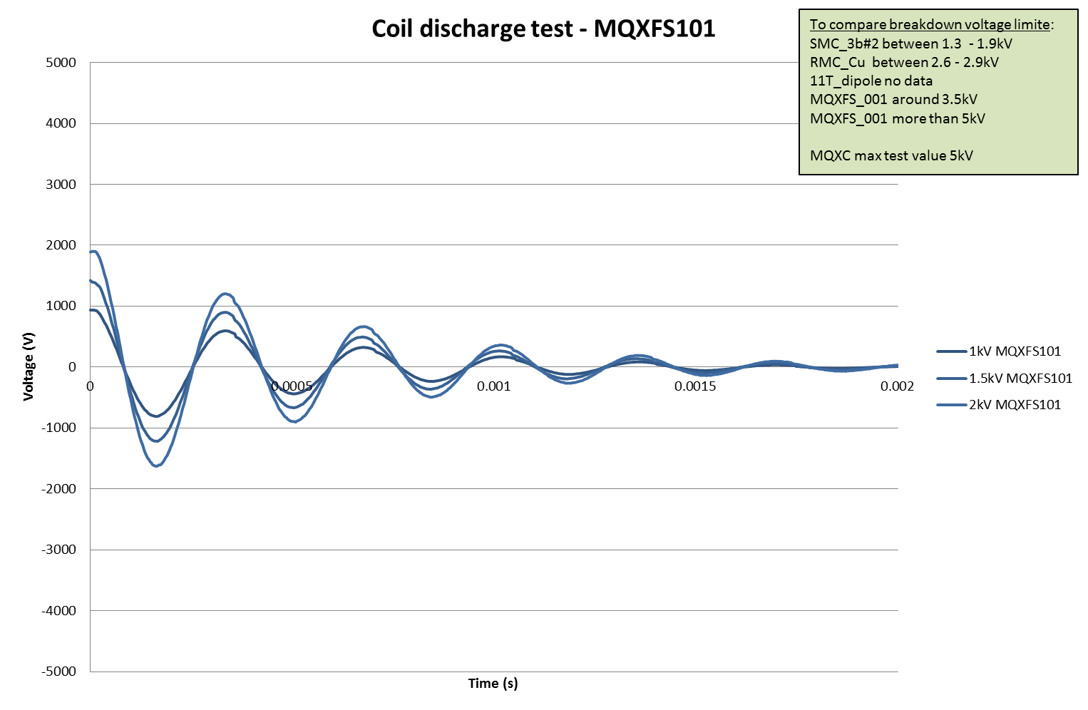
Coil 101 – Discharge test

Slide 33
Electrical QA under QXF criteria (1)
MQXFS_001 | coil
QH inner | 2000 / 2000
QH outer | 2000 / 2000 | QH inner | QH outer | Endshoe inner CS | Endshoe inner NCS
Endshoe inner CS |  | 1000/ 1000
Endshoe outer CS |  |  | 1000 / 1000 | 600 / 600
Endshoe inner NCS |  | 1000 / 1000
Endshoe outer NCS |  |  | 1000 / 1000 |  | 600 / 600
Central post | 500 / 500
MQXFS_101 | coil
QH inner | 2000 / 2000
QH outer | 2000 / 2000 | QH inner | QH outer | Endshoe inner CS | Endshoe inner NCS
Endshoe inner CS | 0 / 1200 | 1000/ 1000
Endshoe outer CS | 1200 / 1200 |  | 1000 / 1000 | 600 / 600
Endshoe inner NCS | 500/1200 | 1000 / 1000
Endshoe outer NCS | 1200 / 1200 |  | 1000 / 1000 |  | 600 / 600
Central post | 500 / 500

Slide 34
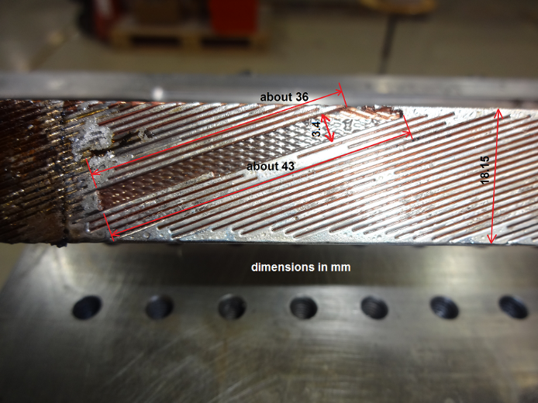
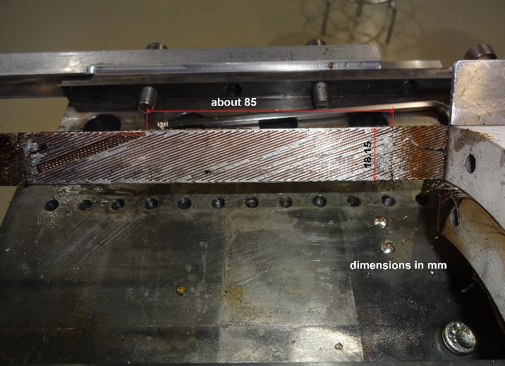
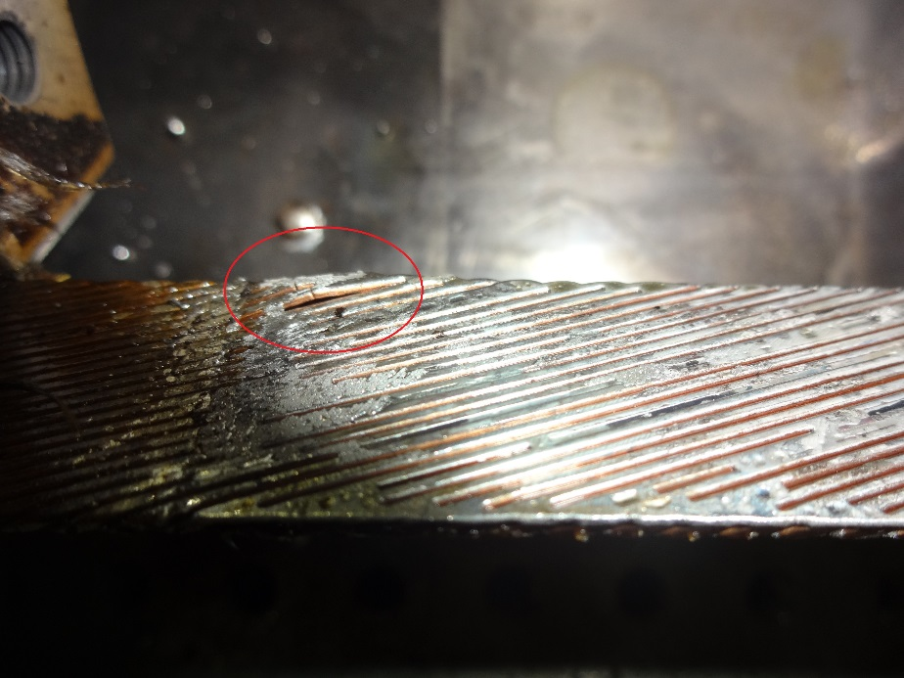
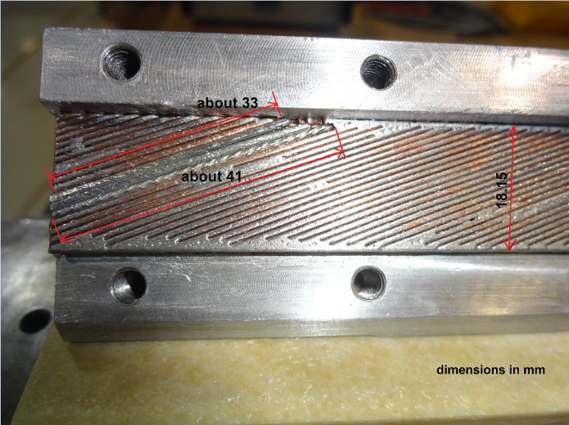
Damage on splice region
In coil 102, some strands broken at the splice region while dismounting the mould for pre-tinning.
The space has been filled with strands of NbTi

Slide 35
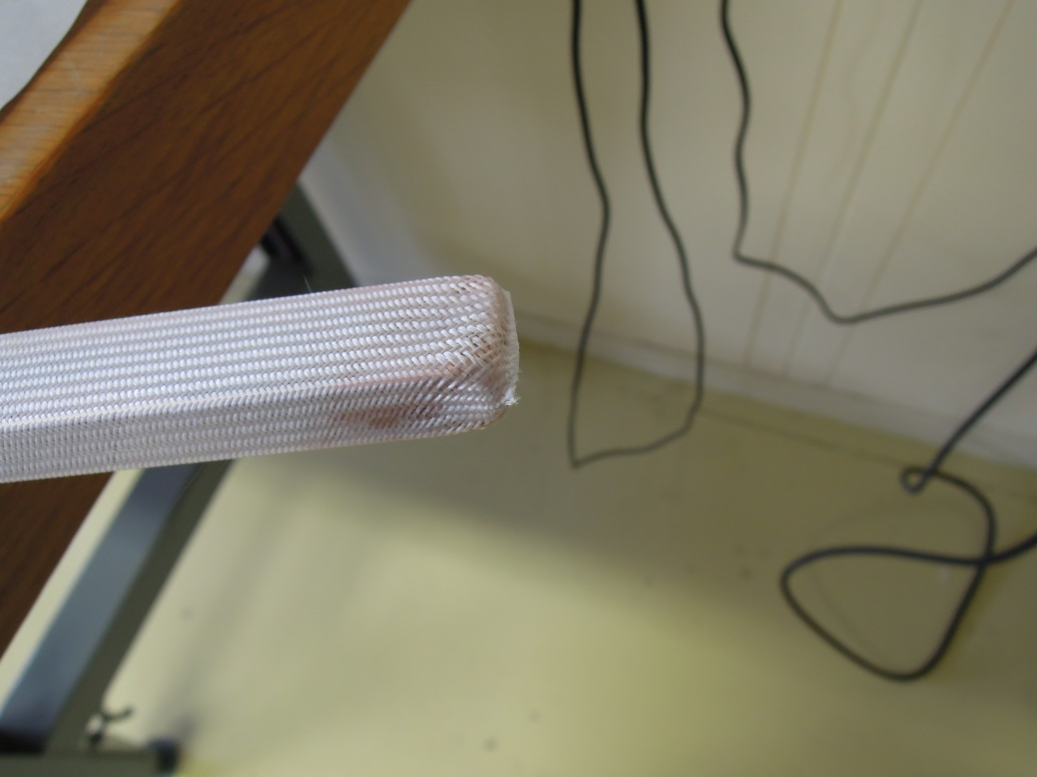

Wedges
Wedge insulation
  S2 Sleeve 0.125 mm thick
  1 sleeve for 2 pieces
  Extremities insulated to “lock” better the sleeve

Slide 36

Wedge dimensions
Outer layer
  Layer-jump side
    nominal in the CAD model 1004.06 mm
    800 mm + 203 mm
      1 mm (0.5 mm per extremity) shorter
  Side opposite to layer jump
    nominal in the CAD model 1014.24 mm
    800 mm + 213 mm
      1 mm (0.5 mm per extremity) shorter
Inner layer
  Layer-jump side
    nominal in the CAD model 1038.37 mm
    800 mm +237 mm
      1 mm (0.5 mm per extremity) shorter
  Side opposite to layer jump
    nominal in the CAD model 1042.85 mm
    800mm + 241mm
      1 mm (0.5 mm per extremity) shorter
We have to keep in mind that we have 3 mm pole gaps
~ 800
~200

Slide 37





End Spacers Selective Laser Sint.
Design file with a detailed description of the manufacturing parameters.
Any modification on the parameters shall be communicated and approved by CERN
1. Parts build up by SLS
5. Sand blasting
Step 1: Glass bead blasting to remove adhered grain
Step 2: Metal ball blasting to compress surface
6. 3D scan + re-work if required
4. Holes and threads
7. Wire EDM grooves
2. Stress relief treatment
650˚C 2h
(heating up 1.5 h, cooling 13 h in the oven)
3. Supports removal

Slide 38


Coating (Al2O3)
Electrical tests performed on 18 qualifying samples Parameters varied:
Bonding agent → Ni80Cr20, NiCrAlY or none
Thickness of the bonding agent → 0.03 mm or 0.05 mm
Roughness of the stainless steel substrate → NK16, NK20 or NK40
Temperature of the metallic substrate during deposition → no preheating or 200-300°C
No cracks in this region after reaction and cool down to 77K
After cool down to 77K, cracks in this region in 15 samples out of 18
The measured breakdown voltage was always above 750 V
(even after reaction at 650°C + cool-down at 77K).
Notes:
No cracks were ever observed in the groove of the samples (inner cylinder or walls) neither after reaction at 650 C, nor after cool-down at 77K. Only cracks were detected in the outer diameter of sample #4 after reaction. After cool-down at 77K cracks appeared in this region in all the samples except #7, #9 and #18. The presence of cracks in this region didn’t affect the electrical tests.
ELECTRICAL TESTS
The insulation resistance at 500, 750, 1000 and 1250 V during 30 s was measured for all samples as well as the breakdown voltage. Very similar trends are observed in all samples. The measured breakdown voltage was always above 750 V (even after reaction at 650 C + cool-down at 77K).
The highest insulation resistance and breakdown voltage were recorded for sample #12 (NK 16 finishing, 0.01-0.03 mm of NiCrAlY). However, sample #11 was coated using exactly the same parameters and didn’t perform as well as #12.
#15 and #16 are the pair of samples sharing the same coating parameters (NK 40 finishing, 0.01-0.03 mm of NiCrAlY) that performed marginally better than the rest: highest values of insulation resistance at 1kV after reaction, and breakdown voltage above 1 kV after the 650 C thermal cycle.

Slide 39

Too long to reach the dwell… decision to use SQXF-101 to optimize the cycle!
Remarks:
No ventilation in the retort
Argon flow 2500-3000l/h in the retort

Slide 40
Instrumentation layout SQXF-101
tc19
Position of the thermocouple in block 5, 16 and 28.
tc20
tc14

Slide 41


Slide 42


Slide 43


Slide 44


Slide 45


NbTi / copper stabilizer soldering lay out
Splice soldering lay-out

