Slide 1
LARP: Status & Challenges
G. Apollinari
LARP Director
24th LARP Collaboration Meeting
May 11th, 2015

Slide 2

Some Definitions !
LARP (FY15-FY17/18):
  Continue LHC R&D with emphasis on minimizing risk of US in-kind deliverables for HL-LHC Project.
    Deliver 5 QXF Models/Prototypes & 4 dressed CC (SPS Test)
    Support Toohig Fellowship and - if possible - Acc. Phys. activities
US-HiLumi (FY18-FY24):
  US in-kind deliverable to HL-LHC, controlled as a 413.3b Project
    Follows
      DOE-CERN agreement on ICA (now)
      DOE-CERN Protocol (end CY15)
      Coll. Agreement with in-kind deliverables
      (early CY16?)
“LARP2” (FY??-FY30):
  Hypothetical program to support US intellectual involvement in HL-LHC while US-HiLumi is being executed or HL-LHC operates

Slide 3
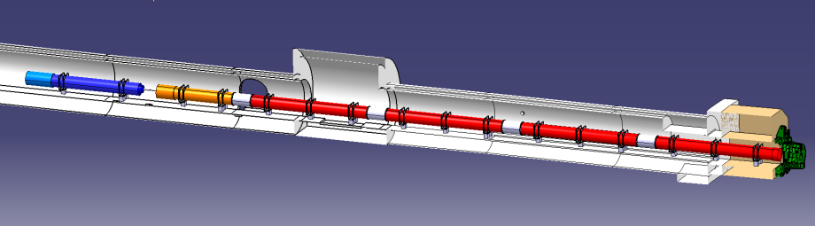





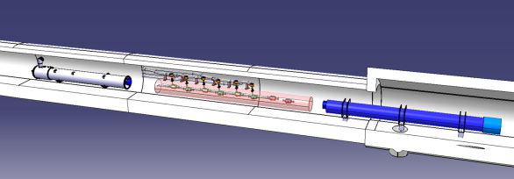


New IRs
ATLAS
CMS
Q1-Q3 : R&D, Design, Prototypes and in-kind USA
D1 : R&D, Design, Prototypes and in-kind JP
MCBX : Design and Prototype ES
HO Correctors: Design and Prototypes IT
Q4 : Design and Prototype FR
CC : R&D, Design and in-kind USA
CC : R&D and Design UK
3
G. Apollinari – High Field Magnet Development Toward the High Luminosity LHC
3
L. Rossi @Kick-off Meeting 11 Nov 2013

Slide 4
Where does LARP come in ?
More Luminosity: increase squeeze at interaction region
  Increase magnet aperture, therefore increase field.
  Use Nb₃Sn Technology as Baseline
More beam: larger beam-beam interactions in region where they are brought close together.
  Solution 1: keep beam as separated as possible increasing crossing angle from 300 μrad to 600 μrad. Use Crab Cavities as Baseline
  Solution 2 (Plan B): If solution 1 does not work, reduce crossing to 300 mrad and mitigate beam-beam interaction with Long Range Beam Beam Wire or hollow e-lens (R&D effort).
  Control possible transverse instabilities or e-cloud effects with Wide Band Feedback System (R&D effort).

Slide 5
Candidate US In-kind deliverables suggested by CERN
Top Priority in 2012
Backup

Slide 6
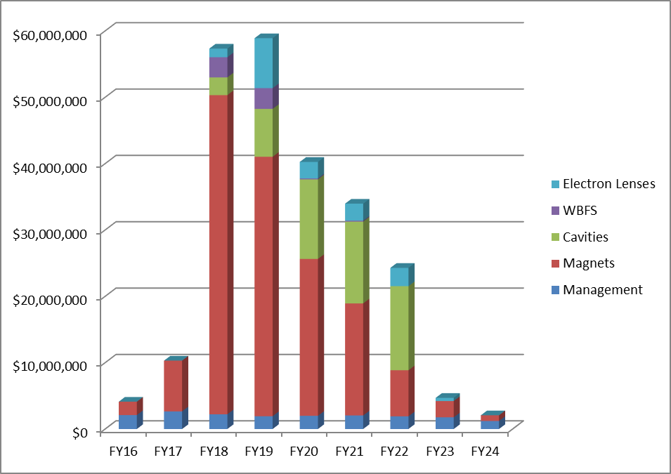
Preliminary Funding Profile Needs
Pre-FY18
($14.4M)
Project
($222M)
CD-0 in late CY15
CD-1/2 in mid-FY17
CD-3 in early FY18
FY16-17 funded by LARP
FY18 to FY24 funded by DOE 413.3B Project
TAC ~ $222M (Project) + 14.4 M$ (Source of funding: LARP)
Unequivocal Message from DOE (Feb ‘15 Visit)
US-HiLumi will not be able to afford all activities mentioned in 2012
Funding profile will not allow needed ramp-up
  Delay of LS3 would help, provided Project start is not postponed
6

Slide 7
How LARP is run in FY15
High Priority Activities
  MQXF Models and Prototypes (2 Toohig Fellows)
  Crab Cavities Prototypes for SPS (1 Toohig Fellow)
  Other AP Intellectual involvements:
    WBFS, e-lens, beam-beam simulation,…
Funds Allocation in FY15:
 | FY15
Acc. Physics | 2 %
Magnets | 74 %
Manag. | 10 %
Crab Cavities | 10 %
WBFS | 4 %
 | FY14 | FY15
SWF (k$) | 10,729 | 10,133
M&S (k$) | 1,873 | 3,867
Total (k$) | 12,600 | 14,000

Slide 8
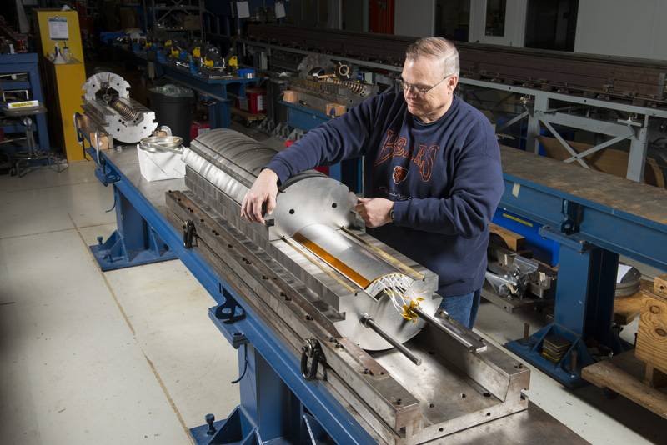
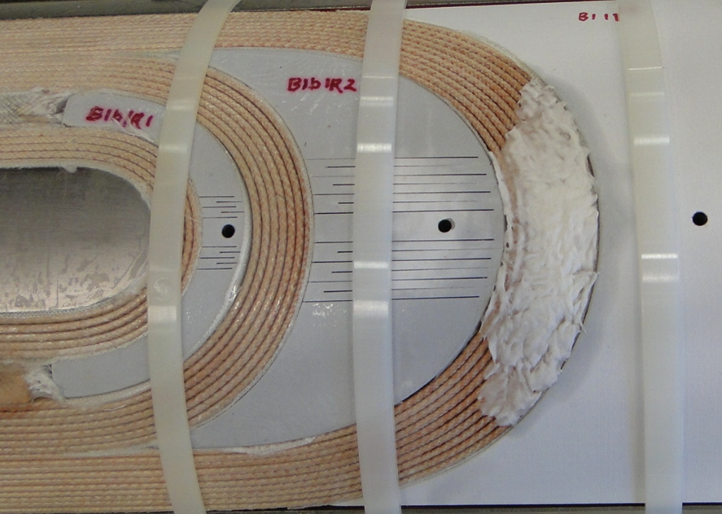
Magnet Progress (Mirror and MQXFS1)
Final assembly of First Mirror Magnet based on MQXF Coil design.
MQXFS1 built with 2 coils from LARP and 2 Coils from CERN.
MQXFS1 Assembly in Jun-Jul ‘15
Coil 05 IL after curing

Slide 9
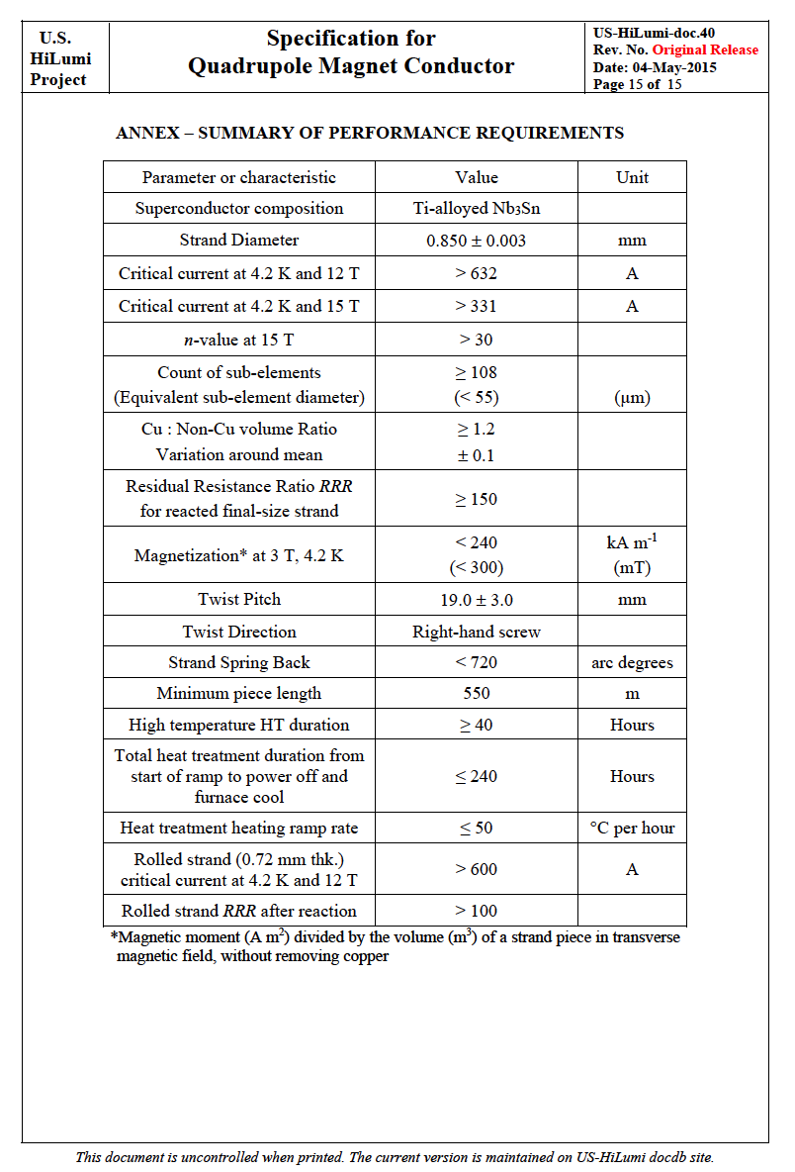
MQXF Conductor “Convergence”
Convergence on 108/127 based on performance and cost analysis.
  Advantages of 132/169 (lower D_{eff}) not worth the cost increase. Stumbled on interesting 144/169.
LARP has extensive experience on 108/127.
Advantages of “Common Specs”
  Lower risk if common vendor for CERN and US-HiLumi orders
  Long prototypes are expensive! Hi-Lumi and CERN will add to each other knowledge basis.
  Possibility of “UL Optimization” (see next slide)
Feb ’14 DOE Review of LARP Recommendations:
  Lock down the technical parameters for the Nb₃Sn procurement by end of FY14 (repeated twice)
  Explore the possibility of CERN being able to lend the project the Nb₃Sn Superconductor
  Explore possibilities other than CDP for funding strand procurement for the QXF model coils

Slide 10
UL Optimization Challenge
Extensive LARP experience on 108/127. 420 kg (83.9 km) procured so far.
Distribution of wire lengths relatively well established for “R&D” quantities, expected to improve for “Production” quantities.
Example from OST production for LARP:
  77 UL at 840 m with ~20% waste
  140 UL at 550 m with ~13% waste
Maximize efficiency from 2 UL by selecting the proper integer numbers of UL that minimize waste (well known effect):
  52 UL at 840 m and 62 UL at 550 m with ~ 6% waste
With all appropriate caveats, there is a chance for ~10% savings !

Slide 11
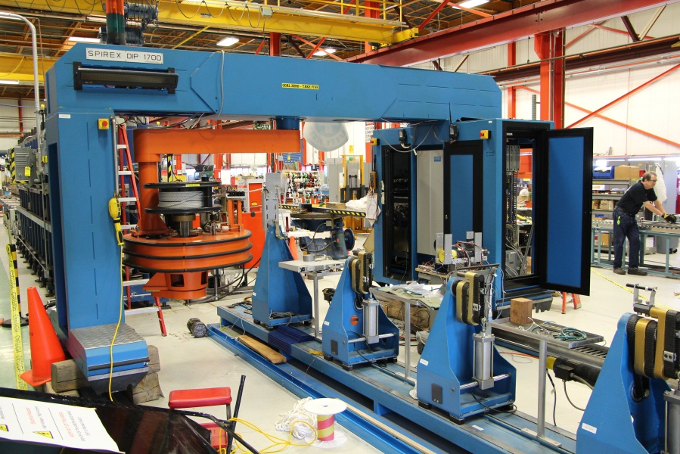
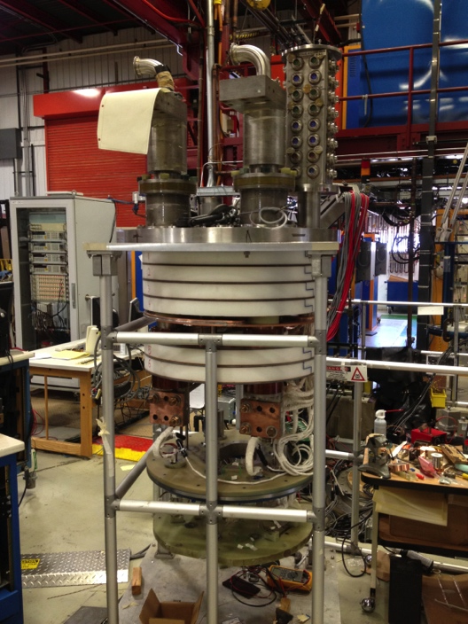
Equipment Challenge
Challenge on Availability of Resources and Operational Support
  SELVA winding machine upgrade at FNAL had to be supported with LARP funds
    Operations Support expected to fund it before FY15 budget crisis in TD.
    Not budgeted in LARP
  Cryogenic Resources conflicts with SRF activities delayed new 30kA, 1.9K top plate upgrade for MQXF
    Addressed, ~6 months delay but huge success story ! (See “Mirror Test” talk next)
Additional Equipment Costs
  MQXFA Length increase will require an elongation of the Reaction oven at BNL.
  Additional (moderate) costs for all long Tooling
SELVA Long Coils Winding Machine:
30 kA, 1.9K Top Plate

Slide 12
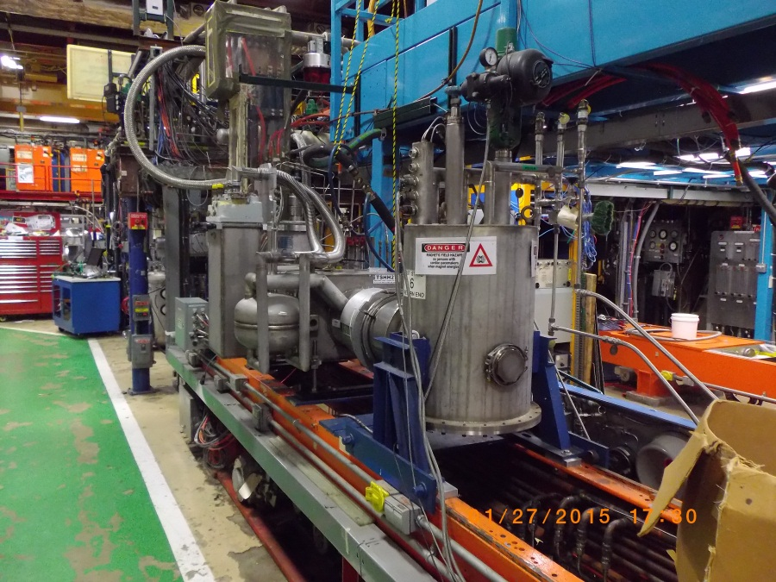
Equipment Challenge (2)
US-HiLumi deliverables will hinge on availability of an Horizontal Test Facility capable of delivering ~20-25 kA and 1.9 K to test ~10-15m long cold masses (2-in-1 Q1/Q3 Magnets)
  No funds presently planned in LARP or US-HiLumi Project for such a facility.
More in Hasan’s talk later today

Slide 13
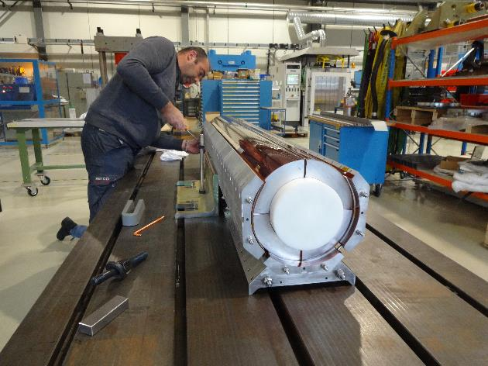
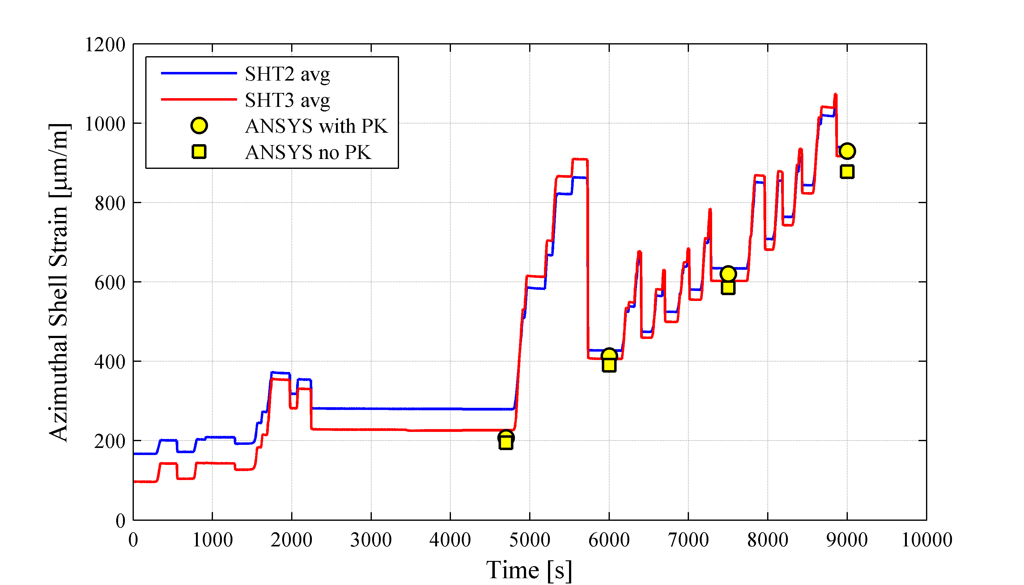
MQXF Mechanical Structure
Feb ’14 DOE Review of LARP Recommendations:
  Provide stronger evidence, including electromechanical modeling, that the planned QXF structure is adequate for managing the strain in this larger, higher stress magnet.
Internal LARP Functional Requirement and Design Review of Long Structure planned at LBL in July ‘15.
  Main goal to insure LARP Program on low risk in procurement of first MQXF long structure using FY15 funds.
  Chance to discuss Value Engineering (laminations vs. machined blocks) and plans for their implementations in MQXFS#2 at LARP or MQXFS#2 at CERN.

Slide 14
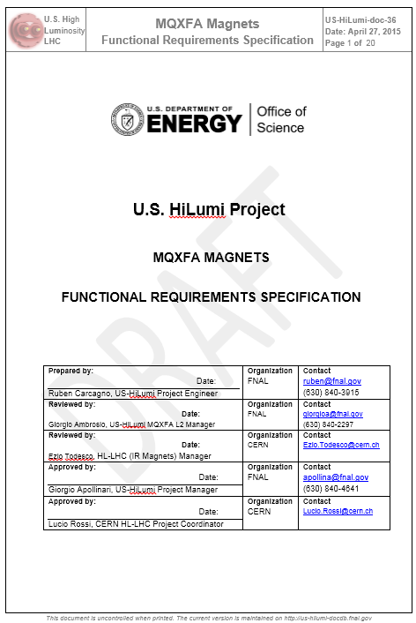
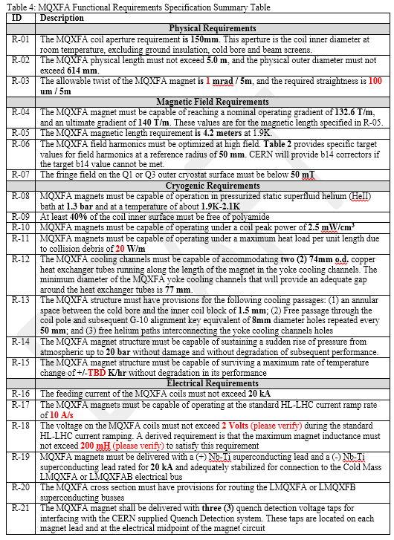
MQXF Functional Requirements
Functional Requirements for MQXF magnets are an essential element of US-HiLumi Project approval. See Ruben’s talk in Magnet Parallel Session
  Draft version(s) will be used to define Goals for LARP prototypes

Slide 15
LHC CC System Specifications
Detailed document for SPS tests
    https://edms.cern.ch/document/1389669/1
Most of this applies to LHC
    Several changes and additions needed
      Alignment, dimensions
Some final convergence needed on impedance requirements.
E. Metral – March 2015

Slide 16
Cavities at Niowave and JLAB: a Short History
Huge intellectual contribution from LARP-Acc. Ph., with 2 POP cavities from US performing adequately in terms of transverse field.
Initial Plans:
  Use ‘13-’14 SBIR (~1 M$) to Niowave to produce 2 cryomodules with 2 cavities each from the US for the SPS test
  Re-dimensioned plans at Daresbury in Nov ‘13: 4 dressed cavities from LARP, still produced at Niowave.
Feb ’14 DOE Review of LARP Recommendations:
  Review the resources and schedule required to produce four crab cavities in two cold masses to ensure there is a reasonable probability of meeting the program requirements.
International Crab Cavities Design review called by LARP & CERN and held at BNL (May ‘14) recommended to maintain only US cavities in SPS test
During (failed) Design reviews in Sep. ‘14 at Niowave it became evident that the probability of “meeting the program requirements” was low.
Negotiations with CERN and JLAB started in earnest.

Slide 17
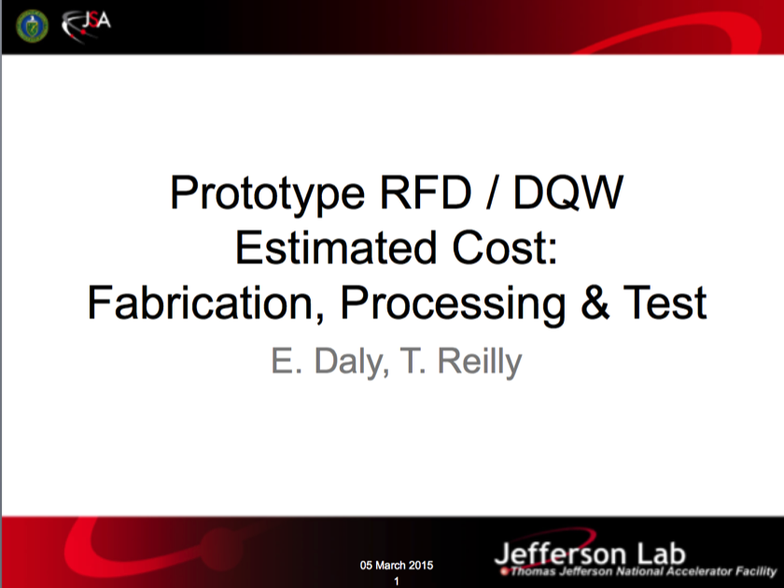
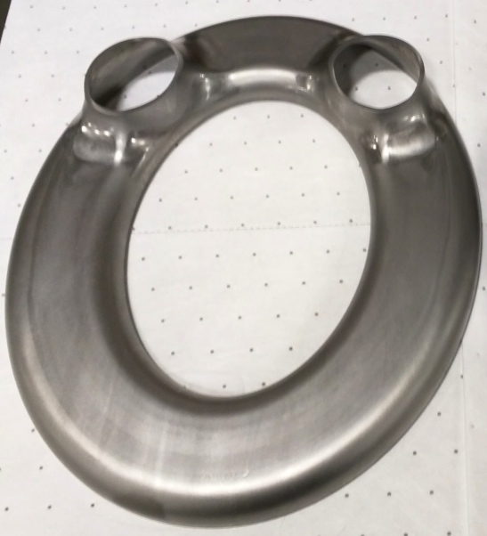
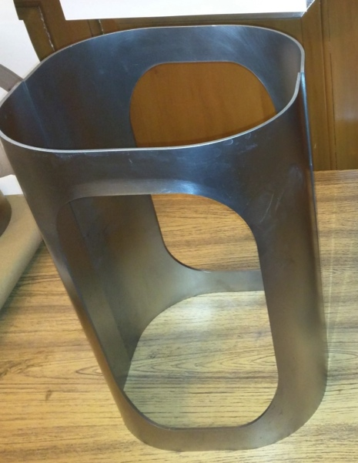
CC Plan
New Plan:
  Nb parts stamping & He Vessel parts fabrication at Niowave (old & new SBIR)
  Cavities assembly, surface processing, He Vessel assembly and testing at JLAB (Order from FNAL/LARP)
  HOM procured by CERN
LARP order to JLAB will straggle FY15 and FY16
  Activities at JLAB approved in Apr ‘15 by JLAB Directorate. Order placed from FNAL on May ’15.
Formed DQW part
at Niowave
Formed RFD part
at Niowave

Slide 18
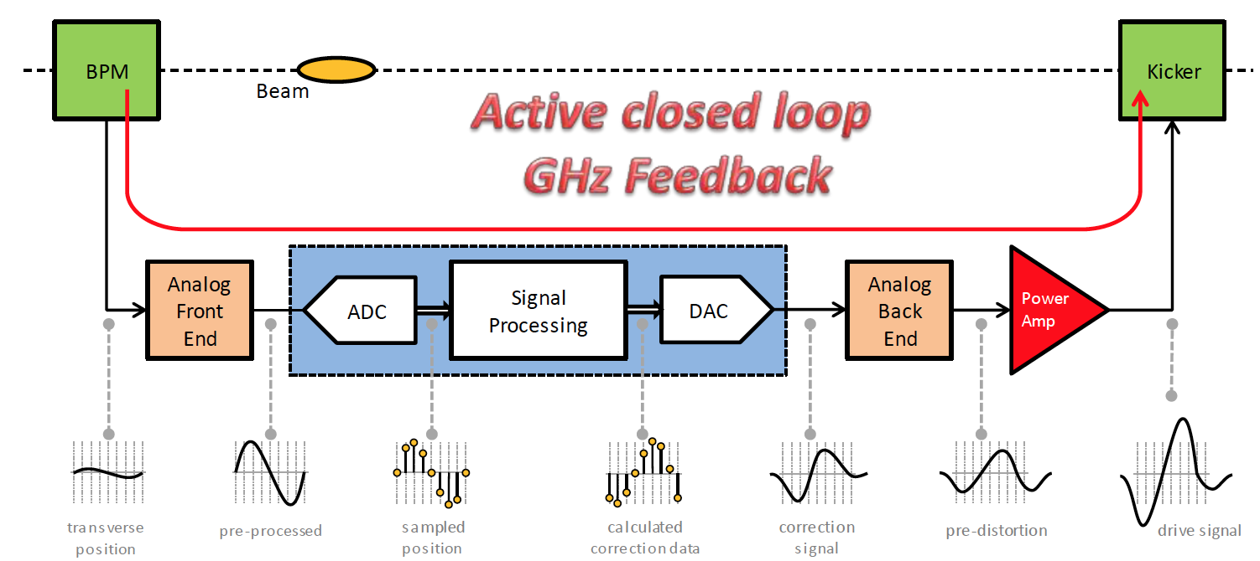
WBFS for Stability Control
Control of Ecloud and Impedance-driven transverse instabilities in the SPS as HL-LHC Injector
  Demo system achieved closed loop control November 2012 before LS1
  2014 and 2015 MD Studies provided huge feedback on feedback system (pun intended !)

Slide 19
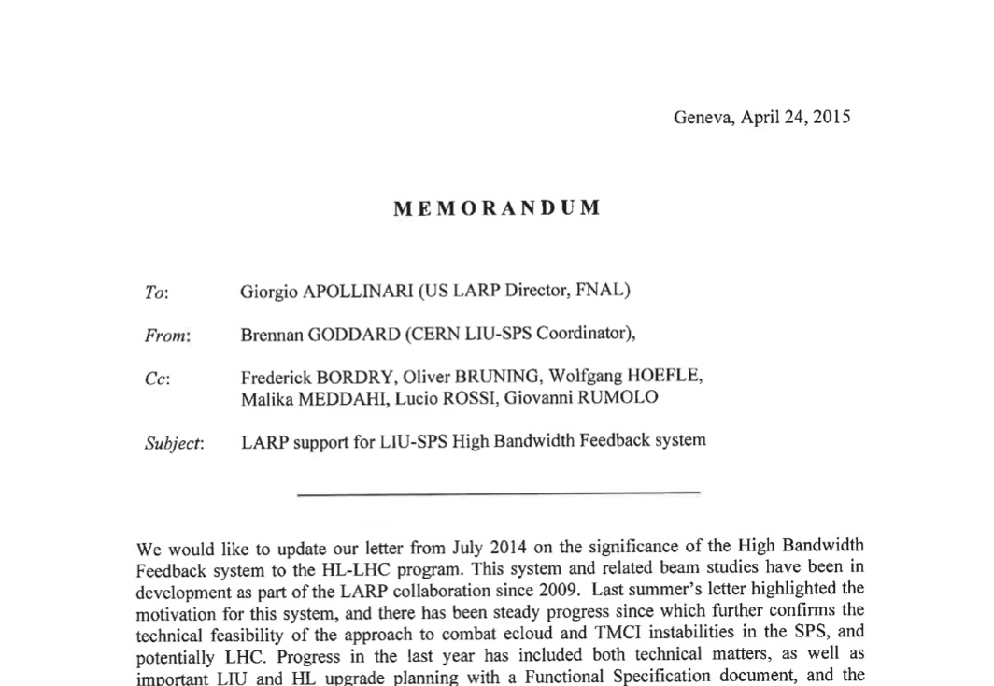
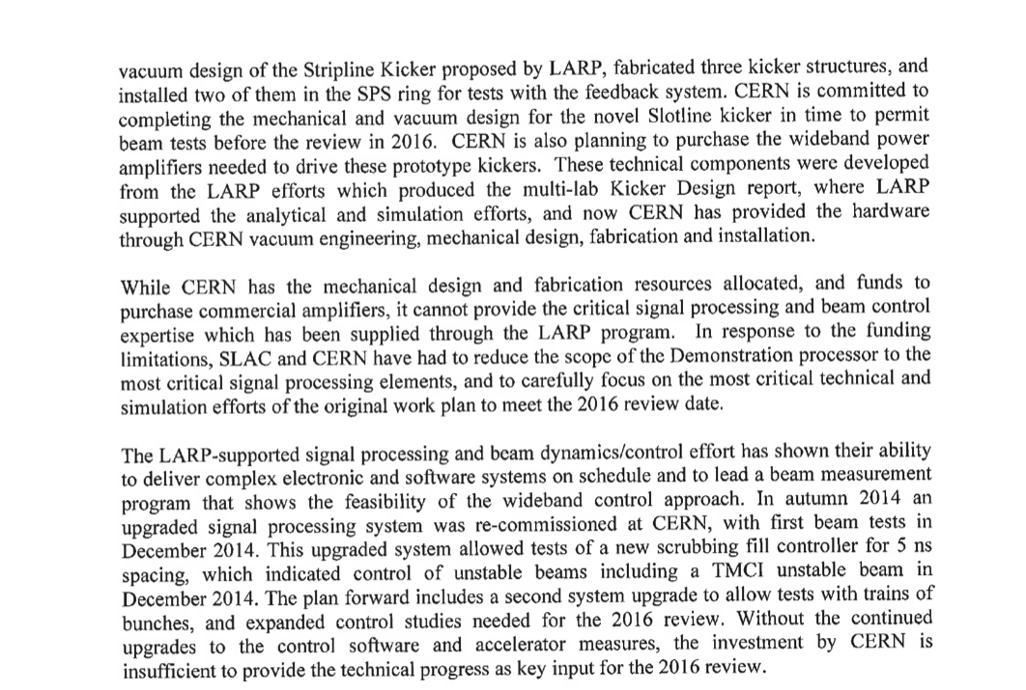
WBFS – CERN Input
Need of US Intellectual Contribution
Commitment to support WBFS in FY16 at same level of FY15 (until 2016 Review)

Slide 20
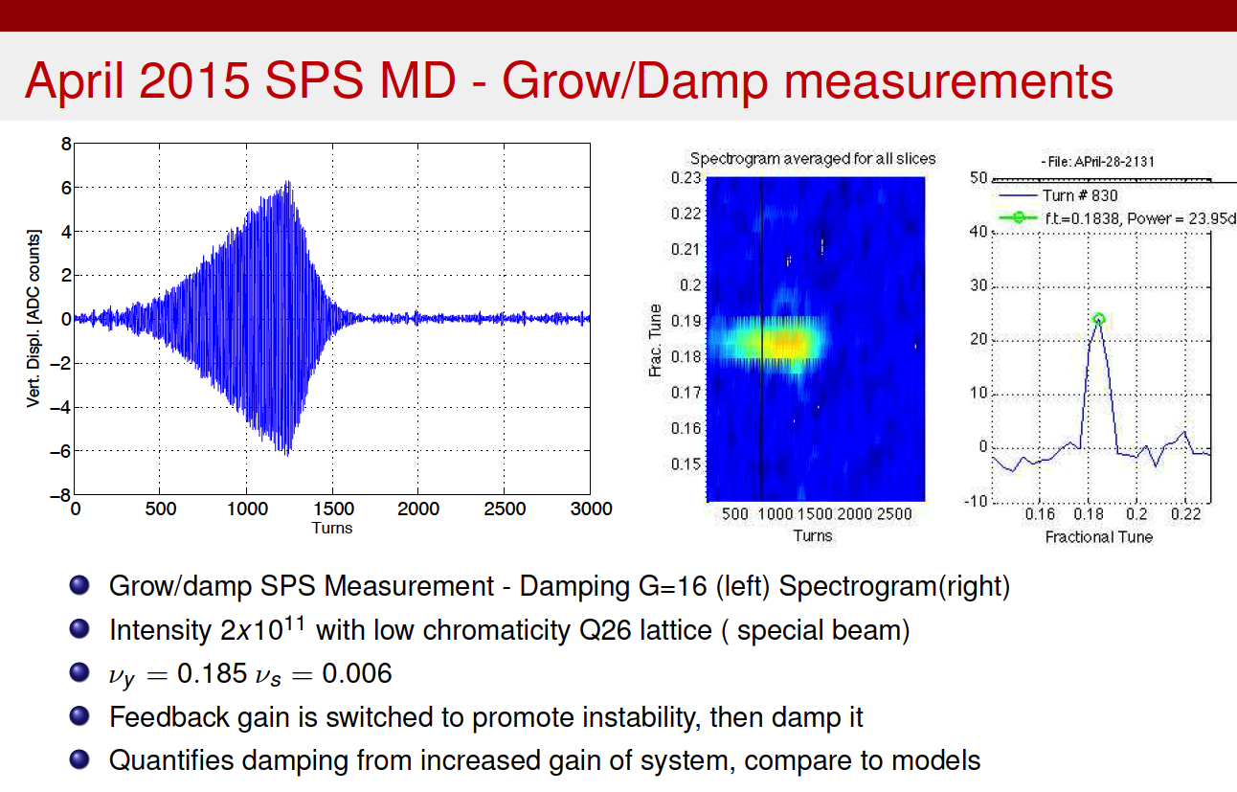
WBFS MD Studies

Slide 21
LARP Plans on e-lens & Beam-Beam
Collimation with hollow electron beams
  Technical design report – draft by end ’15
  Electron gun construction at CERN and tests at Fermilab
    During calendar year 2015
  Beam halo population and diffusion measurements at 6.5 TeV
    Machine studies requested for summer or fall 2015
Long-range beam-beam compensation with electron wire
  Definition of collision scenarios and physical parameters
    First results shown at IPAC15
  Preliminary conceptual design report – Oct. ‘15 HiLumi/LARP
Weak-Strong and Strong-Strong BB studies
  Work to establish the robustness of the baseline scenario and alternative scheme
  Work to establish the tolerances of crab cavity parameters

Slide 22
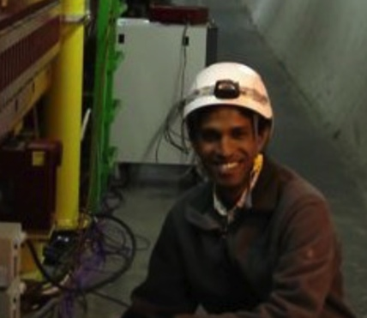
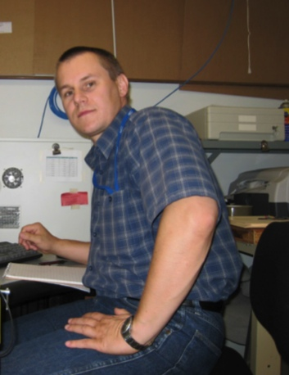

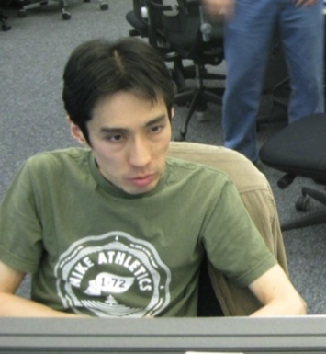
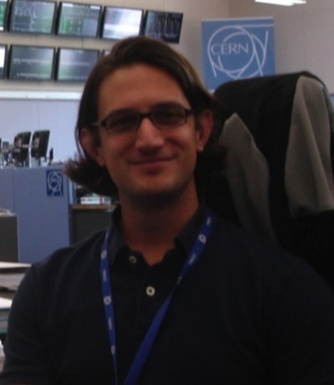
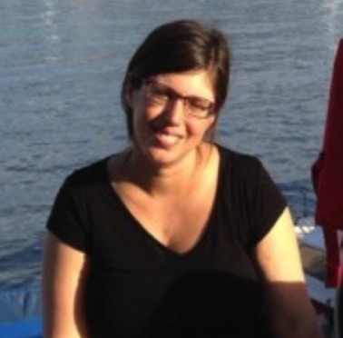
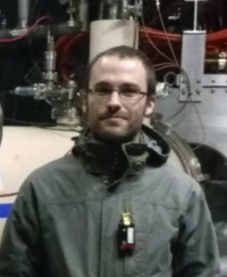
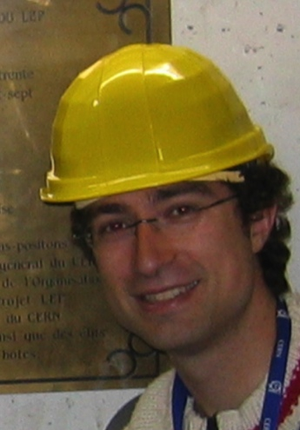
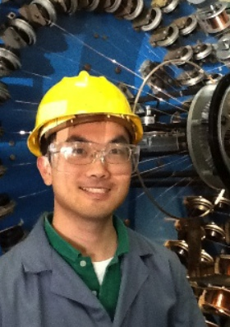
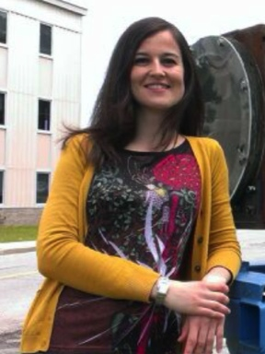
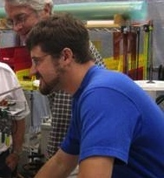
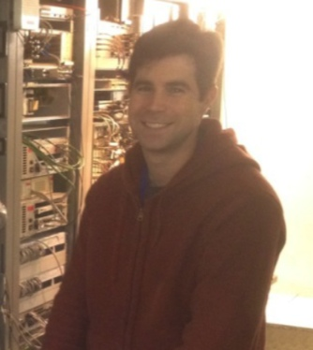
Toohig Fellowship
Extremely successful Fellowship program – Toohig Felloship - with several young Accelerator Scientist providing vital contributions to the LHC and field in general
R. Calaga – CERN
D. Bocian
Prof. HNINP
H. Felice – LBNL
V. Previtali
Teacher, Geneve
R. Miyamoto – ESS
T. Mastoridis
Prof. CPU
S. White – ESRF
R. DeMaria –CERN
S. Verdu
BNL
I.Pong
LBNL
T. Helik
FNAL
J.Cesaratto
Phillips
22

Slide 23
Where will LARP go from here?
FY15 + ~2 M$
FY15 + ~4 M$
 | FY15 | FY16 (Change over FY15) | FY17 (Change Over FY15)
Acc. Physics | 2 % | Constant Level of Effort | ??
Magnets | 74 % | + 0.8M$ M&S | +2-3 M$ Nb₃Sn/Parts +1 M$ Tooling
Manag. | 10 % | + 3FTE for P.O. | +4 FTEs for P.O.
Crab Cavities | 10 % | +1/2 Order to JLAB | Constant at FY16 Level
WBFS | 4 % | Constant Level of Effort | ??
Candidates for GARD or “LARP2” ?

Slide 24
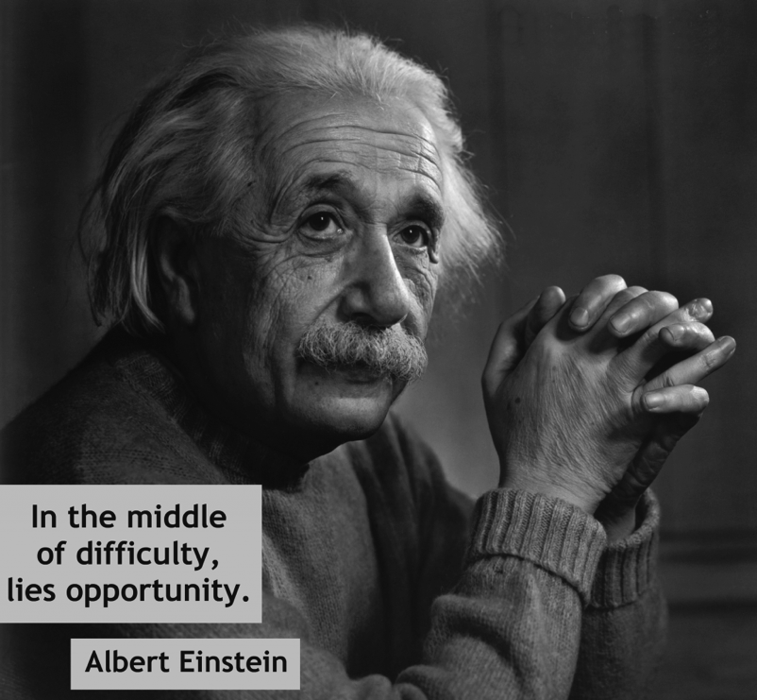

Conclusion
In-House (FNAL) Opportunities:
  Testing Facilities
National Labs Opportunities:
  Coordination and Support of Activities
International Opportunities (CERN)
  Coordination for Mutual Beneficial Outcome

