Slide 1
Cost & Schedule review - report
Lucio Rossi
Joint LARP/HiLumi LHC (LARP CM24)
Fermilab

Slide 4
Presentations are NOT public
Hopefully most can be disclosed once report si finalized
Sensitive information (especially on WP3- IR Magnets and WP4 CC !!)

Slide 5
Charge to the Review Committee
Is the estimated budget of the project adequate (within reasons)?
Are there any options to reduce the budget and does the review team see opportunities for savings? What is the possible scope contingency?
What are the areas of high risk for scope, schedule or cost overrun?
Is the schedule well developed, credible and synchronized between the ongoing activities (as well as the LHC experiments)?
Are the foreseen resources correctly evaluated?
Will the expertise (management and technical) be available when needed?

Slide 6
Scope of the review
The CMAC supported by a number of additional experts was asked to review the alignment of scope, schedule, cost and risk of the LIU and the HL-LHC project.
The review team split up in several subgroups after a series of plenary talks introducing the general CERN strategy and the two major projects to be reviewed, namely LIU and HL-LHC
The Consolidation project (CONS) was introduced and the major interfaces to LIU and HL-LHC were explained.
The other resources of the Accelerator and Technology Directorate (operation, maintenance, etc) were addressed only as far as a comparison was necessary to the LIU and HL LHC projects to make sure that generally sufficient personnel is available for the execution of these projects.

Slide 7
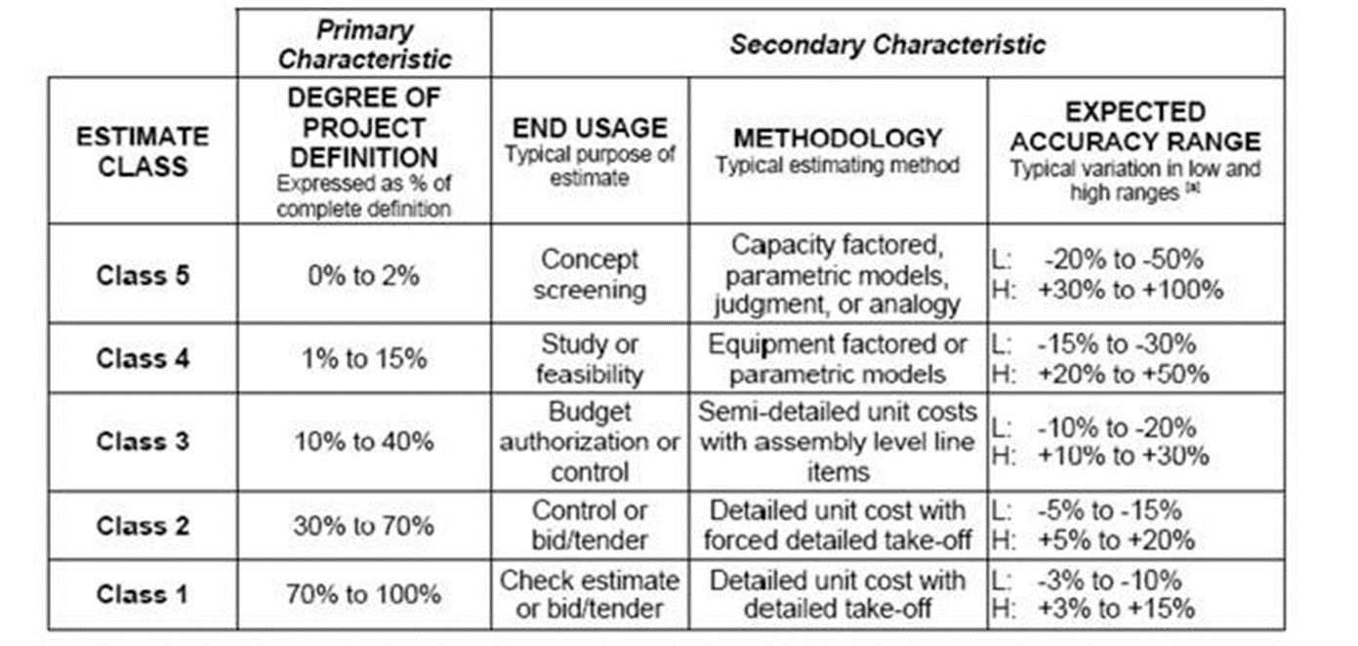
Table Uncertainty Class/ Risk Analysis

Slide 8

Executive summary
The review committee is very impressed with the enormous amount of work that was presented.
A very competent, engaged and effective management team is in place to manage both projects.
The Project Management tools used at CERN are state of the art, well utilized and well understood by the management team.
The presented project organizational structures are suitable to execute the projects. They matrix in-house as well as external resources very effectively into the organizations and they report directly to the Director of Accelerator and Technology.
The QA and QC programs are well established, flexible and effective. They allow to manage foreign contributions, In-Kind participation and international collaborations effectively.
The risk management program is somewhat new and should be fully integrated
The LIU and the HL-LHC project are well advanced in planning and execution for the stage they are in.
Congratulations !

Slide 9
Summary for HL-LHC
Total cost / MCHF (original estimate) | 833
Total cost / MCHF (new estimate) | 949
Uncertainty / % | -15 / +22
Uncertainty / MCHF | -142 / +208
Uncertainty | On average Class 3
% complete | R&D phase
Total FTE / CERN | 1660
Total FTE / MPA | 946
Budgets are correctly assembled and adequate, but uncertainty varies between class 1 and 5
Schedule is generally well defined and realistic
Some options for savings, deferrals or deletion (see table later)
More expensive workpackages have generally less uncertainty (apart from CE).
Unlikely that uncertainty on the negative site will materialize to the degree assumed.
General concern expertise availability
Late information on cost / risk of Civil Engineering creates major risk that needs to be retired asap

Slide 10
Overview of the Uncertainties
Syb-system | Design Readiness | Cost Risk | Schedule Risk
LIU
Linac 4 | final | Low | Low
PSB | detailed | Low | High
PS | detailed | Low | Low
SPS | detailed | Low | Med
Ions | adv conc | Med | Med
HL – LHC*
Magnets for IRs | detailed | High | High
Civil Engineering | conc | High | High
Cryogenics | detailed | Med | Low
Syb-system | Design Readiness | Cost Risk | Schedule Risk
Crab Cavities | preliminary | Med | Med
11 Tesla dipoles | preliminary | High | High
Cold powering | detailed | Med | Low
Collimation | preliminary | Med | Low
Ʃ = > 75% of HL LHC cost
Vacuum | preliminary | Low | Med
Warm powering | detailed | Med | High
MPS | preliminary | Med | Low
Beam Diagnostics | adv conc | High | Med
*WP are in the order of total cost
Description of design readiness by major subsystem. [Conceptual <10%,
Advanced Conceptual 10-30%, Preliminary 30-60%, Detailed 60-90%, Final >90%]
Notes:
Project Management & Technical Coordination
Accelerator Physics and Performance
Magnets for IRs (Inter.Regions and Match. Sections)
Crab Cavities (CC)
Collimation project
A)Cold Powering B)warm powering
Machine Protection & Magnet QPS
Collider-Experiment Interface
CryogenicsBeam
Energy Deposition & Absorber
11-T Dipole Two-in-One for DS
Vacuum
Beam Diagnostics
Kickers and Beam Transfer Lines
Integration and (de-)installation
Hardware commissioning
Infrastructure, Logistic and Civil Engineering

Slide 11
Possible scope deferral into LS4
System | Int Lumi / year | Deferral | Comments
ALL present | 250 | 0
No Crab Cavity | 0.7-0.9 X 250 | 80 MCHF (+20 C.E.) | CC cost – LRBBCW cost (12MCHF ? not proven not baseline) PU density (x1.5-2 for nominal scenario, or more in other scenario!) Also loss of possibility of crab-kissing scheme Possible to defer provided that services done in LS3 For the same pile up density, luminosity decrease to 0.75 X 250
No matching section (D2-Q4-reuse of Q5@1.9K) | 0.65 X 250 | 25 MCHF | But WITH LRBBCW (12?) No CC D2 enough strength?? Probably not (→1.9K) Difficult to defer because of link with ITR If MS upgr. Is eliminated the aperture of triplet and D1 should be reduced

Slide 12
Possible scope deferral into LS4
System | Int Lumi / year | Cost Saving or Deferral | Comments
No 11 T dipole | 0.7-0.85 XL_{ions} 0.8-0.90 X 250 (p-p) Re-evaluation only after LHC restarts | 25 MCHF (IP2 ions debris) 50 MHF (P7 Proton) +5(?) MCHF for crystal? | Ions will not reach the lumi goal (30-40% less?); Proton collimation loss of efficiency: high risk of arc magnet quenches: Limit to LHC ultimate beam (0.86 A) Reduced LIU? Mitigation via crystal collimation (still to be proved: 1 MW absorber??) Possible to defer P2 t or EYETS after LS3 and P7 after LS3
Standard triplet | 0.3 X 250 | 130 MCHF | 180 (present triplet)-50 (NbTi triplet) But loss of USA contribution (70-75 MCHF on value + production line). The present IT accept only 300-400 fb⁻¹. A new IT in NbTi MUST be larger anyway to accept a W-shield). Defer it means to defer the Upgrade

Slide 13
Possible scope deferral into LS4
System | Int Lumi / year | Cost Saving or Deferral | Comments
No cryo plant P4 No Cryoplant P1-P5 No C.E. for CryoPlant P1-P5 | 0.9X250 ?? 0.3 X 250 | 12 MCHF 80 MCHF 35 MCHF | CMS (P5 Left) become weaker for lumi. Decrease availability Possible to defer to LS3 (increase workload in LS3) With no new Cryoplant BS@10K LHC ultimate beam (0.86A) Reduced LIU? L_{peak} 2.5-3x10³⁴ but no compatibility assured with new Amperage in the magnets Arc and MS magnets increase of T_{op} ∼ 2 K NO CC ! Cryo-power at the limit, very little margin for operation! Defer it means defer the upgrade

Slide 14
Possible scope deferral into LS4
System | Int Lumi / year | Cost Saving or Deferral | Comments
TDIS | 0.8 X 250 | 7 MCH (2 on the HL-LHC) | LHC Ultimate beam (0.86A, 3.5 um). No (efficient BCMS) Too high impedance? Reduced LIU?

Slide 20
Follow up
Examining recommendation
    Staging a few elements
    Review some systems for cost optimization (vs. minimal reduction on performance) : see choice of SC wire, and other will follow…
    Accelerate signature collaborations:
      ICA with DOE finalized and signed last week!
      Then protocol HiLumi LHC accelerator and detector to be signed in 2015?
      Finally a Collaboration Agreement with CERN for the deliver of the in-kind (beginning 2016?)
Finding the necessary resources in the CERN budget, synergies with CONS & OP, staging: MTP 2015!
Vigorous tackle of the C.E. issue and planning

Slide 21
First official statement from DG, after interim report to SPC by Norbert
HL-LHC has received a clean bill of health
However we aer waiting the fianl report (end of May)
Final presentation to SPC of June by Norbert

Slide 22
Next events
May 11 – 13 LARP-HiLumi Meeting: NOW!
September : HL-LHC/LIU day (4th event of that type including RLIUP)
26-30 October HiLumi LHC/LARP 5th joint annual meeting
    Including event with members of RRB
    0.5 or 1 day on Collider-Experiment Interface and performance
26-29 January : LHC Chamonix workshop
Next C&S Review Nov.2016!

Slide 24
Summary for LIU
Budgets are correctly assembled and adequate
Schedule is generally well defined and realistic
Some options for savings, deferrals or deletion (<15 MCHF)
Scope on IONS is not well enough defined which leaves uncertainty in the design
Significant ramp up of effort in the next 2 years requires close tracking of resources
General concern about retiring expertise/ expertise availability
Total cost / MCHF | 186*
Uncertainty / % | -12 / +15
Uncertainty / MCHF | 167 - 214
Uncertainty | Class 2
% complete | 17%
Total FTE / CERN | 691
Total FTE / MPA | 194
*Does not include LINAC4

Slide 25
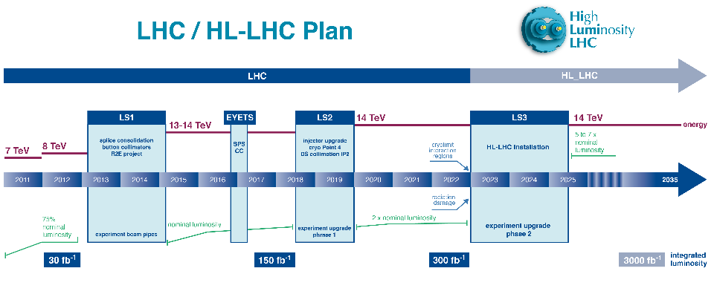
The target for installation

Slide 26
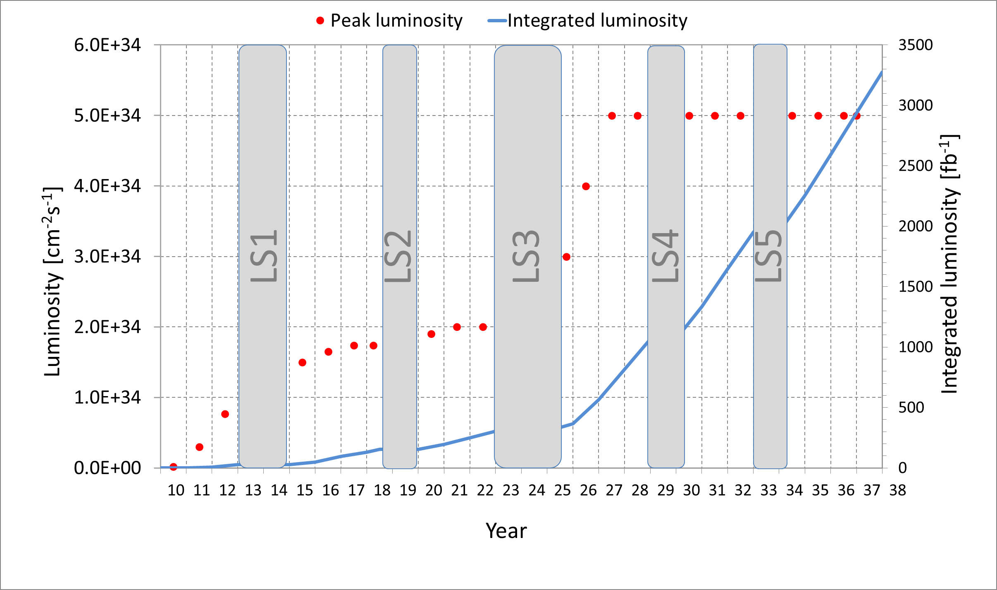
The nominal target performance
See Mike’s presentation

