Slide 1
HL-LHC Project Status
Oliver Brüning
For the HL-LHC Project team

Slide 2
HL-LHC Status
HL-LHC PDR and TDR
Highlights from recent reviews
Key Technology and Study highlights:
  Schedule considerations
  ABP Studies
  Crab Cavities
  DS collimators and 11T dipole magnets
  Civil Engineering considerations
End of the EU funded Design Study

Slide 3
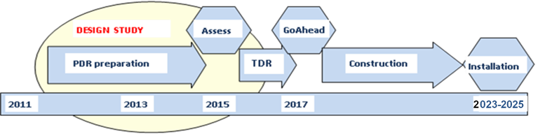
HL-LHC PDR:
PDR: EU Deliverable D1.4
➔ delivered November 2014: CERN-ACC-2014-0300
➔ 345 pages with baseline layout and parameter
descriptions and operational scenarios
➔ PDR publication followed by Assessment (Reviews)

Slide 4
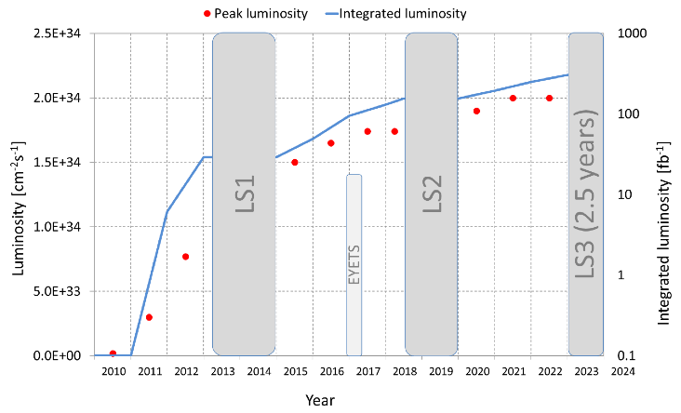
HL-LHC PDR:
PDR: HL-LHC Plan for the next decade:

Slide 5
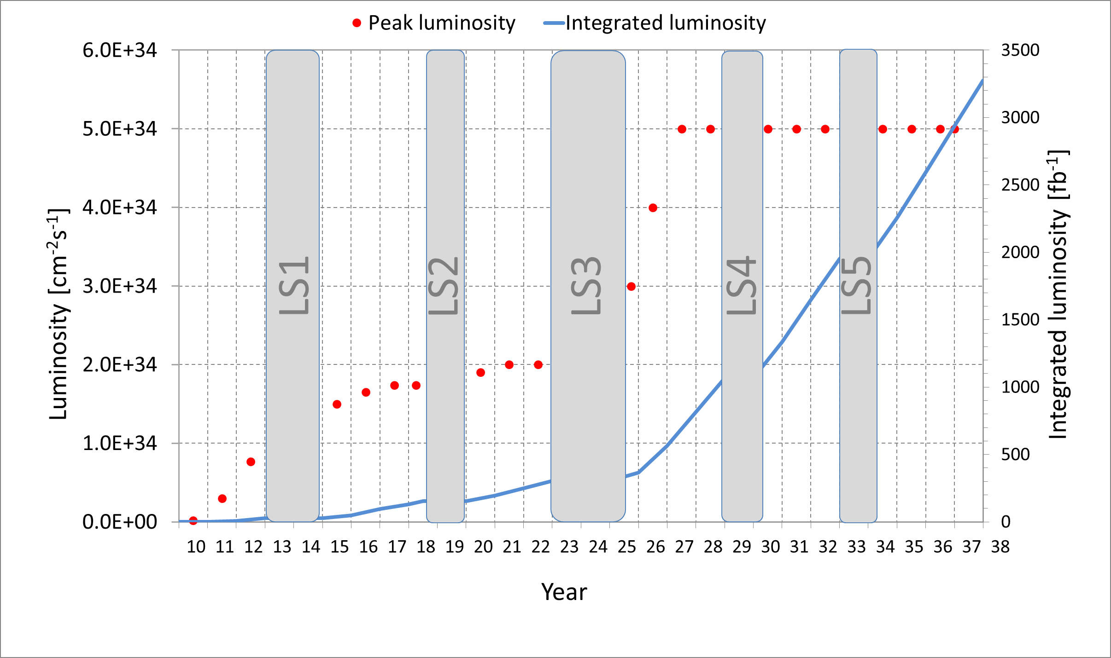
HL-LHC PDR:
PDR: HL-LHC Projection for post LS3 perfromance:

Slide 6
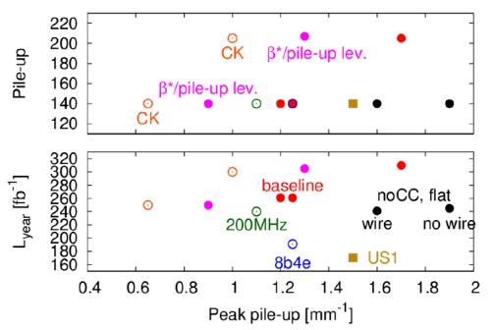
HL-LHC PDR
PDR: HL-LHC Alternative Options
Opens the possibility of operating the HL-LHC with 7.5 10³⁴ cm⁻²s⁻¹ at pileup density limit of 1.2 events per mm and reaching > 300fb⁻¹ per year and > 3000fb⁻¹ for HL-LHC lifetime!
Ultimate performance for component and detector specifications
➔ Ultimate HL-LHC performance reach

Slide 7
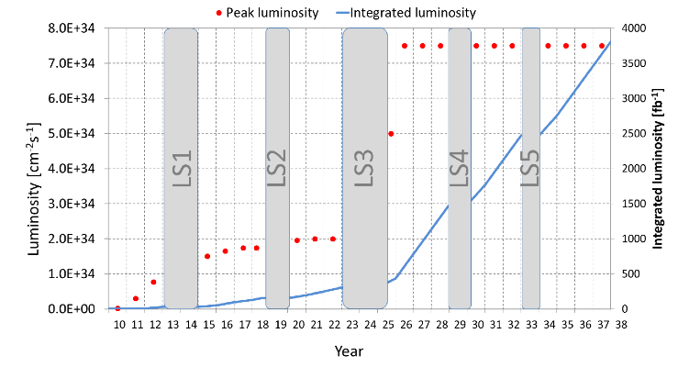
HL-LHC PDR:
HL-LHC Ultimate Performance Projection:

Slide 8
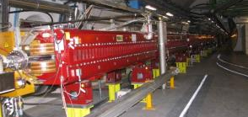
HL-LHC PDR:
HL-LHC Insertion Layout:
Longer Quads; Shorter D1 (thanks to SC)
ATLAS
CMS
LHC
ATLAS
CMS
HL LHC
Thick boxes are magnetic lengths -- Thin boxes are cryostats

Slide 9
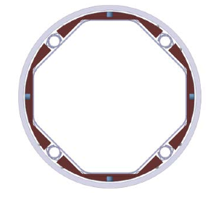
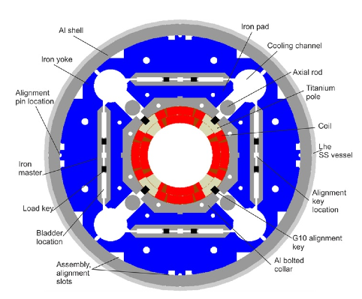
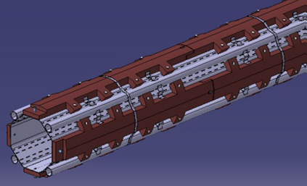
HL-LHC PDR:
Triplet with Beam Screen and W Shielding:
140T/m, 150mm coil diameter, beam screen at 40-60K,
1.2kW from Q1 to D1 @ nominal ➔ 50% more at ultimate

Slide 10
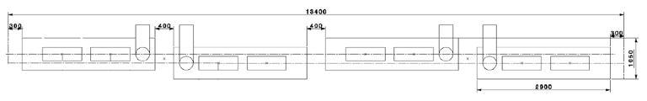
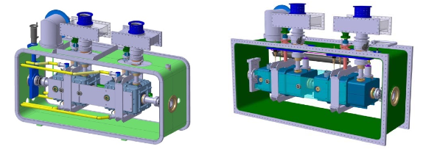
HL-LHC PDR:
Crab Cavity Layout:
4 cryo modules with two cavities each ➔ provides modularity
and flexibility (e.g. phased installation and crab kissing)

Slide 11
Highlights from Recent Reviews
SC Cable Review Nov 2014 & MQXF Review Dec 2014:
Design should be conservative and maximize margins!
Full support for 150mm coil aperture
Revise J_{c} and RRR (20% of samples show lower J_{c}) and
magnet operating point @ 75% of load line (now 80%)
Keep 2 strand supplier policy
Magnets should be tested at 108% of nominal
Revision of operating gradient and length of the
triplet magnets

Slide 12
Recent PLC Discussions on Review:
Triplet Length and Layout: PLC March 2015
Q1/Q3 length increased to 4.2m (two magnets per unit)
Q2 length of 7.15m
Triplet gradient slightly above 130 T/m
Updated HL-LHC layout and interconnection lengths
Found optics that is compatible with the above and
‘only’ 2% loss in integrated luminosity
Still need final agreement of L* and BPM positions
See Riccardo’s presentation for more information

Slide 13
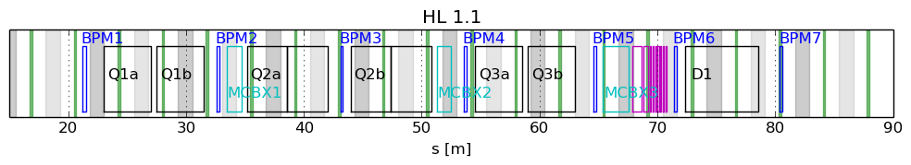
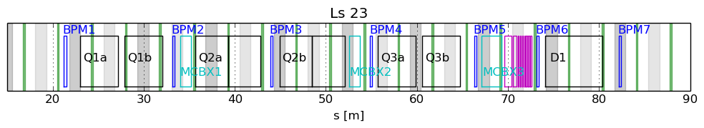
Updated layout:
New triplet layout and optics needed due to lower gradient
New triplet magnetic lengths: 4.2 m and 7.15 m.
On-going integration studies (with WP8/12/13/15) to determine
  Final L*: option of L*=23 m seems feasible
  BPM position optimization (to be far from BB LR encounters)
Nominal
New triplet L*=23 m
Ideal bpm positions
Forbidden areas ±60 cm

Slide 14
Cost & Schedule Review:
USLARP Collaboration Meeting, Mai 2015, FERMILAB, USA

Slide 15
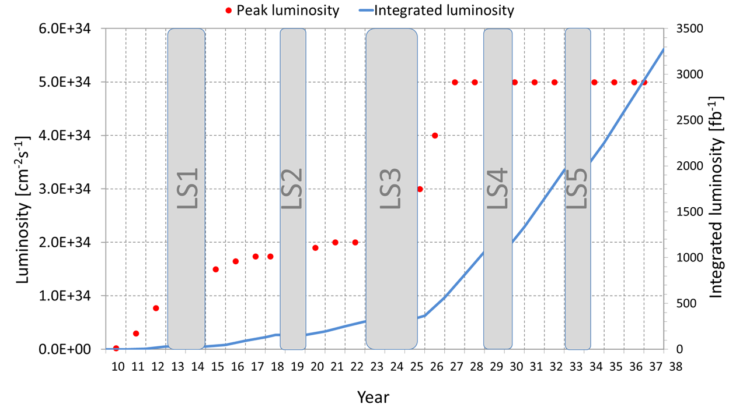
Schedule Considerations: Decision after RunII Startup:
LS2 could start 6 months later, in Jan.2019
LS2 could last additional 6 months
LS4 & LS5
Schedule?
LS3 to start a year later, in Jan. 2024
TODAY
April 2015 Coordination group:
Experiments would not object!
Graph showing nominal upgrade parameters –
3000 fb⁻¹ would be reached in 2036

Slide 16
ABP Studies Highlights:
Revision of triplet powering
Baseline of Q1 & Q3 in series and Q2 in series
versus LHC configuration with all in series and trims

Slide 17
Powering Schemes:
Baseline powering scheme (PDR)
HL-LHC | rms((Q_{z}-Q_{z0})) [10⁻⁴] | ΔQ/ΔQ(Baseline)
Baseline | 1.37 | x1.0
Q1-Q2-Q3 | 0.67 | x0.5
Q1-Q2a Q2b-Q3 | 0.54 | x0.4
PC1 17.4 kA
Q1
Q2a
Q2b
Q3
PC3 ±0.2 kA
PC4 ±2.0 kA
Inner Triplet powering:
  class 1 (1ppm) leads to ≈ 10⁻⁴ rms Q shift
  ➔ further reduction needed (10⁻⁵ k-mod.)
  Q1-Q2-Q3 features a small tune shift in the current and voltage control regime
Separation dipoles:
  class 1 PC preferable, less critical than IT and Q4
Q4:
  class 1 PC needed
PC2 17.4 kA
Q1-Q2a Q2b-Q3 (S. Fartoukh):
PC1 17.4 kA
PC2 17.4 kA
Q1
Q2a
Q2b
Q3
PC3 ±2.0 kA
PC4 ±2.0 kA
Q1-Q2-Q3
PC1 17.4 kA
Q1
Q2a
Q2b
Q3
PC2 ±2.0 kA
PC3 ±0.2 kA
PC4 ±2.0 kA

Slide 18
ABP Studies Highlights:
Revision of triplet powering
Baseline of Q1 & Q3 in series and Q2 in series
versus LHC configuration with all in series and trims
Crossing angle and β* leveling
Full crossing angle only required at the end of a fill
Smaller beam current at end of fill translates into margins
for required maximum compensation strength for
long-range beam-beam effects
➔ LRBB compensation via electron beam becomes feasible
Triplet vibration
Incompatibility of CE works during LHC operation

Slide 19
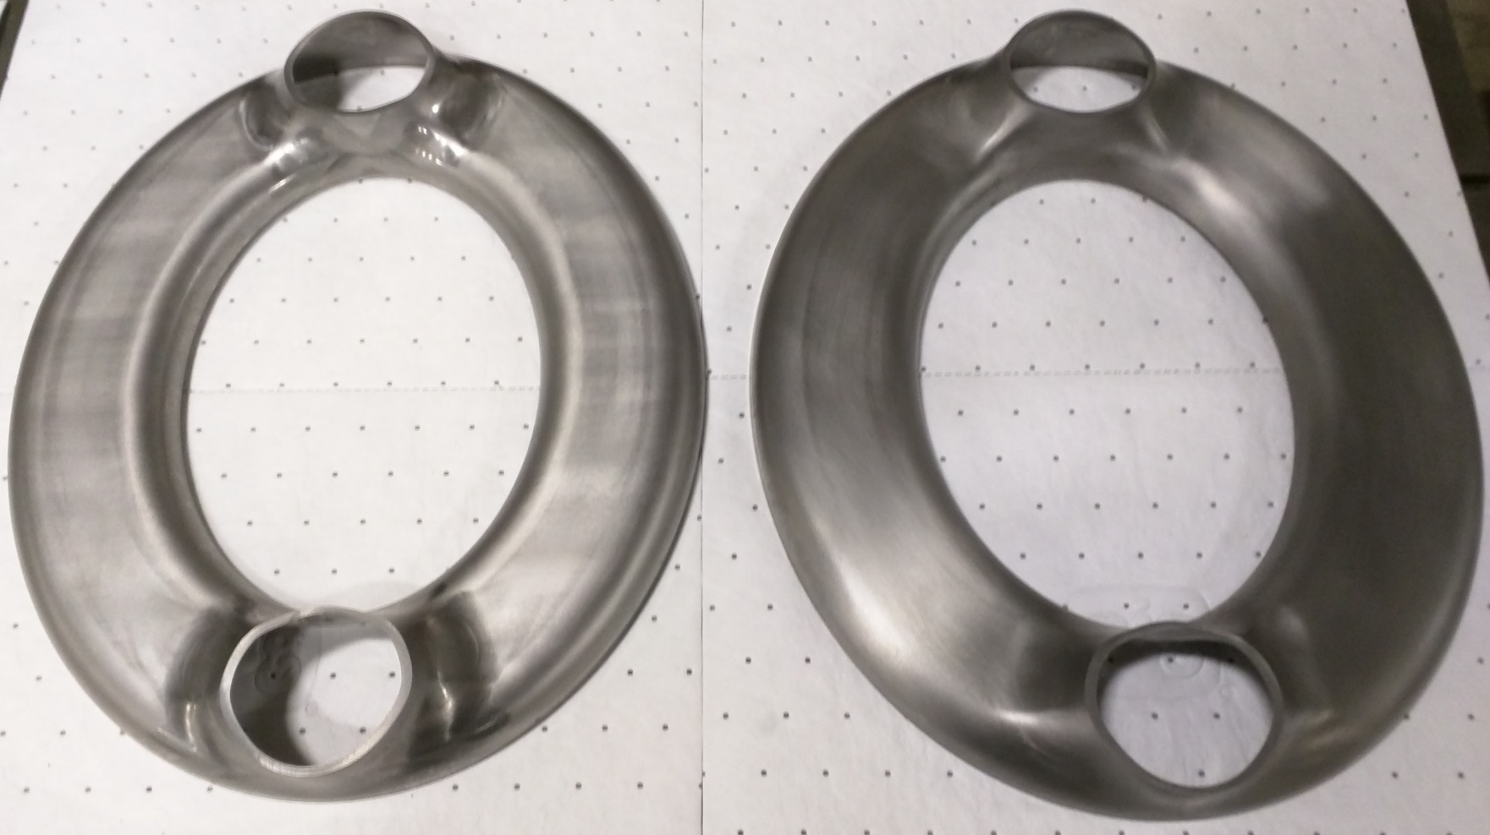
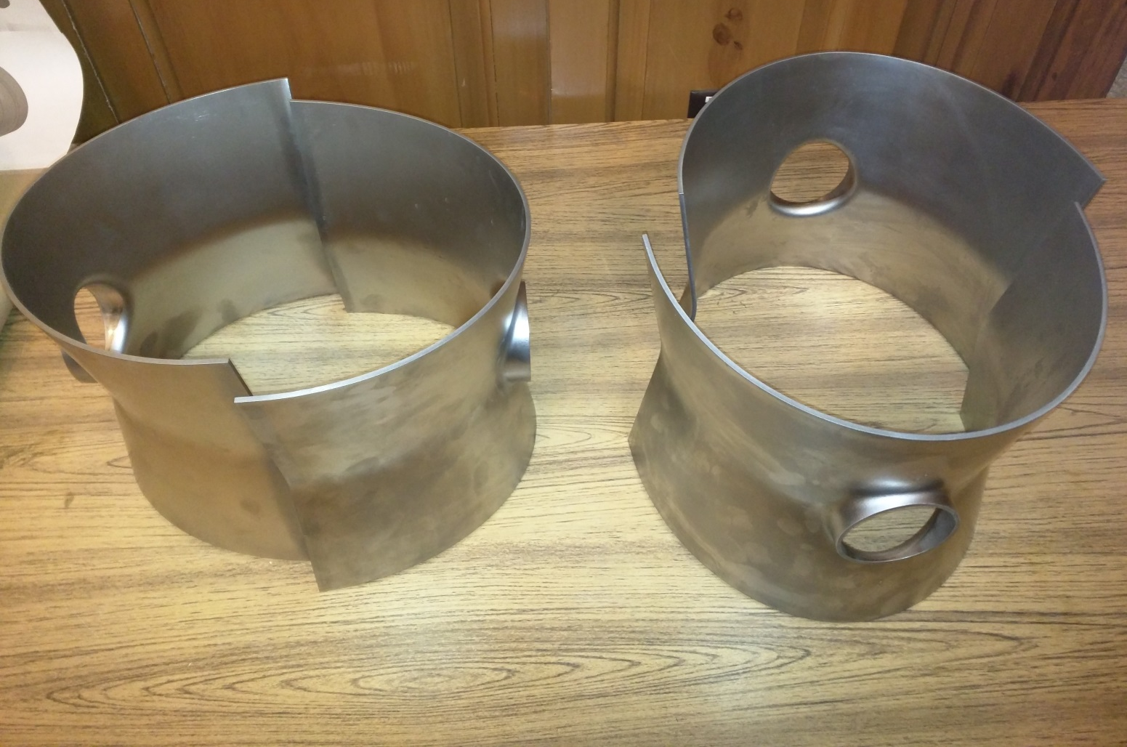
Technology Highlights: RF
Niowave Fabrication progress: Status April 2015
DQW:
Outer conductor
halves: 4 pieces
in QA
Top Cake Pans:
2 pieces in QA

Slide 20
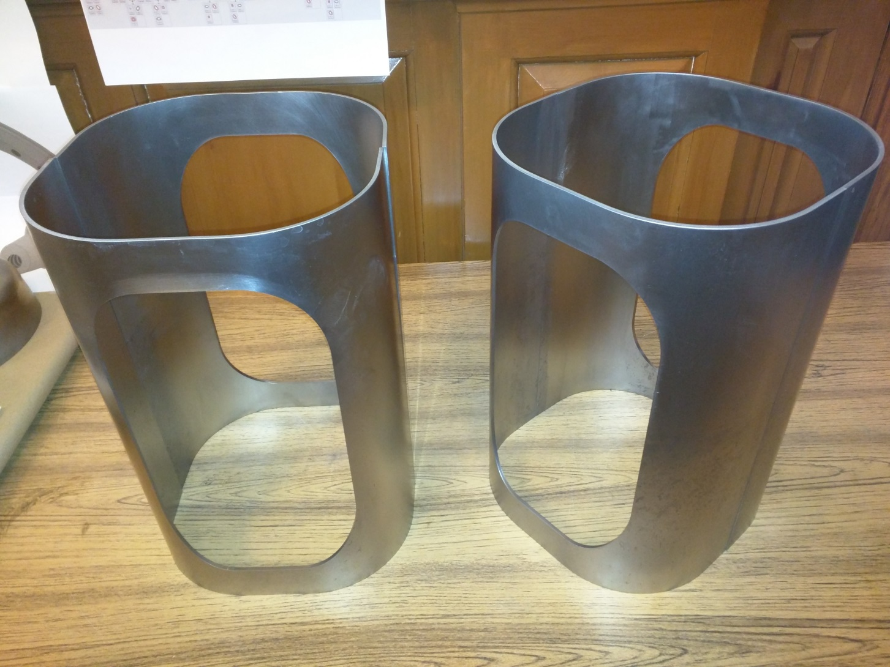
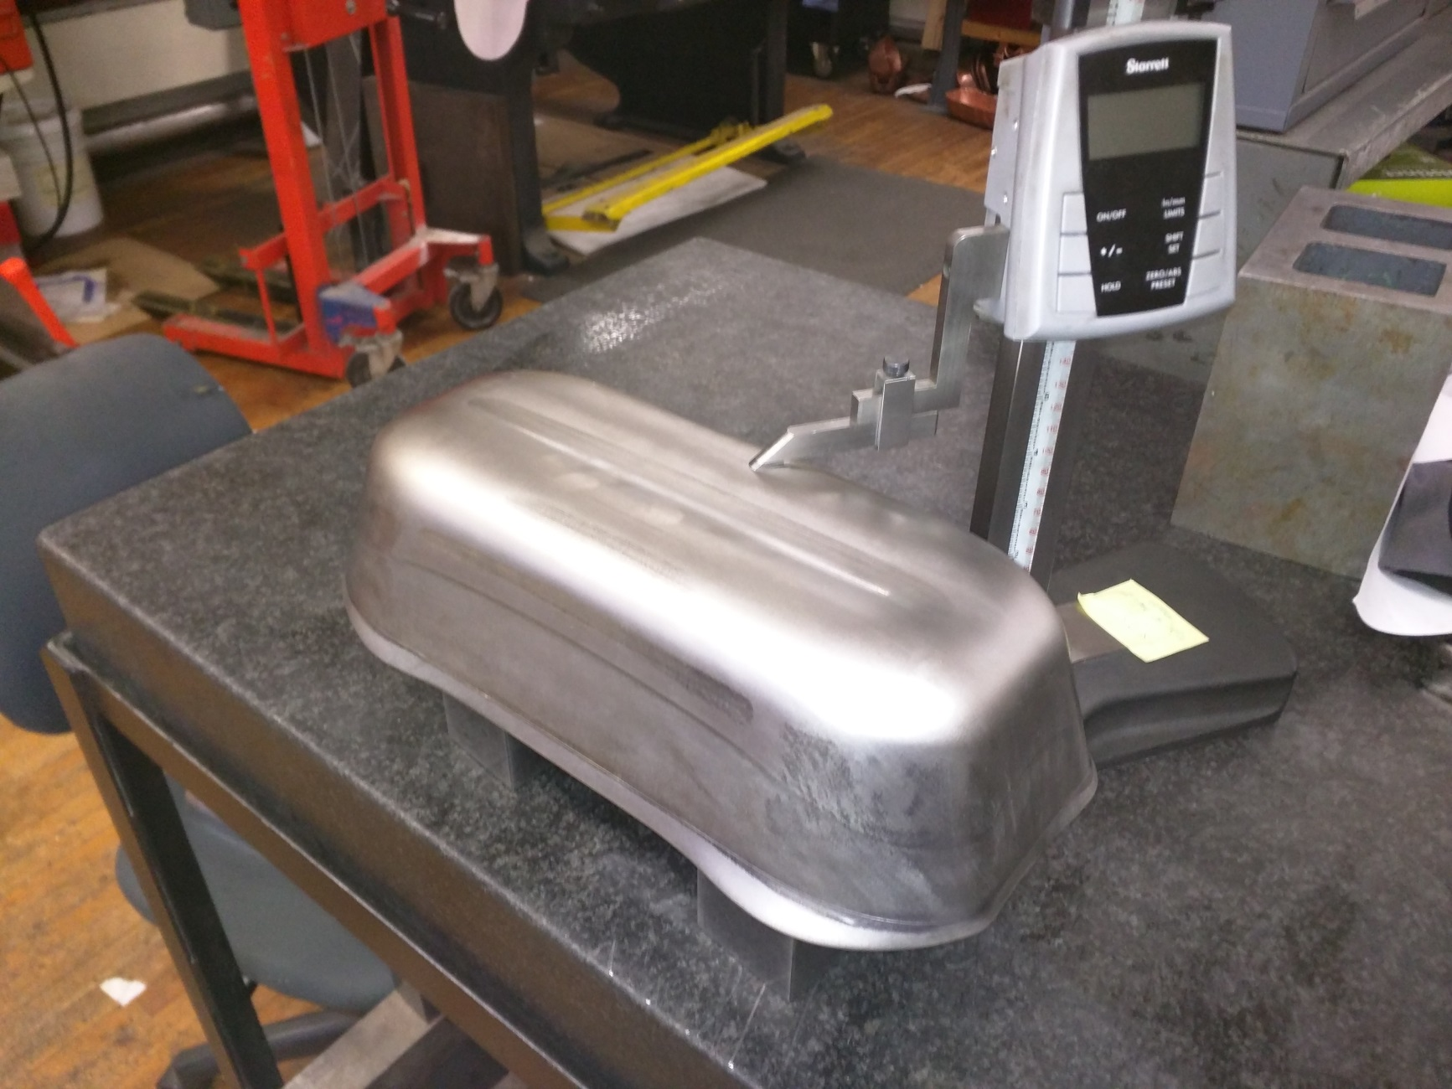
Technology Highlights: RF
Niowave Fabrication progress: Status April 2015
RF-Dipole:
Outer conductor
halves: 4 pieces
in QA
Bowel:
1 Niobium Stamped
others ready

Slide 21
Technology Highlights: Collimation
DS Collimators in IR2 (and IR1 and IR5) could be replaced by
orbit bumps and absorbers in the empty cryostat
Collimation Study Group March 2015
Works for IR1 & IR5 (tested) ✔
Could work for IR2 (ALICE) with optics and bump
modifications
Can not work for IR7!

Slide 22
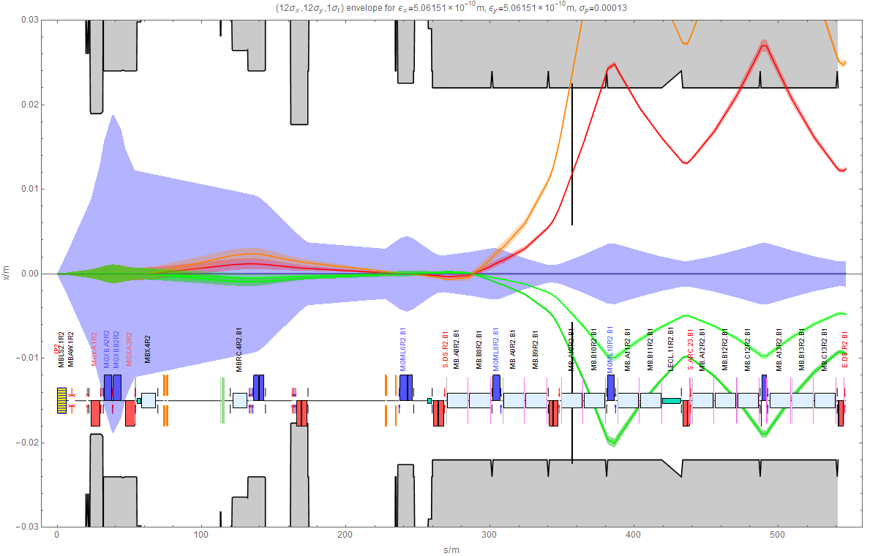
TCLD absorbs secondary beams from Pb-Pb collisions
Can select addition beams by adjusting collimator gap
Example of IR2, deliver full luminosity after ALICE upgrade during LS, quenches likely

Slide 23
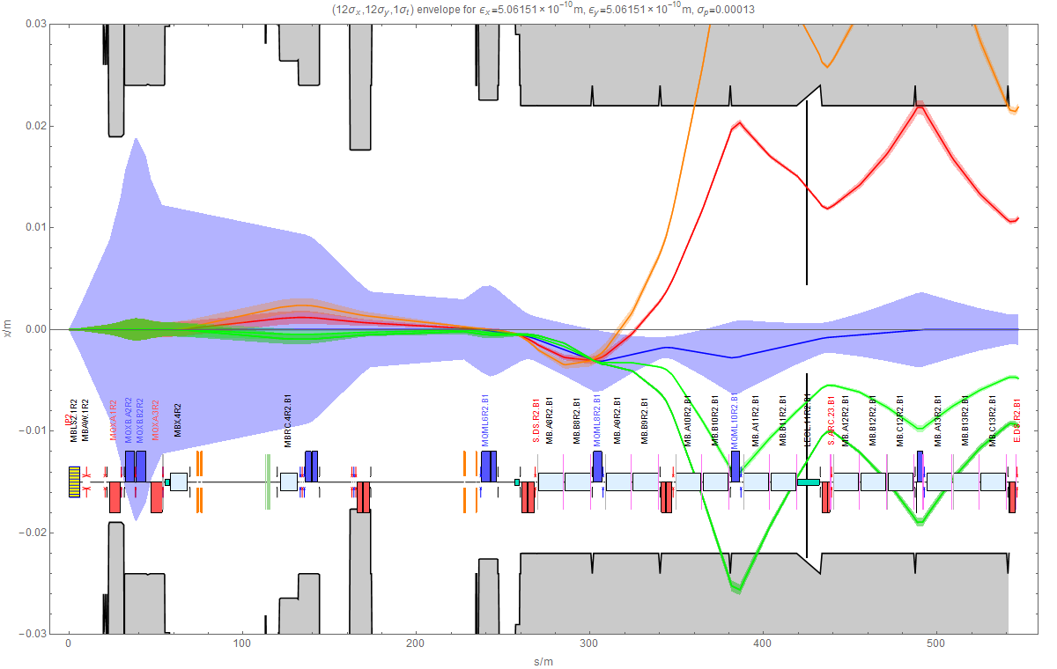
TCLD in connection cryostat at IR2
Variations of optics, bump and use of available orbit correctors studied (Tom Mertens, next talk). Solution only applicable in IR2.

Slide 24
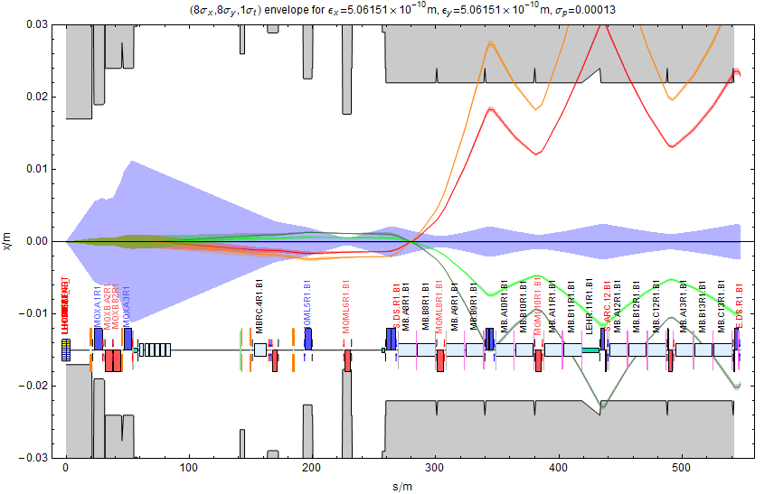
DS Collimator locations around ATLAS (or CMS)
Different from IR2 because of QF/QD polarity in dispersion suppressor

Slide 25
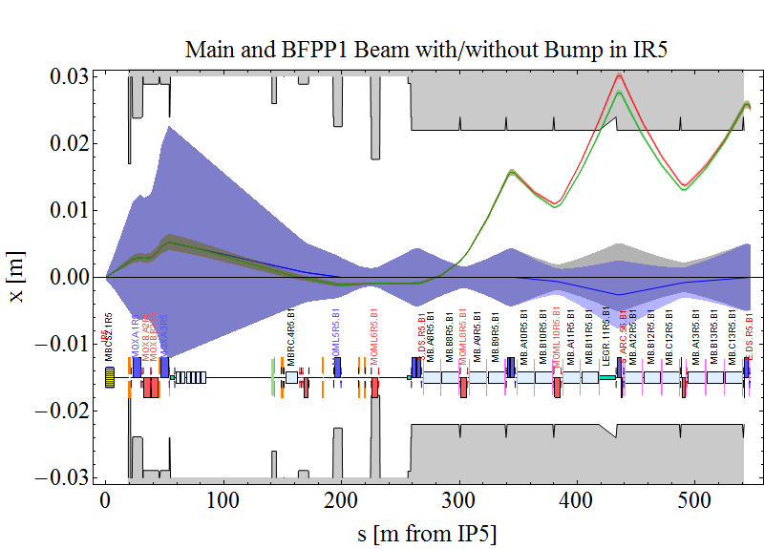
Quench Mitigation with Orbit Bumps tested at CMS
Orbit bumps could be used to spread out and move the secondary beam losses to a less vulnerable location in order to reduce risk of quench.
R. Bruce et al., Beam losses from ultraperipheral nuclear collisions between 208Pb82+ ions in the Large Hadron Collider and their alleviation, Phys. Rev. ST Accel. Beams 12, 071002 (2009)
Will be operational in 2015 for all experiments.
End-of-fill experiment on 24/11/2011 – Fill 2319.
3-magnet orbit bump with peak amplitude of
x = -2.6mm at MQ.11R5.B1
→ Moves BFPP1 beam impact position further downstream, increasing impact angle and spot size.
w/o bump
with bump

Slide 26
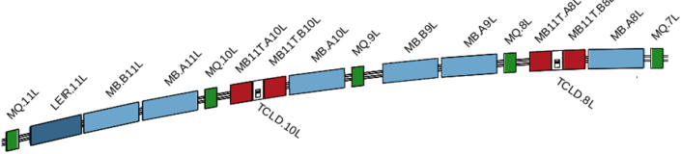
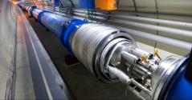
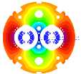
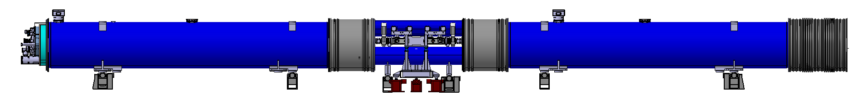
Technology Highlights: 11T magnets
F. Savary @
14th PLC
Create space in the dispersion suppressor regions of LHC, i.e. a room temperature beam vacuum sector, to install additional collimators (TCLD), which are needed to cope with beam intensities that are larger than nominal, such as in the High Luminosity LHC (HL LHC)
Replace a standard MB by a pair of 11T dipoles (the 11T dipole is also called MBH)
By-pass cryostat
15660 mm
11 T dipole cold mass
Interconnect
Space for Collimator

Slide 27
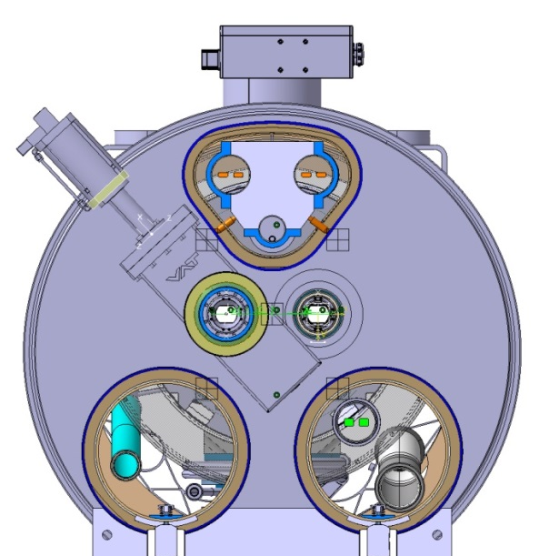
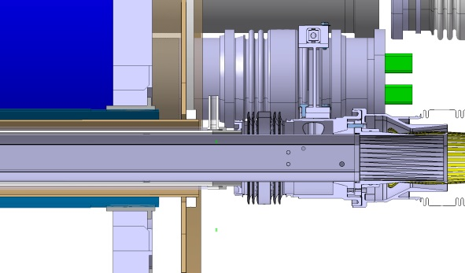
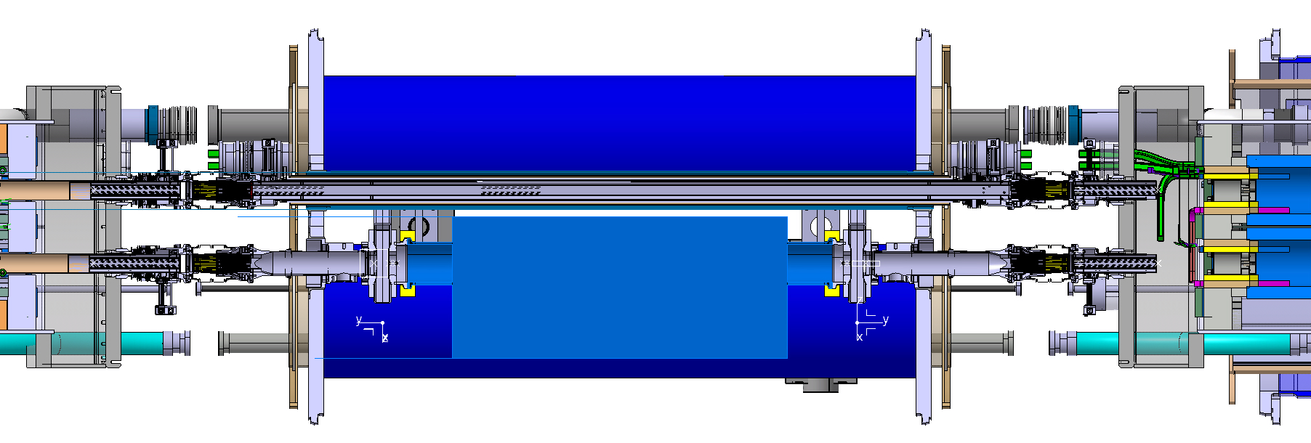
11T: Beam vac. & Collimator length
Courtesy D. Ramos
Work to make a mock-up
by-pass cryostat has started
Interconnects become longer because of the beam screens
Very compact cold line because of the sector valve RF shielding
Cold drift vacuum chamber – Preferred
650 mm Collimator
600 mm Collimator
Transitions avoided because there is no sector valve on the other beam line
Following the 51st Collimation Upgrade Specification Meeting held on Jan. 30, 2015
ColUSM #51
USLARP Collaboration Meeting, Mai 2015, FERMILAB, USA
27

Slide 28
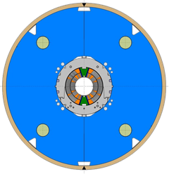
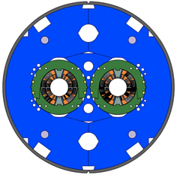
Updated Plan following C&S, Schedule & Col:
 | Phase 1 – LS2, all RRP | Phase 2 – LS3 | Phase 3 – LS4
Models | MBHSM101 (done) MBHSP101 (done) In addition: 4 x 1-in-1 MBHSP102 is under test 2 x 2-in-1 | PIT (new X-section): 4 x 1-in-1 2 x 2-in-1 RRP (new X-section): 2 x 1-in-1 1 x 2-in-1 | None Same design as for LS3
Prototypes | P1: MBH_P001 | P2: MBH_P002 [PIT] P3: MBH_P003 [RRP]
Series baseline | First of a kind¹ 1 x (2 MBH + 1 BPC²) | 2 in IP2 + 2 in IP7 or 4 in IP7 tbc 4⁵ x (2 MBH + 1 BPC) | To complete IP7 or in IP2 2 x (2 MBH + 1 BPC)
Series spares | - | - | 1 x (2 MBH + 1 BPC)
Option | - | - | IP1-IP5 Max. 8 x (2 MBH + 1 BPC)
 | 2 x (2 EC³ + 1 BPC)⁴
With all features to be compatible for installation, may become the 1st unit for installation or the spare unit for LS3
BPC stands for By-Pass Cryostat
EC stands for Empty Cryostat. As a reminder, the connection cryostats currently installed in LHC are shorter than a standard MB. An assembly of 2 EC + 1 BPC completed with a collimator (WP5) will form a CCC (Connection Cryostat Collimator) that would replace an existing connection cryostat
These empty cryostats are an option, which needs to be confirmed
The first of these 4 shall come soon after the first of a kind produced before LS2. As a matter of fact, it will have the same design

Slide 29
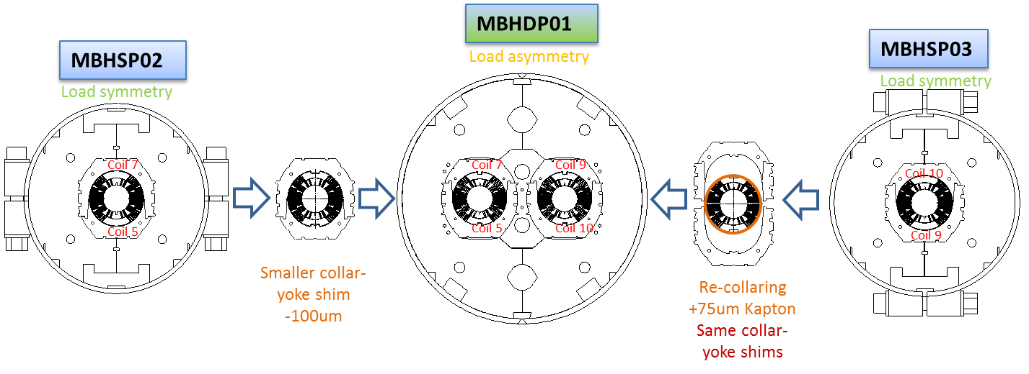
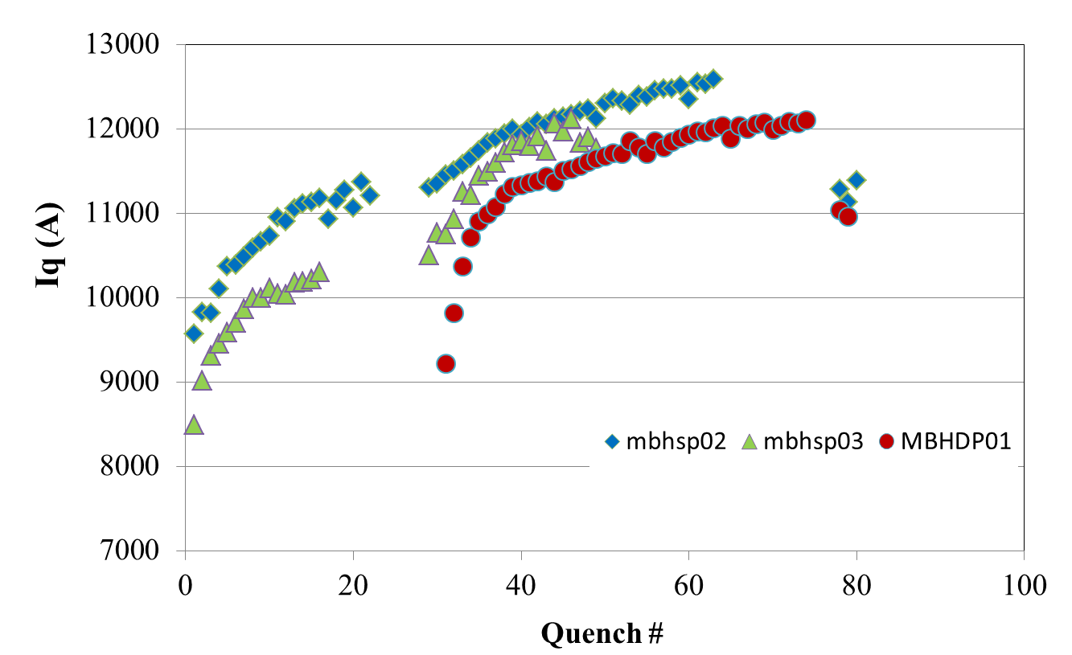
MBHDP01 tested in Feb./Mar. 2015
First 2-in-1 11 T dipole model
11.5 T (∼ 12.1 kA) reached after 36 quenches
80 % of SSL, which is ∼ 15.1 kA, reached in 41 quenches
No further degradation observed between single aperture model results and 2-in-1 results
1.9 K
4.5 K
4.5 K
Courtesy G. Chlachidze,
S. Stoynev, A. Zlobin

Slide 30
Civil Engineering Considerations:
Vibration studies
First studies showed that CE work is incompatible with
LHC operation
Studies showed vibration amplification from triplet
cryostat by two orders of magnitude ➔ Earth quakes,
environmental noise & CE impact on HL-LHC
Schedule and Space Requirements
Integration studies show need for substantial
underground CE work
➔ No major difference in cost and schedule from CE
➔ re-evaluation of on-surface vs underground installation

Slide 31
Inventory of space requirement
Baseline
Option
S
U
R
F
A
C
E
Power converters
320 m²
Power converters
320 m²
S
U
R
F
A
C
E
RF crab cavity equipment
200 m²
RF crab cavity equipment
200 m²
Warm compressors and
4.5 K cold box
1000 m²
Warm compressors and
4.5 K cold box
1000 m²
C
O
N
N
C
O
N
N
T
U
N
N
E
L
T
U
N
N
E
L
RF crab cavity equipment
200 m²
Power converters
320 m²
Power converters
320 m²
RF crab cavity equipment
200 m²
1.9 K Cold box
300 m²
1.9 K Cold box
300 m²
IP
IP

Slide 32
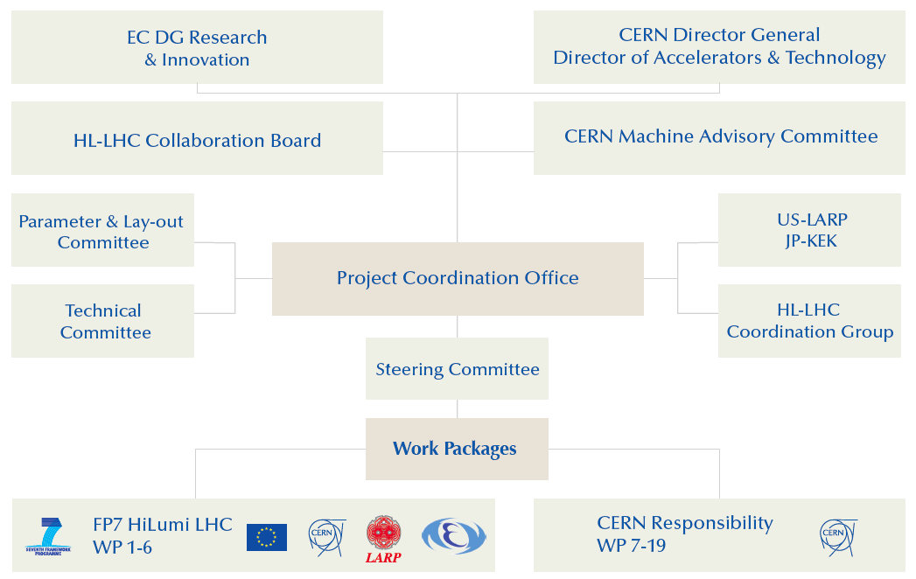
Project Governance during FP7 DS:
No Connection with Department Leaders and Group Leader!!!
32

Slide 33
Project Governance Proposal:
Coordination Group
Scientific Advisory Committee
➔ C-MAC
CERN Director General
Director of Accelerators & Technology
Machine Performance Committee
LMC:
LHC operation &
HL-LHC comm. preparation
HL-LHC Project Office
Revised Collaboration board
US-LARP, JP-KEK, UK, Greece
& other In-kind contributiors
CERN HL-LHC
Technical
Committee
LIU:
Project and injector operation
Work Packages / Groups
33

Slide 34
Other info (HL-LHC Coord group):
Ions performance in P2 under clarifications
Collaborations
    UK (R. Appleby);
    Sweden (RF measurements?)
    Greece (TAXS/TAXN?, BI?)
    Georgia (Cryostat Jacks) ?
    Japan for D1 magnet model and SCRF polishing
    TRIUMF (ABP and BI?)
The HL-LHC book is almost finished!
http://www.worldscientific.com/worldscibooks/10.1142/9581
USLARP Collaboration Meeting, Mai 2015, FERMILAB, USA

Slide 35
Next events
May 11– 3 LARP CM24 (LARP-HiLumi Spring Meeting
17th-18th September : HL-LHC/LIU day (4th event of that type including RLIUP)
19- 23 October HiLumi LHC/Larp 5th joint annual meeting. Closing FP7 HiLumi LHC
    Including 2 events: 1 for officials in CH and 1 in Fr (CMS) with local authorities.
    Half or one full day on Collider-Experiment Interface
        Optimizing performance of proton: how relevant is the PU density?
        TAXS diameter: can it be definitely fixed (or not)?
        LS2 and LS3 duration and timing → C.E. plan (see events with authorities)
    Ion beam intensity: do we need 11 T for DS collimations for IP2?
    The plan is to continue to built whatever is useful ALSO for P7 (a delayed LS2 helps)!
USLARP Collaboration Meeting, Mai 2015, FERMILAB, USA

Slide 37
HL-LHC PDR:
Run III
Run I
Run II
0.75 10³⁴ cm⁻²s⁻¹
50 ns bunch
high pile up ∼40
1.5 10³⁴ cm⁻²s⁻¹
25 ns bunch
pile up ∼40
1.7-2.2 10³⁴ cm⁻²s⁻¹
25 ns bunch
pile up ∼60
Technical limits (machine and experiments) like :
50 ⇒ 25 ns

Slide 38
Accelerator Technology Sector Committees:
BE, TE & EN DH
Accelerator & Technology Sector Management Board
LMC
IEFC
HL-LHC Project
BE, TE & EN DH and GLs
LHC experiments
Experimental areas
BE, TE & EN alt DH and alt GLs
LIU Project
WG:
FOM?
MPP
LBOC?
LHC EIC & MC
Projects:
Collimation
Projects:
LINAC4
Machine Coordinators
& Supervisors
WGs:
FOM
MSWG
Two Separate Worlds that are only connected via the ATS MB

Slide 39
Accelerator Technology Sector Committees:
BE, TE & EN DH
C-MAC
Accelerator & Technology Sector Management Board
Machine Performance Committee (LHC & Injectors)
HL-LHC Project
BE, TE & EN DH and GLs
Working Groups:
FOM
MPP
LBOC
MSWG
LHC experiments
LHC EIC & MC
Sub-Projects:
Collimation
LINAC4
LIU Project
HL-LHC Technical Committee
LIU Technical Committee
Plus a dedicated Injector Complex Operation Committee
reporting to ATS or MPC?

Slide 40
Implementation plan:
PDR: EU Deliverable D1.4➔ delivered November 2014: CERN-ACC-2014-0300
Ext. Cost & Schedule Review in Jan-Feb 2015;
TDR: OCT 2015; TDR_v2 : 2017
Cryo, SC links, Collimators, Diagnostics, etc. starts in LS2 (2018)
Proof of main hardware by 2016; Prototypes by 2017 (IT, CC)
Start construction 2018 for IT, CC & other main hardware
IT String test (integration) in 2019-20; Main Installation 2023-25

Slide 41
LHC schedule beyond LS1
LS2 starting in 2018 (July) => 18 months + 3 months BC
LS3 LHC: starting in 2023 => 30 months + 3 months BC
Injectors: in 2024 => 13 months + 3 months BC
Physics
Shutdown
Beam commissioning
Technical stop
30 fb⁻¹
YETS
EYETS
YETS
LS 2
YETS
Run 2
Run 3
Run 2
LS 2
Run 3
YETS
LS 3
Run 4
YETS
LS 3
Run 4
300 fb⁻¹
LS 4
Run 5
LS 5
LS 4
Run 5
LS 5
(Extended) Year End Technical Stop: (E)YETS
Goal of 3’000 fb⁻¹ by mid 2030ies
LHC schedule approved by CERN management and LHC experiments spokespersons and technical coordinators (December 2013)

