Slide 2
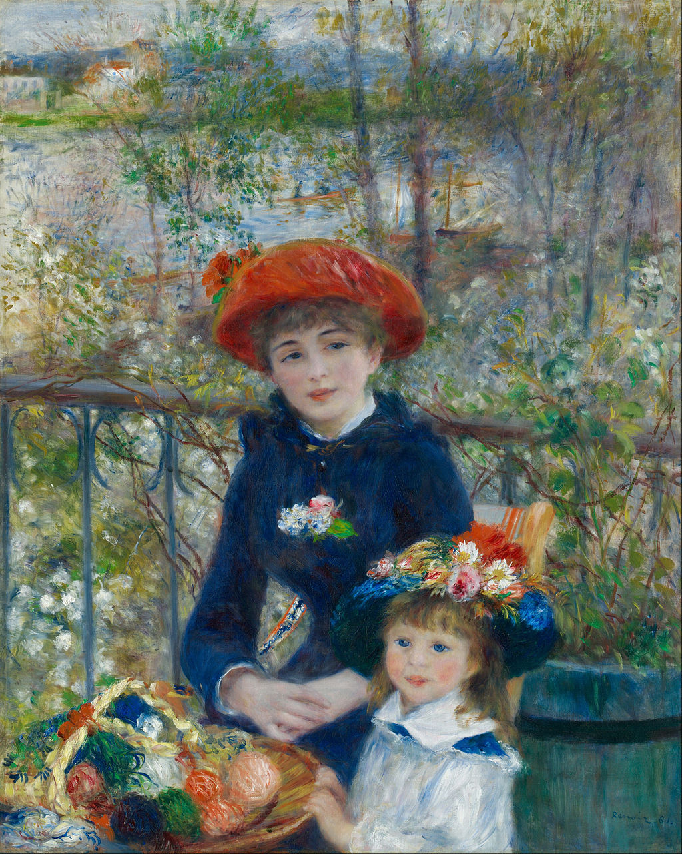
“One must - from time to time - attempt things that are beyond one's capacity”
“The pain passes, but the beauty remains”
Pierre-August Renoir
Two Sisters - Art Institute of Chicago

Slide 3


Social Activities
Collaboration Picture on Monday Afternoon after Toohig Candidates Sessions
  End of Plenary Session on Monday
  ~15:15 in front of Wilson Hall
Welcome Reception Cocktail
  Gently offered by FRA (Thank You !)
  When: Monday evening at 18:00, after completion of all Sessions
  Where: Wilson Hall, 15th Floor
No-Host Dinner:
  When: 7:00 pm Tuesday evening
  Where: Chez Leon (Users Center in FNAL Village)
  Cost: 55$/person, we will be collecting the $
    Exact Change, please !

Slide 4
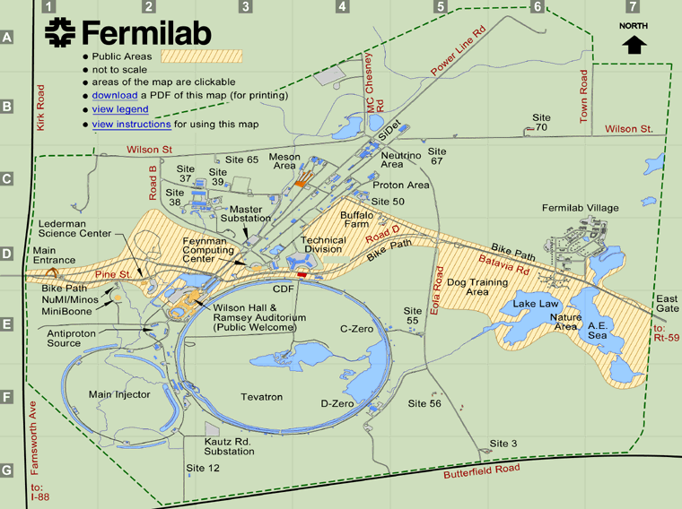
TD
Wed.-Thu.
Users Center
Tue. Evening
Wilson Hall
Mon.-Wed.

Slide 5
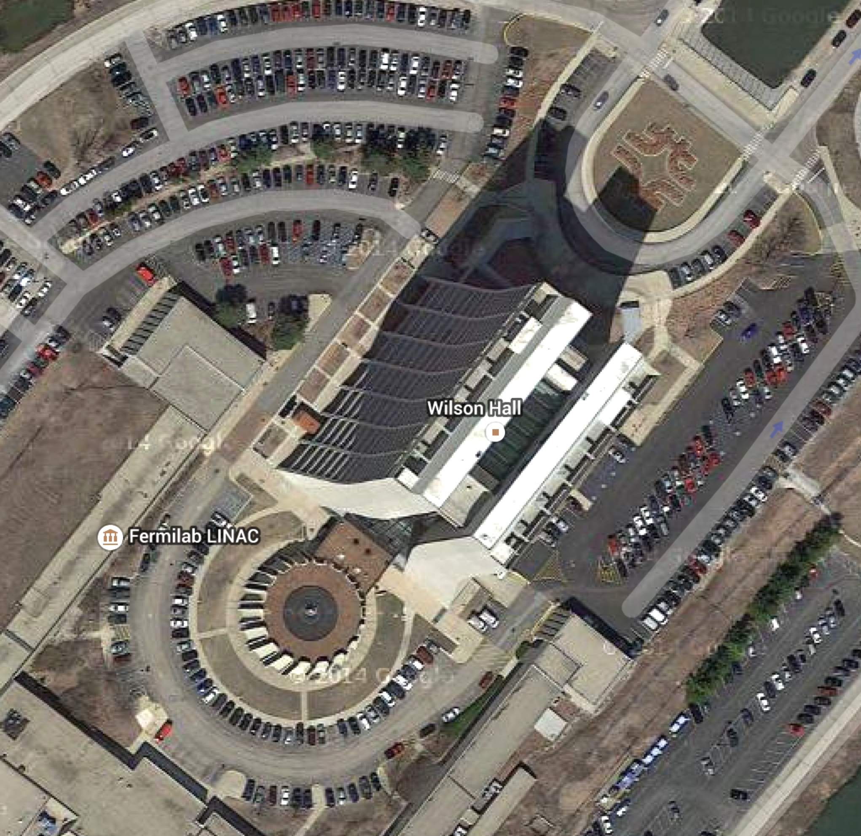
Agenda and Rooms Location
https://indico.fnal.gov/conferenceDisplay.py?confId=9342
  Best reached from: www.uslarp.org
Monday
  Plenary: One West (this Room)
  Parallel
    Magnet: One West (remain here!)
    CC: WH7XO (Racetrack)
    WP5/Acc. Phys: One East
Tuesday
  Parallel
    Magnet: WH7XO (Racetrack)
    CC: WH8XO (Hornets Nest)
    Acc. Phys.:WH2NE (Snake Pit)
Wednesday
  Plenary: Curia II (WH2SW)
What’s up with FNAL Meeting Rooms Names?
  http://www.quantumdiaries.org/2013/11/25/whats-in-a-name-the-wit-and-whimsy-of-a-national-labs-conference-rooms/
Satellite Meeting on Wed. and Thur.
  MQXF Magnet Meeting
  TD-IB3A
North
West
East
South
Coffee Breaks: All 5 breaks in WH Atrium !

