Slide 1
SPS MD Program
N. Biancacci, E. Métral and B. Salvant for the impedance team
Y. Papaphilippou, S. Redaelli.
Acknowledgments: G. Arduini, G. Burt, R. Calaga, J. Delayen,
S. De Silva, E. Jensen, A. Ratti, G. Rumolo.

Slide 2
Context
SPS as testbed for HL-LHC/HiLumi/LARP hardware
  Topic already discussed at recent workshops:
    Nicolo Biancacci and Y. Papaphilippou at KEK 2014
    Several talks at this workshop will also touch this subject
Constraints of SPS:
    LHC beam performance should be maintained and even ramped up during run 2 and run 3 (e.g. with RF upgrade, impedance reduction campaign)
    → tight requirements on aperture, vacuum and impedance
    →Test systems are not allowed to put additional constraints (ex: COLDEX was taken out last month following an alignment issue).
    → space competition with consolidation/upgrade projects (ex: the choice of LSS5 for both the new dump and crab cavities).
    Should be done in parallel with the Fixed target physics program and the studies to improve the performance of the LHC beams (LIU).
    → time for dedicated MDs is (very) limited.

Slide 3
Considered HL-LHC hardware
Crab cavity prototypes
COLDEX for cold beam screen experiments
Beam Beam Long range wire experiments
Collimators (including the SLAC rotatable collimators)
High Bandwidth feedback
→ Will primarily focus on impedance aspects of crab cavities

Slide 4
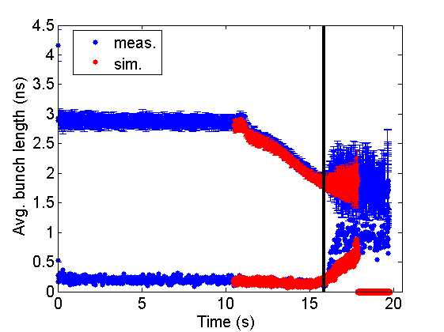
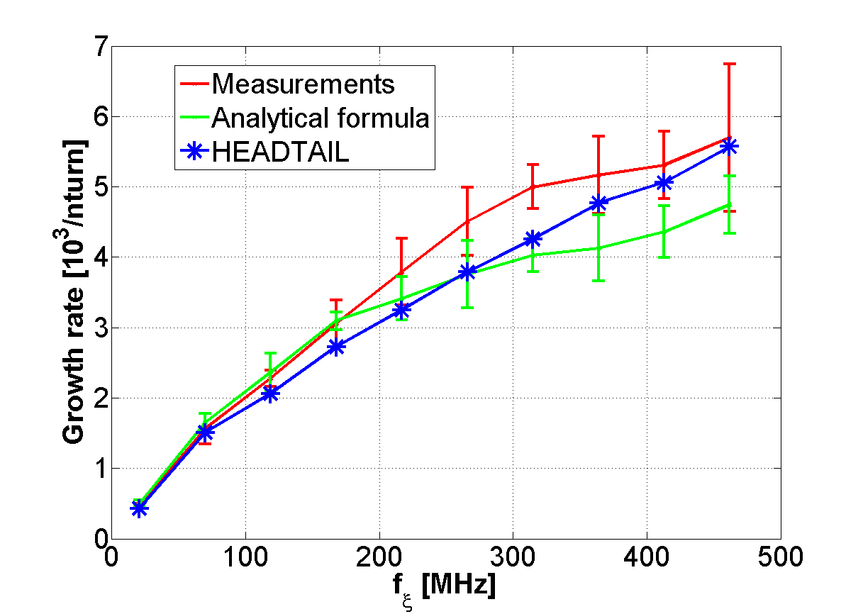
SPS impedance
SPS impedance model progressively built over the years
→ very good agreement now achieved with measurements of longitudinal and transverse single bunch observables
(T. Argyropoulos, H. Bartosik, J. Varela, C. Zannini et al).
→ now will attack the multibunch observables (MDs planned in 2015)
Longitudinal instabilities with 12 bunches
during the ramp
Single bunch Headtail growth rates
T. Argyropoulos et al
LIU-SPS BD 2015
C. Zannini et al,
LIU-SPS BD 2014

Slide 5
Crab cavities
Crab cavities in LHC are a worry for the impedance team due to:
    The very large transverse beta functions at their planned location (~4 km)
    The large number of cavities (16 in the final stage)
    The large number of HOMs and their high Q if undamped.
    The already optimized LHC impedance to reach high brightness beams.
In the SPS, however:
    The beta function can not be very high.
    There are only 2 cavities.
    The large number of HOMs and their high Q if undamped.
    The SPS impedance is large compared to LHC, in particular in the longitudinal plane.

Slide 6
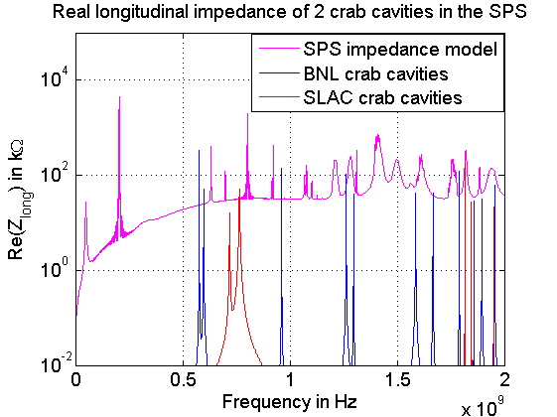
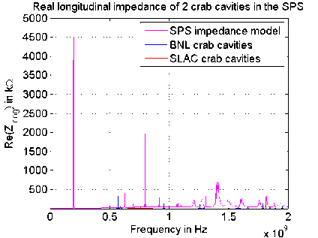
Superimposition of crab cavity modes with SPS impedance model from Jose Varela (BE/RF-BR)
→ The first 3 modes of the BNL cavities are coming out of the SPS background, while the SLAC cavity modes remain below the background.
→ Can the first BNL mode at 580 MHz lead to more instabilities in SPS or be observed with a debunching bunch?

Slide 7
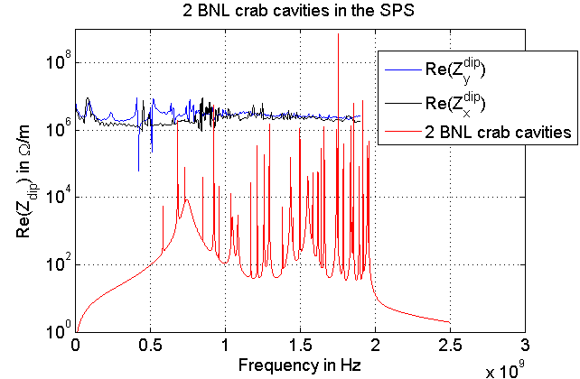
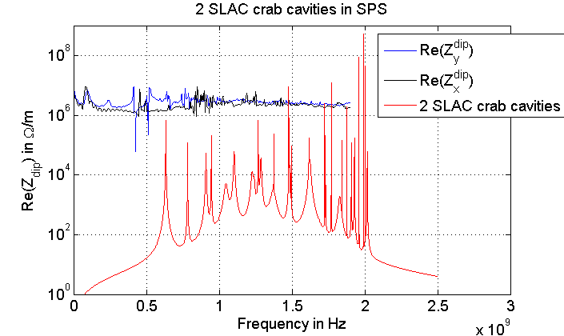
Apart from the large modes beyond 1.4 GHz, not much should be detected by the SPS beam
from the crabs transverse modes (assuming the deflecting mode is always feedbacked on).

Slide 8
Is there hope to see anything?
With the damping of the modes achieved by the cavity and HOM designers, we do not expect to see an impedance effect of the crab cavities in the SPS (expect maybe the potential undamped modes beyond 1.75 GHz).
If increasing the Q of some or all crab cavity modes is possible, then we could hope to see an impact.
However, increasing the Q of a mode reduces the width of the resonance and decreases the probability for the mode to interact with beam resonant frequencies:
  Either we have a low shunt impedance but high chance of hitting a beam frequency
  Or we have a high shunt impedance with lower chance of hitting a beam frequency

Slide 9

Frequencies for the transverse resonant lines?
Sacherer’s formula:
See for instance E. Métral, overview of single beam coherent instabilities in circular accelerators,
CARE workshop proceeding 2005
$$f=\left({Q_{x}+n}_{x}+k.M+m{.Q}_{s}\right){.f}_{rev}$$
n_{x} : coupled bunch mode
Δf between two modes: f_{rev}
In SPS, Δf=44 kHz
In LHC, Δf=11 kHz
Same contribution for all modes
m: azimuthal mode
Δf between two modes: Q_{s}*f_{rev}
In SPS, Δf=370 Hz (for Q20)
In LHC, Δf=22 Hz (at flat top)
Contribution decreases with 1/(m+1)
Contribution strongly depends on mode
frequency and chromaticity
k scans integers in ]-∞;+∞[
Δf between two modes: M*f_{rev}
In SPS, Δf=40 MHz (for 25 ns)
In LHC, Δf=40 MHz (for 25 ns)
Same contribution for all modes

Slide 10
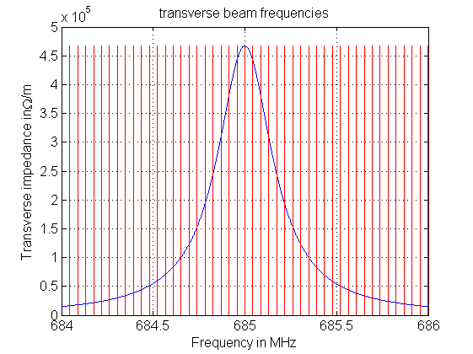
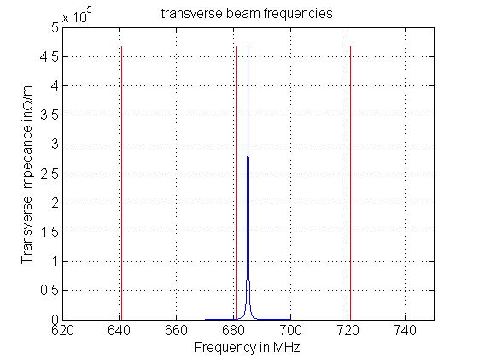

1st DQW transverse HOM: f=685 MHz, Q=1880, R=467 kOhm/m
$$f=\left({Q_{x}+n}_{x}+k.M+m{.Q}_{s}\right){.f}_{rev}$$
1 line every 44 kHz
1 line every 40 MHz
→ Chance of hitting a line with significant impedance with this mode: 100%

Slide 11
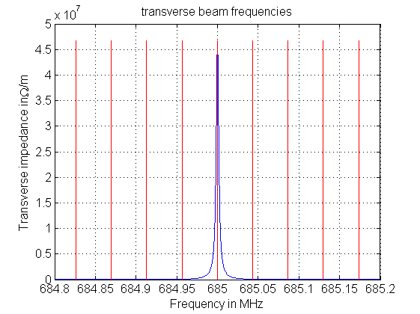
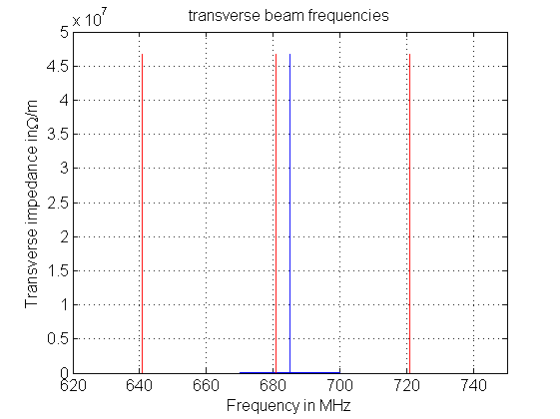
1st DQW transverse HOM with factor 100 reduced damping: f=685 MHz, Q=188,000, R=46700 kOhm/m
$$f=\left({Q_{x}+n}_{x}+k.M+m{.Q}_{s}\right){.f}_{rev}$$
1 line every 44 kHz
1 line every 40 MHz
→ Chance of hitting a line with significant impedance (Rmax/2): 4kHz/44 kHz~10%

Slide 12
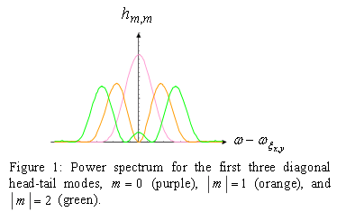
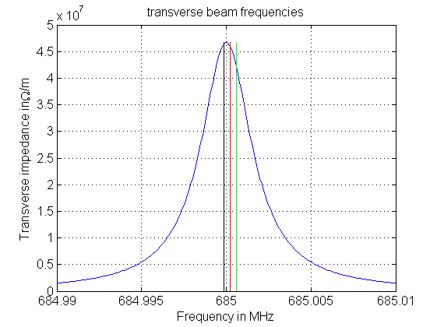

What about the azimuthal mode m?
If we assume that only up to 3 consecutive azimuthal modes have significant power spectrum for a given mode frequency,
$$f=\left({Q_{x}+n}_{x}+k.M+m{.Q}_{s}\right){.f}_{rev}$$
m=0
m=1
m=2
→ Effective widening of the cross-section by
2*Qs*frev~700 Hz in this SPS case

Slide 13
Are the crab cavity modes growth rates significant?
PhD thesis of Alex Koschik: measurements of growth rates with fixed target beams without damper of the order of:
    75 turns (for the vertical plane) ~60turns found with Sacherer formula and 110 MOhm/m (Re(Zdip) from SPS model)
    150 turns (for the horizontal plane) ~120 turns found with Sacherer formula
Computations for a crab cavity mode:
    0.5 MOhm/m → growth rate of 14000 turns (Q~2000)
    Reduce damping by a factor 1000 is needed to reach the same order of magnitude as the resistive wall instability (Q~2e6).
    For this HOM, undamped Q at 10⁹, therefore, possibility in theory to reach growth rates of a few turns with crab cavity HOMs.
    This would enable to see whether such high Q modes can indeed drive instabilities, and learn for the LHC case.
    Can such reduced damping be implemented in the SPS cryomodules?

Slide 14
With full undamped modes
If some modes can be fully undamped, their width will be very small. Chance to interact with a transverse beam line?
Let’s assume for instance the mode that is properly damped in the DQW cavity at 1.75 GHz (Q=4e6, R=0.18 MOhm/m).
→ Growth rate should be of the order of 40 turns
→ but deltaf~400 Hz
→ probability to hit a line is ~1%
Can we change the tune?

Slide 15
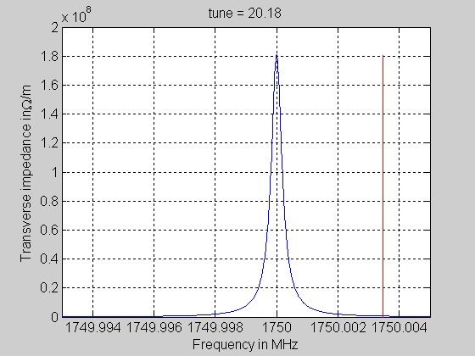
Changing the tune to look for a sharp resonance (Q~4e6)
Changing the tune by 0.15 allows scanning Qx*frev=6 kHz
→ promising but the whole frequency range will be difficult to scan with high intensity

Slide 16
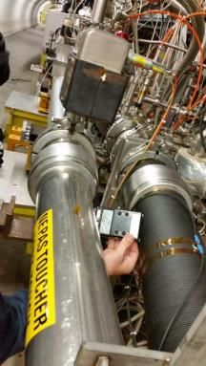
COLDEX
COLDEX aims at qualifying the performance of amorphous coatings at cryogenic temperatures.
Similar setup as the SPS crab cavities
COLDEX was replaced by a straight pipe
due to a broken fixation that led to bad
alignment and beam losses with first
LHC beam injections.
It should be reinstalled during the technical
stop in June 2015 at the latest, but they
may miss the measurement opportunity at
the next SPS scrubbing run, which was the
main measurement possibility this year.

Slide 17
BBLR (slides from Yannis)

Slide 18
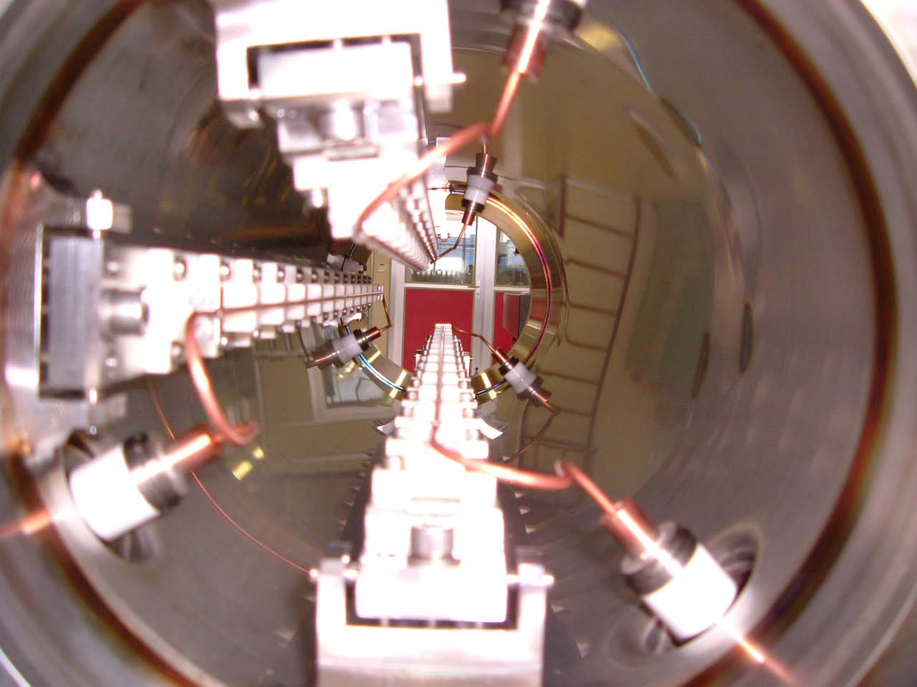
Wires at SPS
Two 60cm long 3-wire compensators installed in the CERN SPS
  Different “crossing” plane and even @ 45deg
Movable in vertical by +/- 5mm (remote controlled)
Water cooled
About equal beta functions in the transverse planes (~50m)
Separated by a phase advance of 3deg (similar between BBC and long range interactions in LHC)
Powered with integrated DC current of up to 360A m (60 LR collisions in LHC)

Slide 19
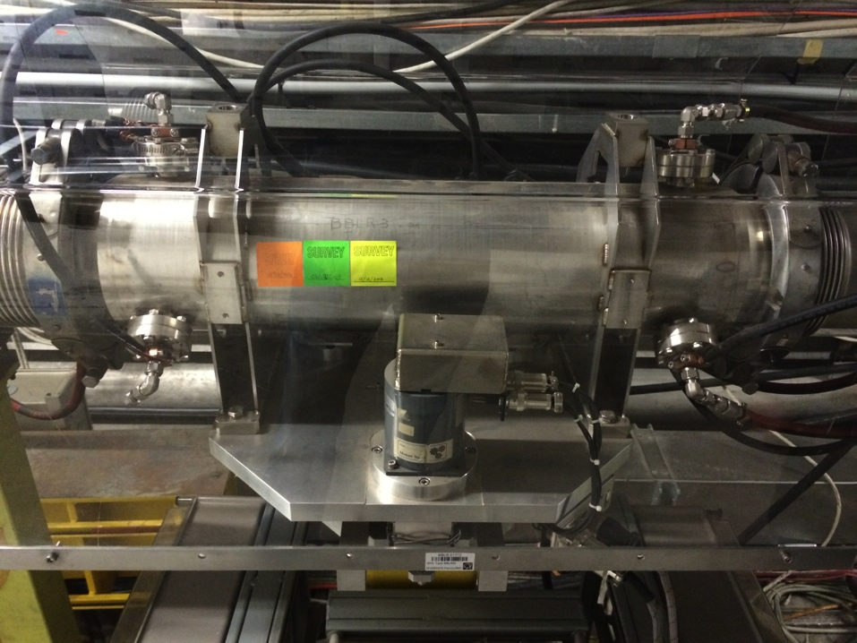
Wires at SPS
Set-up currently re-evaluated during 2014
  New power convertor able to pulse in PPM mode Powering H or V wire, with a switch
  Step motors verified and controller in good shape
  Vacuum integrity to be checked during next technical stop (June 2015)
BBLR 51772
MDs in 2015 for benchmarking wire models
  At SPS flat bottom in parallel MD cycle (single LHC-type bunches)
  Beam brought close to the wire with closed bump (already checked)
  Effect of wire on orbit, tune, tunes-spread, coupling (alignment), resonance driving terms, beam distribution (tails), impedance.

Slide 20
Optics at the SPS wires
Q26
Q20
BBLR2
BBLR2
Q26 optics (nominal for FT beam)
  β_{x} ~53m, β_{y} ~45m, D_{x}~-0.65m
Q20 optics (nominal for LHC beam)
  β_{x} ~63m, β_{y} ~55m, D_{x}~-0.75m

Slide 21
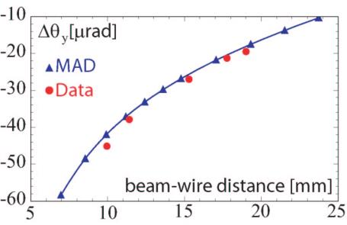
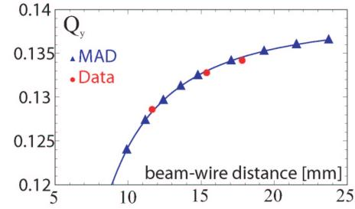
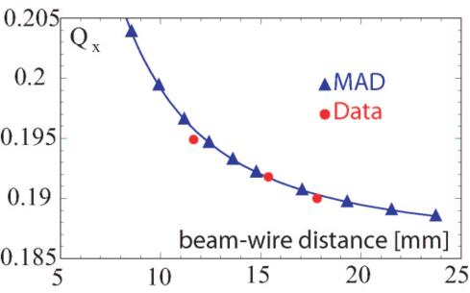
SPS wire calibration
F. Zimmermann et al.
y orbit
change
Q26 optics (nominal for FT beam)
  β_{x} ~53m, β_{y} ~45m, D_{x}~-0.65m
Q20 optics (nominal for LHC beam)
  β_{x} ~63m, β_{y} ~55m, D_{x}~-0.75m
x tune change
y tune
change

Slide 22
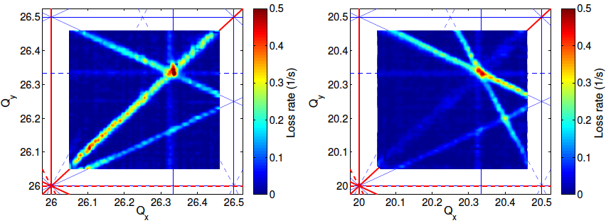
SPS frequency loss maps
H. Bartosik, PhD thesis
Experimental tune scans in the SPS with the nominal Q26 (left) and Q20 optics (right).
Color-code indicates the loss rate during a dynamic scan of the fractional tunes, as (averaging over 4 scan directions)
Study effect of wire in both optics (measure resonance driving terms)

Slide 23
Collimation (S. Redaelli et al)
SLAC rotatable collimator is planned to be installed during the next technical stop in June (and removed during the year end technical stop).
MD program includes alignment tests and impedance measurements.
No plan for electron lens installation.
In case, collimators with new materials (and ferrite) could be checked for impedance and heating in the SPS before being installed in the LHC.

Slide 24
High bandwidth feedback (J. Fox et al)
See talk by J. Fox in this workshop
We managed to reproduce the TMCI after injection by reducing chromaticity, and it will be very interesting to study the effect of the high bandwidth feedback and the regular bunch by bunch transverse damper on this instability.
If crab cavity related headtail modes are observed, the high bandwidth feedback could also be more efficient than the regular damper for azimuthal modes >0.

Slide 25
Outlook
There are many ideas and plans to perform tests of HL-LHC hardware in the SPS.
However there is little dedicated MD time.
Finding parallel time is however very easy and it could be useful to find ways to perform tests in parallel with physics or LHC fillings.
Crab cavity modes will be hard to detect in the SPS, but there is still hope.

