Slide 1
E-lens operation and electron beam characterization
X. Gu
Notes:
30 slides

Slide 2
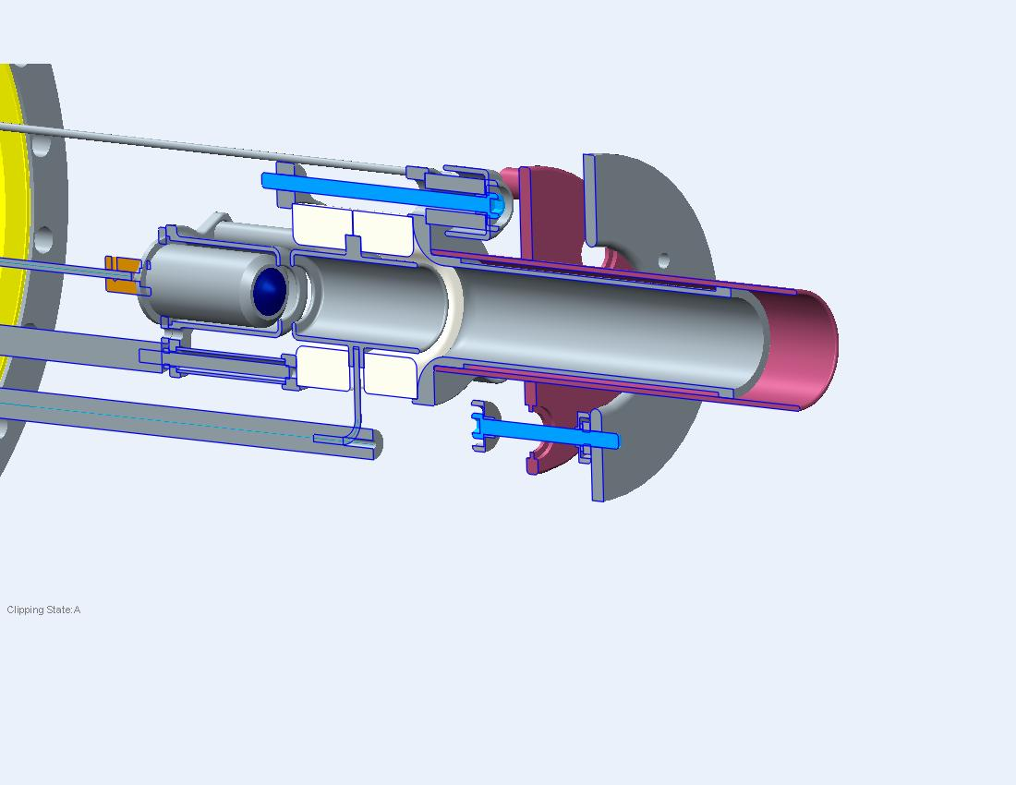
RHIC electron lenses - 2015
2015 – First proton run with electron lenses => compensation
Larger cathodes (7.5 vs. 4.1 mm radius) => allows for matched beam size with high solenoid field => raises instability threshold => easier alignment
Transverse damper => raises instability threshold
New lattice, based on ATS optics (S. Fartoukh, CERN) => phase advance kp between p-p and p-e interactions => small nonlinear chromaticity => no depolarization

Slide 3
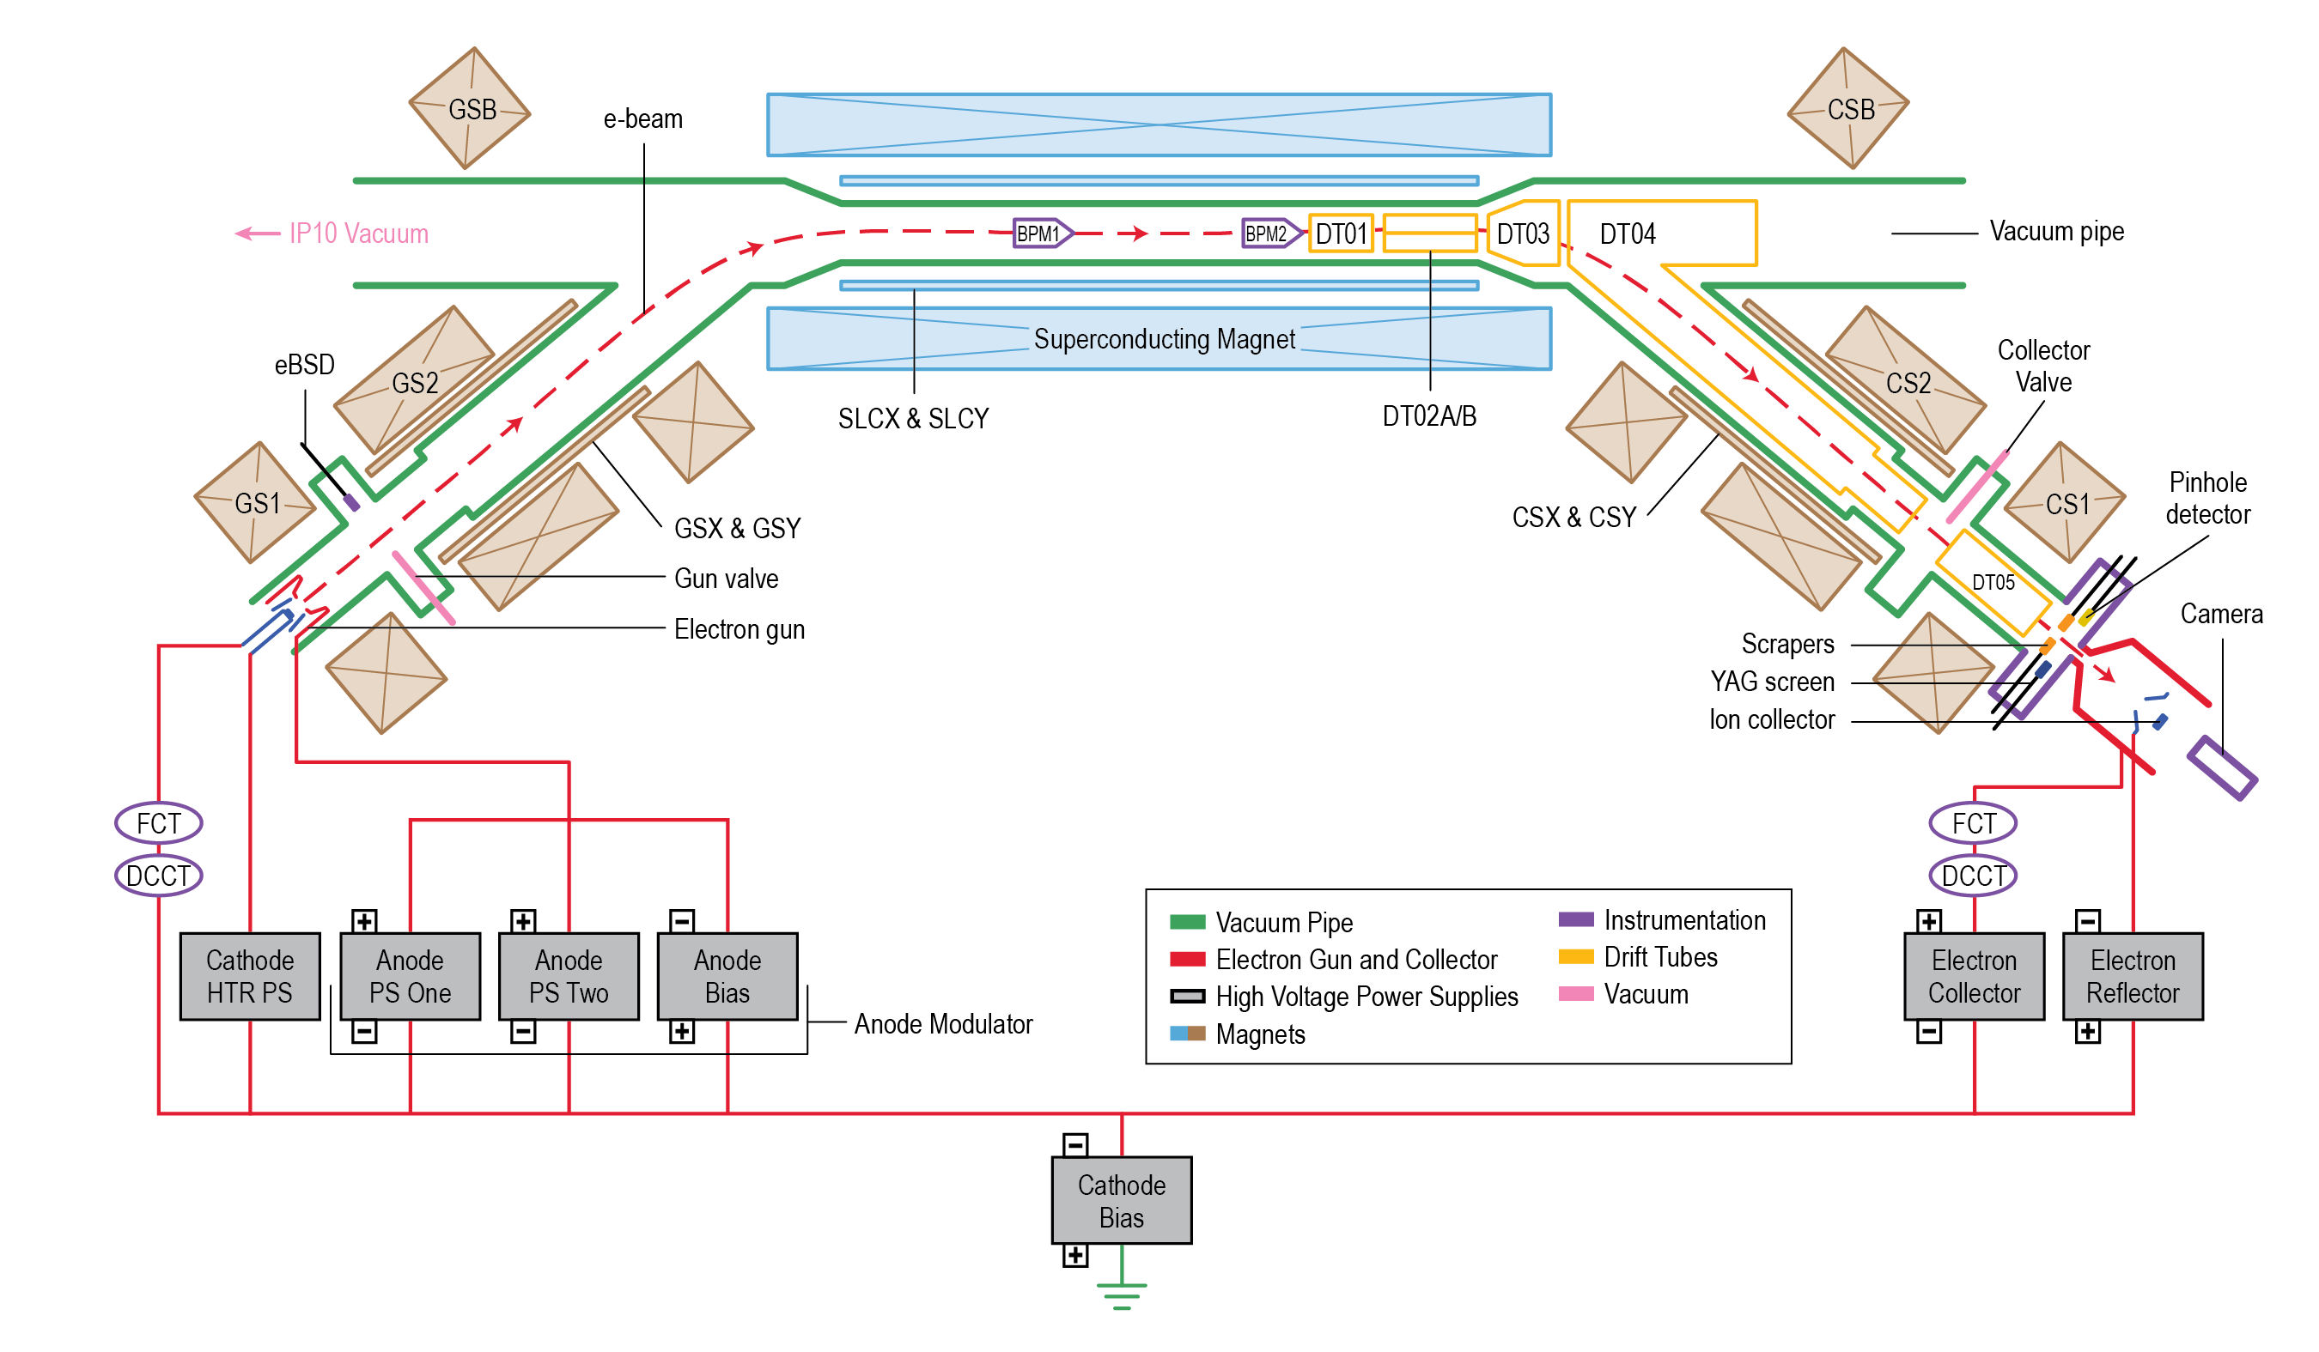
RHIC electron lens -- Layout
1 Anode-Beam Current 3 Collector-Beam Power
2 Bias-Beam Energy 4 GS1-Beam Size

Slide 4
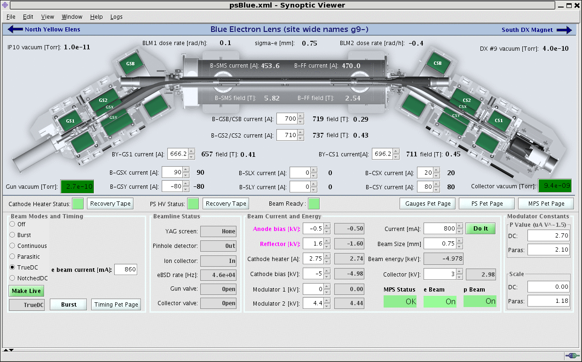
RHIC electron lens – Operating Parameters
Easy to control - operators know how to use it.

Slide 5
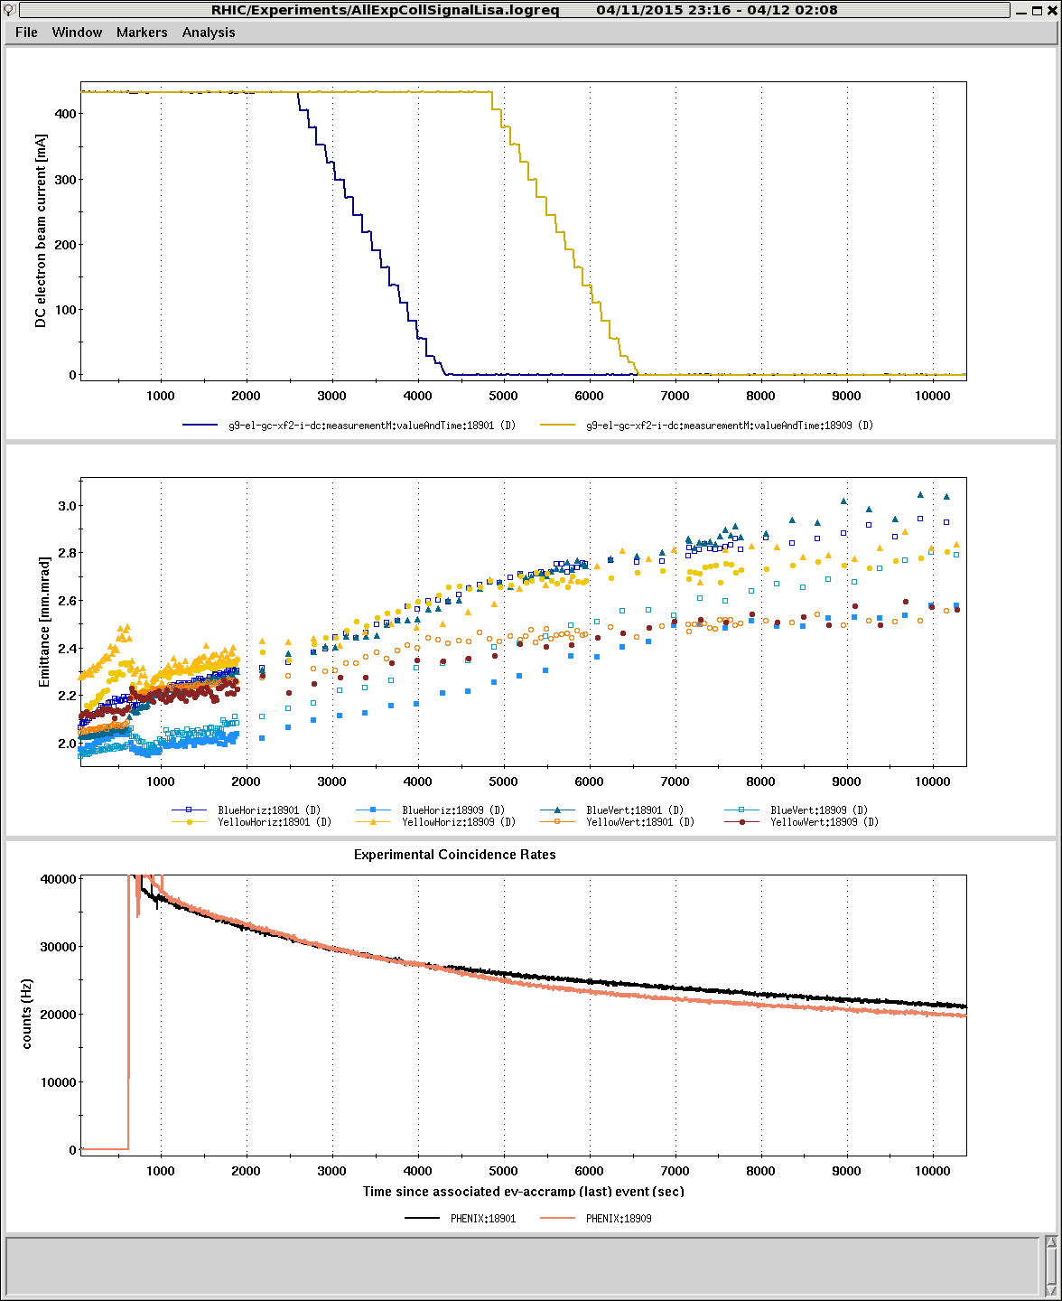
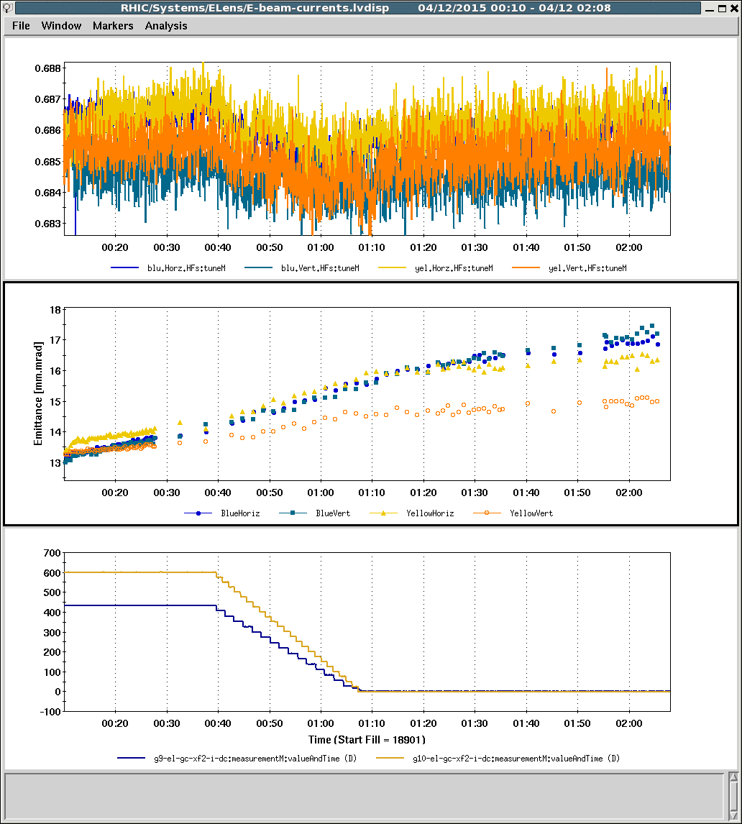
RHIC Operation with E-lens
E-beam current
Tune
Emittance (IPM)
Emittance (IPM)
E-beam current
Intensity
Turned on for every store (45~60 min.)
High reliability: available for all stores after running

Slide 6
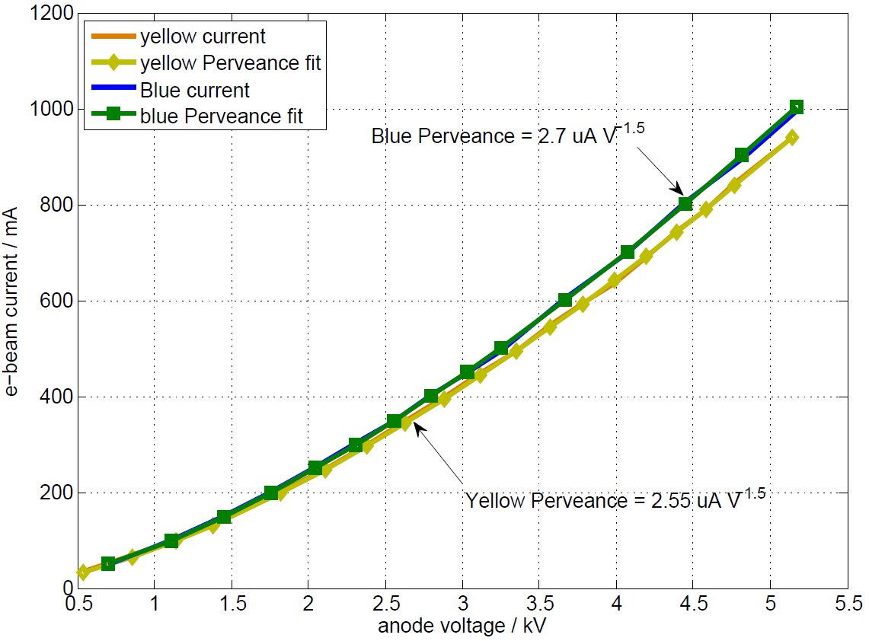
Electron Gun Perveance - Pulse Beam
Design Value = 3.0 uA V^{-1.5}
The perveances of the electron guns are within 10% and 15% of the design value for blue and yellow.
The variation in distance between anode and cathode could account for this.

Slide 7
Electron beam current
Blue e-beam current - DC 600 (400) mA
Yellow e-beam current – DC 1100 (700) mA
With the pulsed mode, both blue and yellow electron currents can reach 1 A.
For a DC beam, the yellow e-lens can reach 1.1 A.

Slide 8
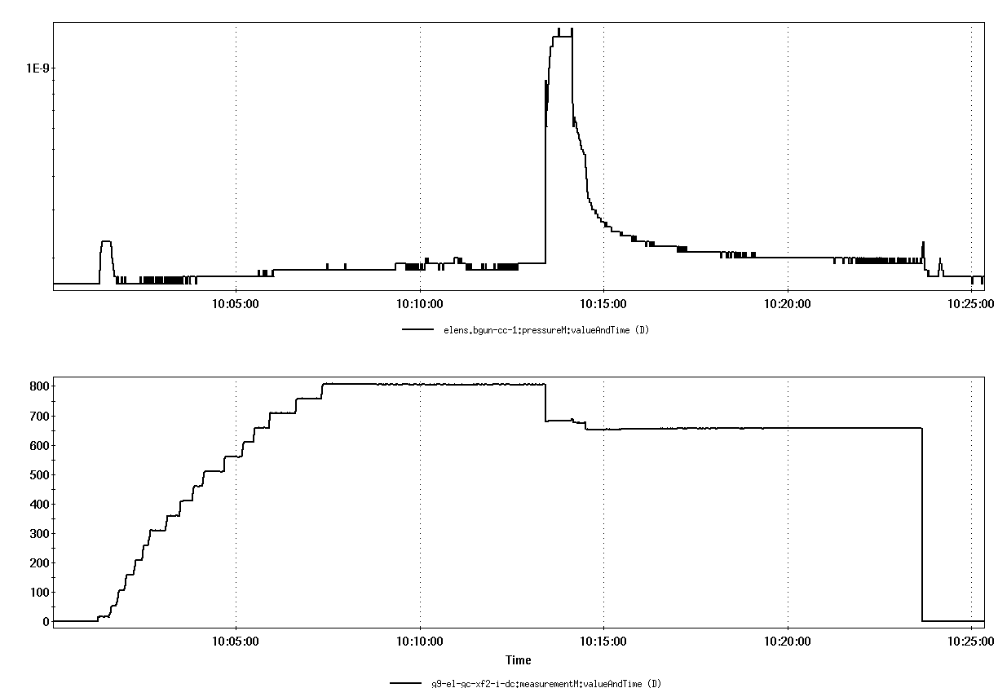
Blue e-beam current instability with ~800 mA
Blue gun vacuum
Blue e-beam current
Can cause beam loss even with 5 mm separation
Can be impressed via higher collector voltage

Slide 9
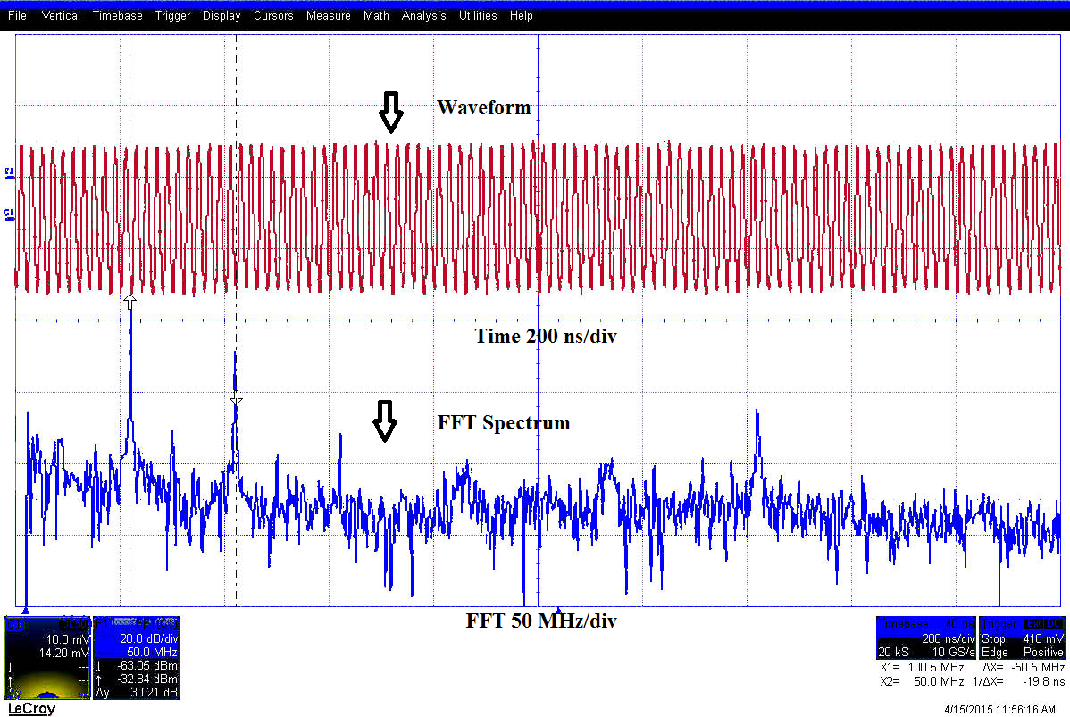
Blue electron beam current oscillation ( < 200 mA)
Blue e-beam current
Oscillations in the blue e-lens DC electron beam were observed when the current was below 200 mA.
The oscillations could be suppressed by using the split drift tube

Slide 10
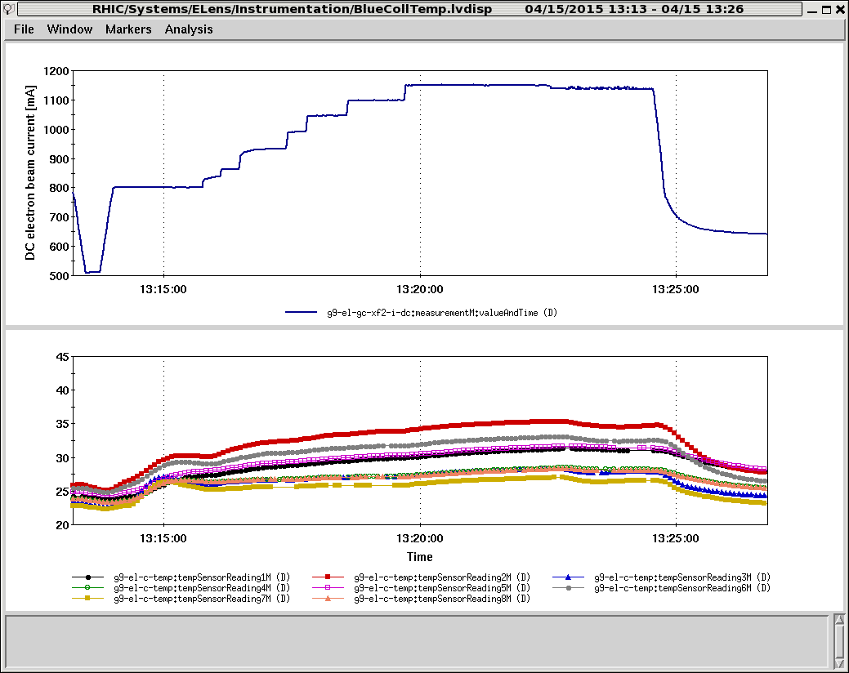
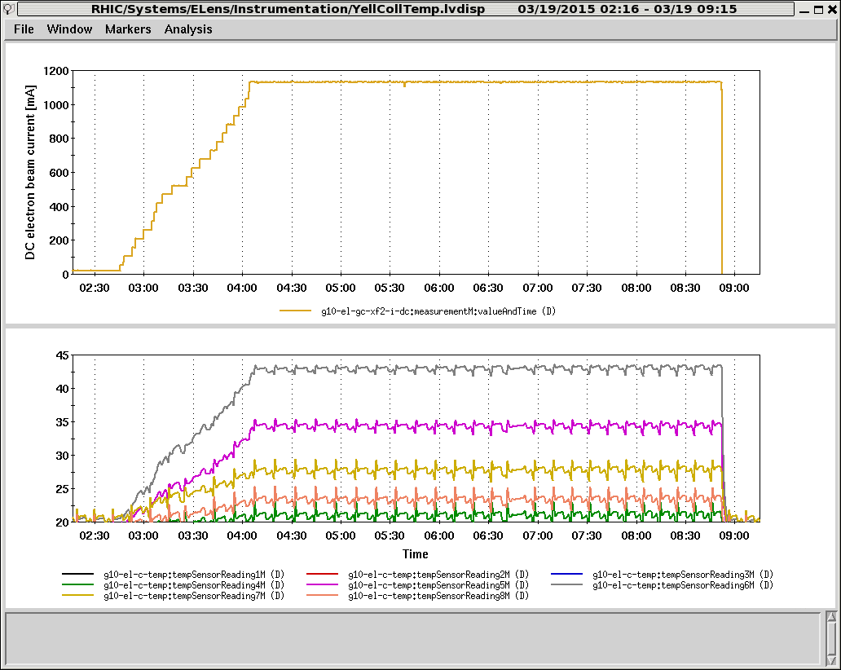
Reasons for Blue Electron Beam Issue
Same DC Beam Current 1100 mA
Blue Collector Temperature
Yellow Collector Temperature
Yellow electron beam is Off-axis inside of Collector.
Reflected electron beam from collector (30 mm vs 22 mm ID)
Ion accumulation (ion collector transmitter failures)
Cathode/gun and collector contamination (high-pot vacuum spikes).

Slide 11
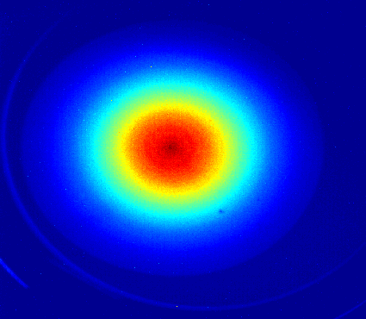
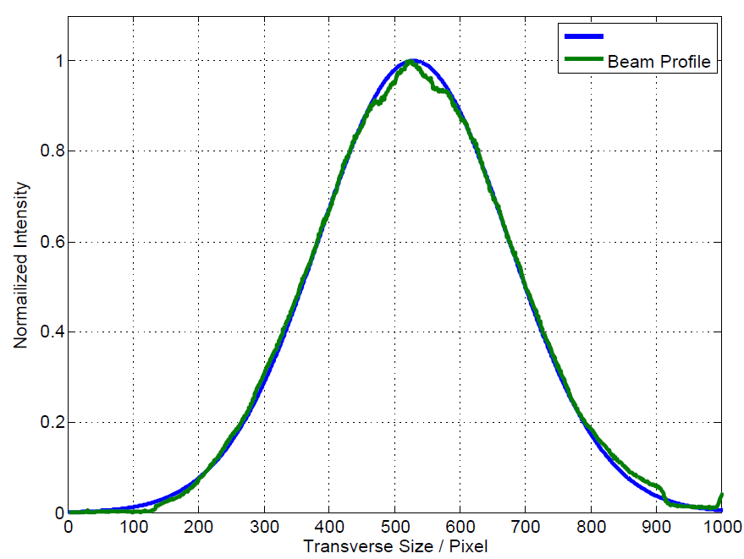
Electron beam profile
Beam Image from YAG Screen
Gaussian Fitting
Beam profile can be fitted well to Gaussian.
Reason for small discrepancies in the center area: unknown .

Slide 12
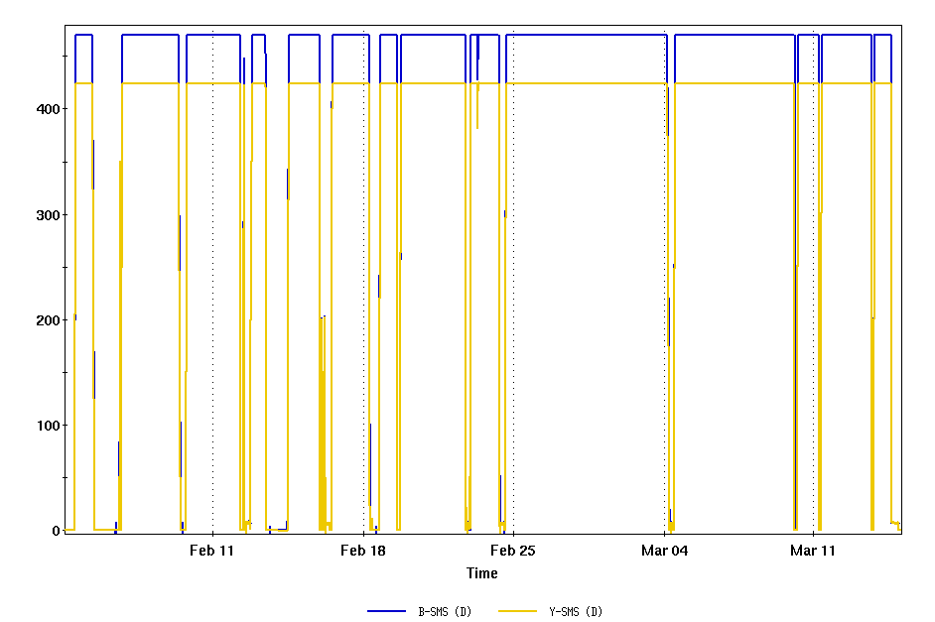
Superconducting Magnet Current and Field
Both blue and yellow solenoid can run 6T;
Reliability is good;
SRF cavity could cause yellow quenches;

Slide 13
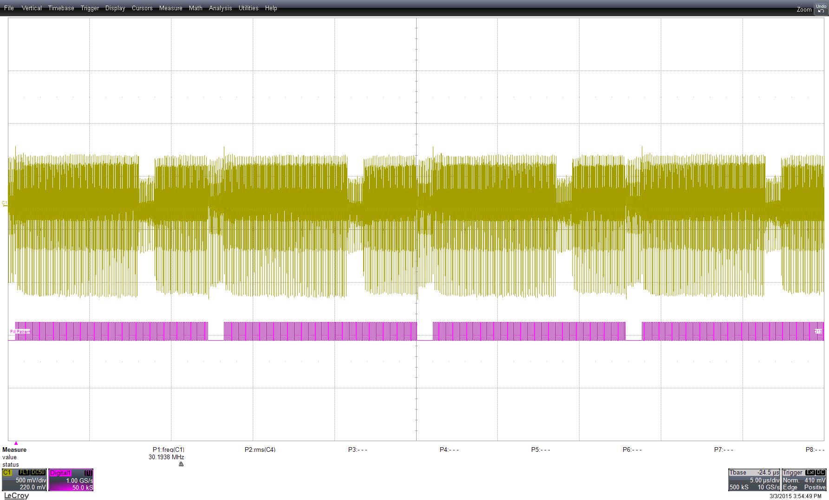
RHIC beam Fill Pattern Imprinted on DT05
Electron beam can ‘see’ the proton beam even without colliding with it.

Slide 14
Thank you !

Slide 15
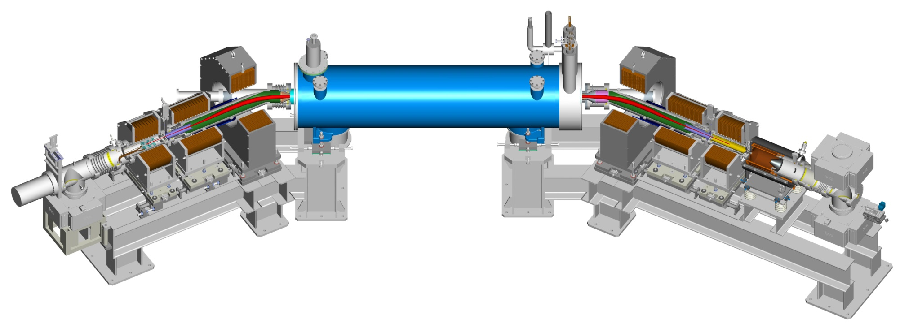
Head-on beam-beam compensation in RHIC W. Fischer, X. Gu, S.M. White, Z. Altinbas, D. Bruno, M. Costanzo, J. Hock, A. Jain, Y. Luo, C. Mi, R. Michnoff, T.A. Miller, A.I. Pikin, T. Samms, Y. Tan, R. Than, P. Thieberger, ... , Brookhaven National Laboratory
LARP supported beam-beam simulations 2005 – 2009.
LARP CM24, 12 May 2015
Notes:
60 min, 45 slides

Slide 16
Acknowledgements
Brookhaven National Laboratory
M. Anerella, M. Bai, C.D. Dawson, A.K. Drees, B. Frak, G. Ganetis, D.M. Gassner, R.C. Gupta, P. Joshi, K. Hock, L. Hoff, P. Kovach, R. Lambiase, K. Mirabella, M. Mapes, A. Marone, A. Marusic, K. Mernick, M. Minty, C. Montag, J. Muratore, S. Nemesure, S. Plate, G. Robert-Demolaize, L. Snydstrup, S. Tepikian, C.W. Theisen, J. Tuozzolo, P. Wanderer, W. Zhang STAR and PHENIX experiments – supported parasitic commissioning
Institutions
FNAL: TEL experience, beam-beam experiments and simulations US LARP: beam-beam simulation CERN: beam-beam experiments and simulations
Individuals H.-J. Kim, V. Shiltsev, T. Sen, G. Stancari, A. Valishev, G. Kuznezov, FNAL; G. Kuznezov, BINP; X. Buffat, R. DeMaria, J.-P. Koutchouk, T. Pieloni, F. Schmidt, F. Zimmermann, CERN; V. Kamerdzhiev, FZJ; A. Kabel, SLAC; P. Goergen, TU Darmstadt

Slide 17
Contents
Head-on beam-beam compensation principle
Electron lenses in RHIC
Tune spread from lens
Additional emittance growth and loss rate from lens
Head-on beam-beam compensation in operation (100 GeV polarized protons)
Beam-beam parameters and luminosity in 2012 and 2015
Operational use
Emittance growth going into collisions

Slide 18
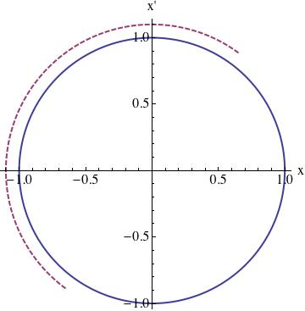
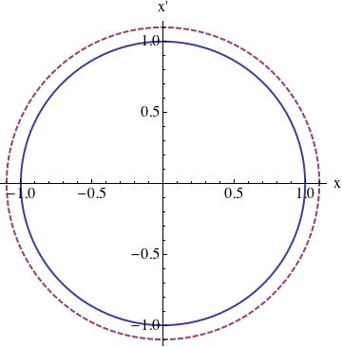
Head-on beam-beam compensation Phase space
p-beam lens defocuses
e-beam lens focuses
Tune spread compensation => e-p has same amplitude dependent force as p-p => provided by electron lens
Resonance driving terms compensation => phase advance between p-p and e-p is Δψ = k π => provided by lattice (new lattice in 2015, based on ATS – S. White)
Notes:
Have phase space picture – also pics of footprint compression and resonance driving terms

Slide 19
RHIC BTF with coherent modes
Coherent σ- and π-modes in all BTF (amplitude response)
Prevent extraction of incoherent tune spread (imaginary part of complex BTF)
Notes:
Run-15 fillno 18917, beginning of store (typical good store)

Slide 20
Tune spread from BTF in presence of coherent modes
incoherent tune spread
P. Görgen, TU Darmstadt, NIM A 777, pp. 43-53 (2015)
π-mode
σ-mode
Determine Im(BTF)
Suppress coherent modes in analysis (location known)
Coherent mode suppression did not work in practice

Slide 21
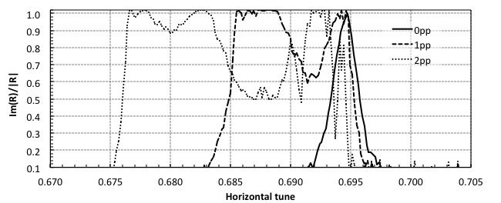
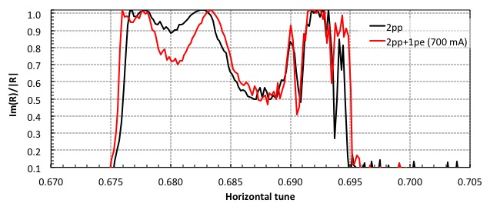
Tune spread with 0, 1, 2 pp collisions, + e-lens
⬅ 0, 1, 2 pp without e-lens
ΔQ = 0.024 given by σ- and π-modes
⬅ 2 pp without and with e-lens
change due to e-lens but incoherent distribution cannot be determined

Slide 22
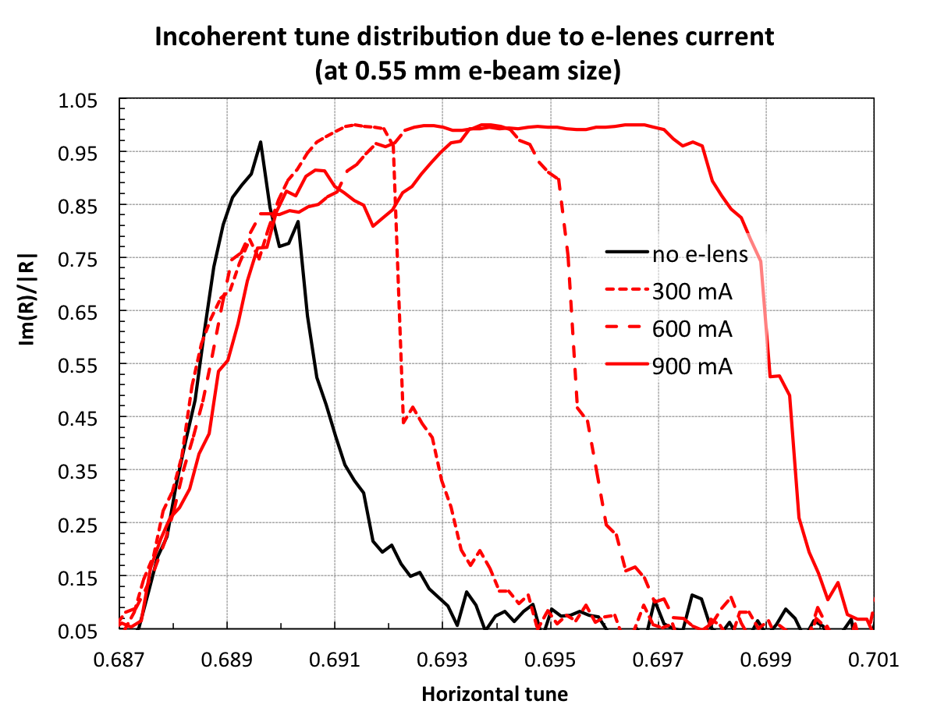
Tune spread from e-lens Current dependence
⬅ e-lens creates
as much ΔQ as one beam-beam collision
ΔQ = 0.013

Slide 23
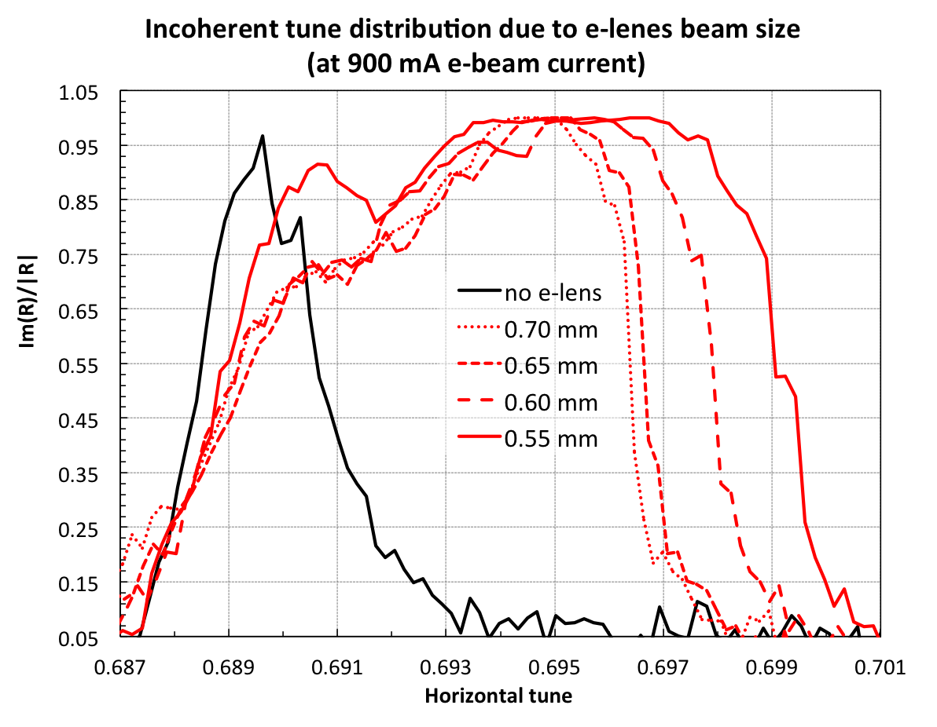
Tune spread from e-lens e-beam size dependence
⬅ e-lens creates
as much ΔQ as one beam-beam collision
ΔQ = 0.013

Slide 24
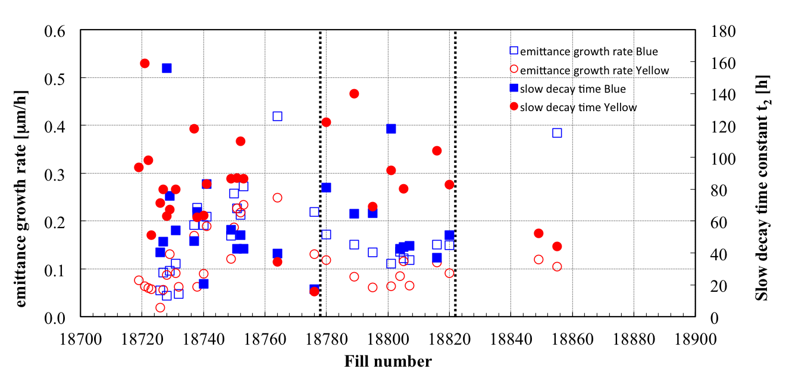
Additional emittance growth and loss rates from e-lens
E-lens in operation typically on for ~1h.
Tested additional emittance growth and loss in Yellow with 2 stores (6.75 h, 5.25 h long).
8 good stores, e-lenses on for ~1 h
Yellow emittance growth ~0.1 μm/h
Yellow intensity decay time ~90 h [loss rate ≤1%/h]
e-lenses on for 6.75, 5.25 h
Yellow emittance growth ~0.1 μm/h
Yellow intensity decay time ~50 h [loss rate 2.5%/h]
When not limited by beam-beam there is no additional emittance growth from the Yellow lens (400 mA), additional losses of 1−2%/h.
Notes:
Fillno 18849, 18855 with Yellow e-lens on for 6.75h and 5.25 h (400 mA)

Slide 25
100 GeV pp stores in 2012 and 2015 (typical good)
2012
2015
300
12
intensity
bb parameter +50%
4
5
rms emittance
140
peak luminosity +120%
[2012: 9 pb⁻¹/week 2015: 25 pb⁻¹/week]
Notes:
2012: fillno 16470; 2015: fillno 18917

Slide 26
e-lens use in operation – collisions at 2 experiments
collisions start
IPM emittances
e-lenses turn on before collision
Beams go into collision at PHENIX
collimators go to store positions (requires PHENIX collisions)
Beams go into collision at STAR e-lenses prevent emittance growth for large bb param. ξ
Lenses are gradually turned off, linear tune shift compensated (off when ξ < ξ_{max,2pp})
beam loss rates
e-lens e-beam currents
eBSD rate [Hz]
backscattered electron rates

Slide 27
Max beam-beam parameter with and w/o e-lens in operation
ξ_{max,2pp+pe} (2015)
intensities
ξ_{max,2pp} (2015)?
ξ_{max,2pp} (2012)
beam-beam parameters ξ/IP
lenses should turn off at ξ_{max,2pp} to avoid additional beam losses
ξ_{max,2pp} also determines luminosity gain from lattice alone, and additional luminosity gain from e-lenses
determination of ξ_{max,2pp} would require about 1 week of operation without lenses (not done for fear of luminosity loss, only 11-week run)
Need to estimate ξ_{max,2pp} from available data (still in progress)

Slide 28
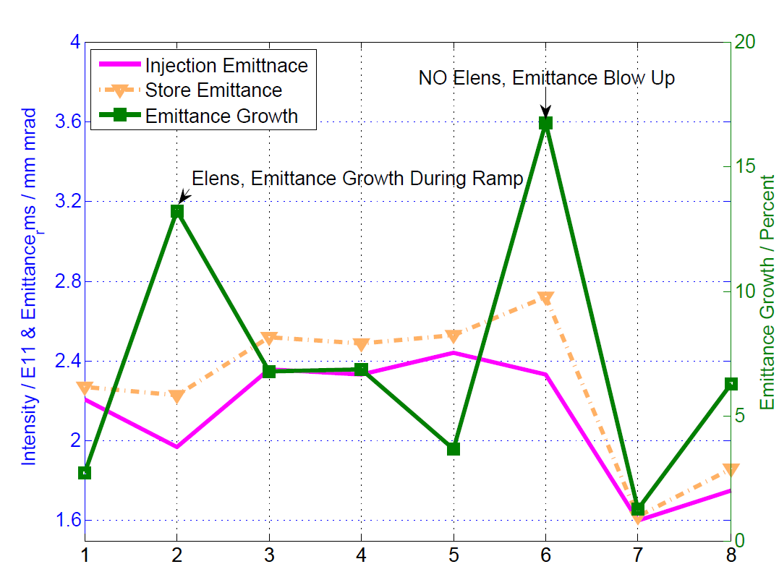
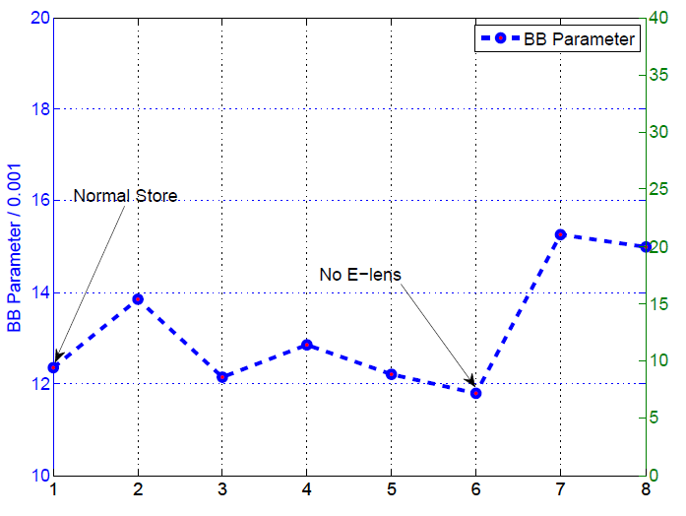
Max beam-beam parameter with and w/o e-lens in APEX (preliminary analysis X. Gu)
Notes:
(1) Tests with 48x48 bunches (gives larger ξ due to smaller ε_{n}) – all but case 1 (ops store)
(2) Use IPM for ε_{n} (reports ~20% less than ZDC calculated ε_{n}) – monitors emittance blow
Limit without e-lens: case 6 – emittance blow-up
Limit with e-lens: not found – not enough N_{b}/ε_{n} from AGS

Slide 29
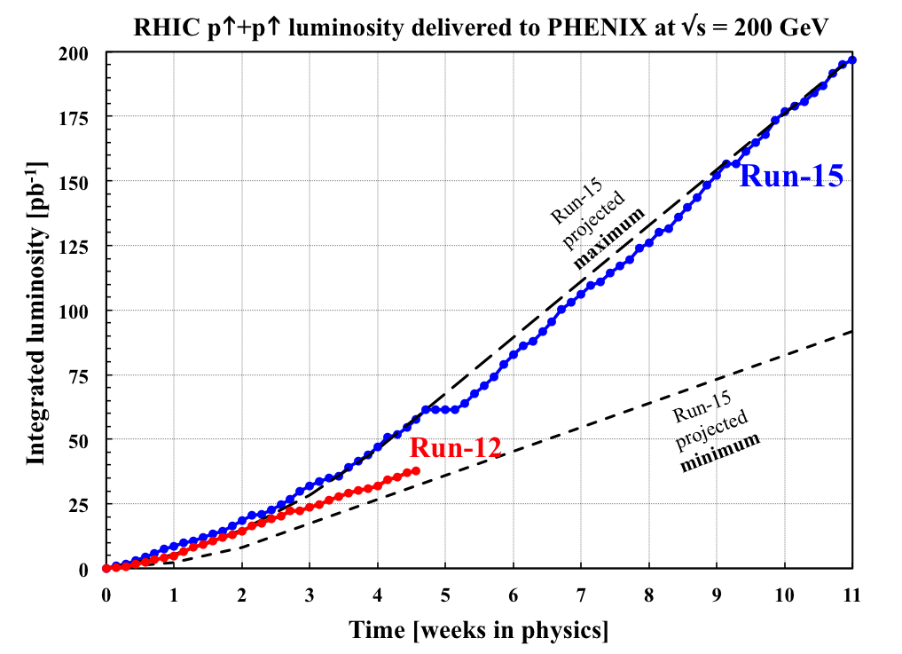
Summary RHIC head-on beam-beam compensation
Head-on beam-beam compensation scheme in operation in 2015, consisting of new lattice (RDT compensation) + e-lenses (ΔQ compensation) L_{peak} +150% L_{avg} +90% L_{week} +170%
e-lens creates beam-beam tune spread without additional emittance growth, and small additional loss rate (1−2%/h)
e-lenses turned on before going into collision to prevent emittance growth, turned off gradually after ~1 h
Higher ξ/IP possible, presently constrained by injectors (potential for ~2× L in future runs)

Slide 31
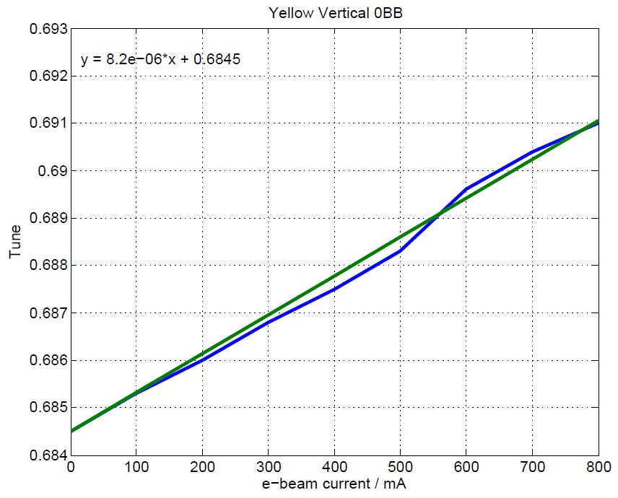
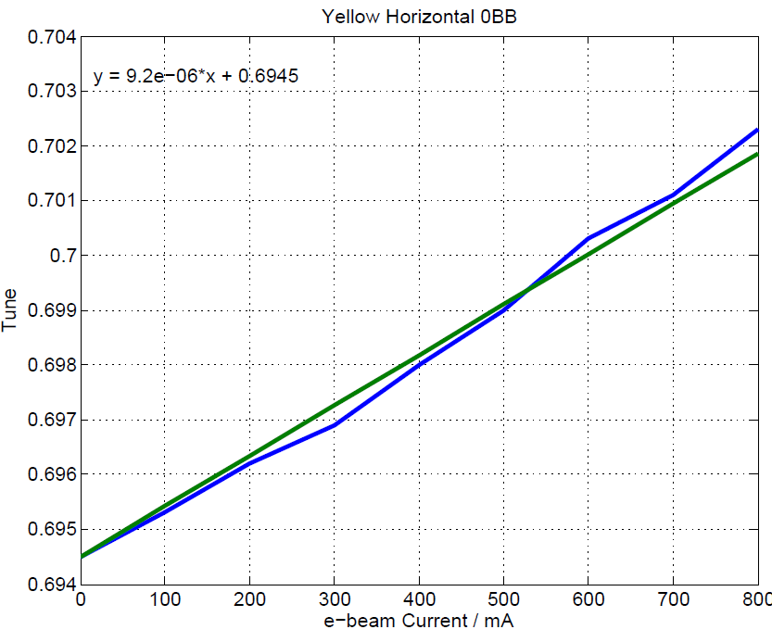
APEX 03/11/2015 Tune shift from e-lenses (X. Gu)
0.89E-3 for yellow, and 0.86E-3 for blue

Slide 32
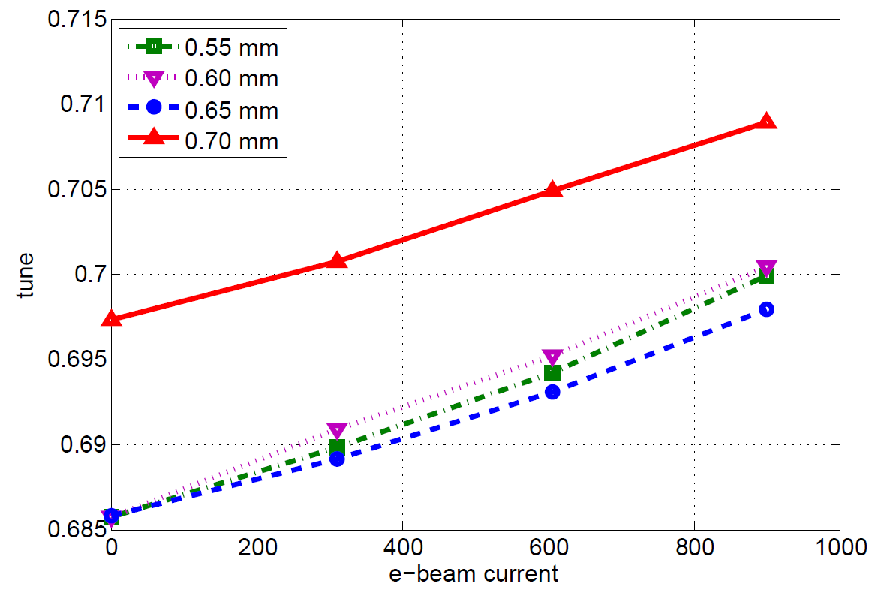
Tune shift as function of e-beam current (X. Gu)
0.00203
0.00171
0.00145
0.00125
Per / 100 mA

Slide 33
Max beam-beam parameter with and w/o e-lens in APEX
*Mark: no e-lens, same injection intensity, y emittance blow up
Calculated with average intensity per bunch and average IPM emittance
No emittance blow-up when going into for any of the stores with the e-lenses
Tune scan with e-lens, with IP6 and IP8, blue /IP = 14.8, yellow /IP = 12.6:
Moving up tunes even 0.0005 will cause Blue beam decay increase. Moving tunes down 0.003, we observed emittance blow-up only in Blue ring. At that point, Qy from schottky was 0.681, which is similar to that from without BB compensation.

