Slide 1
Final SPS RF Design & HOM Couplers for RF-Dipole Cavity
HiLumi – LARP Collaboration Meeting
Fermilab – May 11, 2015

Slide 2
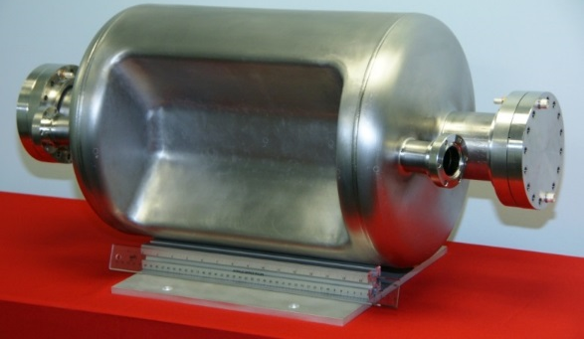
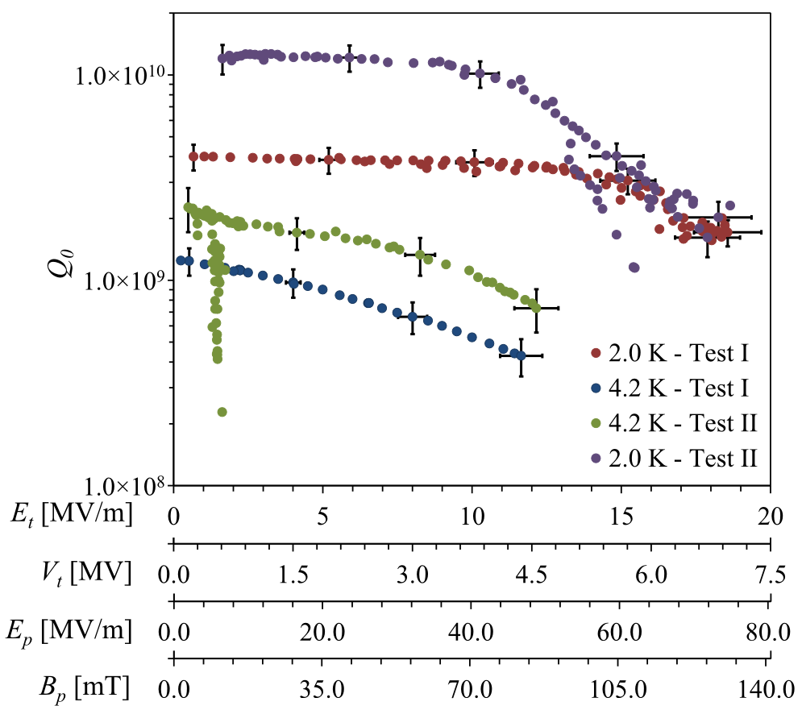
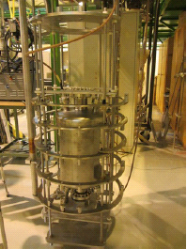
400 MHz Proof-of-Principle Cavity Test
Cavity reached a V_{T} of 7.0 MV
Test II →
  Cavity was retested with Nb coated flanges provided by CERN
  Q₀ increased by a factor of 3 from 4×10⁹ to 1.2×10¹⁰
Multipacting was processed easily and did not reoccur
Results were confirmed by CERN
3.4 MV
5.0 MV

Slide 3
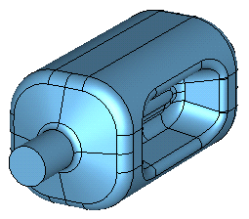
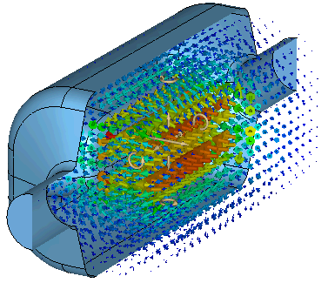
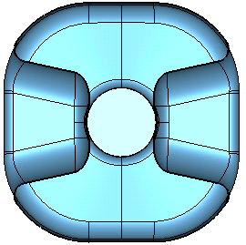
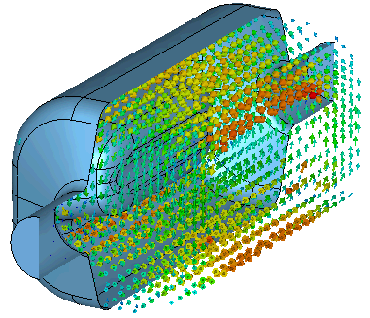
RF – Dipole Prototype Cavity
E Field
Frequency | 400 | MHz
Aperture | 84 | Mm
Nearest HOM | 633.5 | MHz
E_{p}* | 3.6 | MV/m
B_{p}* | 6.2 | mT
[R/Q]_{T} | 429.7 | Ω
Geometrical Factor (G) | 106.7 | Ω
R_{T}R_{S} | 4.6×10⁵ | Ω²
At E_{T}* = 1.0 MV/m
V_{T} | 3.4 | MV
E_{p}* | 33 | MV/m
B_{p}* | 56 | mT
281 mm
281 mm
H Field
Operates in TE11 like mode
Next HOM is 1.5 times fundamental mode
Multipacting is improved compared to P-o-P cavity
Reduced multipoles components with curved poles

Slide 4
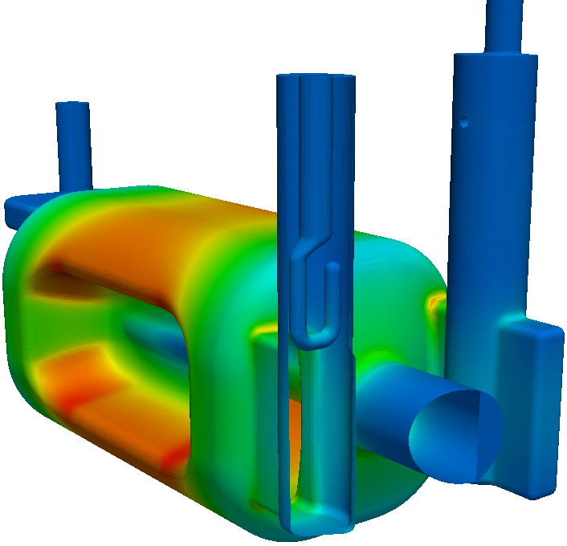
FPC and HOM Coupler Designs
V-HOM
(selective coupling)
FPC
H-HOM
(Hi-pass filter)
Coupler at locations of low field region on cavity body
  Minimizes RF heating on the coupler components
Location preserves field symmetry
  Electrical center moved by 50 microns
Selective coupling (V-coupler) to reduce the number of filters
FPC/HOM ports oriented to keep clearance for the second beam pipe

Slide 5
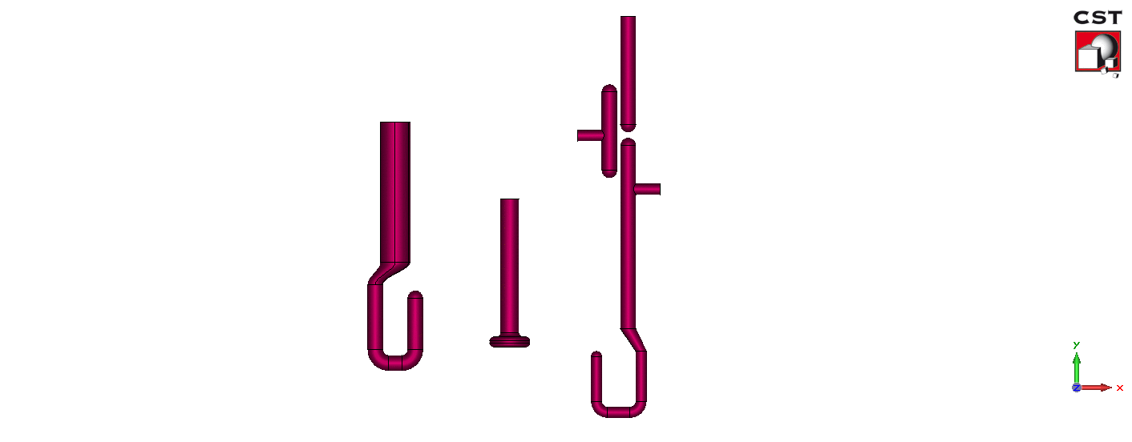
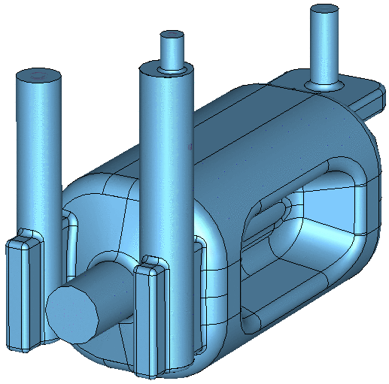
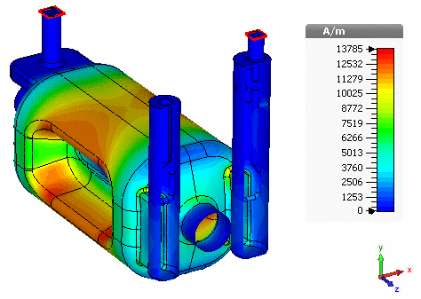
FPC and HOM Couplers
FPC
Outer diameter – 62 mm
Inner diameter – 27 mm
Interface to LHC main coupler design
Q_{L} = 5.0×10⁵
Hook shaped coupler reduced RF heating → 69 W
FPC
Coupling Hook
V-HOM Coupler
V_HOM
Doesn’t couple to fundamental mode
  No filter necessary
Damps vertical dipole modes and some accelerating modes
H-HOM Coupler
H-HOM High Pass Filter
H_HOM
Horizontal HOM high pass filter to cut off fundamental mode
Couples to horizontal dipole modes and accelerating modes
Both options damp adequately to meet impedance requirements

Slide 6
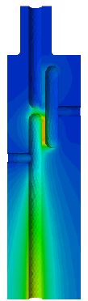
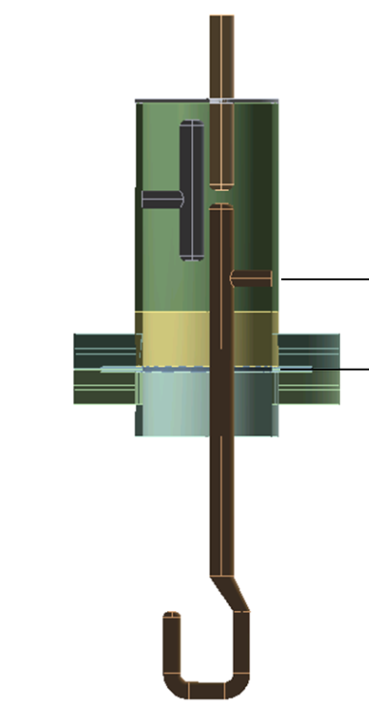
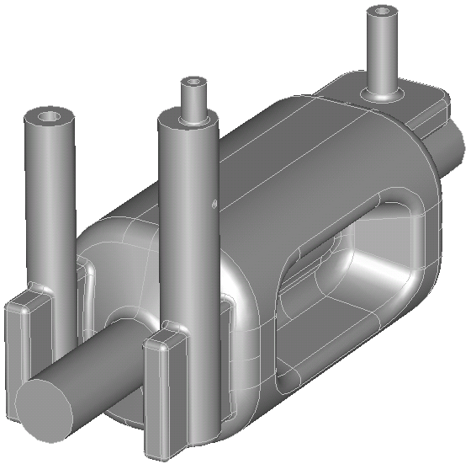
HHOM – High Pass Filter
High pass filter
  Simple filter design
  Damps horizontal deflecting and accelerating modes
  Demountable coupler
  Low fields in the filter
50 Ω probe (Cu)
T (Nb)
Rejection of operating mode
V-HOM
Hook (Nb)
FPC
H-HOM
High pass filter transmission
Dimensions
  Center rod diameter: 14 mm
  Larger cylinder diameter: 74 mm
  50 ohm port: 14mm/32.2mm
S₂₁ [dB]
Frequency [GHz]
MP trajectories in the gap Removed

Slide 7
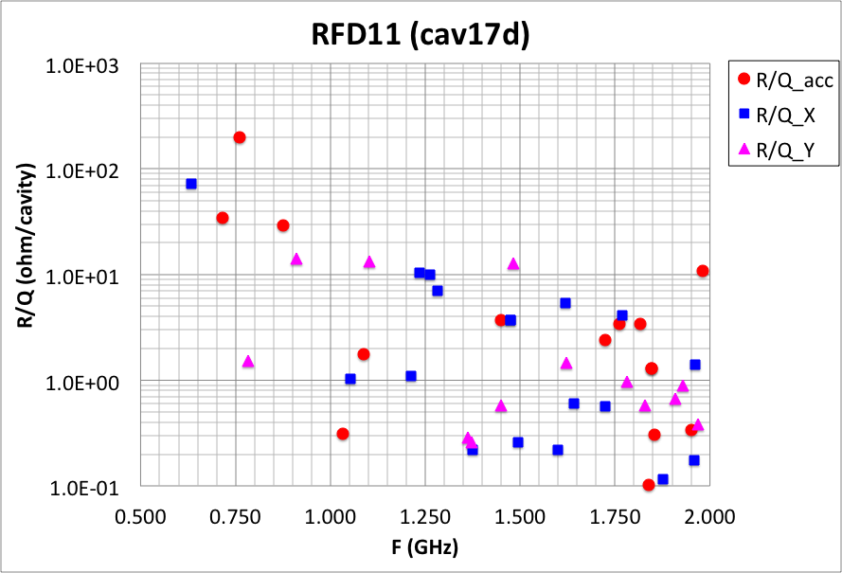
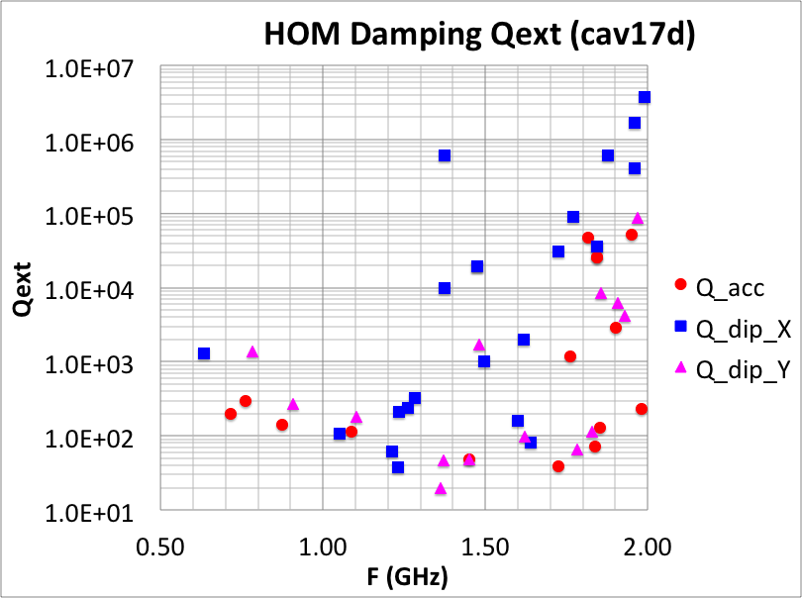
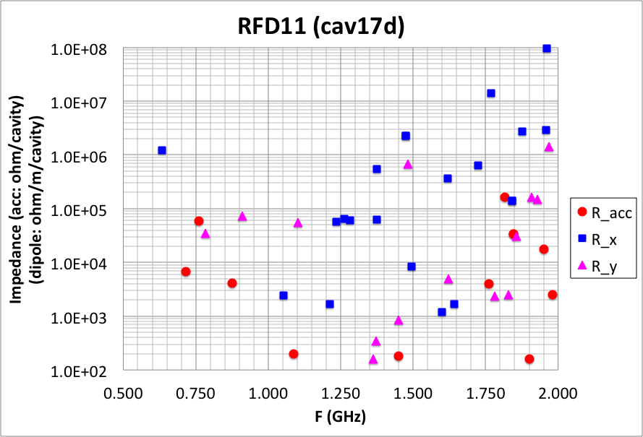
HOM Damping
HOM Couplers with Q and Impedance
Rover Q Plot
Does not have the (1/2) factor in “Impedance”

Slide 8
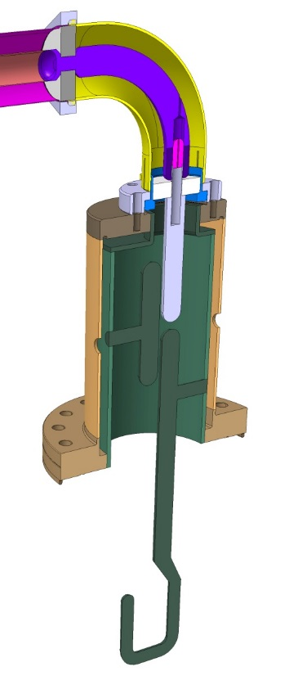
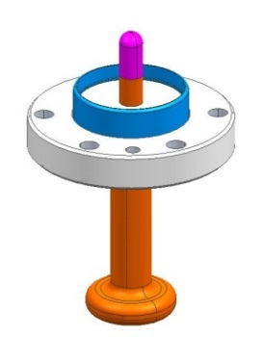
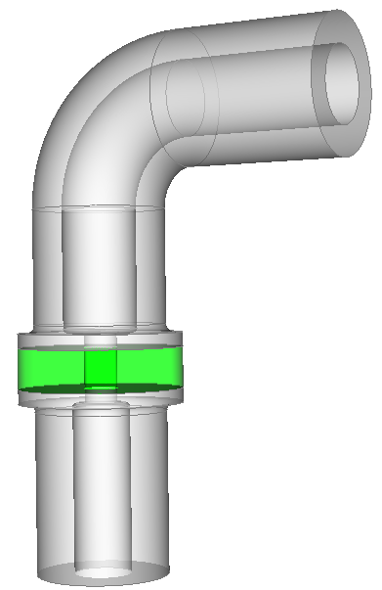
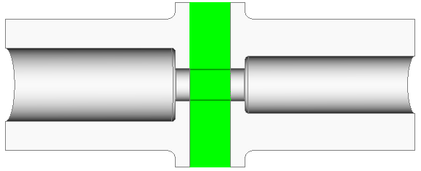
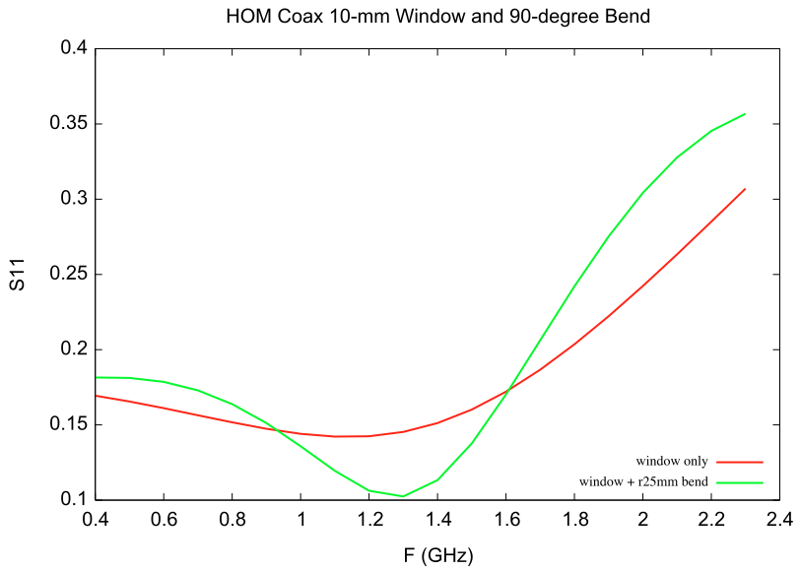
HOM Window and Bend
10-mm window and bend match
Window
Window with a compact bend
10-mm window will be used

Slide 9
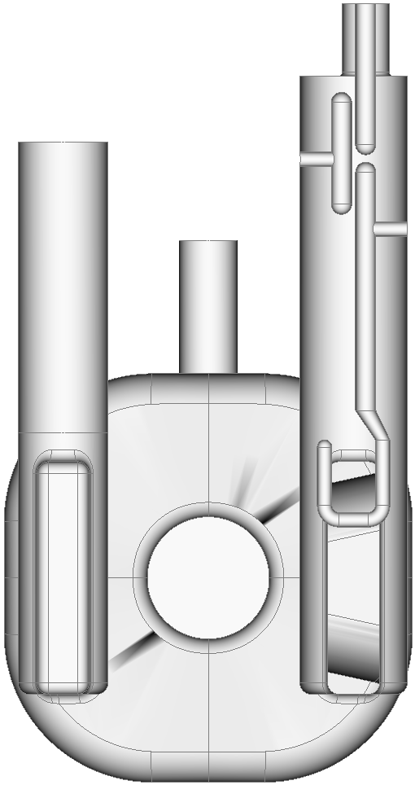
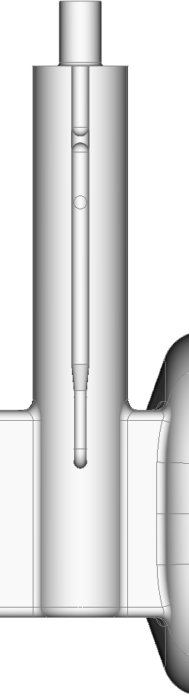
HOM Manufacturing Tolerance
  Deviations introduced during manufacturing and also the most crucial GD&T for performance
  gap_bar
  rot_about_z
Introduced during manufacturing, easily controlled or large allowable tolerance
  tank_radius
  bar_radius
  gap_top
  rot_about_x
Introduced during assembly but with large tolerance
  y_tip
  gap_probe
gap_top
gap_bar
gap_probe
rot_about_x
(+)
rot_about_z
(+)
bar_radius
ytip
tank_radius

Slide 10



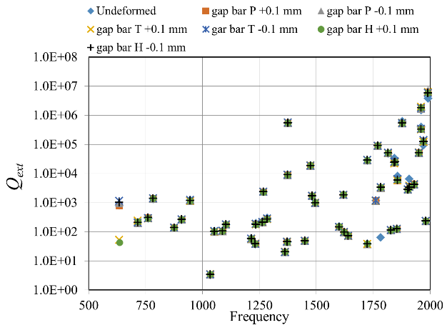
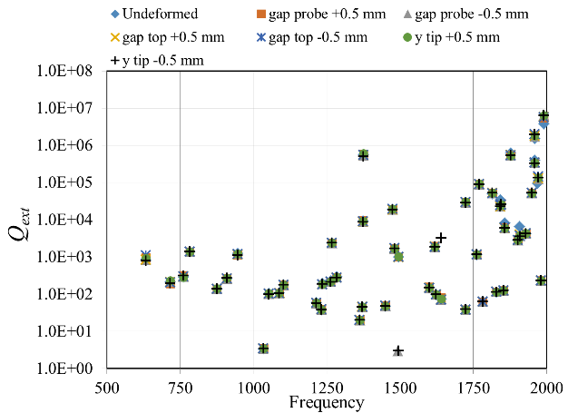
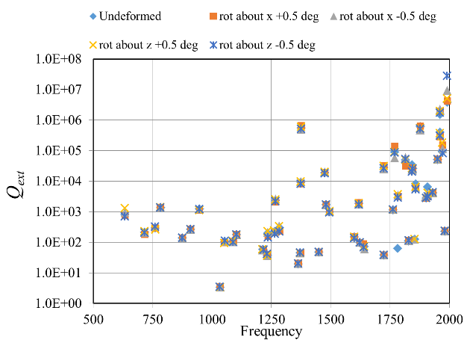
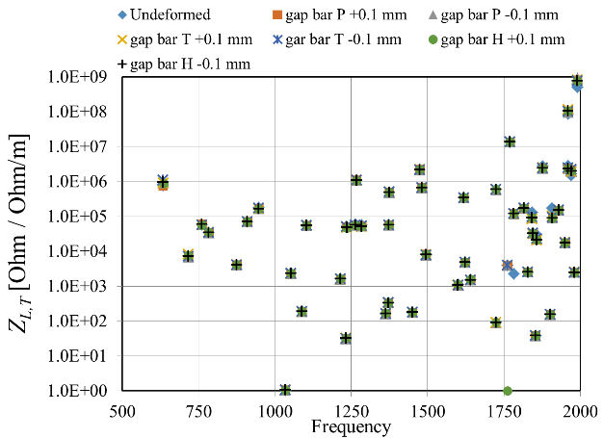
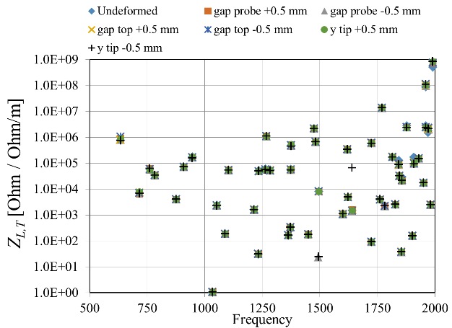
HOM Tolerances
gap top
Tolerances are included in the HOM specification drawing
(+)
(+)
gap bar P
(+)
gap bar T
gap probe
N. Templeton
(+)
rotation about z axis
rotation about x axis
gap bar H
(+)
y tip

Slide 11
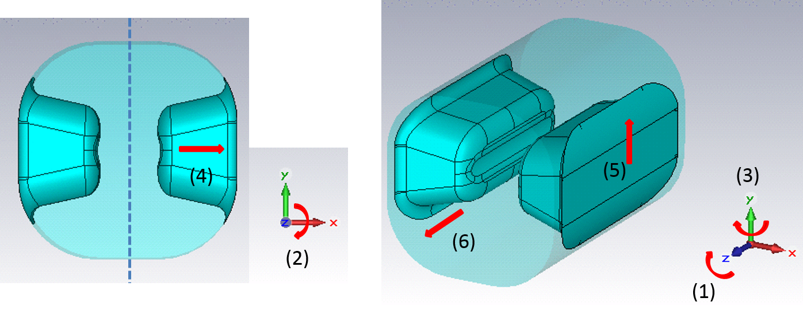
Cavity Tolerances
Roll – Rotation around z axis of one pole → ± 1.0 deg
Pitch – Rotation around x axis of one pole → ± 1.0 deg
Yaw – Rotation around y axis of one pole → ± 1.0 deg
X offset → ± 0.5 mm
Y offset → ± 0.5 mm
Z offset → ± 0.5 mm

Slide 12
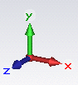
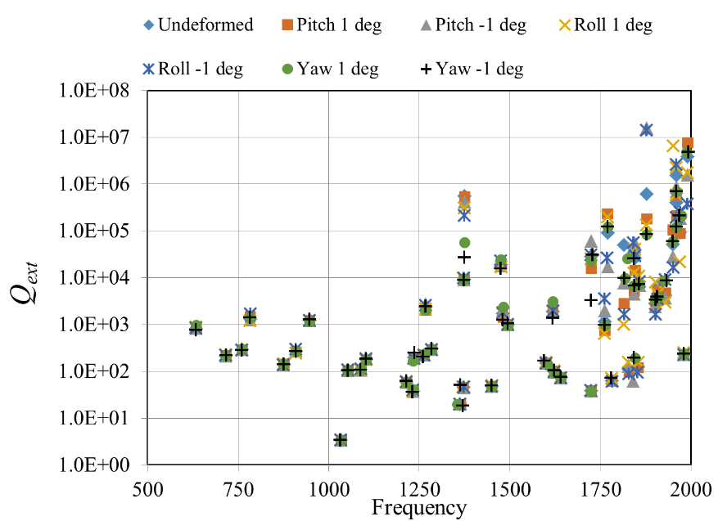
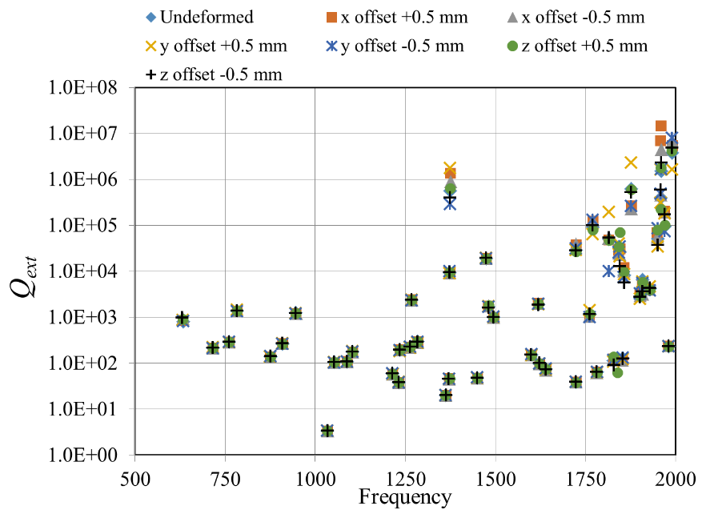
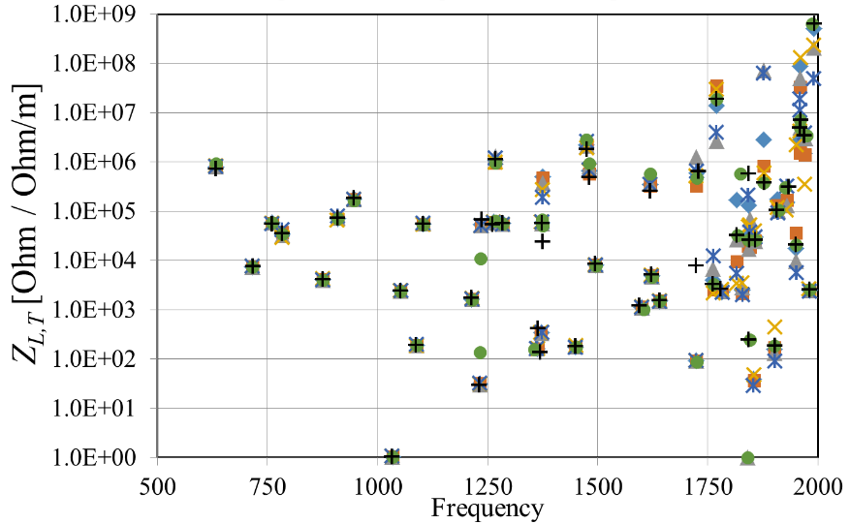
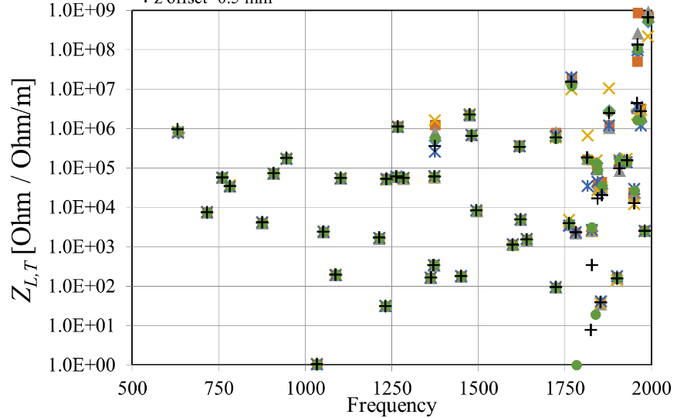
Cavity Tolerances
Yaw
Roll
Pitch
Performance of HOM couplers is not affected by expected fabrication tolerances

Slide 13
Recommendations from HOM Review
Presented at Feb 2015 Engineering Review
Z. Li
(no 1/2 factor in impedance calculation)
Reviewer suggested to take a look at a few higher impedance modes at higher frequencies, (though not critical for SPS test)
Modified H-HOM hook and V-HOM probe → Reduced impedance by 1-2 orders of magnitude

Slide 14
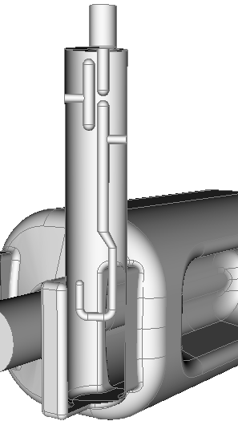
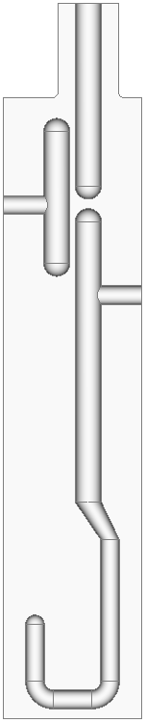
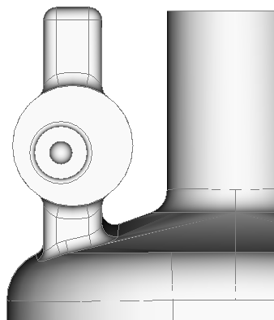
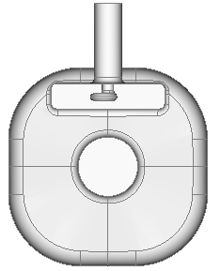
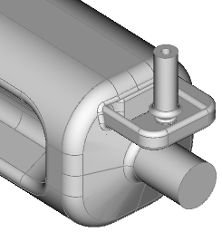
Improved HOM Damping
Horizontal HOM Coupler
Coupling hook optimized
30 degree hook orientation
No change in filter elements
30deg
Vertical HOM Coupler
7 mm offset incorporated into the pickup tip to enhance coupling to the dipole modes at around 2GHz
Small RF power leakage through the coupler, ~1.5W, due to asymmetry

Slide 15
HOM Damping and Impedance
Q_{ext} calculated using Omega3P for modes up to 2 GHz
Solid lines are the impedance budget for dipole HOMs (blue) and accelerating HOMs (red) respectively
Damping scheme meets the impedance requirement (2011)

Slide 16
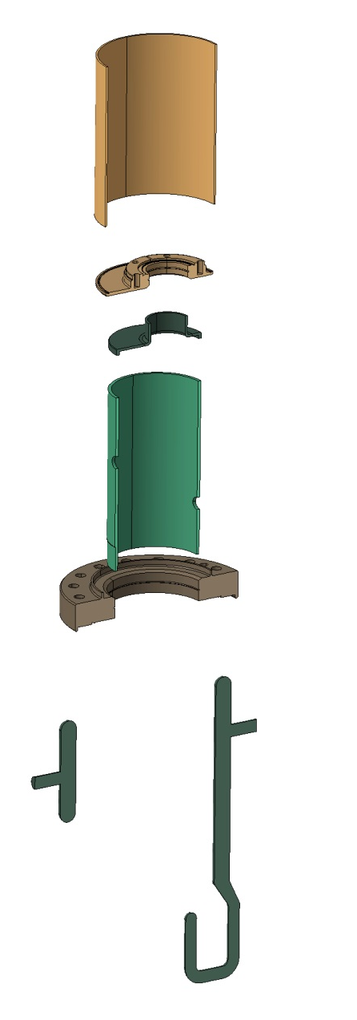
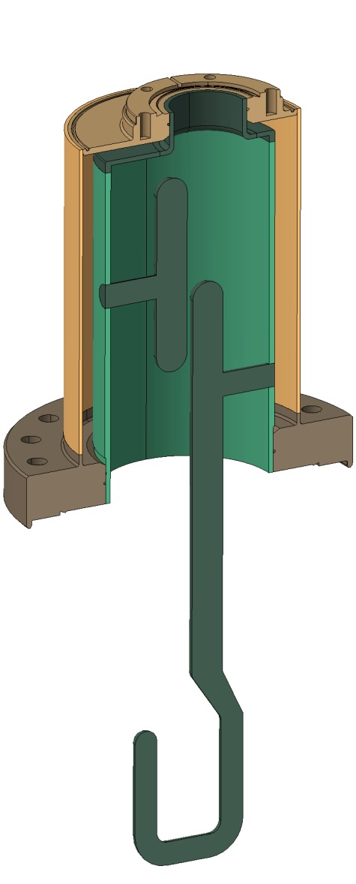
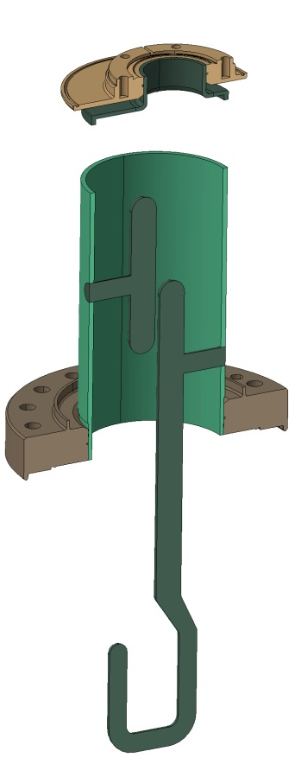
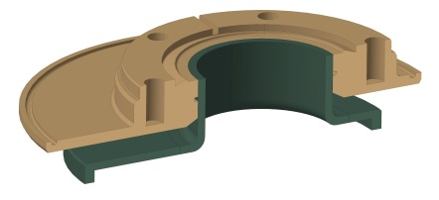
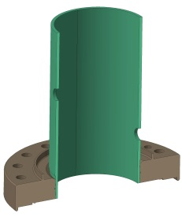
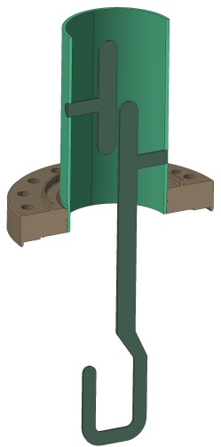
HOM Coupler Fabrication Procedure
H. Park – RFD HOM Manufacturing – Crab Cavity HOM Coupler Design and Fabrication Review II (2/25/2015)
Courtesy of Teddy Capelli

Slide 17
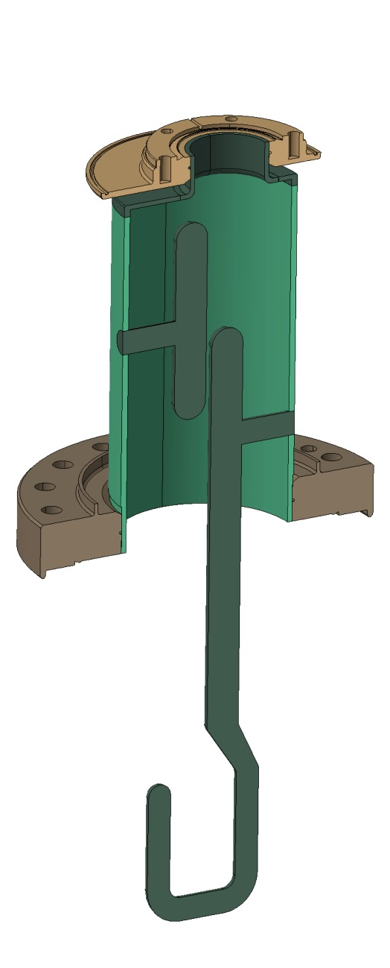
HOM Coupler Fabrication Procedure
Bulk BCP of Nb parts with active thickness monitoring
Total 50 μm removal
Light BCP
For Light BCP/Rinse the spool piece will be mounted to protect hook
Spool piece to enclose the hook during BCP
Courtesy of Teddy Capelli

Slide 18
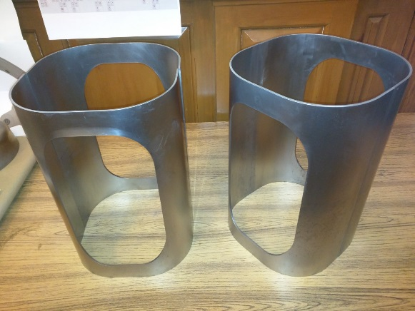
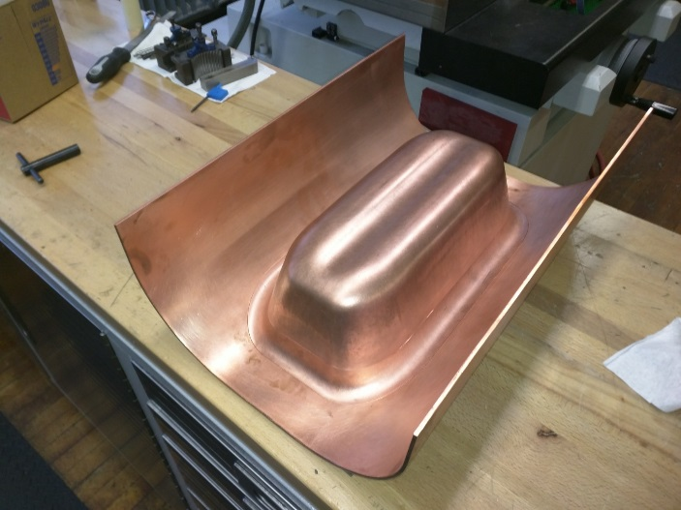
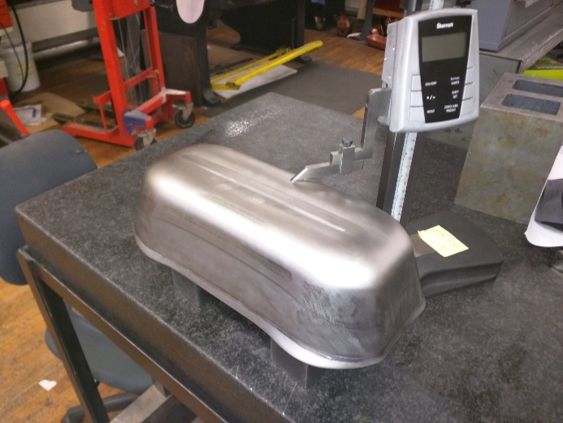




Cavity Fabrication
CERN requested extension of beam pipe 7 mm each side to have space for magnetic shielding.

Slide 19

Cavity Processing and Testing Plan
Bare Cavity (2 cavities)
  Bulk BCP of 150 µm
  HPR
  RF Test
Bare Cavity with HOM Couplers
  HPR
  Assemble H & V HOM couplers
  RF Test
Dressed Cavity (2 cavities)

Slide 20








100 mm Beam Aperture
Reduced curvature of outer body to maintain 400 MHz
E Field
H Field
Surface E Field
Surface H Field

Slide 21

100 mm Beam Aperture
Aperture | 84 | 100 | mm
Frequency | 400 |  | MHz
Nearest HOM | 633.5 | 630.0 | MHz
E_{p}* | 3.6 | 4.2 | MV/m
B_{p}* | 6.2 | 6.9 | mT
B_{p}*/E_{p}* | 1.71 | 1.66 | mT/ (MV/m)
[R/Q]_{T} | 429.7 | 277.7 | Ω
Geometrical Factor (G) | 106.7 | 112.2 | Ω
R_{T}R_{S} | 4.6×10⁵ | 3.1×10⁴ | Ω²
At E_{T}* = 1 MV/m
Preliminary design looks promising
  Still room for further optimization
Remains to be done
  HOM damping
  Multipole components
  Multipacting analysis
Aperture | 84 | 100 | mm
V_{T} | 3.4 |  | MV
E_{p} | 33 | 38 | MV/m
B_{p} | 56 | 63 | mT
R_{s} (R_{res} = 10 nΩ) = 11.3 nΩ
P_{diss} @ 2.0 K | 2.9 | 4.2 | W

Slide 22
Summary
Currently preparing for
  Cavity processing and testing
  HOM filter fabrication and testing
Planning to work closely with cavity manufacturer
  Parts Q&A
  Weld inspection
  Tuning
  Vacuum testing
Investing on the design for LHC
  Possibility of operating at 5.0 MV
  Vertical crabbing (Crab kissing?)

Slide 23
Acknowledgements
ODU – HyeKyoung Park, Rocio Olave, Jean Delayen
CERN – Rama Calaga, Ofelia Capatina, Teddy Capelli, and the team
Alex Ratti - LBNL
Tom Nicol - Fermilab
STFC/UK – Graeme Burt, Tom Jones, Nik Templeton and the team
JLAB
Niowave

Slide 24
THANK YOU

