Slide 1
Final SPS RF Design, Cavity & HOM Coupler for DQW
Binping Xiao, BNL
BNL
Sergey Belomestnykh, Ilan Ben-Zvi, Carlos Marques, John Skaritka, Silvia Verdú-Andrés, Qiong Wu
CERN
Luis Alberty, Said Atieh, Rama Calaga, Ofelia Capatina, Teddy Capelli, Federico Carra, Norbert Kuder, Raphael Leuxe, Thierry Renaglia, Kurt Artoos, Marco Garlasche, Paula Freijedo-Menendez, Carlo Zanoni
Lancaster University/Cockcroft Institute
Graeme Burt, Ben Hall, Tom Jones, Nik Templeton
SLAC
Zenghai Li

Slide 2
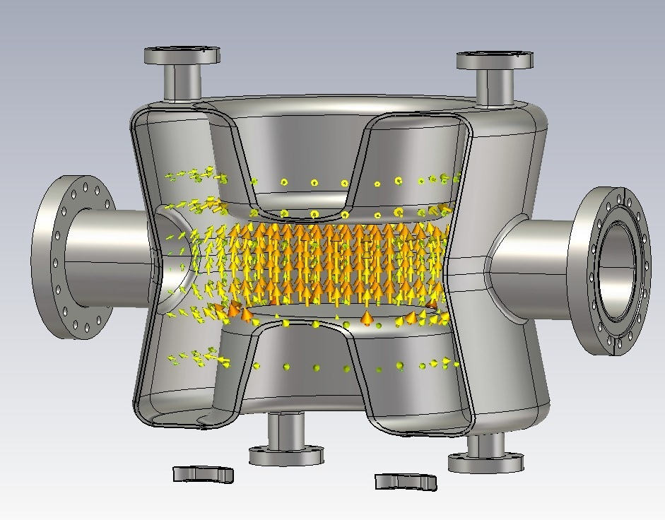
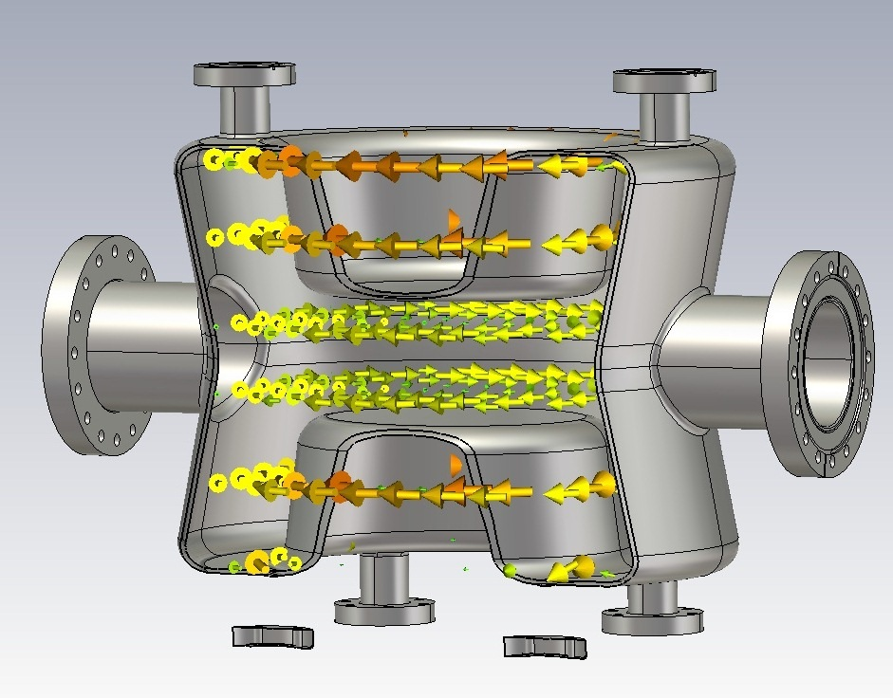
Double-Quarter Wave (DQW) Crab Cavity
f ⁽⁰⁾
Electric field
Magnetic field
Deflecting voltage given when bunch is at cavity center and E-field is zero.
Crabbing mode is fundamental mode. 1st HOM is well away from fundamental mode.
From QW to DQW to reduce residual acceleration (still some due to port asymmetry).

Slide 3
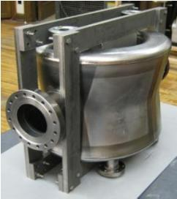
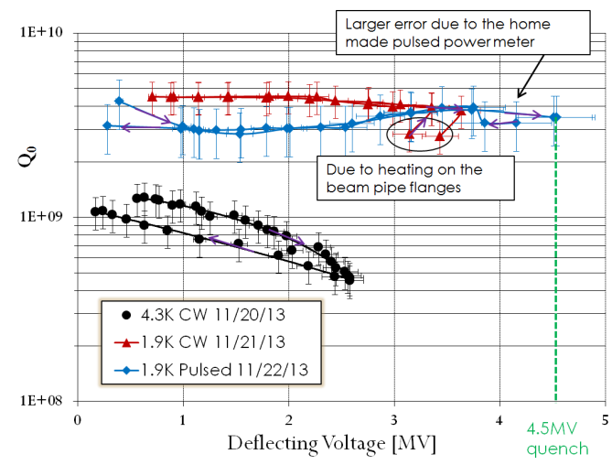
1st stage: validation of nominal deflecting voltage
Successful cold test of PoP DQW cavity at BNL in 2014: Q₀ at around 3~4.5e9.
In CW mode, temperature of beam pipe flanges increased.
Reached 4.5MV kick in pulsed mode, limited by quench.
Temperature increase on pickup port blending area.
Quench for Bpk ~110mT and Epk~ 53MV/m.
PoP DQW cavity
with stiffening frame

Slide 4
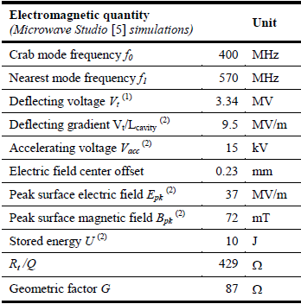
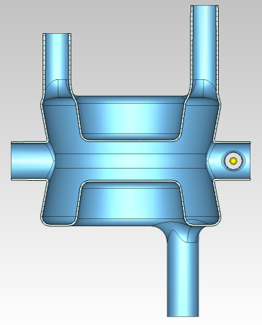
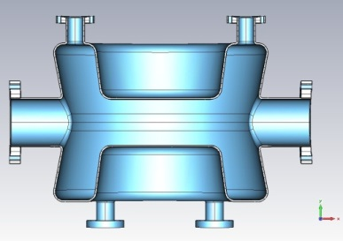
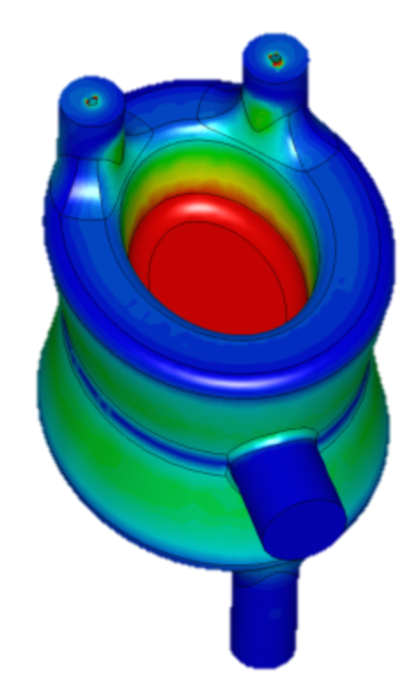
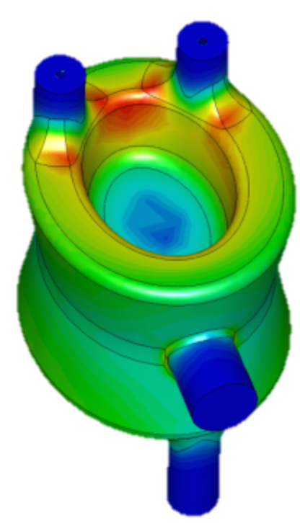
DQW cavities for SPS tests
SPS cavity optimized into 1) a more compact design with 2) lower surface magnetic field.
 | PoP DQWCC | SPS DQWCC
R_{t}/Q [Ohm] | 400 | 429
G [Ohm] | 85 | 87
E_{pk} [MV/m] | 38 | 37
B_{pk} [mT] | 80 | 72
∅ 35 mm
∅ 62 mm
f(0)
Expected performances from PoP DQW cold test results
Quench for SPS DQWCC extrapolated to Vt~ 5.1 MV using measured quench voltage of PoP cavity.
E-field
H-field
Notes:
Electric field offset: due to asymmetric distribution of ports
Size constrains by adjacent beam pipe constraint in cavity height (H-kick) and waist (V-kick) → from circular to elliptical shape
(~ 14% higher voltage)

Slide 5
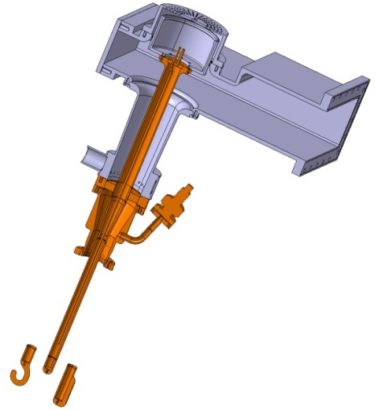
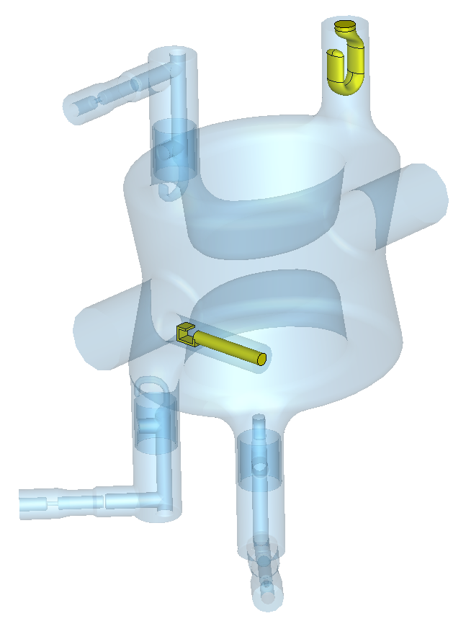
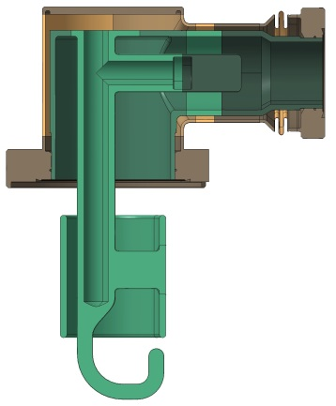
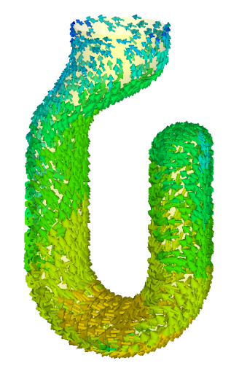
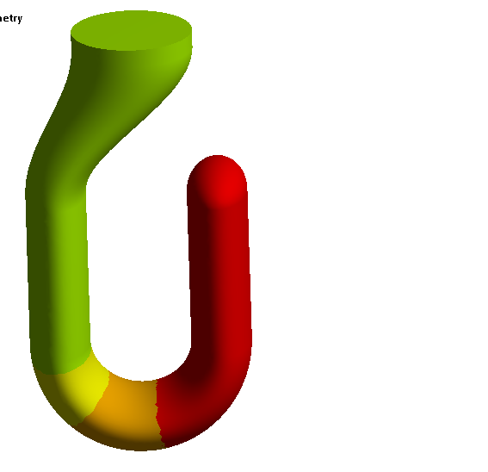
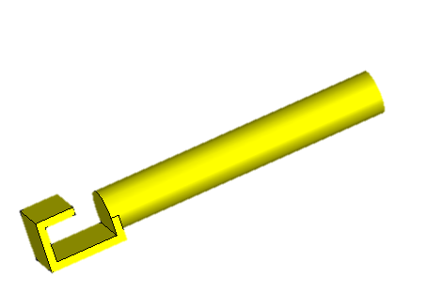
SPS DQWCC – FPC and Pick-Up
Hook-type antennae for well coupling with magnetic field.
Detachable from cavity to ease installation.
Active cooling for FPC and HOM down to hook bending.
FPC
HOM
FPC antenna (Cu):
Qext ^{f(0)} is 5.3x10⁵, 40kW enough to feed cavity. Optimized design to reduce Pdiss on hook tip.
PU
HOM coupler with high pass filter (Nb)
HOM
HOM
Bpk ~ 10 mT
Pick-up antenna (Cu):
Qext ^{f(0)} is 1.6x10¹⁰, extracts about 1.5W of fundamental mode.
373 K
Notes:
Limited He → limited heat load budget: special attention paid to thermal loads
Located on port opened on beam pipe to avoid breaking cavity symmetry.
Thermal losses in RF-seal Cu gaskets considered to determine port length.
40 kW power supply is enough to feed the cavity

Slide 6
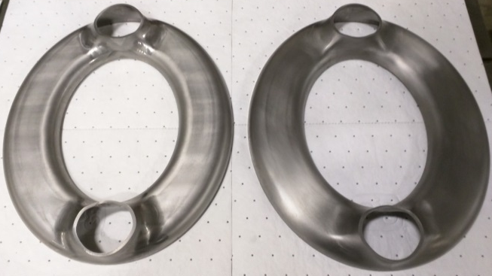
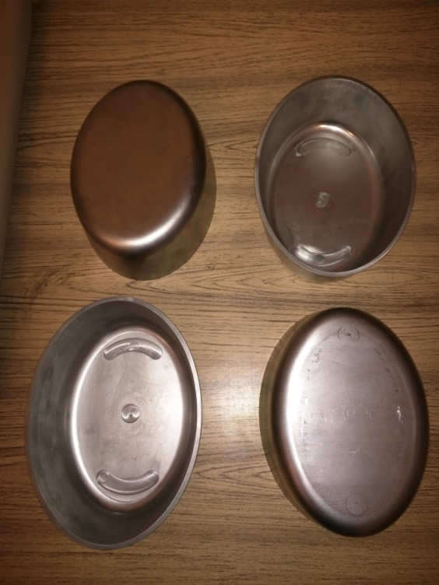
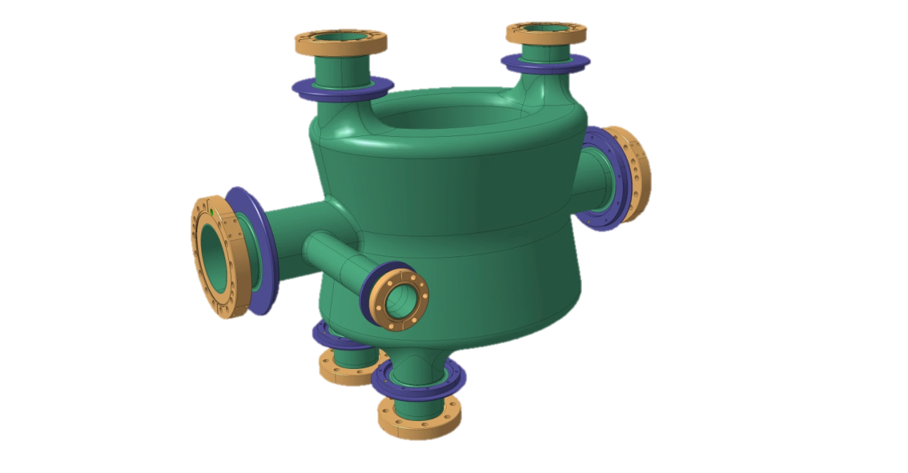
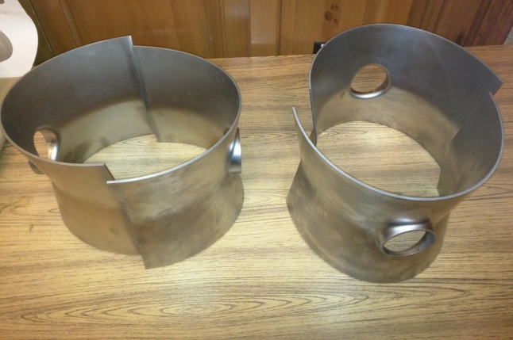
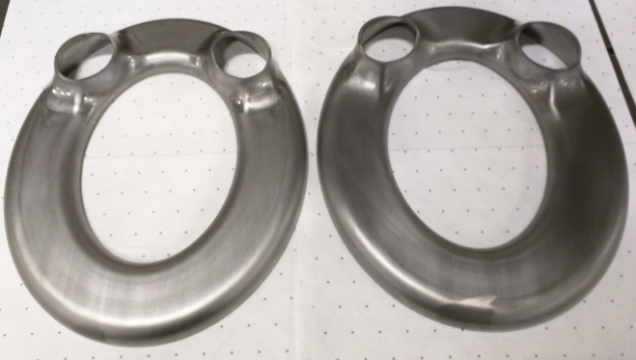
SPS DQWCC – from drawings to reality…
Parts for 2 SPS DQW prototypes
Formed from Nb RRR>300 sheets
Thickness: 4mm for cavity body; 3mm for port tubes
Almost ready for EBW
Notes:
from drawings to reality…

Slide 7
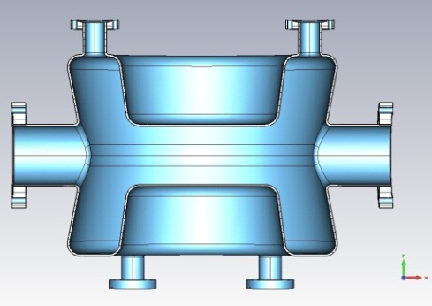
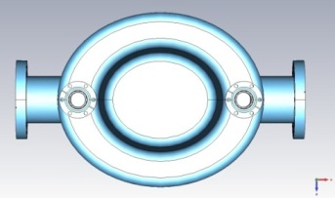
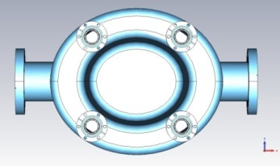
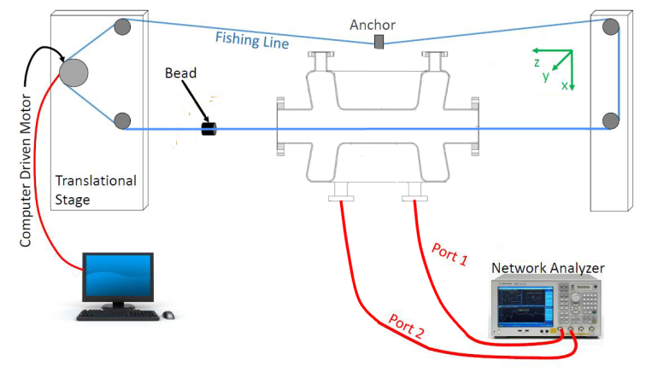
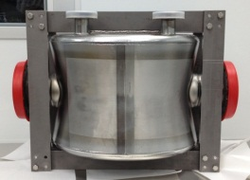
Identify HOMs: Bead Pulling
Proof-of-Principle (PoP)
Double-Quarter Wave Crab Cavity (DQWCC)
After considering that the cavity wall is 140micron thicker than expected
HOM frequencies deviated from designed values due to unspecified tolerances for PoP cavity.
Bead-pull setup

Slide 8
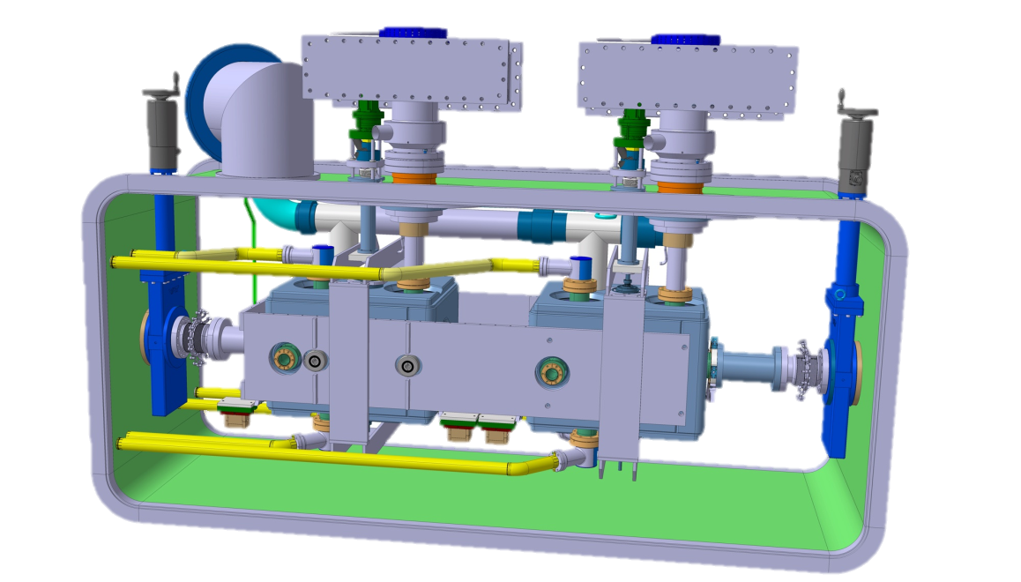
Constraint in the HOM filter design
A liquid helium vessel for the HOM filter was not shown here
© Capatina et, al @CERN
348mm
255mm
143mm
Magnetic & thermal shielding
reference
Notes:
Keep the compactness

Slide 9
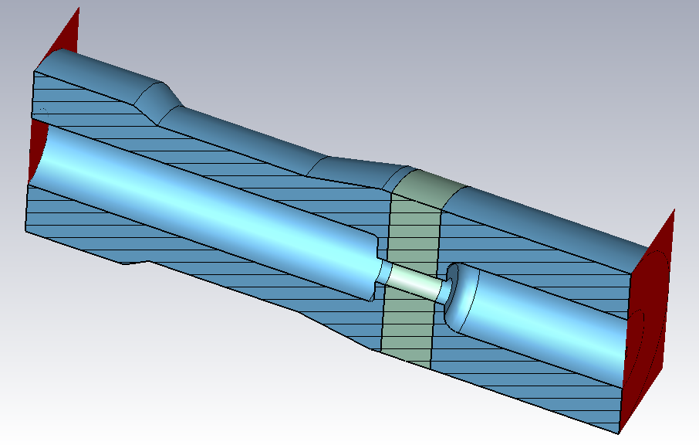
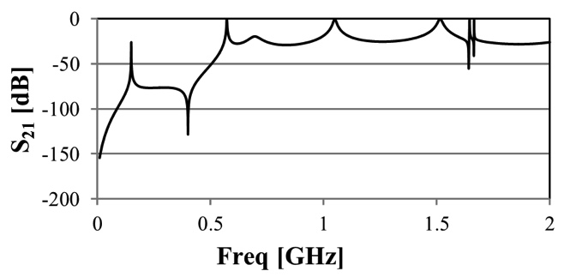
HOM filter design
HOM window

Slide 10
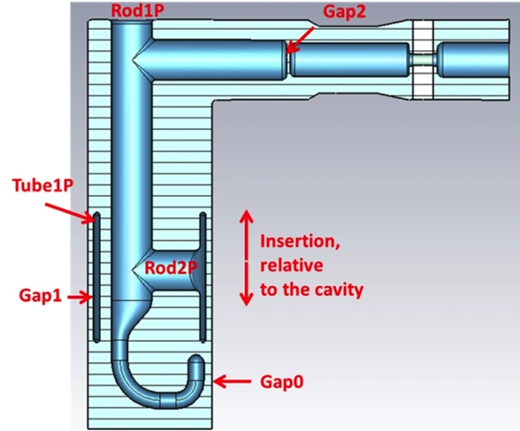
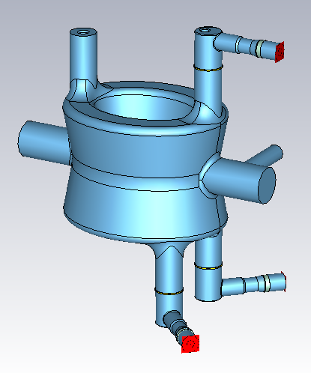
HOM with fabrication errors
Rmi
HT
L1
APER

Slide 11
HOM with cavity fabrication errors (Longitudinal)

Slide 12
HOM with cavity fabrication errors (Transverse)
With high impedance

Slide 13
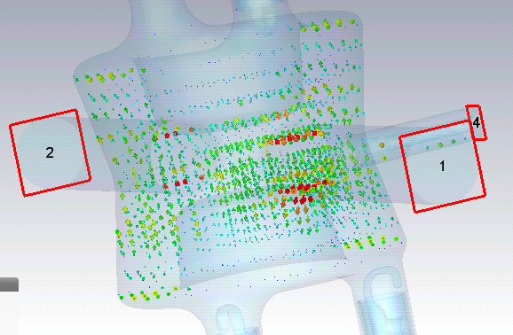
Possible solutions for 1.75GHz
H field inside
and on the surface
Change the coupling positions
Improve filter S21 @ 1.75GHz
Change length of inner conductor
Change the direction of the HOM filter feedthrough with respect to the hook

Slide 14
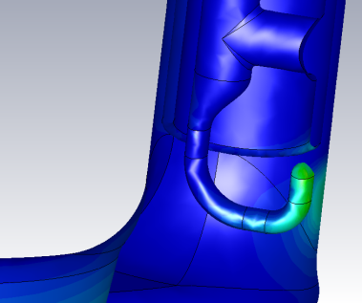
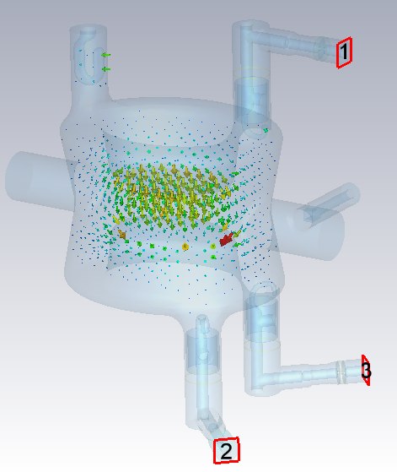
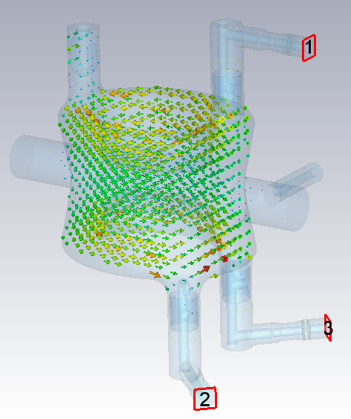
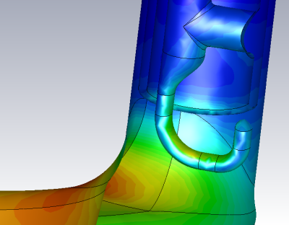
Filter at 400MHz with HOM & Cavity fab errors
E field
H field
For 400MHz crabbing mode with Vt = 3.34MV:
Peak E field on the hook: 19.4~29.7MV/m, on the cavity: 37.0~38.8MV/m.
Peak H field on the hook: 46.2~58.7mT, on the cavity: 70.4~71.6mT.
Coupling to 400MHz: >6.3x10⁹, <1.4 W at each port to outside load.

Slide 15
Increasing beam pipe to 100mm?
Design requirements:
Deflecting mode frequency = 400 MHz
(large amount of stored energy from E-field in between plates… large frequency reduction by increasing plates distance; geometry will need to be adapted somehow to bring frequency back to 400 MHz)
Additional dimensional constraints imposed by second adjacent LHC beam pipe
Two scenarios:
- DQWCC for H and V crab x-sing → design limited in height and width
- DQWCC for V crab x-sing, RFD for H x-sing → design limited in width
Provide required deflecting voltage while keeping a reduced Hpk

Slide 16
Increasing beam pipe to 100mm?
Design study considerations:
Open ports in cavity ring => ring width must be at least 62 mm to accommodate the ports.
CASE A – DQWCC only used for V crab x-sing
Assumed diameter of adjacent beam pipe to be 84mm and tube thickness of 3mm.
Adjacent beam pipe only poses limitation to cavity waist. Few mm distance between cavity waist and adjacent beam pipe.
Preliminary design…
Geometry parameters chosen to fit space constraint and provide resonant frequency of 400 MHz
Still requires optimization to reduce Bpk
Port interface also needs to be optimized
Vacc (3.3 MV) | 8.7 kV
Epk (3.3 MV) | 46 MV/m
Bpk (3.3 MV) | 77 mT
Rt/Q | 314 Ohm

Slide 17
HOM impedance
Results above 1.75GHz are not accurate as the modes started to leak out from the beam pipe.
By inserting the most recent version of HOM filters to the 100mm aperture cavity, the HOM longitudinal and transverse impedances were calculated. There are a few modes need to be optimized. It is a good starting point.

Slide 18
Summary and outlook
Cold tests of PoP DQW cavity demonstrated required nominal deflecting voltage.
Improved DQW cavity design for SPS tests: reduced Bpk, satisfy LHC space constraints, include HOM filters.
Cavity and HOM filter designs for SPS test completed.
Extensive error study showed no degradation on the HOM filter performance
Next steps after EBW:
Heavy BCP, high T bake, light BCP + HPR and bare cavity cold test at BNL in 2016.
Assembly to LHe vessel, light BCP + HPR, pre-tuning, dressed cavity cold test at BNL, assembly into cryomodule, installation in SPS.
First HOM filter prototype being manufactured at CERN.
Cavity with 100mm beam pipe aperture was studied with HOM filters.

Slide 19
Thank you!

