Slide 1
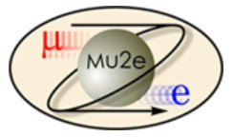
Mu2e Remote Handling Review Overhead Scheme
Mike Campbell
L2 Engineer - Accelerator
L4 Engineer/Designer – Target Remote Handling
3-3-2015

Slide 2
Mu2e RH Review – Overhead Scheme Mike Campbell 3-3-2015
Outline:
Motivation for developing the overhead Remote Handling (RH) scheme
Requirements, Assumptions, and Design Constraints
Basic layout of the overhead building and the RH System
Sequence of Operation
Detailed look at the 3 RH modules and how they would work for the Radiation-Cooled (RC) target
Proposed design for a Convection-Cooled (CC) target
How the overhead RH system would accommodate the CC target
Summary

Slide 3
Mu2e RH Review – Overhead Scheme Mike Campbell 3-3-2015
Motivation for Developing the Overhead RH Concept:
To develop a RH system that could be adapted to either a RC or a CC target scenario, since: (A) the decision to use a RC target is not final yet (B) even if we do choose RC, we may want the option of using CC in the future
To develop a RH system that was more similar to other RH systems that people have experience with at FNAL (AP0, Numi/Nova, planned LBNE – all overhead)
To develop a RH system that could reach through a cask and pull the window and target straight back into it – minimizing contamination risk
To develop a RH system that relied less on robotics / software / electronic motion controls and instead had simpler and fewer motions needed to accomplish the RH task (in general: less complicated = more reliable)
To develop a RH system that was less dedicated to the specific task for which it is designed and more accommodating to other tasks we may ask of it in the future

Slide 4
Mu2e RH Review – Overhead Scheme Mike Campbell 3-3-2015
Requirements, Assumptions, and Design Constraints:
Same as for the horizontal design, except:
Entry / exit from the Target Hall (TH) is via overhead gantry crane through a ceiling hatch opening to the inside of a ground-level building – this means:
A) RH system has no floor rails
B) RH system can be set down onto a structure mounted directly to the PS frame
C) This structure would be above the floor, unaffected by floor movements
D) Thus: RH system move positions can be preset – no need for machine vision
Also means RH system does not need to pass through a narrow doorway. Overhead hatch is 22+ feet long. Thus can place a long module – no need for telescoping motion to reach the target, can just use a long, simple arm with a single in/out motion

Slide 5
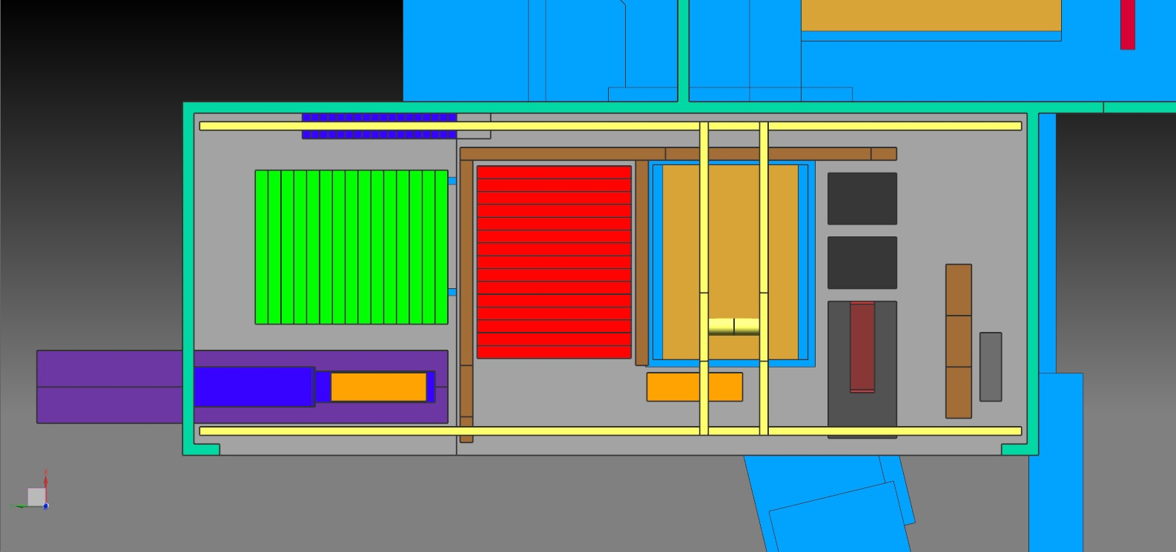
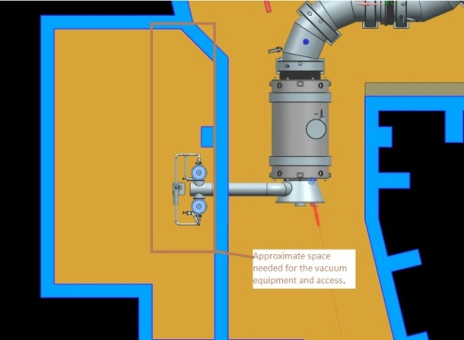
Mu2e RH Review – Overhead Scheme Mike Campbell 3-3-2015
Proposed Overhead Concept: Basic Layout of the Overhead Building and RH System
Existing Mu2e building ends here
Proposed 40’ x 100’ new RH building
RH
module 1
RH
module 2
RH
module 3
Control
Desk
Control
Desk
20’ truck trailer backed-in
Hatch opening to TH below
TH / RH room detail
The basic layout is shown above. The RH system would consist of 3 modules, shown by the 3 dark gray boxes in the picture above. The modules are each lowered in sequence into the TH to perform their specific task and brought back out via crane.
Vacuum equip.
RH room smaller

Slide 6
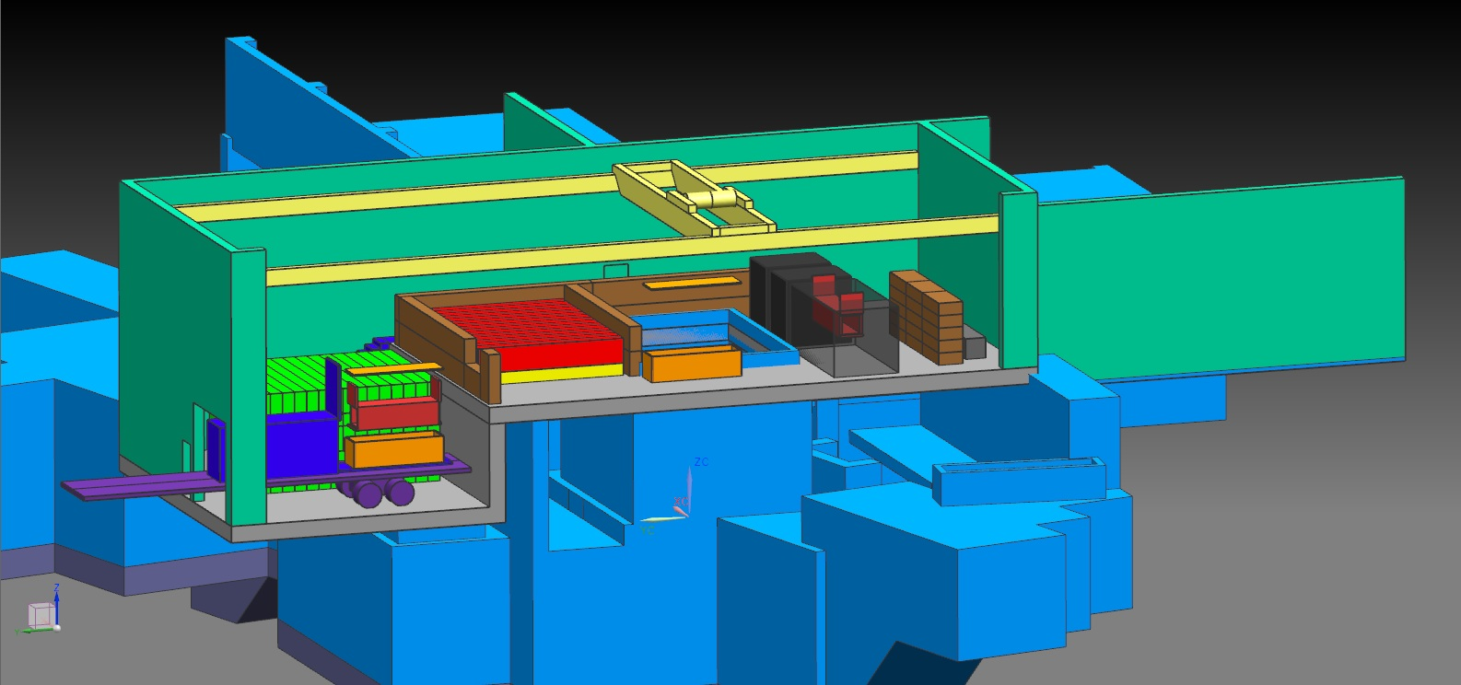
Mu2e RH Review – Overhead Scheme Mike Campbell 3-3-2015
Proposed Overhead Concept: RH System Sequence of Operation
Lower area, approx 40’ x 32’
Upper “loft” approx 40’ x 68’
Rad-Safety controlled area
20T crane hook height set to 18’ above loft area floor. Resulting building height: will be approx 7’ higher than adjacent portion of existing mu2e building
Sequence of Operation . . .
Remove hatch shield blocks and stack up as shown in picture above
Using crane, lower RH module-1 down into the TH and set in place behind the PS

Slide 7
Mu2e RH Review – Overhead Scheme Mike Campbell 3-3-2015
Proposed Overhead Concept: RH System Sequence of Operation
RH
module 1
RH
module 2
RH
module 3
Final / Outer Cask
RH module-1 removes the 36 bolts around the perimeter of the window
Lift RH module-1 back to loft and set down
Lower RH module-2 down into the TH and set in place behind the PS. This module includes a cask with 2” steel wall thickness to contain the old window

Slide 8
Mu2e RH Review – Overhead Scheme Mike Campbell 3-3-2015
Proposed Overhead Concept: RH System Sequence of Operation
RH
module 1
RH
module 2
RH
module 3
Final / Outer Cask
RH module-2 removes the window and pulls it straight back into the cask
Lift RH module-2 (including its’ full cask) back to loft and set down
Using the crane, lift the window cask off the module, place into a final / outer cask. This cask can then be placed into a Numi Horn carrier on the truck trailer

Slide 9
Mu2e RH Review – Overhead Scheme Mike Campbell 3-3-2015
Proposed Overhead Concept: RH System Sequence of Operation
RH
module 1
RH
module 2
RH
module 3
Final / Outer Cask
Lower RH module-3 down into the TH and set in place behind the PS. This module includes a cask with 2” steel wall thickness to contain the spent target assembly
RH module-3 reaches out to retrieve the target and pulls it straight back into the cask
Lift RH module-3 (including its’ full cask) back to loft and set down

Slide 10
Mu2e RH Review – Overhead Scheme Mike Campbell 3-3-2015
Proposed Overhead Concept: RH System Sequence of Operation
RH
module 1
RH
module 2
RH
module 3
Final / Outer Cask
Lift the target cask off the module, place into a final / outer cask. This cask can then also be placed into the Numi Horn carrier on the truck trailer. Truck can leave
Next, a new target assembly is loaded onto RH module-3, which is then lowered down into the TH and set in place behind the PS

Slide 11
Mu2e RH Review – Overhead Scheme Mike Campbell 3-3-2015
Proposed Overhead Concept: RH System Sequence of Operation
RH
module 1
RH
module 2
RH
module 3
Final / Outer Cask
RH module-3 then reaches out to place the new target onto its’ mounting surface inside the PS. When complete, the module is lifted back to the loft and set down
A new window is now loaded onto RH module-2, which is then lowered down into the TH and set in place behind the PS

Slide 12
Mu2e RH Review – Overhead Scheme Mike Campbell 3-3-2015
Proposed Overhead Concept: RH System Sequence of Operation
RH
module 1
RH
module 2
RH
module 3
Final / Outer Cask
RH module-2 reaches out to place the new window onto its’ mounting flange on the PS endcap. When complete, the module is lifted back to the loft and set down
RH module-1 is then lowered down into the TH and set in place behind the PS. This module proceeds to tighten the 36 bolts around the perimeter of the window. Any desired star pattern tightening sequence can be programmed

Slide 13
Mu2e RH Review – Overhead Scheme Mike Campbell 3-3-2015
Proposed Overhead Concept: RH System Sequence of Operation
RH
module 1
RH
module 2
RH
module 3
Final / Outer Cask
Lift RH module-1 back to loft and set down
Put all shield blocks back into place in the hatch
RH target exchange process complete

Slide 14
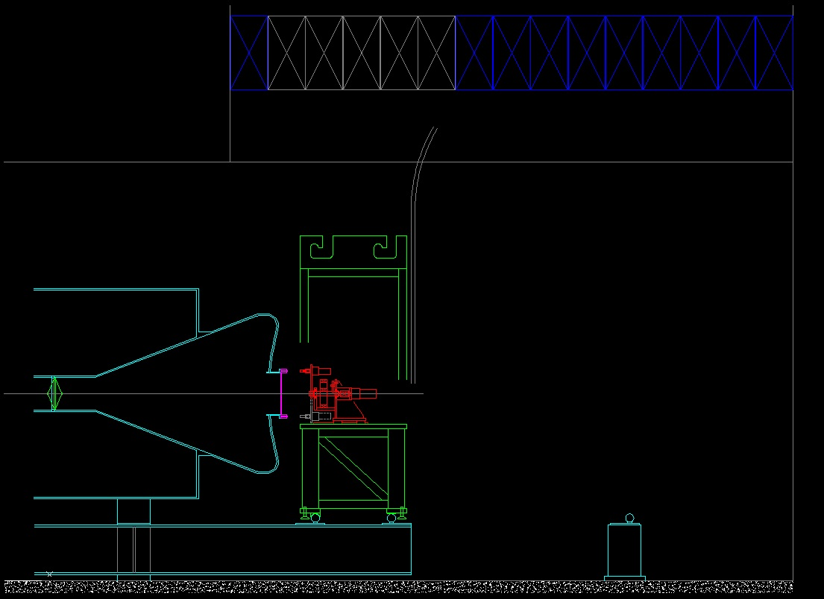
Mu2e RH Review – Overhead Scheme Mike Campbell 3-3-2015
Design Details: RH Module-1 – Bolt Circle
Hatch shield pile:
min. opening =
5 blocks (7.5’ wide)
Cable harness from above
Module frame includes lifting features
RC Target
Window
Module:
In/out motion (pneum)
Rotate axis (stepper)
Bolt driver gearmotor
Spring-loaded drive socket
Module locating features (+/- .010”)
Cantilevered arms mounted to PS frame

Slide 15
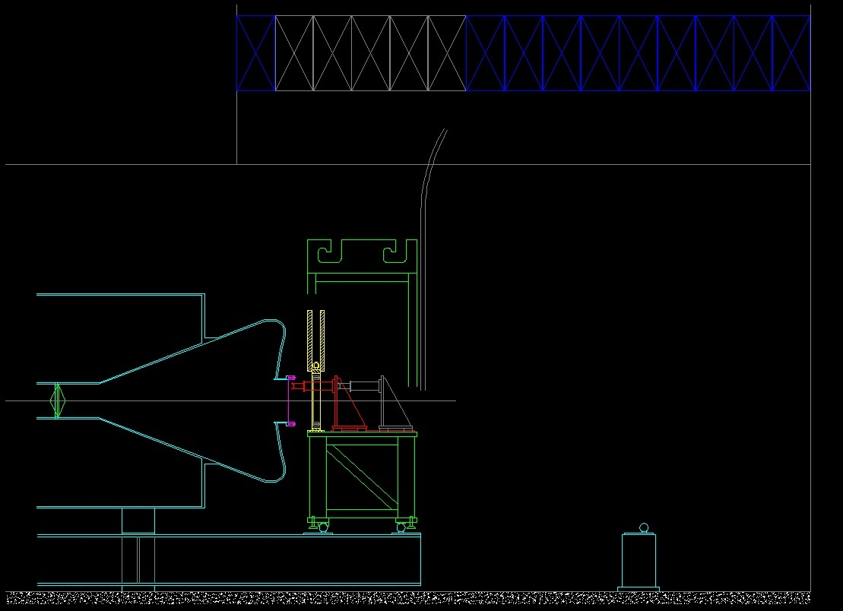
Mu2e RH Review – Overhead Scheme Mike Campbell 3-3-2015
Design Details: RH Module-2 – Window
Hatch shield pile:
min. opening =
5 blocks (7.5’ wide)
Cable harness from above
Module frame includes lifting features
RC Target
Window
Window cask, 2” steel wall thickness
with front & rear doors (pneum lift)
Module:
In/out motion (pneum)
Grip motion (pneum)
Module locating features (+/- .010”)
Cantilevered arms mounted to PS frame

Slide 16
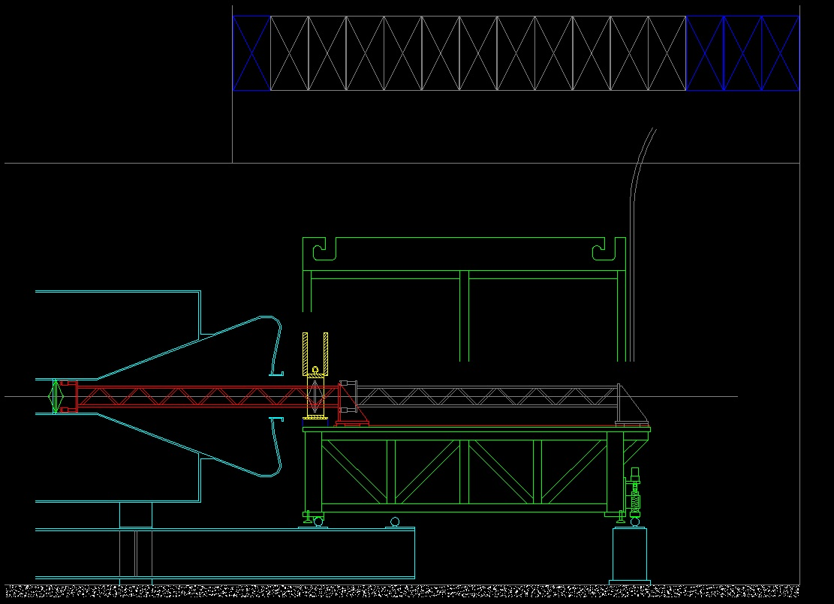
Mu2e RH Review – Overhead Scheme Mike Campbell 3-3-2015
Design Details: RH Module-3 – RC Target
Hatch shield pile:
min. opening =
11 blocks (16.5’ wide)
Cable harness from above
Module frame includes lifting features
RC Target
Arm extended
Target cask, 2” steel wall thickness
with front & rear doors (pneum lift)
Module:
In/out motion (pneum)
Grip motion (pneum)
Module tilt adjustment:
motor / screw
Module Locating
Features (+/- .010”)
Pedestal
on floor

Slide 17
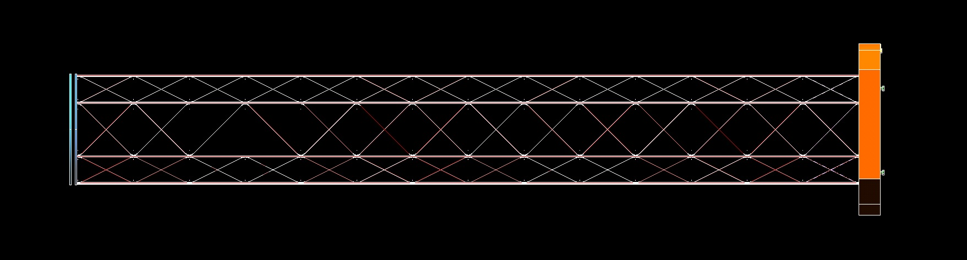
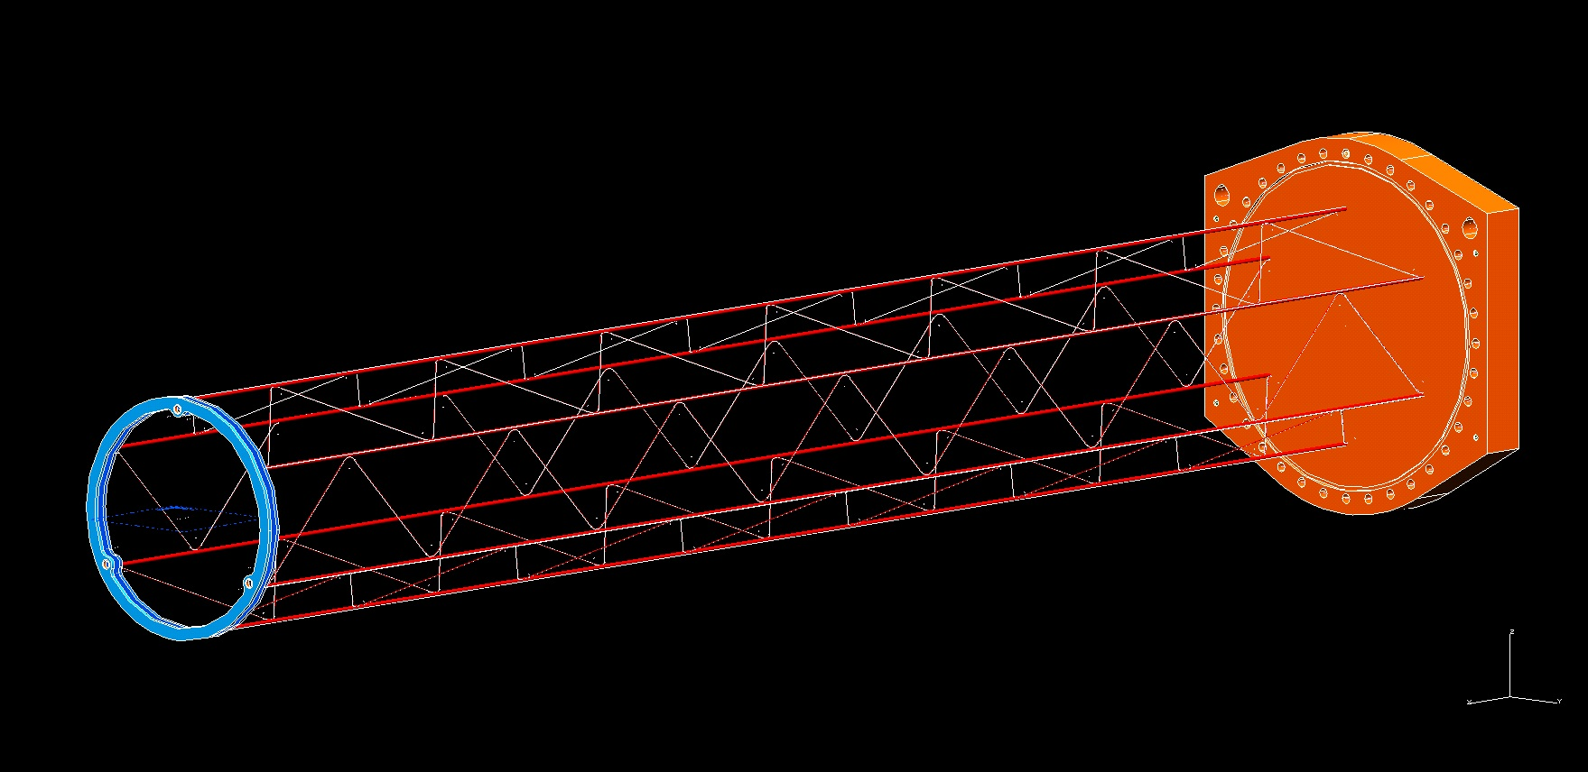
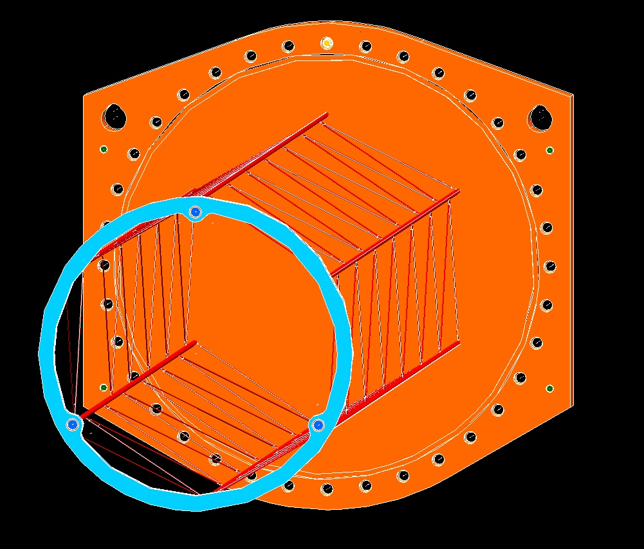
Mu2e RH Review – Overhead Scheme Mike Campbell 3-3-2015
Proposed conceptual design for CC target (version 1)
Physics simulation showed no significant loss of muon yield from this structure
Bicycle wheel
Target access window
~
10’
Skeleton structure extending from window
supports bicycle wheel. Horizontal tubes
also serve as the coolant channels
Wire truss structure between horizontal tubes
Hollow
center

Slide 18
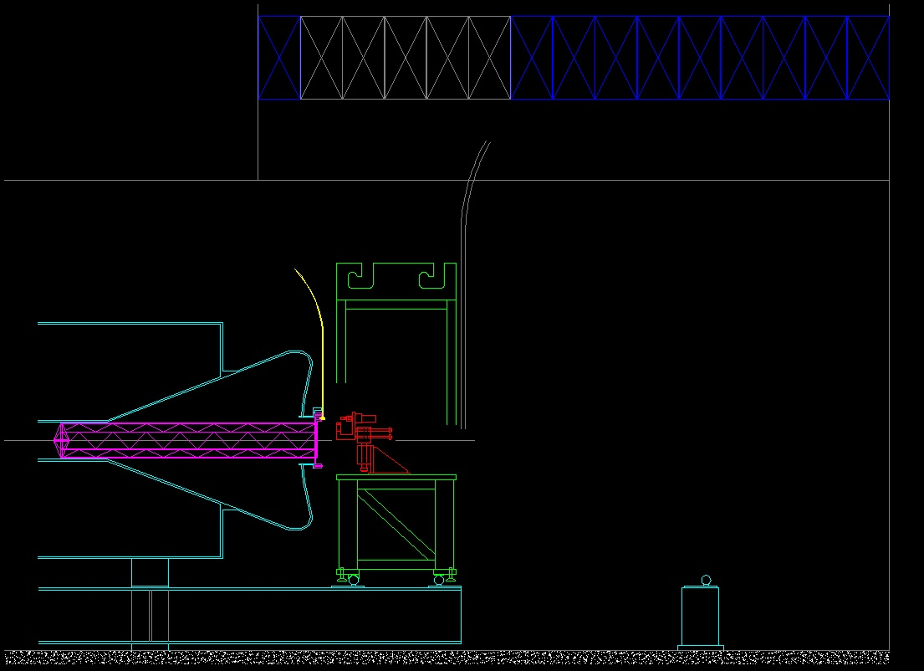
Mu2e RH Review – Overhead Scheme Mike Campbell 3-3-2015
Design Details: RH Module-1 for CC Target – Remove Coolant Lines
CC Target
Coolant supply & return lines
Window/target frame
Module:
In/out motion (pneum)
Grip motion (pneum)
Lift motion (pneum)
2x Bolt driver gearmotors
Spring-loaded drive sockets
Re-use table & frame from the RC target RH system – module-2, just put new actuator mechanism on it

Slide 19
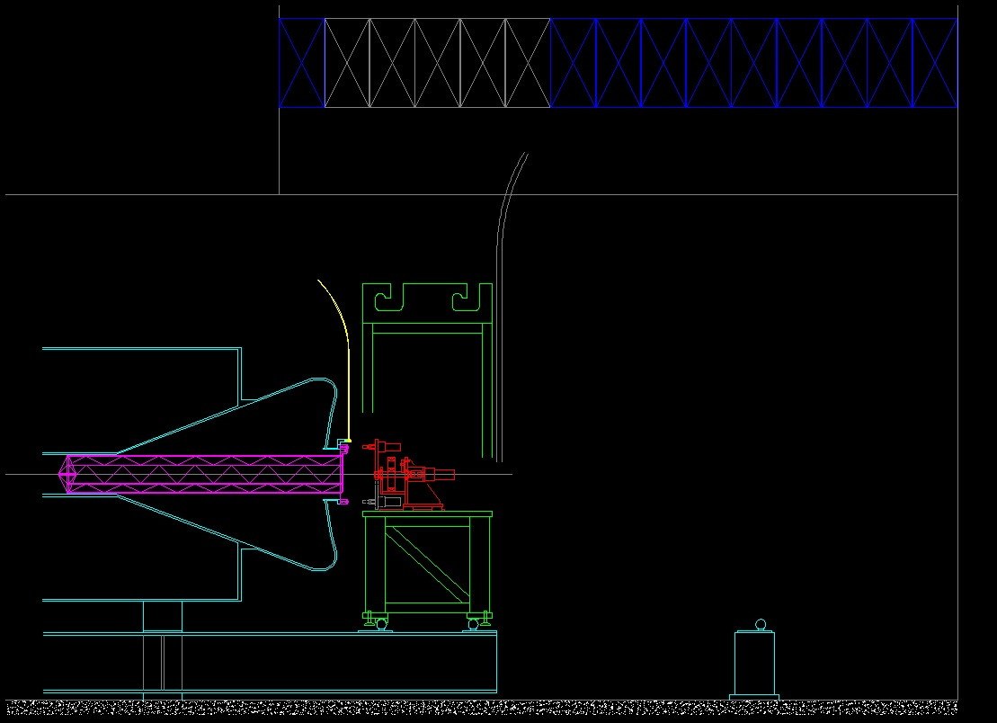
Mu2e RH Review – Overhead Scheme Mike Campbell 3-3-2015
Design Details: RH Module-2 for CC Target – Bolt Circle
Coolant supply & return lines have been removed and re-mounted up and out of the way
Re-use module-1 as-is from the original RC target RH system

Slide 20
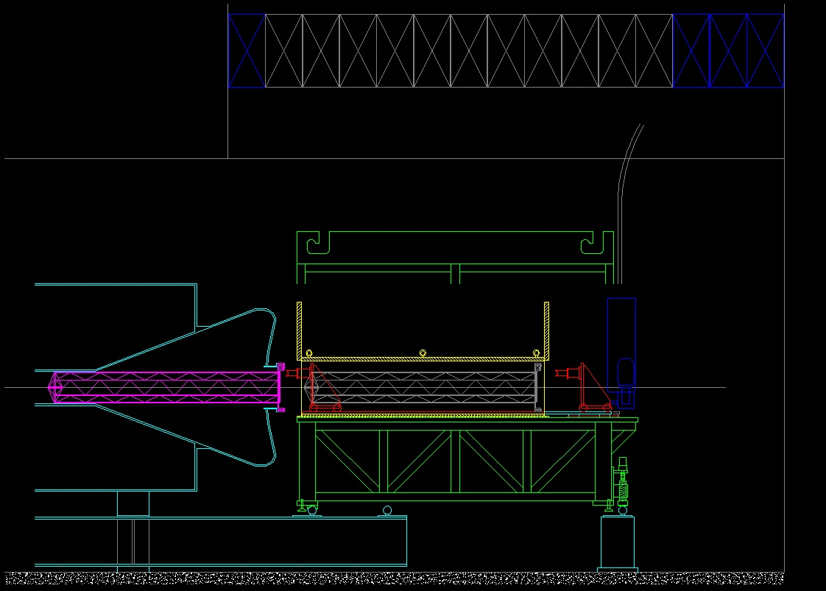
Mu2e RH Review – Overhead Scheme Mike Campbell 3-3-2015
Design Details: RH Module-3 for CC Target – Remove Window/Target Frame
Module:
In/out motion (push/pull chain
drive w/ pneum clutch)
Grip motion (pneum)
Secondary retract motion (pneum)
Window/target frame cask, 2” steel wall thickness with front & rear doors (pneum lift)
Re-use table & frame from the RC target RH system – module-3, just put long cask and new actuator mechanisms on it

Slide 21
Mu2e RH Review – Overhead Scheme Mike Campbell 3-3-2015
Summary:
The Overhead RH Scheme:
Facilitates either the RC or CC target – now or later
Would re-use much of the RH system if a RC --> CC change was made > building layout, 1 complete module, 2 other module bases, control system > proposed CC target design uses same mount as RC (thus interchangeable)
Utilizes an overhead gantry crane, similar to other RH systems at FNAL
Utilizes 3 modules, each with simple motions – thus should have good reliability
Locates on a structure tied directly to the PS, above the floor
Utilizes a non-telescoping arm to reach the RC target with a single in/out motion
Minimizes contamination risk by pulling straight back into the casks
Provides future flexibility - can add new module(s) as needed for whatever task > proton beam exit window, extinction monitor window, other tasks TBD ?

Slide 22
Mu2e RH Review – Overhead Scheme Mike Campbell 3-3-2015
End of Main Presentation
Back-up Slides Following . . .

Slide 23
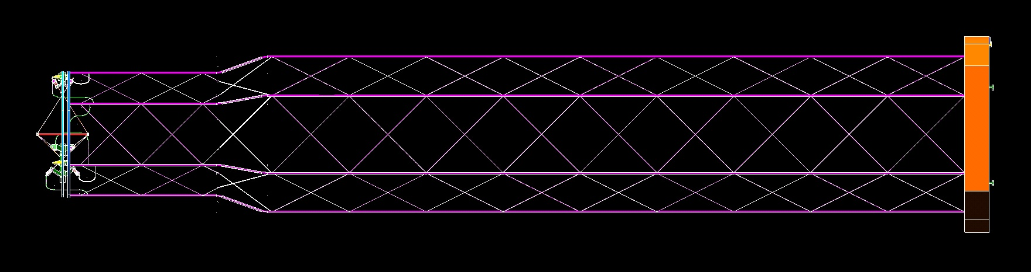
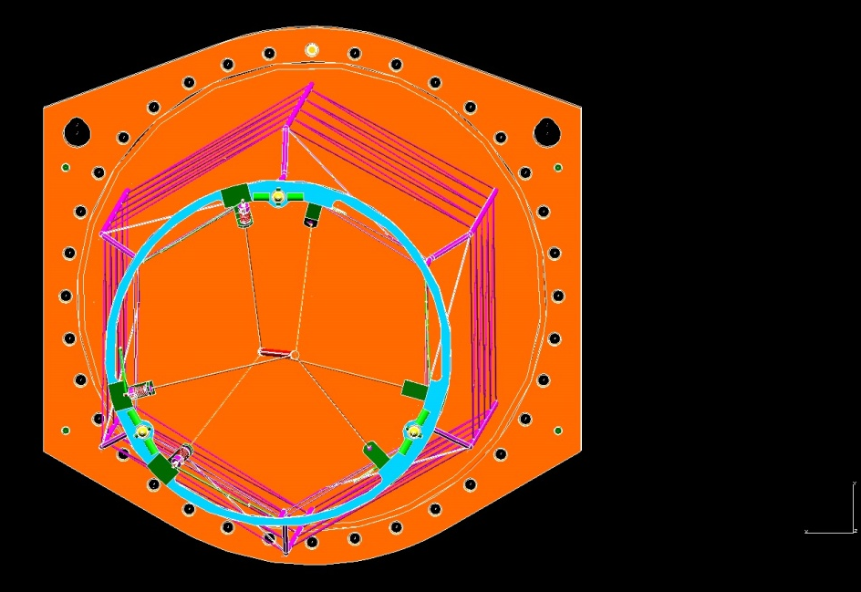
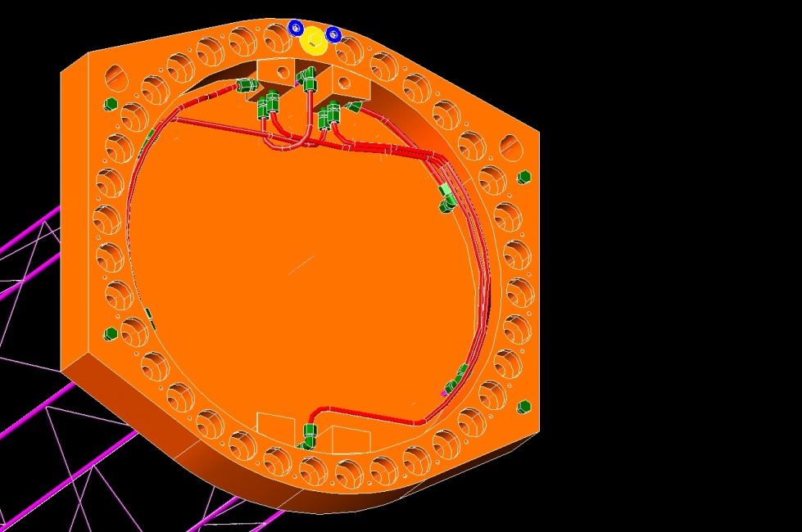
Mu2e Target Handler Mike Campbell 5-12-2014
Proposed Design Details for CC target : Overview
Horizontal tubes stepped outward from 7.5” radius to 9.5” radius
Bicycle wheel:
Hollow spokes
Adjustable spoke
tension springs
Interfaces to
existing HRS
mount features
for location
Interchangeable
with current
RC target
Window:
Has grip handles
Manifolding for
coolant supply
& return lines
Interfaces to
coolant line
connection
block
Interchangeable
with current
window

Slide 24
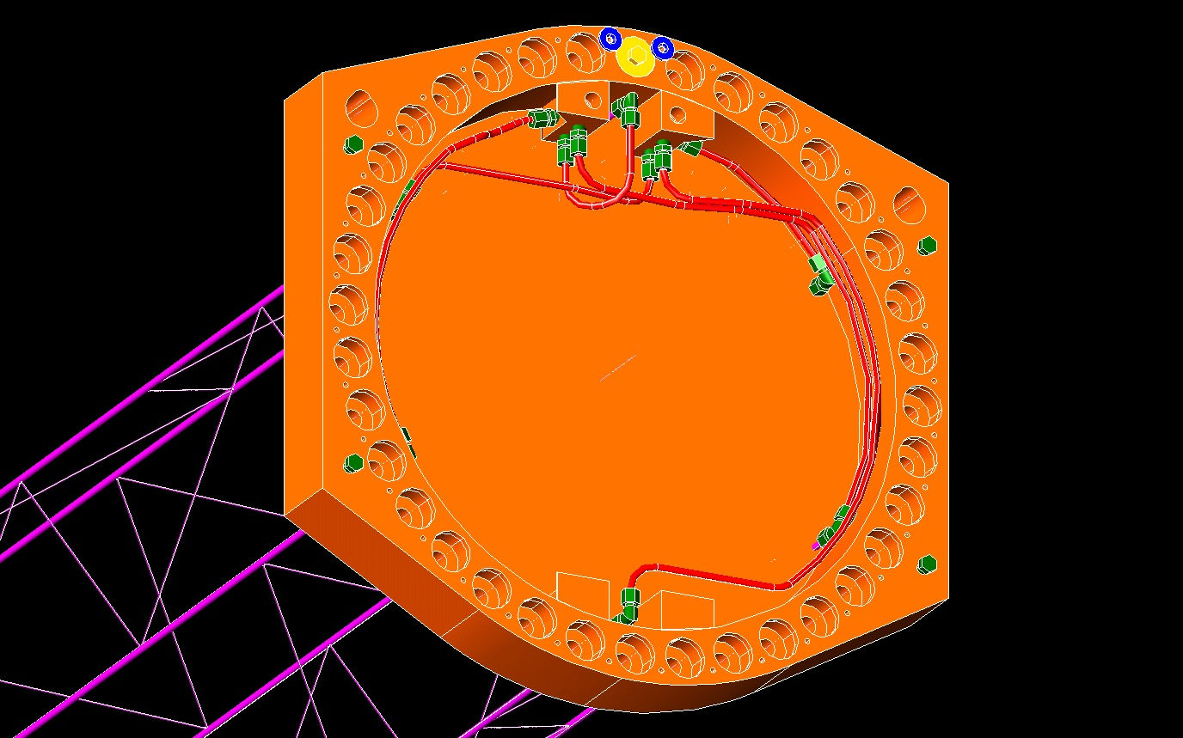
Mu2e Target Handler Mike Campbell 5-12-2014
Proposed Design Details for CC target : Window and skeleton frame
Coolant supply connection port
Coolant return connection port
Dovetail shaped upper grip handles
6x horizontal tubes:
.250” OD x .210” ID
(.020” wall, stainless)
3x supply + 3x return
Manifold tubing:
Flexible aluminum
Routed away from
middle panel
Diagonals:
.062” dia
attached
to horizontals
Fittings:
Compression shown but other types also possible
6x horizontal tubes protrude
through thin middle panel
Dovetail shaped lower grip handles

Slide 25
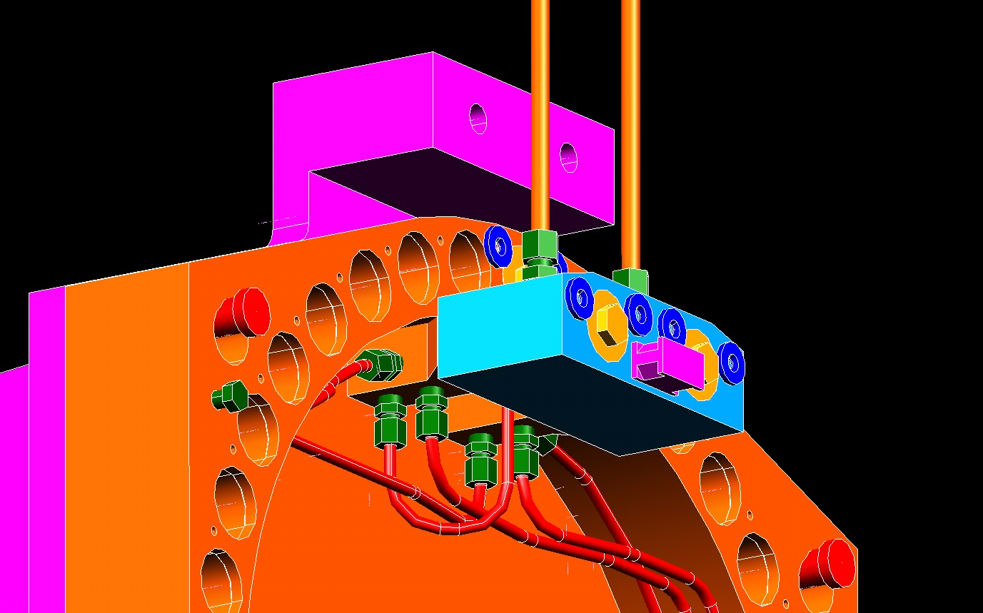
Mu2e Target Handler Mike Campbell 5-12-2014
Proposed Design Details for CC target : Coolant line connection block
Coolant supply and return lines
extending down from ceiling
“Parking place” feature on top of endcap window mounting flange.
Coolant line connection block attaches up here to facilitate window removal
Utilizes hollow bolts with re-usable inner & outer seals (similar to automotive brake-line connection)
Also: bolts spring-loaded & retained
Grip handle
Coolant line
connection block

Slide 26
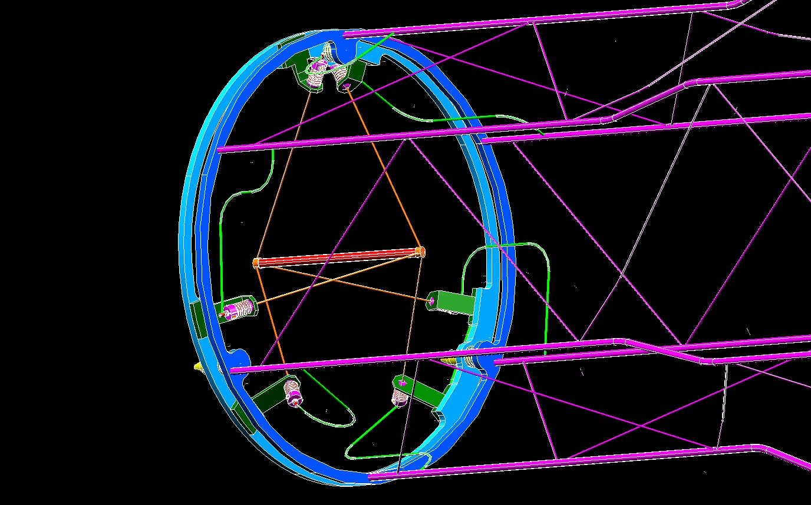
Mu2e Target Handler Mike Campbell 5-12-2014
Proposed Design Details for CC target : Bicycle wheel and coolant routing to spokes
Bicycle Wheel:
2 rings, 15.5” OD, 1/4” thick, stainless.
Coolant tubes dead-end into rear ring.
Spokes mounted
to front ring.
6x Jumpers:
.083” OD x .063” ID
(.010” wall, stainless)
Jumpers connect
6x horizontal tubes
to end of each spoke
3x supply + 3x return
Needs flow analysis
to optimize size

Slide 27
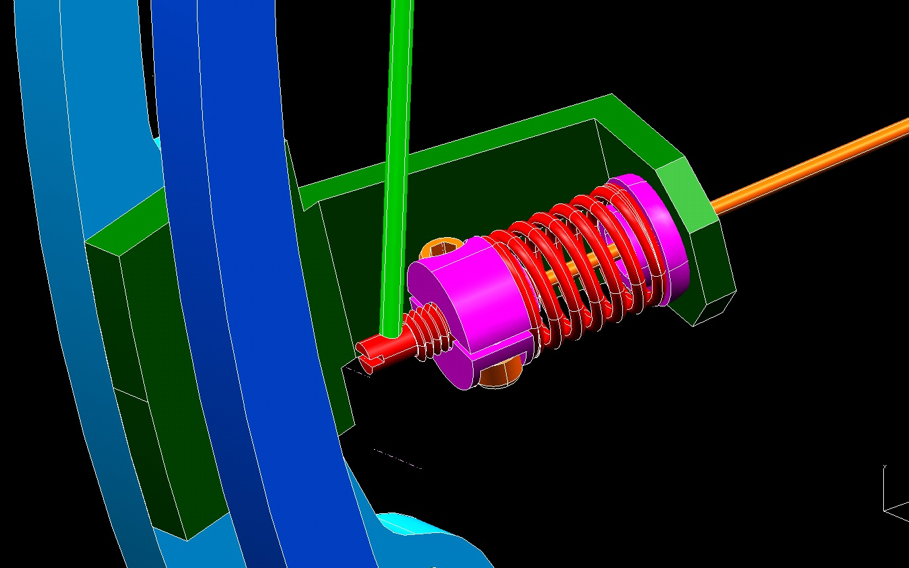
Mu2e Target Handler Mike Campbell 5-12-2014
Proposed Design Details for CC target : Adjustable spoke tensioning
Jumper from horizontal frame tube
Spokes:
.0625” OD x .047 ID
(.009” wall, stainless)
Needs flow analysis to optimize size
Spoke passes through clearance hole in spherical nose
Spherical nose rests in mating spherical hole in mounting bracket
Stainless coil spring
Hollow setscrew welded to end of spoke.
Slot in end of setscrew: Can hold w/ screwdriver
while adjusting collar to prevent spoke wind-up

Slide 28
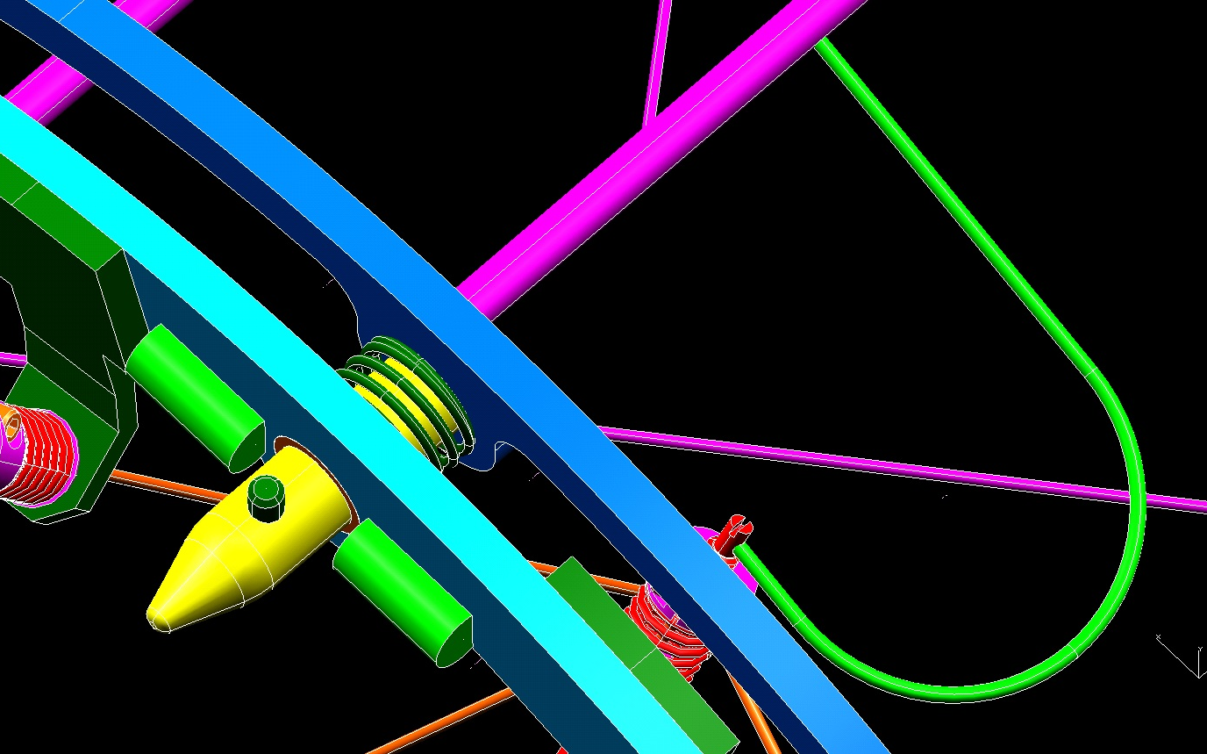
Mu2e Target Handler Mike Campbell 5-12-2014
Proposed Design Details for CC target : Interface to existing HRS mounting features
Bicycle wheel front ring is spring-loaded relative to rear ring
Bicycle wheel rear ring welded to end of frame tubes
3x coil springs and pilot pins around bicycle wheel
Spacers bear against HRS mounting surface to match RC bicycle wheel offset

Slide 29
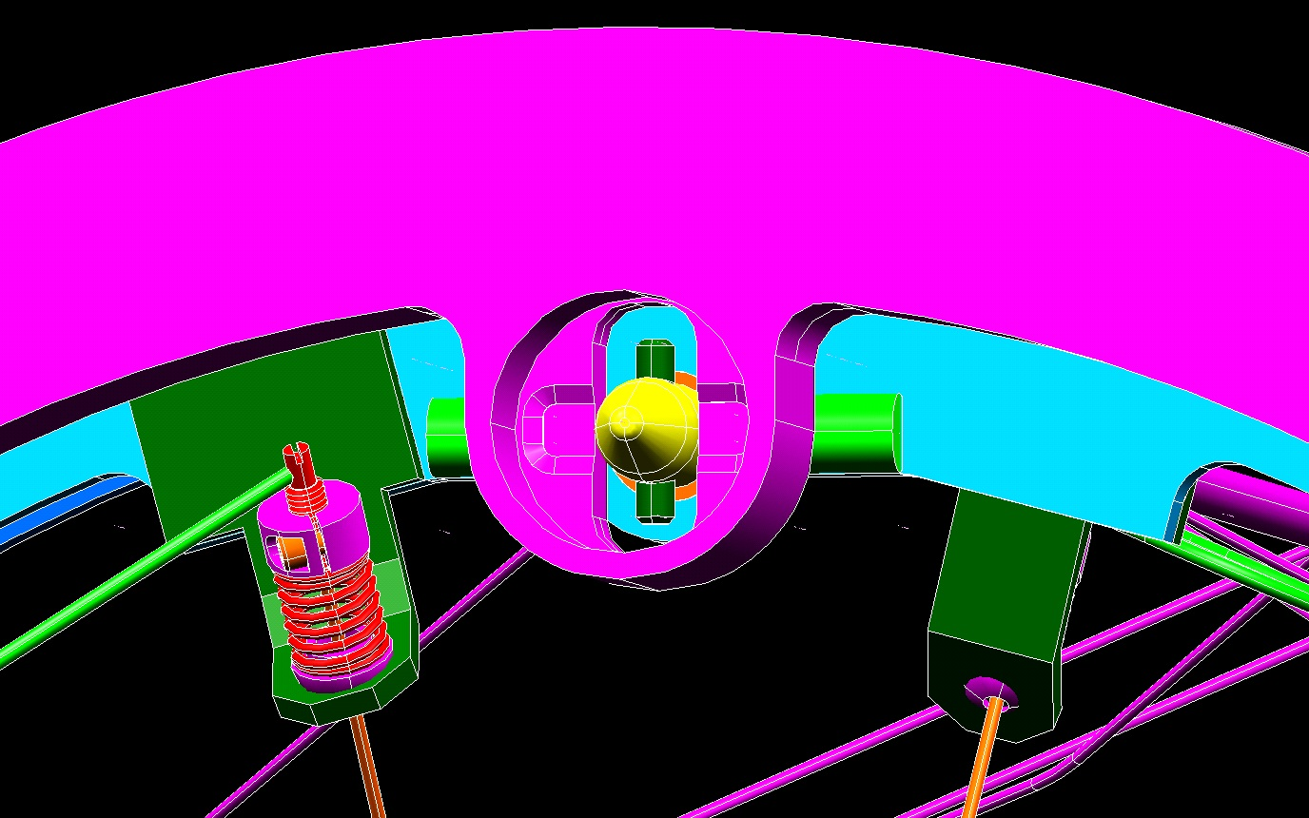
Mu2e Target Handler Mike Campbell 5-12-2014
Proposed Design Details for CC target : Interface to existing HRS mounting features
3x Pilot pins engage the existing 3x slots in HRS mount
HRS ID
1/4” Lip
Spacers bearing against HRS mounting surface

Slide 30
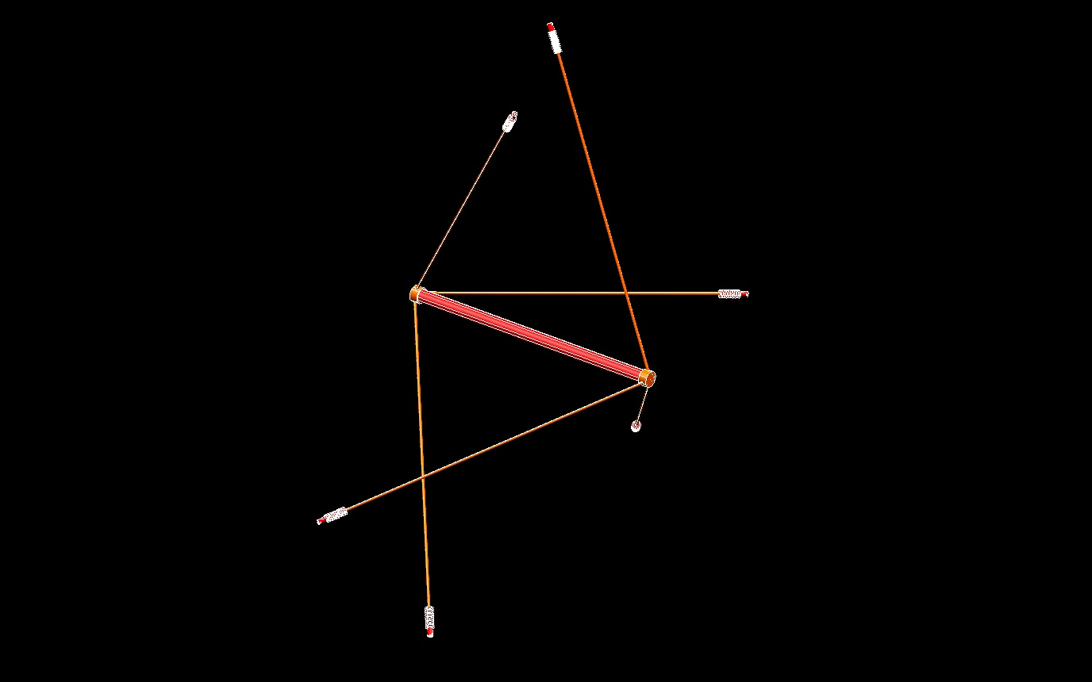
Mu2e Target Handler Mike Campbell 5-12-2014
Proposed Design Details for CC target : Target, sleeve, and spokes detail
Outer Sleeve:
Target rod inside
Needs analysis to optimize sleeve ID, OD, and material
Currently modeled:
.312” OD x .292” ID
(.010” wall, stainless)
Welded-on endcaps and spokes
Currently modeled:
stainless, wall thickness = .020” (needs analysis, can optimize)

Slide 31
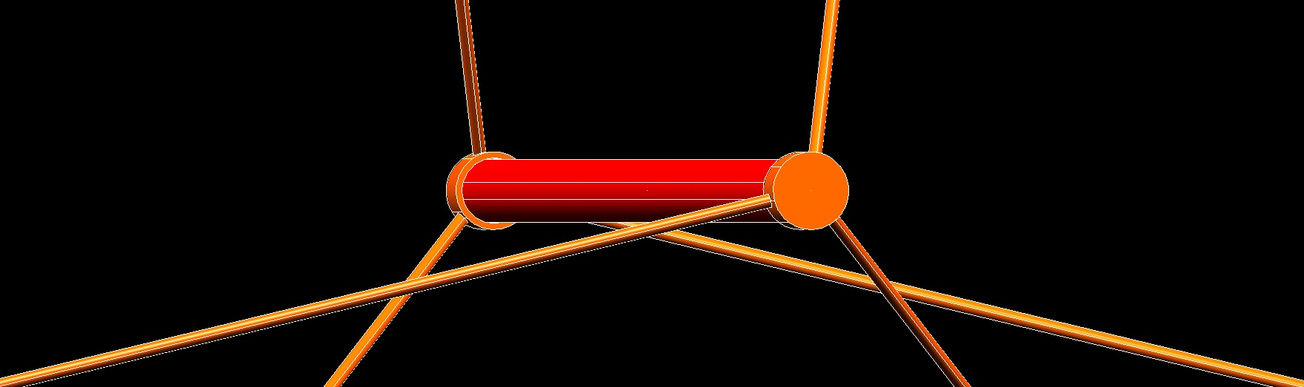
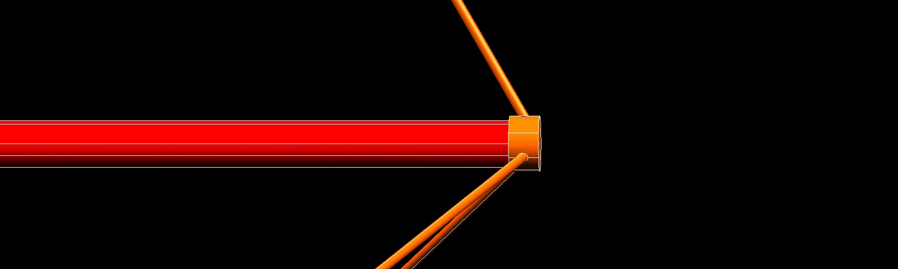
Mu2e Target Handler Mike Campbell 5-12-2014
Proposed Design Details for CC target : Important symmetries maintained for target/spoke
120 deg – All same
All same

