Slide 1
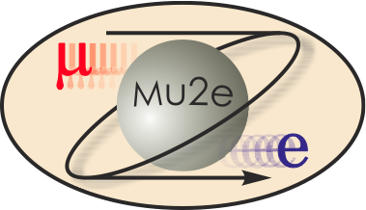
Mu2e Remote Handling Review
Comparisons: Costs, Risks & Maintainability
Ryan Schultz
Deputy L3 Manager Target Station
3/3/2015

Slide 2
Comparisons: Costs, Risks & Maintainability
Costs
  TPC comparison - M. Gardner, M. Campbell
Risks
  Impact of mechanical failure – M. Campbell, R. Schultz
Maintainability
  Configuration & functional flexibility
Conclusions

Slide 3
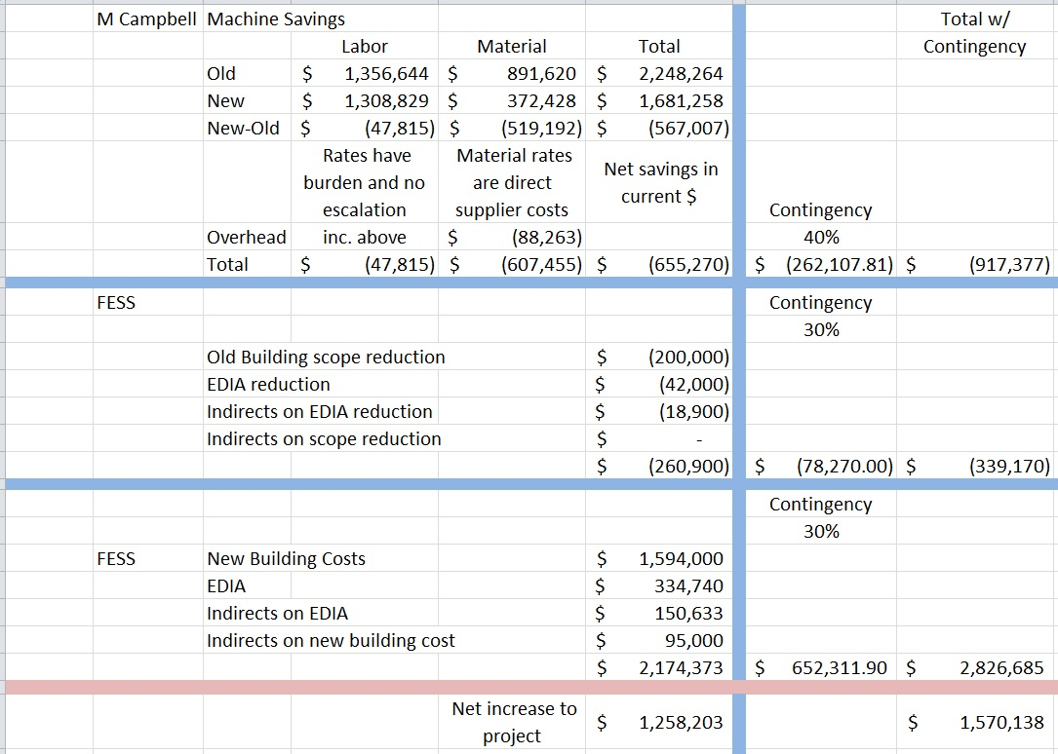
TPC Comparison
$1.25M

Slide 4
Reliability?
Reliability of single point failure systems is irrelevant in the context of highly radioactive Remote Handling Systems
  Must assume failure is a possibility
  What do you do when that happens???
For Remote Handling Systems
  Impact of failure is necessary, regardless of reliability…

Slide 5
Impact of Failure
24 possible failure conditions considered
  Analysis done by M. Campbell, R. Schultz
  First pass (not exhaustive)
  Based on conceptual designs
  System failure, not individual parts
Rated 1-5
  1 = Low (Green) Easy to fix
  3 = Medium (Yellow) Difficult but possible
  5 = High (Red) Very difficult, unclear
Side by side comparisons of both scheme’s
Notes:
FMEA, FMECA

Slide 6
Impact of Failure
Conclusions
  Horizontal scheme will always have a higher Impact of Failure
    Due to telescoping arm
    Due to lack of flexibility that crane provides
    Higher likelihood of operational downtime and expense
    Recovery time from a 4/5 class failure could be months
  Systems with fail safe (or redundancy) are strongly preferred
    Probability of 2-point failures is very low, but it is still possible
    Designs like this are not easy, nor always possible

Slide 7
Maintainability
In engineering, Maintainability is the ease with which a product can be maintained in order to:
  isolate/correct defects or their cause
  repair/replace faulty or worn out components
    without replacing still working parts
  prevent unexpected breakdowns
  maximize a product’s useful life
  maximize efficiency, reliability and safety
  make future maintenance easier
  cope with a changed environment

Slide 8
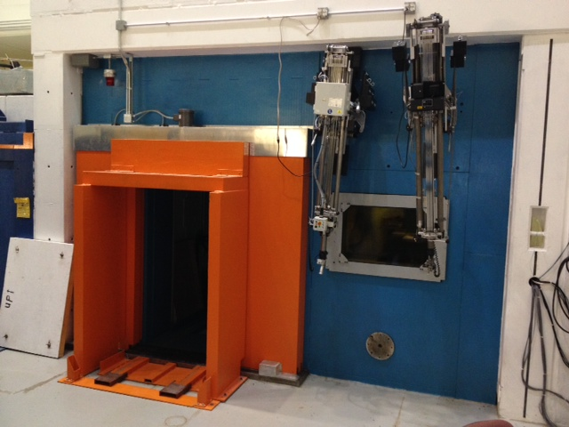
Maintainability
Remote handling systems need to be maintained:
  General maintenance
  Alterations, repairs
  R&D
  Trial and error
  Operator practice time
Experience at the C0 RHF hot cell:
  Things take a LOT longer than expected in a radioactive environment: PPE, shielding, contamination controls, etc.
  R&D, assembly, practicing, implementation, etc.
  C0 is not constrained by beam operations

Slide 9
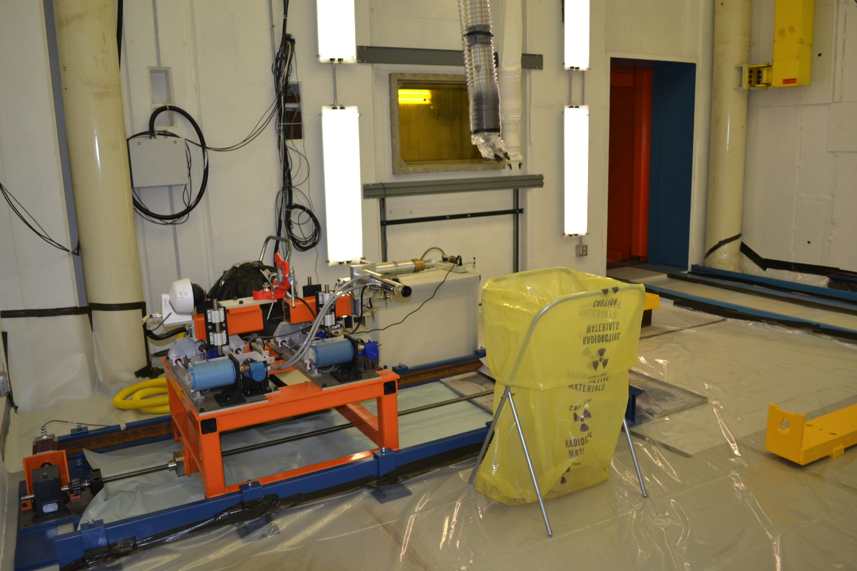
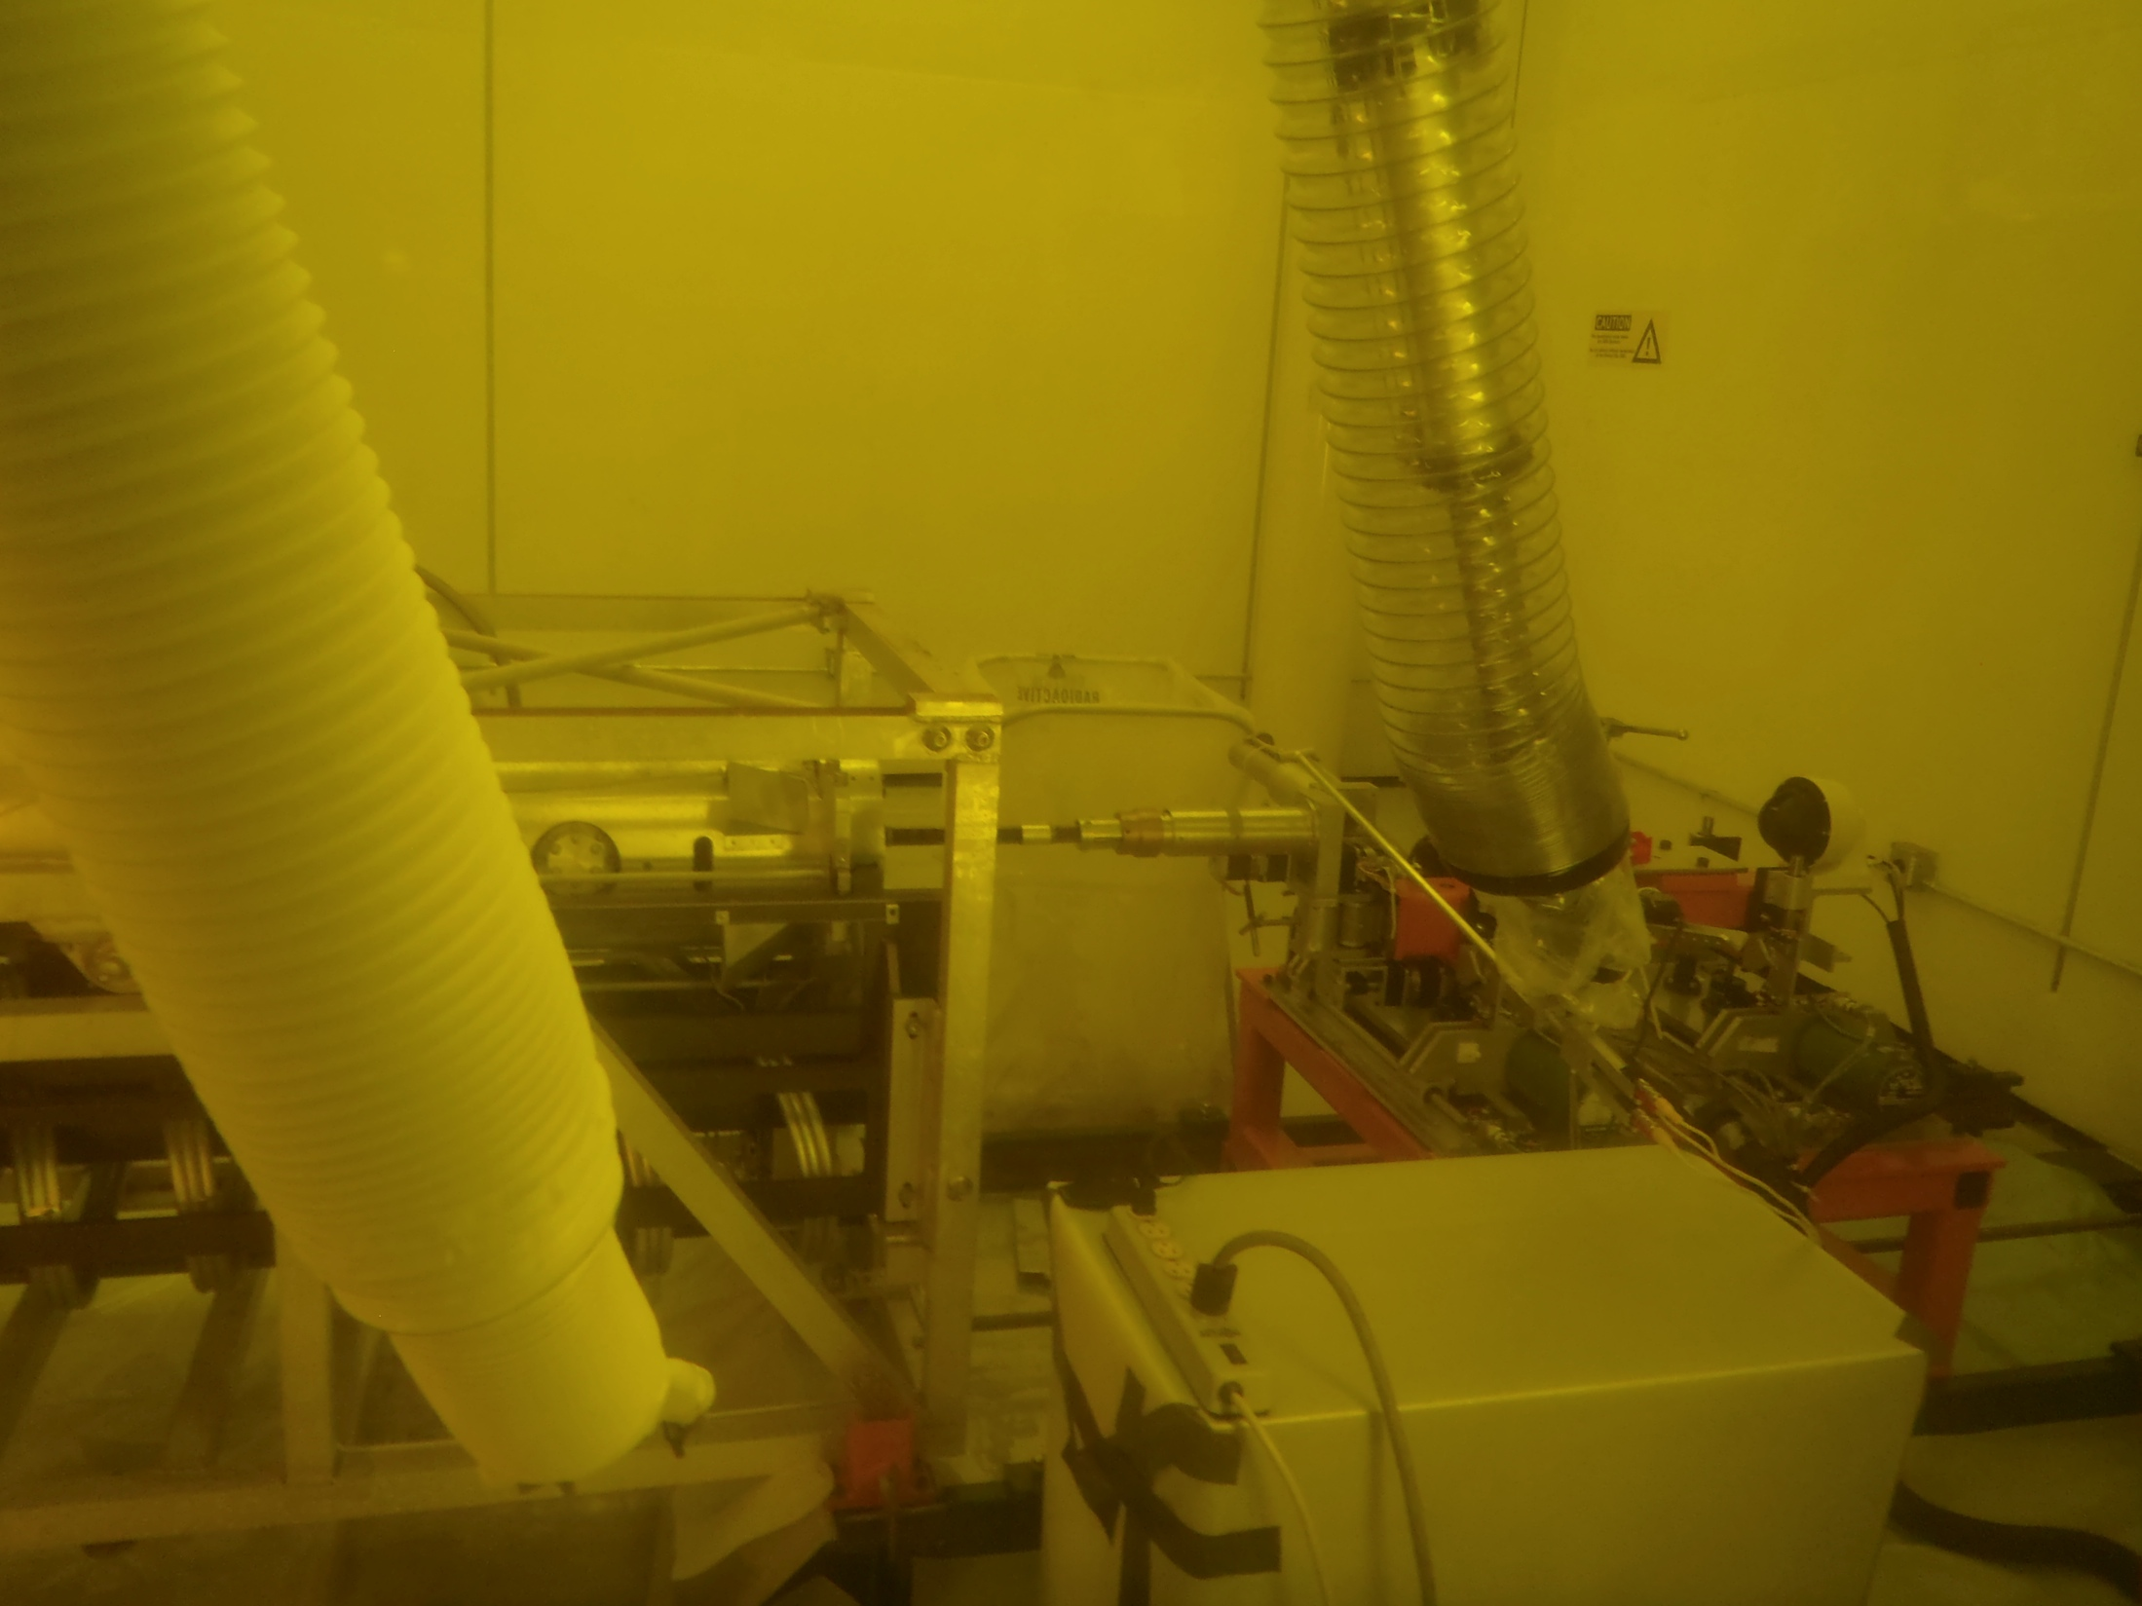
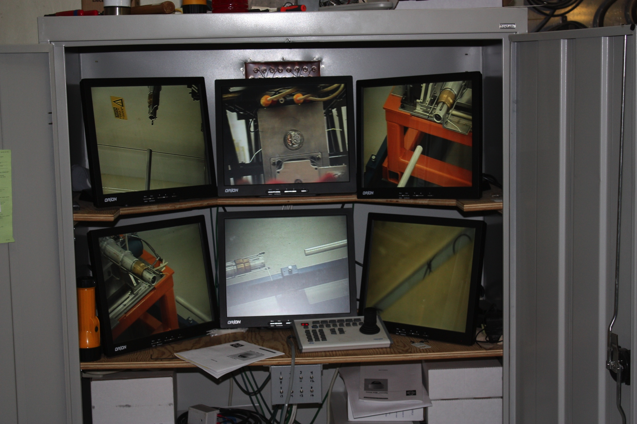
C0 RHF – Hot Cell
Mu2e Target Hall RH will be similar to C0 hot cell - contaminated environment, radioactive material
PPE & shielding required makes even the simplest task difficult
Cameras lack depth of field

Slide 10
Maintainability
Horizontal Scheme - Remote Handling Room
  Is inaccessible during beam operations
  Some equipment will be removed from the room
    Electronics only?
    Possibly entire robot
  Assembly-disassembly of contaminated robot is time consuming
  Any practice would have to be performed during shutdown
    or on separate practice robot ($$$)
  This setup will increase operational downtime

Slide 11
Maintainability
Overhead Scheme - Remote Handling Area
  Likely Accessible during beam operations
  This probably allows for activities during operations
    Assembly/disassembly
    Repairs, alterations
    Practice time!!!
  Minimizes operational downtime

Slide 12
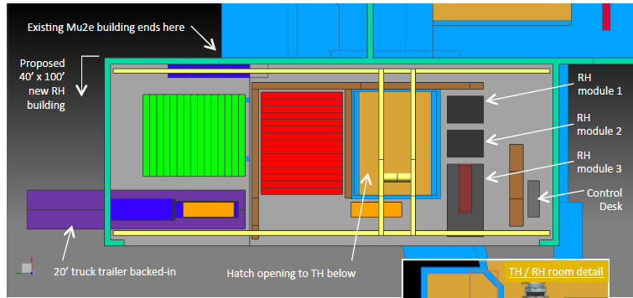
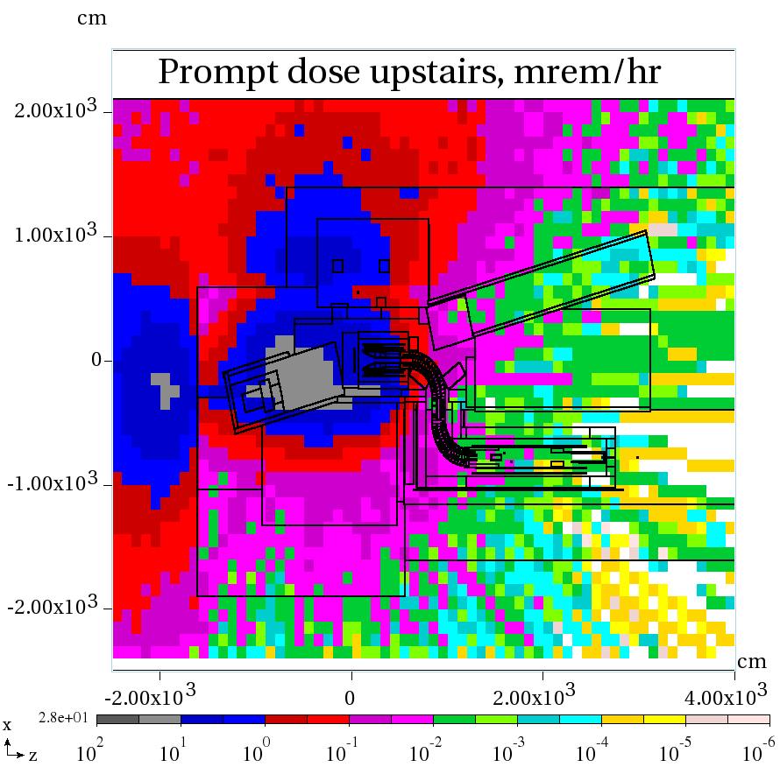
Operating Notes – vertical scheme service building access
Yellow box indicates remote
handling equipment service area
Prompt dose rate 0.1- 3 mrem/hr
Occupancy at the discretion of AD ES&H
Requires radiation work permit

Slide 13
Target Change-out Time
 | Horizontal | Overhead
Cool down & shield block removal | 5 | 5
Install robot, controls, assembly, calibrate | 6 | -
Operator training, practice, adjustments | 5 | -
Target change | 3 | 6
Dismantle robot, controls, electronics | 4 | -
Reinstall blocks, hatch | 2 | 4
Days | 25 | 15
Weeks | 5 | 3
Overhead scenario allows access to robot during operations
  Assembly & disassembly not necessary
  Plenty of time for calibration, practice, adjustments, etc.

Slide 14
Maintainability
Conclusions
  Remote Handling systems
    take time to maintain
    take time to use due to contamination controls
    take practice to use effectively
  Overhead scheme will minimize operational downtime
    ~3 weeks for target change-out
  Horizontal scheme operations will take longer
    ~5 weeks for target change-out

Slide 15
Overhead Advantages
Target removal arm is non-telescoping
  Less complex, less likely to fail, easier to mitigate problems
Does not rely on floor level-ness
More easily allows for Convectively Cooled target
  horizontal robot is not designed for 10’ long target
  would be difficult to retrofit for CC target after area is contaminated
Overhead crane gives future flexibility
Likely allows building access during beam operations
  Robot/module setup, testing, operator practice time
PS magnetic field
  Overhead RH area estimates 10-30 Gauss
  Horizontal RH area estimates 50-250 Gauss

Slide 16
Horizontal Advantages
Costs less by $1.25M

Slide 17
Comparisons: Costs, Risks & Maintainability
Costs
  Overhead scheme increases TPC by $1.25M
Technical Risks
  Horizontal scheme has higher Impact of Mechanical Failure
Maintainability
  Overhead scheme will reduce change-out time due to probable access during beam operations

Slide 18
Charge to Review Committee
Horizontal Scheme
  Is baseline (horizontal) technically sound?
    Risks, contingencies, radiological hazards been addressed?
Overhead Scheme
  Is alternative (overhead) technically sound?
    Risks, contingencies, radiological hazards been addressed?
    Are there significant advantages to warrant increased cost?
Complete assessment of both schemes
  not necessarily a choice or preference
Ask for committee to meet and submit questions by 5:00
  Design team will respond to questions Wednesday morning

