Slide 1
Mu2e Remote Handling Review Radiological Issues
Tony Leveling
March 3-4, 2015

Slide 2
Outline
Facility radiation dose rates (sans major sources)
PS Room
Remote Handling Room
Major radiation sources
Air flow
During operations
During remote handling operations
Contamination sources
Radiation Protection – entry controls
Operating notes
Summary
Note: All radiation dose units are in the format mrem/hr (mSv/hr)

Slide 3
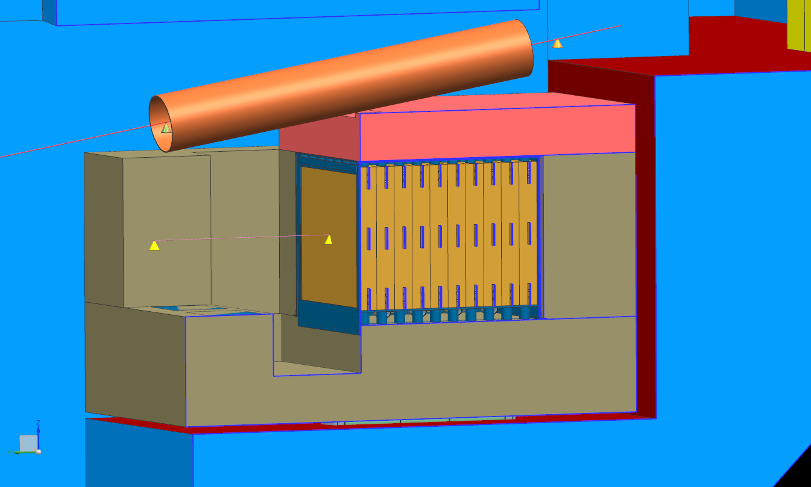
Elevation View
Transport
Solenoid
(not shown)
Drop
hatch
Production
solenoid
16’
Beam
Dump
17’
7.6’
9.3’
24’

Slide 4
Plan view - Facility radiation dose rates (sans major sources)
At beam elevation – 7.6’ from the floor
0.02 (0.0002)
0.01 (0.0001)
Robot staging area
0.5 (0.005)
5 (0.05)
0.5 (0.005)
hourly dose rates
at wall surfaces
365 d irr., 7 d cooling
0.04 (0.0004)
16 (0.16)
SS door
0.04 (0.0004)
1 (0.01)
0.8 (0.008)
0.3 (0.003)
5 (0.05)
25 (0.25)
250 (2.5)
If a concrete door is substituted for
The SS door, dose rate at door would
be similar to the RHR wall
0.2 (0.002)
50 (0.5)
Source: V. Pronskikh
MARS run129
100 (1)

Slide 5
Plan view - Facility radiation dose rates (sans major sources)
At floor elevation
0.005 (0.00005)
0.005 (0.00005)
0.02 (0.0002)
0.01 (0.0001)
0.05 (0.0005)
0.01 (0.0001)
0.4 (0.0004)
0.01 (0.0001)
0.03 (0.0003)
0.1 (0.0001)
hourly dose rates
at floor surfaces
365 d irr., 7 d cooling
1.6 (0.016)
0.5 (0.005)
0.2 (0.002)
0.2 (0.02)
1 (0.01)
3 (0.03)
5.8 (0.058)
5 (0.5)
Source: V. Pronskikh
MARS run129

Slide 6
Plan view - Facility radiation dose rates (sans major sources)
Robot setup
Significant preparation time in yellow zone
Several people
Several shifts
Significant collective dose in 16 mrem/hr (0.16 mSv/hr field)
Change door from SS to concrete to reduce collective dose
Robot
preparation zone

Slide 7
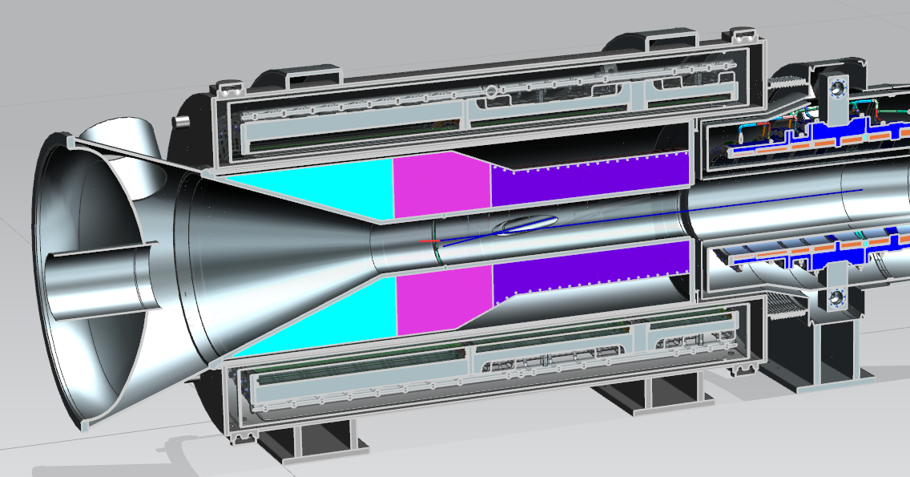
Major Sources – tungsten target
Source: V. Pronskikh
MARS
Tungsten target
460 Ci (1.7E13 Bq)
1350 isotopes
330,000 rem/hr (3.3 kSv/hr) @ contact
210 rem/hr (2.1 Sv/hr) @ 1 foot
19 rem/hr (0.19 Sv/hr) @ 1 meter
In situ
Tungsten target is well shielded by the HRS
Small dose contributor to end cap region
Little to no effect on dose rates in the PS room

Slide 8
Major sources – end cap & vacuum window
Source: V. Pronskikh
MARS run129
Vacuum window @ contact
Separated from PS
1 to 7 rem/hr
(10 to 70 mSv/hr)
In situ end cap @ contact
32 rem/hr (321 mSv/hr)
Preliminary results based upon a previous end cap design
The latest design has 10 x thinner windows
Vacuum window dose rate should be lower!

Slide 9
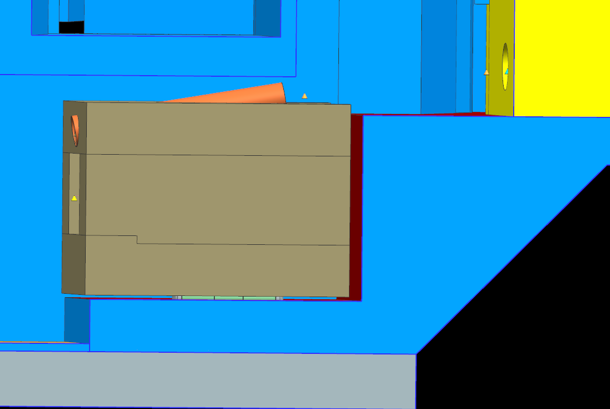
Major Sources – beam dump (beam entrance face)
2 to 3 rem/hr (20 to 30 mSv/hr)
Source: V. Pronskikh
MARS run129
6’
30 rem/hr (300 mSv/hr) at contact

Slide 10
Air flow during operation – supply air comes from a common source
Air pressure in DS room
to exceed pressure in PS room
Ensures activated air does not
enter the DS room
Air flow decay path
Air dam w/HEPA filter
100 cfm supply
air to RHR
Air dam
800 cfm supply
air to beam dump
800 cfm
Leakage paths

Slide 11
Air flow during target change out – horizontal scheme
Normally closed doors
Air dam open for coffin moves
Air dam
~500 cfm supply
air to RHR
0 cfm supply
air to beam dump
Leakage paths

Slide 12
Air flow during target change out – vertical scheme
Air flow
Fan must be placed away from PS magnetic field
Air dam with
HEPA filter
Air flow
Fan
air duct
Control of air flow for the vertical scheme requires this additional fan and duct. The duct
could also be employed for the operational mode and the horizontal scheme.

Slide 13
Surface Contamination Sources – RHR
Contamination issues in the Remote Handling Room are very unlikely unless the robot tracks it in
Engineered controls for ventilation limit activated air infiltration from the PS room
Used targets and vacuum window should never be returned to the RHR
AD ES&H department radiation protection group will monitor/control traffic between the PS and RH rooms to prevent spread of contamination

Slide 14
Surface Contamination Sources – Production Solenoid Rm
PS room surfaces
0.5 to 250 mrem/hr
Experience-based relationship exists between:
the possibility of surface contamination on walls and floors and
residual dose rates of those surfaces
AD checks for surface contamination on floors when residual dose rate exceed 100 mR/hr (1 mSv/hr) @ 1 foot from beam line components
Measureable contamination is nominally not expected until ~500 mR/hr (5 mSv/hr) @ 1 foot from components
Expect mild contamination at the west wall surface at 7.6’ from floor (~nCi/100cm²)

Slide 15
Surface Contamination Sources – beam dump
Supply air is filtered and dried
Exhaust air velocity 33 ft/min (10 m/min)
Air cooling flow is around the outside surfaces of the 1.5 m x 1.5 m x 2 m mass
Air mixing between steel plates is not prevented
Main air flow is over surfaces with lowest specific activity
Dump steel is to be painted, no rusted surfaces
Peak temperatures should not lead to thermal degradation of paint
Paint on entrance surface could eventually become radiation damaged
Albedo trap should provide fallout region for any air-entrained particulates

Slide 16
Surface Contamination Sources – beam dump
Primary emission for exhaust should be
C11
N13
O15
Other short-lived isotopes
Ar41
Be7 will be produced as spallation product in air
Primarily deposited in HEPA filter at air dam
Other gaseous isotopes will pass through the HEPA filter
Directed to exhaust stack for decay during transit time
Expect contamination in the albedo trap, but contributes very little to general surface contamination in the PS room

Slide 17
Surface Contamination Sources
End cap and vacuum window
Expect surfaces to be contaminated
Multiple nCi/100 cm²
Would not expect contamination from these surfaces to spread except by physical contact

Slide 18
Surface Contamination Sources
Target
460 Ci (1.7E13 Bq) after 1 year of operation
Expect extremely contaminated target surface
Extreme care required for target handling
Post operation surface condition is difficult to predict
Could range from reasonably intact to friable
Target coatings could
increase emissivity
Reduce target temperature
Reduce impact of poor vacuum
PS vacuum
Major factor
Target coating | Yes | No | No | Yes
PS vacuum quality* | Good | Good | Poor | Poor
Severity of contamination | bad | worse | Really awfully bad | worse to TBD
*poor vacuum > 1E-5 Torr > good vacuum

Slide 19
Surface Contamination Sources
Target handling considerations
prevent physical shock & rough handling
provide robust containment for target outside of PS
containment should accommodate a broken target, spokes, etc.
Catch basin, e.g., plastic bag, SS box, sticky pad, or similar to capture target detritus
Minimize air movement
move target into full containment as soon as practicable
Move target/containment to target coffin
Target coatings are promising, however
Coating degradation could eventually lead to
Target hot spots
accelerated corrosion
Good vacuum quality remains a high priority

Slide 20
Radiation Protection - Entry controls for the PS Room
Once mu2e beam operations begin, entry into the PS room will be under the exclusive control of the AD ES&H department radiation protection group
Work will be controlled by radiation work permit
Work is planned by target station engineers
Approval of work is by AD RSO, or in exceptional cases, by the Fermilab Senior Radiation Safety Officer
Pace of work is controlled by AD ES&H personnel
ES&H ensures adherence to:
radiological check points
radiation dose control
contamination control

Slide 21
Operating Notes - Aisle for coffin loading
The dose rate in the aisle for the coffin position < 1 mrem/hr
Staging/manipulating target/window coffins in the aisle is completely feasible for the horizontal scheme

Slide 22
Operating Notes – robot storage during operation
Majority of the robot structure may reside in RHR
Absorbed dose calculation is Si sample is 60,000 to 230,000 rad/year (0.6 to 2.3 kGy/y) (V. Pronskikh, MARS)
We typically assume service life degradation at 10,000 rads (100 Gy) for electronics
Radiation resistant LVDTs and resolvers remain on the machine
Electronic components are removable by quick disconnect cables prior to beam operation

Slide 23
Operating Notes – PS Room Access
It should be possible to shield the major sources in the PS room to allow personnel access
Stack shielding across PS window
Lift truck
3’ X 3’ X 6’ C blocks
Stack concrete shield in front of beam dump entrance
Such temporary shield arrangement would permit
PS alignment
Other off normal maintenance/repair activity
robot assistance

Slide 24
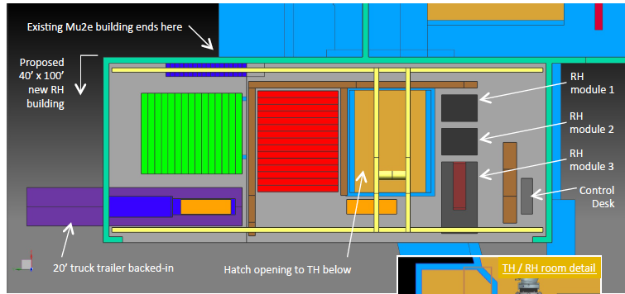
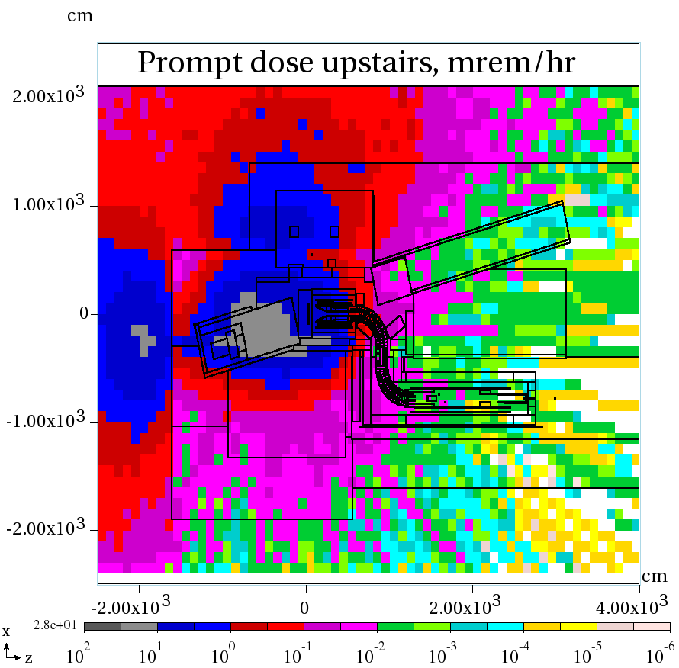
Operating Notes – vertical scheme service building access
Yellow box indicates remote
handling equipment service area
Prompt dose rate 0.1- 3 mrem/hr
Occupancy at the discretion of AD ES&H
Requires radiation work permit

Slide 25
Summary
Radiological parameters for the mu2e facility are within the range of experience and expertise of the Fermilab staff
Handling of the irradiated tungsten target will require extraordinary care considering its activity (460 Ci) and potentially fragile nature
Application of concrete shields at the PS window and beam dump should permit personnel access to the PS room under supervision of AD Radiation Protection Personnel

