Slide 1

Target Hall Overview
Rick Coleman
L3 Manager Target Station
3/3/2015

Slide 2
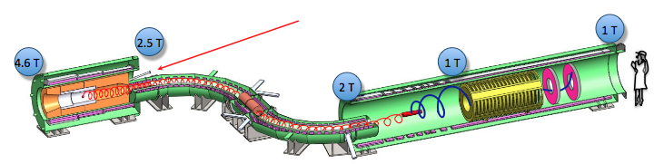
WBS 475.02.09 Target Station
The Target Station
  proton beam production target
  heat and radiation shield (HRS)
  target remote handling system
  proton beam absorber
  protection collimator
There is a WBS task for each of above, plus one for simulations and one for technical documentation (& general support)

Slide 3
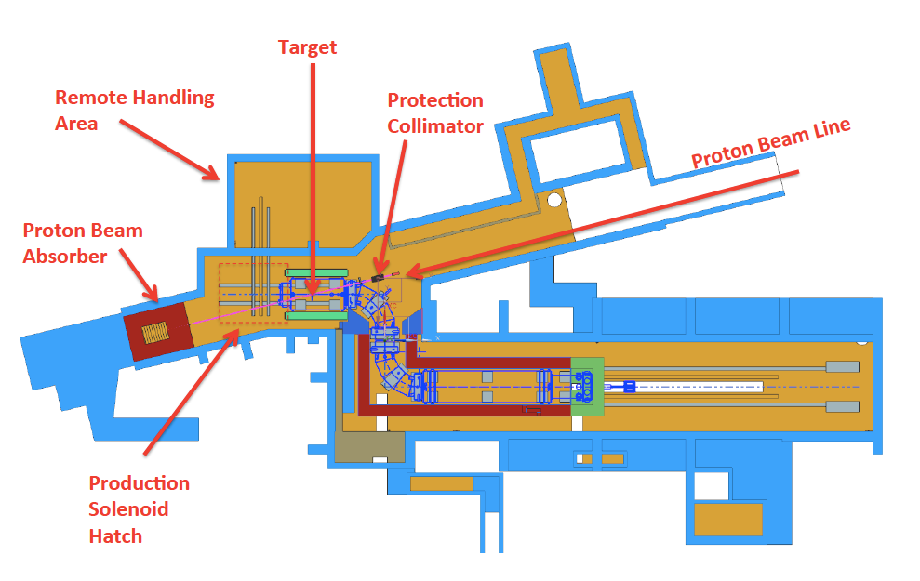
Overview of Layout

Slide 4
Requirements
Mu2e Proton Beam (see Steve's talk)
Production Target Requirements
  Maximize number of stopped muons (high Z material, small radius target and minimize target support structure material to reduce pion reabsorption)
  Target Lifetime > 1 year to minimize interruptions to experiment
  Target-Beam Alignment < 0.5 mm transverse, < 10 mr angle
Remote Handling Requirements
  Control Radiation exposures
  Preserve target alignment
  Handle window replacements as well
  Minimize Downtime- Replace target within time period of ~ one month (annual downtime expected)

Slide 5
Organizational Breakdown
WBS 475.02.09
Target Station
R. Coleman
R. Schultz (deputy)
WBS 9.3
Remote Handling
M. Campbell
AD/FNAL
WBS 9.4
HRS
L. Bartoszek
Bartoszek
Engineering
WBS 9.5
Proton Absorber
A. Stefanik
PPD/FNAL
WBS 9.6
Protection
Collimator
A. Stefanik
PPD/FNAL
WBS 9.7
PS Hatch
Blocks
R. Coleman
AD/FNAL
WBS 9.1
Simulations
R. Coleman
V. Pronskikh
AD/FNAL
WBS 9.2
Fabricate Target
C. Densham
Rutherford
Labs
WBS 9.8
Technical
Doc.
R. Coleman
AD/FNAL

Slide 6
Target Station Team
Steve Werkema, Vladimir Nagaslaev, Mike Campbell
- L2 Manager, Deputy and Engineer
Rick Coleman, Ryan Schultz
  L3 Manager, Deputy
Target- Rutherford High Power Targetry Group- Chris Densham, Peter Loveridge, Joe O'Dell, Roger Bennett, Otto Caretta
Remote Handling- Mike Campbell
Heat and Radiation Shield- Bartoszek Engineering- Larry Bartoszek
Proton Beam Absorber and Protection Collimator- Andy Stefanik
Simulations- V. Pronskikh, N. Mokhov, Y. Eidelman
Radiation Safety & ES&H – A. Leveling, M. Wolter, D. Hahn
Project Mechanical Engineer (Integration) - K. Krempetz
Muon Beamline L2 Manager- G. Ginther
University Collaborators- J. Popp, K. Lynch
Alignment- H. Friedsam

Slide 7

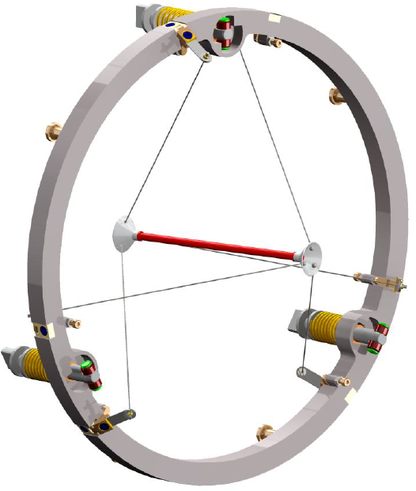
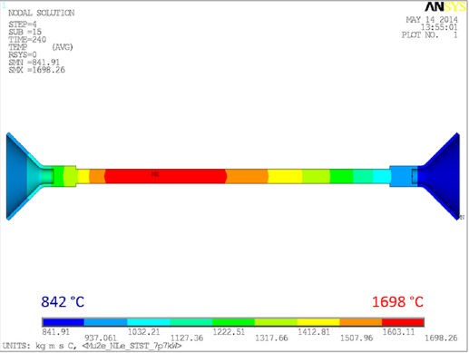
Target Design
Doc db 2406
68 pages,
August 2012
Tungsten Rod
L=16 cm r=3.2 mm

Slide 8
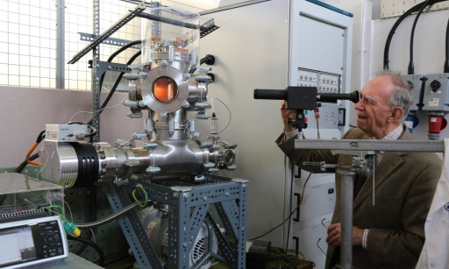
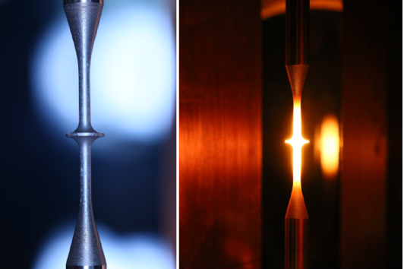
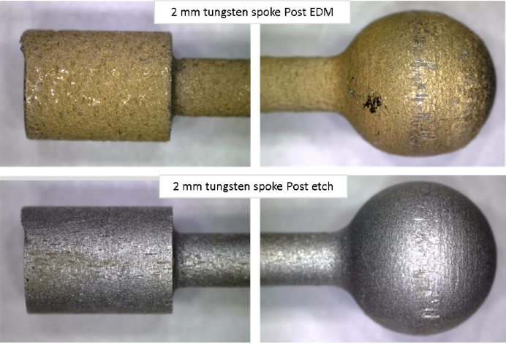
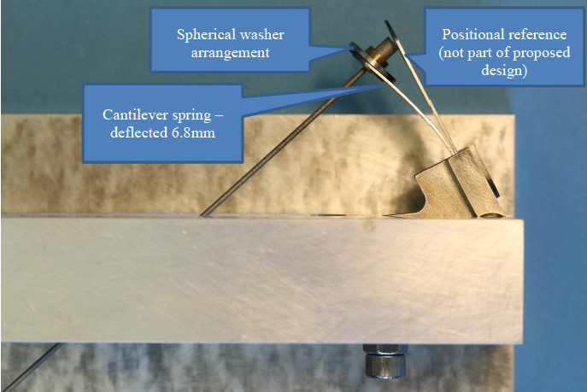
Target Design/R&D
STFC Rutherford Appleton Laboratory
High Power Targets group
Completed Design, Testing, and Prototype work
  Design shown on previous page
    spoke tensioner, support ring detailed work
  Measurements
    vacuum vessel and equipment setup for testing
    emissivity measurements at high T (5% verification of literature)
    lifetime pulsed heating tests (fatigue)- OK for 4 years equivalent
  Study of Creep in the Target Support- 6 micron elongation OK
  Spoke Prototyping (manufacturing, spring tests, adjustments)
  Literature Study of Target Material Recession due to Oxidation
    Literature =>1e-5 Torr OK, quick, crude measurement done at 1e-3 Torr showed not good enough
June 2014 Report, 82 pages

Slide 9
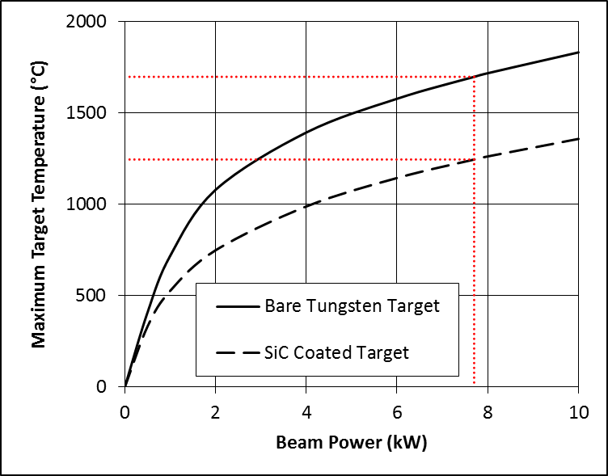
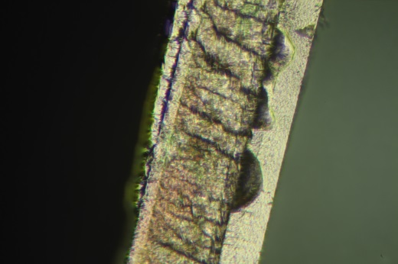
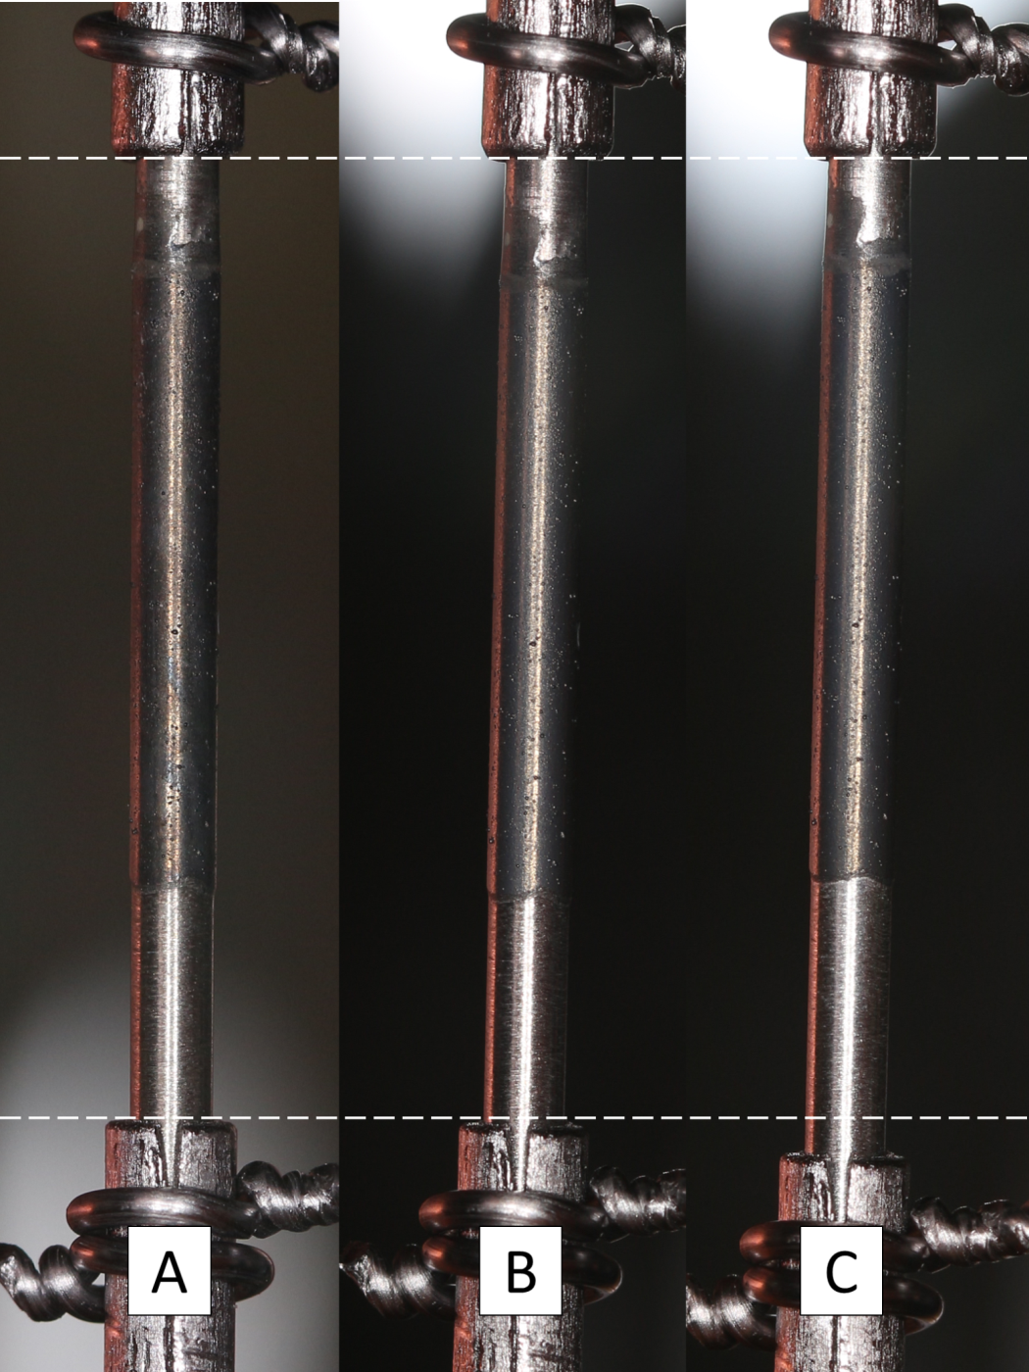
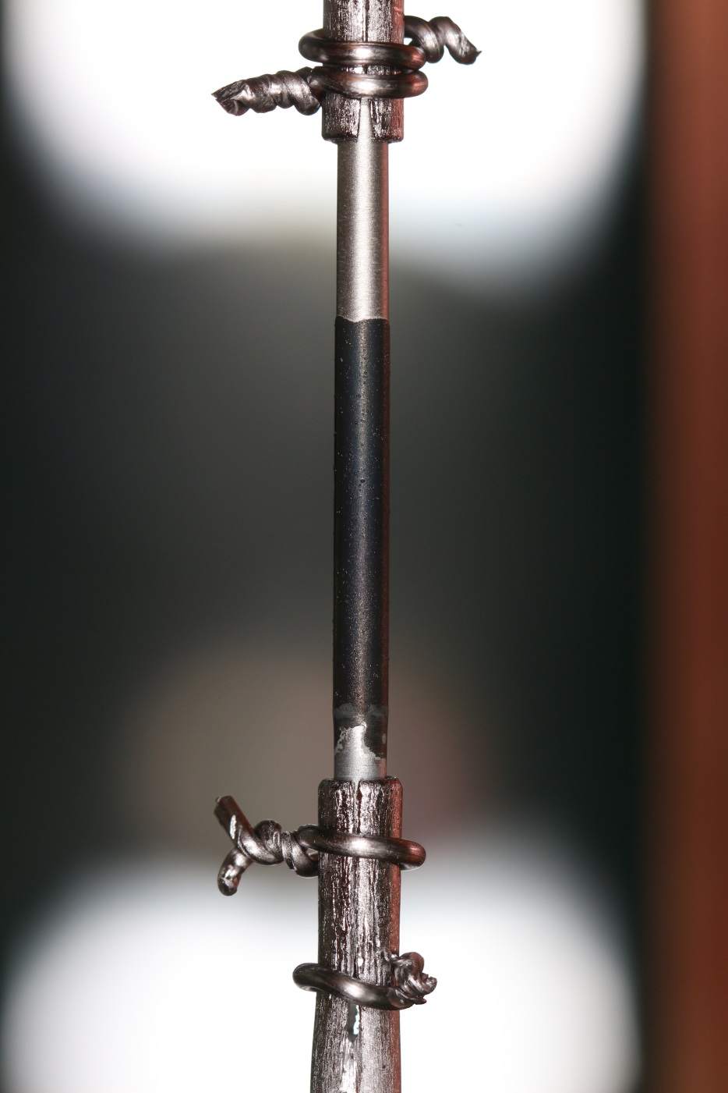
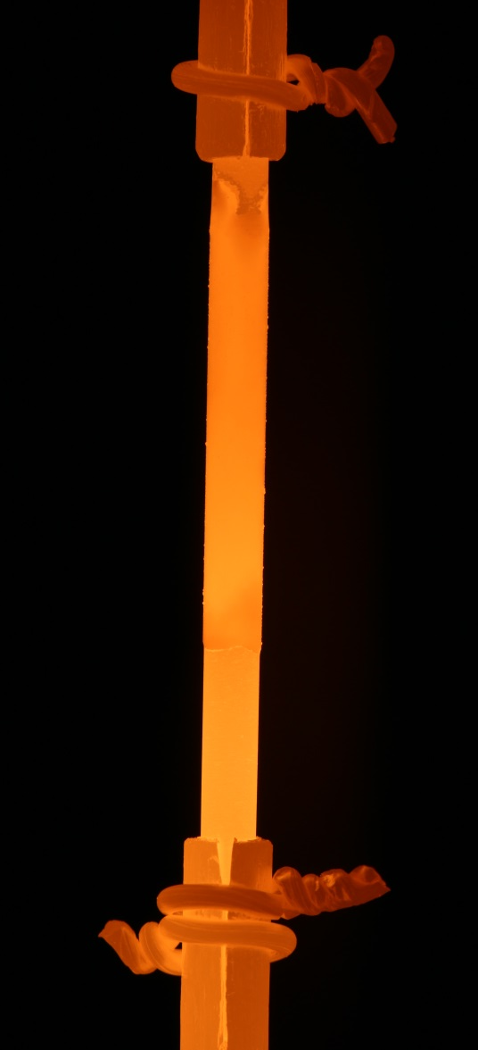
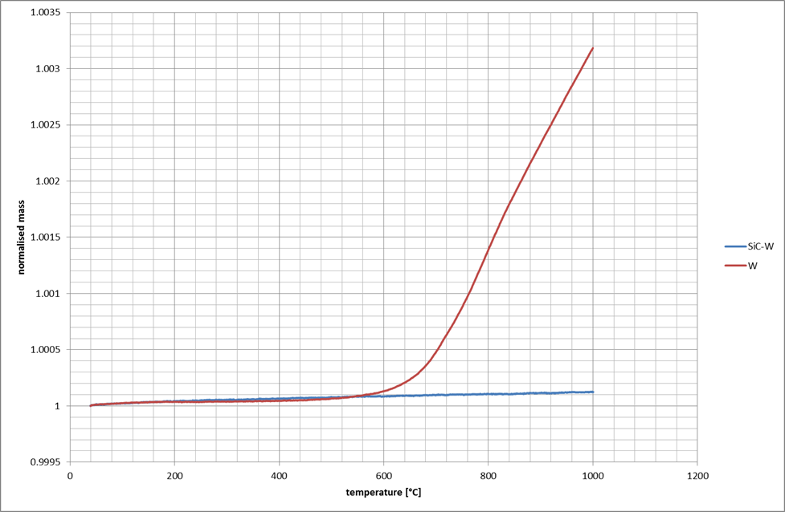
Target Design/R&D
Work started Fall 2014
  Tungsten tests in medium vacuum (10⁻⁴ to 10⁻⁵ Torr)
  SiC coating/surface/oxidation/fatigue R&D, including:
    Various surface treatment/coating R&D
    Emissivity measurements of surface coatings
    Medium vacuum (10⁻⁴ to 10⁻⁵ Torr) lifetime testing
    Pulsed current fatigue testing for shaped test samples (horizontal test)
  High temperature creep testing of spokes and spring tensioners
  He cooling feasibility study and preliminary plant specification
  Optimization of end joints
Baking 40 days
1700 C
Voids in
coating
1250 C
W
SiC
TGA
W
500 C in air
coated
Thermal Cycles 1500 C

Slide 10
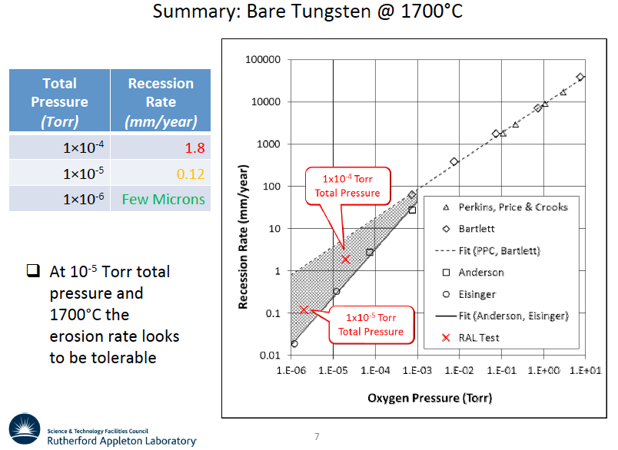
Target Design/R&D – Jan 26 test results
Voids in
coating
W
SiC

Slide 11
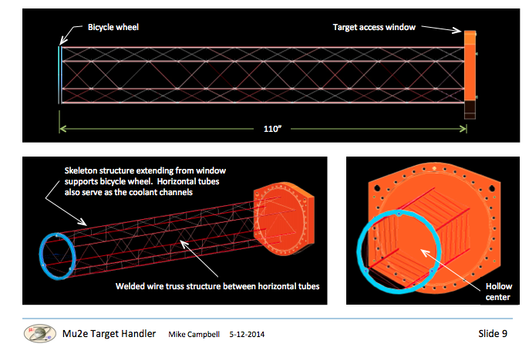
"So far so good" on Radiative Cooled Target but......
Backup: He cooled Target as shown below, viable in vertical scheme only, more later

Slide 12
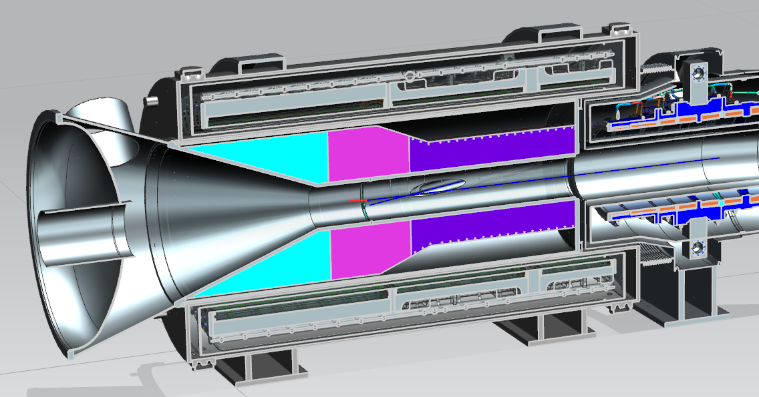
Heat & Radiation Shield (HRS)
Bartoszek Engineering
Target
Water
1.5 m
Bronze
Bronze
Water
Bronze
4 m
12
7/8/14

Slide 13
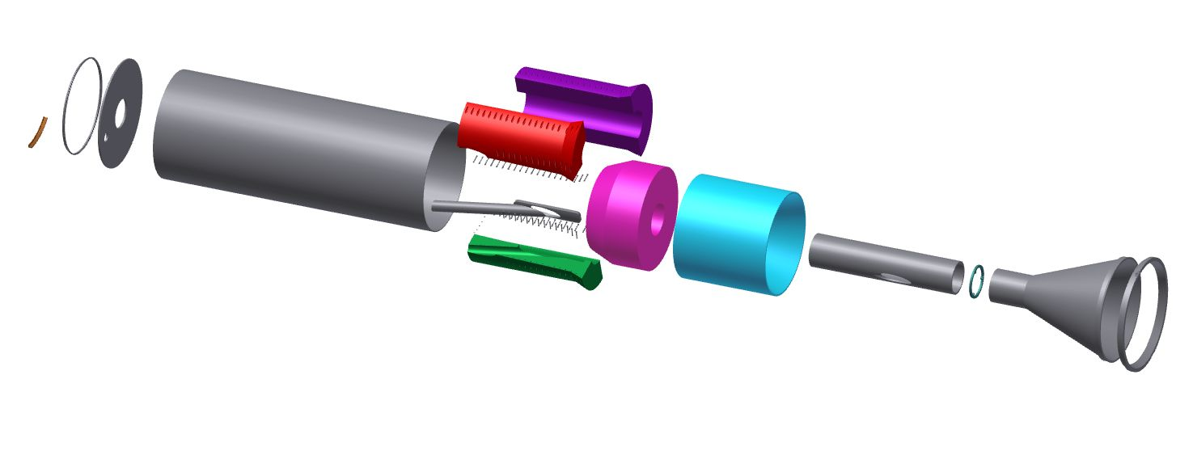
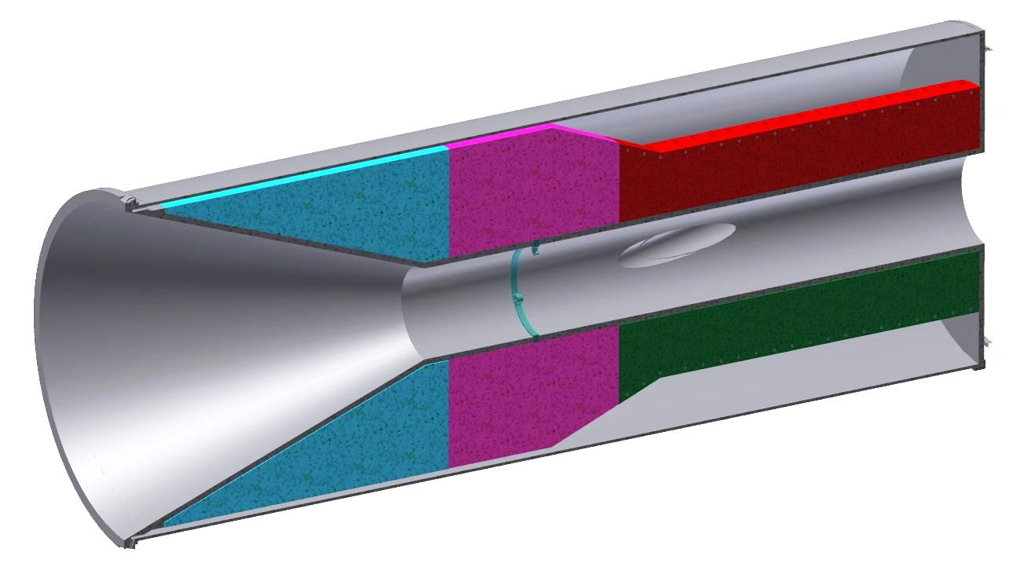
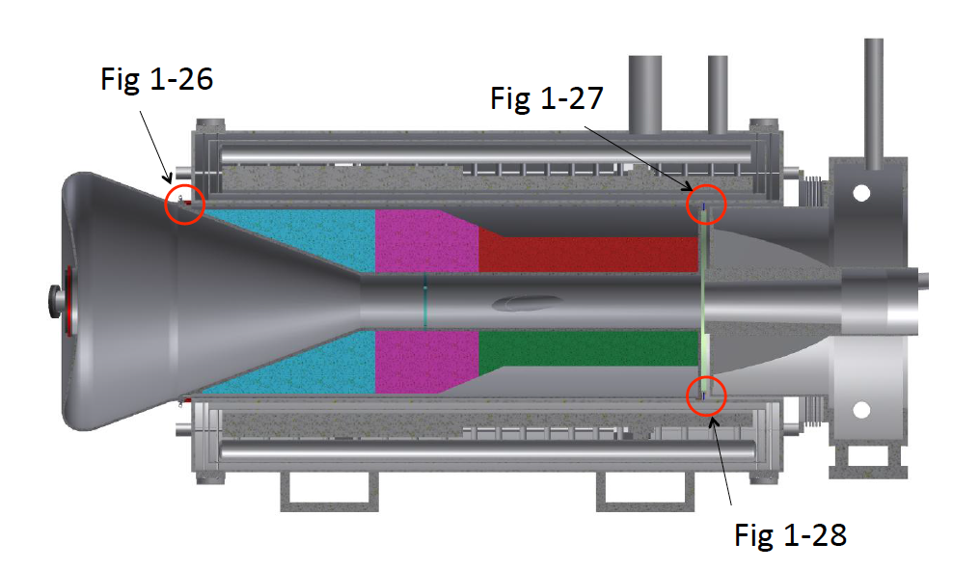
Heat & Radiation Shield (HRS) Details
Figure 4.179
Figure 4.180
Figure 4.181

Slide 14
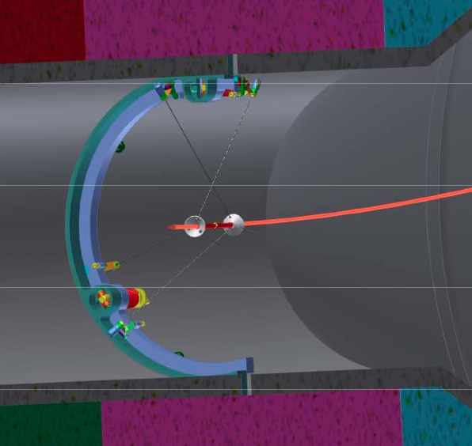
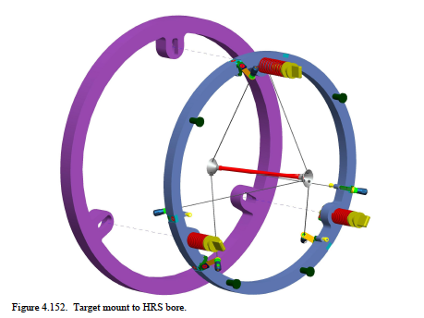
Target Mount Ring in HRS

Slide 15
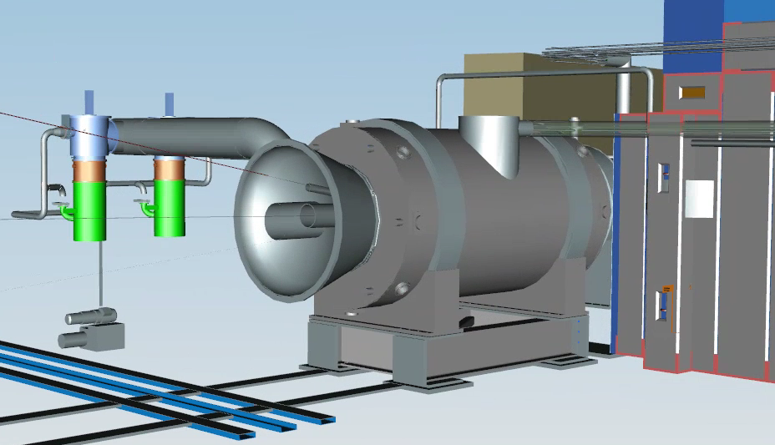
Exit Windows- On-Axis, Proton Beam, Extinction Monitor
On- Axis d=20"
Beam d=16"
Extinction d=4"

Slide 16
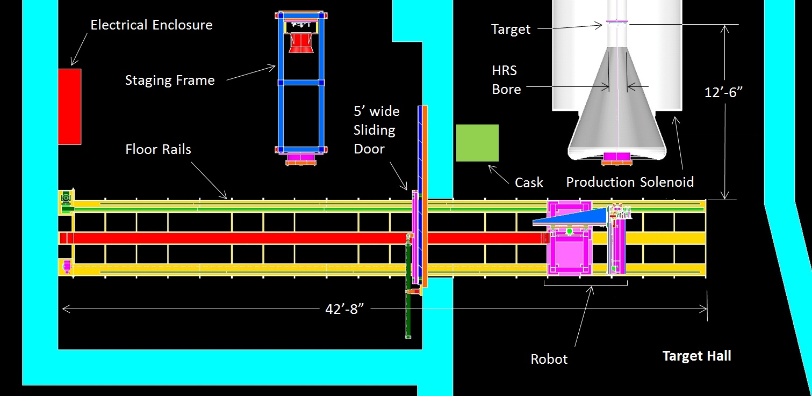
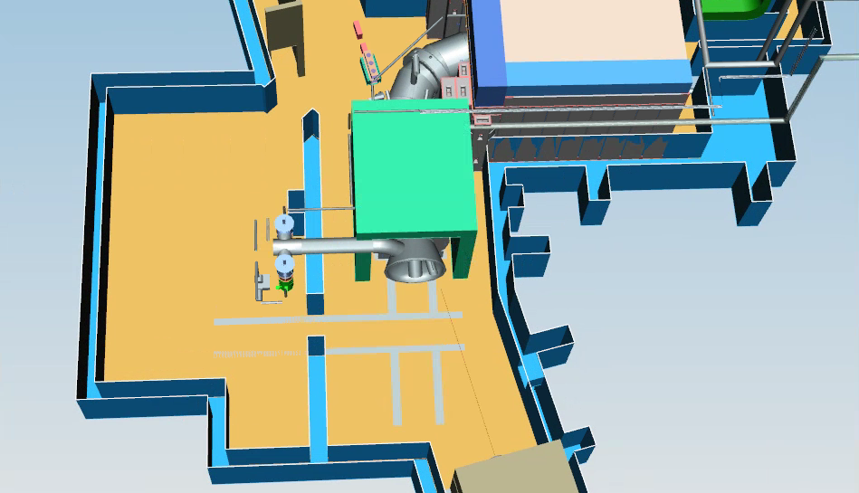
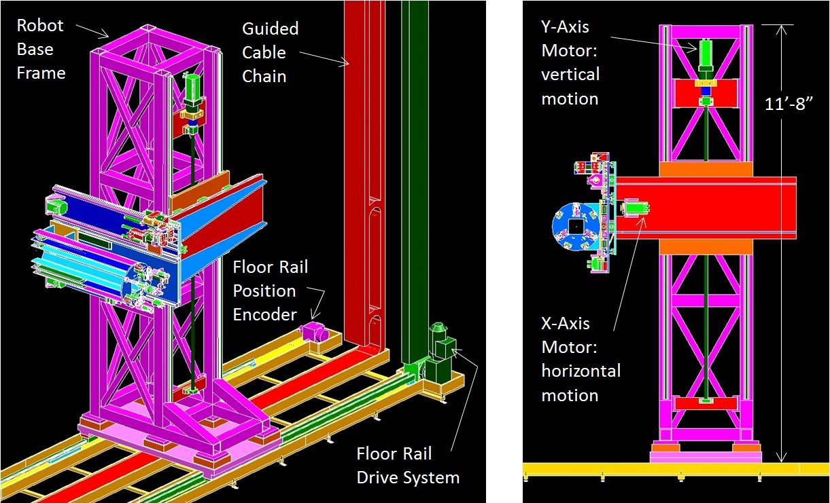
Target Remote Handling Design
see Mike Campbell's talk

Slide 17
Summary from Fall 2014 CD-2/3b Review
The Target Station Design is well integrated with the Solenoids, Muon Beam line, Civil Construction, and Radiation Safety
A preliminary design is complete
A review and choice is needed on the remote handling scheme
R & D is well underway to decide on target choice- radiative or convection cooled
We are ready to baseline our schedule

Slide 18
Backup Slides

Slide 19
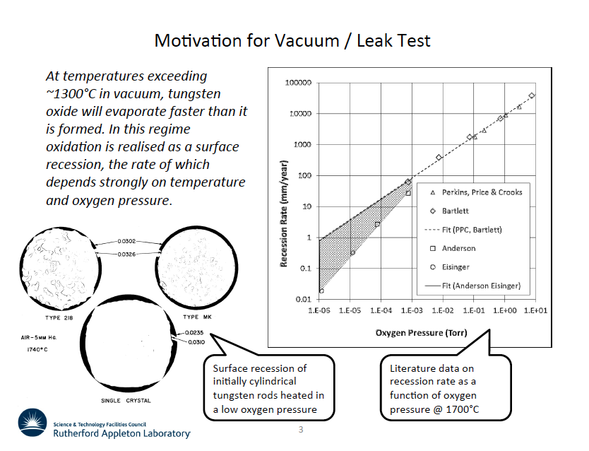

Slide 20
Cost Table
 | Base Cost (AY K$)
 | M&S | Labor | Total | Estimate Uncertainty (on remaining budget) | % Contingency on (on remaining budget) | Total Cost
475.02.09.01 Simulations and Calculations | 67 | 1,329 | 1,396 | 171 | 31% | 1,567
475.02.09.02 Fabricate Target | 1,863 |  | 1,863 | 497 | 41% | 2,360
475.02.09.03 Target Handling | 1,177 | 1,457 | 2,634 | 777 | 33% | 3,410
475.02.09.04 Production Solenoid Heat & Radiation Shield | 2,632 | 200 | 2,831 | 875 | 32% | 3,706
475.02.09.05 Target Station Proton Beam Absorber |  | 57 | 57 | 14 | 53% | 71
475.02.09.06 Solenoid & HRS Protection Collimator | 126 | 201 | 326 | 128 | 42% | 454
475.02.09.07 Hatch Shielding Blocks |  |  |  |  | n/a
475.02.09.08 Technical Documentation |  | 1,240 | 1,240 | 245 | 22% | 1,485
Grand Total | 5,863 | 4,483 | 10,346 | 2,706 | 32% | 13,053

Slide 21
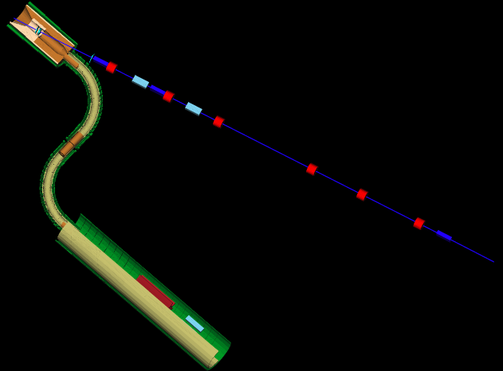
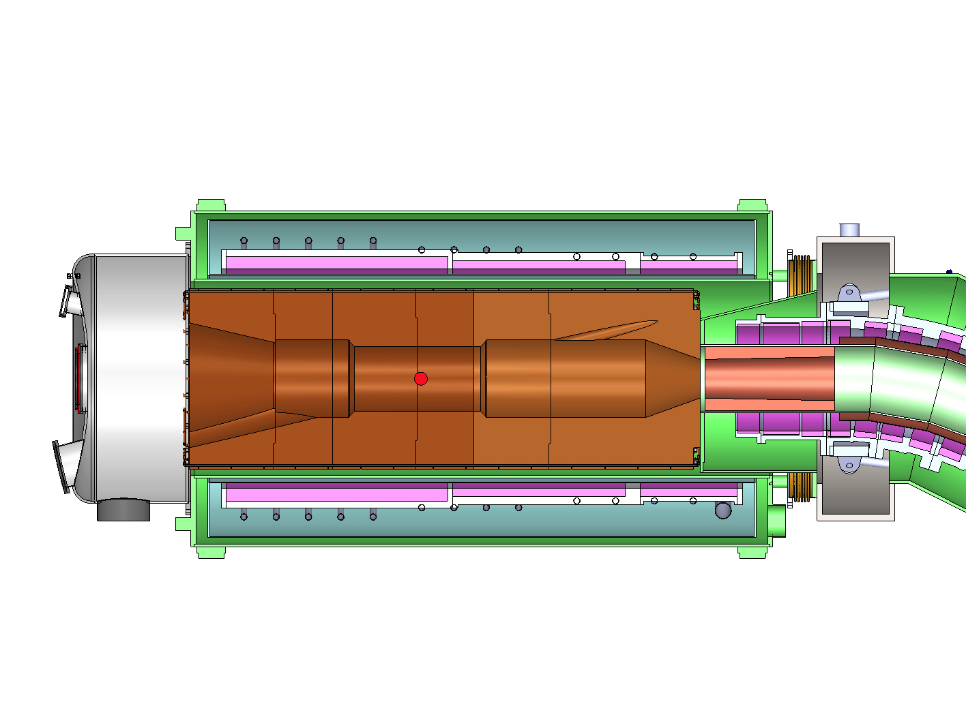
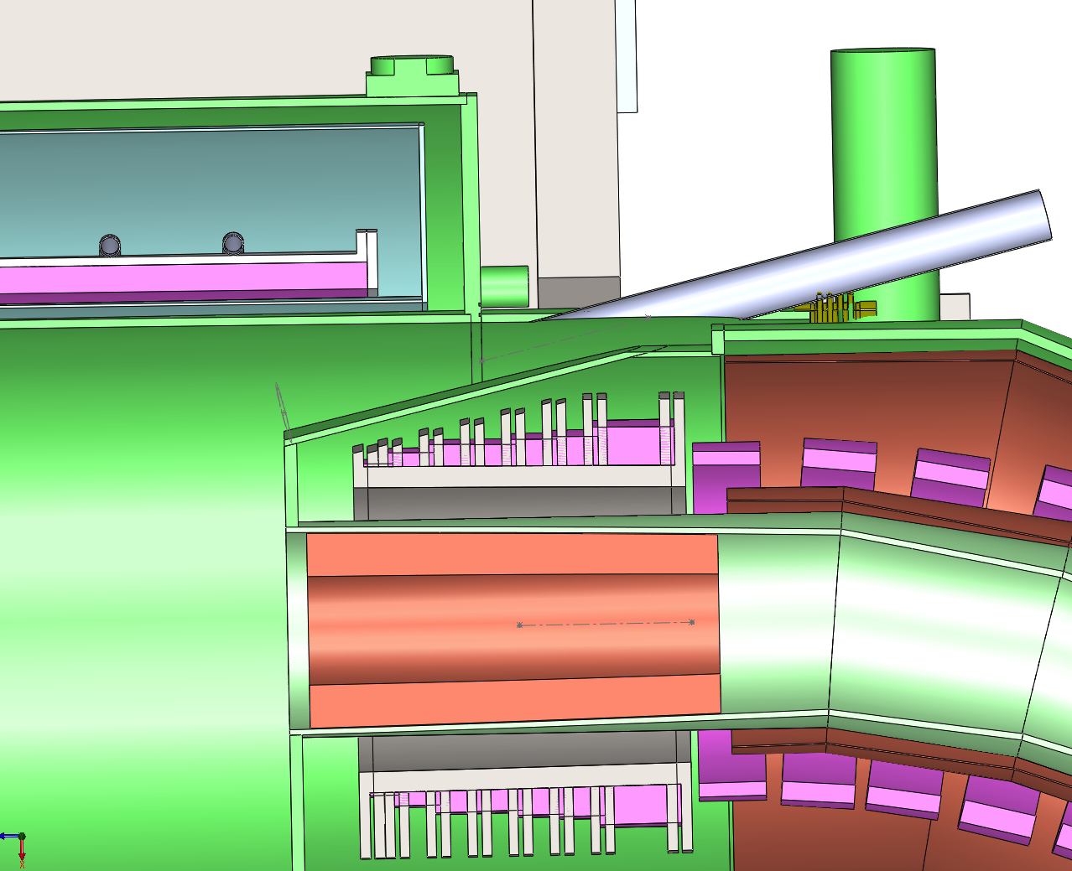
Proton Beam Through Solenoids
T. Page

Slide 22
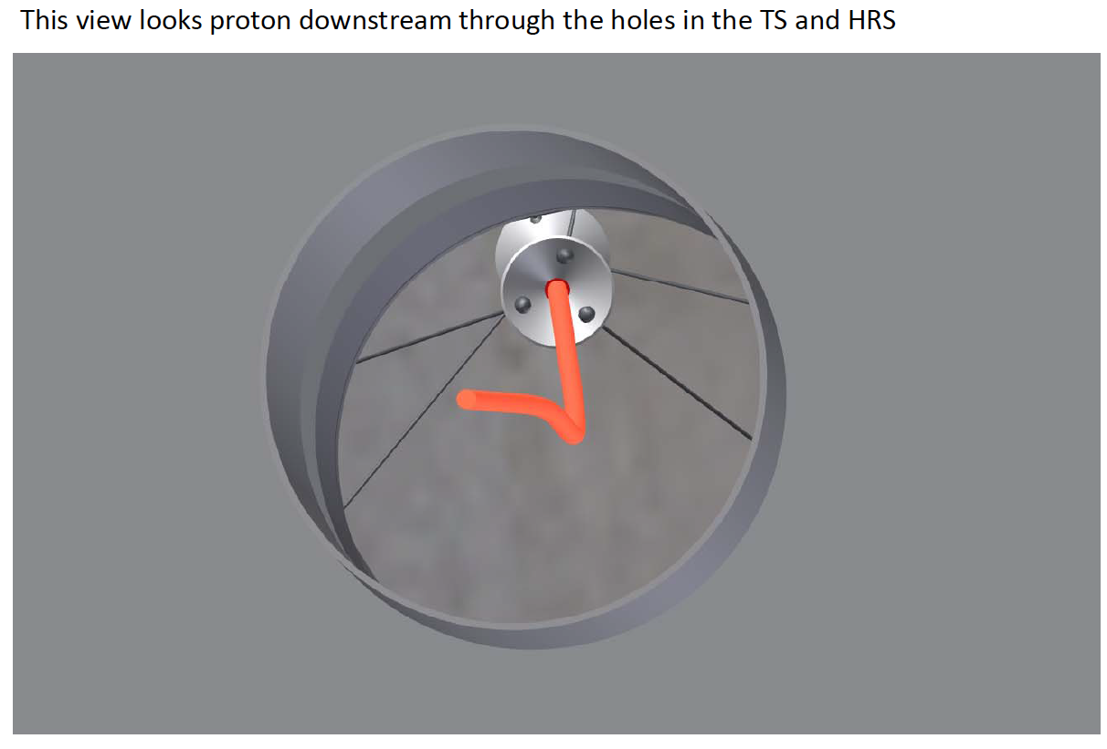
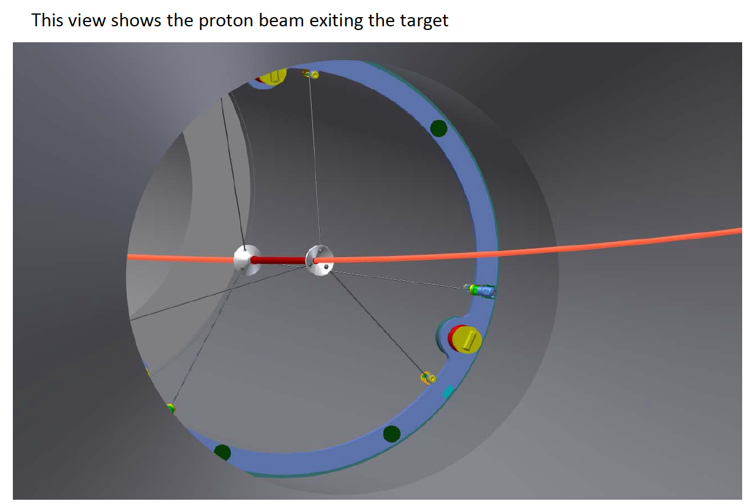
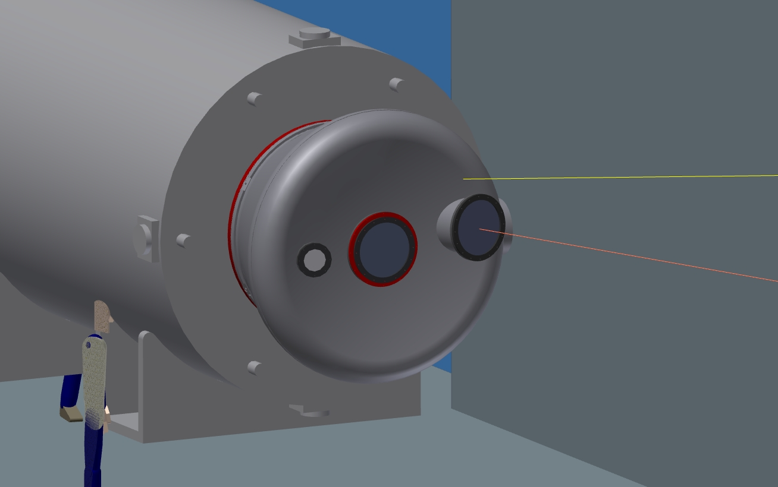
Proton Trajectory in Engineering Model
L. Bartoszek
Check of Trajectory
Other checks by:
A. Stefanik
T. Page
J. Brandt
PS endcap
Beam trajectory

Slide 23
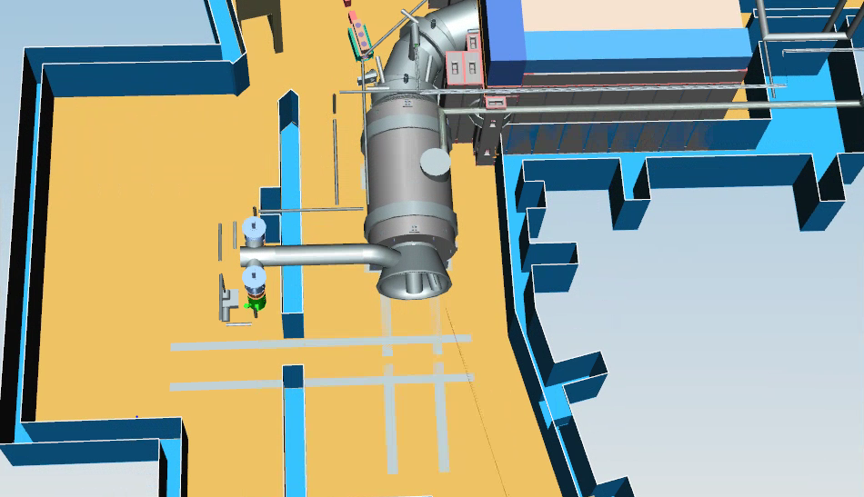
PS without Concrete Shield

Slide 24
Target Alignment/Tolerances Summary
Target dimension tolerances
Target Length = 16 cm ±2 mm
Target Radius = 3 mm ±0.1 mm
Alignment of target with respect to PS/HRS
Replacement target positioning repeatability: ±0.25 mm
Transverse placement w/resp. to PS axis: ±5 mm
Longitudinal placement along PS axis: ±10 mm
Alignment of target with respect to the proton beam:
Transverse beam positioning requirement: ±0.5 mm
Horizontal and vertical angle alignment: ±0.2°

Slide 25
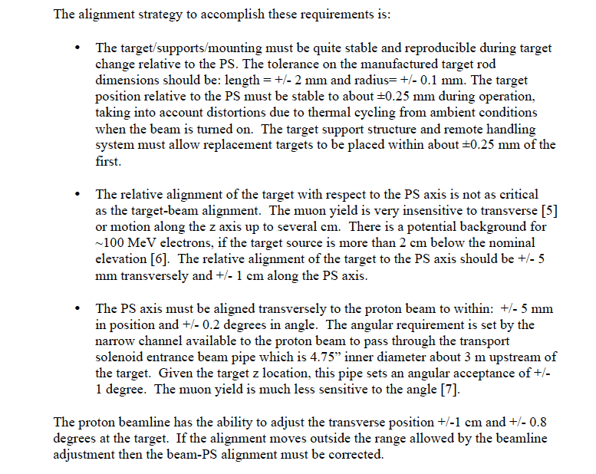
Alignment Details

