Slide 1
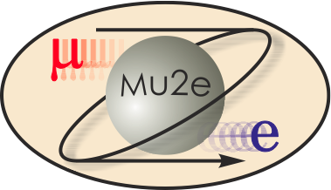
Mu2e Remote Handling Review Remote Handling Overview
Ryan Schultz
Deputy L3 Manager Target Station
3/3/2015

Slide 2
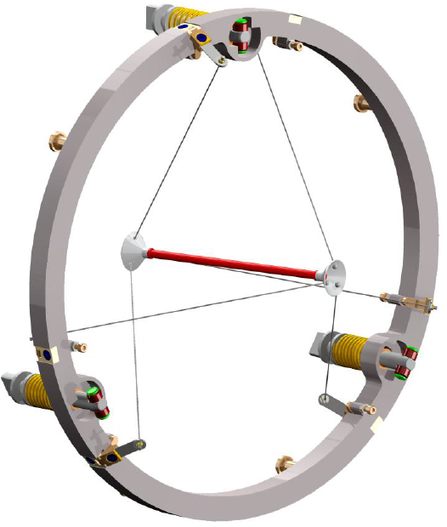
Remote Handling Overview
~210 R/hr @ ft
Design lifetime of 1 year
Radiatively cooled:
higher temps, corrosion
Convectively cooled:
cooler temps
higher complexity

Slide 3
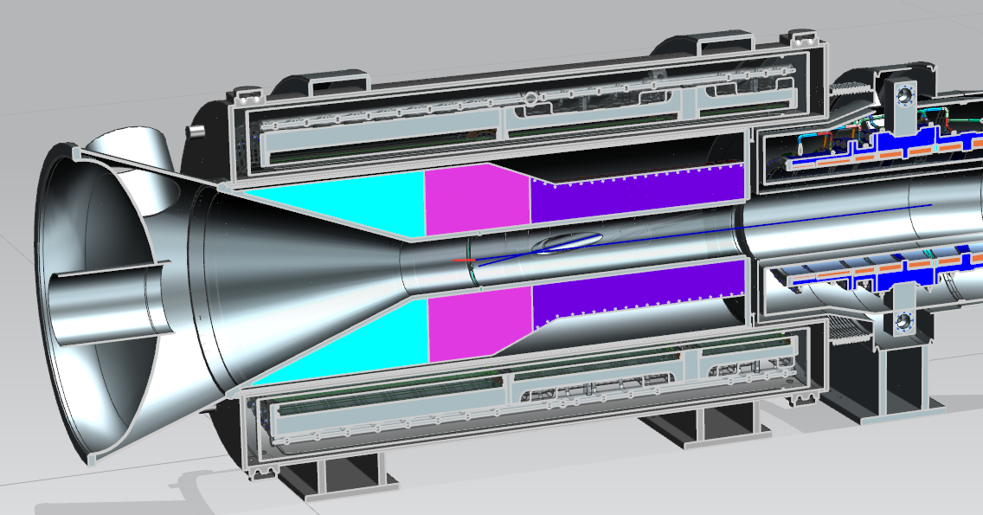
Remote Handling Overview
Target
10’
3

Slide 4
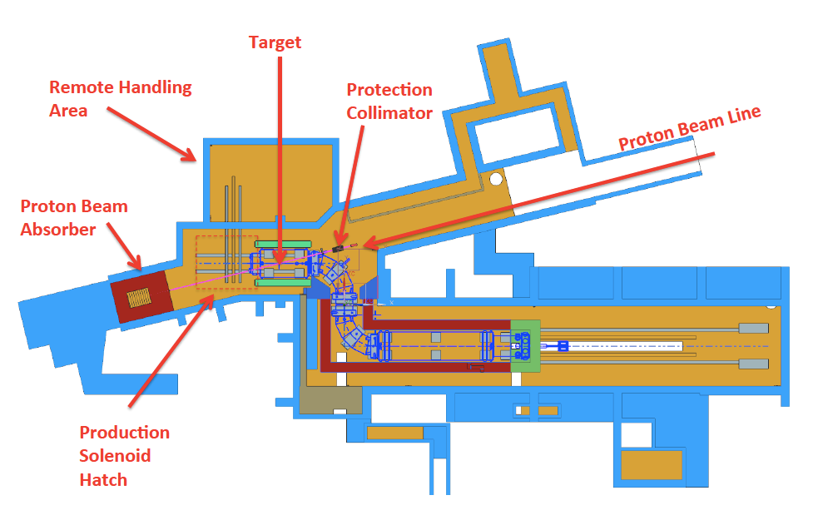
Remote Handling Overview
Horizontal Scheme
M4 Line
Overhead Scheme

Slide 5
Remote Handling Overview
Technical Design Report (2014)
Leave used components in cask within Target Hall
targets, windows, etc.
finite capacity
Used Components:
will be removed from the Target Hall in a cask
Horizontal Scheme cask removed via M4 line
Overhead Scheme cask removed via PS Hatch
Advantages of removing components from target hall:
Simplifies cask designs, reduces failure probability
Allows for infinite target change-outs
<- Outdated

Slide 6
Remote Handling Overview
Production Solenoid is a cryostat under vacuum
General Target Replacement Steps:
Vent and remove the window
Remove target – reaching in 10’
Place target into cask
Remove cask from area
Install new target
Install new window
Achieve appropriate vacuum level

Slide 7
Horizontal Scheme
M4 line
Remote Handling
& Vacuum Room
Target

Slide 8
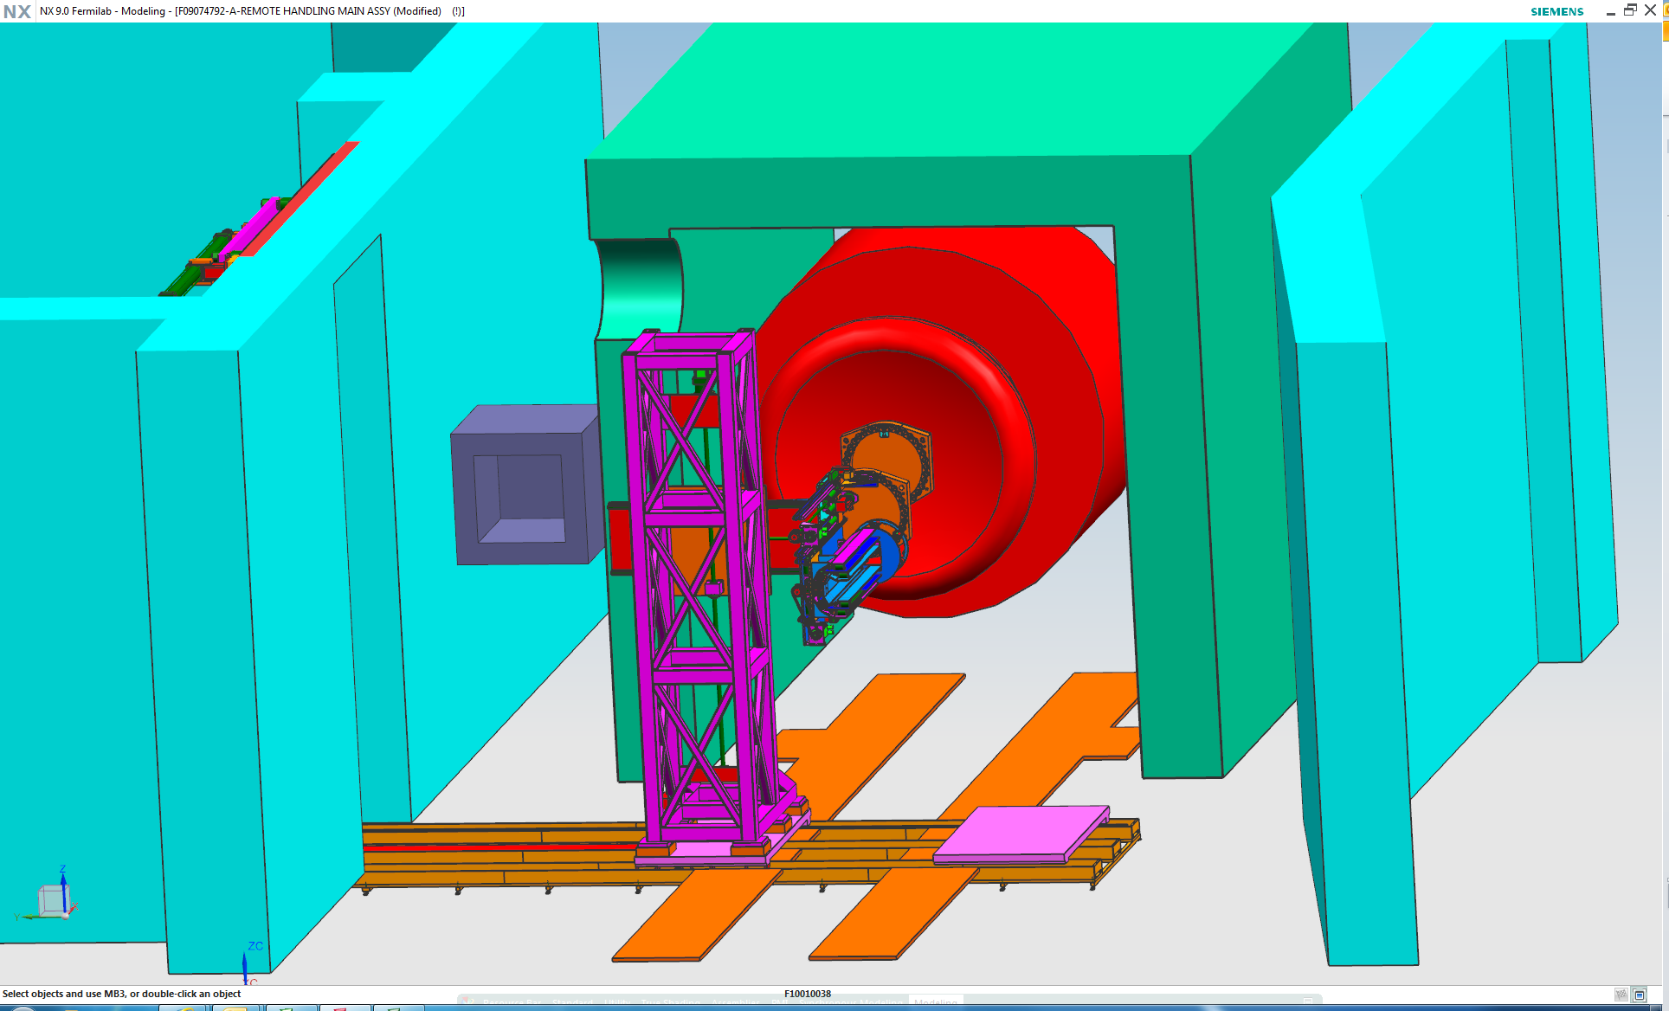
Horizontal Scheme

Slide 9
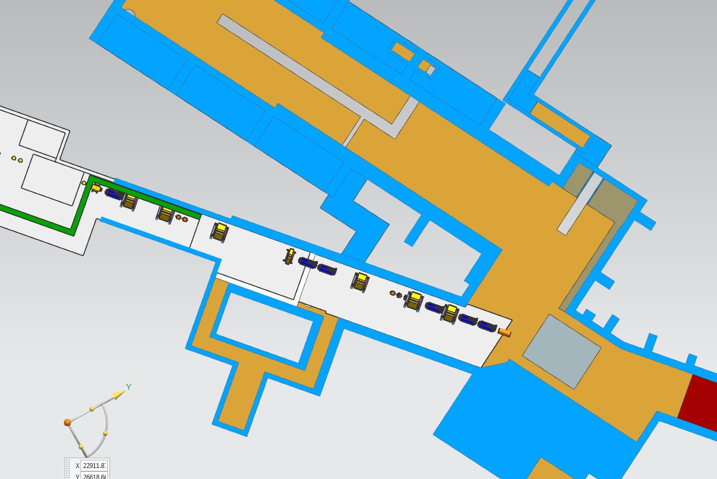
Horizontal Scheme
picture showing M4 line components, maybe in place of previous

Slide 10
Horizontal Scheme
Remote Handling room
Robot for target removal
Single robot, multi-functional
Parts from robot must be removed during operation
No crane coverage
Vacuum equipment
Contamination controls for this room are necessary
Target is placed into a cask next to HRS
Cask removed via M4 line
M4 removal is still conceptual, little design work has been done

Slide 11
Overhead Scheme
Above ground building
Built over Production Solenoid Hatch
20 Ton Crane capacity – sized for sufficiently shielded casks
Loading bay for component removal
Building is NOT a storage facility
Remote Handling Area
Work area for modules of different functionality
Contamination control area
Underground Remote Handling room
Reduced in size for vacuum equipment only
Shield door also not necessary

Slide 12
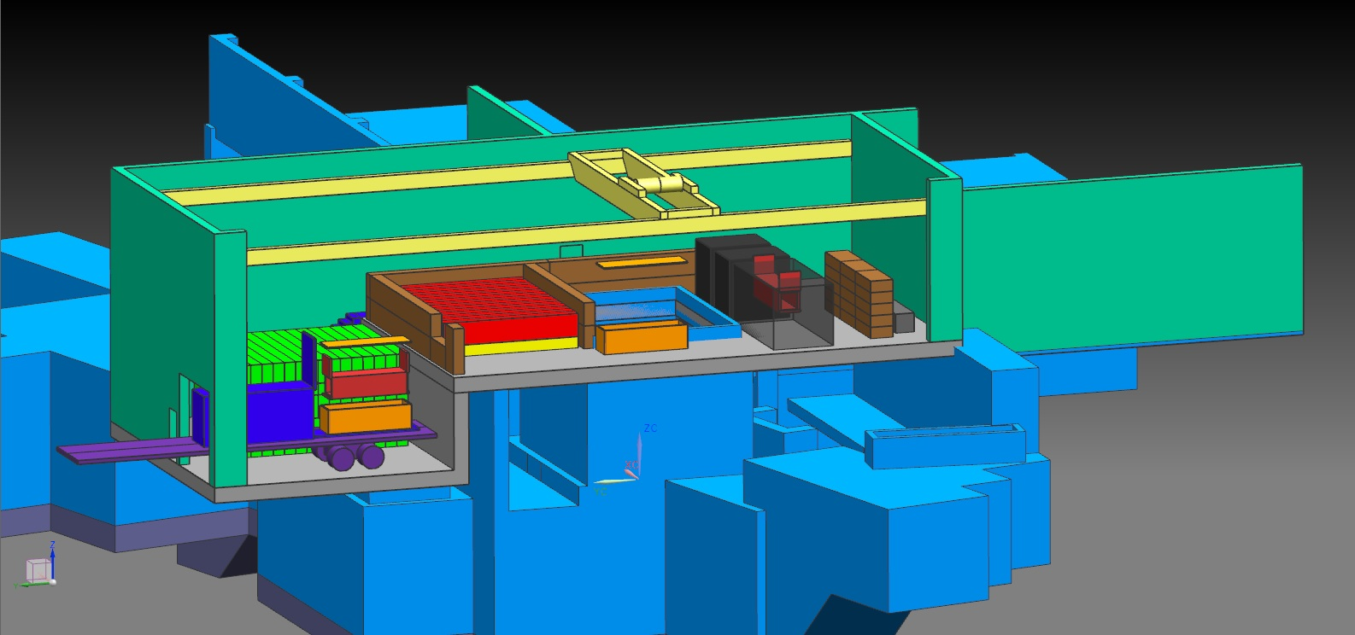
Overhead Scheme

Slide 13
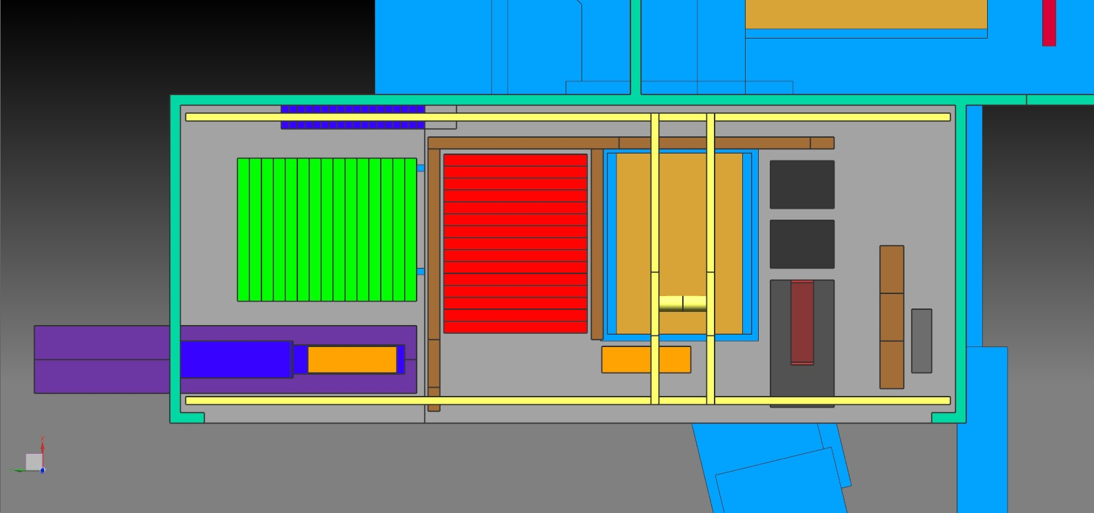
Overhead Scheme
RH
Module 1
RH
Module 2
RH
Module 3
Contamination Control Area

Slide 14
Overhead Scheme
Above ground building
Built over Production Solenoid Hatch
20 Ton Crane capacity – sized for sufficiently shielded casks
Loading bay for component removal
Building is NOT a storage facility
Remote Handling Area
Work area for modules of different functionality
Contamination control area
Underground Remote Handling room
Reduced in size for vacuum equipment only
Shield door also not necessary

Slide 15
Charge to Review Committee
Horizontal Scheme
Is baseline (horizontal) technically sound?
Risks, contingencies, radiological hazards been addressed?
Overhead Scheme
Is alternative (overhead) technically sound?
Risks, contingencies, radiological hazards been addressed?
Are there significant advantages to warrant increased cost?
Reasonable assessment of both schemes
not necessarily a choice or preference

Slide 16
Backup Slides

Slide 17
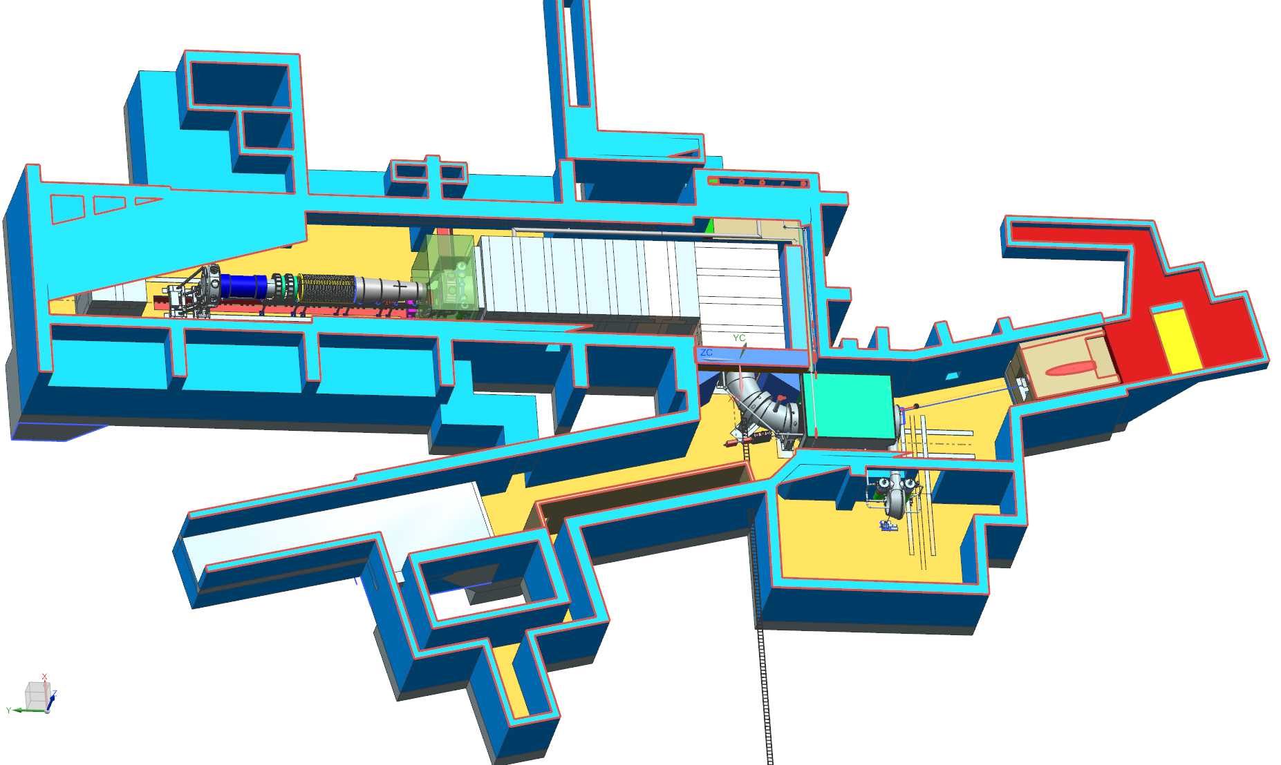
Horizontal Scheme
Target
M4 line
Remote Handling
& Vacuum Room
17

