Slide 1
Technology R&D Program Wrap Up
Hasan Padamsee
Chief Technology Officer
Head, Technical Division
Institutional Review
12 February 2015

Slide 2
The quality and significance of the lab’s recent scientific and technical accomplishments
    First in world accelerator quality 10-12 T dipoles and quadrupoles
      11 T dipole design and model magnets for LHC
      Model magnets for LARP
    Nb3Sn magnet technology demonstration
    Improved Nb3Sn strand configurations and insulation
    Breakthrough in Bi-2212 wire current density
    Design of three complex solenoid magnets for Mu2e
    World record gradient in ILC Cryomodule 31.5 MV/m
    Two major breakthroughs in High Q
      Under application to LCLS-II and PIP-II

Slide 3
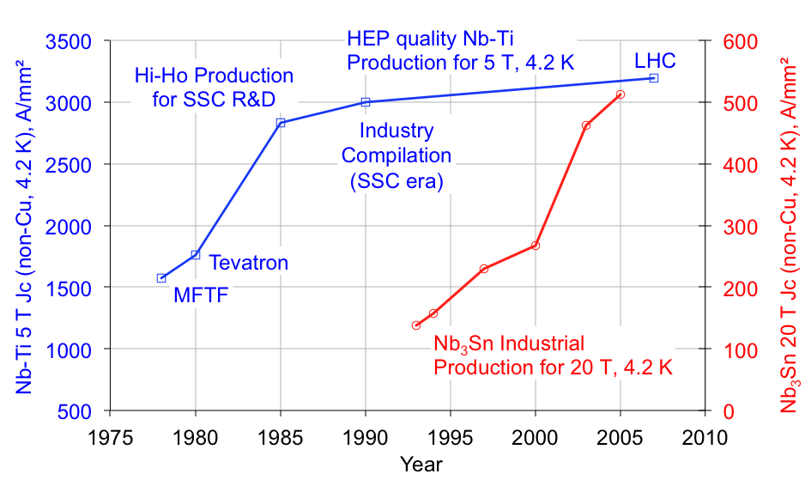
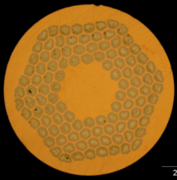
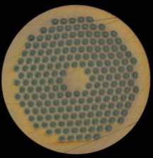
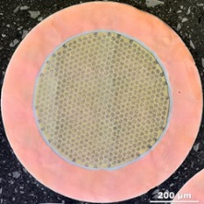
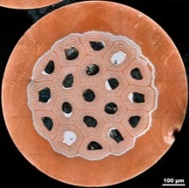
FNAL’s conductor development program is an essential contributor to a larger national effort for circular colliders
D. Larbalestier to P5, Data courtesy of J. Parrell (Oxford Superconductor, Carteret, NJ)
US-CDP
ITER wires
HL-LHC wires

Slide 4
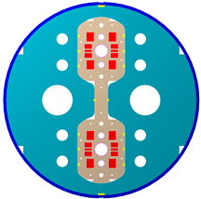
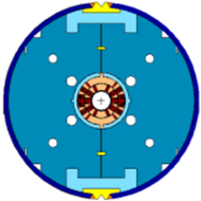
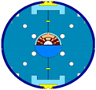
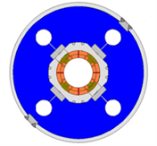
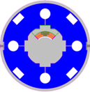
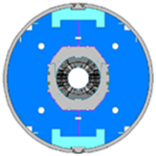
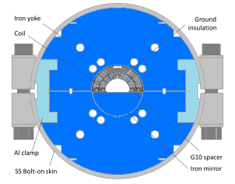
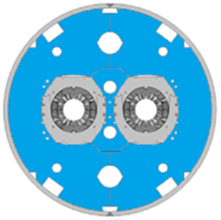
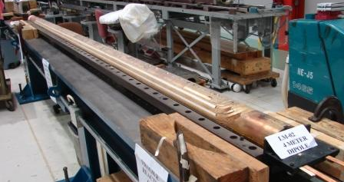
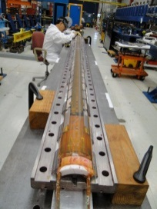
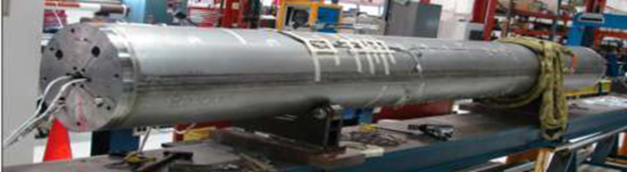
Fermilab HFM R&D Summary for Accelerator Class Magnets
HFDA HFDM-LM
43.5 mm Dipole mirror
10 T dipole
TQC TQM-LQM
90 mm 200 T/m Quadrupole quadrupole mirror
MBHSP MBHSM
60 mm 11 T dipole Dipole mirror
HFDC (R&W)
40 mm 10 T dipole
MBHDP
60 mm 11 T dipole
Nb₃Sn technology scale up
4-m long Nb₃Sn dipole and quadrupole coils
Mirror magnet with 4-m long Nb₃Sn coil

Slide 5

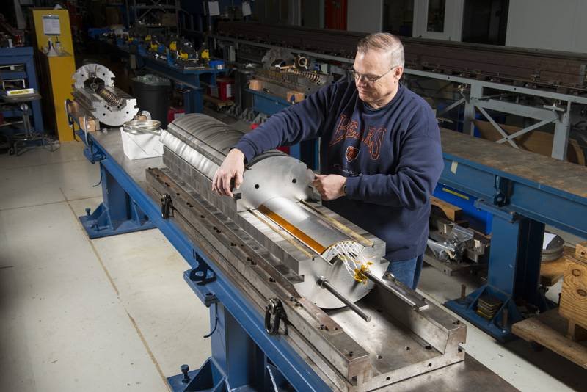
Specific Example LARP
FANL completed first QXF Mirror model
Design of Coils completed, entered production with Short QXF Coils
  Manufactured 5 coils at FNAL
Preparation for production of Long QXF Coils planned later in FY15.
  Tooling being prepared
Test of previous generation HQ models show good reproducibility and performance for Nb₃Sn technology.

Slide 6
World Record Performance ILC Cryomodule
Performance 31.5 MV/m, Q about 10¹⁰
Total Voltage > 250 MV

Slide 7
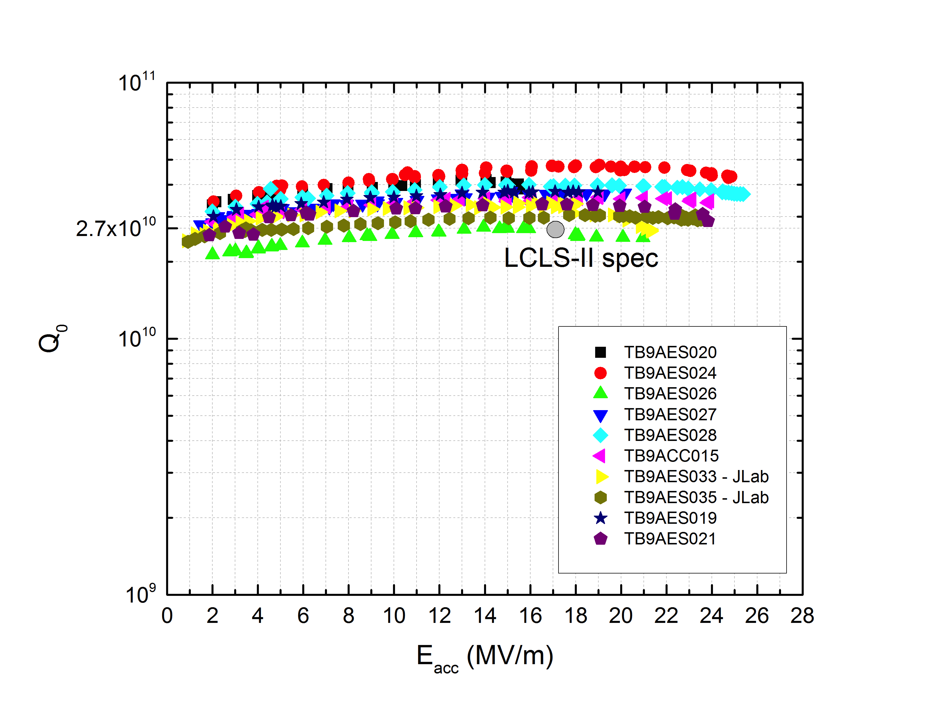
Consistent nine cell results with optimized recipe
Several 9-cell ILC Cavities, to be used for LCLS-II
Reproducible results
LCLS-II spec

Slide 8
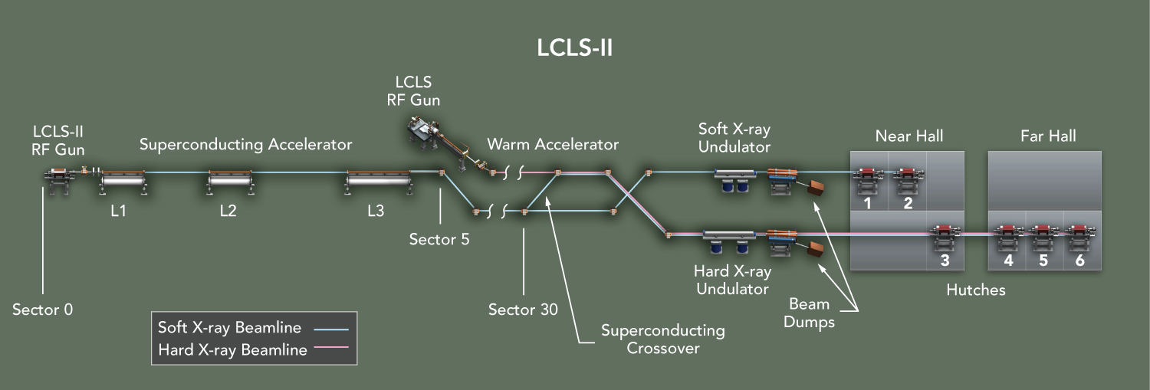
SRF Based Projects
LCLS-II is the top priority project in the laboratory
  Highest priority in the Office of Science
As a combined result of the two high Q techniques
  Capital cost of LCLS–II will decrease by more than 50 Million dollars due to refrigerator cost reduction.
  Operating costs will see a roughly 4 MW reduction.

Slide 9
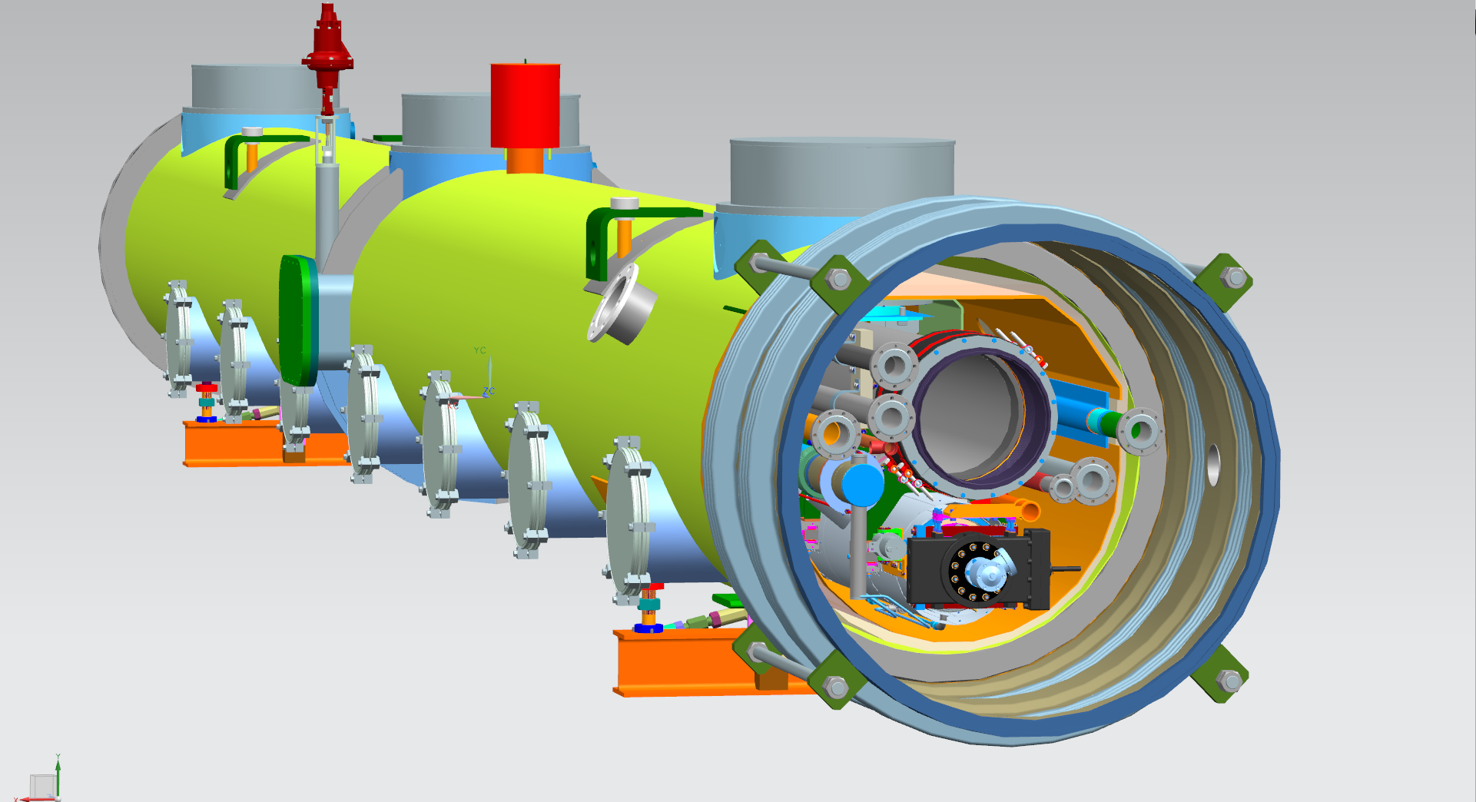
LCLS-II CM Design in 3-D, Prototype Under Construction
Vacuum Relief valve
CM Supports
J-T valve
Line B
Line A
Line F
Line C
Line E
Line D
Line G
HT Shield
LHe Level reservoir
Line H
2.2 K subcooled supply
Gas return pipe (GRP)
Low temperature intercept supply
Low temperature intercept return
High temperature shield supply
High temperature shield return
2-phase pipe
Warm-up/cool-down line

Slide 10
The merit, feasibility, and projected impact of the future planned physics program
    HiLumi LHC IR quadrupoles critical
    High Field Magnet program prepares for FCC, ILC IR…
    High Temperature Superconductor cable and magnet development looks even farther out
    High Q cavities lower refrigeration capital and operating cost for CW and long pulse accelerators

Slide 11
P5 Alignment
    Recommendation 10:
    Complete the LHC phase-1 upgrades and continue the strong collaboration in the LHC with the phase-2 (HL-LHC) upgrades of the accelerator and both general-purpose experiments (ATLAS and CMS). The LHC upgrades constitute our highest-priority near-term large project.

Slide 12

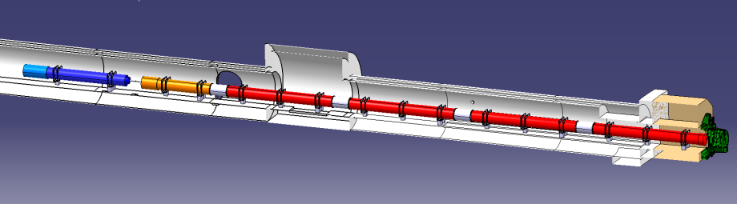






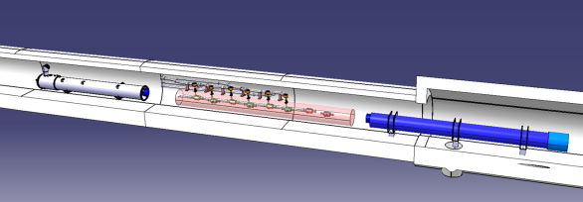


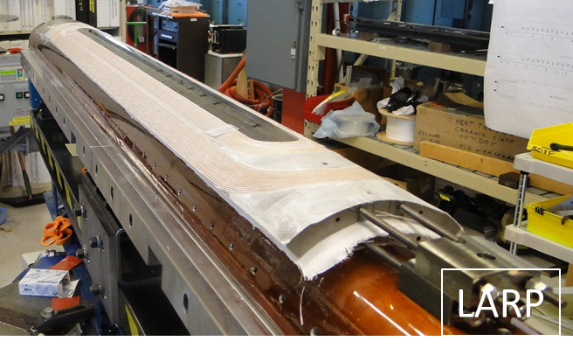
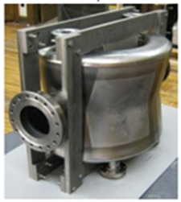
USA for HL-LHC : LARP for R&D
July 2014
8 IT quadrupoles Q1 and Q3 (16 single magnets + 4 spares)
32 Crab Cavities (dressed cavity no cryomod) + 4-8 spares
D1
Cor
Q3
Q2b
Q2a
Q1
ATLAS
CMS
Q4
CC
D2
LARP ¼ wave proto single Crab Cavity
1st LARP quadrupole short coil in Nb₃Sn

Slide 13
P5 Alignment
Recommendation 14:
Upgrade the Fermilab proton accelerator complex to produce higher intensity beams. R&D for the Proton Improvement Plan II (PIP-II) should proceed immediately, followed by construction, to provide proton beams of >1 MW by the time of first operation of the new long-baseline neutrino facility.

Slide 14
PIP-II Linac Technology Map: R&D and Prototyping in Progress
IS
LEBT
RFQ
MEBT
β=0.11
β=0.22
β=0.51
β=0.61
β=0.9
RT
SC
162.5 MHz
0.03-11 MeV
325 MHz
11-177 MeV
650 MHz
177-800 MeV
Section | Freq | Energy (MeV) | Cav/mag/CM | Type
RFQ | 162.5 | 0.03-2.1
HWR (β_{opt}=0.11) | 162.5 | 2.1-11 | 8/8/1 | HWR, solenoid
SSR1 (β_{opt}=0.22) | 325 | 11-38 | 16/8/ 2 | SSR, solenoid
SSR2 (β_{opt}=0.51) | 325 | 38-177 | 35/21/7 | SSR, solenoid
LB 650 (β_{G}=0.61) | 650 | 177-480 | 30/20/5 | 5-cell elliptical, doublet
HB 650 (β_{G}=0.9) | 650 | 480-800 | 24/10/4 | 5-cell elliptical, doublet
All components CW-capable

Slide 15
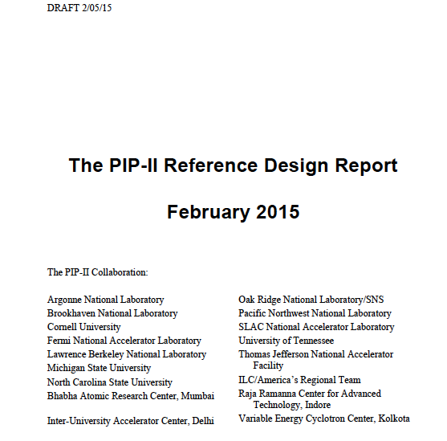

Slide 16
  P5 alignment
    Recommendation 22: Complete the Mu2e and muon g-2 projects.
    Recommendation 23: Support the discipline of accelerator science through advanced accelerator facilities and through funding for university programs. Strengthen national laboratory-university R&D partnerships, leveraging their diverse expertise and facilities.
    Recommendation 24: Participate in global conceptual design studies and critical path R&D for future very high-energy proton-proton colliders. Continue to play a leadership role in superconducting magnet technology focused on the dual goals of increasing performance and decreasing costs.
    Recommendation 25: Reassess the Muon Accelerator Program (MAP). Incorporate into the GARD program the MAP activities that are of general importance to accelerator R&D, and consult with international partners on the early termination of MICE.

Slide 17
P5 Recommendations (con’t)
Recommendation 26: …Focus on outcomes and capabilities that will dramatically improve cost effectiveness for mid-term and far-term accelerators.
Gains will benefit all accelerators for Office of Science
  CW light sources, high intensity proton accelerators, Higgs factory start to Future Circular Colliders (FCC) or ILC-TeV.
  Cost Reduction Avenues Cavities (> x 2 reduction)
    Cut refrigeration capital and operating costs through advances in High Q
    Reduce material costs through Nb-Cu composites and Nb thin films
  Reduce fabrication costs with alternative fabrication methods.
    Spinning, hydroforming demonstrated
    1-cells, 3-cells demonstrated with Eacc > 34 MV/m
    See back-up slides
  Cost Reduction Avenues Magnets

Slide 18
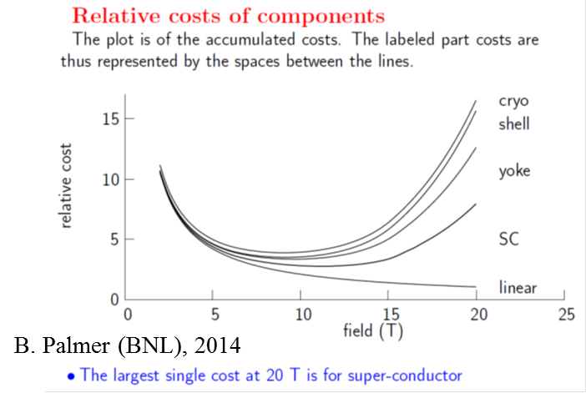
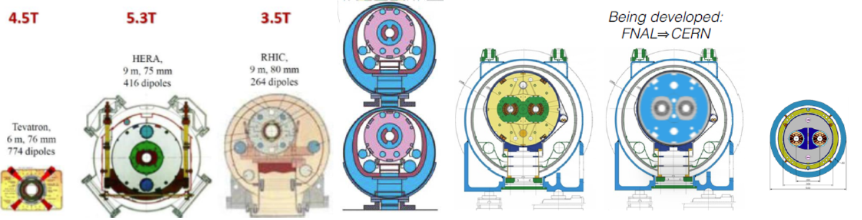
Magnet cost reduction strategy
Cost reduction directions
  Improve performance (increase B_{op} and T_{op})
  Reduce magnet cross-section
  Increase magnet length
  Reduce component cost

Slide 19
The effectiveness and efficiency of facility operations and the planning for future facilities to support the research program!
The magnet facility supports fabrication and testing of magnets for LARP, Mu2e, G-2, CLAS12 (JLAB)
The SRF facility supports processing and testing of cavities and fabrication of cryomodules for LCLS-II, PIP-II and basic R&D
Multiple test stations for magnets
Three vertical test areas for cavity
Two Horizontal test cryostat for dressed cavities
Cryomodule test facility in ASTA
New HTS2 in preparation with India Collaboration
New CMTS in preparation with India Collaboration for LCLS-II Cryomodules in preparation
Lab space under preparation for PIP-2 prototype module
Clean room for Cavity strings ordered

Slide 20
  The effectiveness and efﬁciency of facility operations and the planning for future facilities to support the research program - 2
    Existing magnet fabrication and test facilities used effectively to support LARP and High Field Magnet program
    Fermilab’s Vertical Magnet Test Facility is the only place in the US capable of testing magnets below 2 K.
    Solenoid Test facility built to test both MICE coupling coils and Mu2e Transport Solenoid modules
    Expanded test stand planned to support HiLumi IR quad production testing leveraging existing infrastructure
    Need identified for additional helium liquefaction to support HiLumi IR quad production testing and being addressed
    Existing Strand and Cable Lab effectively used in developing new strand technology and performing quality control on Mu2e solenoid strand and cable
    Additional high bay building in Industrial Area being planned to support future production needs for LARP, PIP-2…

Slide 21
Maximizing the scientific productivity of the facilities
Testing and Instrumentation Department in Technical Division supports activities in both magnets and srf facilities
Refrigerator in operation at all times for both magnet and srf testing
  Except for maintenance periods
  Refrigeration and technical support for Horizontal Test Cryostats in AD
  Cryomodule test facility now in ASTA will move the CMTS

Slide 22
The effectiveness of the lab management in
  Strategic planning
    Work with Lab’s Strategic Planning Initiative
  Core competencies
      SC strand development
      SC magnet design and fabrication
      Magnet testing
      Cavity design and evaluation
      Cavity preparation and testing
      Cavity and surface inspection with state of the art systems
      Cryomodule design, fabrication and assembly
      Cryomodule Testing

Slide 23
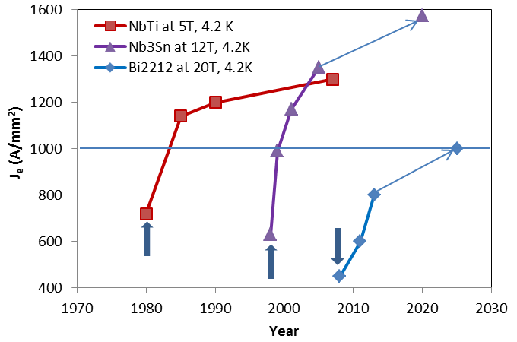
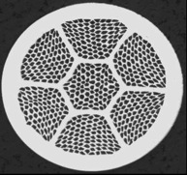
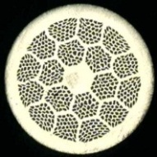
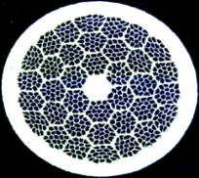
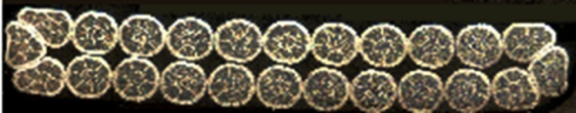
Example LARP
LARP depends on Core Capabilities in:
  SC Strand Development and QC Capabilities
  SC Magnet Assembly Capabilities & Infrastructure
  SC Magnet Testing Capabilities
GARD and other R&D programs (Early Career) need to maintain and reinforce core capabilities
NOT LARP
See. L. Cooley Talk
Goal: improve reliability @ vendor to insure meeting technical specs
  Development of different reaction cycles
  Optimization of Cu-nonCu ratio in SC
Tools: GARD HFM Activities, LARP Procurements, CRADA with CERN for Nb₃Sn, CDP
23

Slide 24
  Implementing prioritized and optimized plan
    Balanced Distribution of personnel in srf and magnet departments
    Supporting staff in T&I department
    Regular Department Head meetings to review the needs of the projects and the resources supplied by Division
    Rebalance as needed
    Augment engineering, technical and srf expertise as needed
    Managing the resources according the lab’s priorities
      LCLS-II, PIP-II and Mu2e are highest in priority

Slide 25
Promoting and implementing a safe work environment
Weekly meetings with chief safety officer of the division
Each Department conducts a self review for the Division Head in rotation
Safety officer keeps track of safety training
  always above 97%
  Regular notices sent out when anyone falls behind
Division wide safety meeting held once per year
Travelers ensure quality and safety in fabrication
Operational Readiness Clearance reviews of any new or modified equipment

Slide 26
The effectiveness of the development and oversight of projects
Once per week meetings between Division Head and Department Heads and their deputies
Regular reviews of LCLS-II project activities organized by SLAC
    AAC review just completed
    Mu2e TS solenoid module procurement passed CD3b review this month
PIP-II MAC to be held in…March 9 – 11, 2015

Slide 27
Development & Oversight of Projects LARP Example
Project is “Scope, Cost & Schedule”
  Scope
    Draft MQXFA Functional Requirements Specification
    Draft Work Breakdown Structure (WBS)
  Cost
    Bottoms-up Cost Model based on standard activity Basis of Estimate Templates (BOEs) developed by US-HiLUmi
    Cost Model includes FNAL, BNL, LBNL, and SLAC labor rates and M&S Overhead; uncertainty contingency; and escalation
27

Slide 28
  Integration of universities and other national labs in projects
    LARP
      – Fermilab, BNL, LBNL, as well as SLAC
    OHEP Conductor Development Program
    Fermilab, LBNL, BNL, FSU, TAMU
      Bi-2212 Strand and Cable Collaboration – Fermilab, NHMFL, LBNL, BNL
LCLS-II High Q collaboration involves Jlab,ANL, Cornell and SLAC
    Various graduate students

Slide 29
Nurturing of Scientific Staff
The leadership, creativity, and productivity of the lab’s
scientific and technical staff
  Career grants
    Alex Romanenko (SRF), Anna Grasselino (SRF), Tingmeng Shen (magnets)
  People’s fellowship
    Romanenko, Grasselino
    Key scientific and engineering staff serve on program committees for IPAC, SRF
Results reported at standard accelerator and accelerator technology, SRF conferences
Papers published: More than 180 Peer-Reviewed Publications in Accelerator Science and Technology since 2009
  Plenary talks at conferences (AAS)

Slide 30
Leadership (cont)
    Giorgio Apollinari is national Director of LARP
      coordinating all US R&D on the LHC
Division Head elected new Chair of TeslaTechnologyCollaboration
Division Head awarded 2015 Wilson Prize for Accelerators

Slide 31
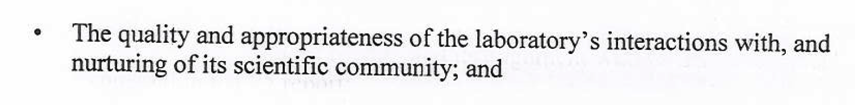
Nurturing of Scientific Staff: Example LARP
Commitment to maintain Toohig Fellow program in LARP and US-HiLumi to facilitate the involvement of PostDocs in the US to work at the leading Energy Frontier Machine for the next ~2 decades.
New Toohig Fellow:
  Trey Holick (U. Texas A&M) selected to spend his fellowship at FNAL to work on QA/QC of Coils and Magnets
Other Toohig Fellows in LARP:
  I. Pong: QA/QC on SC Strand/Cables
  S. Verdu: CC Construction and Testing

Slide 32
Answers to Questions

Slide 33
What is the transition plan as LCLS-II production winds down to PIP-II production.
LCLS II should complete designs by the end of FY16 (hopefully).
At that time design engineering is only needed as a percentage of current numbers in order to follow through on production related engineering issues and testing.
  Therefore the design team could focus full attention on PIP II issues.
LCLS II cryomodule assembly completes in May 2018 and from that point on there will be facilities and a highly trained staff to work on PIP II.
PIP-II prototyping work will continue in R&D mode through LCLS-II production
CMTS1 testing for LCLS-II CM will continue into until the end of FY18.
CMTS1 can transition from LCLS II configuration to PIP II configuration.

Slide 34
What is being done to eliminate the pinch points?
  Preparing parallel space for Clean Room String Assembly and Cryomodule Assembly
  Procure soft walled portable Clean Room
  Increase labor force
    Change model for assembly of SSR1 CM (use Eng./Sci. more)
    Help from ANL colleagues
    Temporary/contract workers
    Loans from other Divisions
    Selective permanent hires with broadband SRF expertise

Slide 35
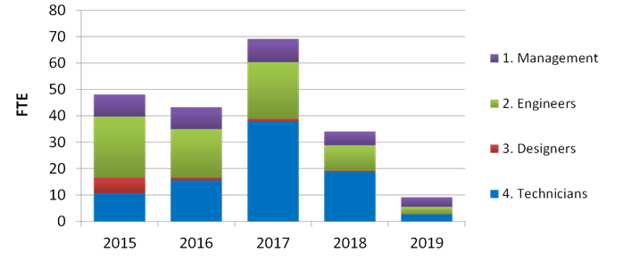

Slide 36
What are the plans to get international and more national lab involvement in LCLS-II.
LCLS II will bring together a strong national lab SRF collaboration particularly between FNAL, Jlab ANL and Cornell.
This collaboration will face and solve most multi-location production issues and will demonstrate how well national labs can work together.
LCLS II will be an opportunity to take national lab collaboration within the SRF technology field to a new level and showcase the combined talent of the lab system.

Slide 37
LCLS II Summary Schedule
Galayda

Slide 38
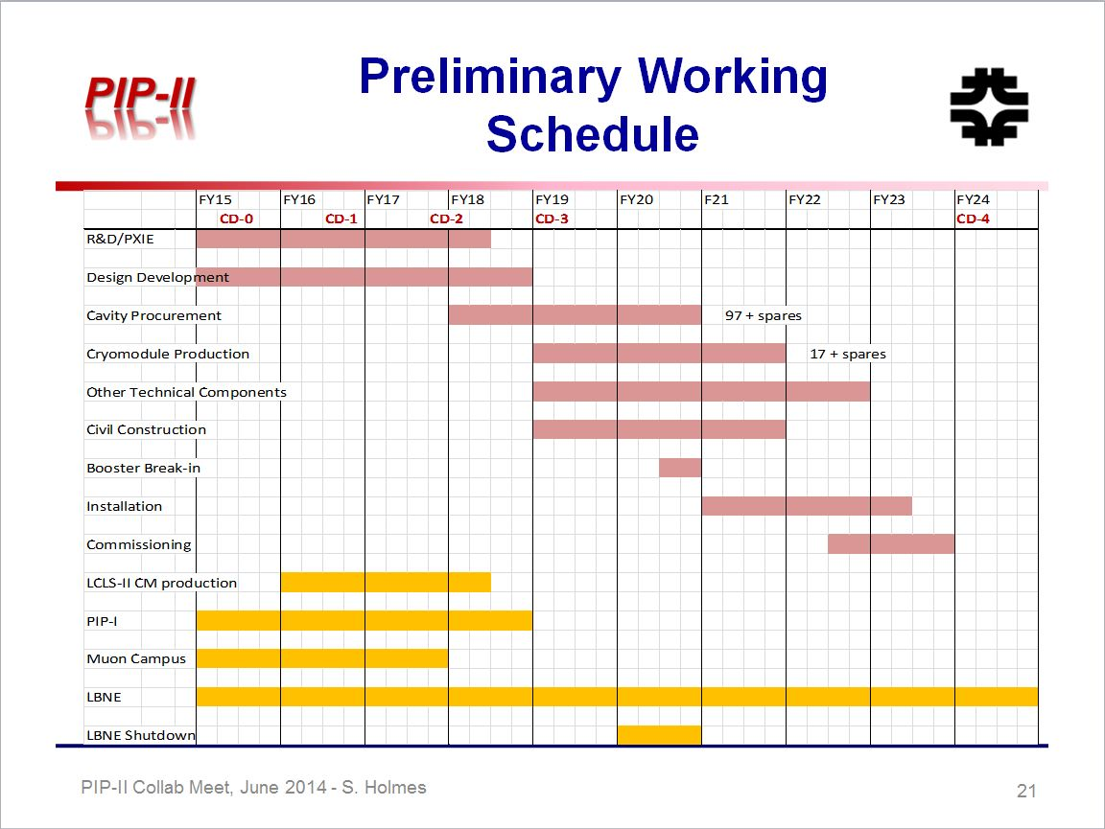
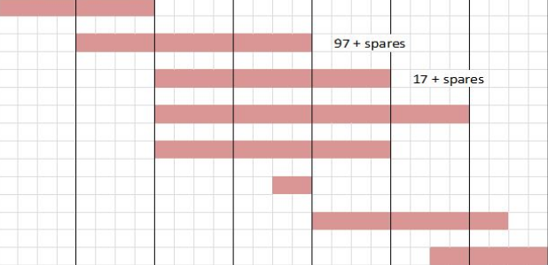
Limited resources may delay project

Slide 39
PIP II international agreements –
India (IIFC) collaboration on Accelerator established
  Annex I signed by India and US
  India would like to gain expertise on all aspects
  Joint efforts on
  SSR1 and SSR 2 cavities
  SSR2 Cavities and Cryomodule
  High Beta Cavities and Cryomodule
  Refrigeration
  RF Power
  Major contribution to new test facilities for future
  VTS 2/3, HTS2, CMTS

Slide 40
Discussion underway for collaboration with CERN and Orsay ( for low beta 650 MHz)
PIP II can also take advantage of the LCLS-II established national collaboration capability to further reduce the risk of cryomodule production

Slide 41
Summary: Superconducting Magnet
Fermilab has been master of Superconducting Magnet Technology for decades
Program supports a wide variety of projects for Fermilab and CERN, as well as preparation for future accelerators.
  11-T Dipoles for LHC
  LHC-IR Quads for High Luminosity Upgrade Project
  High Field Magnet Program,
FNAL is an essential member of a national conductor development consortium, with a strong track record of enabling new colliders by making better and cheaper magnet conductors.

Slide 42
Summary: SRF
  FNAL has world-class capabilities in all aspects of SRF technology and cryogenics, from R&D to design to construction to testing
  LCLS II scope of work is well defined and aligned with our current capabilities and long term goals of PIP II
    Advantages in doing LCLS II while PIP II is still in R&D stage
  SRF Collaboration (JLab,Argonne, Cornell, SLAC) working well
  Support for LCLS II is positive “across the board”
    SC => OHEP => FNAL Director => Divisions/Departments => to the shop floor
  FNAL is committed to making LCLS II a success and to preparing for PIP II project

Slide 43
Summary: Technology R&D
Benefits to Wider Community
LHC IR magnet development
High Field Magnet for Future Circular Colliders
High Gradient accomplishment positive impact on ILC
SRF Cryomodules for LCLS-II – SLAC
High Q for cost reduction for CW and Long pulsed accelerators.

