Slide 1
Fermilab Accelerator R&D Program
Wrap-up
Vladimir Shiltsev, Accelerator Physics Center
Institutional Review of the Fermi National Accelerator Laboratory
12 February 2015

Slide 2
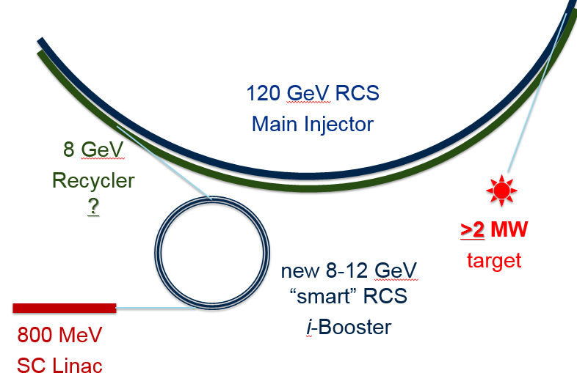
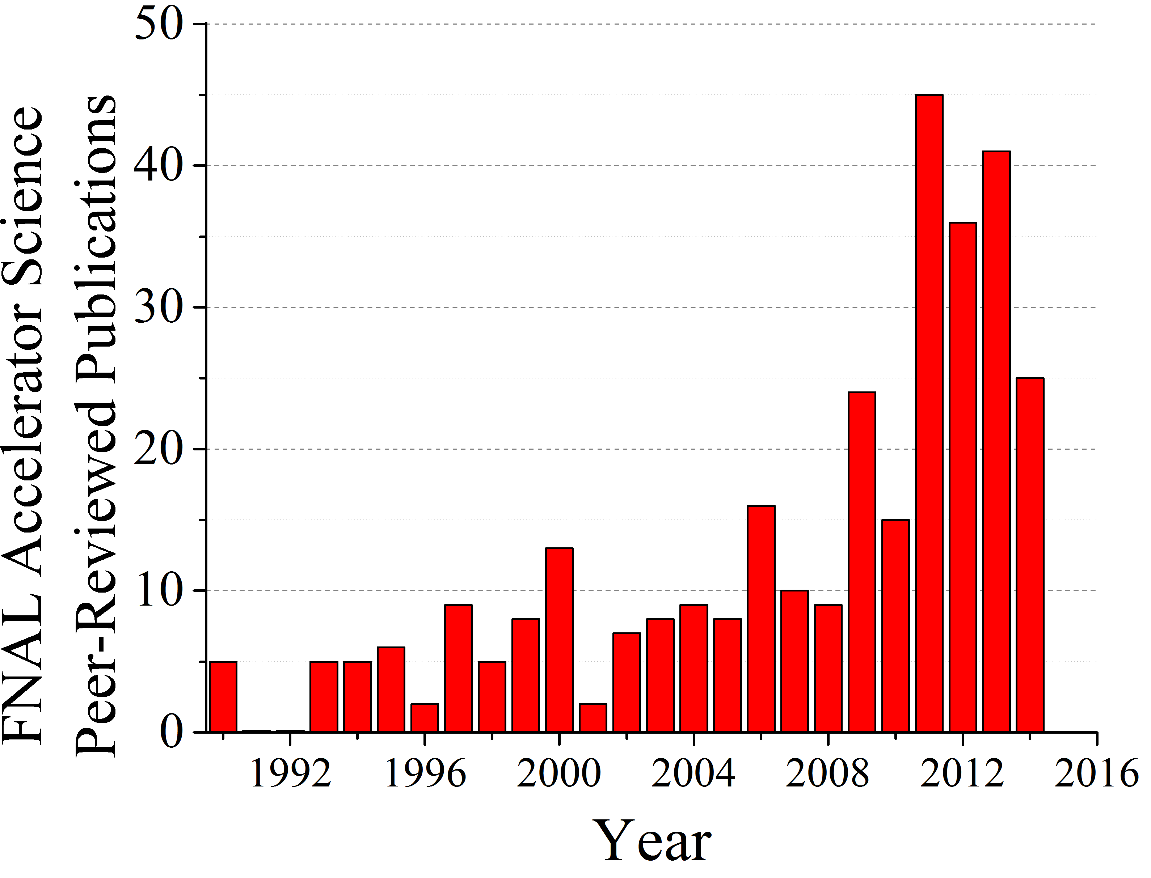
Question 1 – Accelerator R&D
The quality and significance of the lab’s recent scientific and technical accomplishments, the merit, feasibility, and projected impact of the future planed physics program, P5 alignment
Very strong record of publications:
  Tevatron, instabilities, SRF, SC magnets and materials, targetry, MARS, etc
P5 directive → multi-MW beam power facility (PIP-III) exploratory R&D:
  Super-high dQ_sc rings
  Cost-effective SRF
  High power targetry R&D
P5 directive → strong R&D program toward a 100 TeV scale pp collider (cost effective ~15 T magnets) and support core capabilities (theory, codes, training)

Slide 3
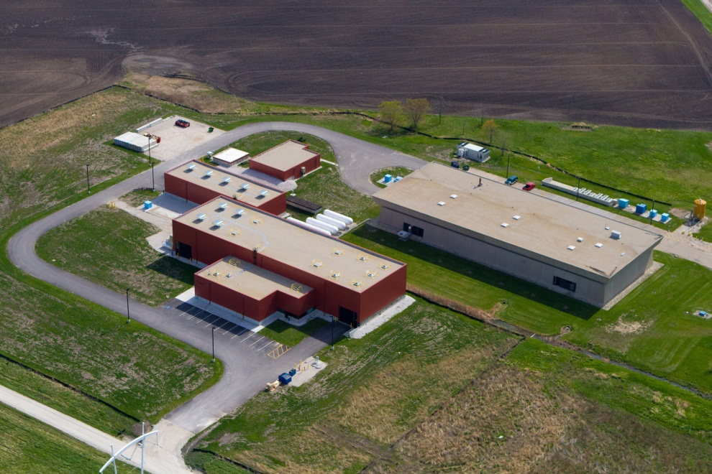
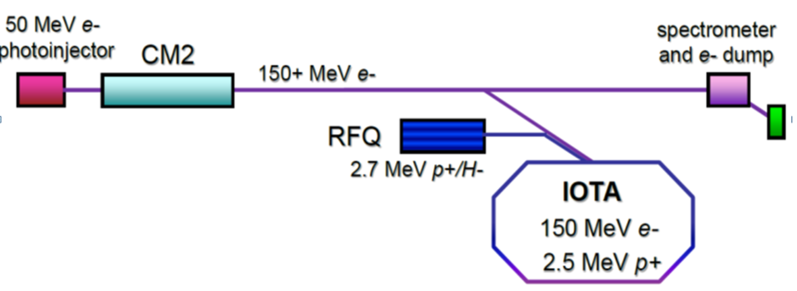
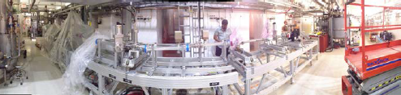
Question 2 – Accelerator R&D
The effectiveness and efficiency of facility operations, and the planning for future facility upgrades to support the research program as organized into the crosscut…
IOTA facility is being built to carry out critical R&D on high-intensity space-charge dominated proton beams:
  IOTA ring and p+ and e- injectors
  Breakthru experiments on NL integrable optics and space-charge compensation
~40% of the ring built, 5 MeV injector commissioned → 25-50 MeV this year
Complete construction of the facility in FY15-17 (with appropriate funding) and start full research program in FY18

Slide 4
Question 3 – Accelerator R&D
The effectiveness of current laboratory management in strategic planning, developing appropriate core competencies, implementing a prioritized and optimized program, and promoting and implementing a safe work environment
Fermilab actively participated and provided input to Snowmass, P5 and now to the HEPAP General Accelerator R&D subpanel
FNAL across-divisional GARD priorities working group of 27 chaired by J.Lykken and S.Nagaitsev has submitted recently two White Papers to the Sub panel, priorities :
1. High-Field Magnets and Materials
2. Novel Techniques for Multi-MW Beams and Targets
3. Cost-Effective SRF Technology
4. Advanced Accelerator Concepts
5. Accelerator Science, Modeling and Design
6. Core Accelerator Competencies

Slide 5
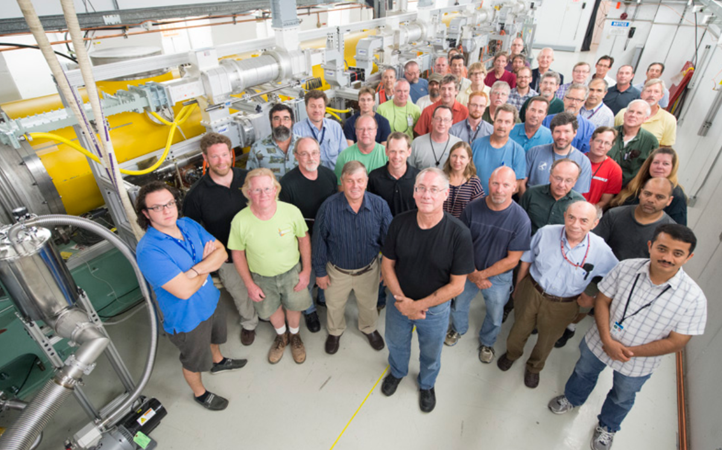
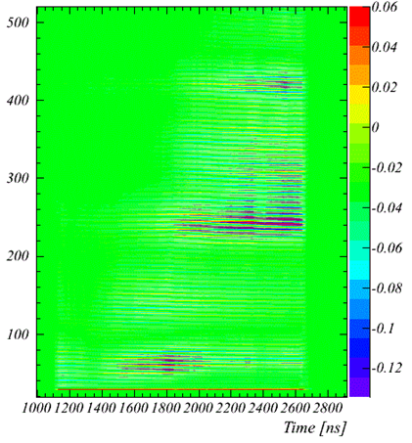
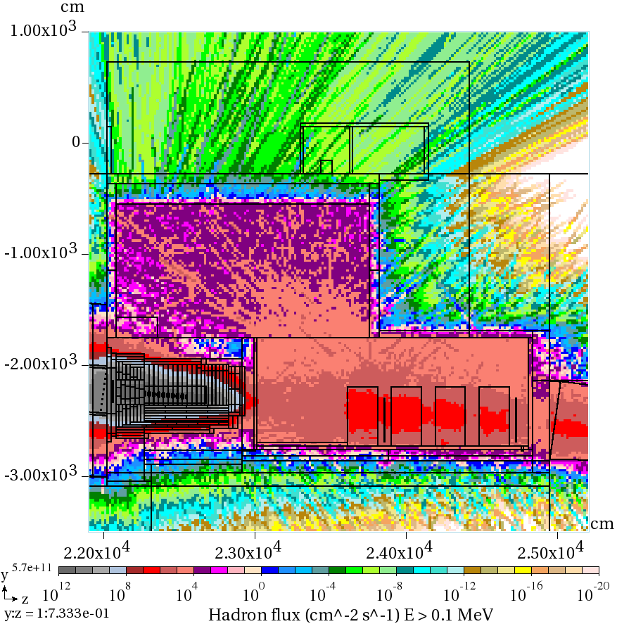
Question 5 – Accelerator R&D
The leadership, creativity, and productivity of the facility's scientific and technical staff in carrying out the above activities
Profound contributions of AD and APC scientists, engineers and technical staff to all aspects of Lab’s program:
  Push the accelerator performance
  Establish and carry out projects (LCLS-II, PIP-II, LBNF)
  Contribute to mu2e, g-2 and neutrino experiemnts
  Build IOTA/ASTA R&D facility
  Train next generation accelerator scientists and engineers
turn
x
MARS : ELBNF H-Absorber
RR instability
½ synchrotron period

Slide 6
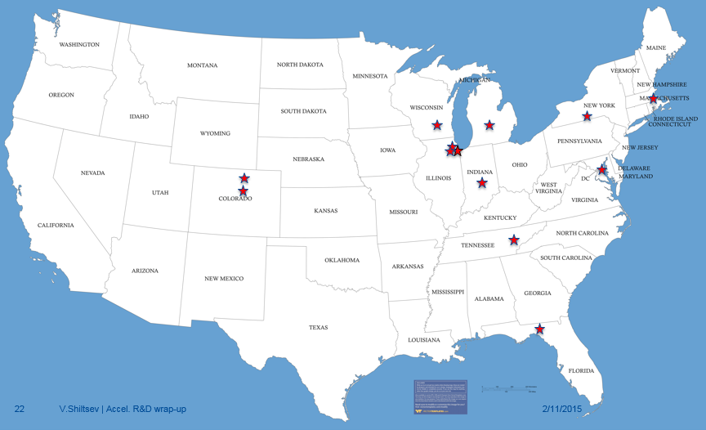
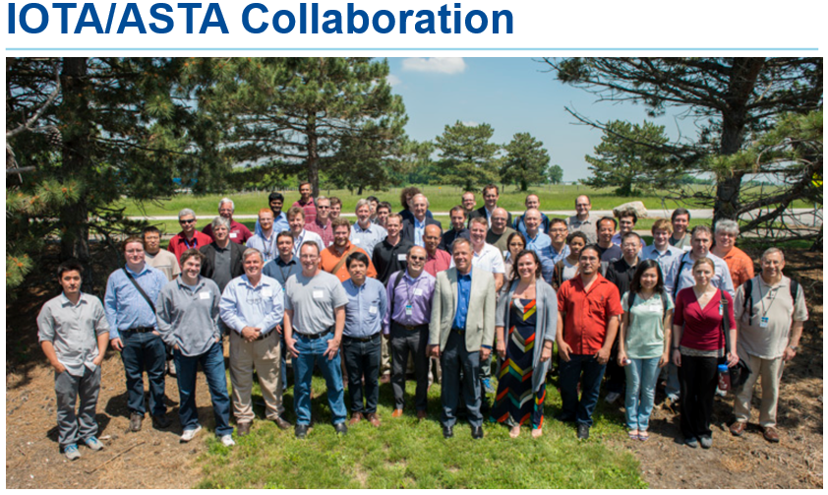
Question 6 – Accelerator R&D
The quality and appropriateness of the laboratory's interactions with, and nurturing of its scientific community
More than dozen University groups collaborate with FNAL and come to do accelerator research at the Lab
IOTA/ASTA facility and program in the center - 6 universities, 4 labs, 4 Int’l partners, 2 SBIR partners – community of about 80 and growing
Boosting Illinois accelerator research community – NIU led consortium , incl. U.Chicago, IIT (Swapan Chattopadhyay)

