Slide 1
High Performance Computing Activities at Fermilab
James Amundson
Breakout Session 5C: Computing
February 11, 2015

Slide 2
High Performance vs. High Throughput Computing
Much of the computing in HEP relies on High Throughput Computing (HTC)
  One task per processor on many processors
  Trivial to perform in parallel
This talk is about High Performance Computing (HPC)
  One large task on many processors
  Tightly-coupled communications
    Advanced networking
      Low latency and high bandwidth
  Includes Linux clusters with specialized networking and supercomputers

Slide 3
Cooperative Work in High Performance Computing (HPC)
Lab facilities
  HPC clusters
  Next-generation HPC testbeds
Lab competencies
  Scientific
    Computational Physics on HPC
  Technical
    HPC programming and optimization
    HPC cluster support
Relevant lab science topics
  Lattice QCD
  Cosmology
  Accelerator Simulation
Much of this work
Funded by DOE HEP
CompHEP through
SciDAC

Slide 4
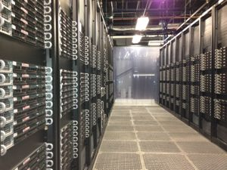
Shared HPC Facilities
Lattice QCD
  Three clusters
    ~25,000 CPU cores total
    Two clusters include GPUs
    Infiniband interconnects
Accelerator Simulation and Cosmology
  Two clusters
    ~2,500 CPU cores total
    Infiniband interconnects
Next-generation research
  Two clusters
    72 traditional cores
    Phi cluster
      16 Intel Xeon Phi 5110P accelerators
    GPU clusters
      2 NVIDIA Tesla Kepler K20m GPUs and 2 K40m GPUs
    Infiniband interconnects

Slide 5
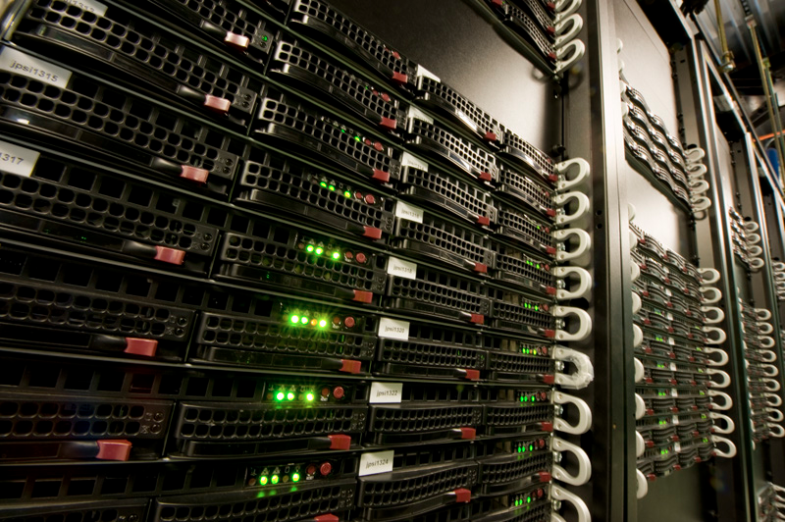
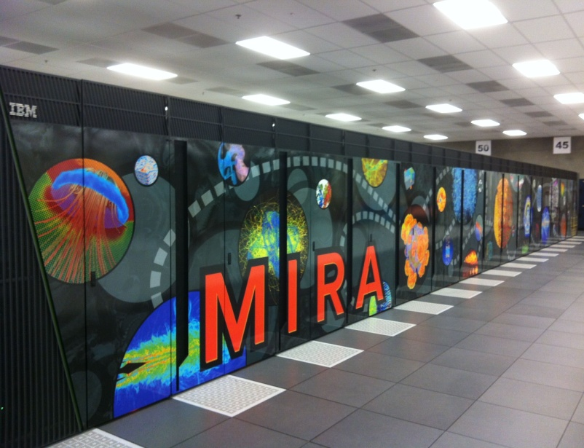
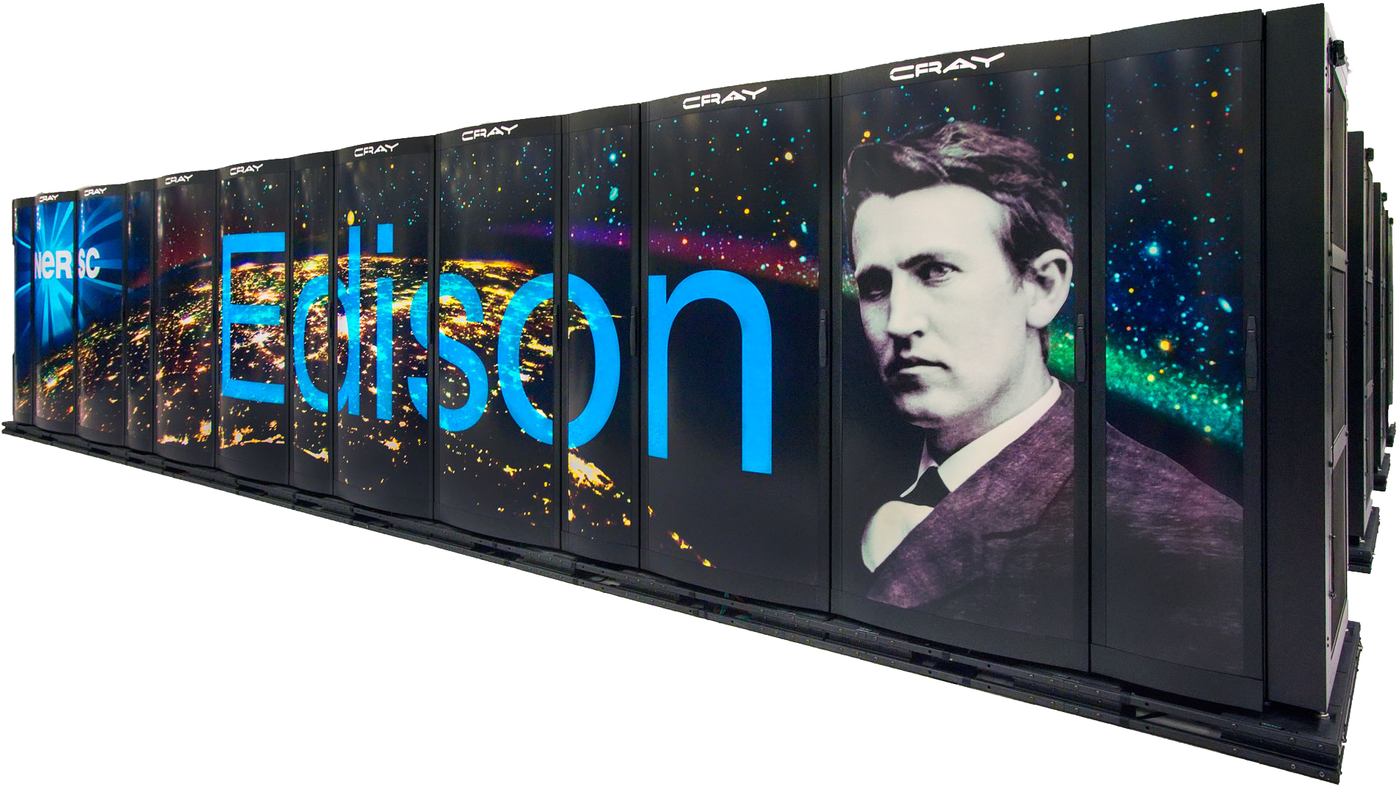
Sharing HPC Facilities
Facilities are operated by Computing (CS); use is shared between Particle Physics (PPD), Center for Particle Astrophysics (FCPA) and CS.
All three subjects also utilize leadership class supercomputing facilities, for example
  ALCF at Argonne (Mira: BlueGene/Q)
    Resources obtained through the INCITE program.
  NERSC at LBL (Edison: Cray XC30)
    Resources obtained through the SciDAC program.

Slide 6
Shared Competencies
HPC cluster support
  LQCD group has developed highly specialized expertise in acquisition, deployment and support of HPC Linux clusters.
    Difficulty of each is easy to underestimate.
      Exotic hardware and drivers.
  Expertise is shared with Accelerator Simulation and Cosmology through the support of specialized clusters.
Computational Physics on HPC
  Many overlaps between LQCD, Accelerator Simulation and Cosmology
    Numerical Algorithms
      Particle-in-cell techniques, linear algebra and spectral methods
    Parallelization Algorithms
      Load balancing, data layout, communication avoidance, etc.

Slide 7
Shared Competencies, continued
HPC programming and optimization
  Similar technical issues are faced by all HPC efforts at the lab.
  Groups meet in a regular series of technical seminars (“NEAT Topics”).
  LQCD and Accelerator Simulation submitted SciDAC cross-cutting project.
  Accelerator Simulation and Cosmology share technical personnel.

Slide 8
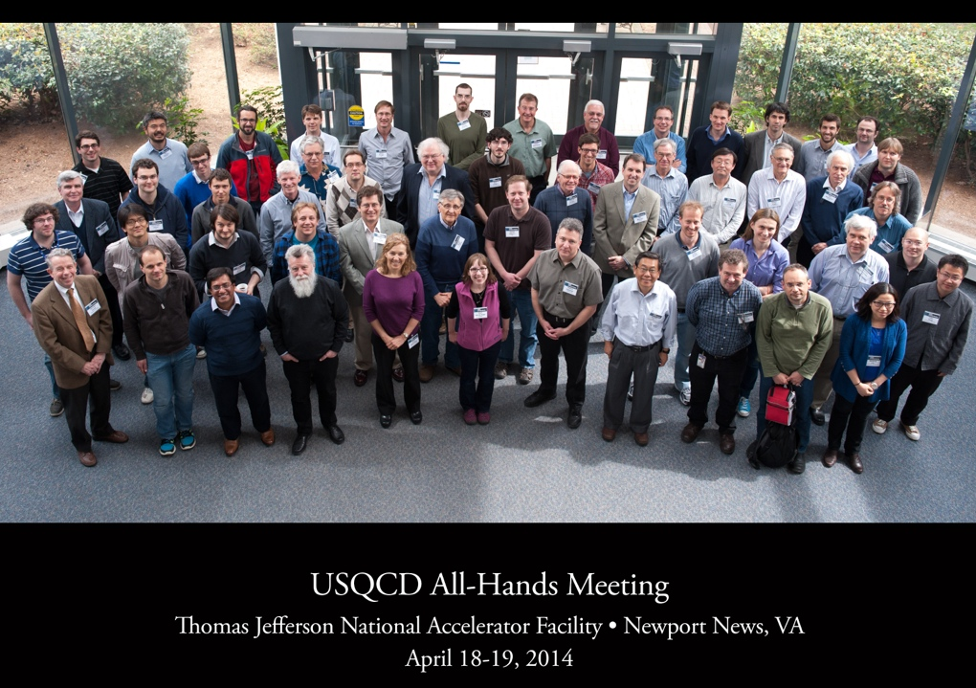
Lattice-QCD computing and USQCD
Lattice-QCD applications cover all science cross-cuts, e.g. hadronic contributions to (g-2)μ, nucleon axial-vector form factor for CCQE X-section, quark masses & αs for Higgs predictions
  Calculations require supercomputers (provided by DOE’s LCFs) and even more flops on medium-scale computing clusters (naturally provided by DOE laboratories)
Fermilab deploys and operates large computing clusters for U.S. lattice gauge theory community (organized by USQCD Collaboration), which is mostly based at universities.
USQCD effort over 100 strong
Hardware funded by DOE HEP & NP offices
Hosts largest share of USQCD’s computing hardware
Highest user satisfaction among three USQCD facilities
Fermilab plays leading roles in U.S. lattice effort including:
  Paul Mackenzie USQCD
  spokesperson and project PI.
  Bill Boroski (office of CIO) LQCD project manager.
Computing and PPD interactions crucial for successful science!

Slide 9
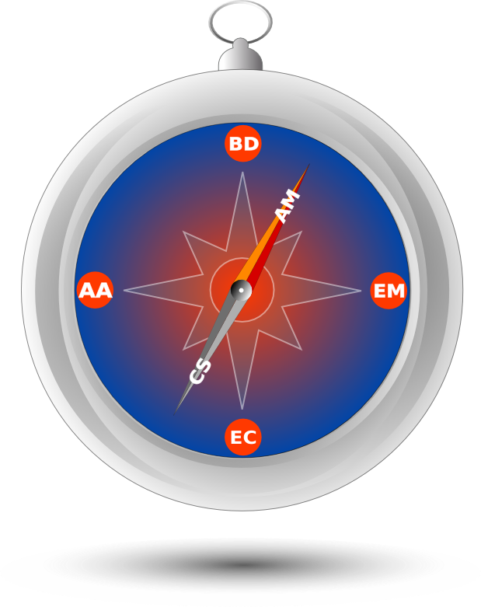
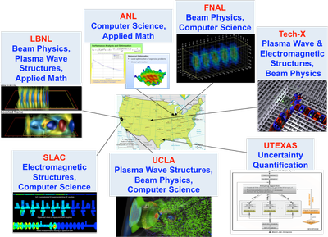
Accelerator Simulation and ComPASS
Community Project for Accelerator Science and Simulation (ComPASS) collaboration
  Mission is to develop and deploy the state-of-the-art accelerator modeling.
  DOE CompHEP+ASCR funding through SciDAC
  Collaboration includes national labs, universities and one company
Fermilab is the lead institution on ComPASS
  More discussion of accelerator simulation to follow…

Slide 10
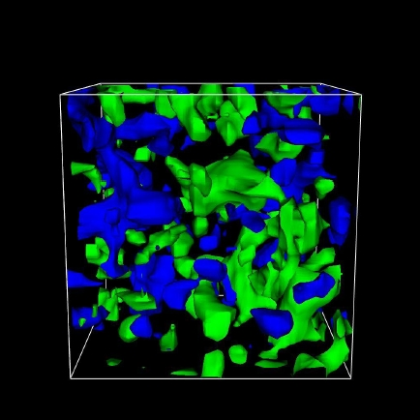
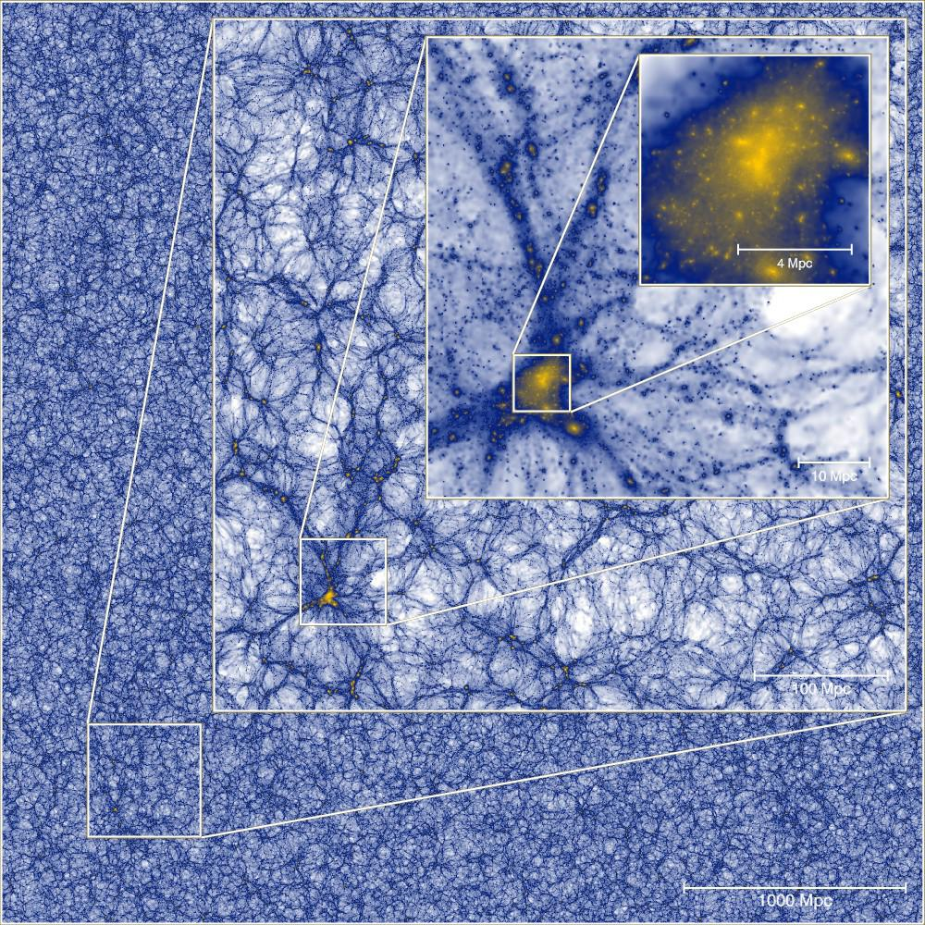
Science on HPC
The point of these shared facilities and competencies is producing science.
  Lattice QCD is covered in other cross-cutting sessions.
  Cosmology is covered in other cross-cutting sessions.
I will focus on Accelerator Simulation.
  Accelerator simulation serves HEP by enabling accelerator technology.
    Directions must be in sync with HEP priorities.
    Work is done in collaboration with Fermilab’s Accelerator Division and other accelerator facilities, especially CERN.

Slide 11
Accelerator Simulation Directions Set by Lab Goals
We choose simulation topics based on Lab goals, which are ultimately driven by P5 goals.
  Extend the scientific reach of existing accelerator facilities
    Simulate existing Booster, Delivery Ring, Recycler and Main Injector.
  Launch a test facility to enable “transformative” Accelerator Science
    Simulate the Integrable Optics Test Accelerator (IOTA).
      IOTA is an experimental machine to explore using intrinsically nonlinear dynamics to overcome intensity limitations inherent to ordinary linear machines.
  Establish Fermilab as essential contributor to future large accelerators
    Simulate LHC Injectors for HL-LHC.

Slide 12
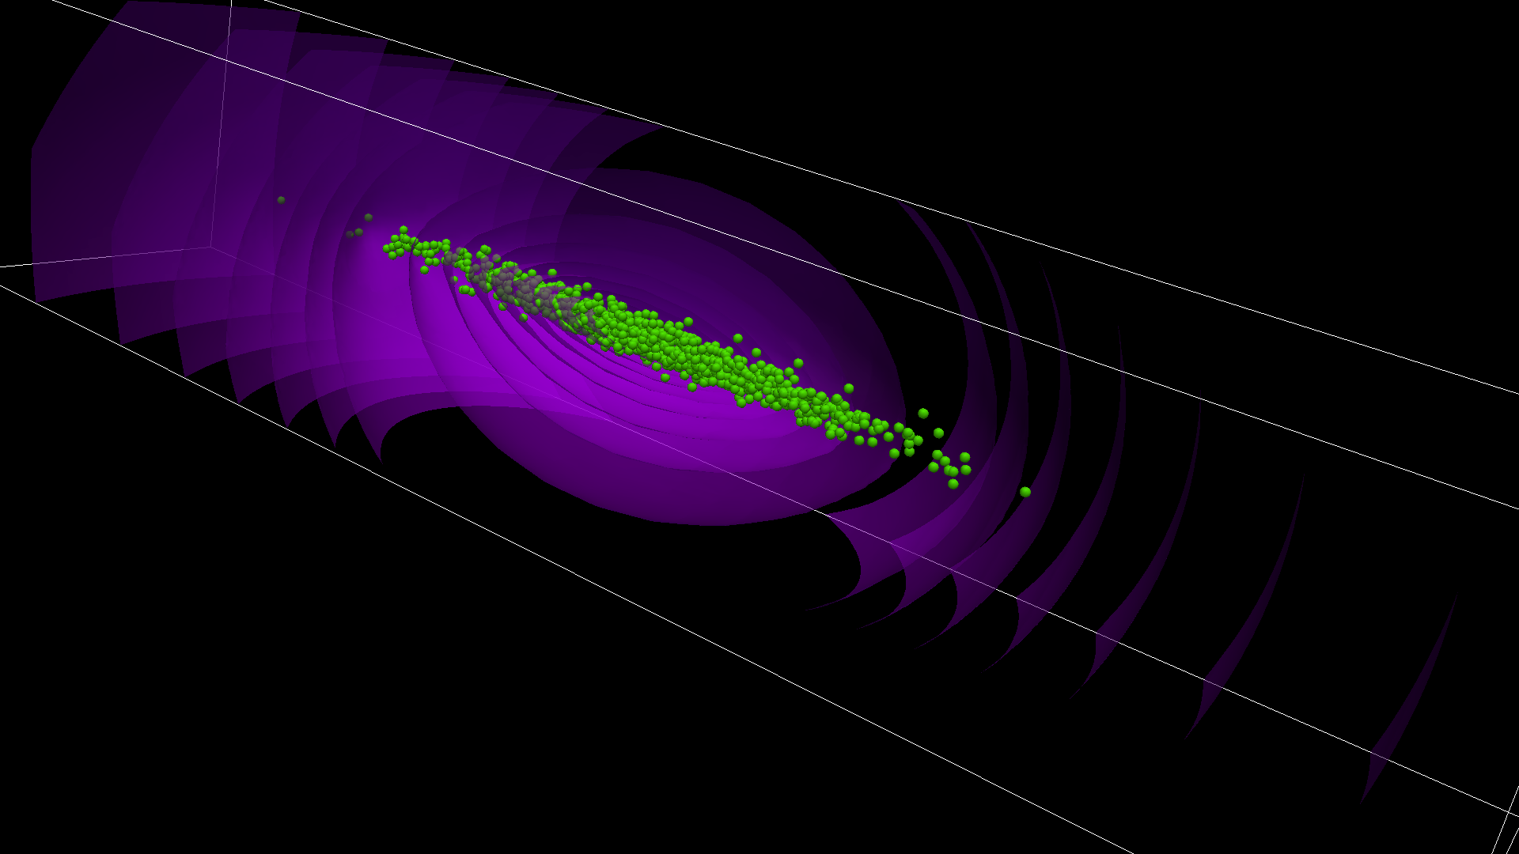

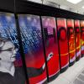
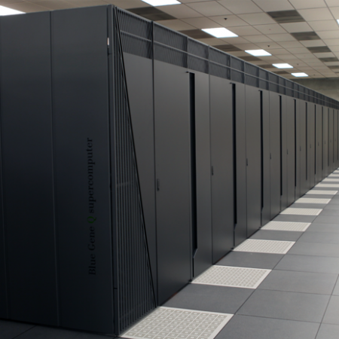
Synergia
Beam Dynamics Framework
  Developed at Fermilab with support from SciDAC ComPASS Collaboration (CompHEP+ASCR)
    Fermilab leads ComPASS
Advanced capabilities
  Collective effects
  High precision through high statistics (many particles)
  Single- and multi-bunch physics
    Multi-bunch capability is unique to Synergia
Runs on everything from laptops to supercomputers
Synergia also used to teach students from around the world at the US Particle Accelerator School
(e.g., two weeks ago)

Slide 13
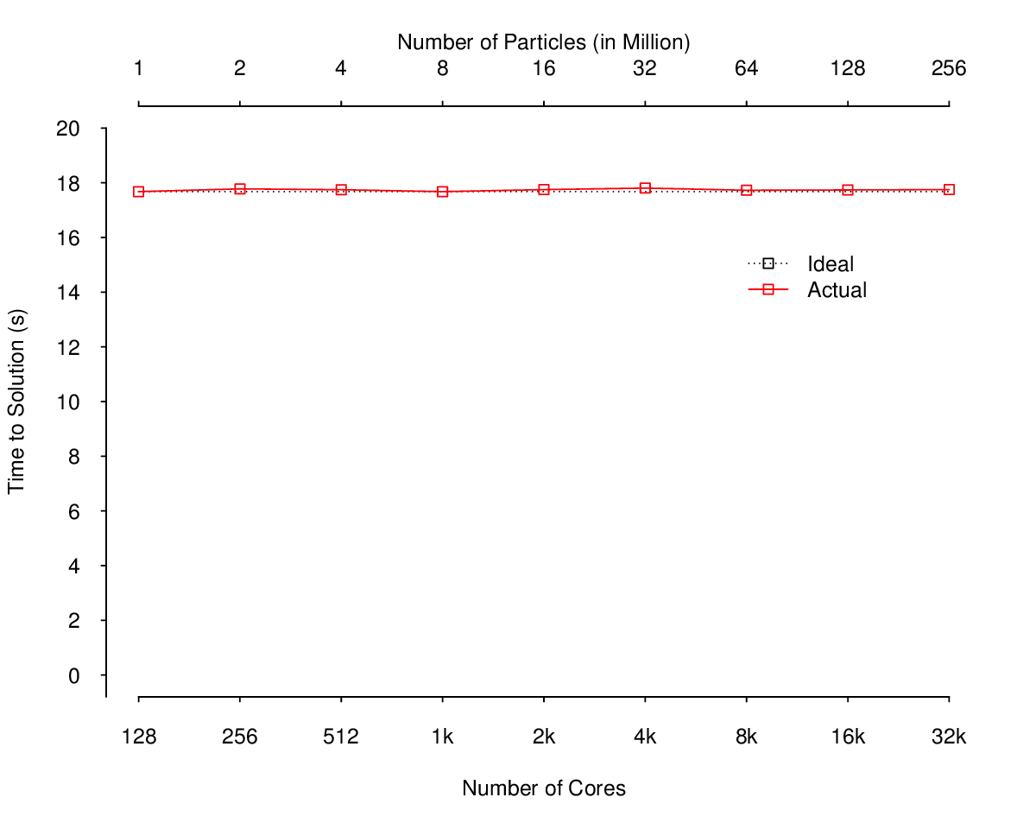
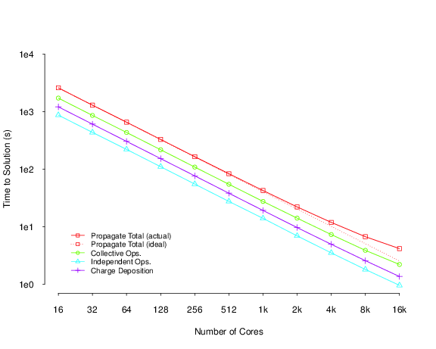
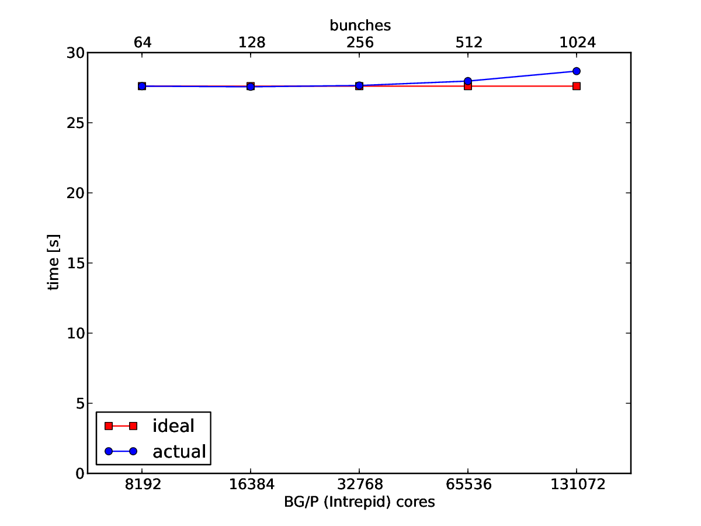
Synergia and Current-Generation HPC
Synergia was constructed for HPC
  Core model is MPI + (optional) OpenMP
  Strong scaling over 1000x
  Weak scaling to 100,000+ cores
Weak scaling from 1M to 256M particles
128 to 32,768 cores
Single-bunch strong scaling from
16 to 16,384 cores
32x32x1024 grid, 105M particles
Weak scaling from 64 to 1024 bunches
8192 to 131,072 cores
Up to over 10¹⁰ particles

Slide 14
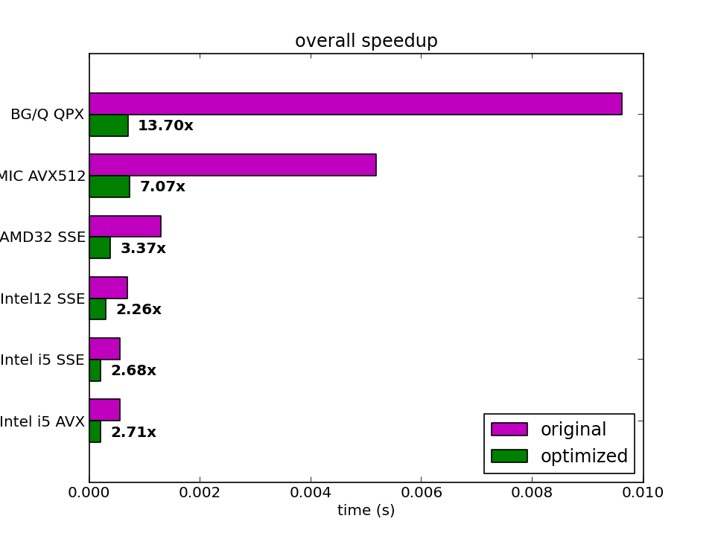
Synergia and Next-Generation HPC
Dramatic changes in near future HPC architectures
  Supercomputers and clusters alike
    OLCF’s Summit: GPU + PowerPC
    NERSC’s Cori: Intel MIC
Synergia GPU and MIC ports in progress
  Using shared expertise and facilities
First production-level GPU results
Vectorization benchmark for MIC

Slide 15
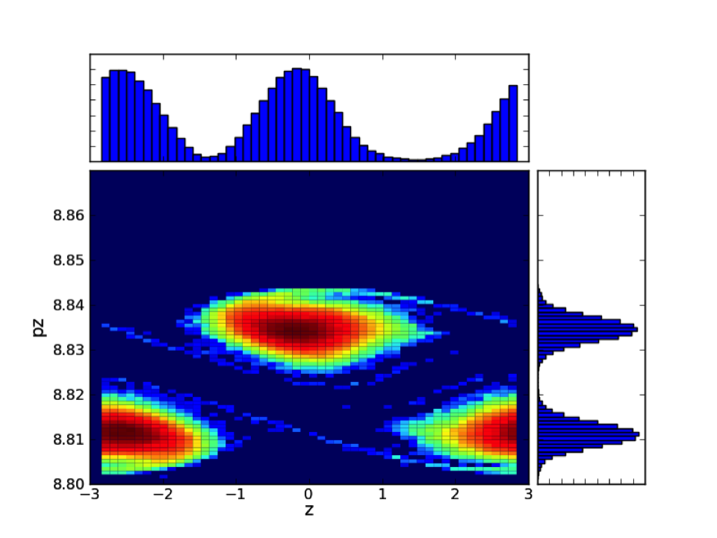
Synergia Applications
  Lab Goal: Extend the scientific reach of existing accelerator facilities
    Simulate the Main Injector and Recycler under high intensities
      Work done with Accelerator Division Main Injector personnel
      Multi-bunch capabilities in Synergia used to simulate slip stacking
        Slip stacking uses RF to combine multiple bunches to increase intensity

Slide 16
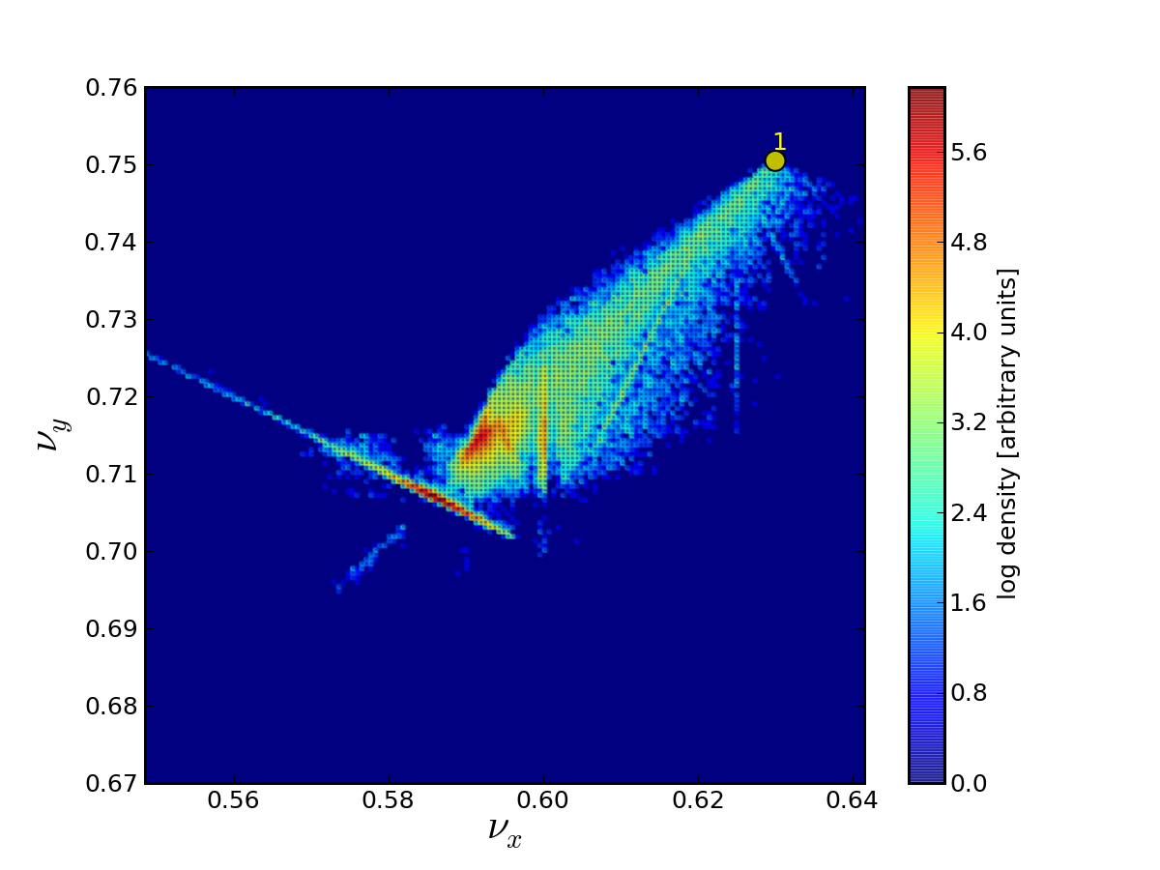
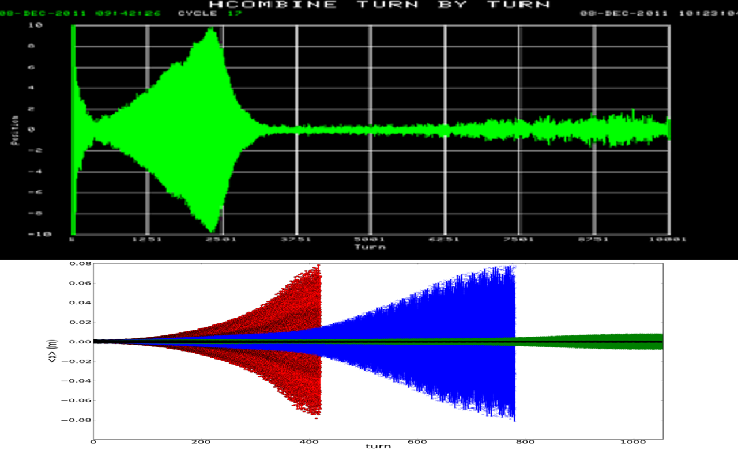
Synergia Applications, continued
Resonant extraction in the Delivery Ring for Mu2e
  Work done with Accelerator Division Muon personnel
  Important collective effects
Multi-bunch instability in the Booster
  Work done with AD Proton Source personnel
  Requires multi-bunch physics with
  collective effects

Slide 17
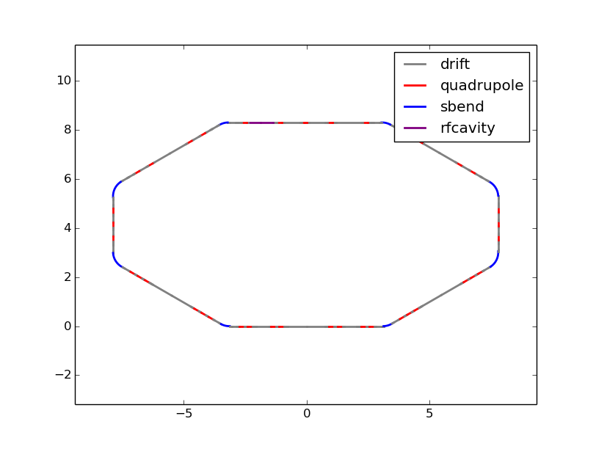
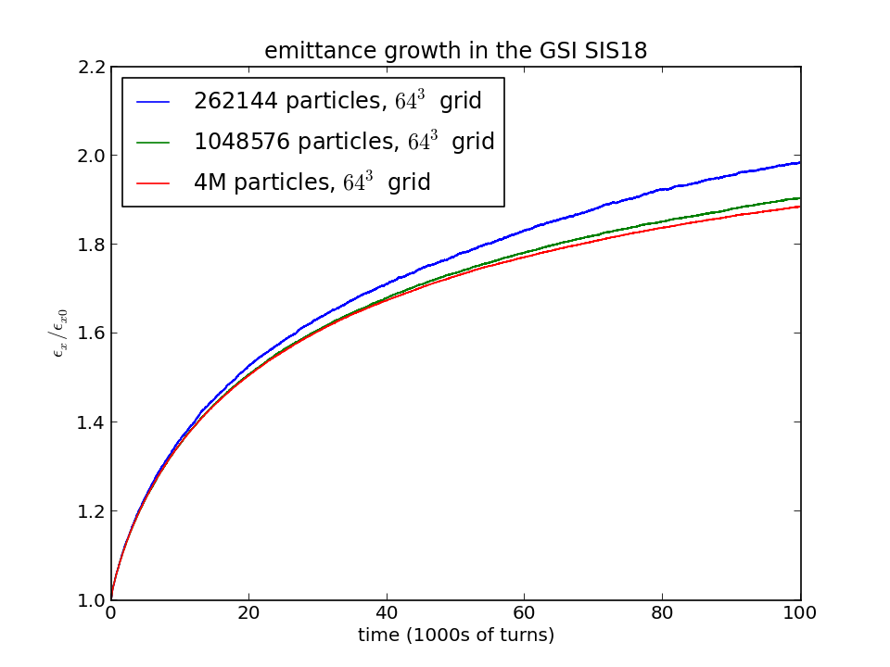
Other Synergia Applications
  Lab Goal: Enable “transformative” Accelerator Science
    Synergia extended to handle nonlinear lens for IOTA
    Work done with Accelerator Physics Center personnel
  Lab Goal: Establish Fermilab as essential contributor to future large accelerators
    Synergia benchmarking exercise and simulations for HL-LHC
    Work done with CERN Accelerator personnel
71 steps/turn
7,100,000 steps (~ 7 million)
4,194,304 particles (~ 4 million)
29,779,558,400,000 particle-steps (~ 30 trillion)
1,238,158,540,800,000 calls to “drift”
(~ 1 quadrillion)

Slide 18
Conclusions
Three scientific areas at the lab use significant HPC resources
  Lattice QCD, Cosmology, Accelerator Simulation
Share facilities
  Acquired, deployed and operated by Computing
  Used by all
Share Competencies
  Computational Physics
  HPC programming and optimization
Produce science aligned with lab priorities
  Accelerator simulation in support of P5/Lab goals

