Slide 1
Accelerator Program
Sergei Nagaitsev
Fermilab Institutional Review
10 February 2015

Slide 2
Fermilab after the Tevatron
Fermilab operates the largest accelerator complex in the U.S., 2nd largest in the world (even after termination of the Tevatron)
Apr 2012 – Sep 2013, ~18 months have been spent in shutdown and commissioning, adapting the accelerator complex after the end of the Tevatron era
Present mission: deliver high-intensity proton beams to explore the Neutrino Sector and rare decays

Slide 3
What is on our plate?
Operating the Fermilab accelerator complex
MI beam power ramp-up (part of operations)
350 kW (now) to 700 kW in mid. FY16
Proton Improvement Plan (PIP) in Linac and Booster
a multi-year campaign managed like a project, but constrained within operations
Muon Campus projects (4 AIPs)
Test facilities (cryo plants, beam test facilites, SRF, magnet)
Projects: Muon g-2, Mu2e, LBNF, LCLS-II (at SLAC), PIP-II
Programs: MAP, LARP, ILC
Research: HFM, HPT, SCRF, R&D towards cost-effective technologies, accelerator science, SC materials, new computational methods, new beam diagnostics, future colliders.
Commercialization of our accelerator technologies.

Slide 4
Accelerator Operations
Fermilab operates a total of 16 km of accelerators and beamlines
A 400-MeV proton linear accelerator (0.15 km)
An 8-GeV Booster synchrotron (0.5 km)
An 8-GeV accumulator ring (3.3 km)
A 120-GeV synchrotron (3.3 km)
Soon: A Muon Campus Delivery ring (0.5 km)
Soon: Muon g-2 ring
Transfer lines and fixed target beam lines (8 km)
Two high power target stations, several low-power targets
And maintains
130 buildings, structures, service bldgs,…

Slide 5
Fermilab Accelerator Complex
Linac: MTA
BNB: MicroBooNE
NuMI: MINOS+, MINERvA, NOvA
Fixed Target: SeaQuest, Test Beam Facility, M-Center
Muon: g-2, Mu2e (future)
Also, test and R&D facilities:
ILC Cryomodule
IOTA
SRF
Cryo
PXIE

Slide 6
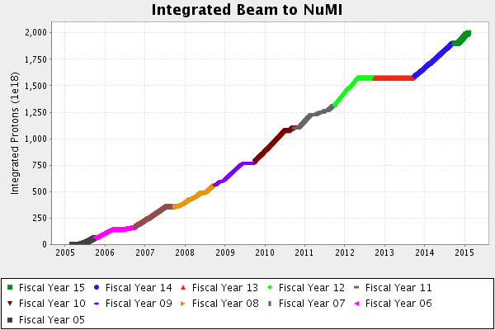
Accelerator Performance for NuMI
Started delivering protons to NuMI in 2005
~1.55e21 in 7 years; NOvA goal is 3.6e21
Most intense high energy neutrino beam in the world

Slide 7
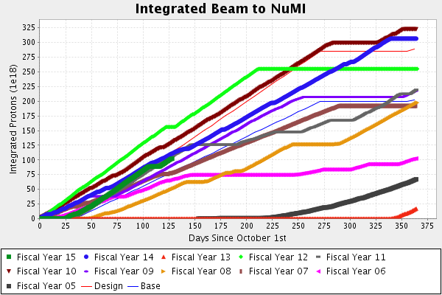
FY14 was the second best year, ~3.1e20 POT

Slide 8
Accelerator Upgrades for NOvA
Provided the capability to increase power on target to 700 kW
Slip Stacking in Recycler
1.33 second cycle in Main Injector
Target station upgrades
v energy configuration
to handle increased power
Element of NOvA Project
14 kton detector in Ash River MN
CD-3b Oct 2009
CD-4 Sep 2014

Slide 9
Operations for NuMI (during Tevatron ops)
Recycler was used for pbar cooling
11 batch injection into Main Injector & slip stacking
10/15 second to accumulate beam in MI
Ramp to 120 GeV and extract
takes 1.533 seconds
2 batches for pbar production ~8e12, 70 kW
9 batches to NuMI target ~3.5e13, 305 kW
Total cycle duration: 2.2 seconds
5 Hz demand on Booster

Slide 10
NOvA operations
Injection and Slip Stacking in Recycler Ring
Cut 2/3 second for injection from cycle time;
12 batches from Booster instead of 11
Single turn transfer to MI
Ramp to 120 GeV
Faster ramp: 1.333 second
All 12 to NOvA target: ~4.9e13, 706 kW
1.333 second cycle
9 Hz demand on Booster
12 consecutive pulses
1.4e17/hour
Target Station: new horn configuration and new target design

Slide 11
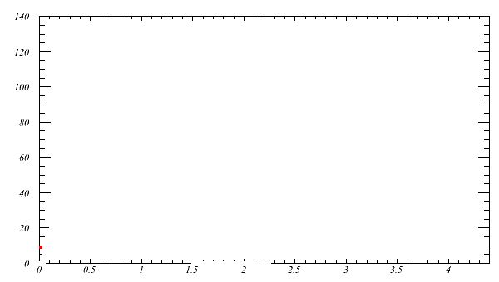
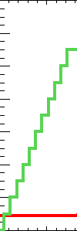
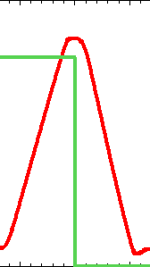
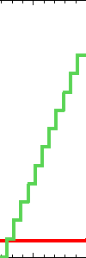
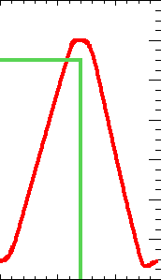
Before NOvA
Previous operation:
H- linac at ~35 mA
Charge exchange injection into Booster 10-11 turns: 4.3e12
11 pulses (at 15 Hz) into Main Injector with RF slip stacking
Ramp to 120 GeV at 204 GeV/s and extract to NuMI target

Slide 12
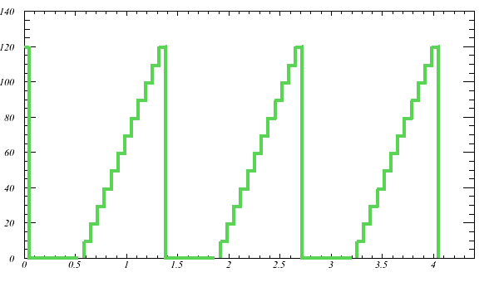
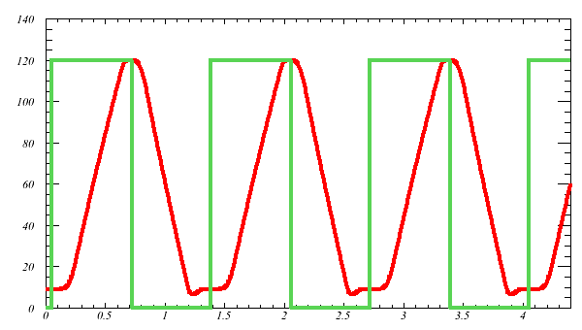
Increasing Beam Power to 700 kW
Move slip-stacking to recycler
11 batch -> 12 batch
Increase Main Injector ramp rate (204 GeV/s -> 240 GeV/s)
380 -> 700kW with only ~10% increase in per-pulse intensity
Peak intensity 10% just more frequent
Recycler
Main Injector
Notes:
at limit for increasing beam intensity, what other approaches are available?

Slide 13
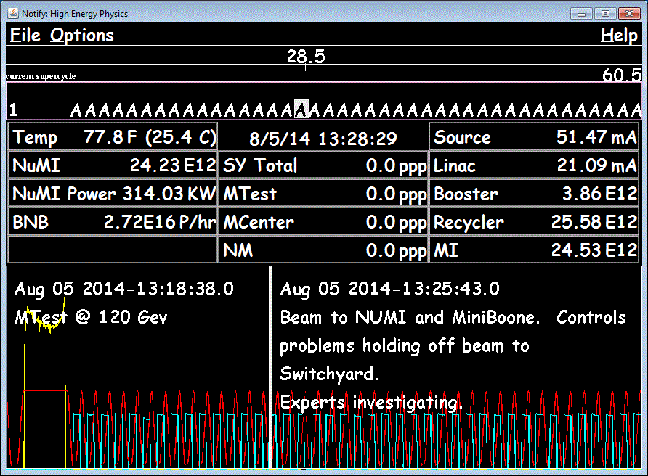
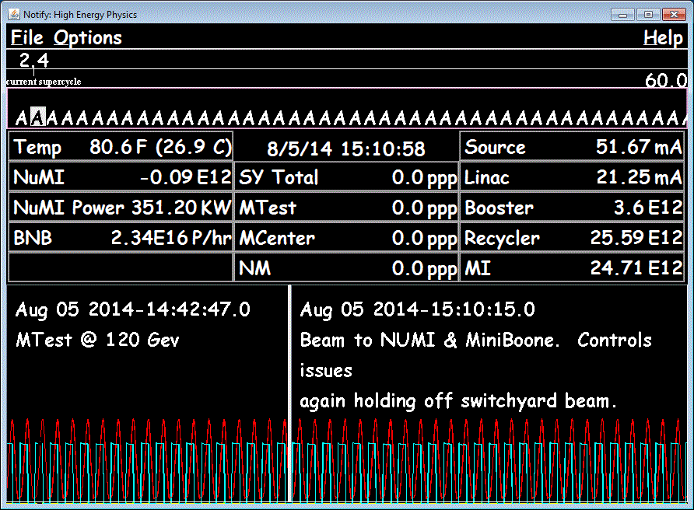
MI Beam power with and without slow extraction
350 kW with ½ intensity

Slide 14
Current MI operation and plans
We are delivering ~2.5E13 ppp every 1.333sec by using the Recycler as a proton stacker (6 Booster batches, no slip stacking)
350 kW beam power (320 kW with slow extraction)
No instability under normal operating conditions.
Working on commissioning the 2+6 operation, achieving 450 kW of beam power (within one month).
Requires 6 Hz Booster operation (achievable today).
Gradually increase the number of the slipped stacked batches.
We can test 4+6 operation, with the current Booster rep rate (7.5 Hz, achievable as a test with no beam to MicroBooNE).
Identify any show stoppers.
It’s all about beam losses.

Slide 15
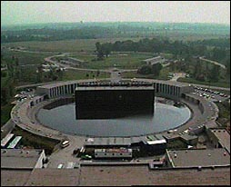
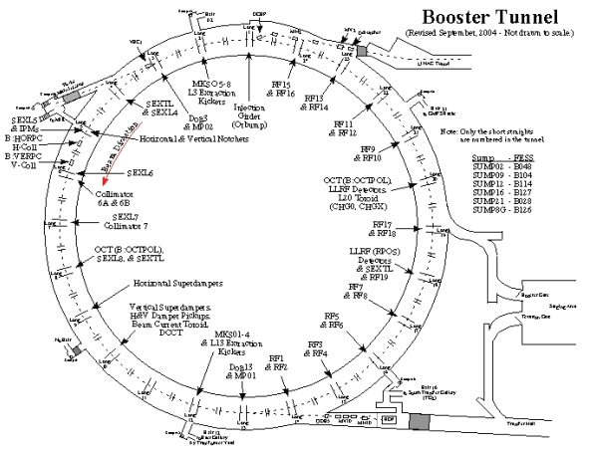
Fermilab Booster
Booster is a resonant machine running at 15 Hz
RF is pulsed, limited to ~7.5 Hz
at higher frequencies the cavities spark
at higher frequencies the tuners overheat
Refurbishment plan to achieve 15 Hz is part of PIP
There is an RF pre-pulse associated with beam cycles
It means that the actual beam pulse rate is less than 7.5 Hz
Need at least 9 Hz for NOvA 12-batch slip-stacking

Slide 16
PIP Goals and Scope (Established in 2011)
Goals:
Increase the beam repetition rate from the present ~7 Hz to 15 Hz
Eliminate major reliability vulnerabilities and maintain reliability at present levels (>85%) at the full repetition rate
Eliminate major obsolescence issues
Increase the proton source throughput, with a goal of reaching >2E17 protons/hour
Presently operating at <1E17 protons/hour
Ensure a useful operating life of the proton source through at least 2025
Now extended to 2030 to accommodate the PIP-II schedule
PIP is NOT a Project but a campaign of many activities scheduled around the on-going 24/7 operations by the same people (by lab and DOE choice)
It is managed like a project
budget, schedule, WBS, milestones, project controls..

Slide 17
15 Hz operations: Booster rf cavities
Booster has 22 slots for rf cavities
We can not run (4.3e12) beam with fewer than 17 cavities.
We now have 20 cavities on hand
At any given time: 17 are installed, 2 are out for repair
each cavity requires 3 tuners. Tuners require 3 weeks to rebuild during the 10-week refurbishment process.
Our plan is to have 17 refurbished cavities before this summer’s shutdown (July 2015).

Slide 18
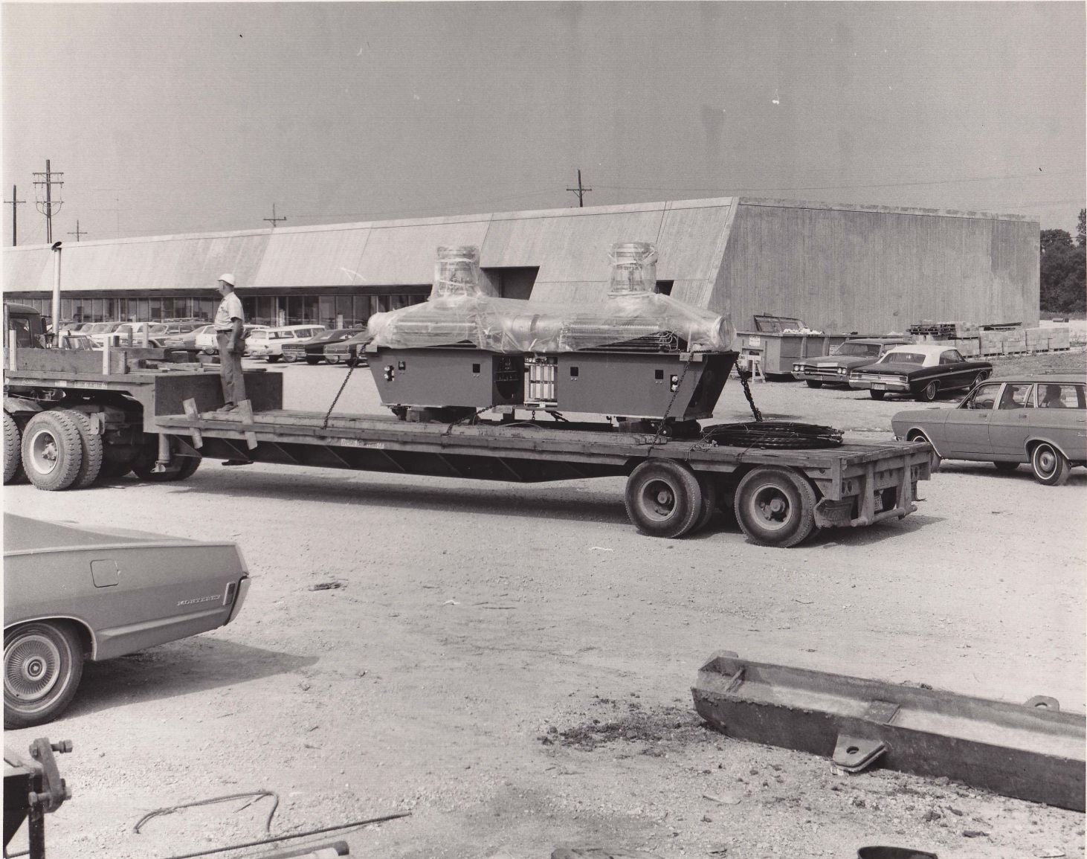
Booster RF cavities
July 1970 Flatbed semi delivering Booster RF cavity pair
Cavities built by GE

Slide 19
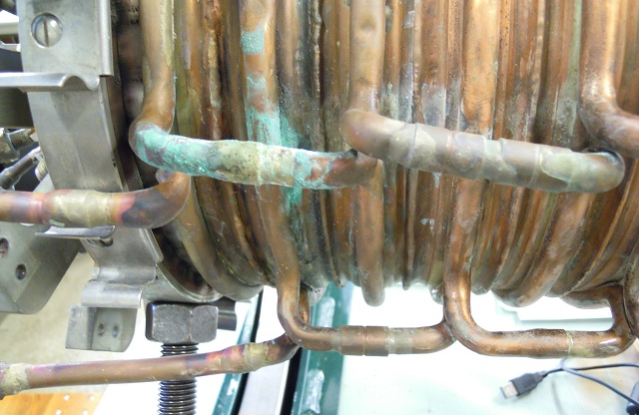
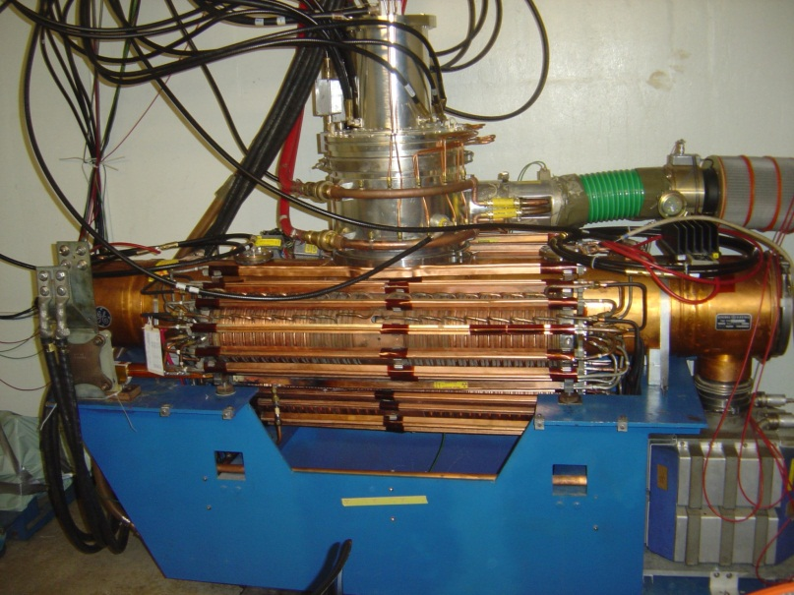
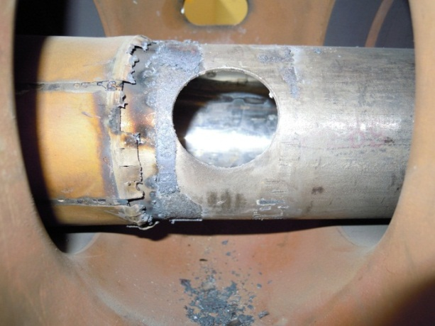
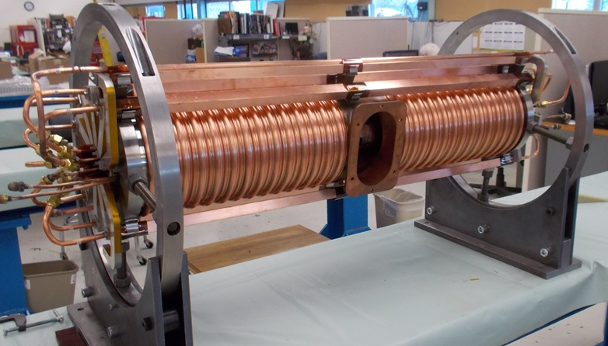
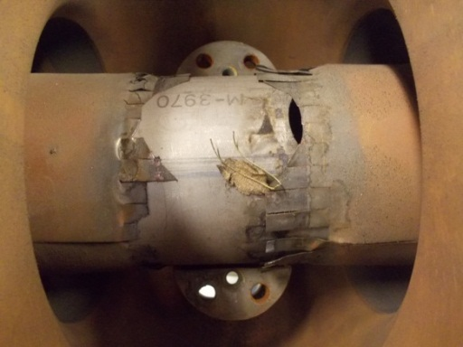
PIP – Booster Cavity Refurbishment
Cavity work: 2 – 4 weeks
Tuner work: 4 weeks
Tuner installation: 1+ week
RF testing: 1+ week
Potential delays: vacuum and water complications
Rate of repair improved by 1.5 wk
Additional 20th cavity being tested 15 Hz (salvaged original cavity – major rebuild)
After 2+ years vendor able to produce suitable ferrite for new tuners
Old cavities had many problems - especially the tuners:
Water Leaks
Burnt RF Fingers
Connection Flange
First new tuner – built & tested

Slide 20
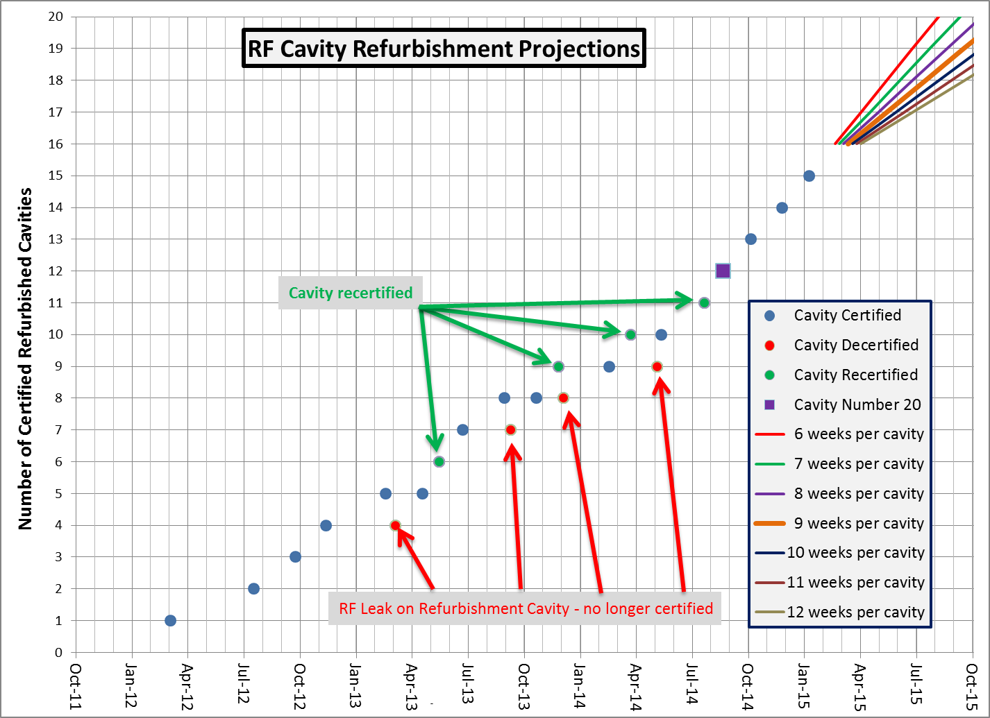
Goal is to have all installed stations (17) refurbished and operated at 15 Hz before summer shutdown.
PIP – Booster Cavity Refurbishment
East Gallery Completed - running 15 Hz tests
Additional Labor Added
Summer Shutdown
Starts
When PIP completed, Booster will have 22 stations capable of 15 Hz operations.
Updated January 8, 2015 by K Gollwitzer

Slide 21
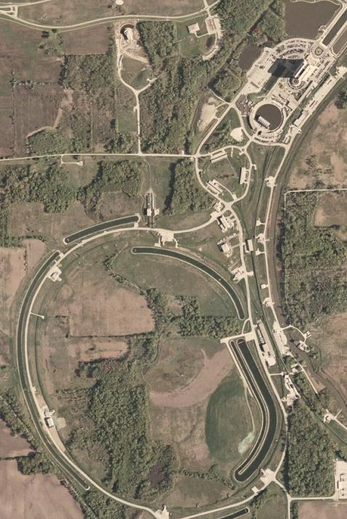
Proton Source – Flux delivery plans
NOνA
~ 1.3 E17 pph
Mu2e
Muon Production
~ 2.0 E16 pph
Fixed Target
~ 2.0 E14 pph
g-2
Muon Production
~ 6.0 E16 pph
Booster Neutrino Beamline
~ 3 to 8 E16 pph

Slide 22
POT Projections: FY16 & FY17
 | NuMI (e20) | BNB (e20) | g-2 (e20)
FY16 Range | 4.2 – 6.0 | 1.4 – 2.1 | 0
FY16 Target | 4.8 | 1.7
FY17 Range | 4.7 – 6.8 | 2.7 – 3.9 | 0.72 – 0.85
FY17 Target | 5.4 | 3.1 | 0.76
Target: (2 * lower + upper)/3
metric used in previous years

Slide 23
Proton Program Management Group (aka Proton PMG)
Sets expectations and monitors progress against accelerator performance goals and projections;
Reviews of all accelerator impact statements prepared for incoming proposals to the Fermilab Physics Advisory Committee (PAC);
Establishes and monitors accelerator operating schedules, including the annual shutdowns;
Focuses on PIP, resource management and ES&H.
Monthly meetings; Experimental spokespersons and operations coordinators, Directorate Management and Program Planning, observers from the U.S. DOE HEP and Fermi Site Office.

Slide 24
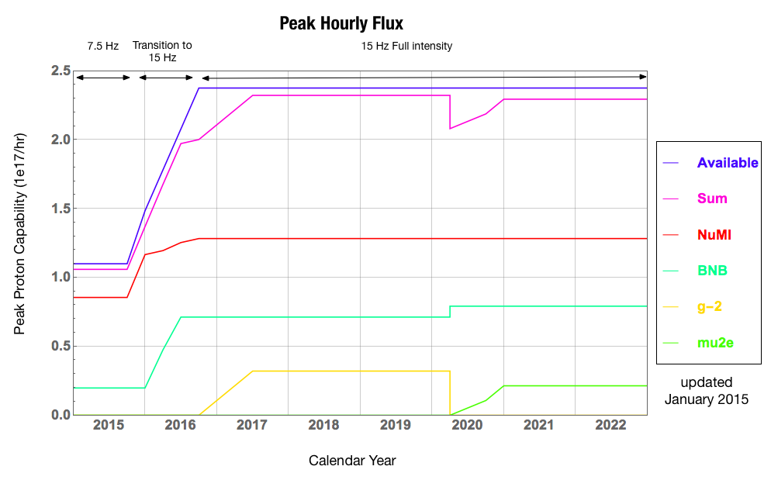
Proton delivery scenario (approximate)

Slide 25
Proton Improvement Plan-II (PIP-II, Fermilab)
Goal: Provide >1 MW at the time of LBNF startup (~2023)
800 MeV superconducting pulsed linac + enhancements to existing complex; extendible to support >2 MW operations and upgradable to continuous wave (CW) operations
Builds on significant existing infrastructure
Capitalizes on major investment in superconducting rf technologies
Eliminates significant operational risks inherent in existing linac
Siting consistent with eventual replacement of the Booster as the source of protons for injection into Main Injector
Whitepaper available at
projectx-docdb.fnal.gov/cgi-bin/ShowDocument?docid=1232

Slide 26
PIP-II schematic (see S. Holmes’ talk)
120 GeV
Main Injector
8 GeV
Recycler
1.2 MW
target
New 800 MeV
SRF Linac
Existing 8 GeV
Booster

Slide 27
PIP-II Performance Goals
Performance Parameter | PIP-II
Linac Beam Energy | 800 | MeV
Linac Beam Current | 2 | mA
Linac Beam Pulse Length | 0.5 | msec
Linac Pulse Repetition Rate | 20 | Hz
Linac Beam Power to Booster | 13 | kW
Linac Beam Power Capability (@>10% Duty Factor) | ~200 | kW
Mu2e Upgrade Potential (800 MeV) | >100 | kW
Booster Protons per Pulse | 6.4×10¹²
Booster Pulse Repetition Rate | 20 | Hz
Booster Beam Power @ 8 GeV | 120 | kW
Beam Power to 8 GeV Program (max) | 80 | kW
Main Injector Protons per Pulse | 7.5×10¹³
Main Injector Cycle Time @ 120 GeV | 1.2 | sec
LBNF Beam Power @ 120 GeV* | 1.2 | MW
LBNF Upgrade Potential @ 60-120 GeV | >2 | MW
*LBNF beam power can be maintained to ~60 GeV, then scales with energy

Slide 28
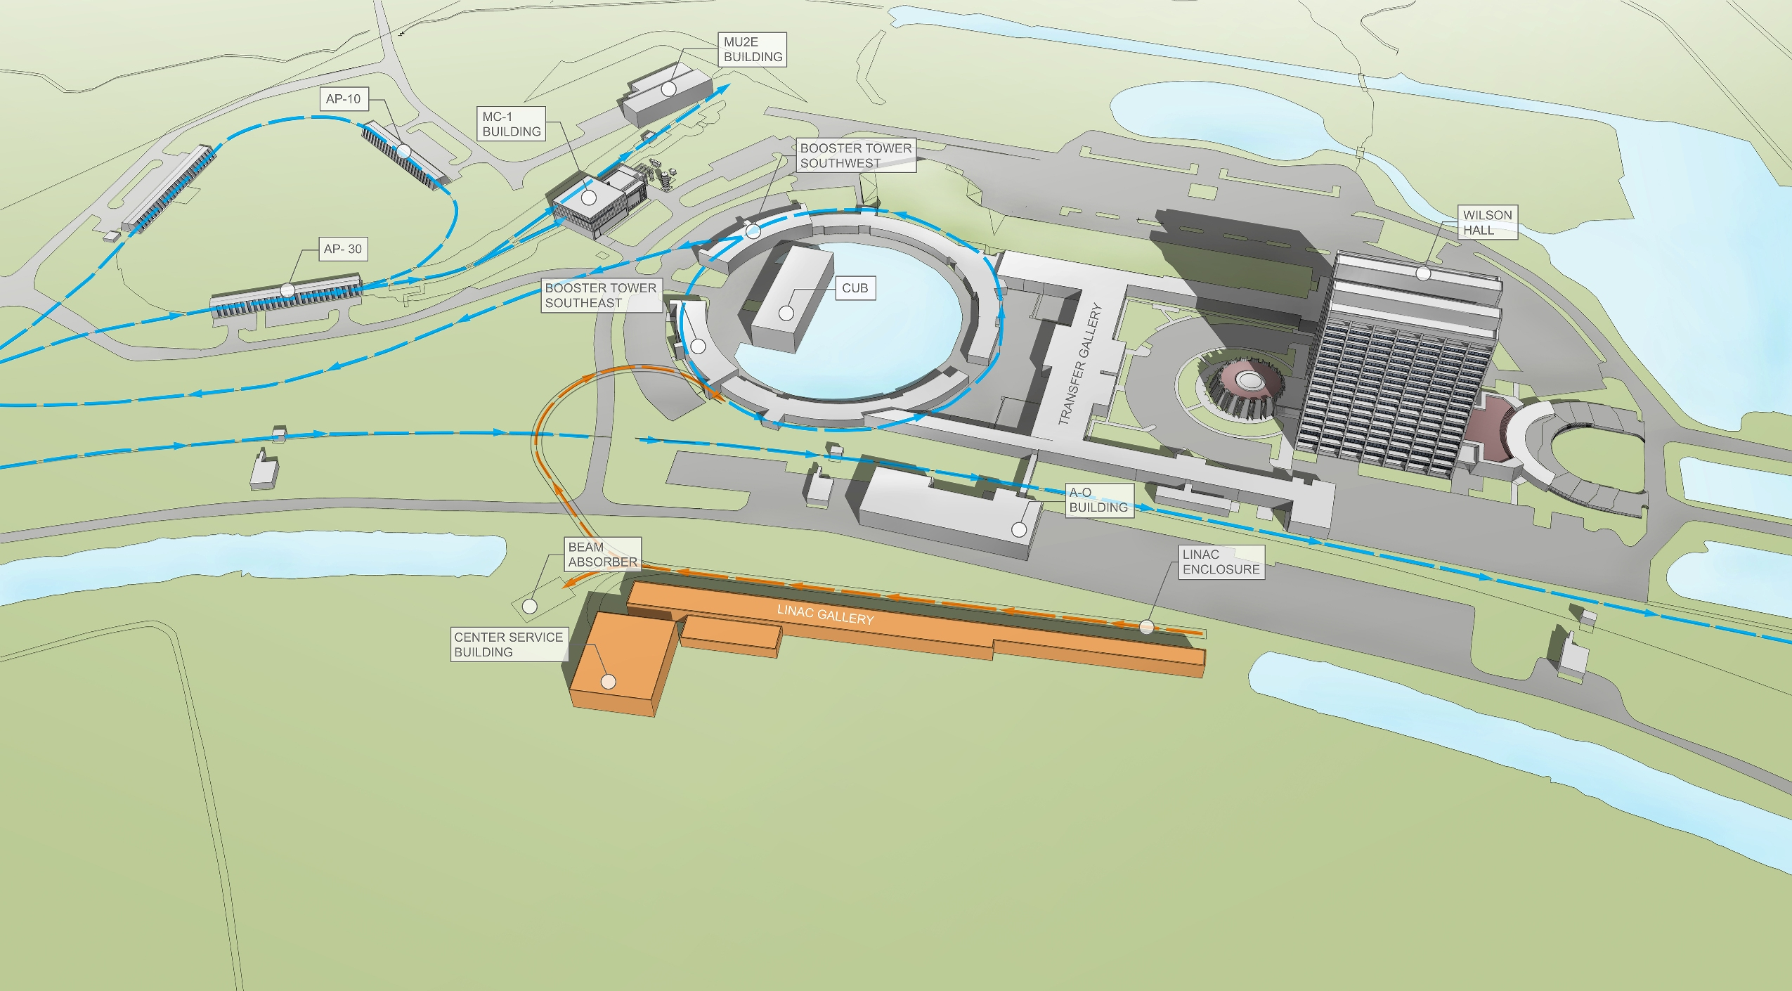
PIP-II Site Layout (provisional)

Slide 29
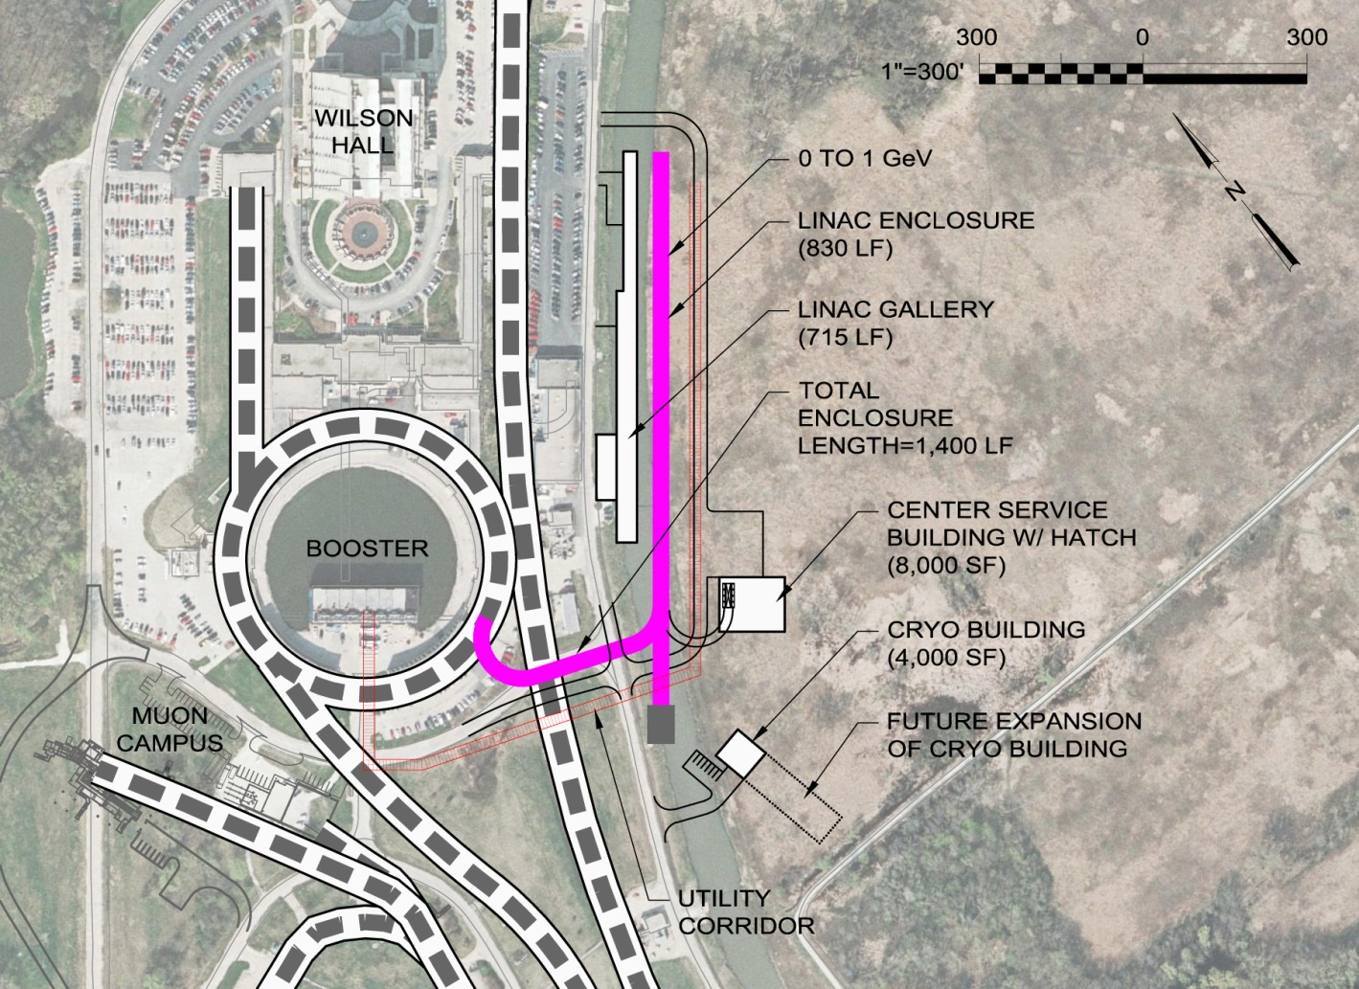
PIP-II Status
Development phase
R&D program supports 2018-2019 construction start
Collaboration with India
Strong support from P5, U.S. DoE, and the Fermilab Director
Five year construction period would support operations startup in 2023

Slide 30
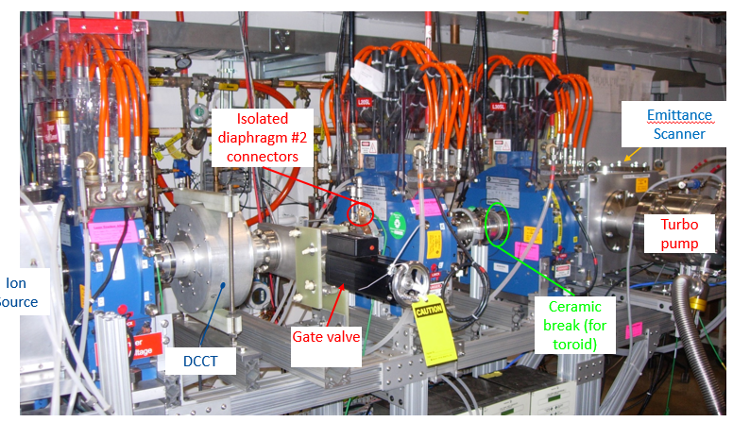
PXIE : Front End Test of PIP-II H- Source thru SSR1
PIP-II R&D facility under operation to address technical risks: source, warm RFQ, SC HWR and SSR1
Reaserch goal: demonstrate feasibility of the most technically challenging PIP-II front end systems
Technical challenge: to demonstrate fast beam chopping pre-chopping, operation of SSR with beam, emittance preservation and beam halo formation through the front end
FY14 highlights: 30 keV IS and LEBT installed and commissioned with beam
Partnerships
ANL: HWR
LBNL:LEBT, RFQ
SNS: LEBT
BARC: MEBT, SSR1
Operations: 2014 -

Slide 31
R&D toward multi-MW beams and targets at Fermilab
Beyond PIP-II (mid-term)
Strategy after PIP-II depends on the technical feasibility of each option and the analysis of costs/kiloton versus costs/MW
R&D on cost-effective SRF, control of beam losses in proton machines with significantly higher currents (Q_{SC}) and on multi-MW targets
Establishing IOTA facility to explore novel approaches to rings
Significant contributions from universities and lab partners
See V. Shiltsev’s presentation
PIP-II

Slide 32
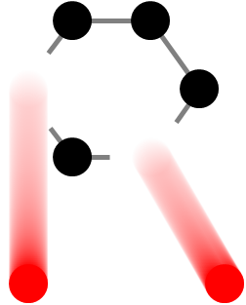
High Power Targetry R&D Status and Plans
RaDIATE Collaboration (Radiation Damage in Accelerator Target Environments)
MOU revision (adding 7 institutions) received DOE approval
NuMI beryllium beam window Post-Irradiation Examination (PIE) at Oxford
Planning for low-energy ion irradiation studies at various universities
Continuing PIE at BNL of irradiated graphite (2009)
Other activities
Design of compact fatigue tester for hot cell use
Evaluation of new/upgraded irradiation facilities for HEP-HPT purposes
NuMI primary beam Be window dose map comparison
Radiographic film (left) versus MARS calculation (right) shows good agreement
Undergoing micromechanical evaluation of material properties

Slide 33
LARP
Fermilab has been collaborating with other US labs as part of LARP since its inception in 2003
Expect HL-LHC Upgrade project to start in 2018 with FNAL working on construction and testing of cold masses for IR quads

Slide 34
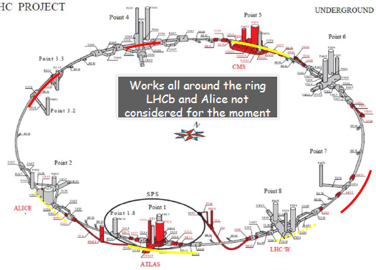
The HL-LHC Project
Physics driven requirements:
Increase luminosity limiting Pile-Up (PU) to ~140 events/crossing
L = 5 x 10³⁴ cm⁻² s⁻¹
Limit PU linear density to ~1 event/mm
Lepton Isolation at online Trigger Level
LARP Involvement
U.S. Leadership
New IR-quads Nb₃Sn (inner triplets)
Crab Cavities
Beam Dynamics
New 11 T Nb₃Sn (short) dipoles
Collimation upgrade
Cryogenics upgrade
Machine protection
…
Major intervention on more than 1.2 km of the LHC

Slide 35
CERN FCC
CERN is undertaking an integral design study for post-LHC particle accelerator options in a global context. The Future Circular Collider (FCC) study has an emphasis on proton-proton and electron-positron (lepton) high-energy frontier machines.
To be delivered before the end of 2018.
Collaboration with US partners and CERN on high-field magnets.
Contribute to accelerator design studies:
University partners: Duke (physics), NIU, MSU (both machine)
Fermilab: Tevatron experience, MARS expertise (MDI, collimators)

Slide 36
Summary
Fermilab is ready for the Intensity Frontier
highest power neutrino beam at present
well-defined strategy to maintain world leadership (PIP-II)
Accelerator improvements will soon enable the SBN and the muon program (Muon g-2, Mu2e)
concurrently with NOvA
R&D toward multi-megawatt beam power and targets on the way
IOTA, SRF, HPT, RaDIATE
Significant contributions at present and in the future to:
LARP, MAP, LCLS-II
Continue to work with our partners on FCC and ILC design.

