Slide 1
Overview of
Fermilab Detector
Research and Development
Erik Ramberg
Institutional Review
10 February, 2015

Slide 2
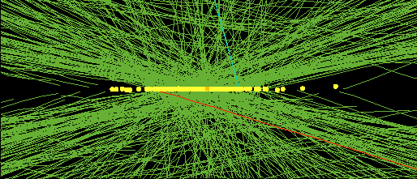
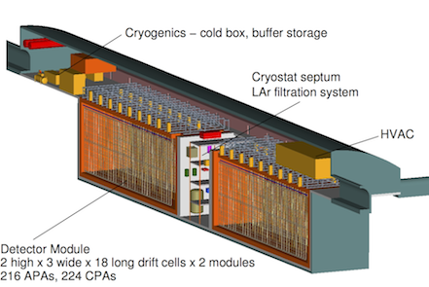
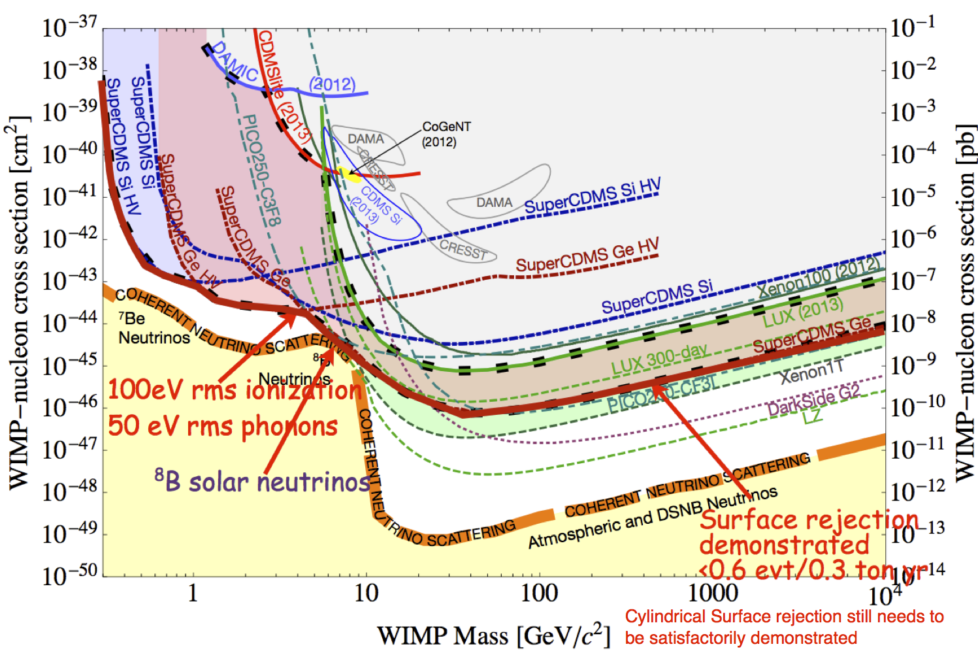
Priorities in the Frontiers of Detector R&D
Energy Frontier:
  Vertex sensors will have to withstand a total fluence of 10¹⁶ particles/cm²
  At full luminosity, several hundred overlaid events per 25 nsec crossing will make current triggers untenable
Intensity Frontier:
  LBNF will require high-performance, low cost multi-kton liquid Argon TPC’s, with cold electronics
  Ultra-fast, ultra-thin and rad hard photodetectors, trackers and calorimetry will become the norm
Cosmic Frontier:
  Dark matter detectors will need background levels of less than 1 nuclear recoil per ton per year
  Spectrophotometry of large sky surveys need new methods to efficiently measure red-shifts in coincidence with position.
Fermilab has a coordinated portfolio of detector research projects that are designed to meet these priorities
2

Slide 3
Examples of cross–cutting in Detector Research
Fermilab detector R&D cuts across the frontier boundaries:
  Liquid Argon program for neutrino detectors shares facilities and techniques with Dark Matter program
  Ultra fast photon timing detectors are used in intensity frontier experiments, CMS and astrophysics
  Silicon Photomultiplier characterization and readout used in all frontiers
  CCD team uses DES sensors for Dark Matter search
  3D ASIC architecture development can be used in CMS, Electron Collider and X-ray sources such as LCLS-2
  Fermilab Test Beam Facility supports many Fermilab led detector R&D projects
3

Slide 4
Fermilab Detector R&D Organization
The “Detector Advisory Group” consists of:
  Technical Point of Contact Erik Ramberg (PPD)
  Silicon tracking representative Ron Lipton (PPD)
  DAQ and Triggering rep. Alan Prosser (SCD)
  Calorimetry and photodet. Rep. Jim Freeman (PPD)
  Liquid Argon R&D representative Stephen Pordes (ND)
  Astrophysics detectors rep. Juan Estrada (PPD)
  External Representative Ulrich Heintz (Brown University)
  External Representative Cecilia Gerber (University of Illinois, Chicago)
  Various PPD/SCD/ND management are members ex-officio.
Members monitor activity within their area, give advice on the future of the program and participate in reviews
Detector R&D Point of Contact informs the Division Heads and Offices of Research and Computing of plans rising out of group discussions and reviews.
After consultation with DOE, Division Heads and CRO then decide on approval of major new thrusts
4

Slide 5
Portfolio’s of R&D projects overseen by the Detector Advisory Group
5

Slide 6
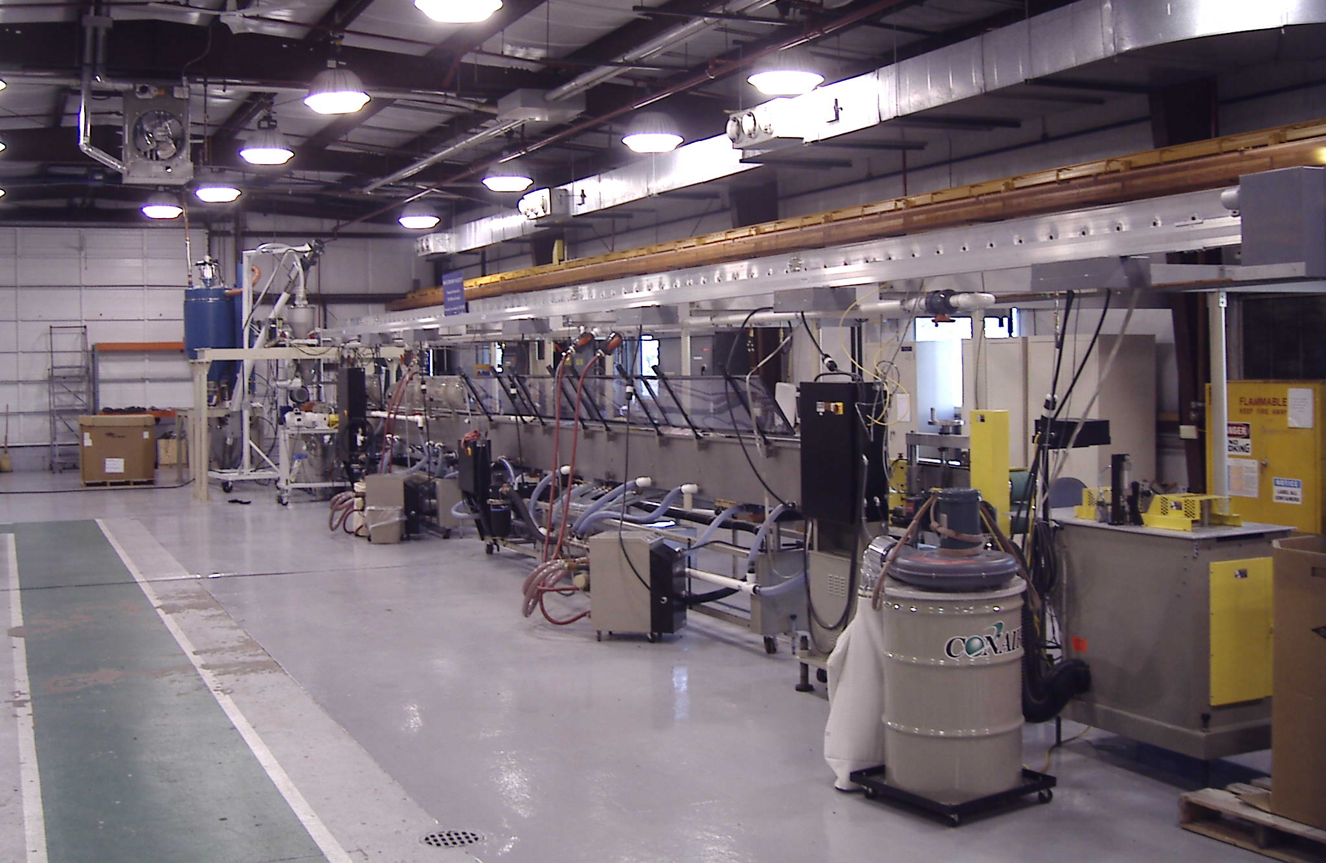
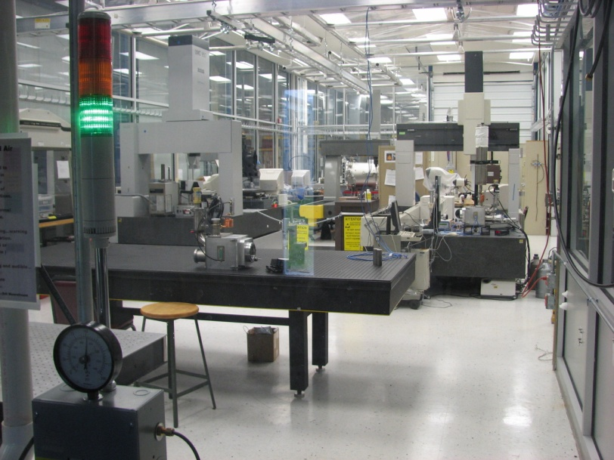
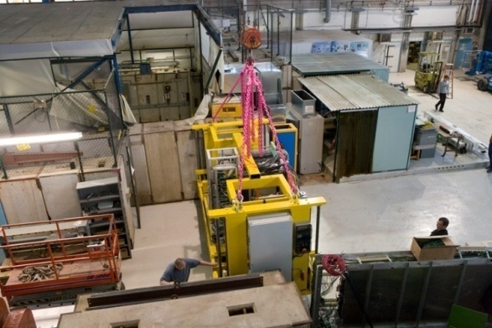
Fermilab Assets for Detector Research
Detector R&D program at Fermilab is enabled by our institutional strengths:
  Research facilities such as:
    Test beam facility
    Silicon Detector facility
    Precision Metrology facility
    Rapid prototyping and Special Materials
    Scintillator Detector Development
    Thin-Film Facility
    Liquid Argon Test Facility
    ASIC Development Facility
  Experienced, well established engineering groups, such as
    ASIC development
    Cryogenics
    Data Acquisition
  We encourage a high degree of collaboration with the university community and other national labs.
Scintillator extrusion at Lab 5
Clean rooms and metrology at SiDet
CALICE at the
test beam
6

Slide 7
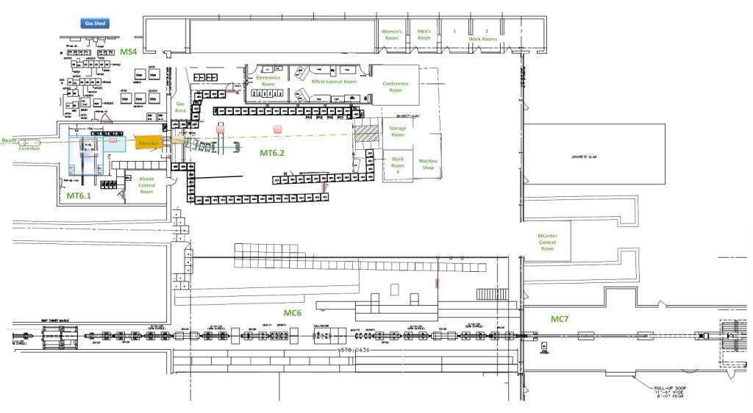
MCenter beam coordinated with MTest to form
Fermilab Test Beam Facility (FTBF)
Tertiary beam moved to MC7
An electronics room in the MWest stub, with access to Meson Detector Building
Installed cable
route for users
Walkway to access MC7
MCenter target
This section of pipe has been removed. User area is here.
7

Slide 8
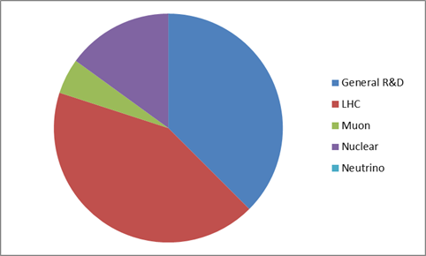
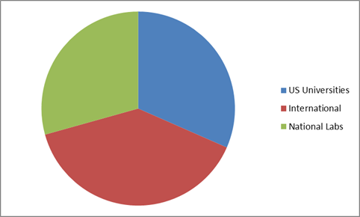
Test Beam Users (FY2014)
T1015 DRO Calorimetry
T1037 FLYSUB-Consortium
T958 FP420 (CMS+ATLAS) Fast Timing Group
T979 Fast Timing w/Cherenkov Counters
T989 DAMIC
T1058 Secondary Emission Calorimeter
T1031 Atlas Tile Calorimeter Electronics
T1036 CMS High Rate Pixel Detector
T1041 CMS Forward Calorimetry
T1049 ATLAS large scale TGC
T1056 ATLAS DBM Module Qualification
T992 Radiation-hard Sensors for the SLHC
T1042 Muon g-2 straw tracker
T1018 Spacordion Tungsten Fiber Calorimeter
T1044 sPHENIX
T1048 PHENIX fast TOF
T1054 sPHENIX Pre-Shower Calorimeter
T994 JASMIN
18 Experiments
321 Users
84 Institutions
20 Countries
9 New TSW’s
Two Large Neutrino experiments on schedule for FY15: MINERvA & LAriaT
8

Slide 9
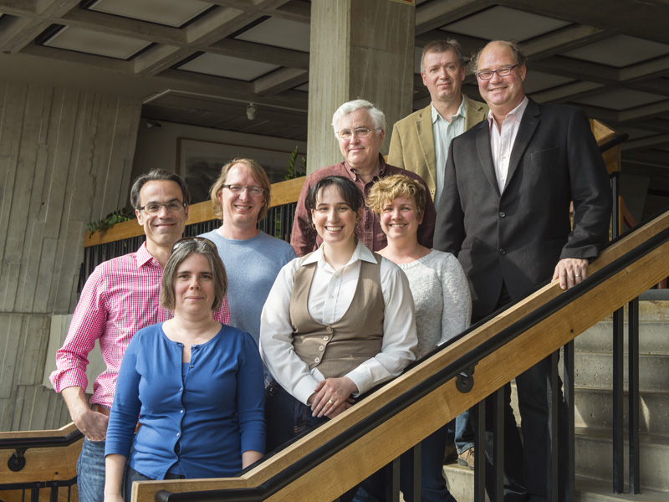
New FTBF ‘Steering Committee
Advises Program Planning if there are any difficulties with resources
Devises guidelines for FTBF use
Suggests facility improvement
Fermilab, Argonne, CERN, Cornell University, Iowa State University and SLAC.
9

Slide 10
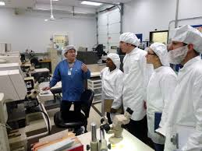
EDIT Instrumentation School 2012
Speakers
David Nygren
  History of particle detection
Dan Green
  Collider detectors
Frank Krennrich
  Cosmic and gamma-rays
Karsten Heeger
  Neutrino detectors
Juan Estrada
  Astronomical Imaging
Stan Majewski
  Medical application
Augusto Ceccucci
  Rare decays
Sunil Golwala
  Cryogenic detectors
Jim Brau
  Lepton colliders
- 64 grad students, most of whom
had rarely worked with detectors
Used KA25 detector R&D funds
Performed hands-on activities in SiDet and FTBF
- Fermilab would be excited to perform
this training outreach service again
10

Slide 11
CMS Upgrade R&D
11

Slide 12
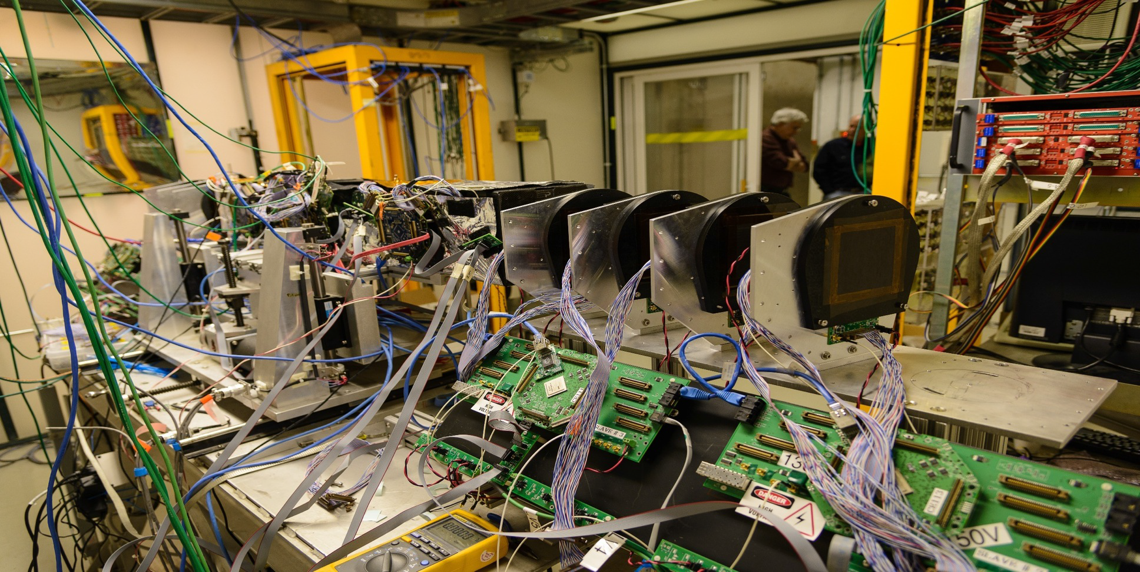
FNAL Provides Comprehensive Approach to Silicon Tracking,
Triggering and DAQ R&D for Phase II upgrade of CMS
Creating a tracking and trigger system that can withstand the projected HL-LHC luminosities is arguably the most important detector challenge in the field of High Energy Physics.
There must be a comprehensive approach:
Sensor
Testing radiation hardness in new sensors (3D columnar + Diamond).
Sensor thinning and interconnects
15 US universities
19 foreign institutions
5 laboratories
8 industrial partners
Front End
Providing new readout for pixel detectors.
Low noise systems using 3D bonding
L1 Trigger
Track trigger using 3D techniques
Data Transmission
Multi-wavelength optical DAQ
Track Fitting
GPU’s and Associative Memory
Page 12
12
LLNL Visit - 24 January, 2012
12

Slide 13
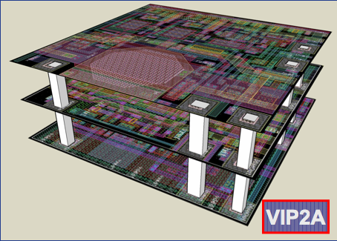
Transformative Capability of 3D Techniques in Integrated Circuits
Over the past several years we have
demonstrated the ability to:
Collaborate with commercial vendors to
build multilayer (3D) integrated circuits
with interconnection pitch of 4 microns
Bond the ICs to sensor and thin the two-layer circuits to 34 μm
Thin full sensor wafers to 50 microns and process the back contact
Reduce interconnect noise to ~0, reducing overall noise in finee pitch pixelated sensor by 2x
Build low mass support and cooling structures
We intend in the future to extend this to the development of
8” thinned sensor wafers for CMS HGC and others
Low cost finely pixelated large area, ‘edgeless’ tiled arrays
Ultra-fast stacked trigger processing using associative memories
3 tier 3D stack for FNAL ILC vertex chip, fabricated by MIT-LL
13

Slide 14
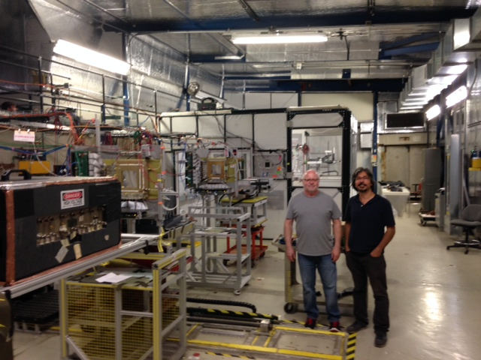
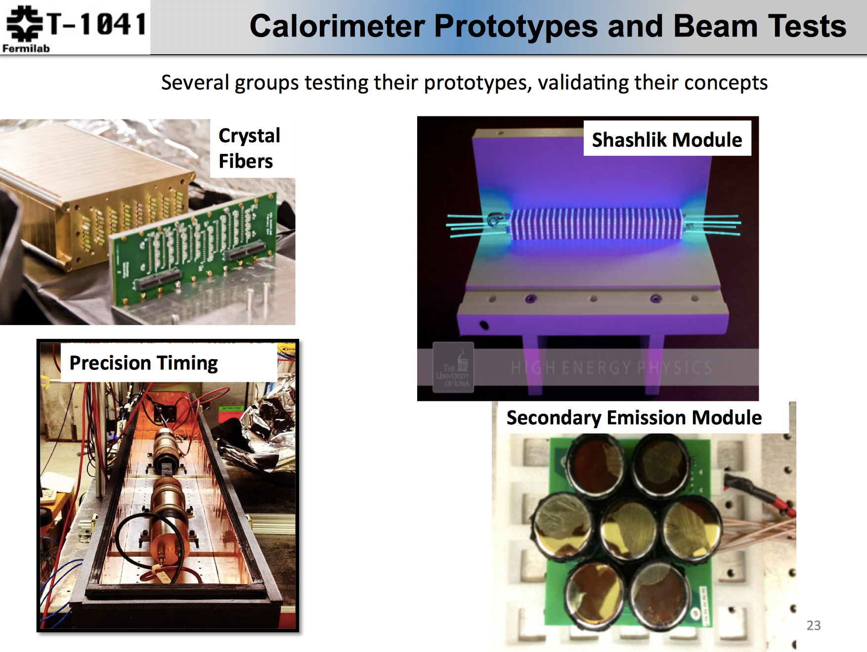
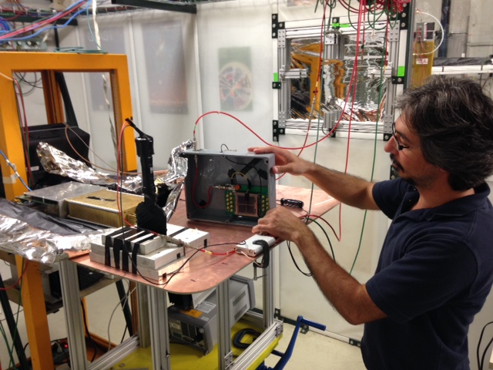
A CMS-centric day at FTBF
Collaborative efforts in photodetection and calorimetry:
  SiPM readout
  LAPPD project
  QIE readout
  Radiation hard scintillator
  Fast timing in SiPM and MCP-PMT
  Silicon detector handling
  Fiber handling
14

Slide 15
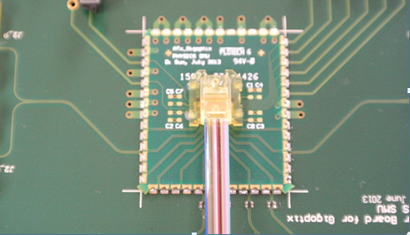
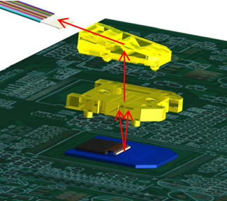
12-channel Array Optical Transmitter Module (ATx)
ATx is a compact (1.9 cm x 2.2 cm x 0.44 cm), radiation-tolerant, 12-channel array optical transmitter module towards 120 Gbps optical link, integrating array optical components, a VCSEL array with a driving ASIC in a custom transmitter module.
A custom low-cost and reliable “active-alignment” method was developed to solve the challenging alignment issue in the array optics area.
With a commercial VCSEL array driver, the ATx module successfully operated at 10 Gbps/ch and aggregate data rate of 120 Gbps. The optical transmitter eye diagram passed the eye mask, and the transmitted BER less than 10⁻¹² was achieved at 10 Gbps/ch.
Prizm Connector
MOI
Optical Interface
ATx Module with
ribbon fiber attached
15
Notes:
15

Slide 16
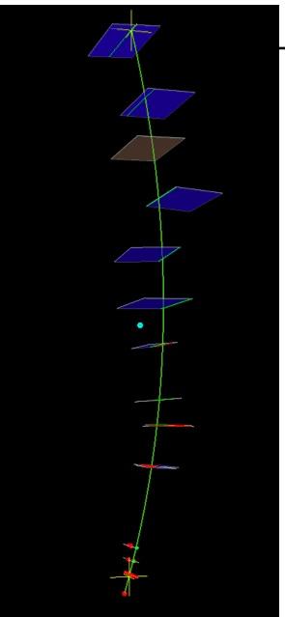
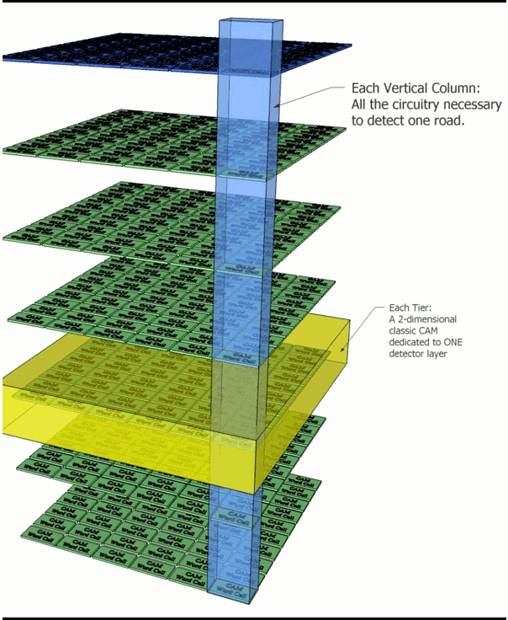
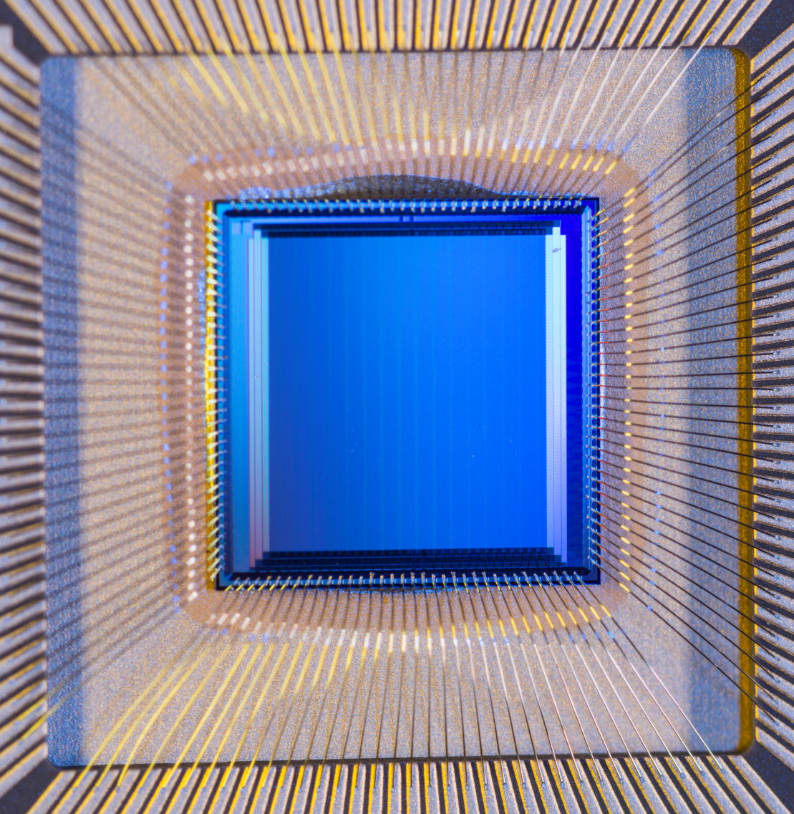
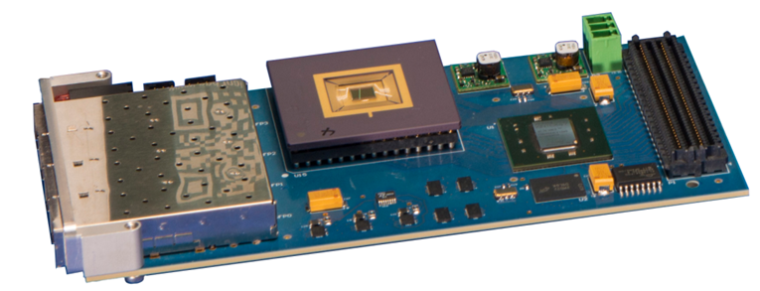
VIPRAM Project Status Summary
(Associative Memories for fast L1 triger)
The past: with steady progress
Initial Idea: ~2010
VIPRAM concept paper: 2011
CDRD award: 2012
First 2D Design submission: 2013
First ProtoVIPRAM00 chip successfully tested: 2014
→ Design building blocks are ready for 3D stacking
CAM cell size: 25 um x 25 um, @ 130nm GF CMOS
The present and future:
The actual 3D design (protoVIPRAM01) ready: 2014
A 2-tier design for CMS tracking trigger (protoVIPRAM02): 2014-2015
Both Designs ready for submission: 2015
2-tier stacking testing for both designs: 2015-2016
Multi-tier stacking & testing for protoVIPRAM01: 2016-2017
→ Need continue generic R&D support for work related to 3D
16

Slide 17
Liquid Argon Detectors for Neutrino and Dark Matter Experiments
17

Slide 18
Integrated Approach to Liquid Argon R&D
The development of entire liquid argon systems means that new techniques in materials, electronics, or simulation can be addressed immediately:
Argon Purification techniques and cryogenics design
TPC Materials qualification and design
Readout Low-noise amplifiers in liquid
Full System in Neutrino Beam ArgoNeuT, LAriaT
Institutions we are collaborating with
in hardware R & D:
Yale - Syracuse (ArgoNeuT)
Michigan State University (TPC electronics)
M.I.T and Indiana University (Light readout)
BNL (TPC electronics and TPC design)
Princeton (depleted Argon recovery)
Indiana University (LAPD)
Automated Reconstruction LArSoft Simulation
ArgoNeut event
Synergies Dark Matter, Proton Decay,
SCENE absolute recoil efficiency
18
LLNL Visit - 24 January, 2012
18

Slide 19
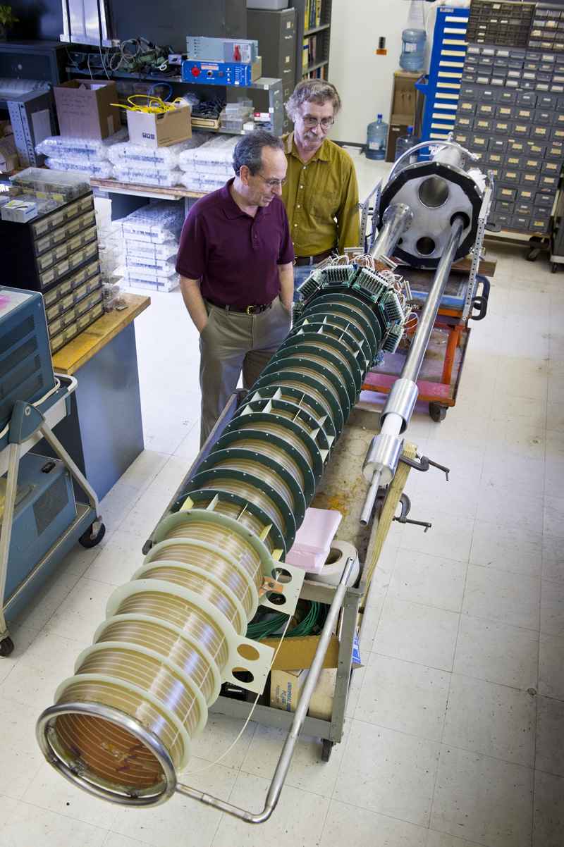
Recent Liquid Argon R & D at Fermilab
Neutrino Specific
TPC performance with electronics and HV -> ‘BO’ TPC and new ‘Long BO’ TPC
Detailed behavior of particles in liquid Argon -> Test beam in FTBF to ‘LArIAT’
Dark Matter Specific
Light yield from nuclear recoils at low energy (<50 keV)
-> SCENE (Scint. Efficiency of Noble Elements)
Argon for low-background experiments
-> Purification of underground argon
19

Slide 20
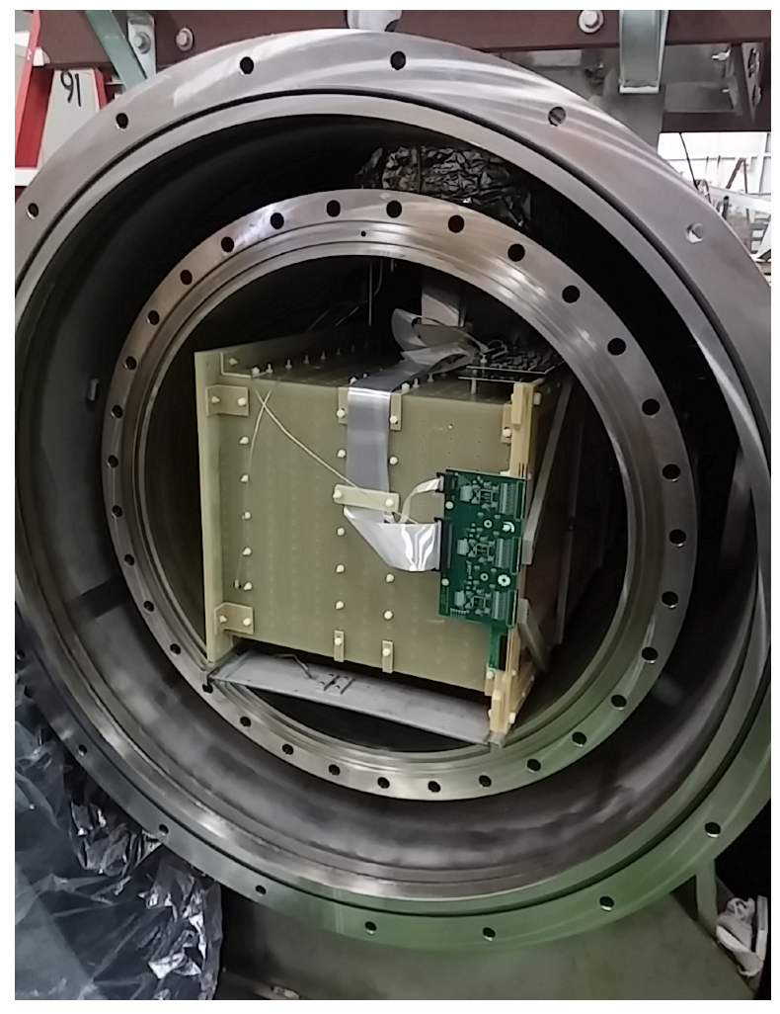
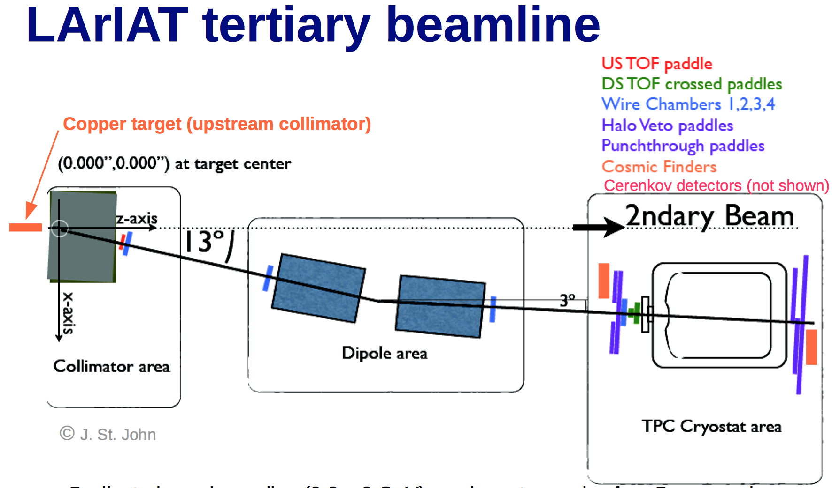
‘Liquid Argon in a Testbeam’=LArIAT
Tertiary beam used by MINERVA moved to new MCenter Test Beam line
TOF Particle I.D. for 0.2-0.8 GeV beam
20

Slide 21
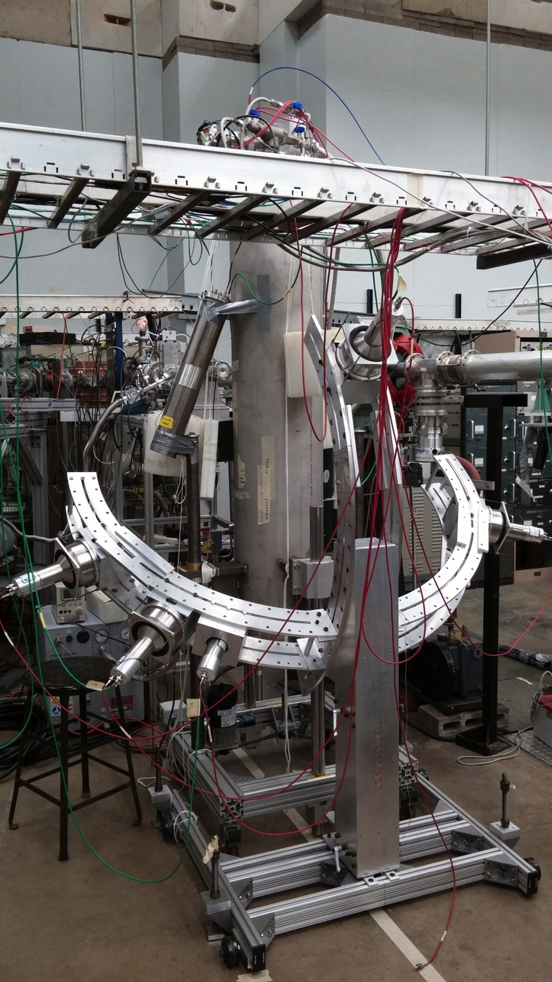
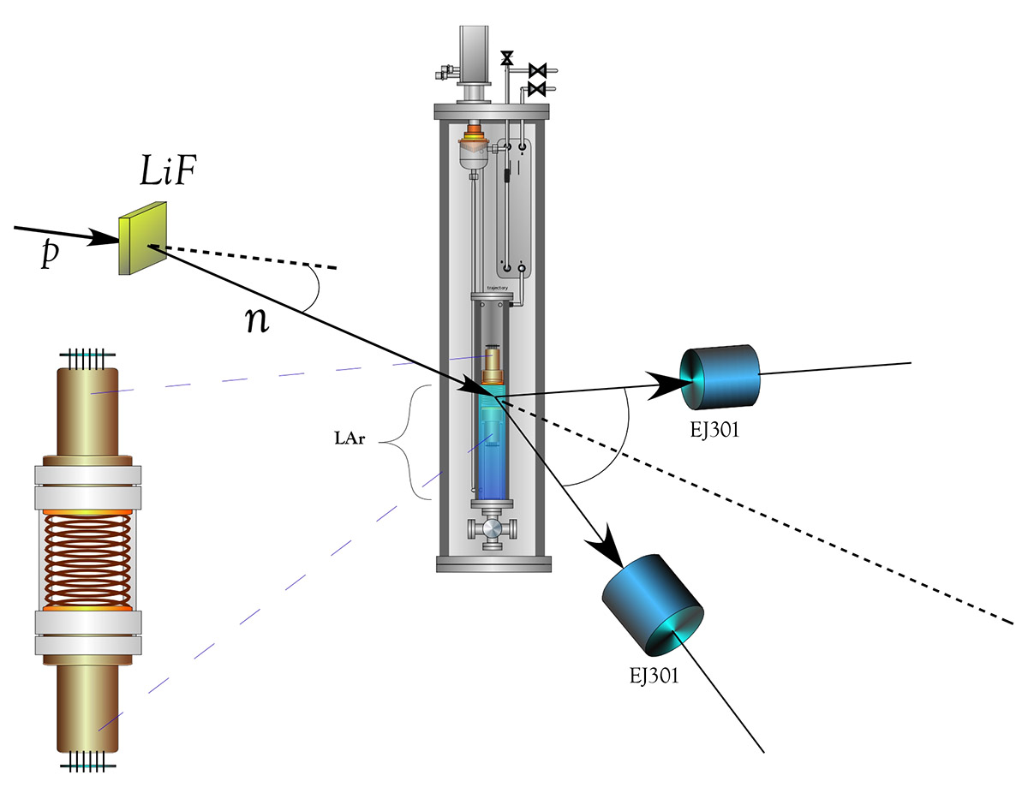
SCENE – Scintillation Efficiency of Noble Elements
Precision measurement of light output of Argon nuclear recoils in a dual-phase LArTPC using monoenergetic, low energy, pulsed Neutron Beam at Notre Dame
(Chicago, Fermilab, Princeton, Naples, Notre Dame, Temple, UCLA)
SCENE Schematic
2.5 MeV
0.5 MeV
β = 0.01
Scattering kinematics gives energy transfer
SCENE at Notre Dame
21

Slide 22
Astrophysics Detectors for
Dark Matter/Dark Energy
22

Slide 23
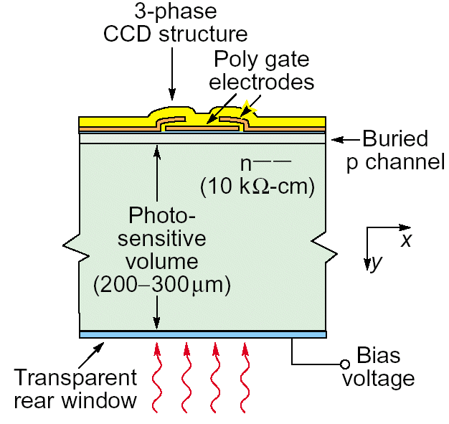
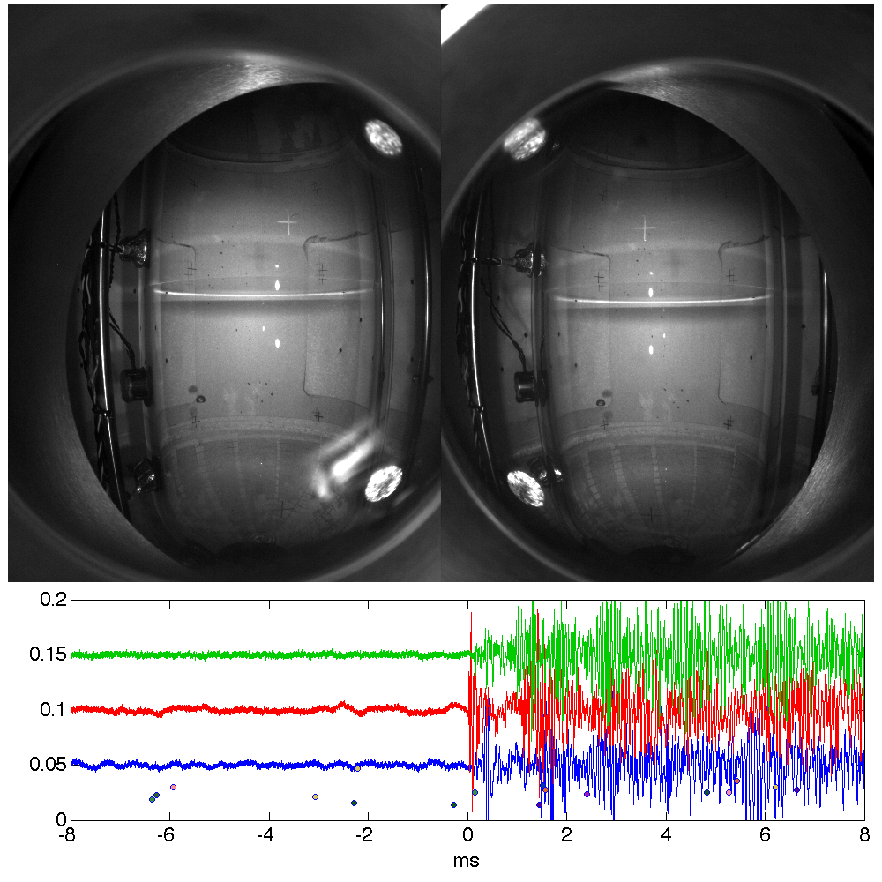
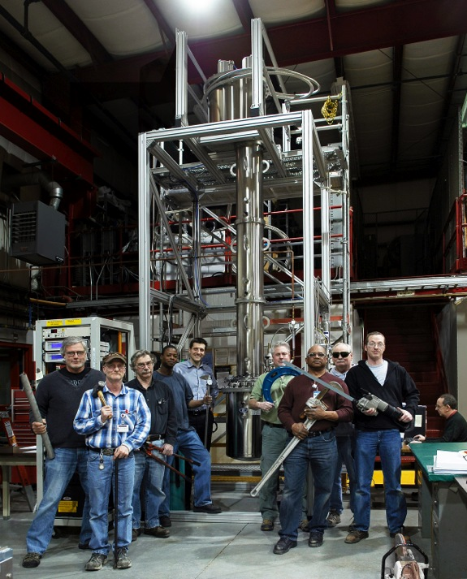

Alternative Techniques We Have Explored in
Dark Matter Detector R&D at Fermilab
Supported bubble chamber calibration R&D, such as threshold measurements and acoustic particle i.d. Has been adopted at ANL for stellar nuclear cross section measurements
Distillation column producing 39Ar depleted Argon for dark matter community.
Muons electrons diffusion limited hits.
Use DECAM thick CCD sensors for low-mass dark matter search (DAMIC)
Each avenue has had a strong collaborative
framework with significant Fermilab support, leading to operating experiments
23

Slide 24
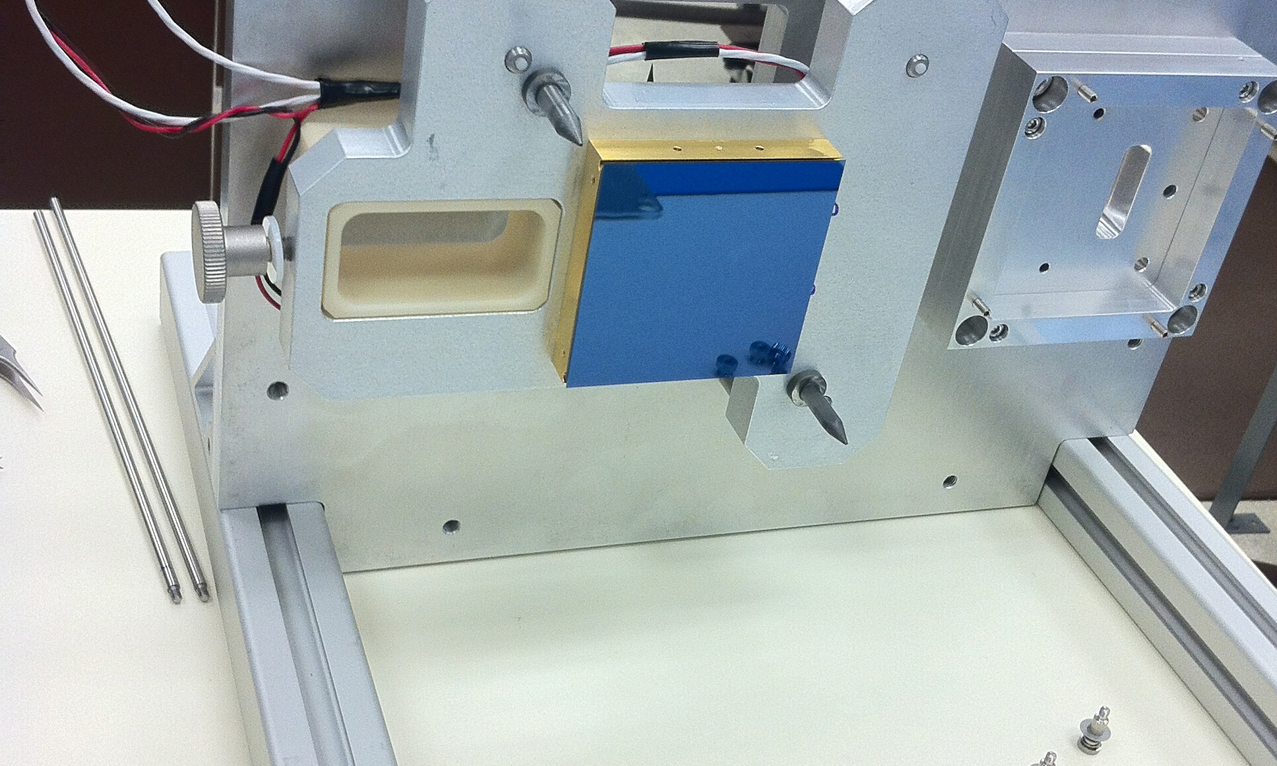
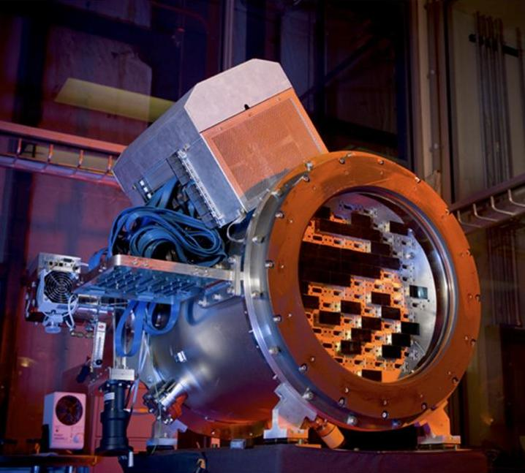
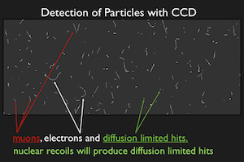
Expertise we gained from low noise readout and systems integration of DECAM sensors has transitioned to detector R&D for DAMIC and is preparing us for DESI
24

Slide 25
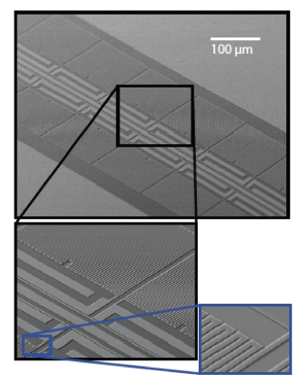
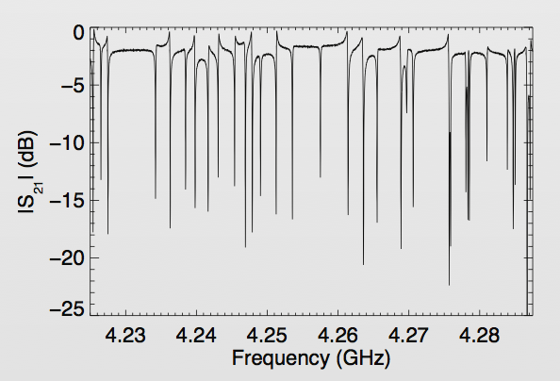
MKIDs : Have established a new cosmic frontier detector research effort at Fermilab
MKID = “Microwave Kinetic Induction Detectors”
Unlike CCD’s, MKID arrays can give a photon-by-photon energy and timing measurement, as well as position.
The capability of these detectors is well matched to our future astrophysics needs, namely spectrophotometry for large area sky surveys
Fermilab’s resources are an excellent match to what is needed for optical MKID research: experience in low level RF, high speed digitization and multiplexing.
Great deal of collaboration on this direction:
Resonances from each array element
25

Slide 26
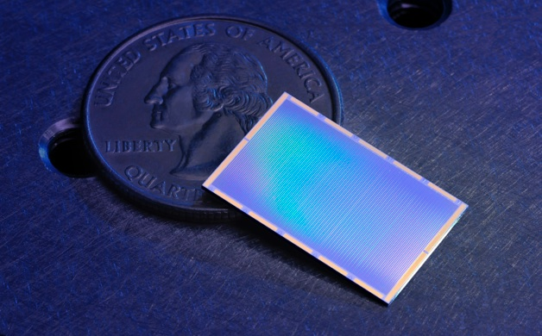
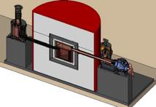
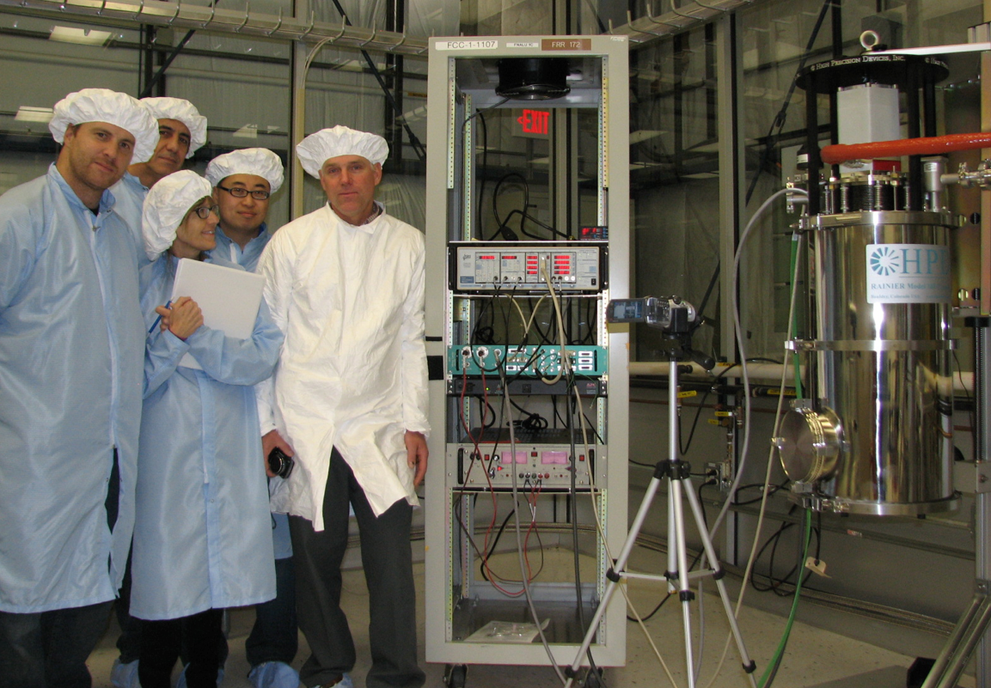
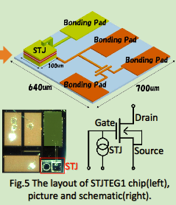
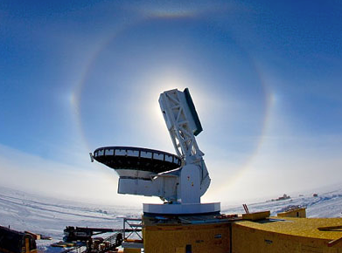
Using new Adiabatic Demagnetization Refrigerator resource to establish low noise and multiplexing techniques in cryogenic detectors (<100 mK)
MKIDs (Dark Energy)
(main driver for the facility)
Super CDMS (Dark Matter)
Materials properties measurements
Adiabatic Demagnetization Refrigerator @ FNAL.
Operations started 2013.
30mK at FNAL for the first time!
STJ (neutrino decay)
Photon detector development with KEK group
SPT-3G (CMB)
Resonator tests
…build it and they will come. Used 100% of the time since day 1.
26

Slide 27
Evolution in R&D Projects:
The detector research program is always evolving. A good example is the CCD work just mentioned:
    CCD characterization facility was built using DES Project funds
    Noise reduction techniques and facility maintenance carried on under KA25
    Proposal to use CCD’s for dark matter obtained an early career award for Estrada.
    Dark Matter in CCD’s (DAMIC) was developed and becomes an experiment, ultimately situated in SNOLAB.
    Progress was reviewed by Advisory Group based committee, whose recommendations included transitioning into MKID’s (Microwave Kinetic Inductance Detector). KA25 budget used to support the low noise and multiplexing work needed for MKID’s
    The acquisition of an Adiabatic Demagnetization Refrigerator for MKIDS from KA25 funds has opened up the potential to use this for other detector development (SCDMS, STJ, CMB, Axions)
    Juan Estrada receives LDRD award to use CCD’s near a reactor to search for coherent neutrino interactions
  This same trajectory of modest generic work leading into full-fledged projects and experiments has been a hallmark of Fermilab detector R&D (Liquid Argon, Holometer, SiPM, MKID’s, 3D ASIC, etc.)
27

Slide 28
Recent Recommendations and Reviews
The P5 report’s recommendations on detector R&D:
  Recommendation 27: Focus resources toward directed instrumentation R&D in the near-term for high-priority projects. As the technical challenges of current high-priority projects are met, restore to the extent possible a balanced mix of short-term and long-term R&D.
  Recommendation 28: Strengthen university-national laboratory partnerships in instrumentation R&D through investment in instrumentation at universities. Encourage graduate programs with a focus on instrumentation education at HEP supported universities and laboratories, and fully exploit the unique capabilities and facilities offered at each.
28

Slide 29
Recent Recommendations and Reviews
The lab received the final report from the 2012 DOE comparative review on detector research:
  “It was generally agreed that the FNAL KA25 program’s management and direction was much improved since the 2009 review. There is a good internal structure with a coherent plan that emphasizes on those areas that are a good match to FNAL resources. A series of internal reviews (under a Detector Advisory Group) of the R&D projects guides the management of Detector R&D program. The panel suggested external review of new ideas would be beneficial. The Panel noted that collaboration with other laboratories and with universities has also grown since the 2009 review.”
The Director’s Review of Detector R&D (Oct.29, 2014):
  “The detector R&D program is broad and continues to nurture creative ideas that advance the experimental programs in the directions of the Energy, Intensity, and Cosmic Frontiers. At the same time, the range of programs and management of same is sufficiently well focused to maximize the benefits of the high value facilities supported by the KA25 program at FNAL with strong university collaborations. The R&D program appears to conform to Recommendations 27 and 28 of the P5 report insofar as there is a large amount of university involvement and an emphasis on R&D to enable near-term experiments.”
29

Slide 30
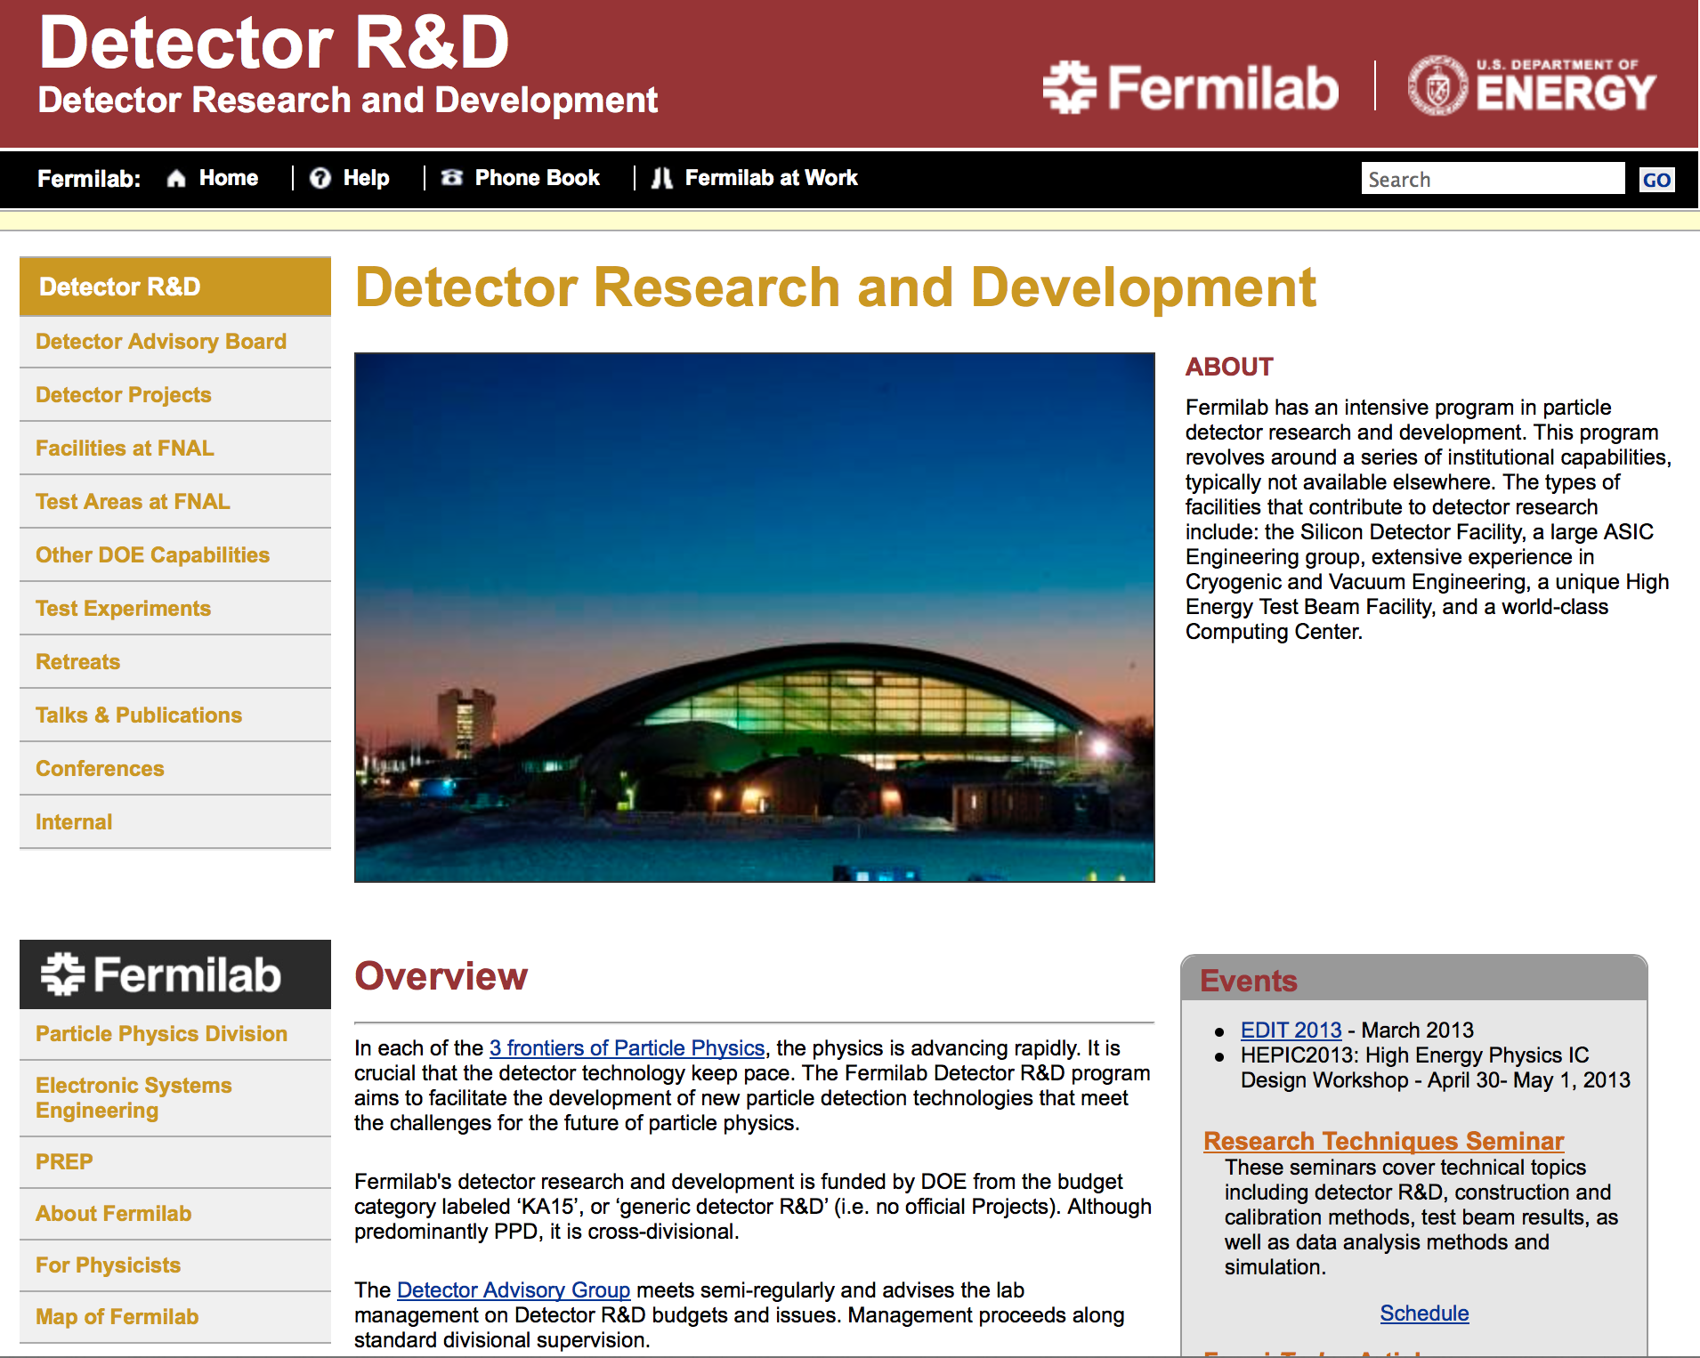
Our web site has links to our detector organization and facilities, as well as links to the EDIT school and our detector retreat and reviews:
http://detectors.fnal.gov
Useful Email:
FNAL detector point-of-contact:
ramberg@fnal.gov
Detector Advisory Committee:
detector-advisory@fnal.gov
Detector R&D mail list (94 members):
detectors@fnal.gov
Test beam users (116 members):
test_beam@fnal.gov
30

Slide 31
Summary
Fermilab has based its detector R&D organization on a “Detector Advisory Group”, consisting of representatives of the major detector efforts and lab management
R&D efforts are centered on several major portfolios, linked to the highest priorities of HEP:
  Collider tracking and triggering that can support Phase 2 CMS upgrades
  Liquid argon detector studies for neutrino and dark matter experiments, while guiding production of new SBN near detector. Test beam studies with LAriAT in new MCenter beamline
  High speed calorimetry and photodetection for pileup mitigation at LHC.
  Astrophysics dark matter/dark energy/CMB detector development, including new concentration on cryogenic detectors
Detector R&D cross-cuts among these areas.
Fermilab’s resources, facilities and collaborations are crucial in detector research and testing
Considering the P5 report, detector R&D is making a stronger balance between generic research and more project-directed approach
31

