Slide 1
DES Operations and Science
Josh Frieman
Fermilab Institutional Review
Feb. 2015

Slide 2
Dark Energy Survey
  DES Context, Overview, History, Collaboration, Structure
  Fermilab Roles:
    Project Management/Organization
    Construction (Brenna), Maintenance, Operations
    Science
    Calibration
    Computing
    Data Management
  Early Science Highlights & Science Plan
  Cross-cut Themes:
    Synergies between Operations & Science
    Strong connections with Universities & Other Labs & Theory

Slide 3
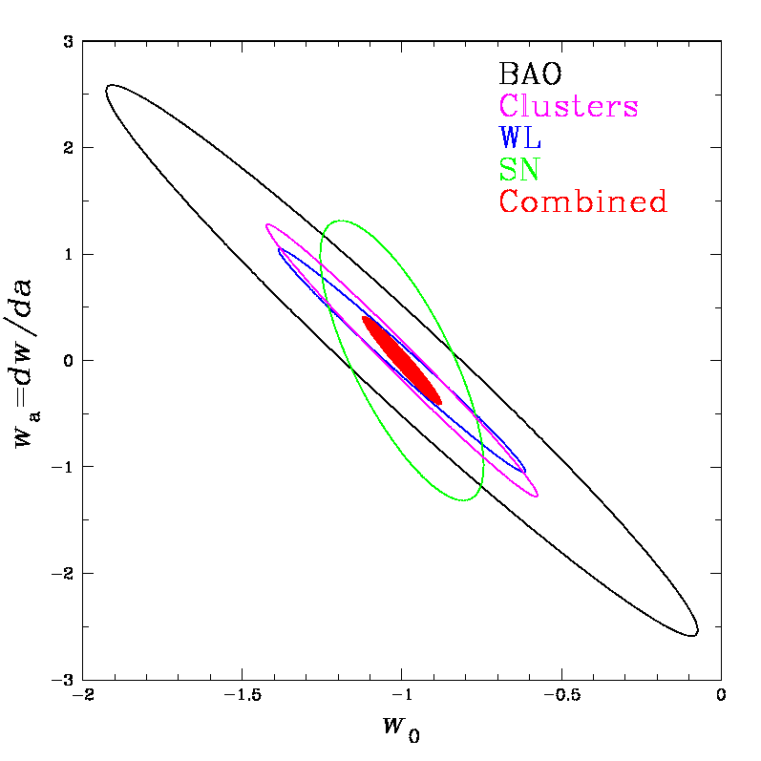
Context: Current Dark Energy Constraints
DES forecast
Assuming constant w: Assuming w=w₀+w_{a}(1-a):
w=−1.027±0.055 w₀=−0.957±0.124 w_{a}=−0.336±0.552
SN
CMB
Betoule etal 2014
JLA=SDSS SN + SNLS + low-z SNe
DES designed to improve DE constraints by factor of a few

Slide 4
DES Overview
Science: probe cosmic acceleration with 4 techniques:
  Clusters, Weak Lensing, Large-scale Structure, Supernovae
• Two multiband imaging surveys:
  5000 deg² grizY: positions, shapes, photo-z’s for 200 million galaxies, 100,000 clusters
  30 deg² griz time-domain survey: light curves for 3500 type Ia supernovae
Collaboration constructed DECam: 3 deg² FOV, 570-megapixel imager and 5-element optical corrector for Blanco 4-meter telescope at CTIO, and Data management (DESDM) system to produce science-ready data products.
Five-year (525-night) survey began Aug. 2013.
  Seasons run Aug.-Feb.
  Nearly through 2nd season
DECam also a premier facility instrument for the astronomy community
Raw+reduced single-epoch images released 1 yr after they’re taken on rolling basis; 2 Public Releases of co-add images+catalogs planned.

Slide 5
Project History & Plan
2003 Project conceived, initiated, developed, led by FNAL Theoretical & Experimental Physicists, in collaboration with University scientists
2004-8 R&D, collaboration-building, optics procurement (non-federal funds)
2008 Construction start
2012 Sept.: First light
2012 Sept. – 2013 Feb.: Commissioning, Science Verification (SV)
2013 Aug. – 2014 Feb.: 1st Observing Season (Y1)
2013 Sept.: SV Data products served to collaboration (~250 sq deg)
2014 May: first DES science paper submitted (based on SV data); 8 so far
2014 Aug. – 2015 Feb.: 2nd Observing Season (Y2)
2014 Dec.: Y1 co-add data products served to collaboration (1800 sq. deg)
2015 April: 14 APS abstracts+comparable number of journal papers
2015 Aug.: Y1+Y2 data products served to collaboration (4000 sq. deg.)
2016 Aug.: Plan for 1st Dark Energy results (Y1+Y2)
2018 Feb.: end of 5th Observing Season

Slide 6
















DES Collaboration
140 senior scientists
300+ collaborators
25 institutions, including 9 US universities, 4 DOE labs
Fermilab, UIUC/NCSA, University of Chicago,
LBNL, NOAO, University of Michigan, University of Pennsylvania, Argonne National Laboratory, Ohio State University, Santa-Cruz/SLAC/Stanford Consortium, Texas A&M
UK Consortium
ETH Zurich
Ludwig-Maximilians Universität
Spain Consortium
Brazil Consortium
CTIO

Slide 7
DES Project Structure
Construction (completed 2012):
DES Project comprised:
  DECam Project (DOE) led by Fermilab, with University & foreign partners
  CTIO Facilities Improvement Project (NSF) led by NOAO
  DES Data Management (DESDM) Project (NSF) led by NCSA
Operations:
DES collaboration operates the DES experiment, with support from DOE, NSF, and foreign & institutional partners.
NOAO operates and maintains DECam and Blanco for DES and the astronomy community (base support from NSF).
NCSA leads DESDM operations, supported by NSF PI grant.
Fermilab (DOE) leads DES support of DECam maintenance (working with CTIO), manages DES operations, supports DESDM.

Slide 8
DES
Organization
Chart
DES Council
P. Garbincius, FNAL
C. Hogan, FNAL
R. Pennington, NCSA
D. Silva, NOAO
DOE/NSF JOG
K. Turner, DOE
N. Sharp, NSF
reports to
member of
communication
DES Project Office
J. Frieman, Director
R. Kron, Deputy Director
T. Diehl, Operations Scientist
G. Bernstein, Project Scientist
K. Honscheid, Systems Scientist
D. Petravick, DESDM PI
Management Committee
(Collaboration Affairs)
Institutional Reps
Executive Committee
(Operations)
Operations Leads
Science Committee
G. Bernstein
O. Lahav
Publications Board
K. Honscheid
Early Career Scientists
B. Flaugher
T. Kacprzak
DES Data Management
D. Petravick
B. Yanny
R. Gruendl
DES Observing Systems
T. Diehl
Supernovae
B. Nichol
M. Sako
Clusters
C. Miller
J. Mohr
Membership Committee
D. Gerdes
Speakers Bureau
B. Flaugher
DECam Operations
A. Walker, T. Diehl
K. Honscheid
S. Heathcote
Survey Strategy
E. Neilsen
Weak Lensing
S. Bridle
B. Jain
LSS
E. Gaztanaga
A. Ross
Education/Public Outreach
B. Nord
K. Romer
Collaboration Mtg. Steering Committee
S. Bridle
Calibration
D. Tucker
S. Kent
Science Analysis Computing
E. Buckley-Geer
S. Kent
Simulations
G. Evrard
K. Heitmann
R. Wechsler
Photo-z
F. Castander
H. Lin
Gal. Evolution
D. Thomas
M. Banerji
QSOs
P. Martini
R. McMahon
Theory
S. Dodelson
J. Weller
Milky Way
B. Santiago
B. Yanny
Spectroscopy
F. Abdalla
C. D’Andrea
Strong Lensing
E. Buckley-Geer
A. Amara
8

Slide 9
DECam Maintenance & Operations
DECam is an NOAO Facility Instrument on the Blanco.
DECam Operations & Maintenance plan specifies roles & responsibilities of DES, working with CTIO, dealing with technical issues and continuing to transfer expertise.
DES, led by FNAL (T. Diehl, lead), & including University and other lab scientists, works with CTIO to improve observing efficiency & DECam data quality, leading to improved science.
Regular FNAL maintenance/engineering trips to CTIO
Formal coordination through biweekly DECam Operations Oversight Meetings (DOOM), plus ad hoc daily (and nightly) communications.
We have completed a long list of improvements, more in the works.

Slide 10
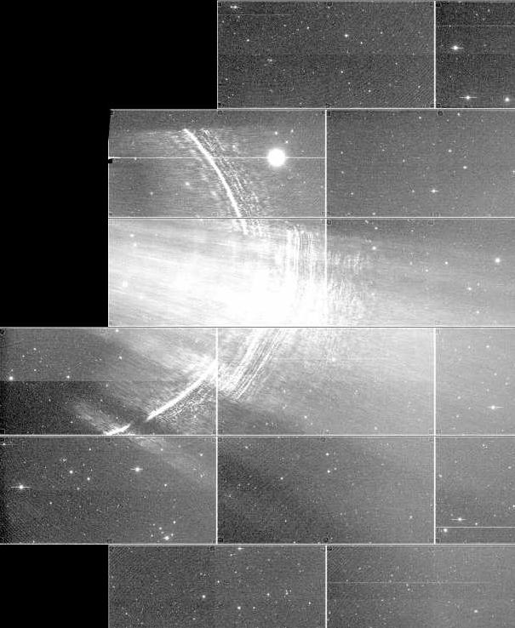
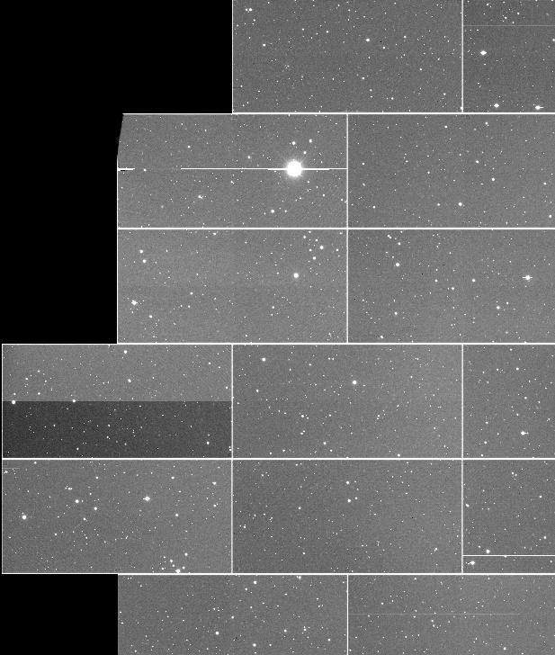
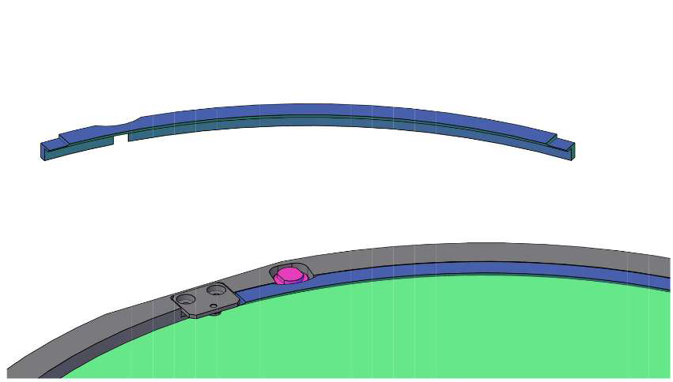
Example: Reducing Scattered Light
Before
After
Bright off-axis stars caused stray light on DECam images. DES identified the sources (S. Kent, FNAL):
  Inner surface of F/8 counter-weight
  Edges of the filters, apertures of the filter-changer, and the shutter
DES supplied filter-baffles (lower left), installed April 2013.
CTIO applied anti-reflective black paint to filter-changer mechanism and shutter, March 2014 (upper left).

Slide 11
Delivered Image Quality
DECam signals and noise are within few % of forecasts
Median delivered FWHM in riz is close to 0.90” specified for weak lensing.
Notes: dome air-handling installed after Y1; new primary LUT just now being tested.
Accepted riz wide-area exposures
(through 12/5/2014)
Number of Exposures
Median 0.92”
Delivered FWHM (arcsec)

Slide 12
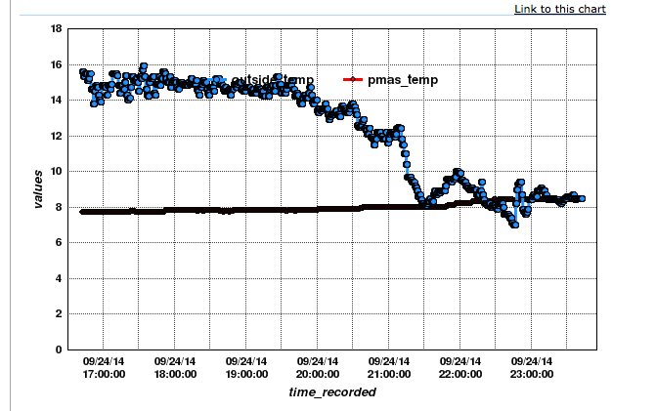
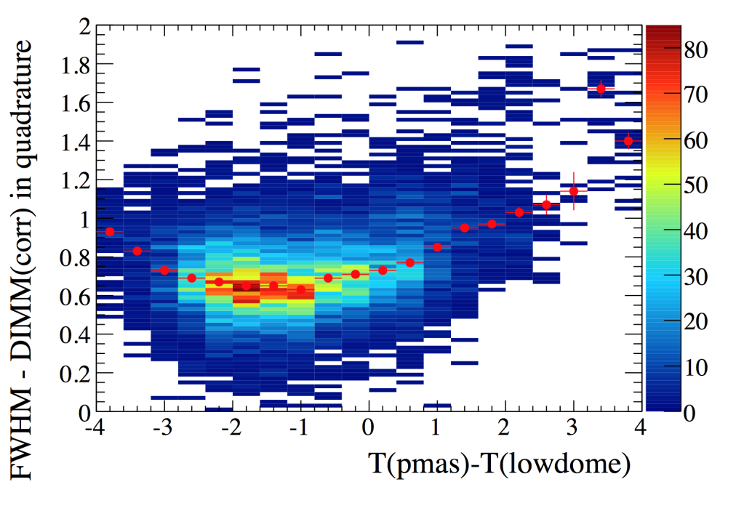
Image Quality Improvement
New Environmental Controls in the Blanco Dome
  2 recently installed large, glycol-cooled air-handlers better maintain primary mirror at or just below air temperature, and minimize temperature gradients within the dome. 40-Ton chiller supplied by DES made this possible.
Seeing due to dome environment and camera
Dome Air Temp
Primary Mirror Temp

Slide 13
Image Quality Improvements
New Primary Mirror Support Pad air-pressure controls
  System controls mirror shape, depending on gravity vector, affecting astigmatism primarily. Higher resolution air-pad controls installed by CTIO just before Y2 start.
  New Primary Mirror shape Look-Up-Table now being tested.
5 DoF “Hexapod” Alignment Algorithm Improvement
  2 years of data supplied an improved hexapod focus default.
  New Hexapod Look-Up-Table being tested (decreases Coma).
Analysis led by DES (A. Roodman, SLAC), working with CTIO.
Improved image quality increases survey depth as well as the Dark Energy power of Weak Lensing (WL) galaxy shape measurements. 0.05” reduction in PSF FWHM reduces WL shot noise by ~10%.
DES has obtained its best images (measured by PSF FWHM) in the last 2 weeks: ~0.6” images.

Slide 14
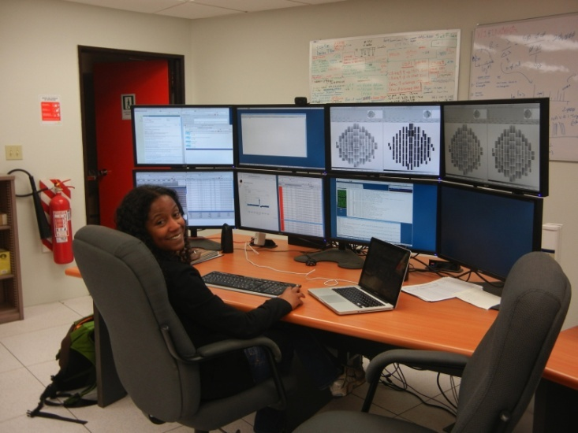
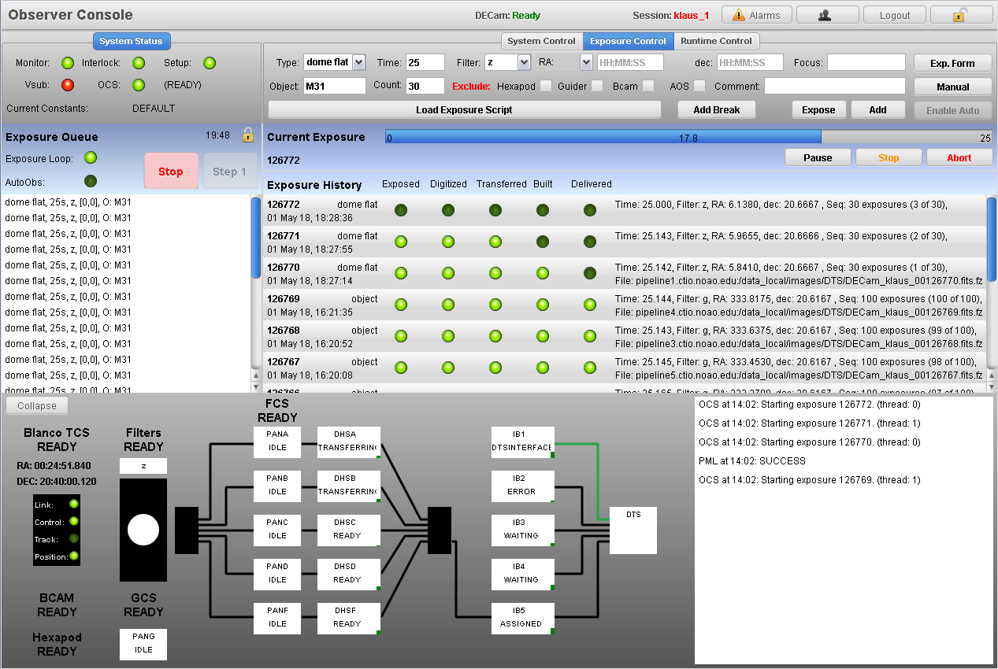
DES Survey Operations
FNAL manages DES operations (T. Diehl):
Schedule & train ~60 collaborator observers each season, meet with on-mountain observers daily by phone.
Lead survey strategy, survey simulations & tactics (ObsTac).
Track observing efficiency & data quality night by night, work with CTIO and collaboration on improvements.
SISPI Observer interface
(K. Honscheid, OSU)

Slide 15
DES Survey Strategy & Tactics
Wide-area survey completion = 10 full “tilings” of 5000 deg².
  SV covered ~150 deg² plus selected targets to 10 tilings.
  Y1 covered ~1800 deg² (areas covered by South Pole Telescope and SDSS) with 2-4 tilings.
  Y1+Y2 will complete 3-4 tilings over ~4000 sq deg.
  Future seasons will increase depth over full survey area.
Tilings interlaced for global calibration.
SN fields observed when PSF too poor for Wide-area survey, or when SN field’s clock is >6 days.
Observer Tactician (ObsTac) program automatically queues up next exposures (wide or SN, filter choice, sky location), based on completed exposures, sky and PSF conditions, etc. (E. Neilsen, FNAL)

Slide 16
Wide-area Survey Status as of 2/1/2015
SDSS region
>35,000
survey-quality
exposures
to date
SPT region
Baseline goal for Y1+Y2: 4 tilings in south (SPT) and north (SDSS) regions, 3 tilings in region between.

Slide 17
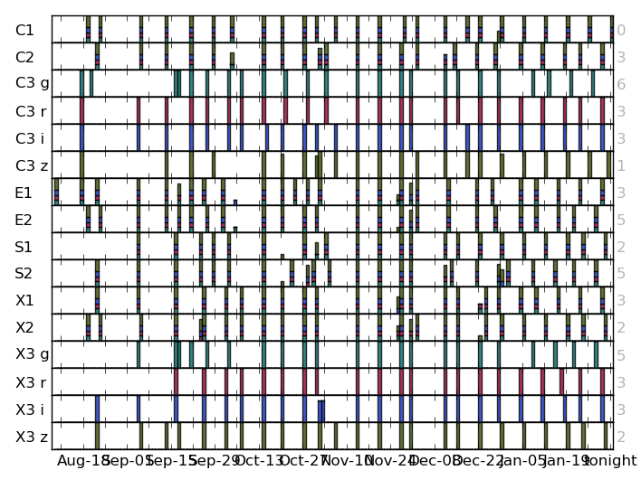
Supernova Survey Status as of 2/2015
Cadence ~6 nights.
Larger gaps due to weather and extended full-moon engineering runs.
Weather in Aug.-Sept. 2014 was 2nd worst of 30 yrs for which we have CTIO records.
SN WG actively involved in operations (fast DQ assessment and spectroscopic follow-up).

Slide 18
Data Management and Computing
DESDM carries out nightly data processing (DQ assessment, SN identification) and co-add processing after each season, leading to annual internal data releases for science analysis.
DESDM led by NCSA, funded by NSF AST grant.
DES collaboration actively engaged in DESDM, contributing expertise, testing, algorithms. Annual cycle of development.
FNAL roles:
  DESDM Project Scientist (B. Yanny)
  Y1 Deputy Release Scientist (A. Drlica-Wagner)
  FermiGrid computing resources for nightly and annual processing, supplementing NCSA resources
  Tape storage recovery system for all data products
  Collaborated with NCSA to restructure DESDM code architecture for efficiency & reliability (Yanny, Buckley-Geer, SCD)

Slide 19
Science Analysis Computing
  Working groups transform outputs of DESDM (images, catalogs) into value-added catalogs, measurements, and science results.
  Science Analysis Computing Task Force (led by S. Kent, FNAL) evaluating/updating analysis computing resource needs to end of project. Estimate ~100M core-hours needed in last yr.
  NERSC allocation: 10M core-hours in 2015, ramping up.
  FermiGrid resources being adapted for dual-use role in DESDM processing and science analysis.
  DES Operations supporting science analysis disk storage at SLAC (N-body simulations) and Brookhaven (weak lensing).
  Additional large-scale resources in Europe (Spain, UK).
  Smaller-scale analysis computing through University grants.
  Cosmosis analysis framework (led by S. Dodelson, w/ FNAL SCD) being developed to combine constraints from multiple DE probes.

Slide 20
Dark Energy Science Plan
Catalogs
DESDM catalogs and masks
Photo-z
Shear
Clusters
Supernovae
Measurements
Galaxy-galaxy correlations
Galaxy-shear
Shear-shear
Optical cluster counts
Cluster-shear
X-ray, SZ vs optical, shear
SN Hubble diagram
Cosmological Constraints
Hubble diagram
Shear 2-pt
Cluster abundance + mass calibration
Galaxy-shear + g-g
Combined 2-point
HOD model with clustering, lensing constraints
BAO
f_{NL}, 3-point, voids, …
All probes combined DE and neutrinos

Slide 21
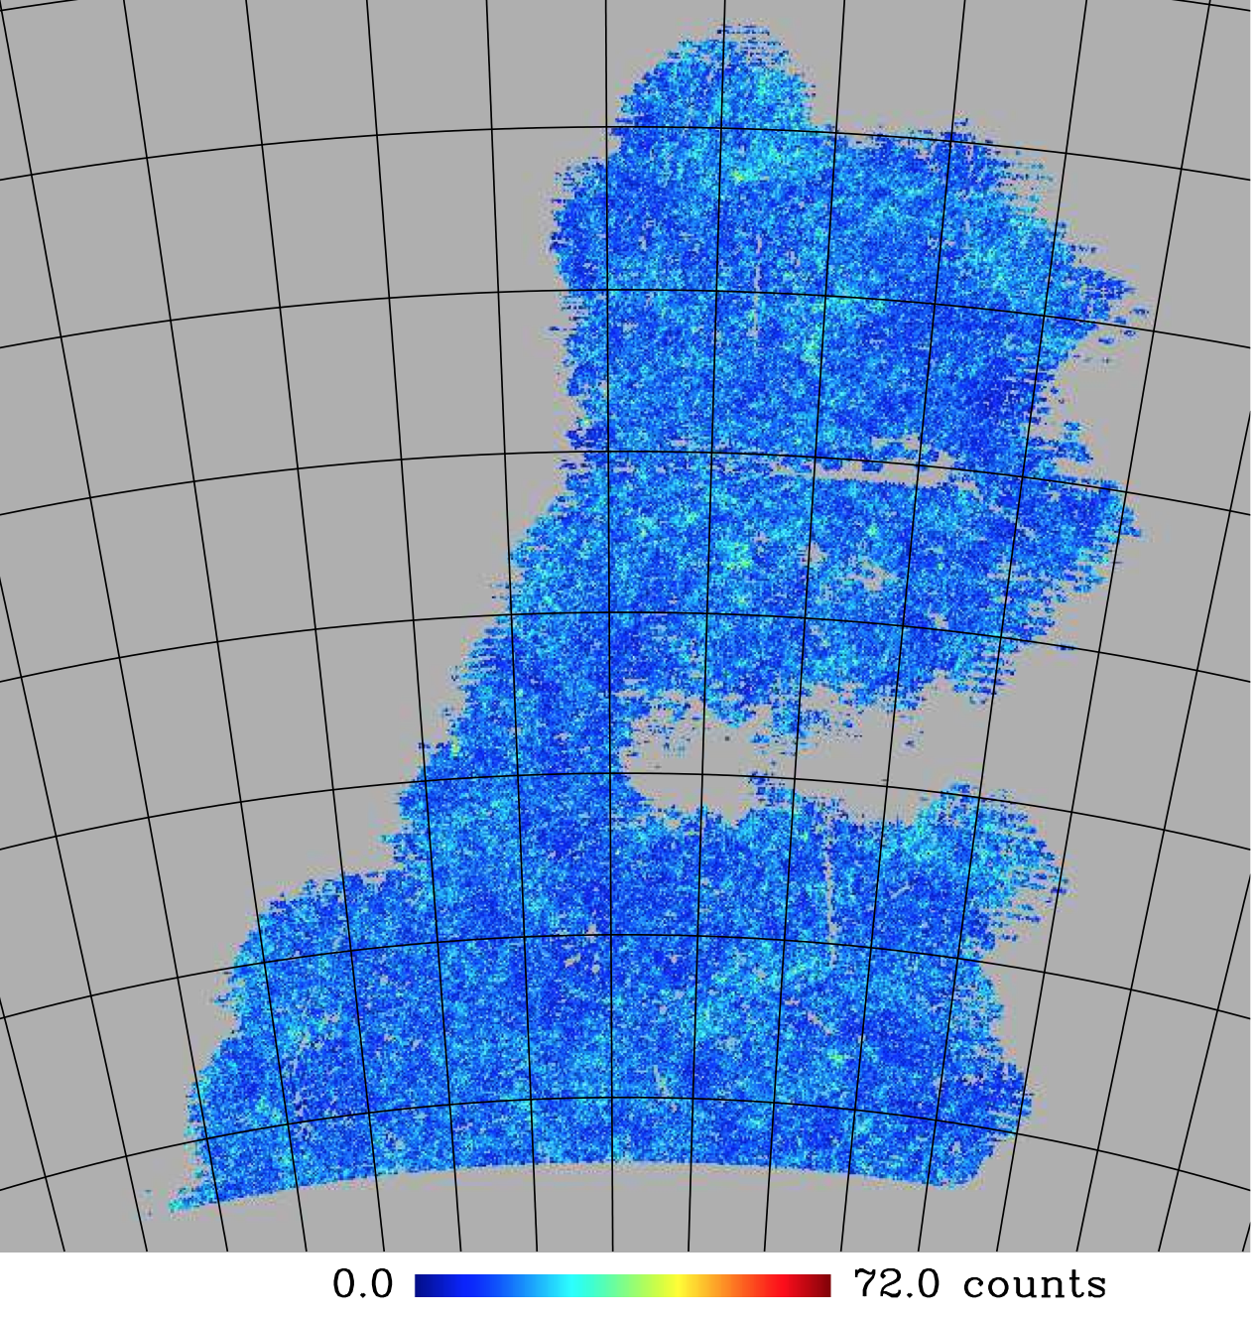
Galaxy Distribution in Science Verification Data
150 sq. deg.
Data set for most of the early science analyses (April APS)
2.5 deg grid spacing
21

Slide 22
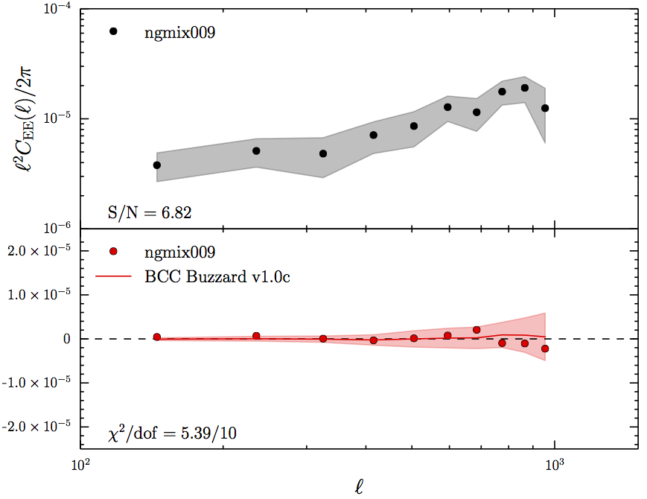
Science Highlights : Cosmic Shear in SV
E mode
DES Preliminary
B mode
(systematic)

Slide 23
Correlation of DES galaxies with CMB lensing
DES SV galaxies,
0.2<z<1.2
SPT gravitational
lensing
DES Preliminary
Dodelson/Frieman student Cawthon playing
lead role in this analysis

Slide 24
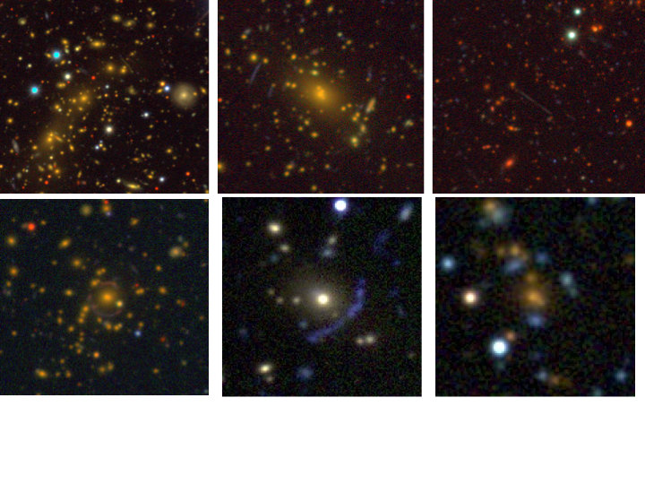
Strong Gravitational Lensing
Gemini large, long program underway for
Strong Lens Follow-up (PI. E. Buckley-Geer, FNAL).
+STRIDES collaboration for lens time-delay monitoring.

Slide 25
High-Redshift Supernovae
Solid lines:
fit to SALT2 SN Ia light curve model.
g-band
r-band
DES Preliminary
Flux
Building on FNAL-led
SDSS-II SN Survey
i-band
z-band
~1000 SNe Ia light curves so far
Days

Slide 26
Summary
DES has successfully completed ~2 seasons of increasingly and now highly efficient operations.
DESDM processes nightly data by the next day: QA & SN.
Collaboration has submitted 8 science papers, another ~20 planned in time for April 2015 APS.
Internal release 12/2014 of Y1 co-add images & catalogs for next round of science analysis.
On track for first Dark Energy results (based on Y1+Y2) late summer 2016, followed by DR1 co-add image & catalog Public Data Release in 2017.
Collaboration highly engaged in all aspects of operations & science analysis. Close coordination between FNAL, other labs, University groups, and CTIO makes this possible.

