Slide 1
The LPC
Boaz Klima (FNAL)
Meenakshi Narain (Brown University)
FNAL Institutional Review
11 Feb, 2015

Slide 2
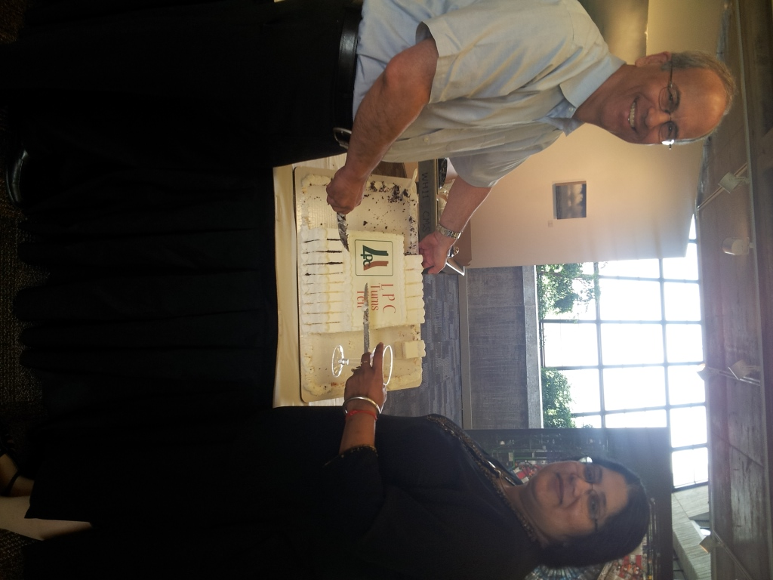
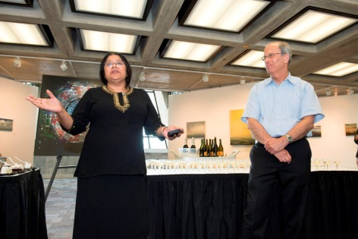
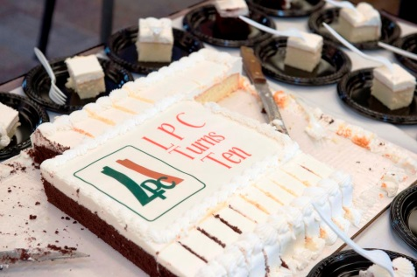
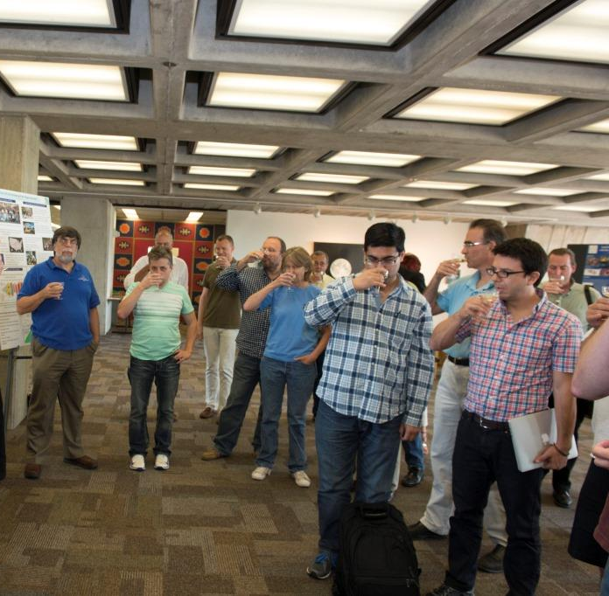
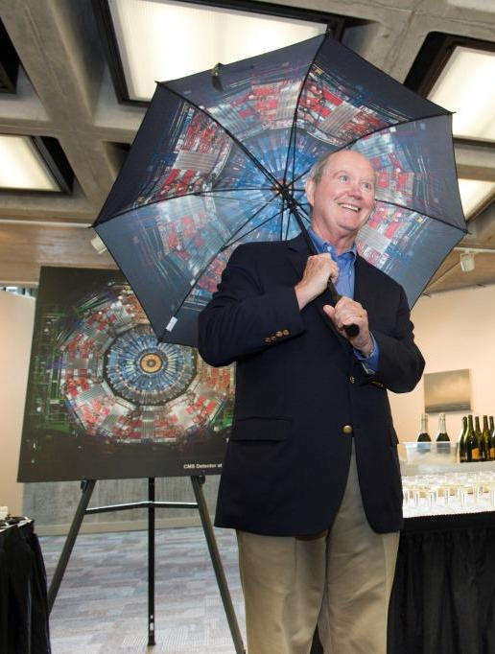
LPC Turning Ten Celebrations!
July 17, 2014
We managed to accomplished a lot while building a new concept in HEP – a vibrant & productive center
away from the location of the experiment

Slide 3
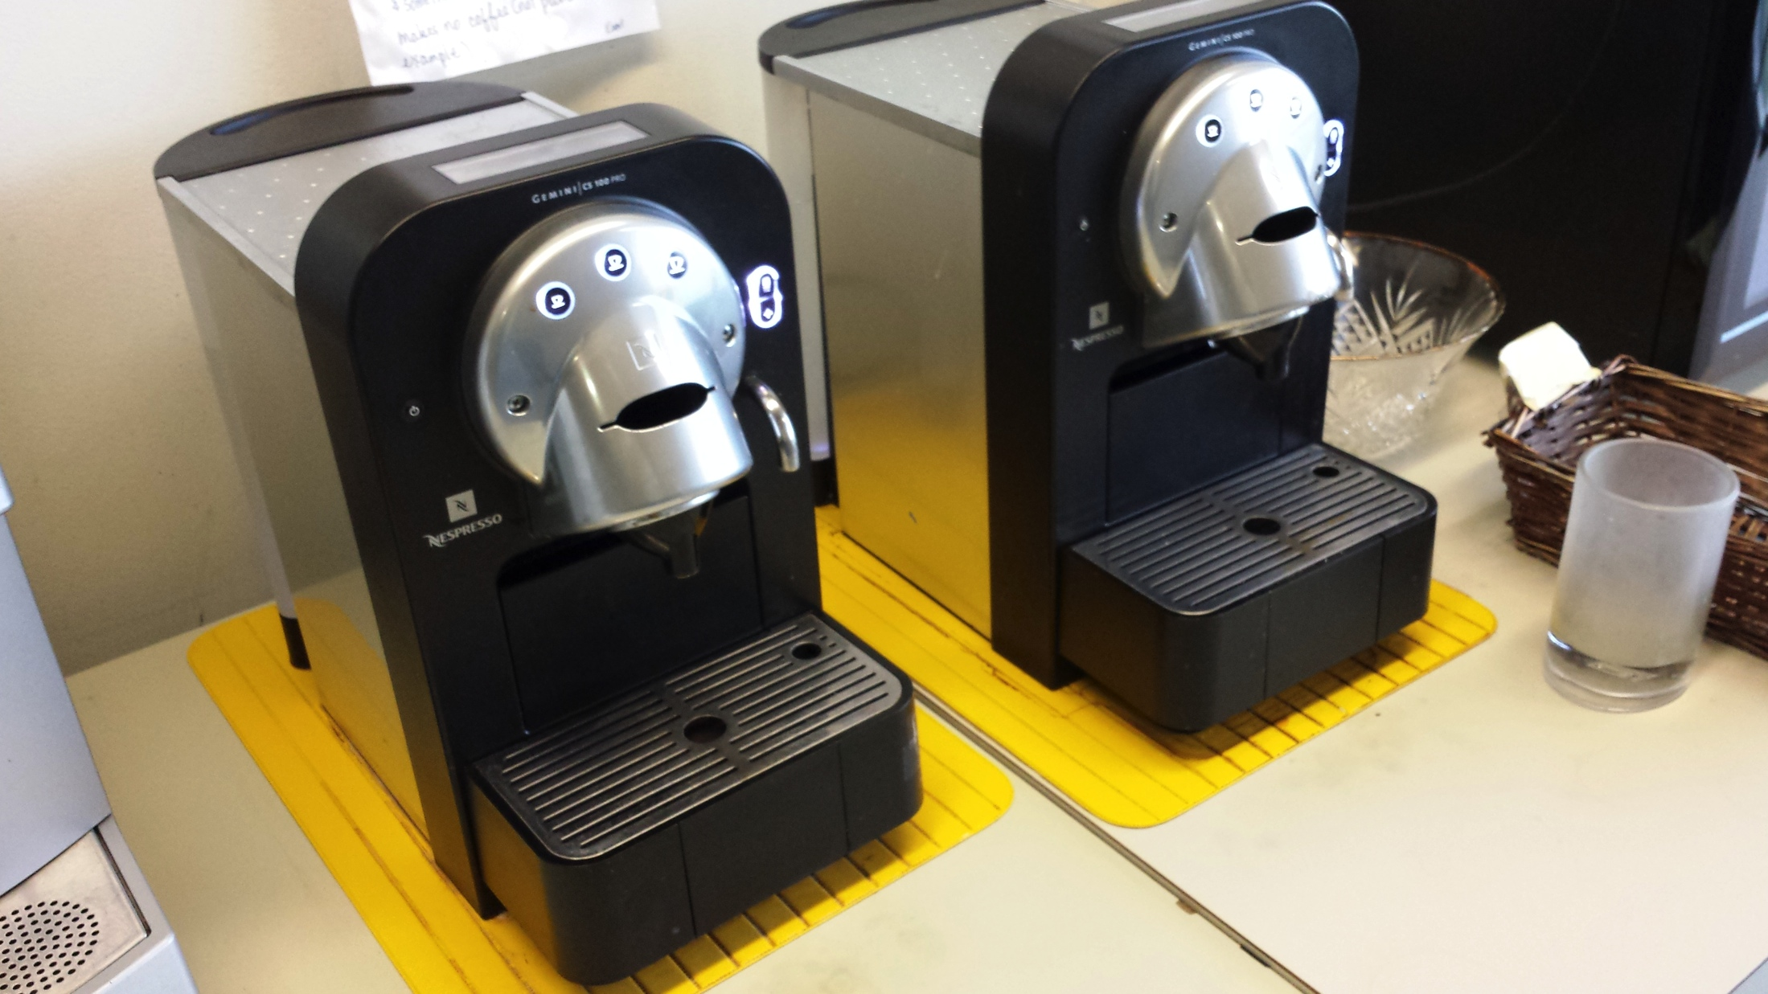
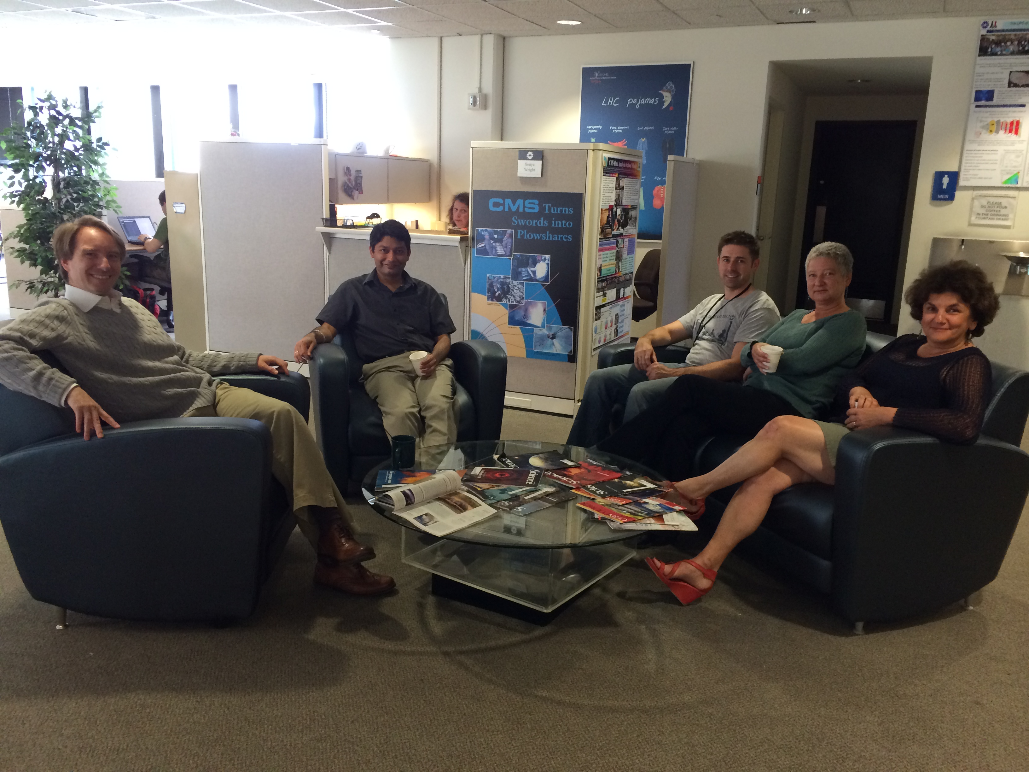
LPC=“Center of the Universe”
But where is it located in Wilson Hall?
our non-CMS friends found it
and visit us every day at 1:30pm
the director found us

Slide 4
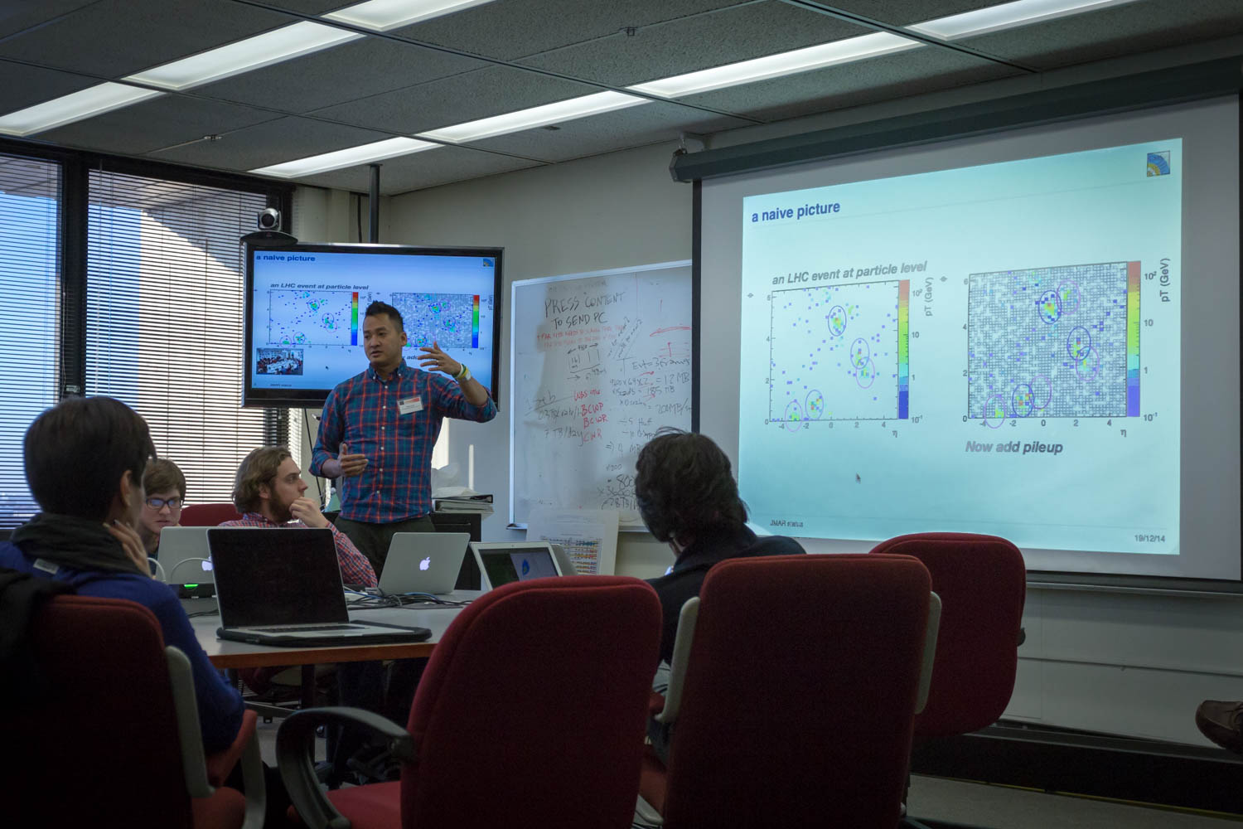
Our Mission:
http://lpc.fnal.gov
Designed to encourage a sense of community
Provide venues for discussions: educational, professional and social.

Slide 5
What is the LPC?
Why do we need the LPC?
The center of the CMS experiment is at CERN, ~4400 miles away, 7 time zones
The collaboration is big and diverse and he experiment is huge and very complex
Most collaborators, most of the time, not at CERN!
The experts are located in many places all over the world – communication is not easy
A shared vision -- and tight coupling between the US-CMS university community and CMS -- is needed to ensure remote users provide added-value and are full-fledged CMS collaborators
By engaging the entire collaboration, more is achieved
The LPC:
The LPC is an established regional center (US) center of excellence for CMS
It acts as a catalyst for contributions of US CMS Collaborators (and others) to the experiment.
It serves as a critical link for remote physicists to participate directly in the CMS experiment, economically and transparently.
It develops opportunities for members of LPC to make major contributions to CMS on hardware, software, computing, and physics
The LPC is a powerhouse of talent, experience and resources

Slide 6
The LPC
The overall focus of our “current” activities
physics topics: BPH, SUSY, B2G, Higgs, Exotica, Dark Matter
completion and publication of Run 1 Analyses
hardware/software/computing during LS1,
Preparation for Run2
contributions to the Phase 1 and Phase 2 Upgrades
A few keywords to describe its community heard often by colleagues and in the corridors
Vibrant, Active, Stimulating, Engaging, Productive
It is steadily growing in its attractiveness within the HEP community. It is referred to, and being duplicated in many places
much appreciated by
CMS, ATLAS Belle, Fermilab and other friends, e.g. theorists

Slide 7
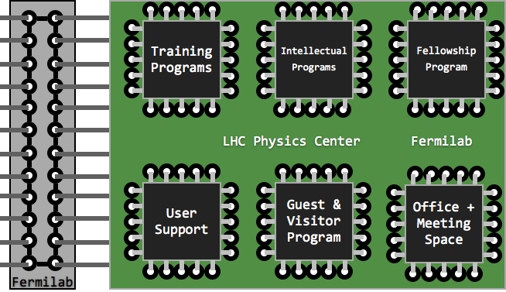
The LPC
Proximity to a broad range of CMS expertise in variety of areas under one roof
A vibrant intellectual community

Slide 8
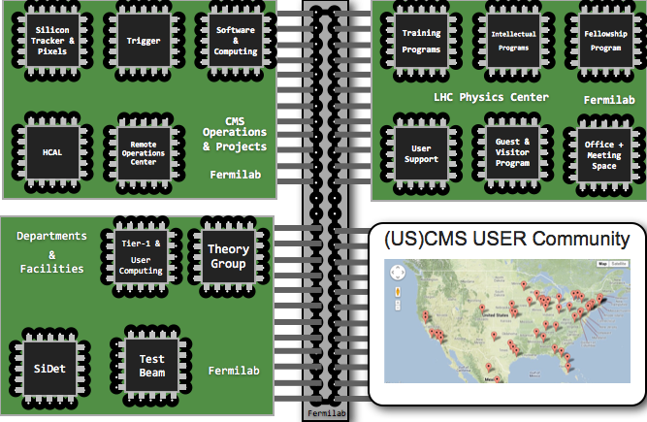
Our Connections within Fermilab:

Slide 9
The LPC User Community
LPC – “home away from home”
Participation from all of the 50 USCMS institutions
LPC community
“direct LPC participants”: 190 members (31% of USCMS)
“connected participants”: 400 members (69% of USCMS)
The LPC is an excellent resource for USCMS:
a venue for collaborations on hardware, software (51% of USCMS)
functions also as a “help-desk” (47% of USCMS)
widely used computing infrastructure (70% of USCMS and many in CMS)
LPC Physics:
facilitates collaboration between LPC and USCMS members (47%)
co-author on publication and internal notes that can be noted as a collaborative effort facilitated by the LPC (43% of USCMS)
the statistics were collected by conducting a survey of all USCMS institutes (Mar 2014)

Slide 10
LPC Distinguished Researchers
Serves two purposes:
brings excellent people to the LPC
gives the junior DRs a way to distinguish themselves and establish an independent research program
This program started in 2012
Total (2012-2015): 80
2015: 10 Junior, 5 Senior
2014: 15 Junior, 7 Senior
2013: 12 junior, 10 senior
2012: 11 junior, 10 senior
Program now duplicated by Intensity Frontier, Belle and ATLAS
2:1 ratio for junior:senior DRs

Slide 11
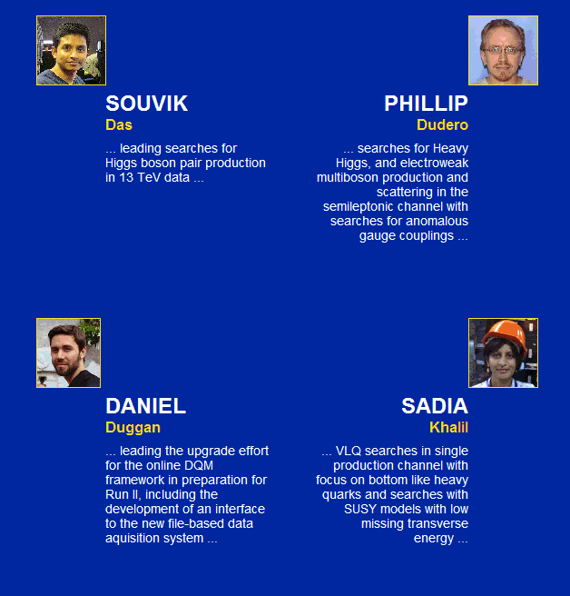
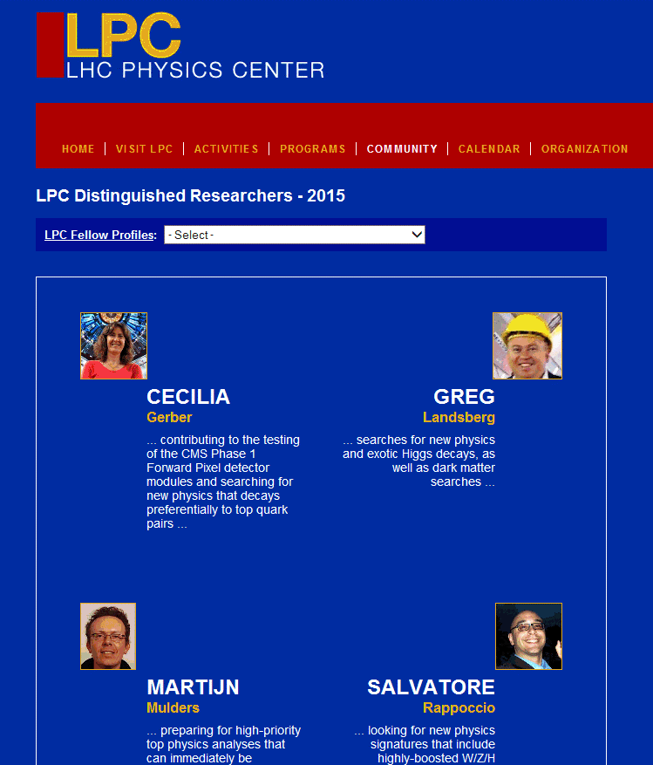
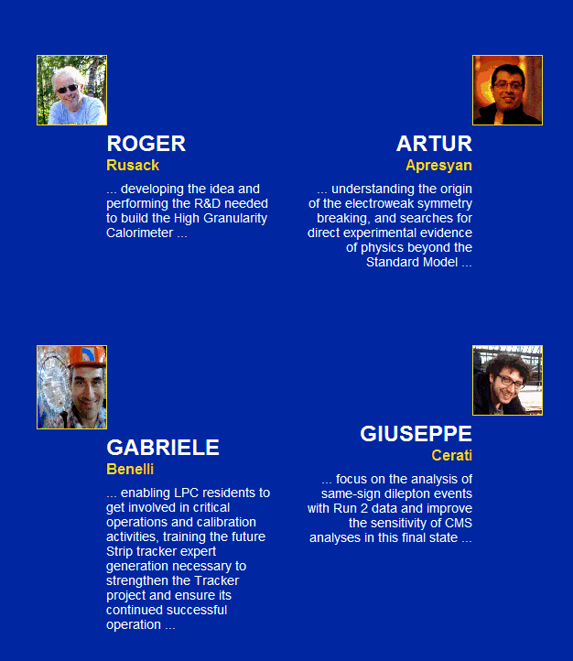
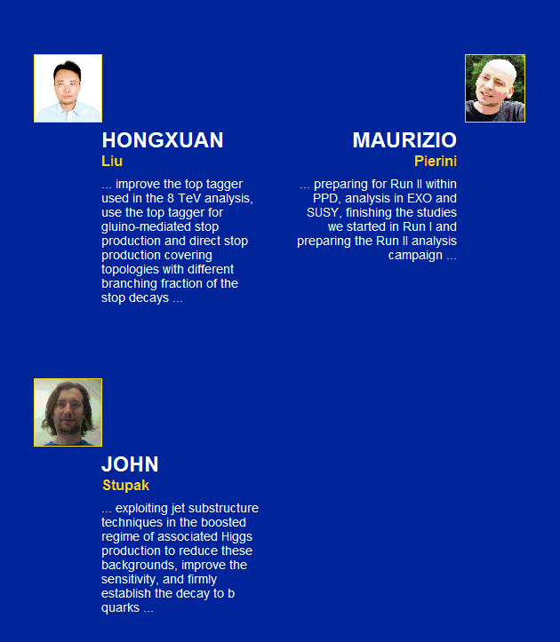
2015 LPC Distinguished Researchers

Slide 12
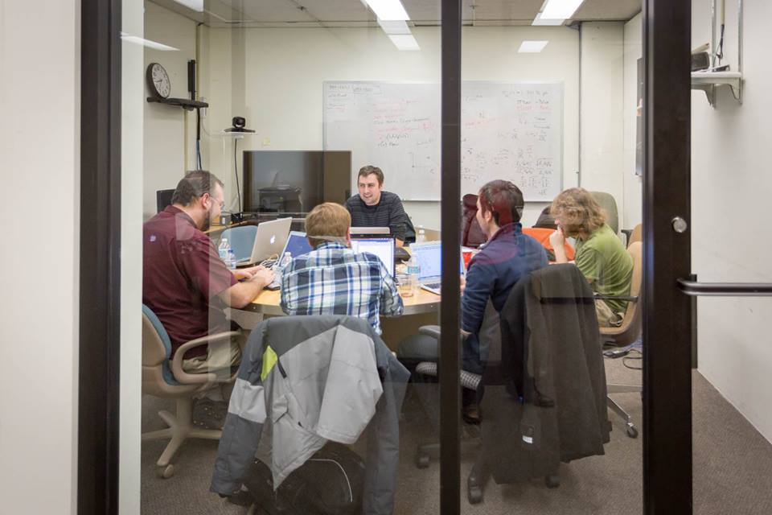
LPC Guest and Visitors Program
http://lpc.fnal.gov/programs/guests-visitors/index.shtml
LPC Guests & Visitors
facilitates CMS members to spend time at the LPC working on projects (hardware/software/physics) that advance, enrich, and impact the CMS experiment
Call for proposals twice a year
Due to personal constraints, it cuts across FYs
Stats for previous years:
FY10-12 (3 years) – 43; FY13 – 30
In FY14:
Fall - 36 proposals; 18 funded
Spring - 25 proposals; 18 funded
US : International ratio of funded 22:14
Many DRs and G&Vs are regularly contributing to the organization and execution of variety of LPC activities

Slide 13
LPC Organization
LPC Coordinators
Boaz Klima
Meenakshi Narain
Management
Board
LPC Activities
Topic of the Week (TOTW)
Physics Forum (PF)
Coffee Hour
Events Committee
Guests & Visitors
Committee

Slide 14
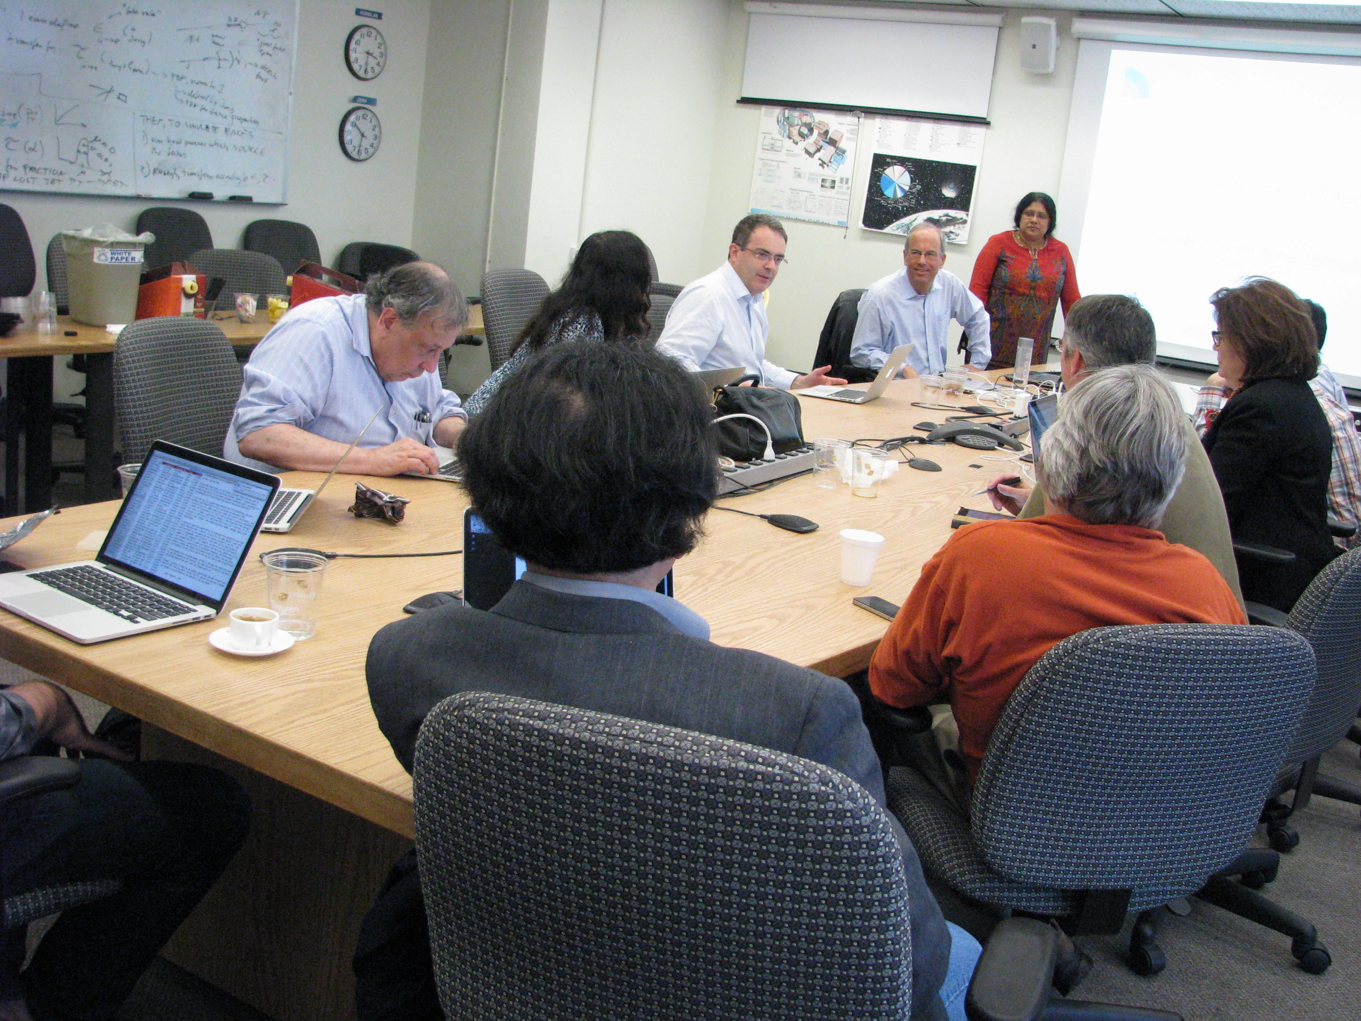
The LPC Management Board
Responsible for defining the policies (vision) and provides oversight of the activities
Act as an advisor to the LPC coordinators
Select the CMS LPC Distinguished Researchers
Membership:
Kerstin Borras (DESY)
Tulika Bose (Boston)
Sridhara Dasu (Wisconsin, USCMS IB Chair)
Rob Harris (FNAL)
Joe Incandela (UCSB)
Teruki Kamon (Texas A&M)
Boaz Klima (FNAL, Chair)
Luca Malgeri (CERN, CMS Physics Coordinator)
Meenakshi Narain (Brown, Chair)
Manfred Paulini (CMU)
Jeff Spalding (FNAL)
Ex-Officio:
Tiziano Camporesi (CERN, CMS Spokesperson)
Kevin Burkett (FNAL, CMS Center Head)
Lothar Bauerdick (FNAL, US Project Manager)
Rick Cavanaugh (UIC/FNAL, Ex- LPC Coordinator)

Slide 15
LPC Activities: Serving the LPC Community
They are all very popular, very well attended
Many initiated by members of the community or by one of the LPC committees
Topic of the Week (TOTW)
Physics Forum (PF)
Coffee Hour
Events Committee
Guests & Visitors Committee
CMS
Theory
Other Experimental
communities
USCMS

Slide 16
Serving the LPC Community
Topic of the Week (TOTW)
meet ≥twice a month
Provide opportunities for discussions on special topics relevant to CMS and the LPC community by inviting theorists and experimentalists to give a series of seminars. These discussions and seminars are focused on starting conversation and dialogues on physics, detectors, computing and on other new topics. Focus continues on phyiscs with Run2, CMS detector and physics with the upgrade.
CMS
Theory
Other Experimental
communities
USCMS

Slide 17
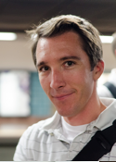
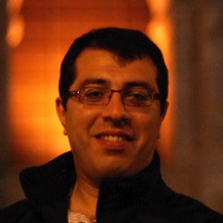
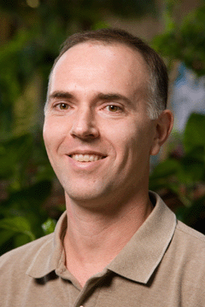
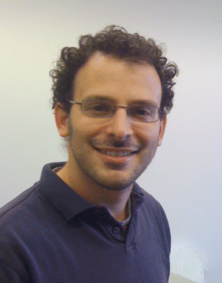
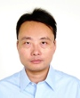
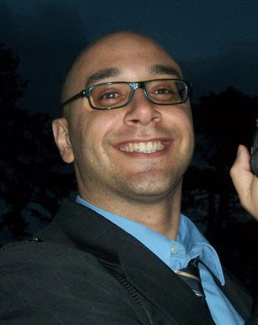
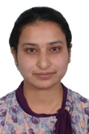
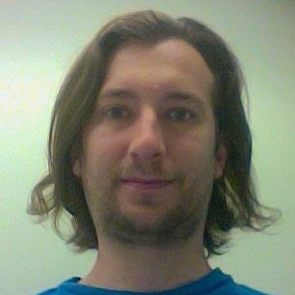
Serving the LPC Community
The LPC strengthened significantly its connections to theorists (FNAL, US, World) by engaging them directly – Roni Harnik & Bogdan Dobrescu
Topic of the Week (TOTW)
committee members
J. Hirschauer
(FNAL)
Chair
A. Apresyan
(Caltech)
Chair
B. Dobrescu
(FNAL)
Theorist)
R. Harnik
(FNAL)
Theorist)
H. Liu
(Baylor)
S. Rappoccio
(Buffalo)
L. Saini
(KSU)
J. Stupak
(Purdue-Calumet)

Slide 18
Serving the LPC Community
Topic of the Week (TOTW)
meet ≥twice a month
Provide opportunities for discussions on special topics relevant to CMS and the LPC community by inviting theorists and experimentalists to give a series of seminars. These discussions and seminars are focused on starting conversation and dialogues on physics, detectors, computing and on other new topics. Focus continues on phyiscs with Run2, CMS detector and physics with the upgrade.
CMS
Theory
Other Experimental
communities
USCMS

Slide 19
Serving the LPC Community
Physics Forum (PF)
Bi-weekly – Thursdays
The Physics Forum, (since 2006), has been providing a unique basis for engaging "on-the-floor" discussions amongst many LPC members. It facilitates energetic cross-fertilization of ideas between analyzers, includes presentations from G&V, chalk-talks from CMS and theory, and gives exposure to our young colleagues.
CMS
Theory
Other Experimental
communities
USCMS

Slide 20
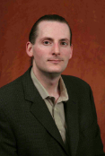
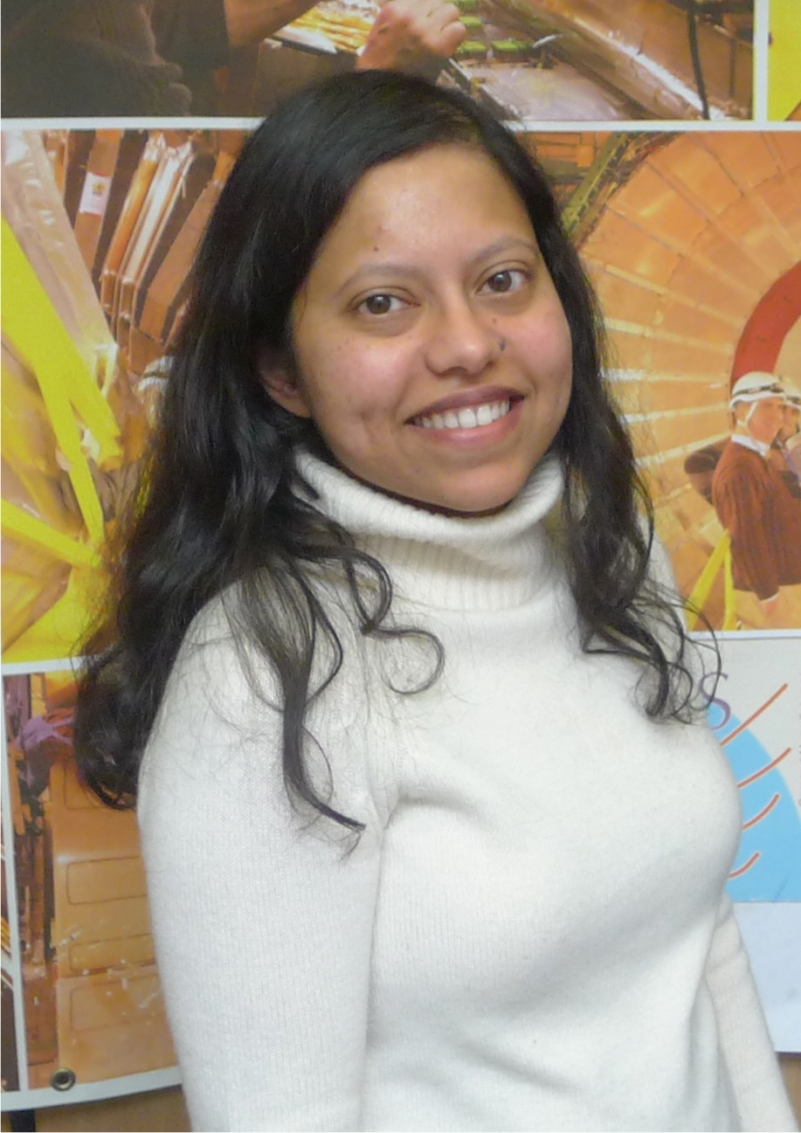
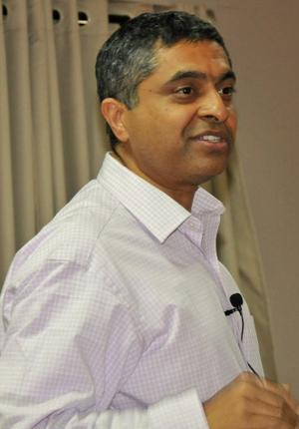
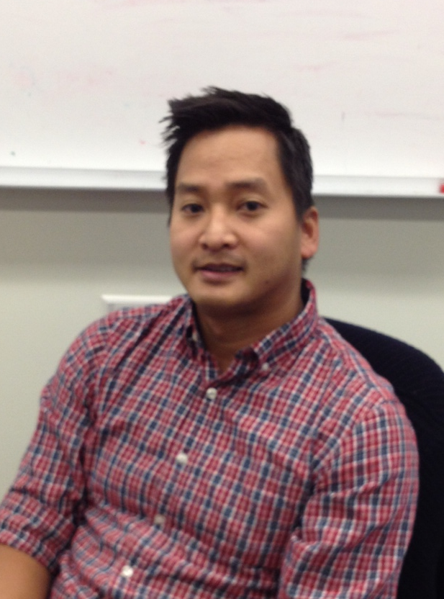
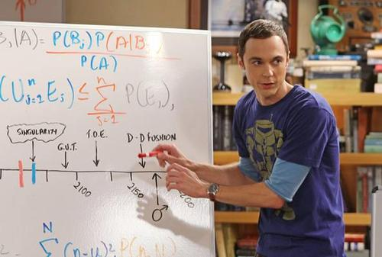
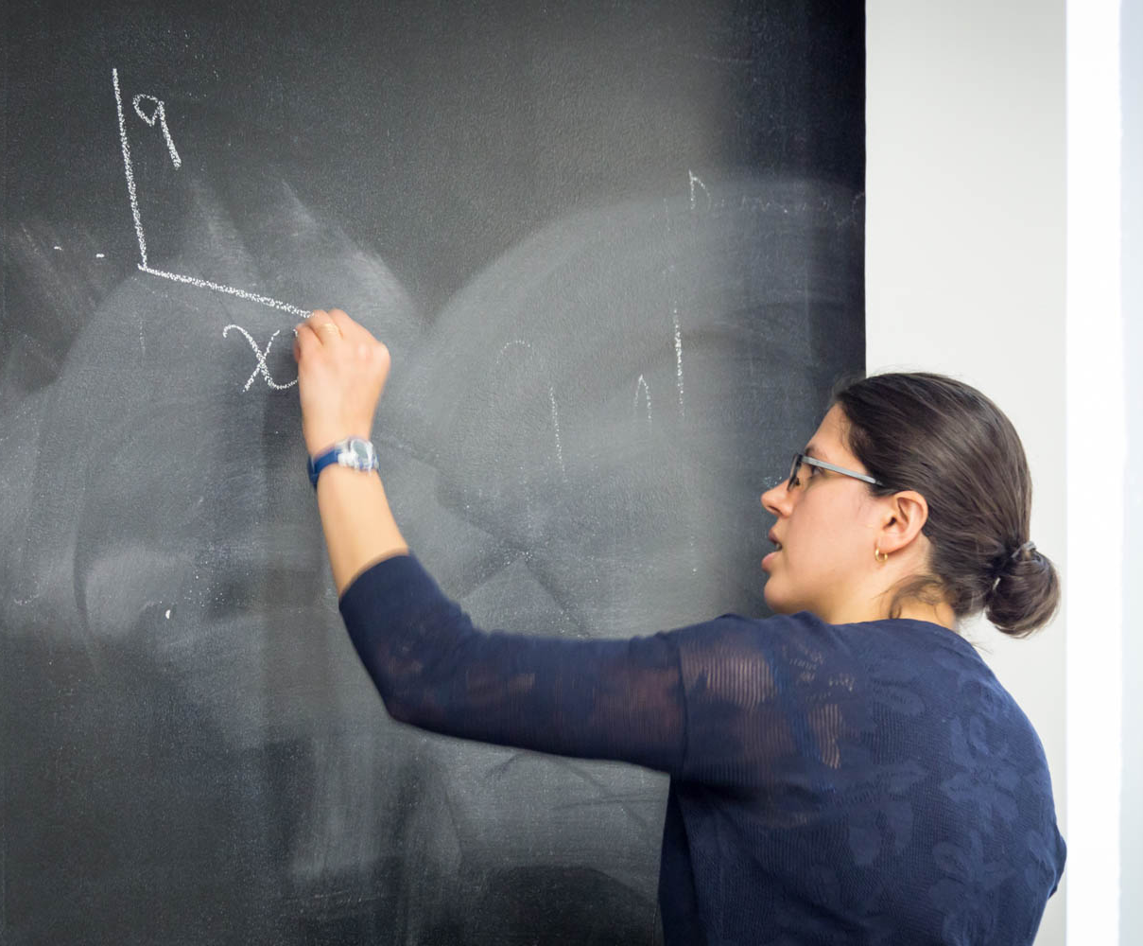
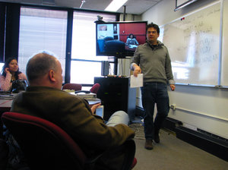
Serving the LPC Community
Physics Forum (PF)
committee members
Askew
(FSU)
T. Bose
(BU)
S. Dasu
(Wisconsin)
N. Tran
(FNAL)

Slide 21
Serving the LPC Community
Coffee Chats
Social Program, once per month
The LPC Coffee hour (or “coffee chat”), is providing an opportunity for LPC residents to gather in an informal setting (at the old ROC on WH11NW) and discuss topics of current interest within the community e.g. P5 report HL HLC Higgs Boson/Nobel P., conf summaries, Snowmass/ECFA,, physics opportunities in Run 2 etc.
CMS
Theory
Other Experimental
communities
LPC residents

Slide 22
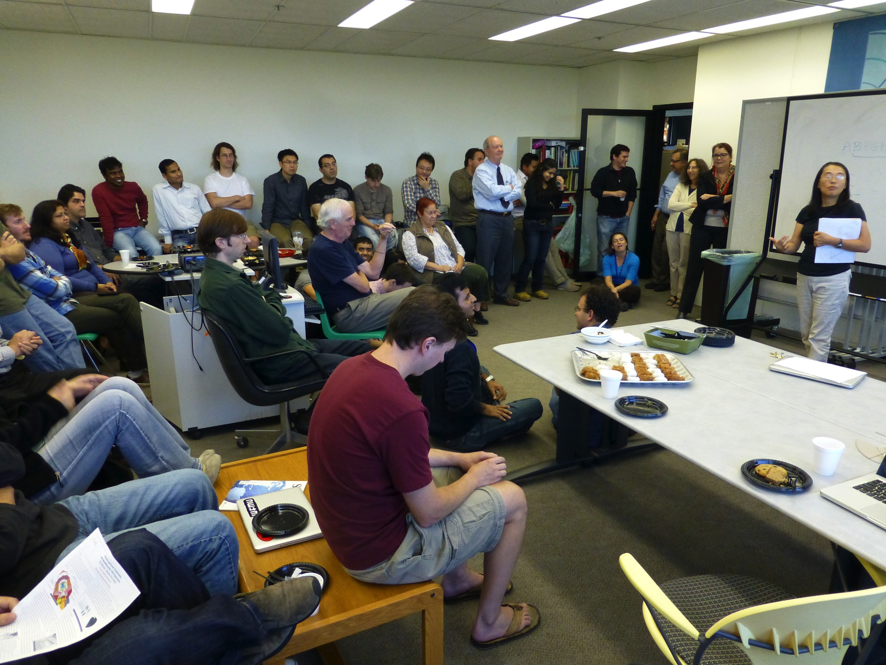
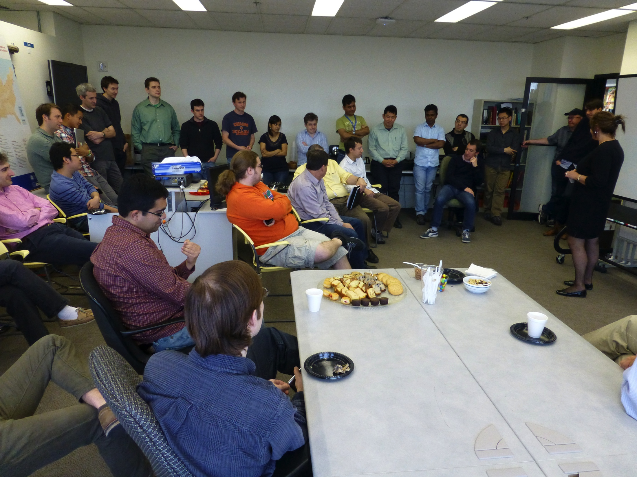
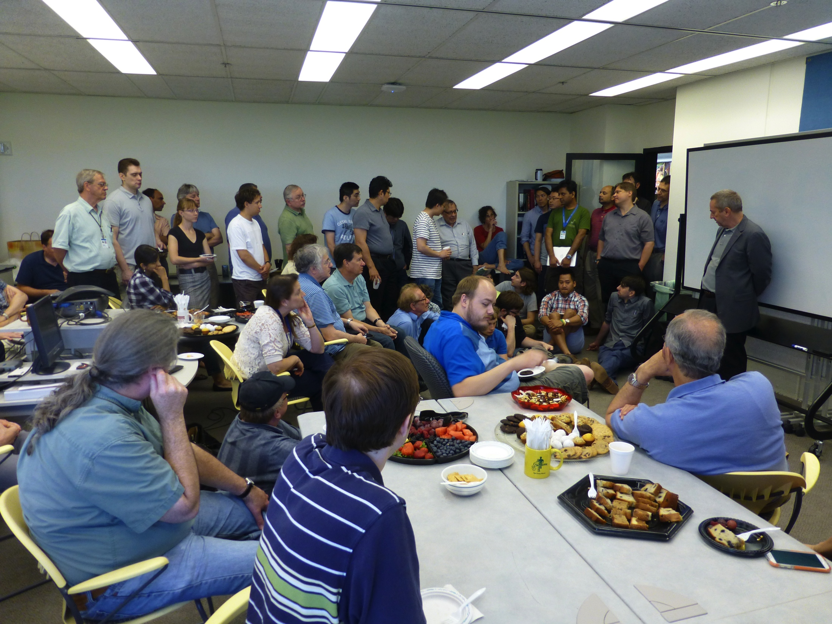
Serving the LPC Community
Coffee Chats
Social Program, once per month
The LPC Coffee hour (or “coffee chat”), is providing an opportunity for LPC residents to gather in an informal setting (at the old ROC on WH11NW) and discuss topics of current interest within the community e.g. P5 report HL HLC Higgs Boson/Nobel P., conf summaries, Snowmass/ECFA,, physics opportunities in Run 2 etc.
CMS
Theory
Other Experimental
communities
LPC residents

Slide 23
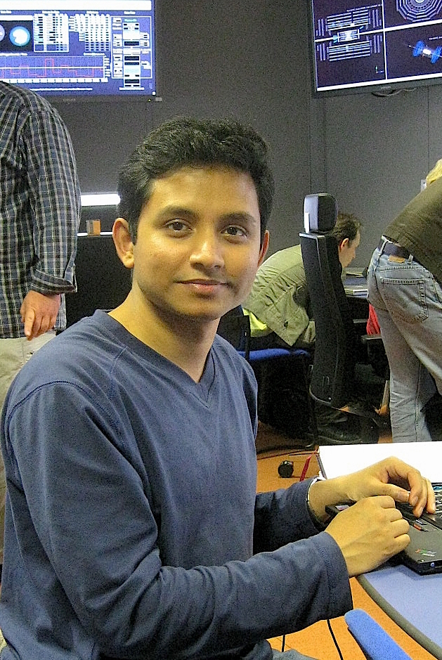
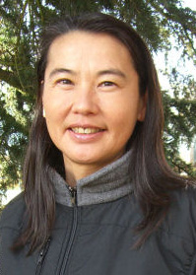
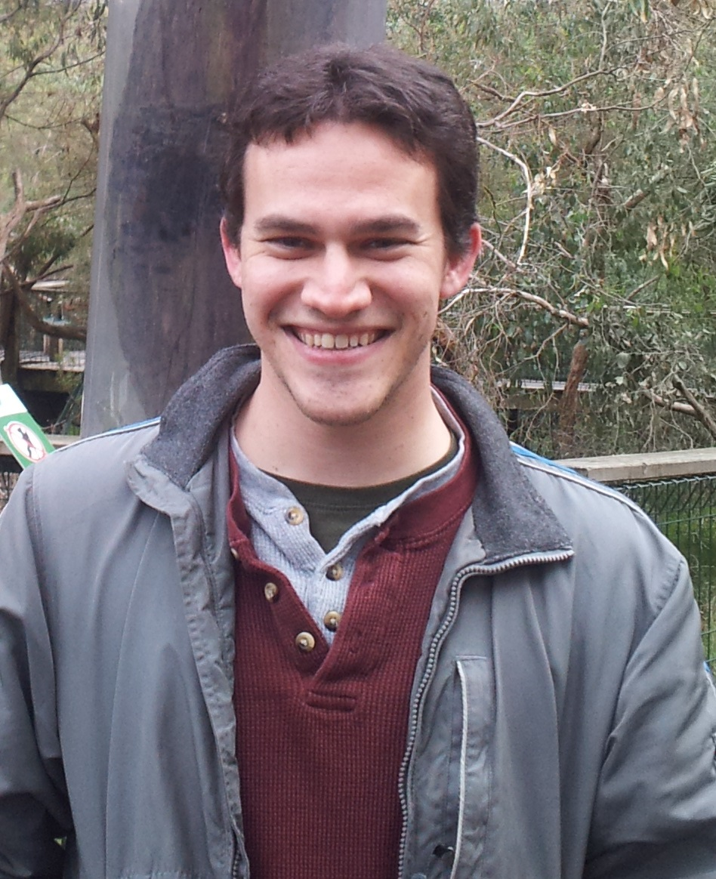
Serving the LPC Community
Coffee Chats
Social Program, once per month
S. Das
(Florida)
K. Maeshima
(FNAL)
M. Weinberg
(Florida State)

Slide 24
Serving the LPC Community
Events Committee
Hands-on Advanced Tutorial Sessions (HATS)
Working groups & Workshops (CMS internal)
Workshops - open to the community
Organize (with experts) events (“workshops”) related to
▪CMS –PAG and topical workshops CMSDAS, HATS, …
▪LHC (CMS, ATLAS, LHCb, theorists) - Topical
▪Energy Frontier activity – CTEQ, Snowmass,…
CMS
Theory
Other Experimental
communities
USCMS

Slide 25
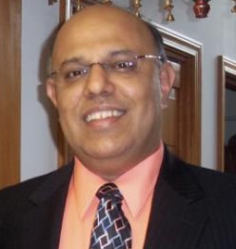
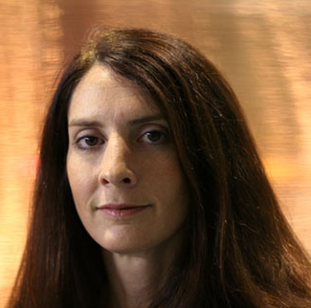
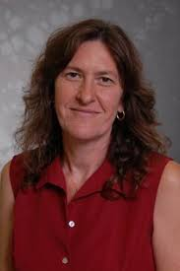
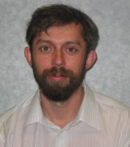
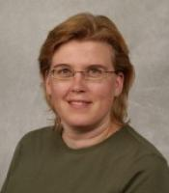
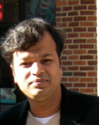
Serving the LPC Community
Events Committee
Hands-on Advanced Tutorials (HATS)
Working groups & Workshops (CMS internal)
Workshops - open to the community
S. Malik
(UPRM)
Chair
Whitbeck
(FNAL)
Chair
R. Erbacher
(UC Davis)
C. Gerber
(UIC)
Y. Maravin
(KSU)
J. Nachtman
(Iowa)
S. Padhi
(UCSD)

Slide 26
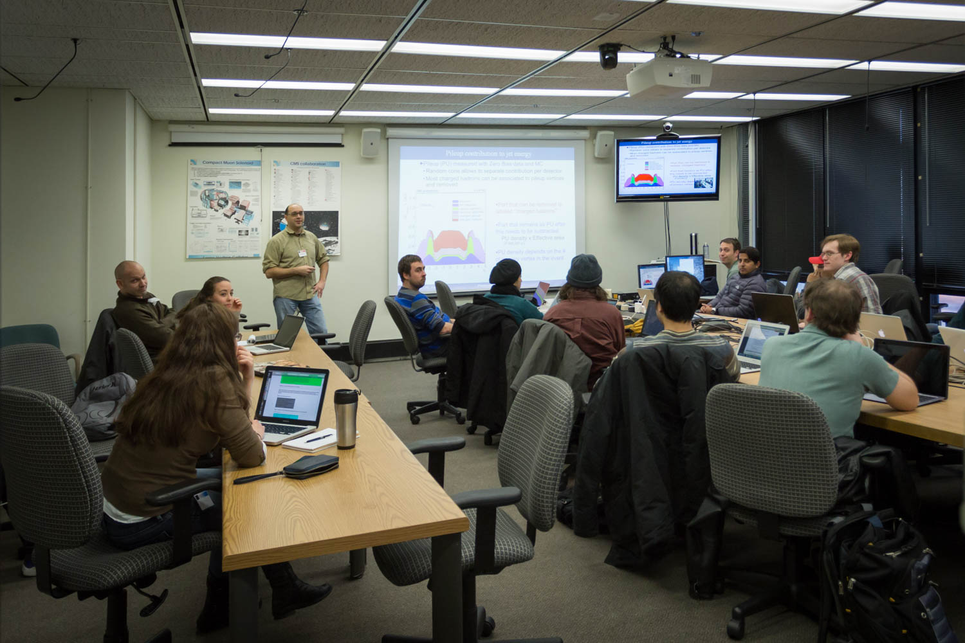
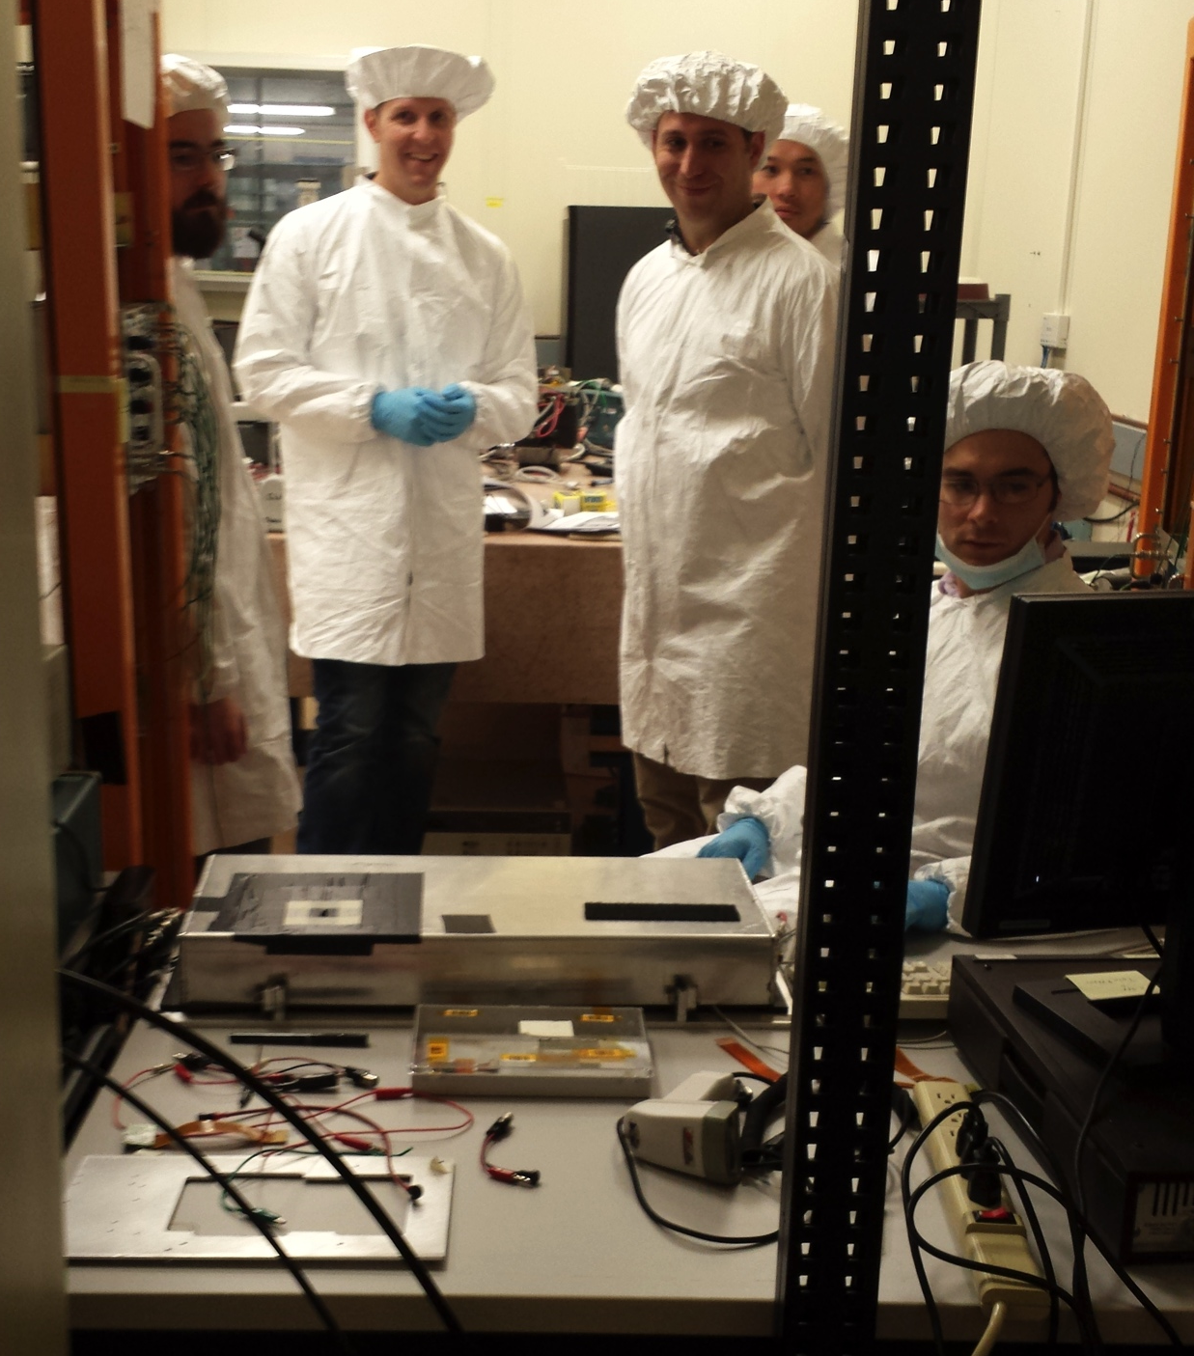
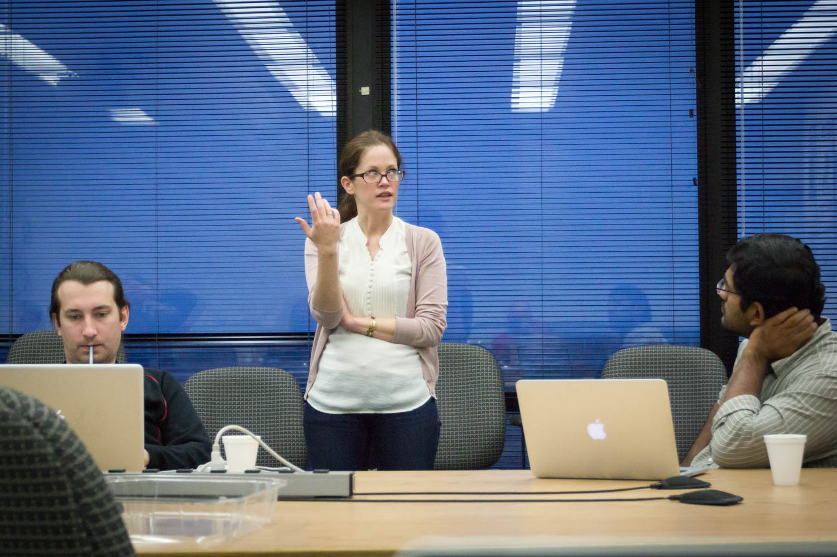
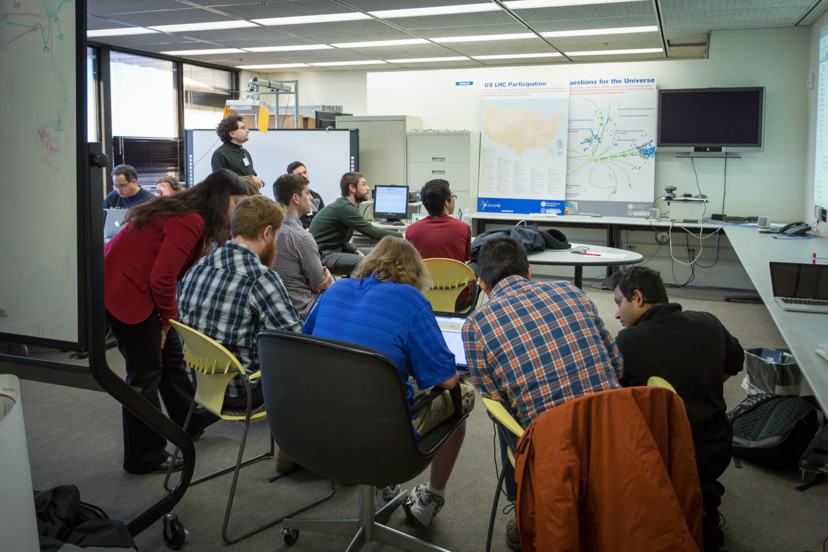
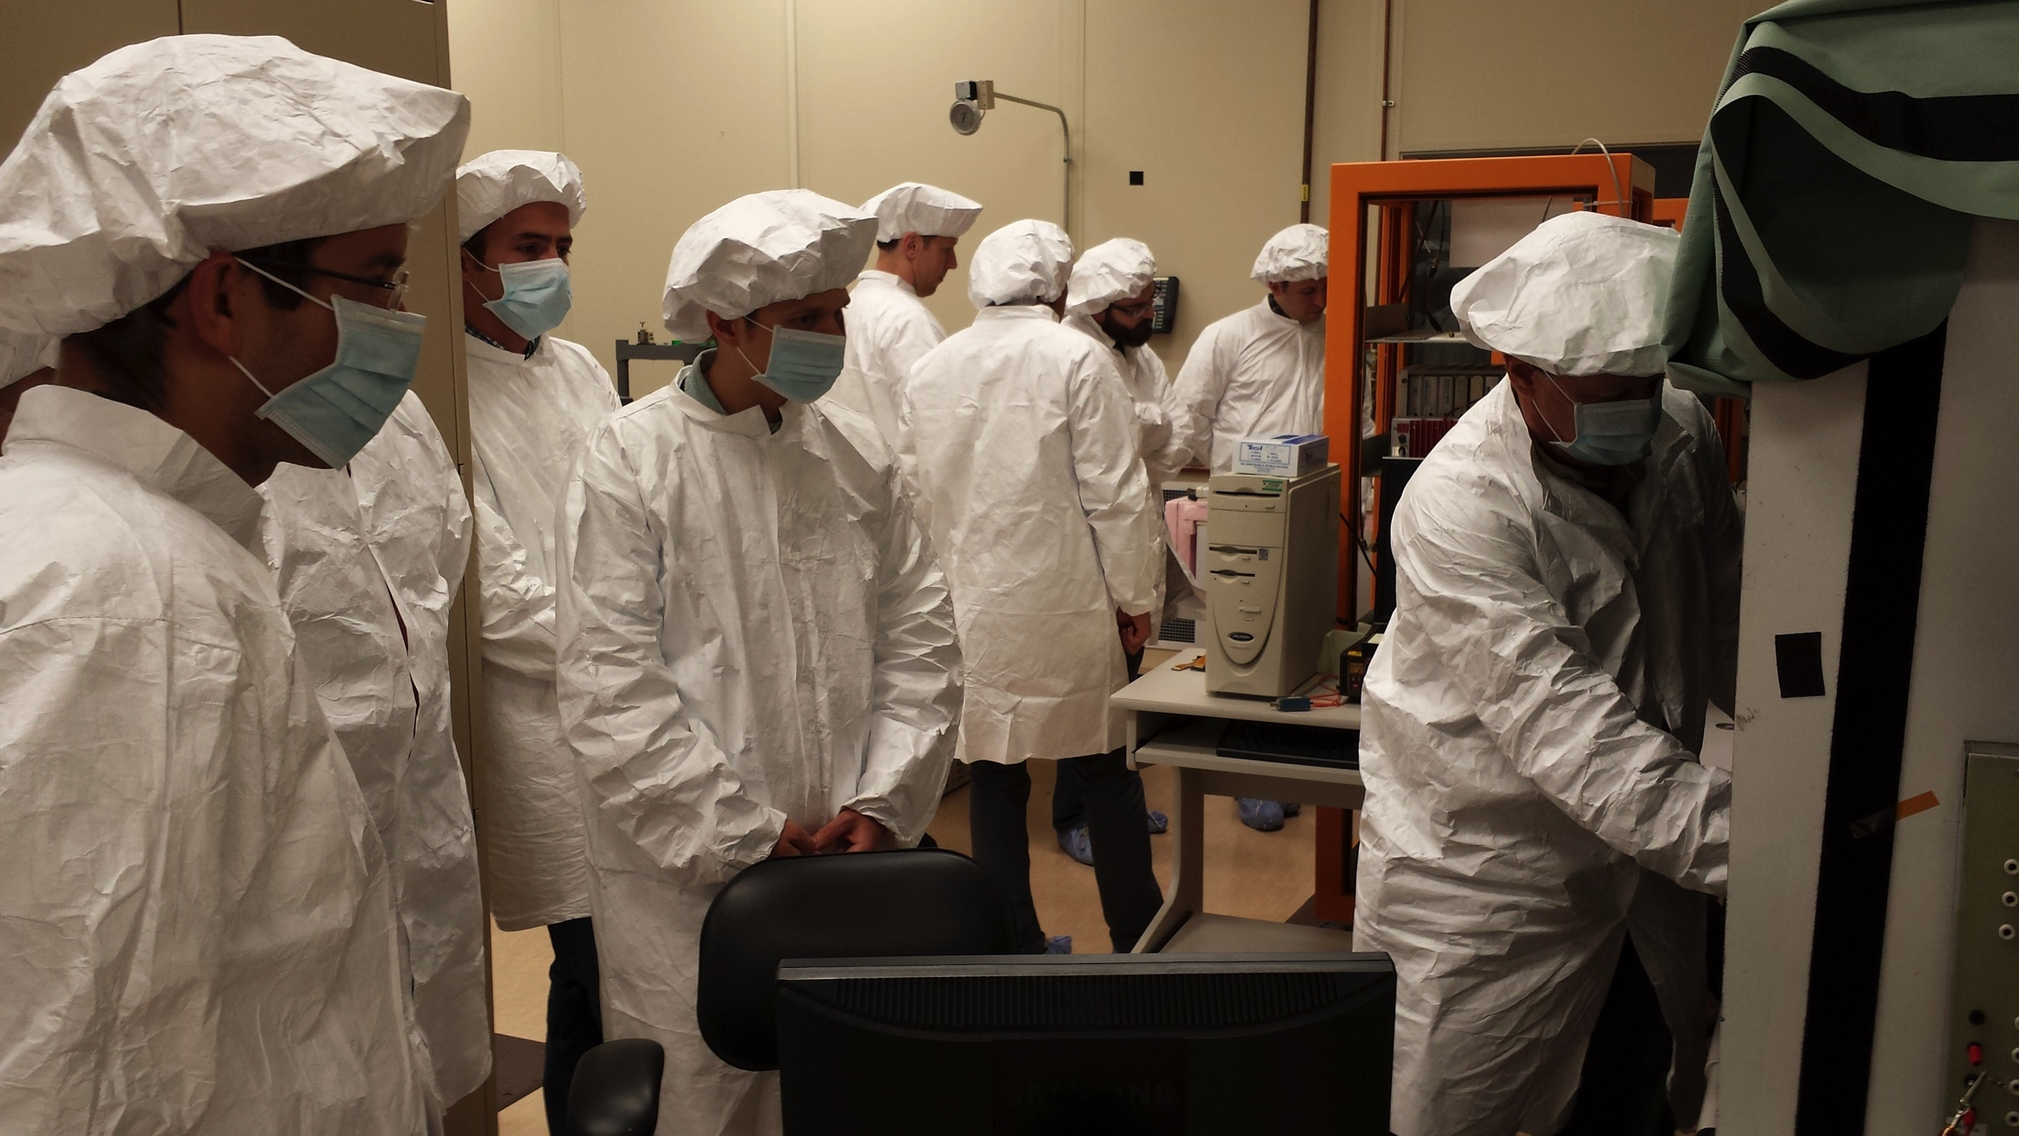
HATS: An LPC Signature Initiative
Training Program
Hands-on Advanced Tutorials (HATS)

Slide 27
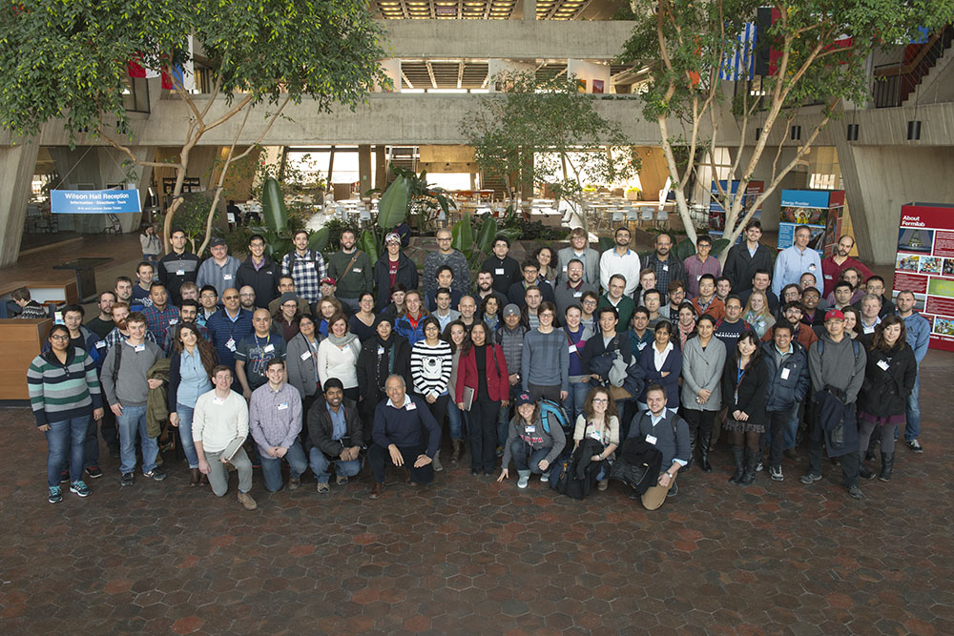
CMSDAS: An LPC Signature Initiative:
Started by the LPC in 2006,
hosted in Asia and Europe
http://www.fnal.gov/pub/today/

Slide 28
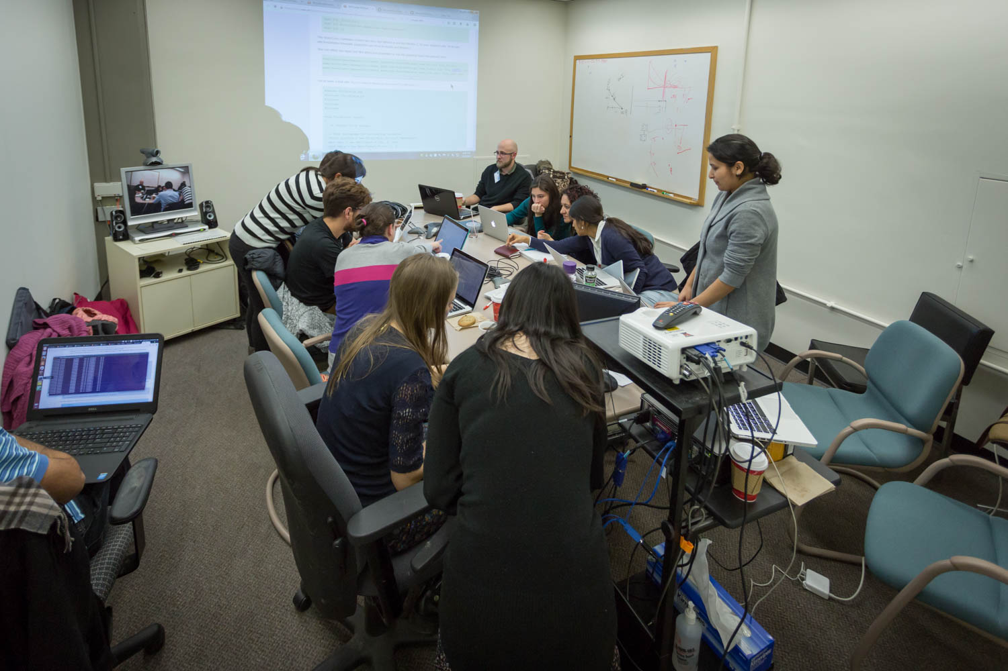
Collaborative & Active Learning
Emphasize student to facilitator ratio of 1:1
request students to perform as set of pre-exercises prior to attending the school.
Introductory Lectures on Detector, Physics, Computing, LHC,
Short exercises (1.5 days) on physics objects, triggers, track
Long exercises (3 days): student teams perform end-to-end analyses and present it on the last day

Slide 29
The Student Presentations
The student groups present their work and compete for the “first prize” judges by a panel of senior CMS physicists.
An impressive performance by students who have little or no-prior experience with CMS software

Slide 30
An impromptu visit from the Boss

Slide 31
Events in 2014
Event Name | Event Type | Date | Facilitators | Participants
CMSDAS | School | 7-11 Jan | 43 facilitators, 8 speakers | 79+40
Fully Exploring Exotic Production of the 126 GeV Higgs | TOTW | 21 Jan | Felix Yu (FNAL) | 27 (17 CMS)
Two Higgs Doublet Model studies at the LHC and beyond | PF | 23 Jan | John Stupak (Purdue University Calumet) | HF
Measuring CP Violation in h -> tau+tau- at Colliders | TOTW | 23 Jan | Felix Yu (FNAL) | 26 (15 CMS)
JME Workshop | Workshop | 27-28 Jan | Tai Sakuma (TAMU), Nhan Tran (FNAL), A. Apresyan (Caltech) & JME group | 54
Where new physics may lie hidden: an experimentalist's perspective, W' decays into odd Higgs bosons | PF | 6 Feb | John Paul Chou (Rutgers) Bogdan Dobrescu (Fermilab) | HF
The Search for Dark Matter at the LHC | TOTW | 13 Feb | Steven Worm (STFC - Rutherford Appleton Lab.) | 49 (41 CMS)
Opportunities in Higgs physics at the LHC Run II | TOTW | 18 Feb | Frank Petriello (Northwestern University) | 54 (39 CMS)
Delphes simulation | HATS | 19 Feb | John Stupak (PUC), Zhenbin Wu (Baylor), Nitish Dhingra (PU) | 21
HL-LHC plans, physics goals and CMS upgrade | PF | 20 Feb | Prateek Agrawal (Fermilab), Markus Klute (MIT) | HF
Higgs Couplings | TOTW | 4 Mar | Sally Dawson | 59 (49 CMS)
Probing the pMSSM, Shedding Light on Unexplored Regions | PF | 6 Mar | Samuel Louis Bein (FSU) Andrew Askew (FSU) | HF
New theoretical insights | Coffee chat | 12 Mar | Chris Hill (Fermilab) | HF
Exotic Decays of the 125 GeV Higgs Boson | TOTW | 18 Mar | Rouven Essig (Stonybrook) | 40 (30 CMS)
Life and Science | Coffee chat | 21 Mar | George Zweig (MIT) | HF
MET (Missing ET) | HATS | 26 Mar | Tai Sakuma (TAMU) | 20
News from Moriond QCD conf. | Coffee chat | 2 Apr | Boaz Klima (Fermilab) | HF
Searches for Top Partners | PF | 3 Apr | Aram Avetisyan (Boston) | HF

Slide 32
Events in 2014 (cont.)
Event Name | Event Type | Date | Facilitators | Participants
Using energy-peaks to measure particle (new and old) masses | TOTW | 15 April | Kaustubh Agashe (Maryland) | 38 total (29 CMS)
Tracking for Run 2 , SUSY with leptons: experience gained with 8 TeV and outlook for 2015 | PF | 17 Apr | Kevin Burkett (Fermilab) Lesya Shchutska (Univ. of Florida) | HF
New developments in dark matter searches at colliders | TOTW | 17 Apr | Greg Landsberg (Brown University) | 68 total (59 CMS)
SUSY in Standard Model Standard Candles | TOTW | 30 Apr | David Curtin (Stony Brook) | 47 total (40 CMS)
Fake Leptons | PF | 1 May | David Curtin (Stony Brook) | HF
Open issues in TP for CMS Upgrade Project - a preview to CMS TP workshop at the LPC | Coffee chat | 6 May | Lucia Silvestris (INFN Bari) | HF
CMS Upgrade TP (Technical Proposal) Performance Studies Group | Workshop | 8-9 May | Lucia Silvestris (INFN Bari) , Markus Klute (MIT) | 60
B-tagging | HATS | 12 May | Alexander Schmidt (Hamburg) and Nitish Dhingra (Brown) | 20
Calo Upgrade Technologies/Simulations | HATS | 16 May | Jake Anderson (Fermilab) and Roger Rusack (Minnesota) | 21
Statistics (Lectures and Hands-on) | HATS | 2-4 June | Jochen Ott (Hamburg) and Ulrich Heintz (Brown) | 39
P5 impact on CMS | Coffee Chat | 3 June | Nigel Lockyer, Fermilab Director | HF
Timing and forward jet confirmation PUPPI ( Pile-Up Per Particle Identification) algorithm | PF | 5 June | Yuri Gershtein (Rutgers) Nhan Tran (FNAL) | HF
Practical Statistics | TOTW | 5 June | Jochen Ott (Hamburg) | 28 total (28 CMS)
Jet Substructure by Accident | TOTW | 17 June | Tim Cohen (Stony Brook) | 42 total (38 CMS)

Slide 33
Events in 2014 (cont.)

Slide 34
Events in 2014 (cont.)
Many activities (65) – Lots of Participants (mostly USCMS)
Some events require a lot of preparatory work, e.g. CMSDAS

Slide 35
Facilitators for HATS and CMSDAS
An impressive investment by junior and senior members in leading the HATS, organizing events, and facilitating CMSDAS exercises (a few in pictures below, not an exhaustive set. )

Slide 36
Summary of 2014 LPC Activities
CMSDAS – 1
Workshops – 8
CMS only – 6 (JME, TP, HCAL, Trig/Track, B2G, SUSY)
Global – 2 (BSM Higgs, Future Colliders)
Hands-on Advanced Tutorial Sessions (HATS) – 11
ID – 4 (e, E_{T}, b-tag, Jet-substructure)
Upgrade – 3 (Calo, Tracker, Trigger)
Tools – 4 (Statistics, Roostat, CRAB3, Delphes)
Topic of the week – 19
Physics Forum – 17
Coffee Hour – 9

Slide 37
Extending the LPC Community
Guests & Visitors Committee
selection: twice a year
Responsible for defining the policies, and providing oversight and selection of the short and long term visitor applications to the LPC, in consultation with the LPC coordinators
CMS
Theory
Other Experimental
communities
USCMS

Slide 38
Guests & Visitors Committee
selection: twice a year
K. Hatakeyama
(Baylor)
Chair
R. Cavanaugh
(UIC/FNAL)
E. Halkiadakis
(Rutgers)
U. Heintz
(Brown)
L. Spiegel
(FNAL)
M. Velasco
(NWU)
F. Wuerthwein
(UCSD)

Slide 39
LPC Contributions to CMS Physics
LPC publication metrics
Quantifying the impact of the LPC on the physics productivity of CMS
Contributions to the CMS publications
Analysis Review Committee (ARC) Chairs
Number of ARC members
Primary Contact for Publication (CADI contact)
Number of Authors
The analysis looks at the above variables in the context of CMS, USCMS and LPC.
Developed a new infrastructure, as this is rather tedious and time consuming process, to gather and connect information from 4 independent sources.
limitations: most of Higgs Notes do not contain an author list, but the name of the team e.g. “VHbb team”, “Hgg team” etc, and hence difficult to classify.

Slide 40
publications/review
Metrics as of June 2014
Green: LPC co-authors from survey
Blue+Green: USCMS
RED: not USCMS
Analysis
Contacts
18%
ARC
Chairs
16%
ARC Members
(incl. chairs)
60%
Tot num of
ARC Members
18%

Slide 41
publications…
Metrics as of June 2014
Green: LPC co-authors from survey
Blue+Green: USCMS
RED: not USCMS
.
majority of US co-authors from LPC
16 papers
Authors
contributing to
52% of all pubs

Slide 42
Some examples of LPC pubs…
B2G:
“Search for Top-Quark Partners with Charge 5/3 in the Same-Sign Dilepton Final State”, Phys. Rev. Lett. 112 (2014) 171801
“Inclusive search for a vector-like T quark with charge 2/3 in pp collisions at sqrt(s)=8 TeV”, Physics Letters B 729 (2014) 149
Search for vector-like quarks in final states with a single lepton and jets in pp collisions at sqrt(s) = 8 TeV. (CMS PAS B2G-12-017 (2014))
Search for monotop signatures in proton-proton collisions at sqrt(s) = 8 TeV", arXiv:1410.1149 [hep-ex], submitted to Phys. Rev. Lett. (B2G-12-022)
Search for W' to tb decays in the lepton + jets final state in pp collisions at sqrt(s)= 8 TeV", CMS Collaboration, JHEP 05 108 (2014), arXiv:1402.2176 [hep-ex].
EXO:
“Search for jet extinction in the inclusive jet-pt spectrum from proton- proton collisions at sqrt(s) = 8 TeV,” Phys. Rev. D 90 (2014) 032005.
Z’ search in dilepton channel at 8 TeV (EXO-12-061),
Exotic 4 lepton resonance search at 8 TeV (EXO-14-006).
Search for new resonances decaying via WZ to leptons in proton-proton collisions at sqrt(s)= 8 TeV", CMS Collaboration, Phys. Lett. B 740 83 (2015), arXiv: 1407.3476
“Search for new phenomena in monophoton final states in proton-proton collisions at √s=8 TeV,” arXiv:1410.8812, submitted to Phys. Lett. B.

Slide 43
Some examples of LPC pubs…
Higgs
HH->4b Physics Analysis Summary: http://cds.cern.ch/record/1748425?ln=en
HH->4b Public Twiki: https://twiki.cern.ch/twiki/bin/view/CMSPublic/Hig14013TWiki
Search for anomalous HVV couplings in VH(->bb) final state
contributions to:
Evidence for the direct decay of the 125 GeV Higgs boson to fermions,” Nature Phys. 10 (2014) 557.
Observation of the diphoton decay of the Higgs boson and measurement of its properties,” Eur. Phys. J. C 74 (2014) 3076.
Constraints on the spin-parity and anomalous HVV couplings of the Higgs boson in proton collisions at 7 and 8 TeV," arXiv:1411.3441, submitted to Phys. Rev. D.
Precise determination of the mass of the Higgs boson and tests of compatibility of its couplings with the standard model predictions using proton collisions at 7 and 8 TeV," arXiv:1412.8662, submitted to EPJC.
JetMet:
“Identification techniques for highly boosted W bosons that decay into hadrons”, JHEP 12 (2014) 017 arXiv:1410.4227 [hep-ex].
”Study of Pileup Removal Algorithms for Jets”, CMS PAS JME-14-001 (2014).
SMP: Drell-Yan differential cross section at 8 TeV (SMP-14-003),

Slide 44
Some examples of LPC pubs…
SUSY:
SUS-14-002 “Searches for electroweak neutralino and chargino production in channels with Higgs, Z, and W bosons in pp collisions at 8 TeV,”; PRD 90, 092007 (2014) arXiv:1409.3168
Search for top squarks in R-parity violating supersymmetry with dileptons and jets in pp collisions at sqrt(s) = 8 TeV. (CMS Internal Review (2015))
Search for stealth supersymmetry in events with jets, either photons or leptons, and low missing momentum in pp collisions at sqrt(s) = 8 TeV. (Sub. to PLB (2014)), arXiv:1411.7255
“Search for top squarks in multijet events with large missing momentum in proton-proton collisions at 8 TeV,” CMS Physics Analysis Summary CMS-PAS-SUS-13-015, 2013.
"Performance of the missing transverse energy reconstruction by the CMS experiment in sqrt(s) = 8 TeV pp data", arXiv:1411.0511
"Search for new physics in the multijet and missing transverse momentum final state in proton-proton collisions at √s = 8 TeV", J. High Energy Phys. 06 (2014) 055
Squark and gluino production cross sections in pp collisions at \sqrt(s) = 13, 14, 33 and 100 TeV, C. Borschensky et. alarXiv:1407.5066, Published in Eur.Phys.J. C74 (2014) 12, 3174
SUSY Simplified Models at 14, 33, and 100 TeV Proton Colliders, T. Cohen et. al., Published in JHEP 1404 (2014) 117
Search for new physics in events with same-sign dileptons and jets in pp collisions at sqrt(s)=8 TeV, arXiv:1311.6736, Published in JHEP 1401 (2014) 163
TOP:
PAS: ttbar+photon cross section using muon+jets (TOP-14-XXX0
PAS: Measurement of the top quark mass in the dileptopn channel (TOP_14-010)
BPH:
BPH-11-026, observation of peaking structure near jpsi+phi threshold. published in Phys.Lett. B734 (2014) 261
BPH-13-009, observatoin of B+ -> psi(2s) phi K+, approved, preparing paper draft for CWR.
+ many more…

Slide 45
LPC contributions to CMS physics
Summary
LPC members are engaged in Higgs, SUSY, Exotica, B2G,
B physics, SM Physics, and Top quark analyses.
An impressive set of high impact topics and publications.
LPC members have made significant contributions to:
many analyses and reviews (ARC)
quite a few analyses in B2G, SUSY, EXO groups with a majority of co-authors from LPC
16 out of 99 publications – since 2012
caveat: not much information can be extracted by the automated scripts for Higgs analyses

Slide 46
LPC-FNAL Theory connection
Remarkable scientific progress in the last few years, based on the CMS data
benefitting from strong connections with FNAL theory dept.
Few places have that connection as strong as the LPC
20 Fermilab theorists, including valuable contributions to LPC/CMS program
SM measurements & backgrounds for BSM: Campbell, Ellis, Furlan, Giele, Parke, Röntsch
BSM searches: Agrawal, Bishara, Carena, Dobrescu, Eicthen, Fox, Frugiuele, Harnik, Hill, Kearney, Lykken, Quigg
Participation in many LPC activities:
Topic of the Week seminars –
theory speakers: Craig, Davoudiasl, Dawson, Ellis, Evans, Feng, Kats, Kilic, Low, Luty, Matchev, Toro, Wang ... + 20 more
“Open” Physics forum – one experimentalist + one theorist (whiteboard talks!)
Coffee hour – informal discussions
Workshops, meetings, schools,

Slide 47
the LPC-theory interaction diagram

Slide 48
CMS papers with significant theory-LPC collaboration
Exotica Group/ New Particle Searches:
Search for pair-produced resonances decaying to jet pairs CMS-EXO-12-052 (2014/12/25)
https://twiki.cern.ch/twiki/bin/view/CMSPublic/PhysicsResultsEXO12052
Extensive interactions with Kai Yi (and also with Rob Harris and Eva Haldakiakis) for over 2 years. Dobrescu wrote the MadGraph files used by CMS for the signal simulations, we had many physics conversations.
Search for neutral color-octet weak-triplet scalar particles (CMS PAS EXO-12-007 (2015/01/13))
http://cds.cern.ch/record/1980941/files/EXO-12-007-pas.pdf?version=1
Extensive interactions with Kaori Maeshima, Aron Soha‎ and Sho Maruyama for over 2 years, discussing many physics aspects of this search. Dobrescu wrote the MadGraph files for the models targeted in this search. These MadGraph files were key to the CMS signal simulations.
Search for Heavy Resonances Decaying into bb and bg Final States (EXO-12-023 (2013-04-15))
https://twiki.cern.ch/twiki/bin/view/CMSPublic/PhysicsResultsEXO12023
Dobrescu wrote the MadGraph files for simulating the b bbar resonance signal and sent them (in May 2012) to John-Paul Chou. We also had various conversations on this subject.
Four top final state (pairs of t tbar resonances):
Dobrescu wrote MadGraph files for Francesco Yumiceva and gave extensive input to analysis.
Searches in the W+jets final state. Dobrescu suggested certain new particle searches to Ilya Osipenkov and Kalanand Mishra, and has written MG5 files. Also various communications with Dan Green on this subject.
Effects on Higgs production and decays: Carena, et al JHEP 1207 (2012) 175 etc, triggered interest in the search for light staus within the LPC DR Eva Halkiadakis and led to cPAS-SUS-12-004
Benchmark scenarios for Additional Higgs searches: Eur.Phys.J. C73 (2013) 9, 2552 (Carena et al), and discussions with CMS/LPC members (specially withLPC DR Landsberg) led to CMS-HIG-12-033 and CMS-HIG-13-021

Slide 49
CMS papers with significant theory-LPC collaboration
Higgs to four leptons:
https://twiki.cern.ch/twiki/bin/view/CMSPublic/Hig14018PaperTwiki
Collaboration between Roberto Vega-Morales, a Fermilab Fellow, and LPC members (including Nhan Tran) and theory group members (including Joe Lykken) about using the Higgs decay to four leptons most effectively. His work has had a profound impact on the analysis, and he was made a co-author of CMS-HIG-14-018. Vega-Morales worked closely with Yi Chen and other member of Maria Spriropoulo’s group. He provided the analytic formulae necessary to perform the likelihood fits.
Higgs width constraint:
https://twiki.cern.ch/twiki/bin/view/CMSPublic/Hig14002PubTWiki
Keith Ellis and John Campbell worked quite closely with LPC fellow Andrei Gritsan and Yanyan Gao. The thrust of the interaction was to use it in matrix element discriminants and event simulation for H->4-lepton events.
Higgs to tau mu
https://twiki.cern.ch/twiki/bin/view/CMSPublic/Hig14005TWiki
The search was suggested by Harnik in a paper with Kopp and Zupan. Colin Jessop of Ndis the main person on the search.
Dark matter mono-jet
https://twiki.cern.ch/twiki/bin/view/CMSPublic/PhysicsResultsEXO12048
Patrick Fox and Roni Harnik were among the theorists who proposed the search. They worked with the local LPC group working on the analysis (headed by Sarah Al-Malik) and provided Madgraph files.
Dark matter mono-photon
https://twiki.cern.ch/twiki/bin/view/CMSPublic/PhysicsResultsEXO12047
Patrick Fox and Roni Harnik were among the theorists who proposed the search. They worked with the group working on the analysis (Mani Tripathi and exotics convener JP Chou) and provided MC events.
Razor search for DM: CMS is finalizing this search proposed by Harnik and Fox. They provided MG files. LPC DR Perini is the contact
CP violation in Higgs to tau tau : Currently investigating the feasibility of this search suggested by members of the theory group. LPC DR Andrew Askew is involved in the study.

Slide 50
Near Future Activities
Announced regularly
Available from our main web page
Upcoming Events at the LPC
See latest Bulletin at http://lpc.fnal.gov/bulletin/LPCbulletin.shtml

Slide 51
LPC support
People behind the scenes
LPC Support
Jesus Orduna (Since Sep 2014) – Computing Liason
Zhenbin Wu (Sep-Dec 2014, partial event support)
Sudhir Malik (until June 2014)
Computing Support:
Burt Holzman (until Dec 2014), Catalin Dumitrescu, Lisa Giaccheti, Dave Mason (since Dec 2014)
Administrative support:
Terry Grozis, Carrier Farver, Terry Read, Sonya Wright

Slide 52
Keen interest in the LPC by CMS management
LPC has been entrusted with many important tasks, such as miniAOD validation, event generation for technical proposal (phase2), delphes simulation, b-tagging validation, jet-substructure etc
Spokesperson:
“LPC is one of the two main centers of CMS”
relies on close co-operation and leadership for physics, analysis tools and software, deterctor operations etc.
Physics co-ordination:
recent interest in
getting in touch directly with the LPC community to gather feedback and concerns. both a public meeting and also some one-to-one discussion time.
serve the purpose of a two-way discussion where PC can propose potential areas where the LPC community (and USCMS at large) can have a substantial contribution and take a leadership role.

Slide 53
Conclusions
The LPC is an integral part of CMS
The LPC serves as an important resource to the USCMS community
a venue for collaborations on hardware, software, physics.
functions also as a “help-desk”
widely used computing infrastructure
Events @ LPC, mostly for CMS members only, are widely attended
The LPC continues to steadily grow in its attractiveness within our community
The LPC members have made significant contributions to:
many analyses and reviews
quite a few analyses in Higgs, B2G, SUSY, EXO with majority LPC co-authors (16 out of 99 – since 2012 {as of June 2014})
The productivity and contributions to LPC and CMS by the Distinguished Researchers, the LPC residents and Guest &Visitors is impressive.
LPC is referred to, and being duplicated by many places

Slide 55
CMS GED effort and the LPC:
In the Particle Flow approach to event reconstruction, the goal is to reconstruct all the particles in a collision event.
And treat the event as having the full Monte Carlo truth at our disposal.
CMS is the best of the LHC detectors for this purpose due to its wonderful tracking capability
The Global Event Description (GED) effort represents the completion of PF Integration and its extension for the upgrade.
Goals:
achieve the best reconstruction for the physics analysis.
re-start after LS1 with a fully GED-based release. More robust against the harsher pileup conditions
input to the detector design for the upgrade to guarantee a PFlow friendly detector for phase2
GED is a coordination effort, the work happens in the POGs/PAGs. Hence regular workshops are essential to bring all the contributors together to take stock of the accomplishment and new plans.
Why GED @ LPC (From P. Azzi) (2013)
GED is a change in the way we do physics: it is important to train our US collaborators and be present in person to talk to them.
By construction the knowledge of the PFlow has been too much CERN-centric.
LPC has a very big concentration of key people for the GED development+help finding new synergy
Professors that come here and talk to me, go back home and find students…
practical merits: people are focused and being away from CERN is a major plus.

Slide 56
Opportunities as a LPC resident
.

Slide 57
Opportunities provided by LPC G&V program
.

Slide 58
Collaborations facilitated by the LPC

Slide 59
Testimonials
.

Slide 60
Testimonials
.

Slide 61
LPC Distinguished Researchers
.Hold various leadership positions in CMS
Leadership Roles in CMS (2014 DRs)
Engaged in various Projects

Slide 62
DR Publications & Analysis Notes
Physics Analysis Summary (PAS)
& journal publications
ARC reviews by DRs
num of CMS internal
Analysis Notes

Slide 63
CMS Schools worldwide
Facilitated by the LPC
FNAL 2010
FNAL 2011
FNAL 2012
DESY 2013
FNAL 2013
NTU 2012
Taiwan
Pisa 2012
SAHA Inst. 2013, India
FNAL 2014
CERN 2014

Slide 64
LPC publication metrics
Direct contributions to publications determined by examining the lead contacts, internal Analysis notes (AN), and Analysis reviews for publications.
Information extracted from CMS databases
CMS people database
to determine the list of authors from USCMS
“CADI”: database contains information on publications and tracks the review status
analysis contact, Analysis Review Committee chair, Analysis Review Committee (ARC) members, associated analysis notes
Analysis Notes: list of authors
free format
USCMS survey used to determine the LPC authors
Developed a new infrastructure, as this is rather tedious and time consuming process to gather and connect information from 4 independent sources.
limitations: most of Higgs Notes do not contain an author list, but the name of the team e.g. “VHbb team”, “Hgg team” etc, and hence difficult to classify in an automated manner.

