Slide 1
High Field Magnet Program (HFM)
Alexander Zlobin
Fermilab Institutional Review
10-13 February, 2015

Slide 2
HFM Program Mission and Goals
The mission of the High Field Magnet Program is the development of advanced SC accelerator quality magnets and baseline technologies for present and future particle accelerators, personnel training.
Present focus is on the high-field accelerator magnets with operating fields up to 15 T based on Nb₃Sn superconductor.
In the longer term, the program will support the development of accelerator magnets with operating fields above 20 T based on HTS and LTS coils.

Slide 3
HFM Program Results
Accelerator quality R&D is a multi-parameter problem
  Success is an optimal combination of accelerator quality parameters (not just highest field!)
During the past decade the FNAL HFM program demonstrated
  the first in the world series of 10-12 T Nb₃Sn accelerator-quality dipoles and quadrupoles
    coil magnetization and iron saturation compensation methods
    Nb₃Sn magnet quench protection
  Nb₃Sn magnet technology and technology scale up
    Coil collaring techniques and support structures
    Dipole and quadrupole mirror to test individual coils
  New SC strands, cables and structural materials
    RRP108/127 and RRP150/169 Nb₃Sn strands
    Cored cable and several high-temperature insulation materials
    Radiation resistant impregnation materials Matrimid
Strong foundation for the success of US LARP and HL-LHC.

Slide 4
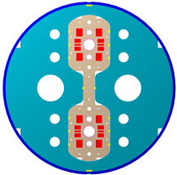
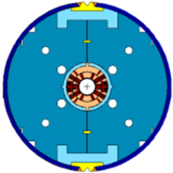
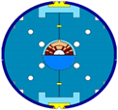
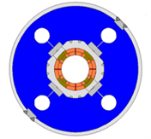
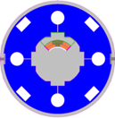
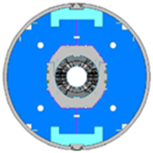
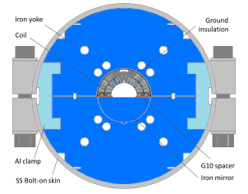
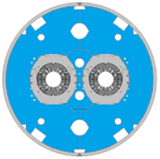
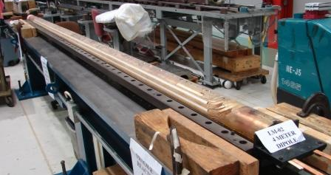
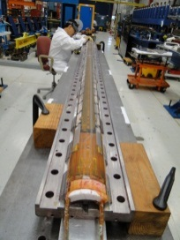
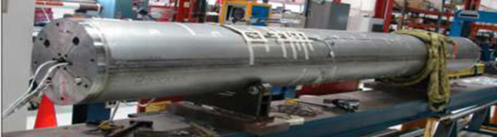
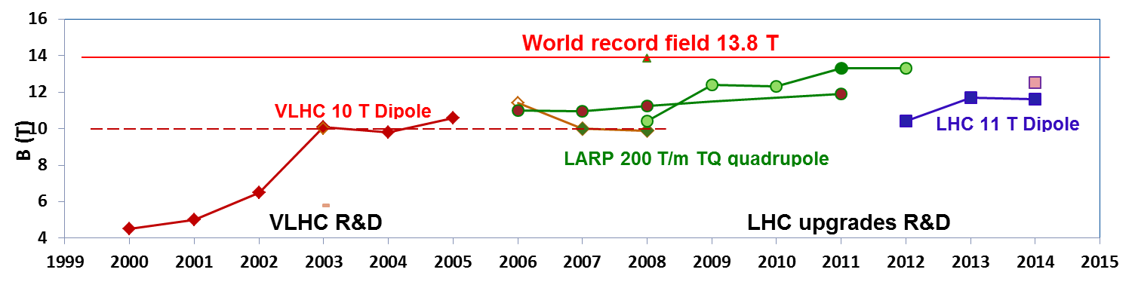
HFM R&D Summary
HFDA HFDM-LM
43.5 mm Dipole mirror
10 T dipole
TQC TQM-LQM
90 mm 200 T/m Quadrupole quadrupole mirror
MBHSP MBHSM
60 mm 11 T dipole Dipole mirror
HFDC (R&W)
40 mm 10 T dipole
MBHDP
60 mm 11 T dipole
Nb₃Sn technology scale up
4-m long Nb₃Sn dipole and quadrupole coils
Mirror magnet with 4-m long Nb₃Sn coil

Slide 5
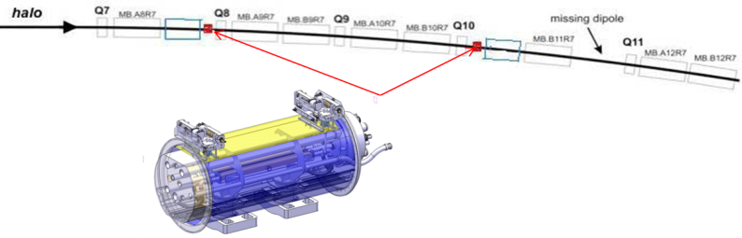
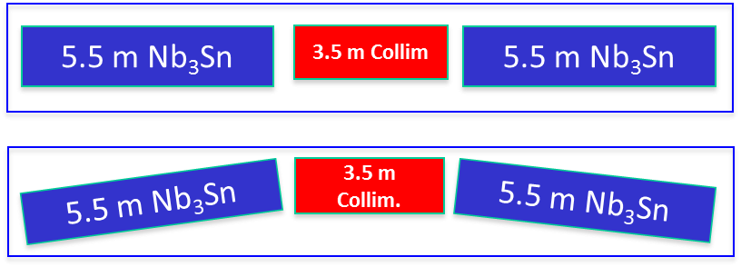
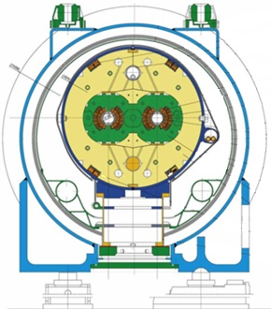
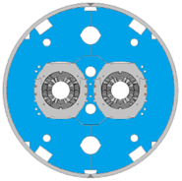
11 T Dipole: R&D Program (FNAL)
The LHC collimation system upgrade
  ~3.5 m additional space => 11 T 11 m long Nb₃Sn dipoles
3 phase FNAL-CERN plan:
  Phase 1 (FY11-12): design and construction of a 2 m long, 60-mm single-aperture 11 T demonstrator dipole
  Phase 2 (FY13-14): fabrication and test of two 2 m long, twin-aperture demonstrator dipoles
  Phase 3 (FY14-15): technology scale up by fabricating and testing a 5.5 m long twin-aperture dipole prototype
In FY13 the FNAL plan was modified to take into account the HFM budget reduction and the new CERN priorities and schedule for U.S. contributions to HL-LHC
  Phase 3 of the program has been cancelled
  the model length was reduced to 1 m to cut the cost

Slide 6
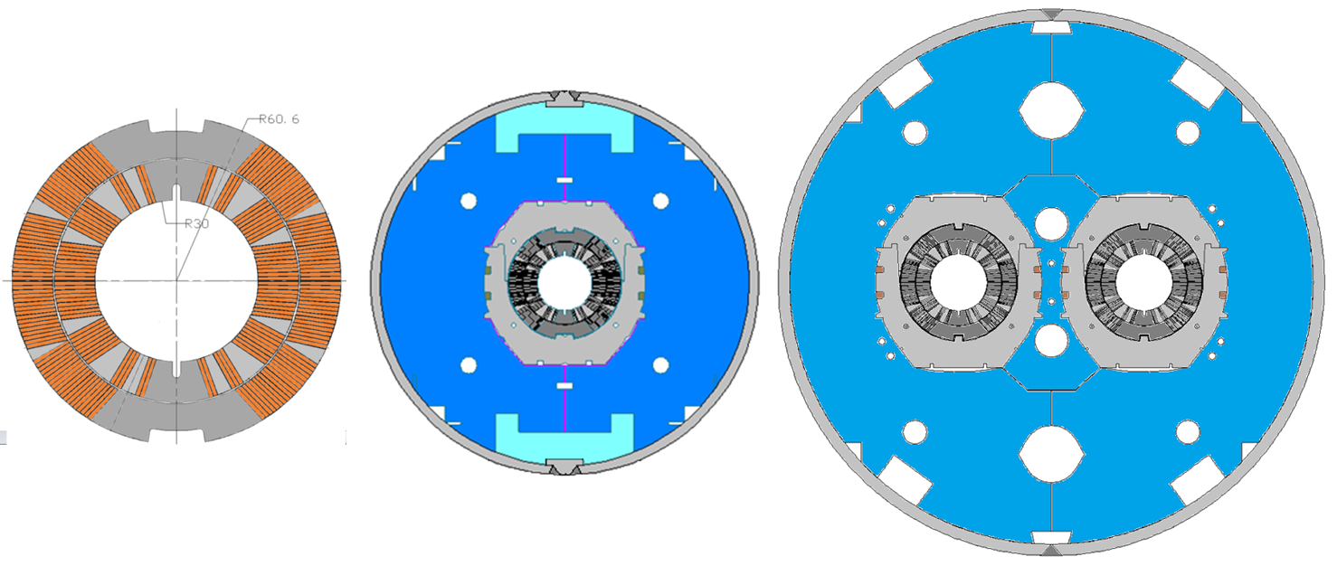
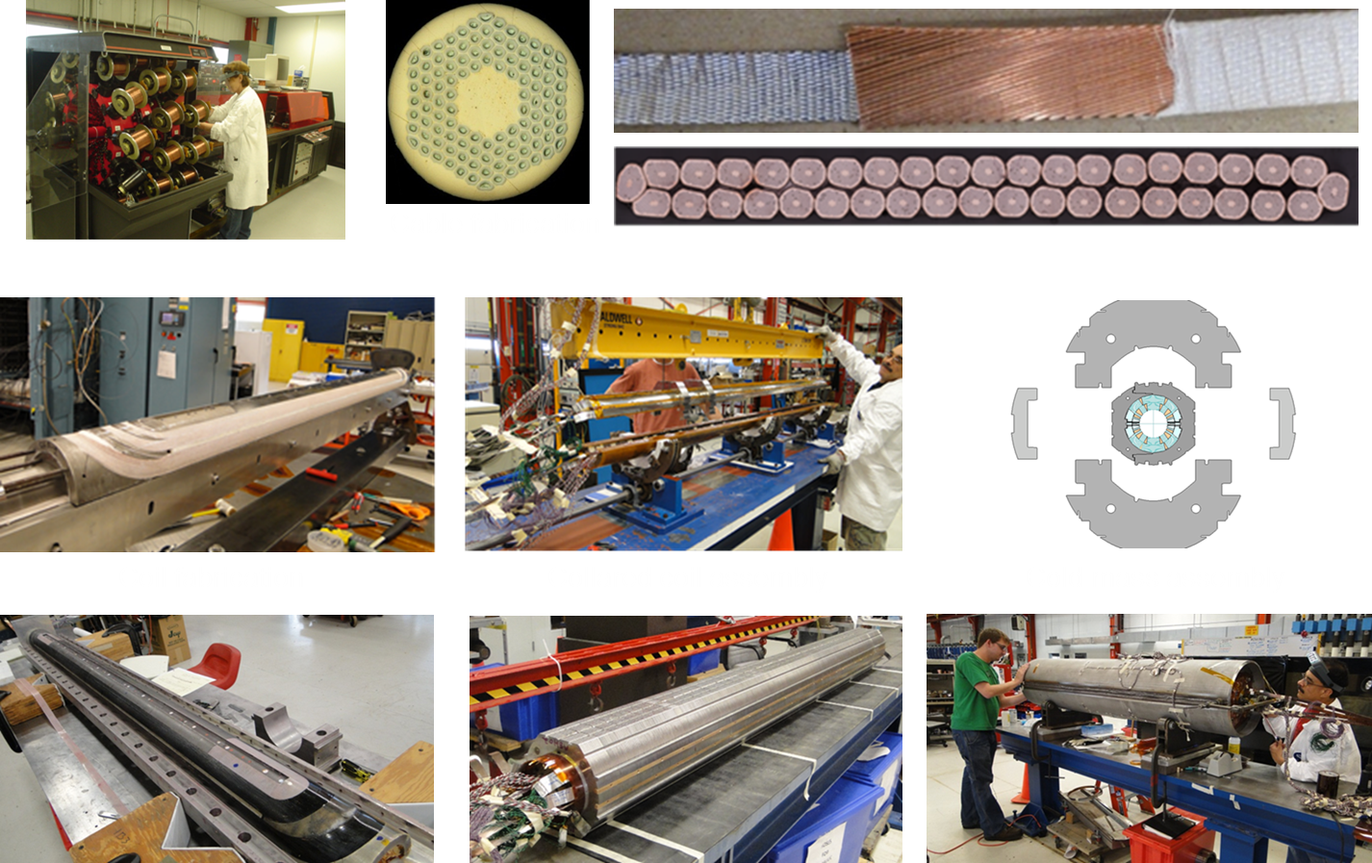
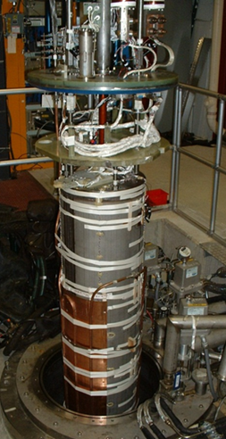
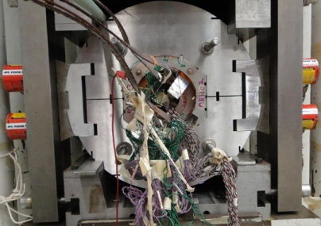

11 T Dipole: Design and Technology
Design: single-aperture, twin-aperture (FNAL/CERN).
Fabrication: from cable to complete magnet.
Test: whole characterization including quench performance, field quality, quench protection.

Slide 7
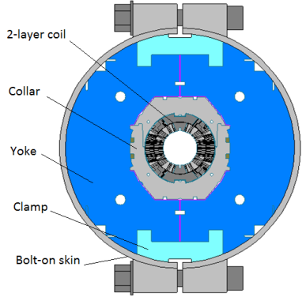
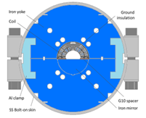
11 T Dipole: Model Design Features (FNAL)
MBHSP01: 2-m dipole demonstrator (June 2012)
  RRP108/127
  Cable w/o core
MBHSP02: 1-m dipole model (February 2013)
  RRP150/169
  Cable with 11 mm core
MBHSM01: 1-m dipole mirror December 2013)
  RRP108/127 (114/127)
  Cable with 11 mm core
  Optimized pre-stress
MBHSP03: 1-m dipole model (May 2014)
  RRP108/127
  Cable with 11 mm core
  Modified coil end parts (FNAL)
  Modified collar
  Optimized pre-stress
MBHSP01
MBHSP02, MBHSP03
MBHSM01

Slide 8
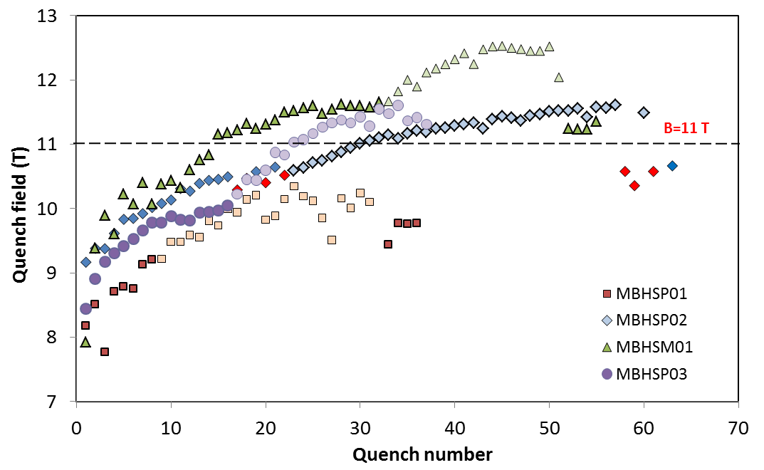
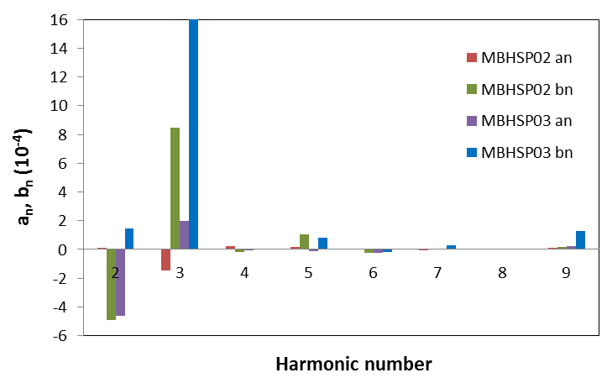
11 T Dipole: Performance Summary
MBHSP01 (June 2012):
  B_{max}=10.4 T at 1.9 K, 78% of SSL
  strong ramp rate sensitivity
  “holding current” quenches
MBHSP02 (February 2013):
  B_{max}=11.7 T at 1.9 K
  98% of B_{des}=12 T
  low ramp rate sensitivity
  “holding current” quenches
MBHSM01 (December 2013):
    B_{max}=12.5 T at 1.9 K
    ~100 (97)% at 4.5 (1.9) K of SSL
    low ramp rate sensitivity
    no holding current quenches
MBHSP03 (May 2014):
  B_{max}=11.6 T at 1.9 K
  97% of B_{des}=12 T
  no holding current quenches

Slide 9
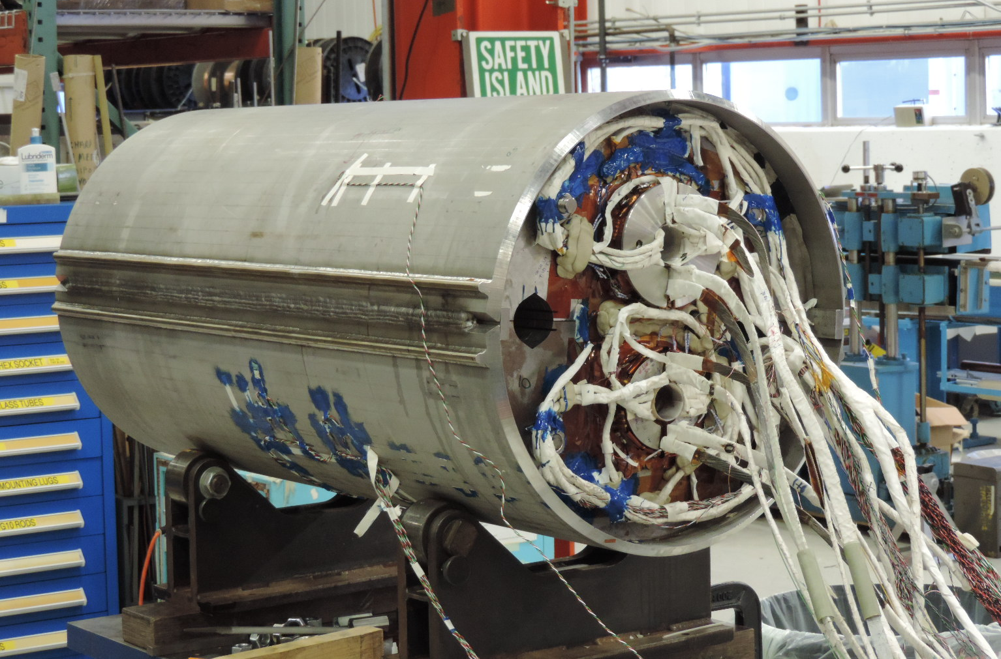
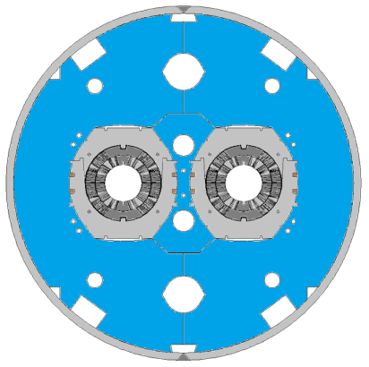
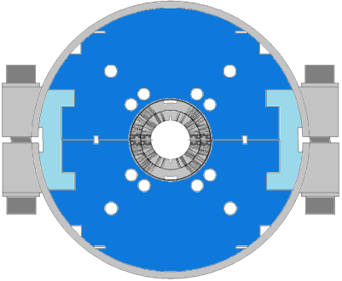
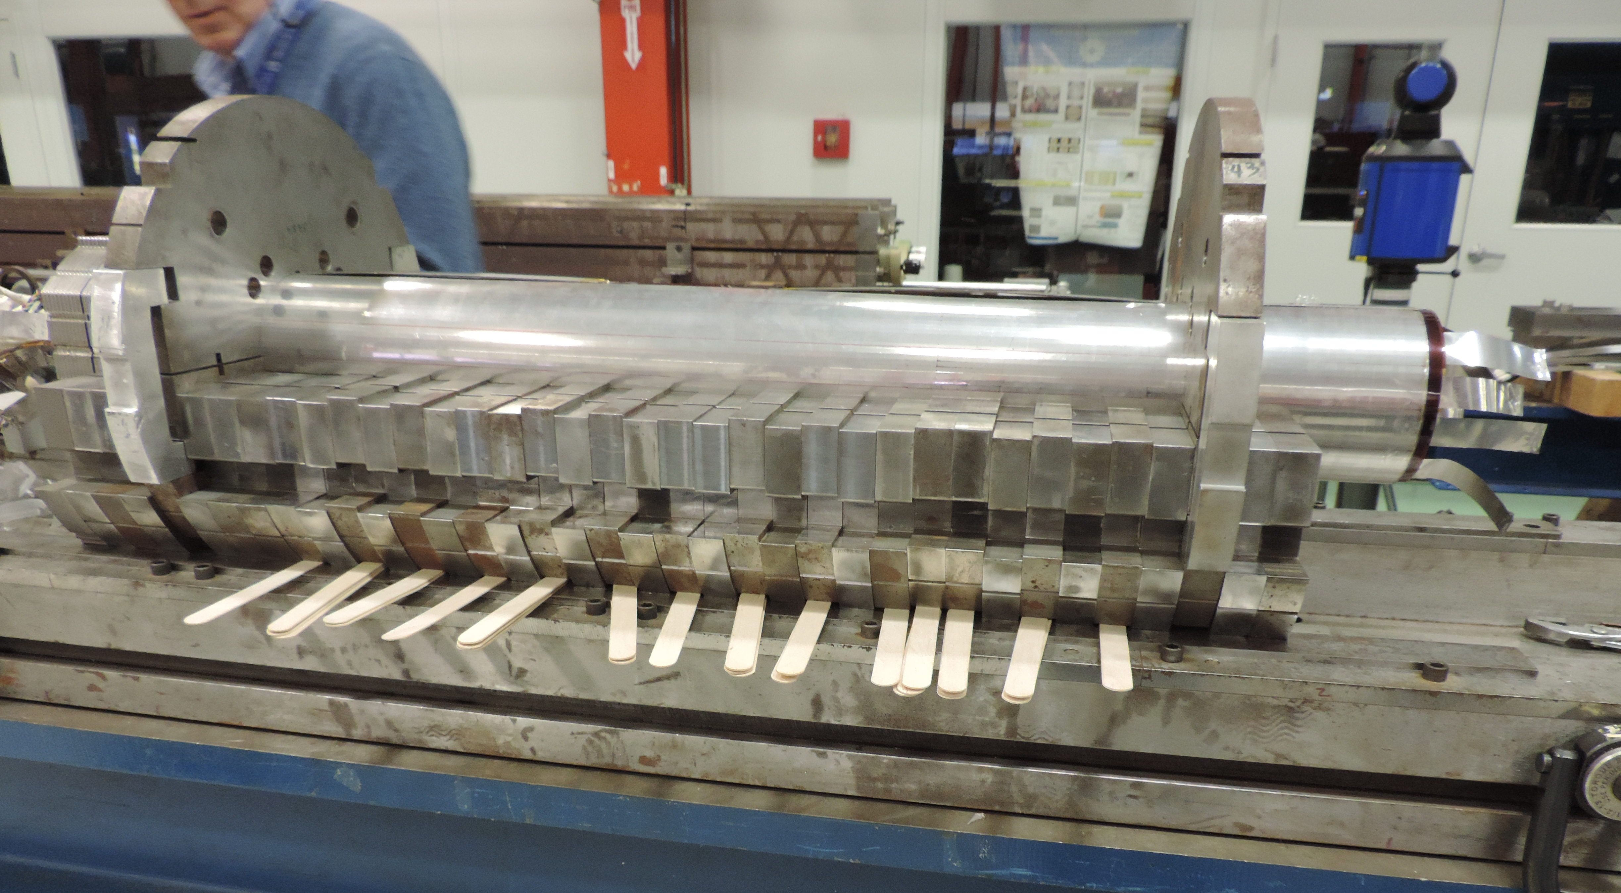
11 T Dipole: FY15 Plan
Twin-aperture dipole model MBHDP01
  1st twin-aperture demonstrator
  Assembly – finished
  Test – Feb 2015
Single-aperture dipole model MBHSP04 w/o collar
  Cost reduction
  Additional space for collimator
  Coil test for 15 T dipole
  Assembly – Jan-March
  Test – April 2015
MBHDP01
MBHSP04

Slide 10
HFM Program: Next Steps
P5 report (May 2014):
  “…a very high-energy proton-proton collider is the most powerful future tool for direct discovery of new particles and interactions under any scenario of physics results that can be acquired in the P5 time window… The U.S. is the world leader in R&D on high-field superconducting magnet technology, which will be a critical enabling technology for such a collider.”
Recommendation 24:
  “Participate in global conceptual design studies and critical path R&D for future very high-energy proton-proton colliders. Continue to play a leadership role in superconducting magnet technology focused on the dual goals of increasing performance and decreasing costs.”
FNAL HFM plan was coordinated with the P5 recommendations and the updated DOE-HEP GARD program.
National Program on High Field Accelerator Magnet R&D was proposed by FNAL
  White Paper, signed by FNAL, LBNL, NHMFL and BNL, was submitted to the 2014 HEPAP Accelerator R&D Subpanel
    Goals, phases, directions, etc.

Slide 11
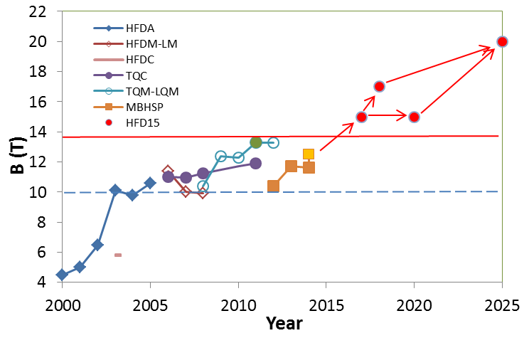
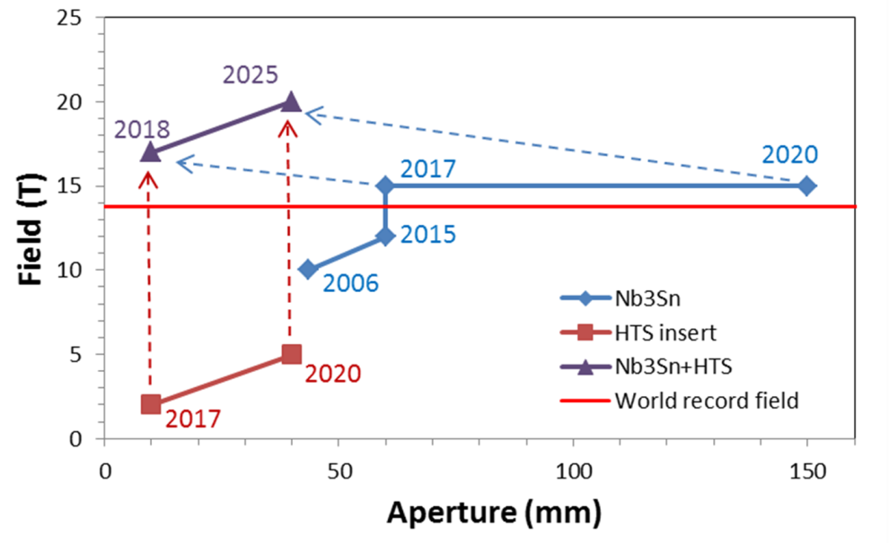
HFM Program Plan
In collaboration with U.S. National labs, universities and industry develop accelerator magnets with world record parameters
  Small-aperture 15 T SC dipole suitable for FCC, based on Nb₃Sn superconductor and innovative approaches which would lead to a substantial reduction of accelerator magnet cost, 2 T small HTS dipole insert
  Large-aperture 15 T Nb₃Sn dipole and 5+ T HTS insert with stress management
  Small-aperture 20 T accelerator dipole beyond the limits of Nb₃Sn technology based on combination of LTS (Nb₃Sn) and HTS (Bi-2212 or YBCO) coils
Continue SC and structural material R&D (strand, cable, insulation, etc.) for 15-20 T accelerator magnets.

Slide 12
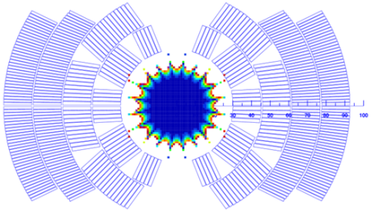
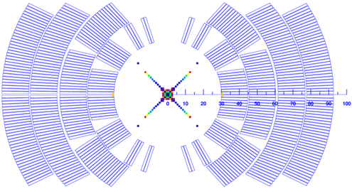
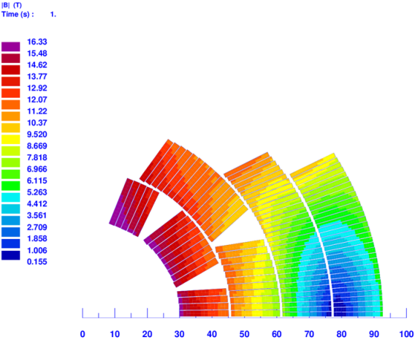
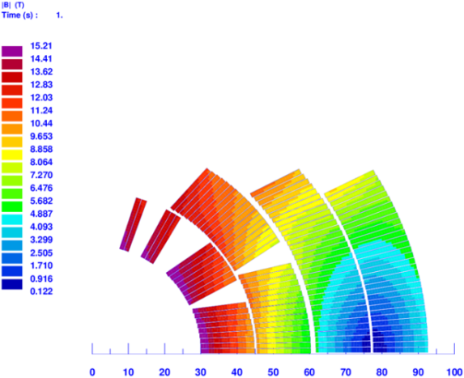
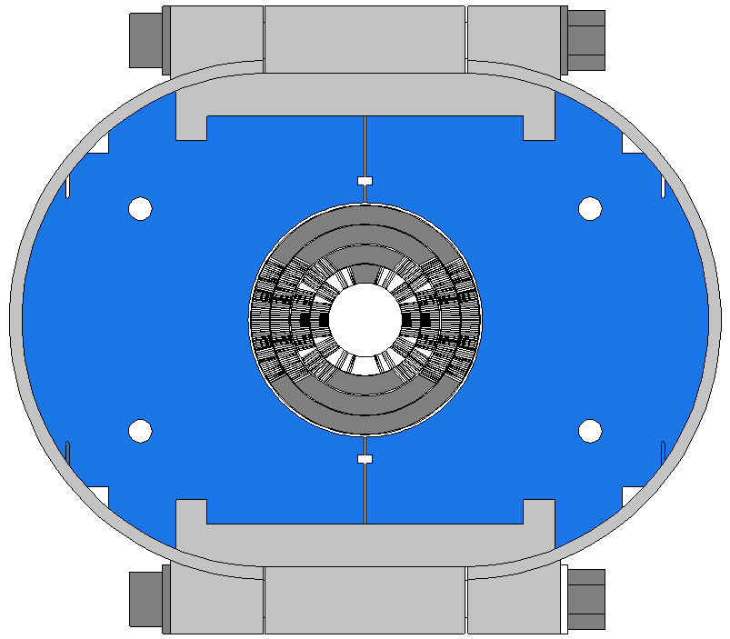
15 T Dipole Demonstrator
Approach:
utilize the available components of the 11 T dipole models, tooling, and FNAL fabrication and test infrastructure
  R&D cost and time reduction
Design concept:
4-layer 60-mm aperture graded coil
Transitional design with 11 T coil
Minimal coil size
Stress and quench protection requirements
B_{des}= 15.2/16.3 T at 4.3 K
Mechanical design:
Vertically split yoke with SS clamps
Bolted skin from 11 T dipole
Cold mass OD<610 mm
First test is planned for January-March 2016.
Optimized graded design
Design with 11 T inner coil
Bmax=16.3 T
Bmax=15.2 T

Slide 13
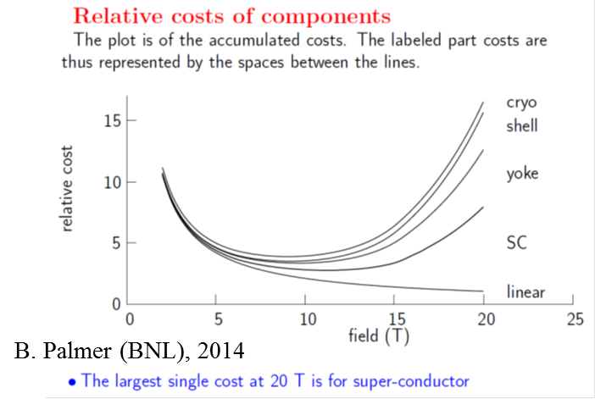
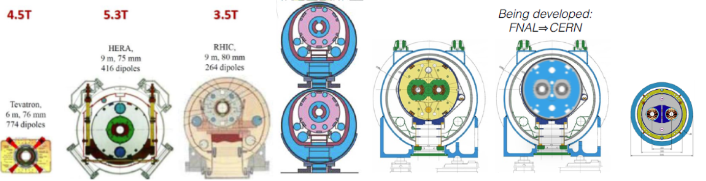
Magnet cost reduction strategy
Cost reduction directions
  Improve performance (increase B_{op} and T_{op})
  Reduce magnet cross-section
  Increase magnet length
  Reduce component cost

Slide 14
Summary
HFM R&D Program at Fermilab is well-defined and prioritized according to the HEP needs and recent P5 recommendations.
As a core part of a coordinated national and international effort, FNAL HFM R&D program develop and demonstrate next generation accelerator magnets and technologies for the future world-wide Energy Frontier Programs, including the LHC upgrades and feasibility studies for a Future Circular Collider (FCC), and assess magnet cost reduction strategies.
In FY15 we conclude the 11 T dipole model R&D and continue the technology transfer to CERN.
In FY15-18 we will develop a 15 T Nb₃Sn dipole demonstrator for FCC and perform design studies to reduce the cost of accelerator magnets
  as a part of the proposed National HFM Program if approved by the DOE.
In longer term the Program will explore 15 T large-aperture Nb₃Sn and 20+ T HTS/LTS dipole magnets.
  high-current HTS cable is the key to 20 T accelerator magnets.
Stable and adequate funding is critical for the success of the Program.

