Slide 1
The Fermilab Neutrino Platform
Steve Brice
DOE Institutional Review of Fermilab
Thu 12 Feb 2015

Slide 2
What is the Fermilab Neutrino Platform?
The suite of Fermilab neutrino activities that are in support of it’s experiments, but not experiment specific
The Neutrino Platform activities …
  serve the user community and are executed in partnership with it
  work together coherently to support current and future experiments at all scales
  span multiple divisions at the lab, but are coordinated by Neutrino Division
Fermilab has been doing neutrino physics for a long time and the Neutrino Platform is built from that experience

Slide 3
The Fermilab Neutrino Platform
Programs complete
ELBNF
Operations phase
Proposed or planned
technology & physics
NOvA
SBN
T600
LArIAT
Captain-
Minerva
Minerva
LAr1ND
DCTPC,
ANNIE,
Captain-
BNB
PAB
Test
stands
ArgoNeuT
PEANUT
MicroBooNE
SciBooNE
35 ton
MINOS
MiniBooNE
LAPD
Fermilab Neutrino Platform

Slide 4
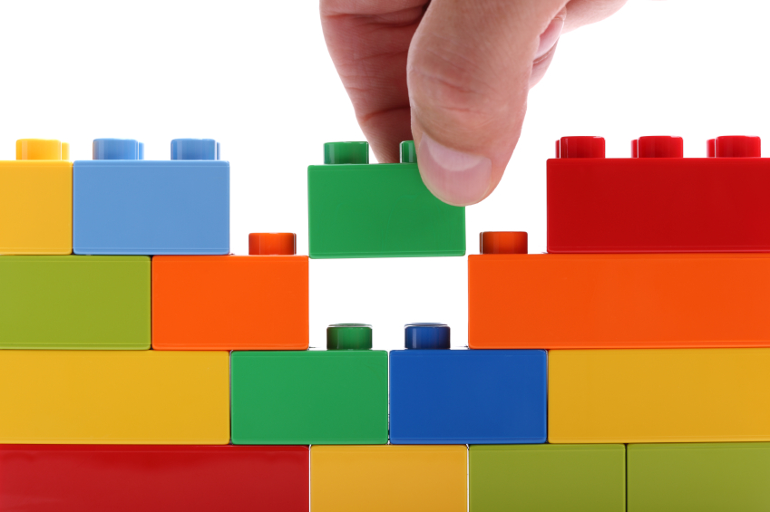
Fermilab Neutrino Platform
Neutrino Division
Scientific Computing Division
Accelerator
Division
Detector
R&D test
stands
Detector Halls :
NuMI, SciBooNE,
LArTF
GENIE
Geant4
ART
ARTDAQ
Neutrino Beams :
NuMI, BNB
Neutrino
Beam
Group
Collaboration
with
Neutrino
Theory
Charged Particle
Test beams
LArSOFT
NuTools
ND
Operations
Support
High Power
Targets and
Horns
Neutrino
Physics
Center
ROC
West
Facility
Engineering
Support Services
Particle
Physics
Division
Core
Computing
Division
Technical
Division

Slide 5
Outline
Detector R&D Test Stands
Detector Operations Group
Neutrino Div Beam Group
ROC-West
Neutrino Theory
Cross-Section Coordination (NuSTEC and FeNIX)
Charged Particle Testbeams (LArIAT and MINERvA)
High Power Target Design
Computing for Neutrinos

Slide 6
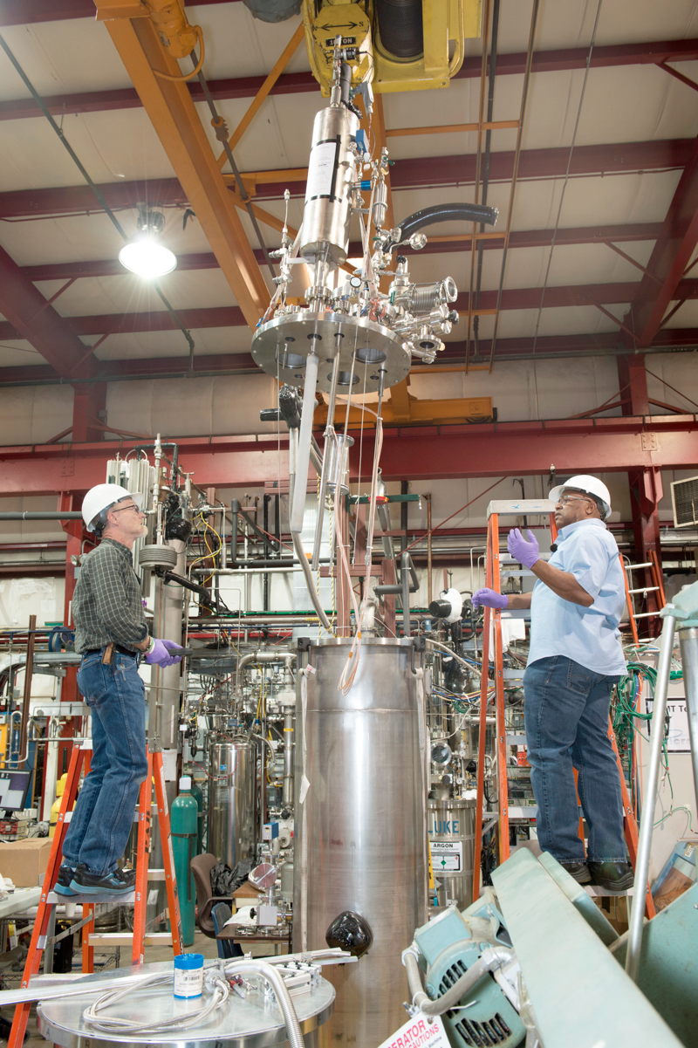
Liquid Argon TPC R&D Facilities
PAB has become the launch pad of Fermilab’s efforts to enable the deployment of a multi-kiloton LArTPC
Have intentionally established the infrastructure over the last decade to support variety of small scale tests
Focus on technical topics not previously fully explored
These smaller tests led to ArgoNeuT, LAPD, LBNE 35t, and MicroBooNE
Key components include
  An excellent staff of technicians to support experimenters
  Dedicated liquid argon distribution system with purification from electronegative contaminants
  Analyzers to monitor the level of contaminants
  Condensers to maintain closed systems of liquid argon
  Common safety system including ODH and ventilation
Fermilab organizes and hosts workshops dedicated to R&D efforts (LArTPC R&D 2013, 2014; HVNL 2013)
Technicians supporting R&D at PAB

Slide 7
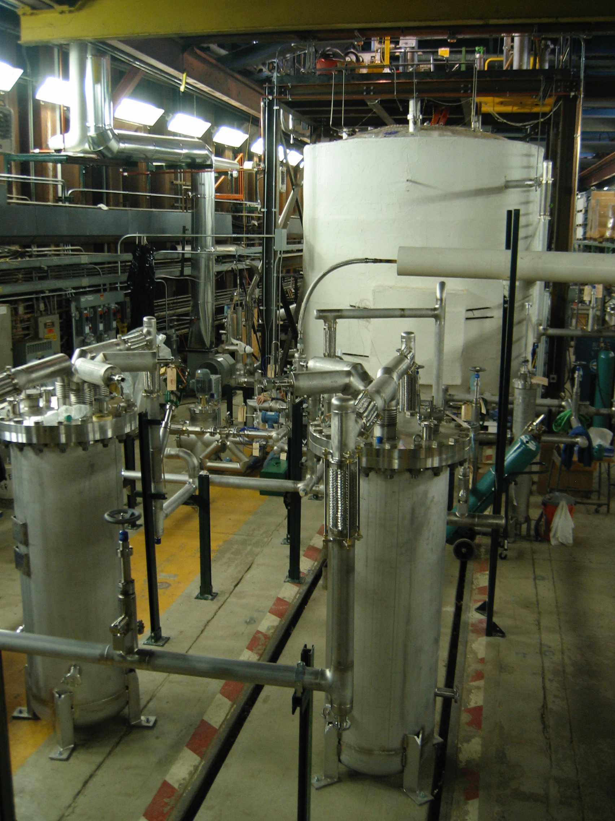
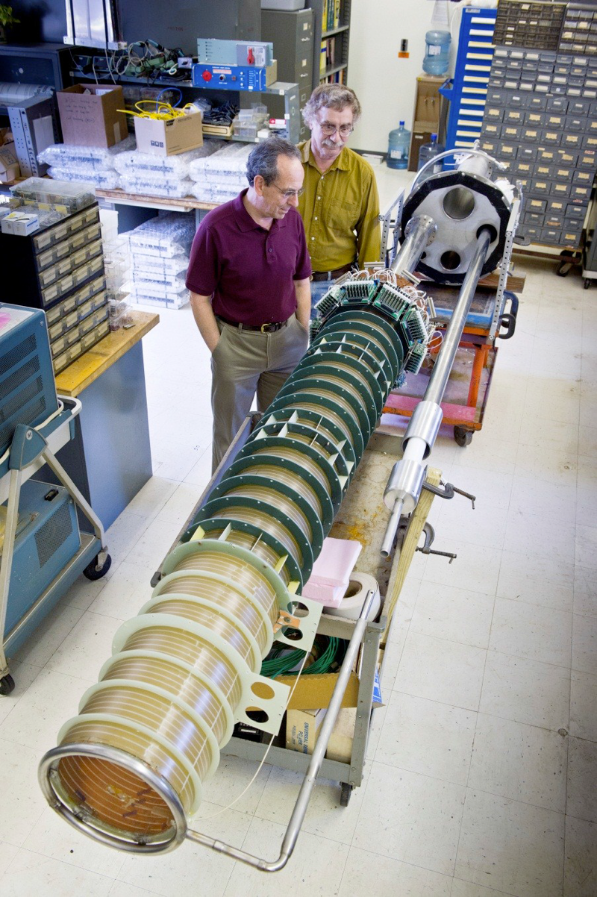
Liquid Argon Purity Demonstrator and LongBo
JINST 9 (2014) P07005
LAPD showed that one can achieve several ms long electron drift lifetimes without first evacuating the cryostat
First use of filters that could be regenerated in situ - now common to all Fermilab LArTPCs
Achieved > 6 ms lifetime, LBNE requirement is 1.4 ms
LongBo is first US LArTPC with long (2 m) drift distance
Installed in LAPD - also tested purification with an actual LArTPC in the volume (> 6 ms achieved)
LongBo tested cold electronics and high voltage distribution as well, provided timely input for MicroBooNE

Slide 8
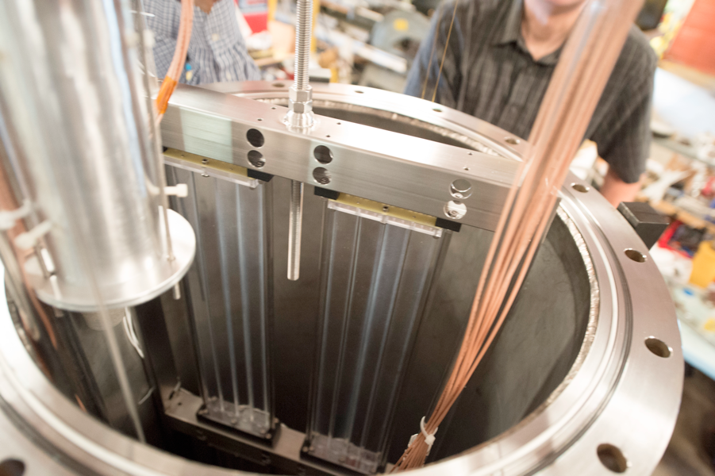
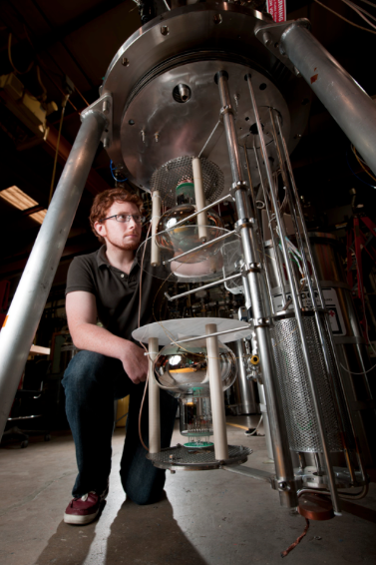
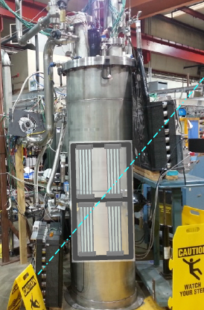
TallBo Facility for Scintillation Light Collection Studies
TallBo is a 56 cm diameter, 156 cm high cylindrical cryostat
Dedicated to studying light collection techniques
Capability to inject contaminants/dopants into the argon
Extensively used by Conrad MIT group (MicroBooNE and general R&D) and Mufson Indiana University group (LBNE)
Other users from LBNE planning studies for 2015 as well

Slide 9
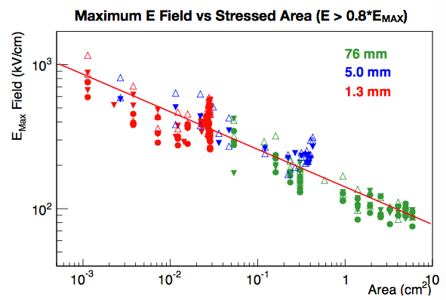
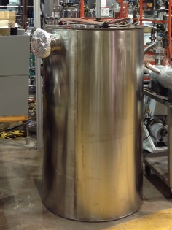
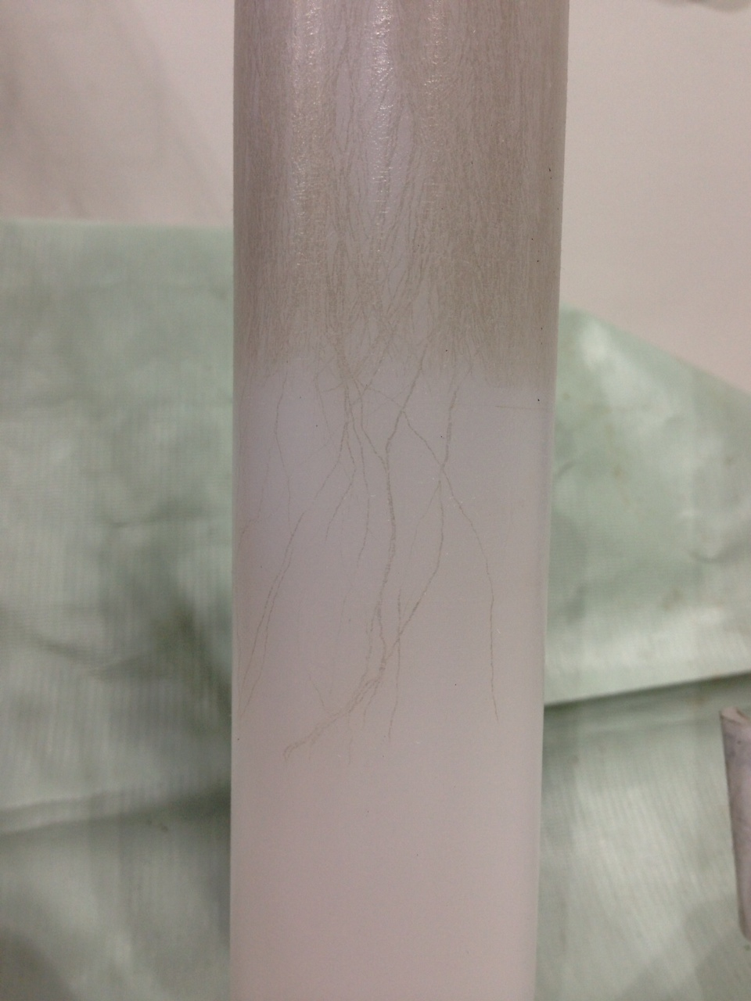
BLANCHE Facility for High Voltage Breakdown Studies
Funded by LDRD awarded in 2014 to S. Lockwitz
Goal is to establish guidelines for optimizing high voltage system design for LArTPCs as many experiments are having difficulty achieving stable HV JINST 9 (2014) T08004
Study dielectric strength of argon as a function of argon purity, stressed area (volume), and light production
Also testing insulator materials to establish best ones to use for feedthroughs
After LDRD program is complete, will open facility to other users
R. Acciarri et al (2014) JINST 9 11001
BLANCHE
Breakdown on test piece

Slide 10
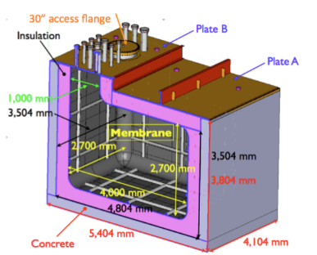
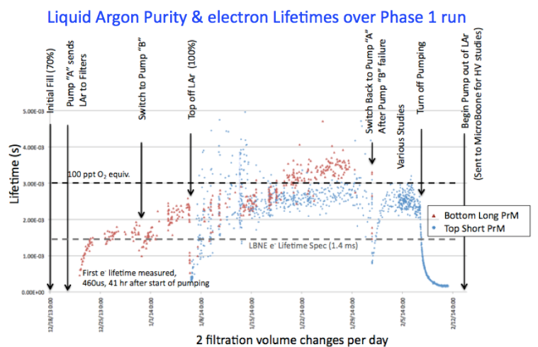
LBNE 35t Prototype Detector
First test of membrane style cryostat for LArTPCs
Initial run doubled (3 ms) the minimum electron lifetimes (1.4 ms) needed for LBNE
Next step is to place mini-APA style TPCs into the cryostat and do a vertical slice test of the detector
APAs are at Fermilab and are being tested through February 15
Installation into cryostat planned for March 1, 2015
Liquid argon filling expected at the end of April

Slide 11
Next Steps
Building on the successes of the current program we can meet the needs of the future ELBNF
  Test enhanced purification with new filter media, necessary for dual phase LArTPCs with 16 m drifts
  Using dopants, e.g. xenon, has potential to improve scintillation light signal by producing light in range more readily observed by photodetectors
  SiPMs may be a cost effective photodetector for LArTPCs when coupled to light guides, would like to explore improving readout electronics for them
When dreaming big, we look to magnetizing LArTPCs
  Fermilab has the experience with superconducting magnets
  We have the test beams to study the charge selection and energy reconstruction performance

Slide 12
Neutrino Division Technical Support Department
Operations and technical support for running experiments and new projects
  Direct support and coordinate liaison with other lab resources
Operations group (7 staff)
  Experienced operations and DAQ staff (earlier collider experience)
  Current activities: MINOS+, MINERvA, NOvA, MicroBooNE
    Direct operations support (Experimental Liaison Officers, ROC west)
    DAQ and electrical infrastructure and software support
  Future activities – SBN, ELBNF. Already beginning.
Liquid Argon Engineering group (8 staff)
  Expertise drawn from across lab
  Currently supporting next-generation cryostat and cryosystems engineering and drafting at FNAL and liaison with CERN.
  Expect to expand support as new projects require.
Notes:
Slide from Rob P.

Slide 13
Neutrino Division Beam Group
Neutrino Division recently created a Beam Group
  A. Marchionni, Ldr.
  C. James
  P. Lebrun
  B. Lundberg
  Z. Pavlovic
  D. Jensen, GSR
The group has a wide range of competencies, from experience in the design, construction and operation of neutrino beamlines, expertise in hadroproduction measurements and neutrino flux predictions, to specific skills in computing and simulation software
The group will provide support for the experimenters who want to get involved in beam activities, and interface with the AD Targetry Department

Slide 14
Design of new neutrino beamlines and upgrades of existing ones
Investigate possible upgrades of the BNB beamline
At this time we have a pre-conceptual design for an upgrade to the BNB which involves the addition of a second focusing horn. A team consisting of members of the ND Beam Group and the AD External Beams Group is in place to advance this work to the level of a Conceptual Design, including cost and schedule, by the time of the summer PAC meeting.
Participate in the conceptual design and optimization of the LBNF neutrino beamline
Working with the ELBNF Collaboration/LBNF project, perform an optimization of the target and horn focusing system to increase the physics reach, and interface with AD Targetry Department to evaluate feasibility and cost of the proposed solutions

Slide 15
Monitoring of the performance of neutrino beamlines
Two running beamlines: NuMI and BNB
Keep track of running conditions and alignment measurements of beamline components
Maintain tools to monitor primary proton integrated intensity, targeting precision and stability of running conditions (horn currents, temperatures,…)
Provide support for neutrino beamline instrumentation (hadron monitor, muon monitors,…) and develop analysis tools

Slide 16
Simulation of neutrino beamlines and prediction of the neutrino fluxes
Maintain simulation tools for neutrino beamlines
Precise prediction of neutrino fluxes (BNB, NuMI, LBNF)
  Prediction of NuMI fluxes at large off-axis angles (MicroBooNE, SBN)
  Participation in NuMI-X
  Make use of existing hadroproduction data
  Possible participation in future hadroproduction experiment (NA61?)

Slide 17
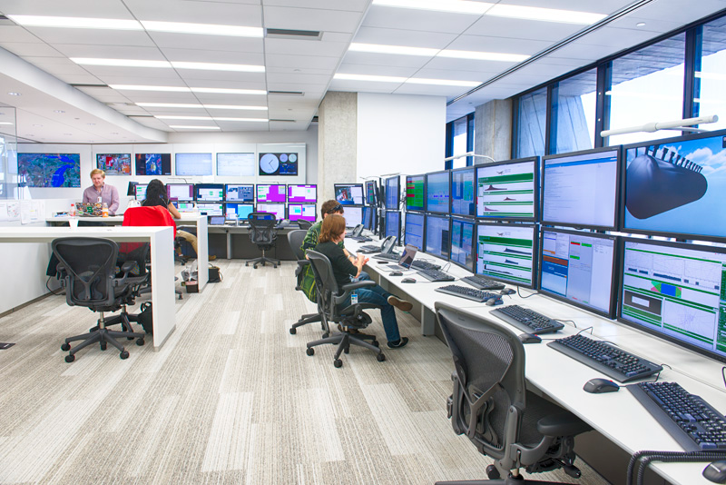
ROC-West
The Remote Operations Center (West) is a new control room facility available to any Fermilab experiment.

Slide 18





Neutrino theory
Fermilab neutrino theory research efforts in Theoretical Physics & Astrophysics Departments cover wide range of topics
  Two full-time neutrino phenomenologists (Parke + RA Coloma), one active emeritus scientist (Kayser) + several others involved part-time in study of connections between neutrinos and dark matter, cosmology, etc...baseline oscillation experiments
sensitivities of current, proposed experiments
MINOS
strategies for studying standard ν paradigm
impact of light sterile ν’s and non-SM interactions
proposals for future experiments
improved determination of nuclear effects
cosmic neutrinos

Slide 19
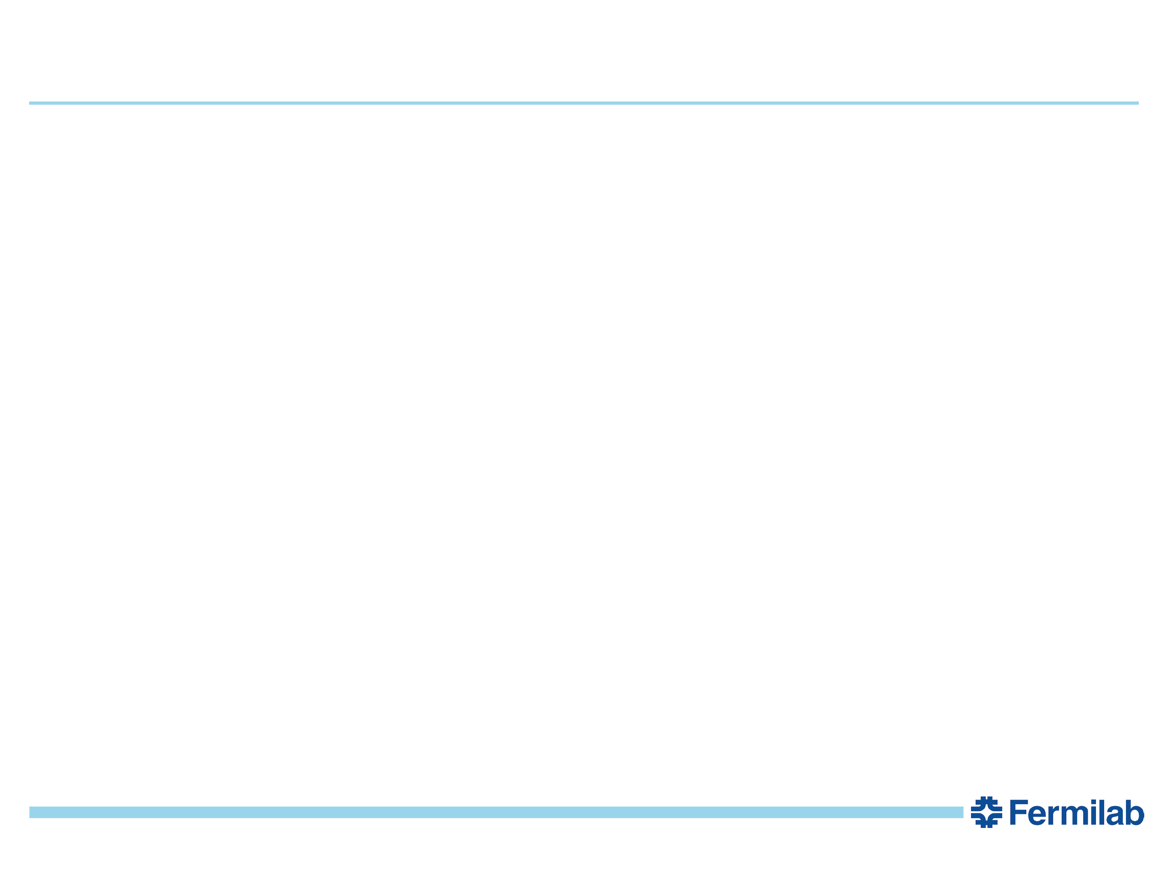
Theory visitors
Andre de Gouvea (Northwestern) spends about one day a week at Fermilab
Collaborators spend many person-weeks a year here, in particular:
Hisakazu Minakata (Sao Paulo)
Others include Hiroshi Nunokawa, Renata Zukanovich Funchal, ...
Invisibles Network (Europe): Silvia Pascoli (Durham) spends between one and two months at the Lab and frequently brings students and RAs. Also member of Fermilab PAC.
Providing partial support to nuclear theorists
Luis Alvarez-Ruso (Valcenia) to interface between nuclear theory and Monte Carlos used in neutrino experiments
Joe Carlson (LANL) in Fall (will bring two RAs)
Neutrino visitors complement expertise of group members.
4
Stephen Parke | Fermilab DOE Institutional Review 2015

Slide 20
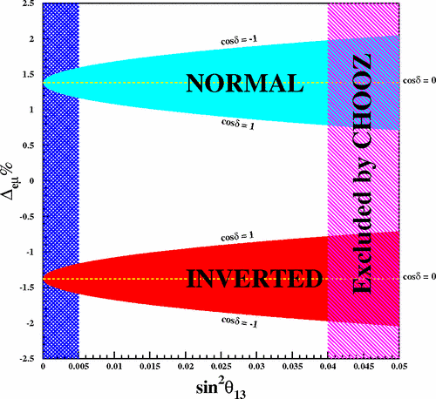
Neutrino phenomenology
In neutrino disappearance experiments, the effective δm² measured at the first oscillation minimum is the flavor average of δm²32 and δm²31 :
MINOS (νμ): δm²μμ = cos² θ12 δm²32 + sin² θ12 δm²31
Daya Bay (νe): δm²ee = sin² θ12 δm²32 + cos² θ12 δm²31
In principle could be used to
determine mass hierarchy with
precision measurements of both
[Nunokawa, Parke, Zukanovich
Funchal, PRD72 (2005) 013009].

Slide 21
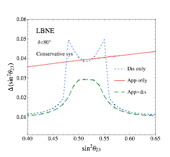
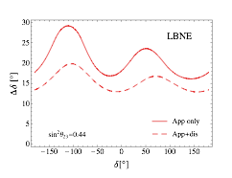
Neutrino phenomenology
Interplay between appearance and disappearance channels for precision measurements of θ23 and CP-violating parameter δ of long baseline experiments NOvA, ELBNF, HyperK,... [Coloma, Minakata, Parke, arXiv: 1303.6178, 1406.2551]

Slide 22
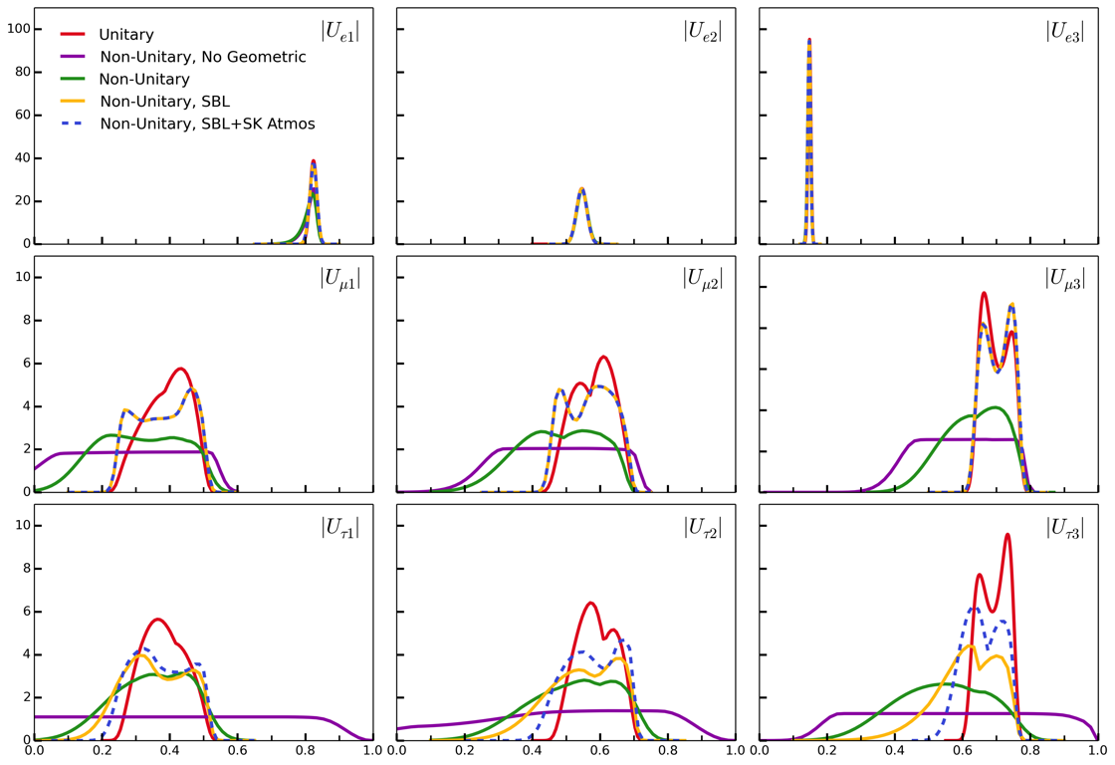
Neutrino phenomenology
What do we really know about the PMNS matrix, not assuming unitarity?
As you relax this assumption the νe row doesn’t change much, the νμ row degrades somewhat and the ντ row degrades significantly. [Parke and Ross-Lonergan (Durham, Invisibles Network), in preparation]
2

Slide 23
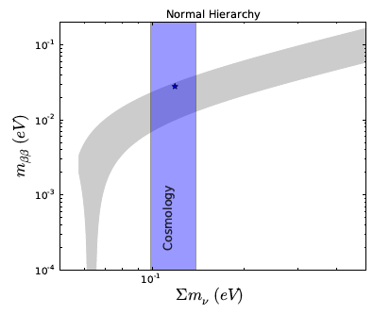
(Select) other Fermilab neutrino efforts
Cosmic constraints on neutrinos
Dodelson & Lykken showed that cosmological constraints
could provide lower limit on rate for neutrinoless ββ decay and constrain Majorana phase.
[Dodelson & Lykken, 1403.5173]
Lattice QCD for neutrino cross sections
Kronfeld co-supervising U. Chicago student Aaron Meyer on first-principles calculation of FA(q²) merging analyticity constraints with lattice QCD
Important input into determination of CCQE X-section
Engagement and interest from MINERvA, MicroBooNE, and other experiments
New-physics searches with neutrinos
Fox & Harnik (with Batell) hosted workshop “New approaches in the Search for Dark Matter.” Searches for light DM and light mediators with neutrino beams.
Dobrescu & Frugiuele showed that NOvA can search for GeV DM [1410.1566].
3
Notes:
In case a question about CMS comes up, Ron Rechenmacher and I were on a hiring
committee run by Viv O'Dell for positions on the CMS DAQ because of our work
with Myrinet on LQCD.

Slide 24
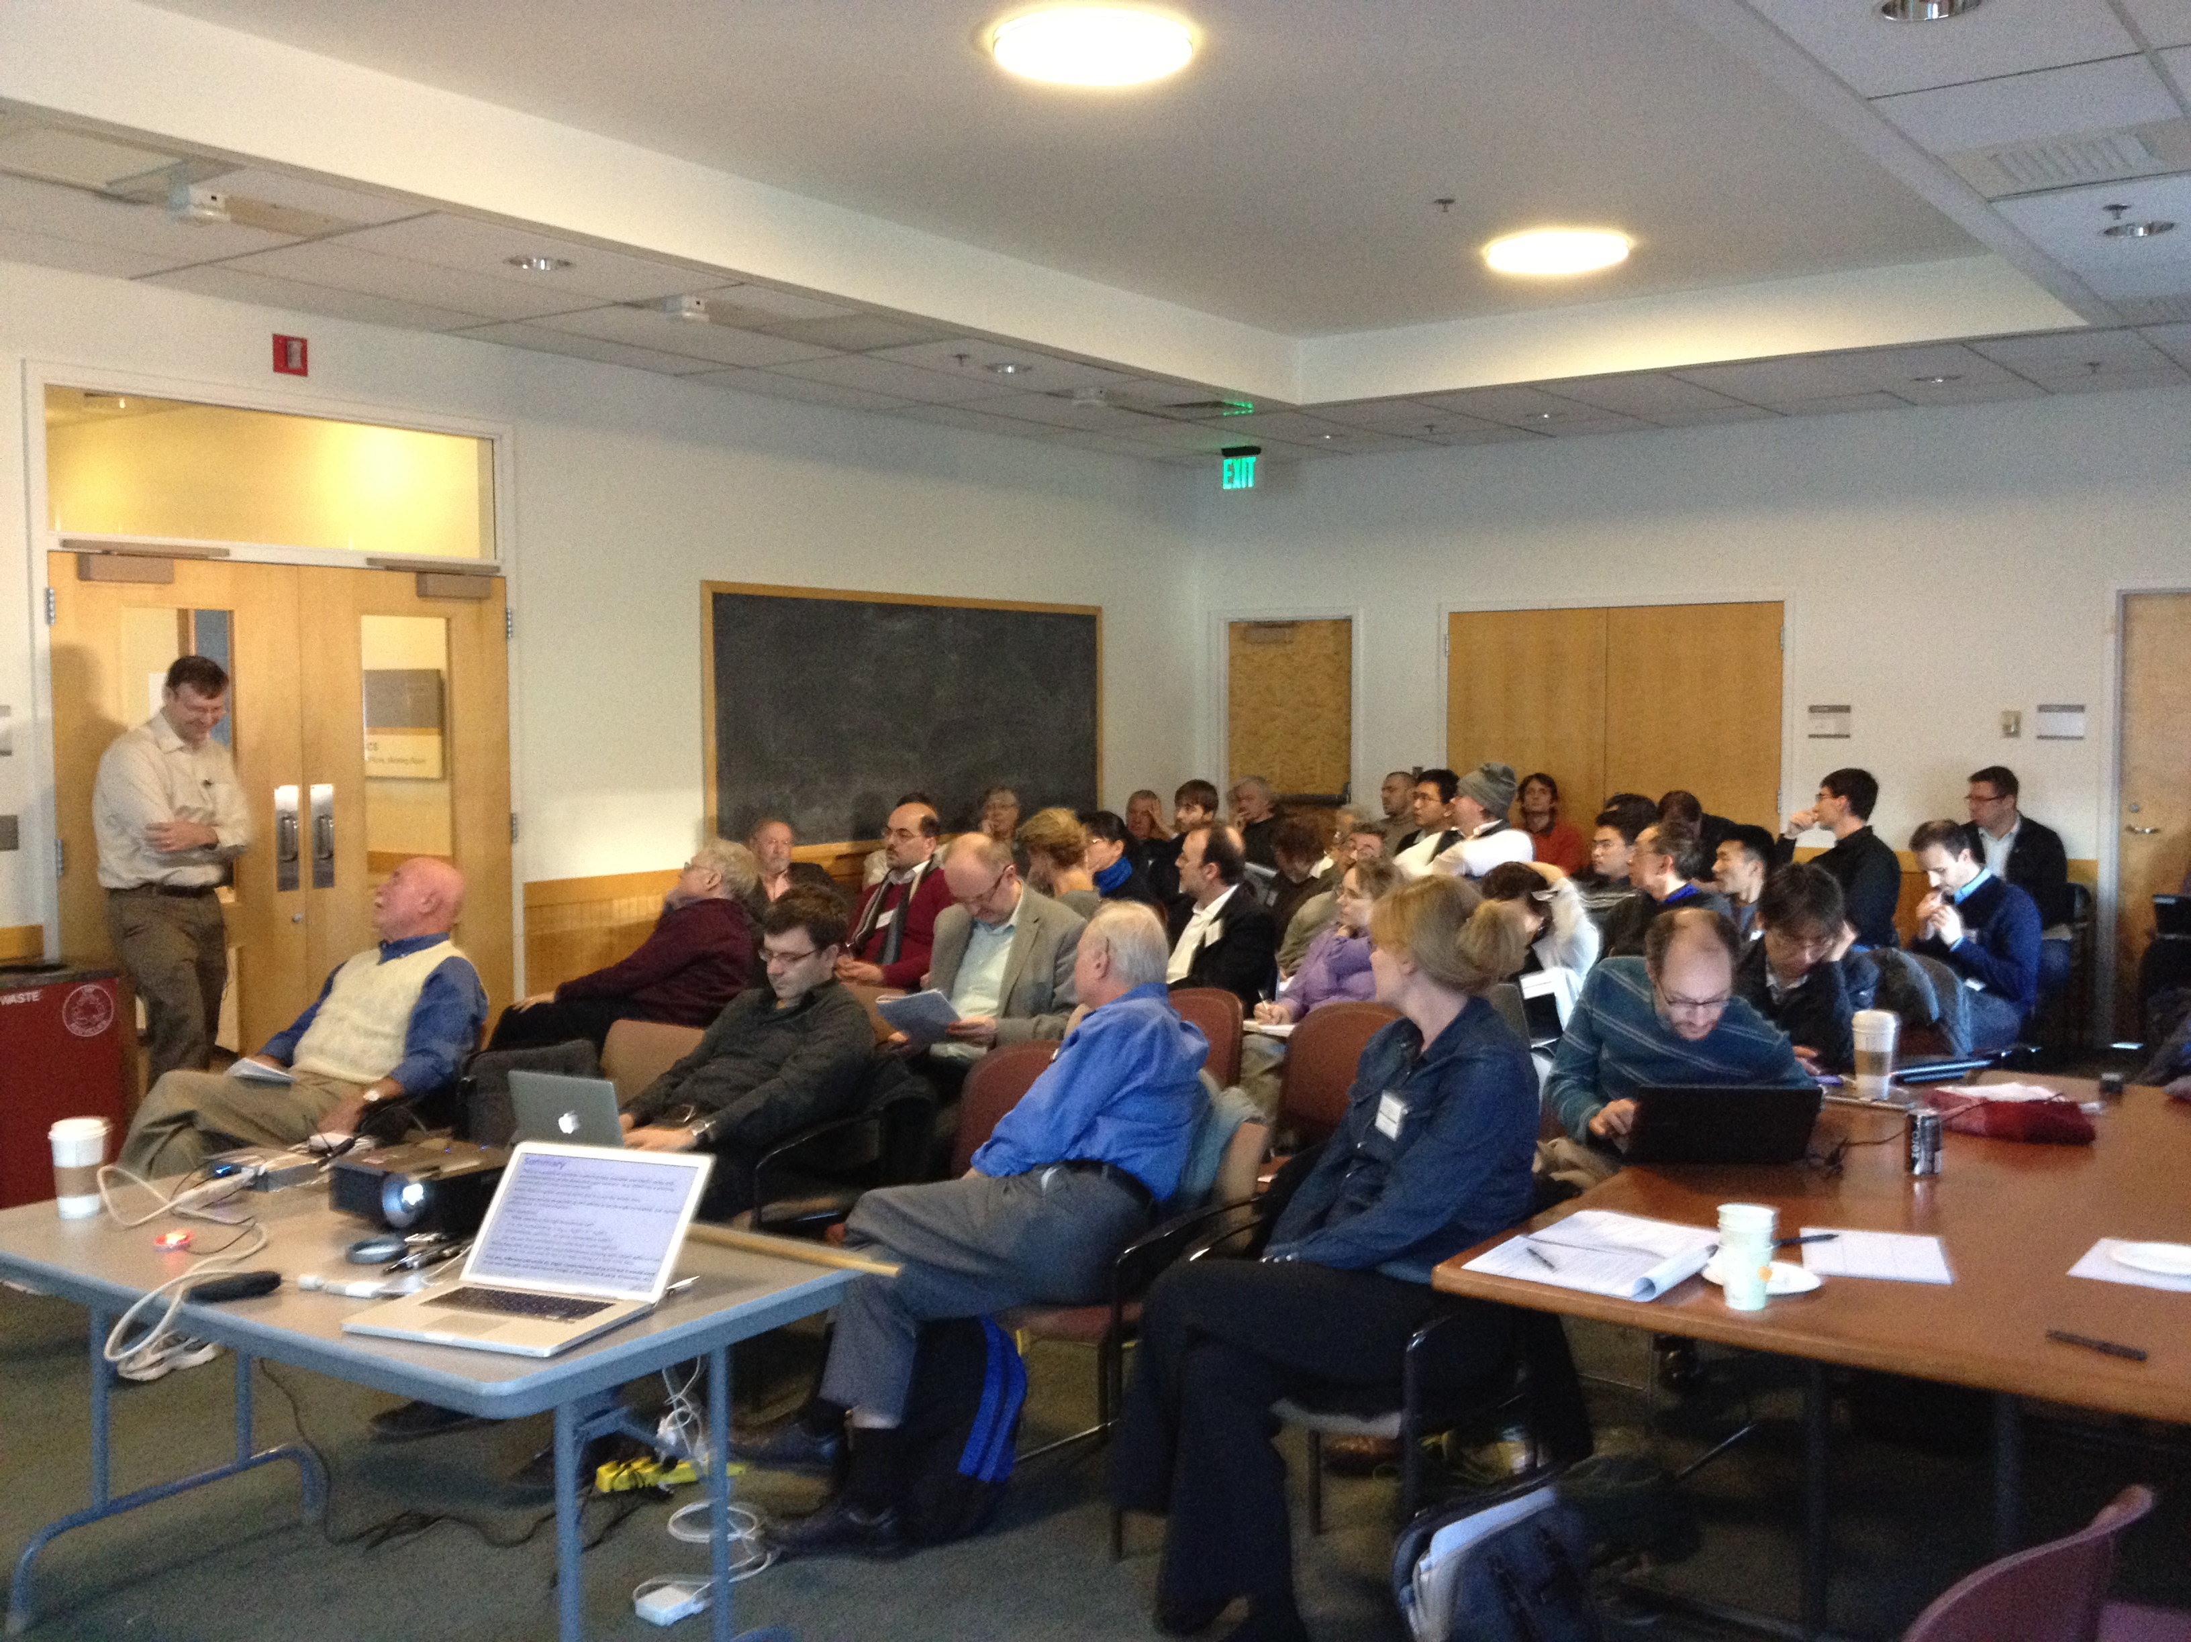
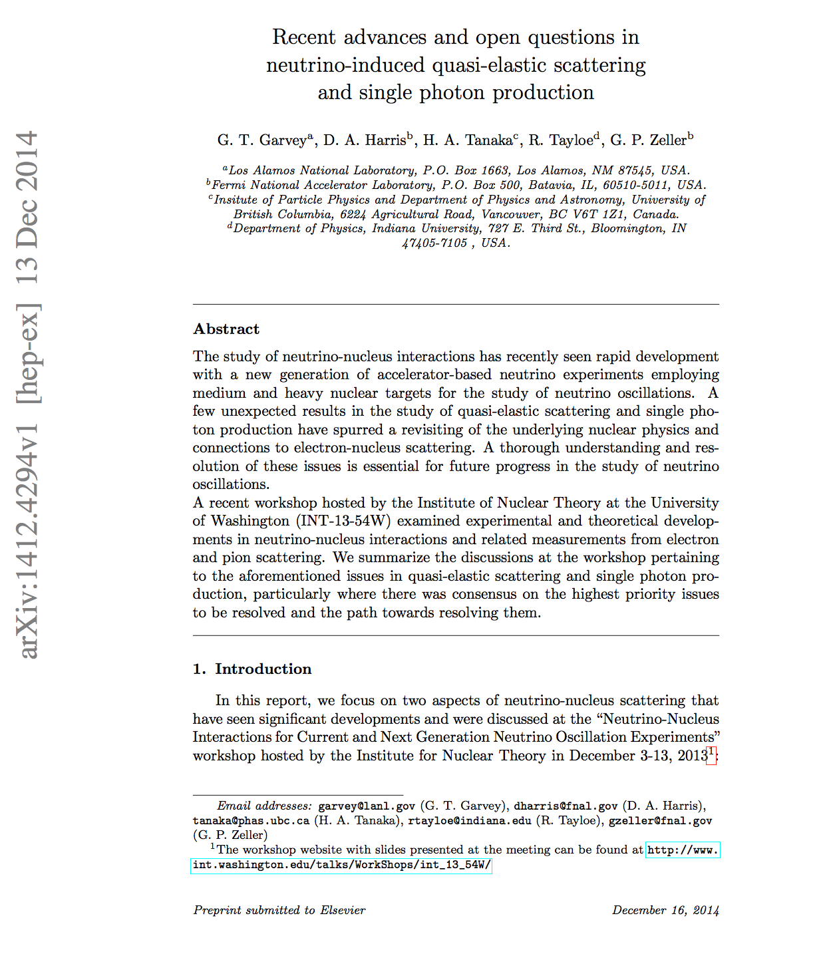
INT Workshop
workshop on neutrino-nucleus scattering
held at the INT in Seattle Dec 3-13, 2013
- >60 theorists and experimentalists, experts
in ν and e⁻ nucleus scattering locked in one
room for 2 weeks to hash out this physics
- 54 talks, *large blocks of time for discussion
pivotal consensus-building workshop
set a clear direction for future theoretical
work and experimental measurements
follow-up workshop being planned for
2016 (F. Sanchez, Valencia)
workshop summary: G. Garvey (LANL), D. Harris (FNAL), H. Tanaka (TRIUMF),
R. Tayloe (Indiana), G. Zeller (FNAL), arXiv:1412.4294, submitted to Phys Reports
Notes:
.

Slide 25
Collaboration with Nuclear Theorists
Fermilab scientists are actively engaged with nuclear theorists to develop a multi-year program of ab-initio neutrino-nucleus interaction calculations

Slide 26
NuSTEC (Neutrino Scattering Theory Experiment Collaboration)
Emphasis on Collaboration between NP Theorists, Event Generator Collaborators and Neutrino Experimentalists
Generators: Coordinate theorist-experimentalist collaborative efforts to improve generator(s).
  GFMC collaboration: 6 NP Theorists with 4 HEP Neutrino Experimentalists
Global Fits: Combine results from multiple experiments – not only neutrino - to compare with and adjust a theory/model framework.
Training: Organize/Run a a generator and neutrino-nucleus scattering physics theory Training Program
  Generator School: May 2014 at Liverpool – 25 participants
  Nuclear Physics Theory Training: Fermilab October 2014 – 85 participants
  Planning for 2015 NuSTEC School underway- Okayama, Nov. 2015
Workshops: Organize Community-wide Workshops when needed.
  MEC in Exclusive States – Europe, 2015

Slide 27
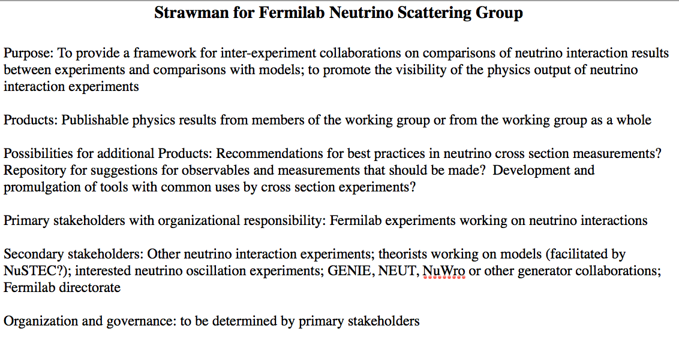
FENIX
FErmilab Neutrino Interactions and XSs group
being kick-started by University & Fermilab personnel on
MINERvA, MiniBooNE, MicroBooNE, NOvA
model is LEPWWG
goal is to combine data sets
and provide comparisons
of neutrino scattering data
coming out of Fermilab (and
other) neutrino experiments
opportunity to supply input to the PDG and, in general,
elevate the σ_{ν} measurements coming out of this program
DRAFT
(K. McFarland)
Notes:
First meeting of this group occurred in January. Next meeting coming up in mid-February.

Slide 28
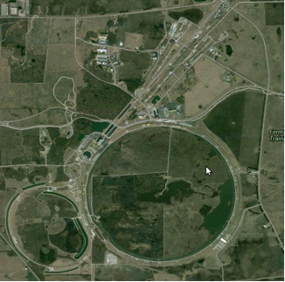
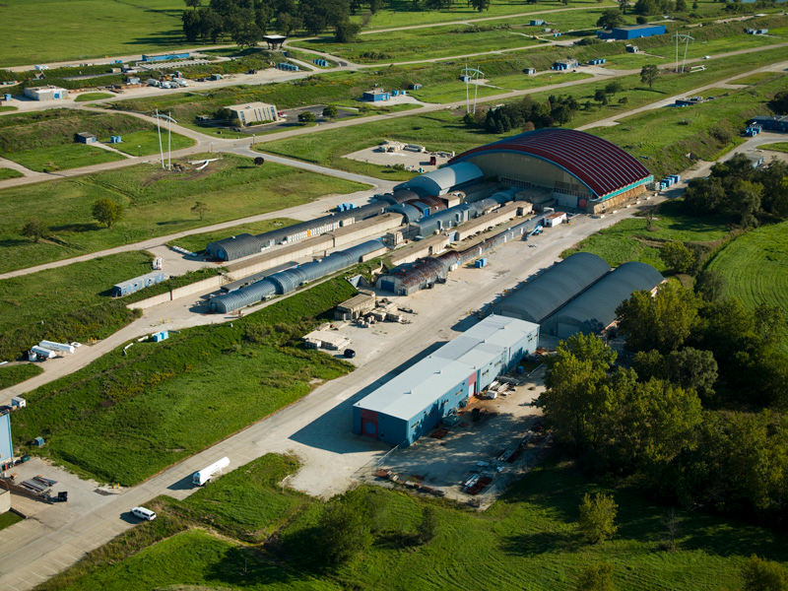
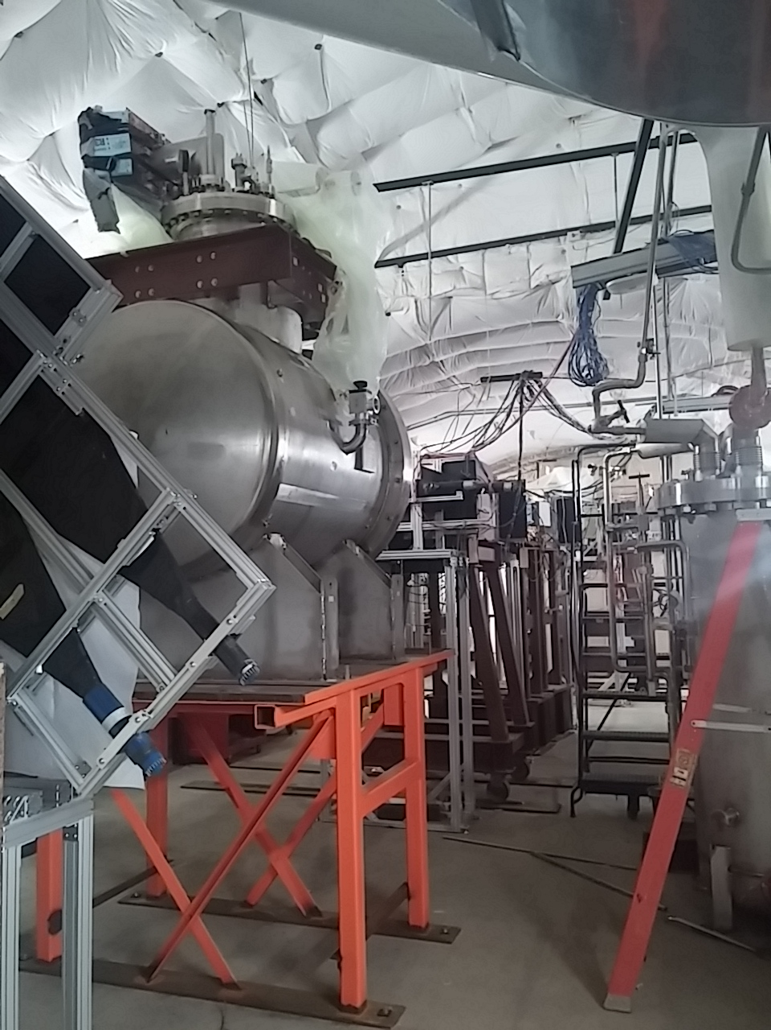
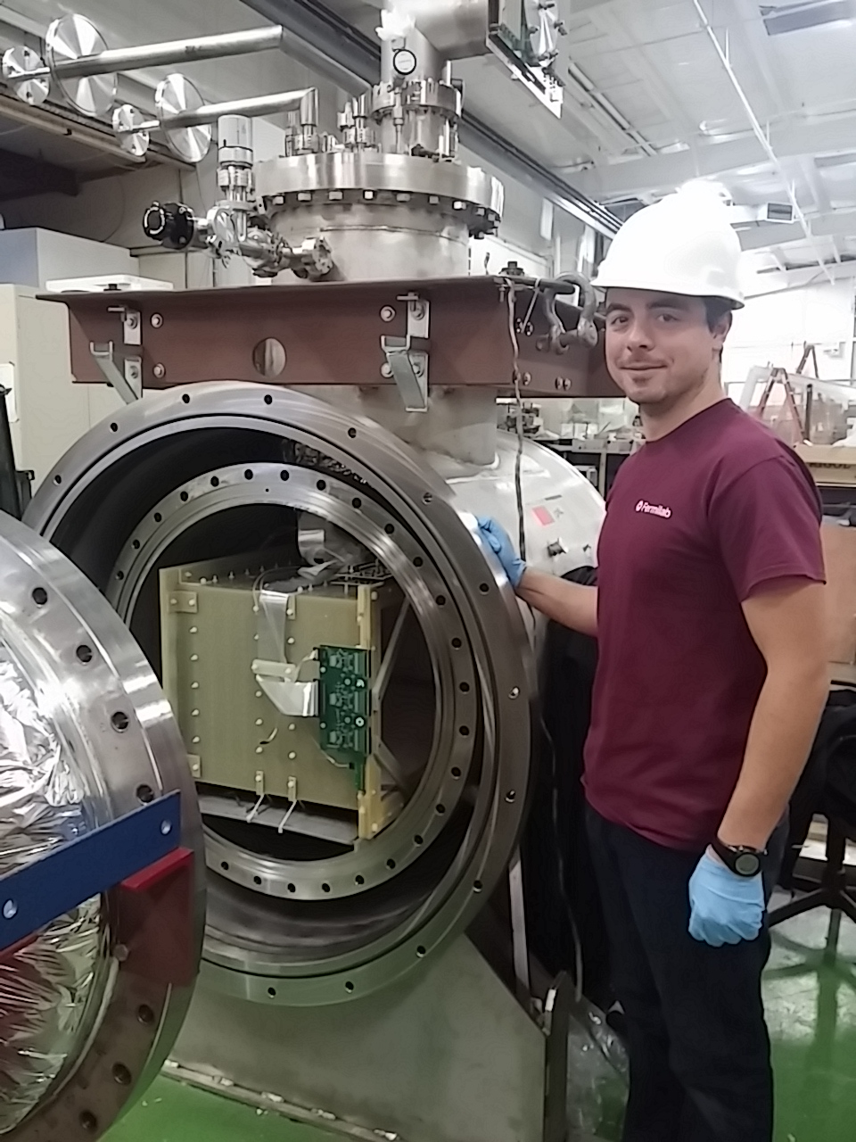
LArIAT (Liquid Argon In A Testbeam)
Repurposed 550-𝓁 ArgoNeuT LArTPC detector with modifications for operation in Fermilab Test Beam Facility charged particle tertiary beam (~200 MeV – 2 GeV).
Main Injector Proton Beam
Fermilab Test Beam Facility
LArIAT TPC
MCenter Tertiary Beam (looking upstream)
Goals Characterize LArTPC performance in the range of energies relevant to upcoming SBN and LBN experiments for neutrino physics and for proton decay searches.
Study energy resolution improvement by combining information from scintillation light and ionization charge signals
Experimentally measure e-γ separation
Develop criteria for charge sign determination
Optimize pion and kaon ID capabilities
arXiv:1406.5560 [physics.ins-det]

Slide 29
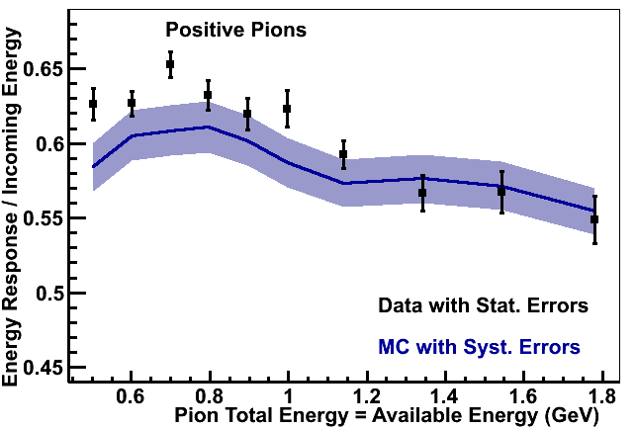
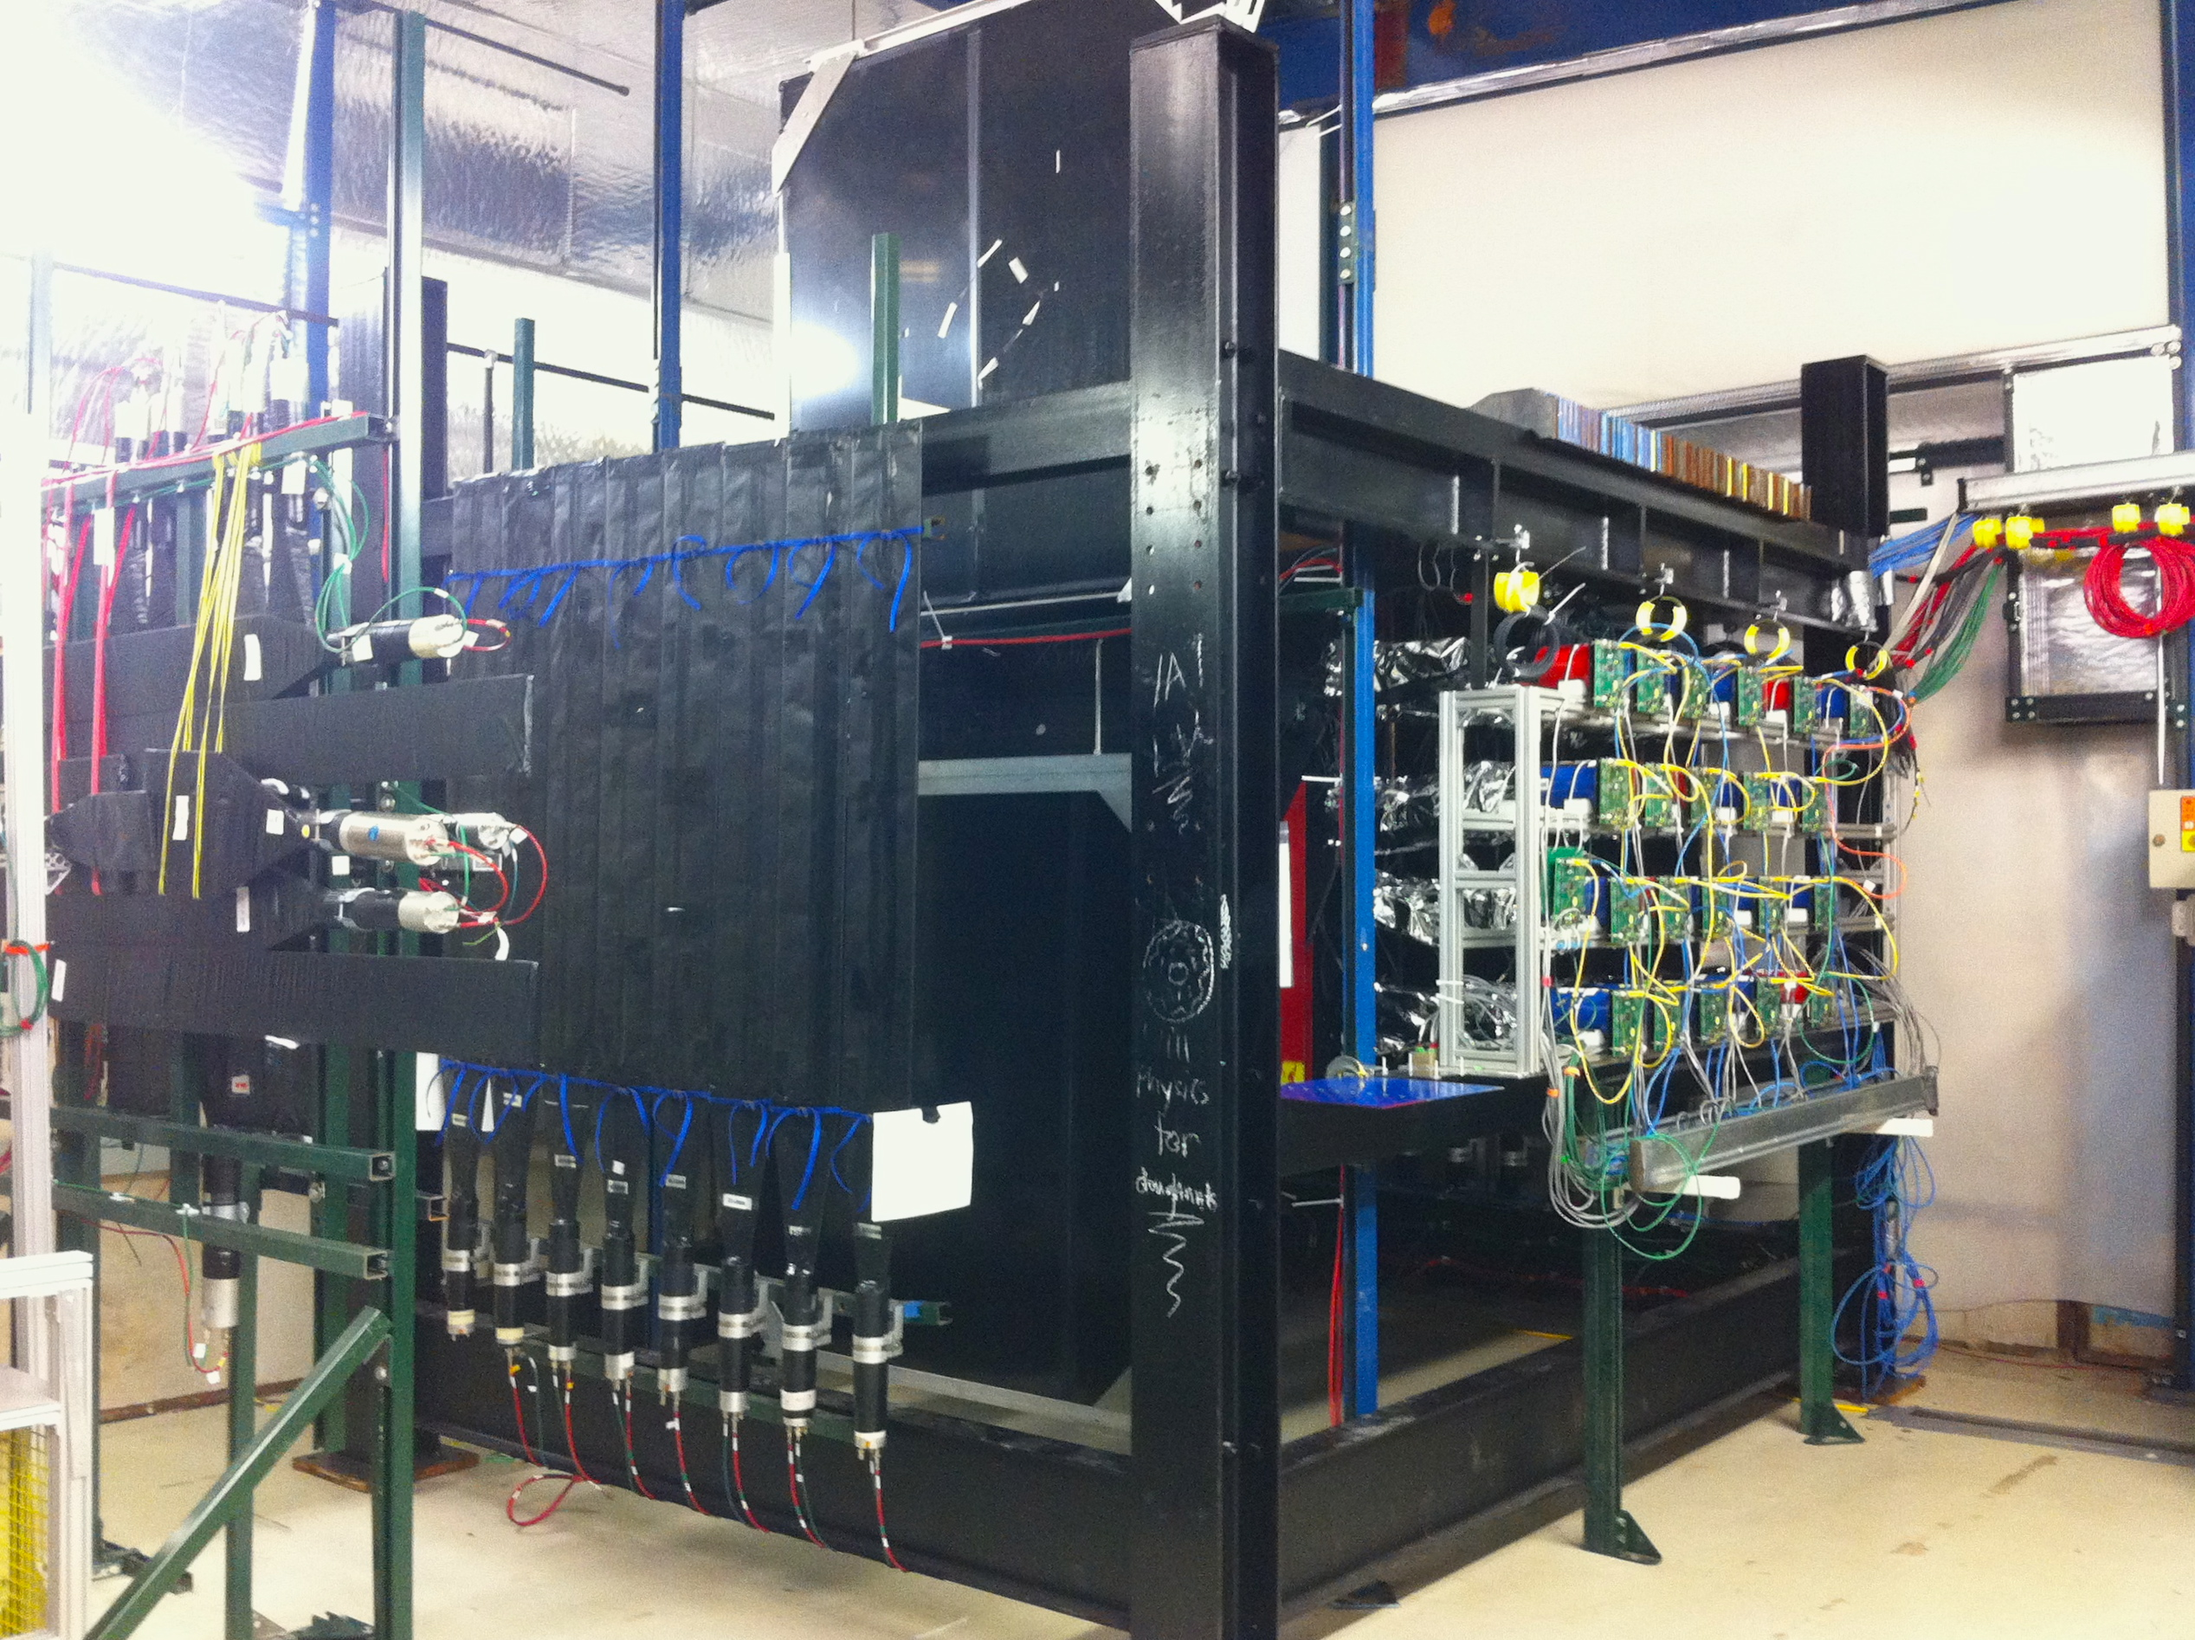
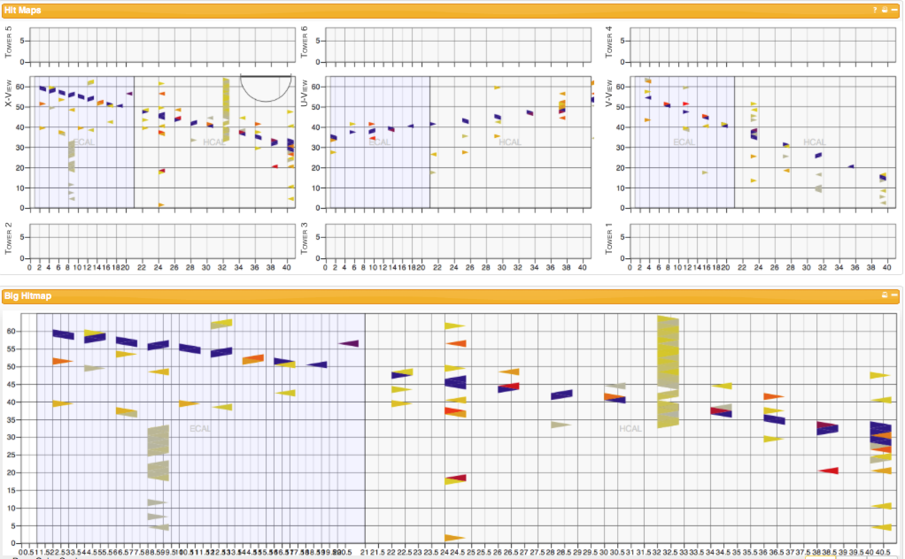
MINERvA ME Testbeam
what: wire chambers, TOF, veto system
and 42 1.2m² MINERvA planes
readout by 42 multi-anode PMTs
why: to calibrate the hadronic
EM energy scale from 2-6 GeV
when: commissioning in FTBF now
(example from LE testbeam run)
Notes:
Picture of a cosmic ray muon going through the testbeam detector.

Slide 30
High Power Targetry at Fermilab
Located in Accelerator Division
Central to current/future neutrino programs
Expertise developed at the lab:
  NuMI 400kW
  NuMI / NOvA being upgraded to 700 kW (PIP II)
  Planning for LBNF includes 1.2MW proton beam
  …not likely to stop there
2014 P5 report:
  “High power targets… will address critical needs…”

Slide 31
Fermilab R & D Program
Mega-watt class facilities present technical challenges :
  Radiation damage, heat removal, shock response, radiation protection and remote handling
Ten-year R&D program addresses these issues :
  Fermilab hosting fruitful RaDIATE collab.
  Cooperation with CERN (e.g. HiRadMat)
  Engineering/Mat. Science with BNL, ORNL etc.
Fermilab will continue to coordinate activities to enhance and leverage complimentary capabilities

Slide 32
GENIE
GENIE (Generates Events for Neutrino Interaction Experiments) is an Object-Oriented Neutrino MC Generator supported and developed by an international collaboration of neutrino interaction experts. GENIE is currently used by T2K, MINOS, NOvA, MINERvA, ArgoNeut, MicroBooNE, ELBNF, INO, LAr1-ND and others.
  Every running and planned neutrino experiment at the lab!
Fermilab has joined the Executive Board and is driving more thorough physics validation and a more aggressive release schedule.
We are creating a “developer’s hub” and recently created a user group (along with the Geant4 group) for more active engagement with neutrino experiments at the lab.

Slide 33
Geant4
Geant4 is a toolkit for the modeling of the passage of particles through matter with applications in HEP as well as nuclear, medical, accelerator, and space physics.
Fermilab participates in the Geant4 Collaboration in the areas of hadronic physics, CPU performance monitoring and improvement, and maintains a validation database.
Partnerships with the neutrino community at Fermilab has lead to new efforts within Geant4 (e.g., special programs to study systematic uncertainties of the simulations).
Neutrino experiments use new Fermilab software tools and infrastructure such as new quick-start toolkits and the above-mentioned validation database, and benefit from the new development efforts such as new physics lists.

Slide 34
art
Event-processing framework for particle physics experiments, processing data in a variety of contexts, including high-level software filters, online data monitoring, calibration, reconstruction, simulation, and analysis.
Designed to be used across many experiments.
Developed and maintained by software engineers who are specialists in the field of particle physics infrastructure software.
Perhaps the larges user base is within the Intensity Frontier at this time; used by experiments at and outside of Fermilab.
Significant interaction between users and developers informing framework design.

Slide 35
Artdaq
Artdaq is a data acquisition toolkit for HEP experiments. It provides core DAQ functionality, and provides a framework for experimenters to build the custom software components that are unique to their experiment. It uses of the art event processing framework for filtering events in software.
Fermilab is collaborating with experimenters from LArIAT and LBNE 35-ton to develop their DAQ systems using artdaq. Others using artdaq include DarkSide and Mu2e.
We are adding functionality to the toolkit based on experiment needs, and we are investigating providing a menu of recommended commercial hardware modules for back-end data readout. The goal is to provide off-the-shelf DAQ hardware, firmware, and software to enable experiments to develop their DAQ systems quickly.

Slide 36
LArSoft
The Liquid Argon Software (LArSoft) project manages simulation and reconstruction algorithms for LAr TPC detectors built on art and ROOT.
Experiment-specific code for LAr1-ND, MicroBooNE, ELBNF, etc., but also many common core libraries for analysis, reconstruction, event display, event modeling, TPC-specific simulation codes, etc.
Developed using continuous integration on the Fermilab Central Build Service.
Some basic stats…
  43 releases since January 2014
  1200 files, 130k lines of code
  50 active contributors, 1800 commit

Slide 37
FIFE
FabrIc for Frontier Experiments (FIFE) provides collaborative scientific data processing solutions.
FIFE covers the full range of data processing and storage needs including grid computing on FermiGrid, onboarding users onto the Open Science Grid (OSG), specialized batch submission tools (jobsub), authentication, software delivery to remote worker machines (OASIS/CVMFS), data transfer and delivery (IF Data Handling Client tools, ifdhc, and a File Transfer Service, FTS), file cataloging (Sequential Access via Metadata, SAM), large-scale volatile and long-term storage (dCache), on-demand cloud computing (FermiCloud), Conditions Databases, and Electronic Logbooks.

Slide 38
Summary
The Fermilab Neutrino Platform is the suite of Fermilab neutrino activities that are in support of it’s experiments, but not experiment specific
The Neutrino Platform activities …
  serve the user community and are executed in partnership with it
  work together coherently to support current and future experiments at all scales
  span multiple divisions at the lab, but are coordinated by Neutrino Division

Slide 39
Backups

Slide 40

The “Platform” is composed of the building blocks upon which
we build an experimental program
Mega (?)
Experiments
Large
Experiments
Medium
Experiments
Small
Experiments
Small Tests
Fermilab Neutrino Platform

Slide 41
Recent Recommendations and Reviews
The P5 report’s recommendations on detector R&D:
  Recommendation 27: Focus resources toward directed instrumentation R&D in the near-term for high-priority projects. As the technical challenges of current high-priority projects are met, restore to the extent possible a balanced mix of short-term and long-term R&D.
  Recommendation 28: Strengthen university-national laboratory partnerships in instrumentation R&D through investment in instrumentation at universities. Encourage graduate programs with a focus on instrumentation education at HEP supported universities and laboratories, and fully exploit the unique capabilities and facilities offered at each.

Slide 42
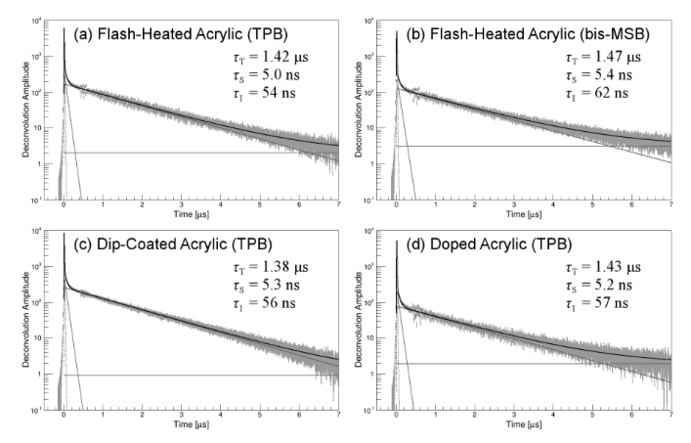
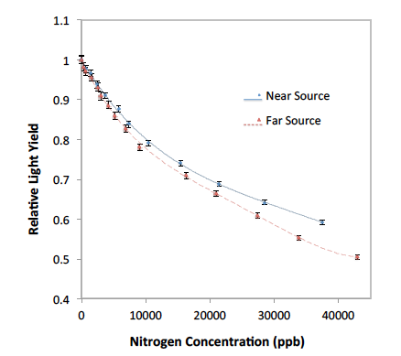
TallBo Facility for Scintillation Light Collection Studies
IU: Comparisons of different light guide production techniques
TallBo is a 56 cm diameter, 156 cm high cylindrical cryostat
Dedicated to studying light collection techniques
Capability to inject contaminants/dopants into the argon
Extensively used by Conrad MIT group (MicroBooNE and general R&D) and Mufson Indiana University group (LBNE)
Other users from LBNE planning studies for 2015 as well
Whittington and Mufson 2014 arXiv:1408.1763
BJP Jones, et al 2013 JINST 8 P07011
BJP Jones, et al 2013 JINST 8 P09001
BJP Jones, et al 2013 JINST 8 P12015
MIT: Scintillation light attenuation due to nitrogen

Slide 43
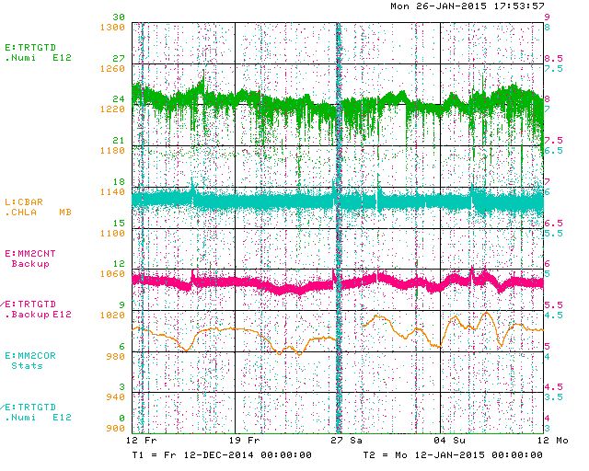
Example: NuMI Muon Monitor #2
Proton intensity
Normalized and corrected
Muon Mon. #2 signal
Normalized
Muon Mon. #2 signal
Atmospheric pressure
ACNET “online” plot.
The analysis needs to be extended over many months
1 month period

Slide 44
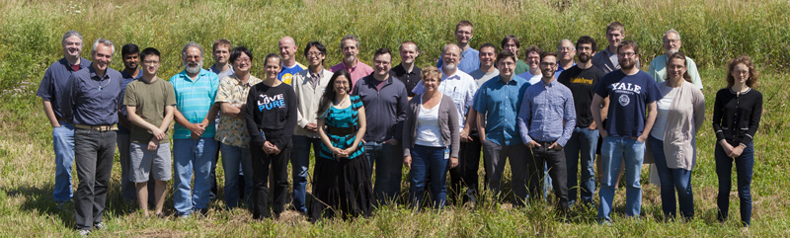
LArIAT Collaboration
July 2014 Collaboration Meeting
~70 people from 20 institutions (US, UK, Italy, Japan)
A few of the many contributions:
  Cold electronics (MSU, Boston U, FNAL FWP)
  FPGA-based trigger (W&M)
  TPC refurbishment (Syracuse, Boston U)
  Light collection system (U. Chicago, L’Aquila U, Yale)
  Cherenkov counters (UT Austin, Cincinnati, KEK)
  Online monitoring & controls (LSU)
  DAQ (FNAL)

Slide 45
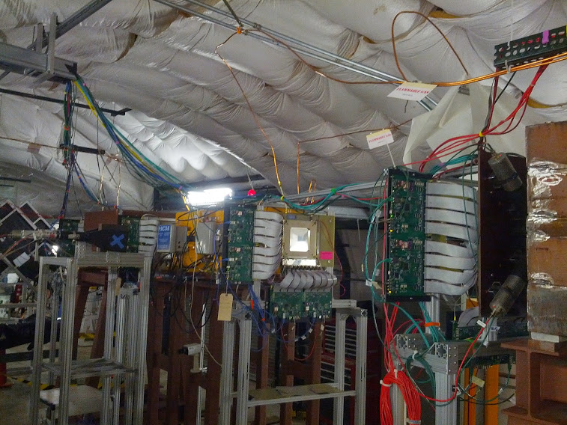
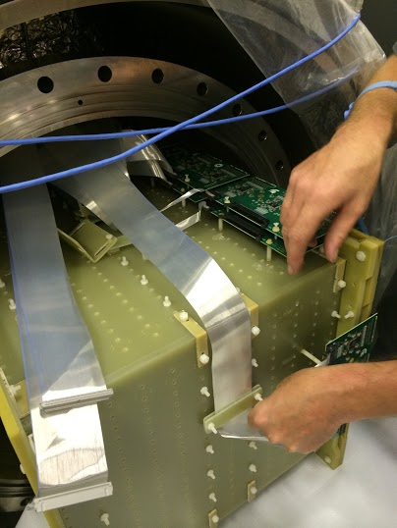
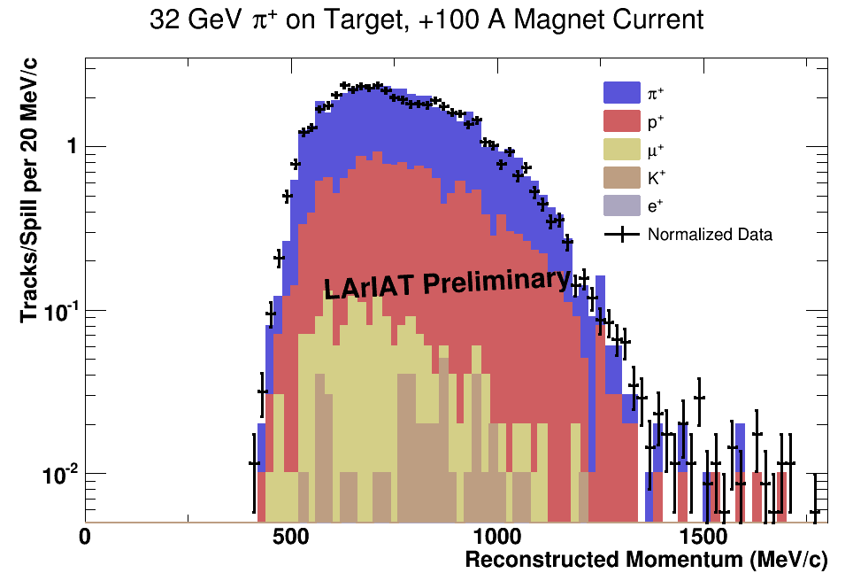
LArIAT Status
Detector refurbishment complete
  New TPC wire planes
  New cold electronics readout
  New light collection system
Installed in MCenter
  Tertiary beam components
    target, collimators, magnets
  Beamline detectors
    wire chambers, time-of-flight system
  Auxiliary detectors
    beam halo veto, punch-through veto
  Cryostat with installed TPC
  Simplified cryogenic infrastructure
First commissioning steps
  MCenter secondary and tertiary beams commissioned/tuned, Summer 2014
  New LArIAT DAQ commissioned during short engineering run (Sept. 2014)
  Good data/MC agreement!
Tertiary beamline instrumented with wire chambers and TOF
TPC installation

Slide 46
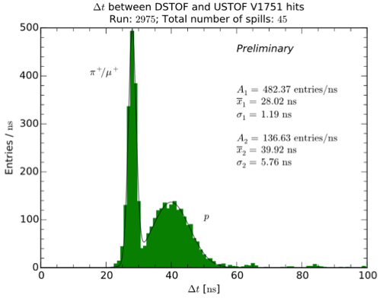
LArIAT Plans
Run 1: Spring 2015
(~3 mos. beam data w/simplified cryogenic system)
  Data will be collected for a range of secondary beam energies and tertiary magnet currents (to enhance event rates and tune momentum ranges for particles of interest)
  Use these data to develop improved PID methods using both charge and light collected in the detector
  Study charged particle reconstruction efficiencies
  Investigate hadronic interactions in argon
Shutdown
Install full cryogenic system
Install Cherenkov counters to tag π vs. μ
Run 2: ~Fall 2015
  Revisit Run 1 beam/magnet configurations, with changes or improvements where appropriate, as learned from Run 1
  Charged particle cross section measurements
  Further study and improvement of PID with combined charge and light information
  Electron/photon separation studies
Data from engineering run show good separation of protons from π/μ using time-of-flight system, but can’t distinguish between π and μ themselves.

Slide 47
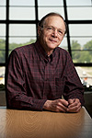
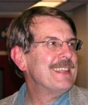
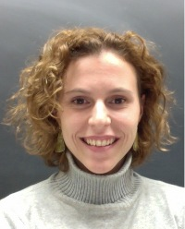
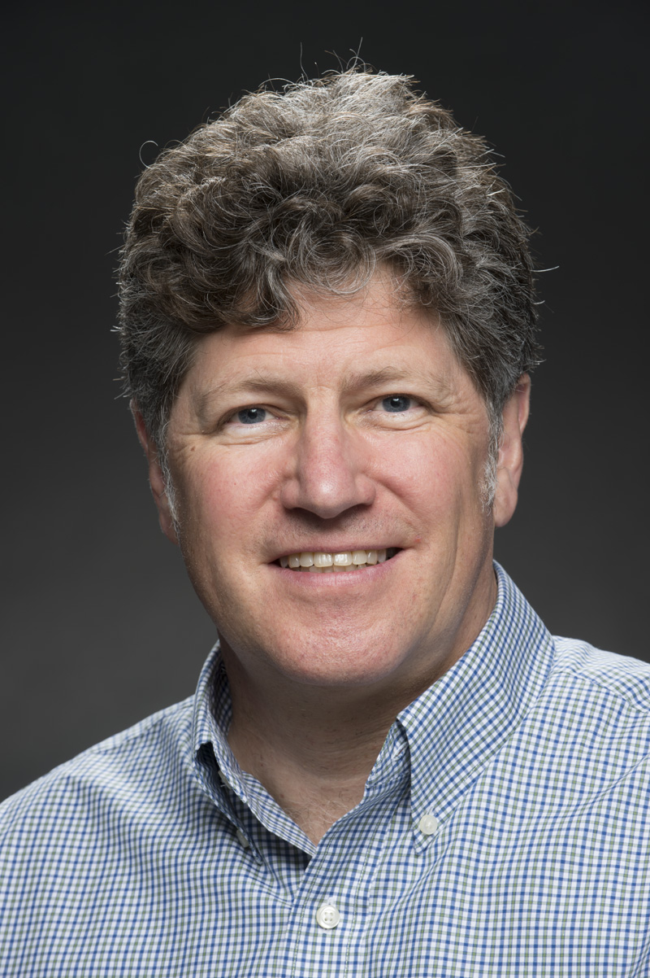
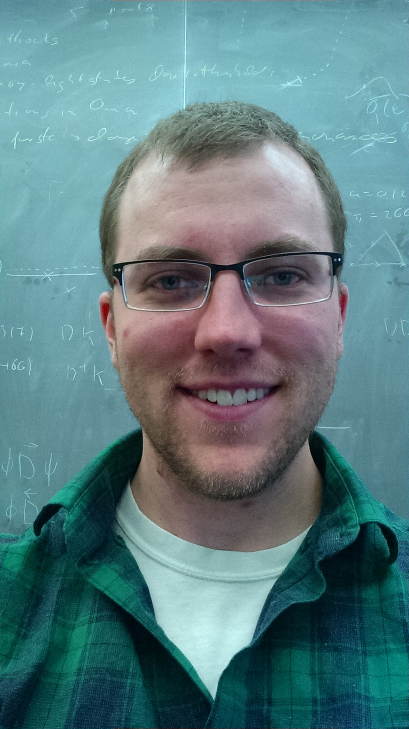
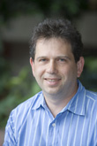
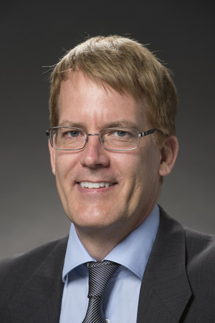
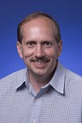
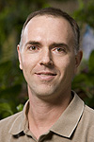
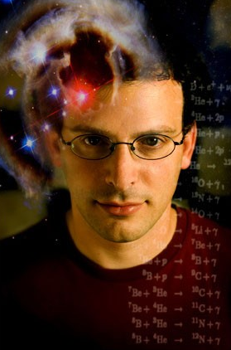
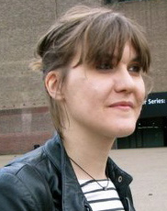
Neutrino theory effort (Emeritus, Scientists, RAs, Student)
Phenomenology
Lattice QCD
Kayser
Parke
Coloma
Kronfeld
Meyer
Cosmic constraints
DM searches
Dodelson
Lykken
Stebbins
Dobrescu
Harnik
Frugiuele
47
Stephen Parke | Fermilab DOE Institutional Review 2015

Slide 48
Intensity Frontier Fellowships
Build an intellectual hub at Fermilab for IF physics, experimental and theoretical.
Financial support for 50% time commitment at Fermilab. Terms 6 months to 1 year.
Strong peer-review by 7 member, majority non-FNAL committee.
  Committee includes theoretical, non-US, and LHC members.
Statistics:
  24 awards in 4 rounds since 2013
  70% neutrino physics
  4 IF theorists

