Slide 1
PIP-II: Answers to Questions
Steve Holmes, Hasan Padamsee
12 February, 2015
Fermilab DOE Institutional Review

Slide 2
What is the transition plan as LCLS-II production winds down to PIP-II production?
LCLS II should complete designs by the end of FY16 (hopefully).
Engineering resources required to follow through on production related engineering issues and testing.
LCLS II cryomodule assembly completes in May 2018 and from that point on there will be facilities and a highly trained staff to work on PIP II production.
We anticipate that design engineering resources will start falling off in FY18.
Therefore the design team could focus full attention on PIP II issues.
PIP-II prototyping work will continue in R&D mode through LCLS-II production
CMTS1 testing for LCLS-II CM will continue into until the end of FY18.
CMTS1 can transition from LCLS II configuration to PIP II configuration in FY19.

Slide 3
What is the transition plan as LCLS-II production winds down to PIP-II production?
What is being done to eliminate the pinch points?
Preparing parallel space for Clean Room String Assembly and Cryomodule Assembly
Procure soft walled portable Clean Room
Increase labor force
Change model for assembly of SSR1 prototype CM (use Eng./Sci. more)
Help from ANL colleagues
Temporary/contract workers
Loans from other Divisions
Selective permanent hires with broadband SRF expertise
Three Indian engineers arriving summer 2015 for 2-year residencies

Slide 4
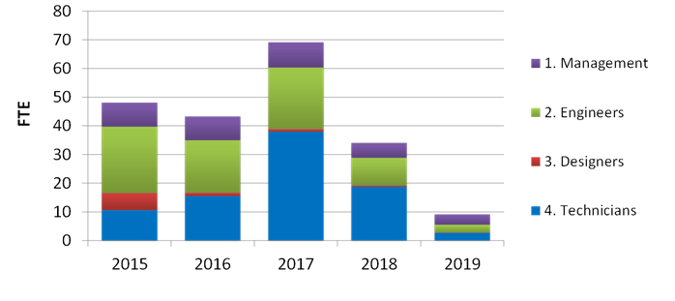
What is the transition plan as LCLS-II production winds down to PIP-II production?
LCLS-II resource requirements

Slide 5
What is the transition plan as LCLS-II production winds down to PIP-II production?

Slide 6
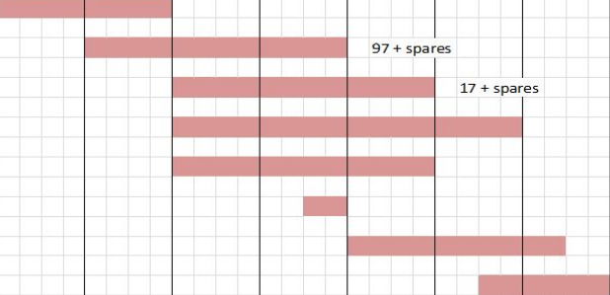
Limited resources may delay project

Slide 7
What are the plans to get international and more national lab involvement in PIP-II?
India
Collaboration well established but details (construction phase) not yet fleshed out
“Indian Institutions and Fermilab Collaboration” (IIFC) established in February 2009 for joint R&D on high intensity superconducting proton accelerators
Fermilab and four Indian laboratories
“Implementing Agreement between the Department of Energy of the United States of America and the Department of Atomic Energy of the Republic of India, for Cooperation in the Area of Accelerator and Particle Detector Research and Development for Discovery Science” signed July 2011
Annex I concerning Indian participation in PIP-II was signed in January 2015
Potential for significant Indian in-kind contributions to the R&D and construction phases.
Indians to benefit by developing knowledge and experience in the construction and operations of high power superconducting proton accelerators
India has a desire to gain expertise in all aspects of PIP-II. Joint efforts on:
Superconducting rf cavities and cryomodules
Refrigeration systems
RF Power
LLRF and Instrumentation
Magnets
EUROPE
Participation will be defined under the DOE-CERN agreement currently being negotiated.
Meetings between the accelerator leadership at Fermilab and CERN have identified priorities for CERN contributions in the event of an agreement
These priorities have been transmitted to the laboratory directors
Joint Fermilab/UCL post-doc assigned to PXIE/FETS

Slide 8
What are the plans to get international and more national lab involvement in PIP-II?
National Program
MOU established national collaboration on Project X for the R&D period (through CD-2)
12 signatories
PIP-II scope is ~30% of Project X as measured in dollars
~50% as measured in the number of technical systems
We have made the following points in discussion with the Fermilab Director and the Director of OHEP:
Fermilab has the core capabilities required to complete the scope encompassed in PIP-II
Fermilab may or may not have the personnel resources to complete this scope, depending upon timing and other activities undertaken by the lab

Slide 9
What are the plans to get international and more national lab involvement in PIP-II?
The following thoughts were discussed with our national partners last summer:
Evolution of the national collaboration should be guided by the following principles:
Engagement and contributions from international partners is critical;
National partners should either bring a required capability that does not currently exist at Fermilab, or
Resources that Fermilab does not have available to dedicate to PIP-II;
Fermilab needs to retain a major role in every accelerator system.
In parallel we need to maintain close ties and a productive relationship with the world-wide srf effort
US DOE/GARD
NSF Accelerator R&D Program
International efforts
Fermilab and partners need to be thinking in this context
Also consideration of other projects that will be pursued by the laboratory:
LBNF, Mu2e, g-2, LHC
Bottom line: Only a subset of the current national signatories will be required to develop and construct PIP-II.
ANL, LBNL fully engaged in development stage; SNS and CSU also engaged
Construction stage assignments TBD
Depends upon final agreement on international contributions and overall timing

