Slide 1
Fermilab On-Site Housing Allocations
Roy Rubinstein
UEC Meeting
25 April 2014

Slide 2
Fermilab On-Site Housing Allocations
Twice a year on-site housing is allocated.
What happens when demand exceeds availability?

Slide 3
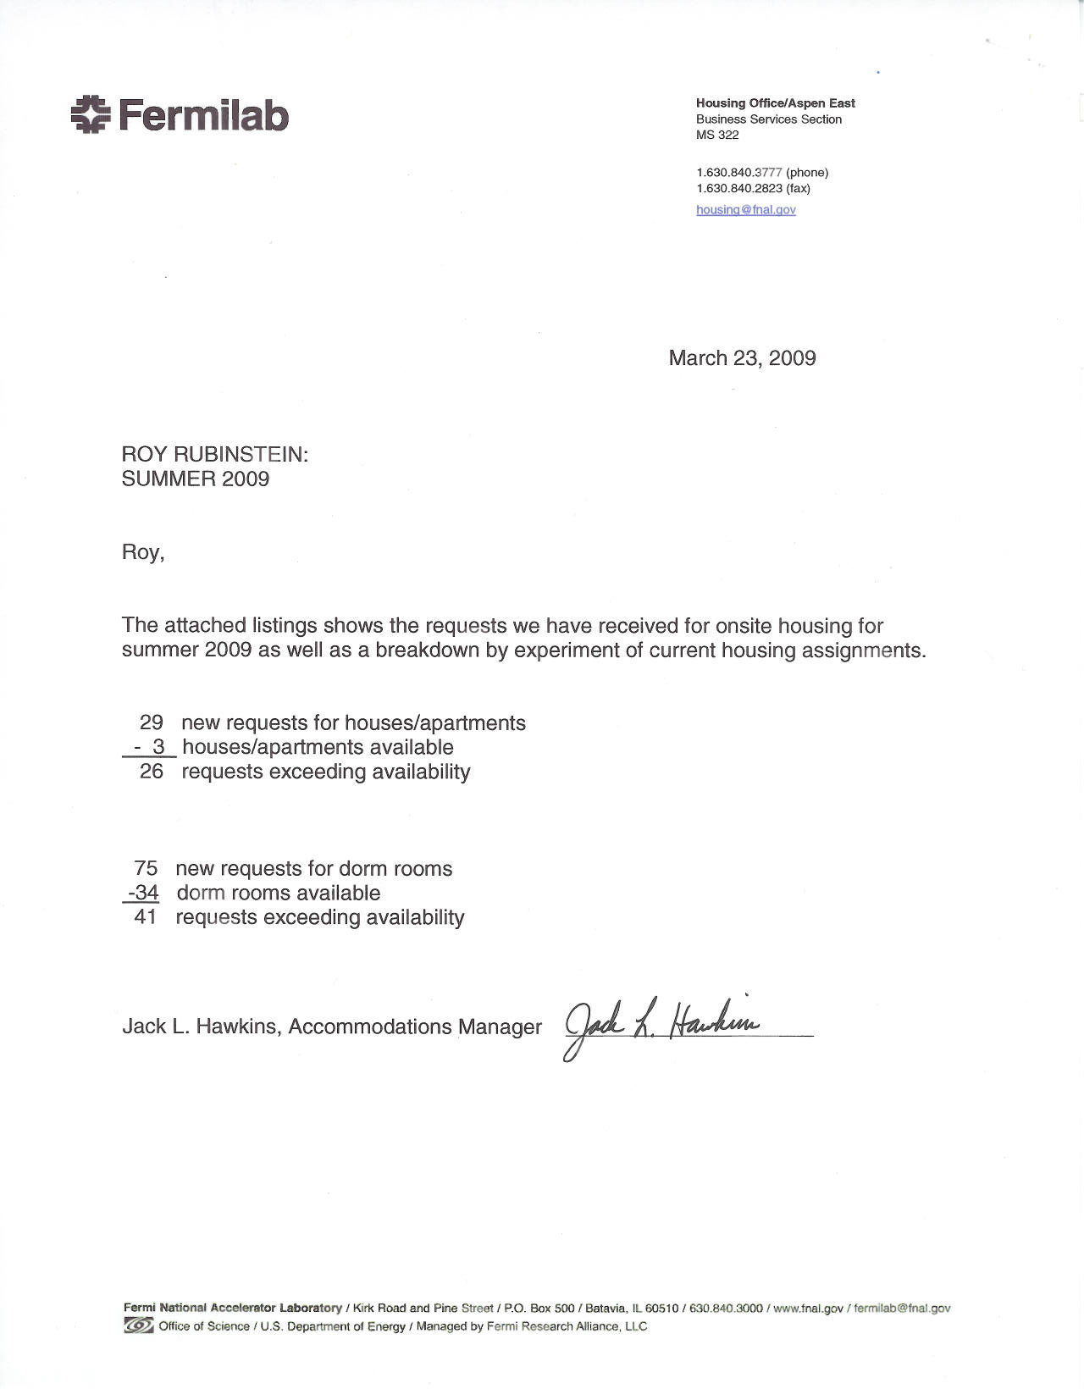

Slide 4
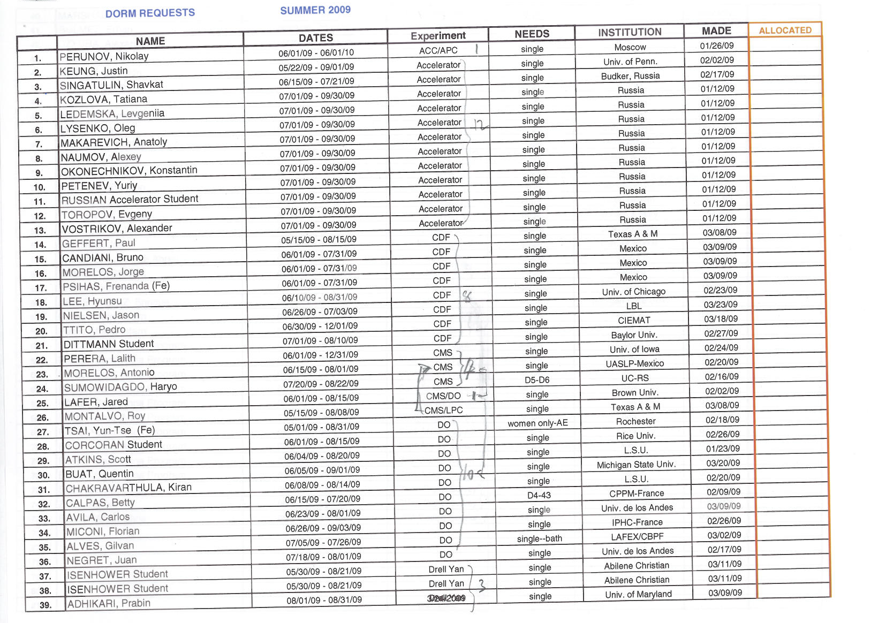

Slide 6
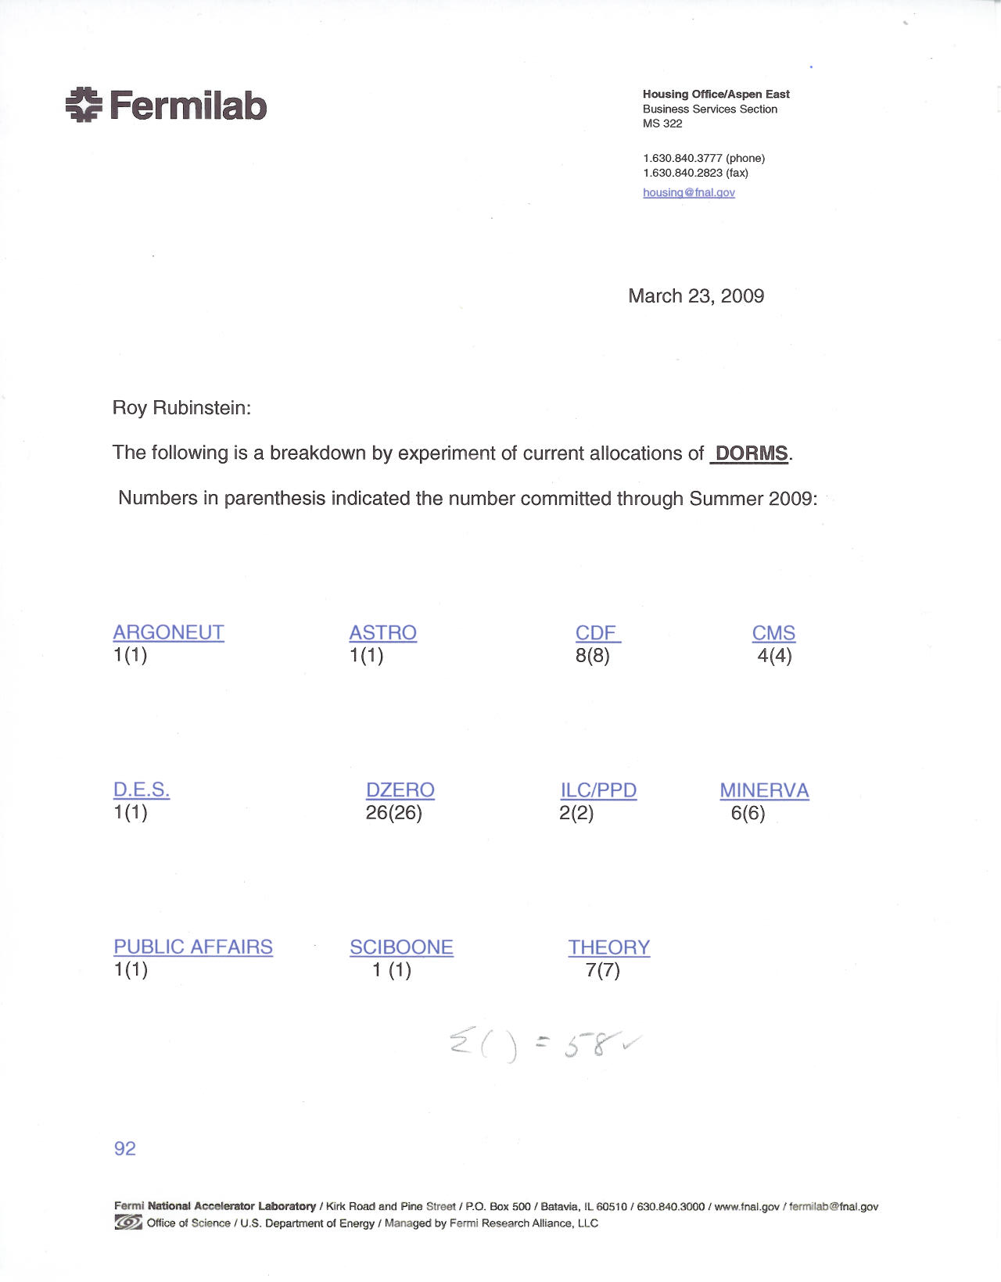

Slide 7
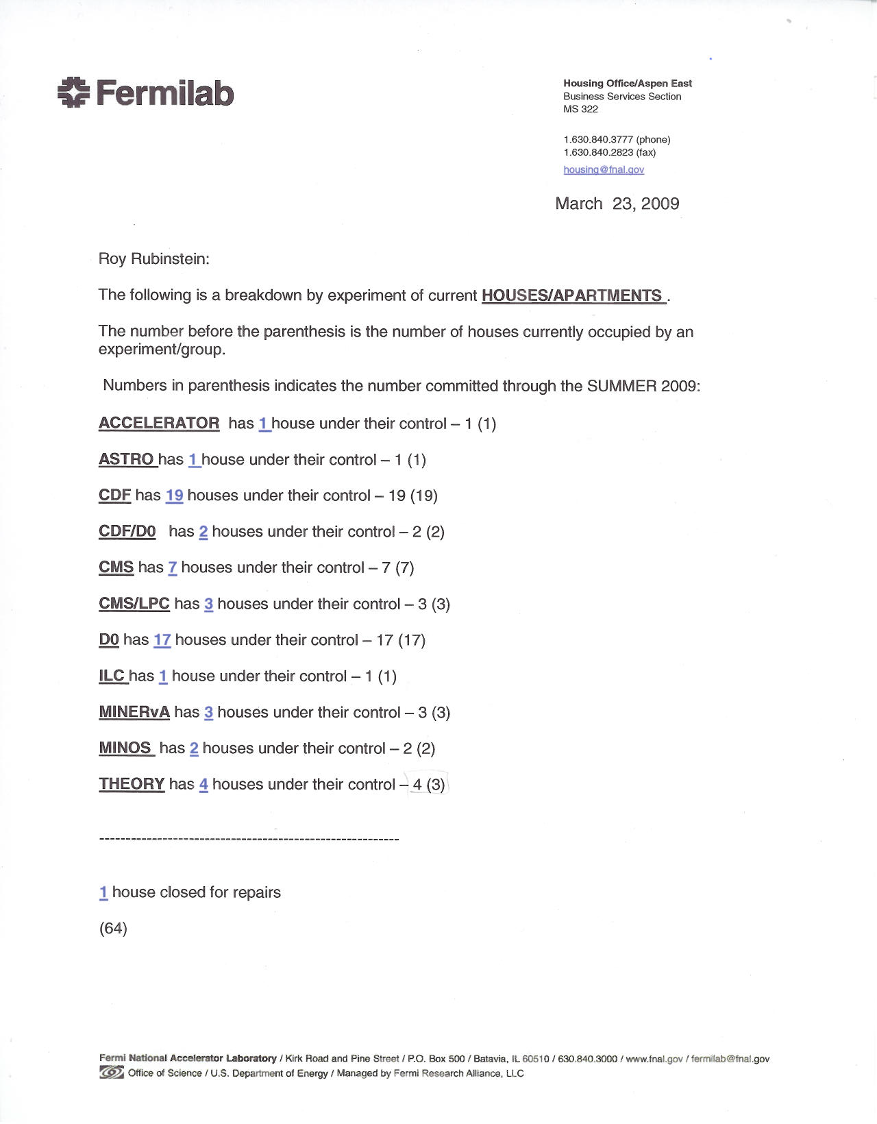

Slide 8
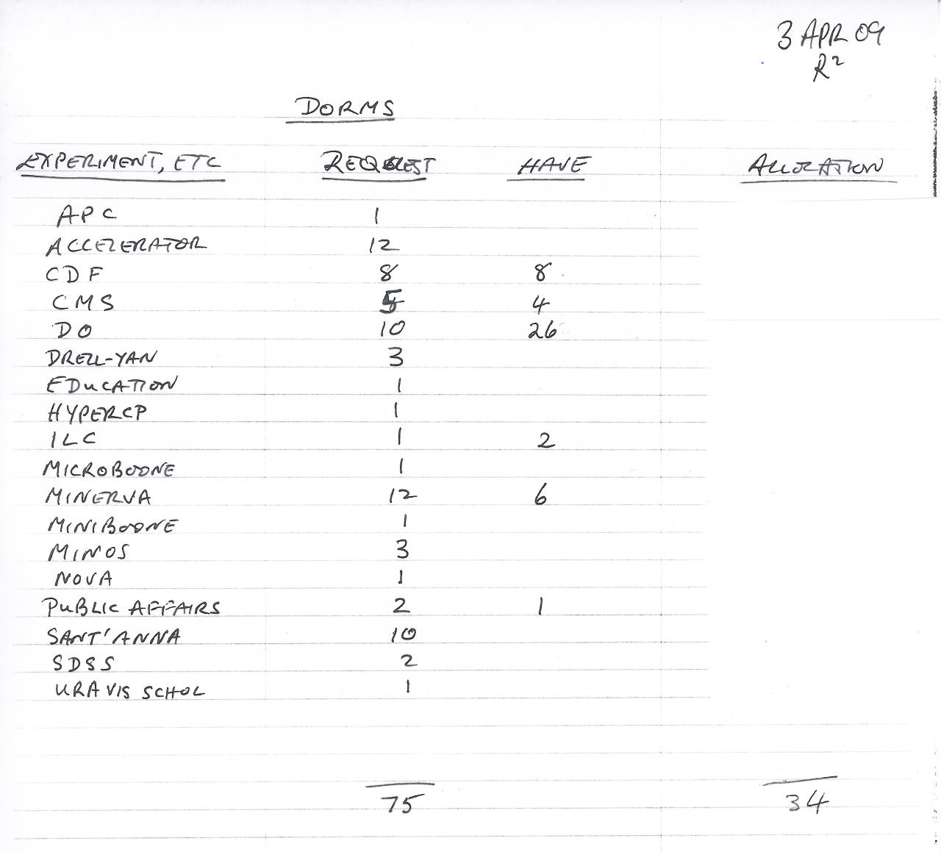

Slide 9
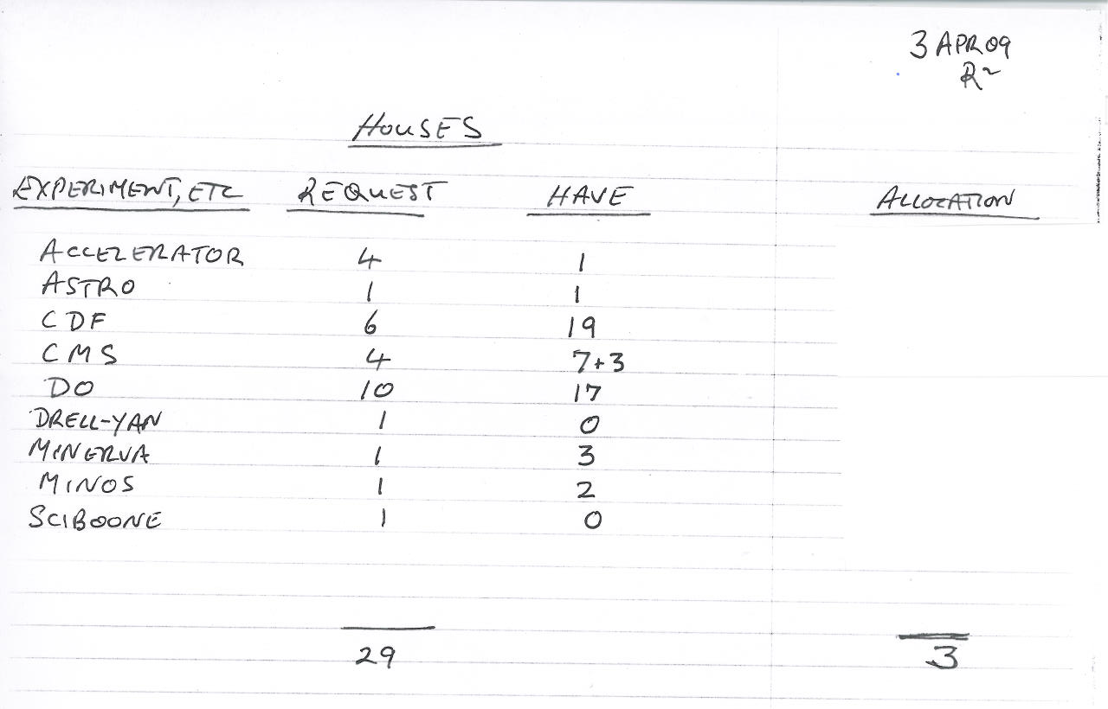

Slide 10
Meet with UEC chair (or designee) to discuss allocation.
Input
Running experiments strongly favoured
Need knowledge of Lab’s current projects
Need knowledge of Lab’s future projects

Slide 11
Output to Housing Office
Housing office notifies each spokesperson of # houses, dorms.
Spokespersons decide who received their experiment’s allocation.

