Slide 1
An Overview of the
Dark Energy Spectroscopic Instrument (DESI) and the Collaboration Efforts at FNAL
Conett Huerta

Slide 2
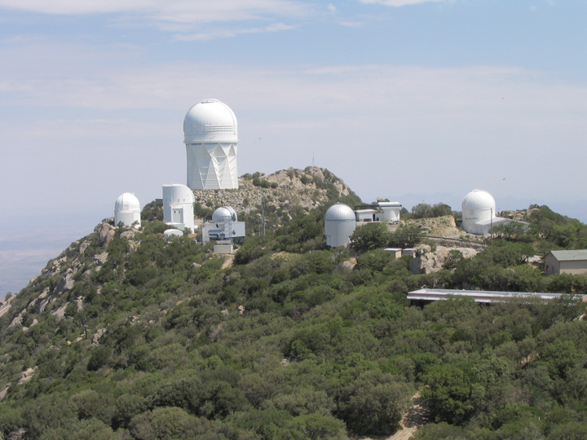
DESI on the Kitt Peak 4-m telescope!

Slide 3
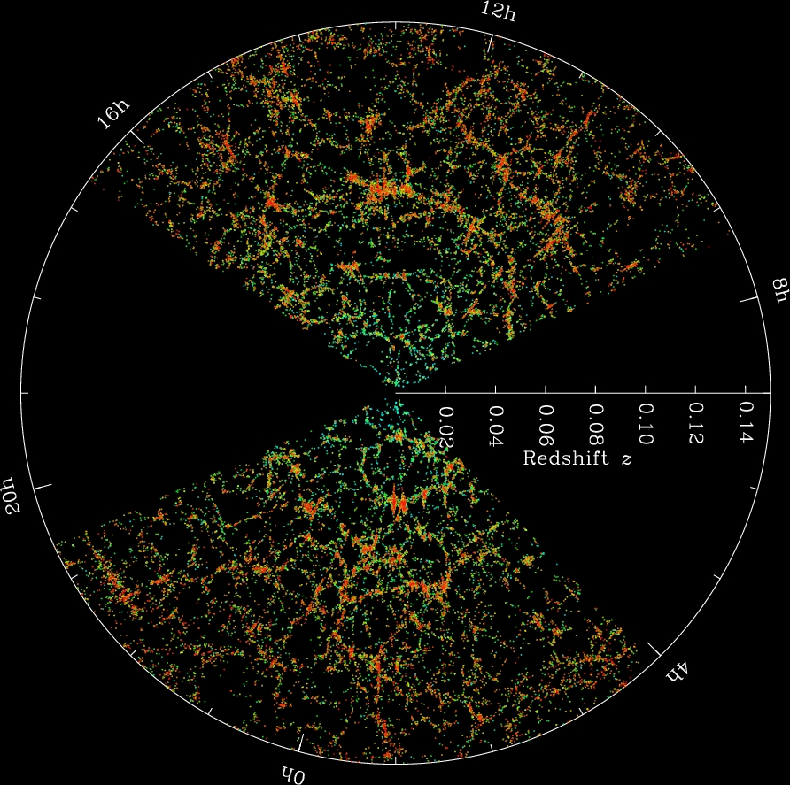
Mapping in Three Dimensions!
Measuring spectra
allows us to measure
velocity and infer distance.

Slide 4

Dark Energy
In 1998, two groups argued from supernova data that the expansion rate of the Universe is accelerating!
Many possible explanations have been advanced.
  Cosmological constant
  New low-mass field(s)
  Modification to gravity
  Extra dimensions
  Your favorite here
All are exotic, and none is so aesthetically compelling as to be the obvious preference.
What more can we do observationally?
  Main path is very accurate distance measurements, 1% and better!

Slide 5
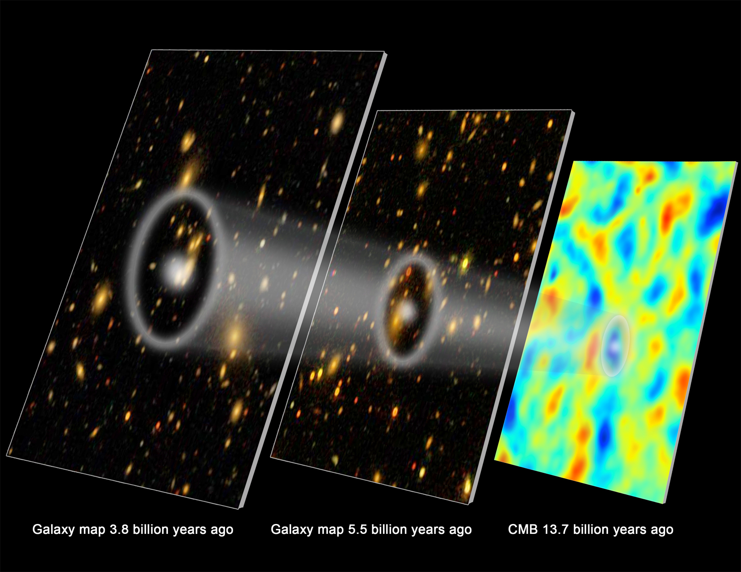

Baryon Acoustic Oscillations
Sound waves propagating in the first 400,000 years after the Big Bang create a distinctive feature in galaxy clustering: pairs of galaxies are slightly more likely to be separated by 500 million light-years than by 400 or 600.
When we see this pattern in the clustering data as an angular scale, we can infer the distance to the galaxies.

Slide 6

Baryon Acoustic Oscillations
Sound waves propagating in the first 400,000 years after the Big Bang create a distinctive feature in galaxy clustering: pairs of galaxies are slightly more likely to be separated by 500 million light-years than by 400 or 600.
When we see this pattern in the clustering data as an angular scale, we can infer the distance to the galaxies.
“Standard Ruler”

Slide 7
The DESI Survey
Will produce the best measurement of BAO by performing a spectroscopic survey over 14,000 sq. degrees out to redshifts of 3.5
4 million Luminous Red Galaxies (LRGs)
18 million Emission Line Galaxies (ELGs)
2.4 million quasars (QSO), including 0.7 million quasars at z>2.2 for Lyman-alpha-forest
Plus bright galaxies, r<19.5 z<0.4

Slide 8
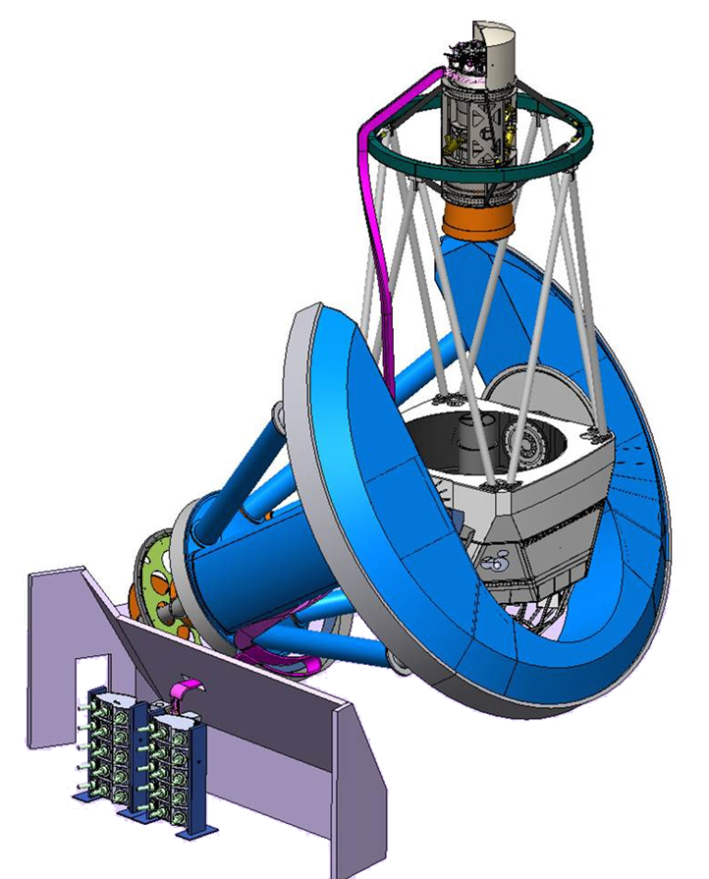
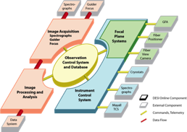
DESI
5000 fibers in robotic actuators
10 fiber cable bundles
3.2 deg. field of view optics
10 spectrographs
Mayall 4m Telescope
Kitt Peak
Tucson, AZ
Readout
& Control

Slide 9
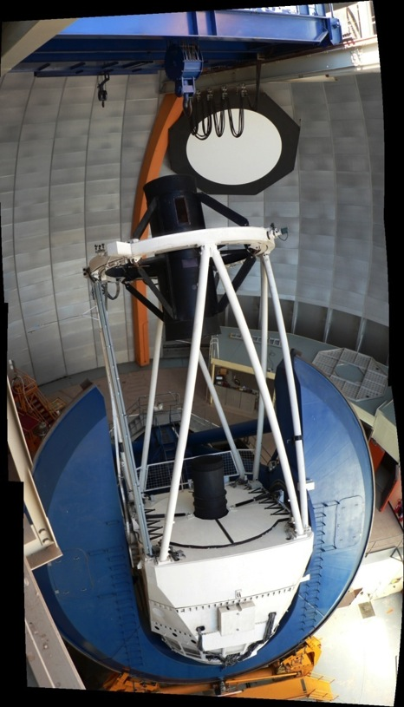
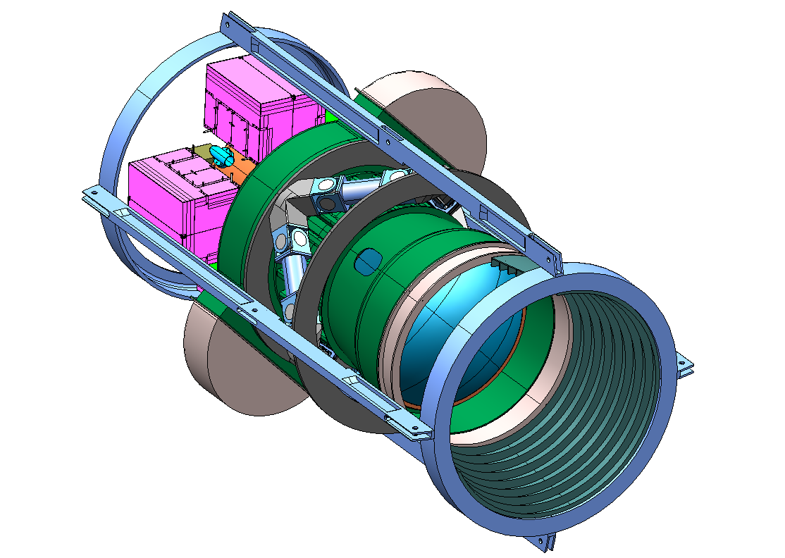
Context: DESI Project is very similar to the DECam Project
DECam Construction 2008-2012 :
570 Mpix, 3 sq. deg. CCD camera, 5 filters (griz,Y)
Dark Energy Survey (DES) just finished 2nd year of operations
Filters
Shutter
CCD
Readout
Hexapod
Optical
Lenses
Blanco Telescope @ CTIO

Slide 10
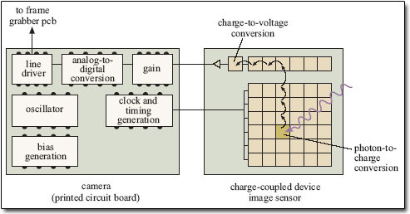
Science grade CCD schematic

Slide 11
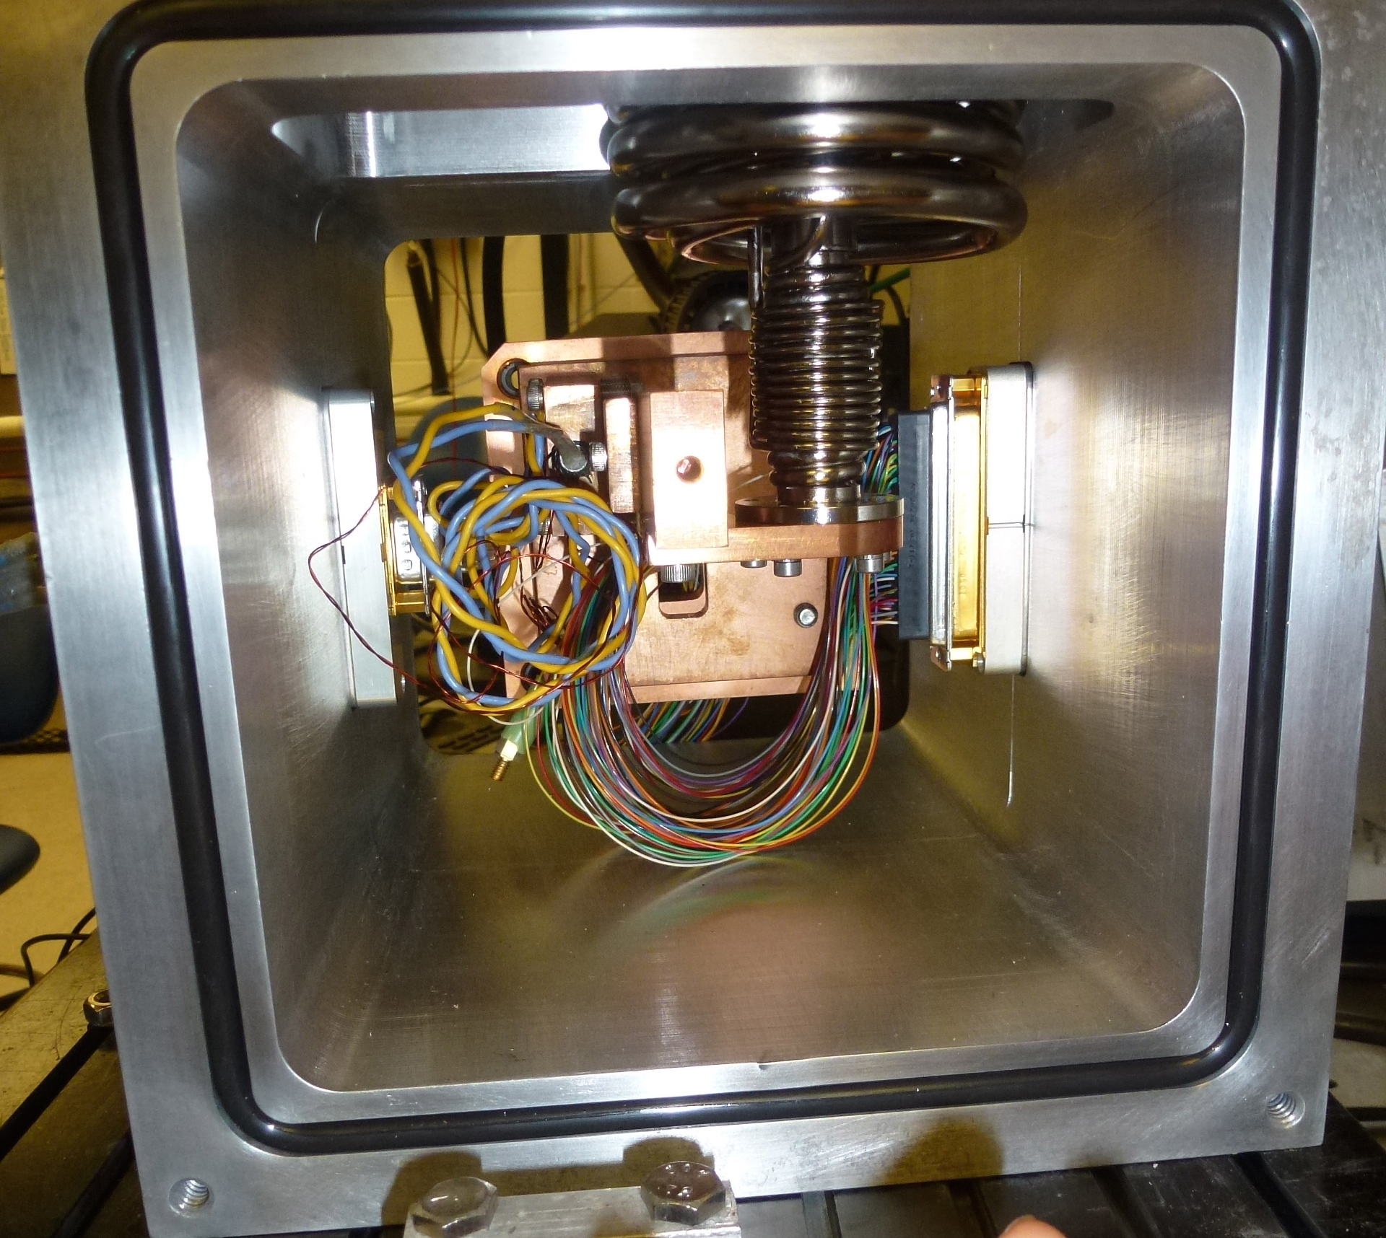
Testing Dewar

Slide 12
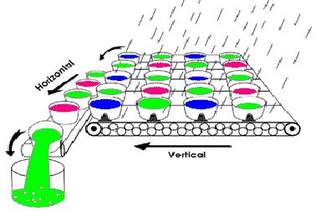
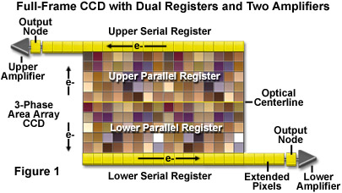
Principle of CCD operation

Slide 13
Science grade CCDs
Low noise.
No defects on the silicon.
Large format.
Science grade CCD – not your typical cell phone camera CCD.

Slide 14
Mapping the Universe
The easiest way to map the density of the Universe at low redshift is with galaxy surveys.
We make two-dimen.
maps with imaging
and then add the
third dimension with spectroscopy.
Largest 3-d maps use about a million galaxies.
SDSS redshift survey
image credit: Blanton

Slide 15
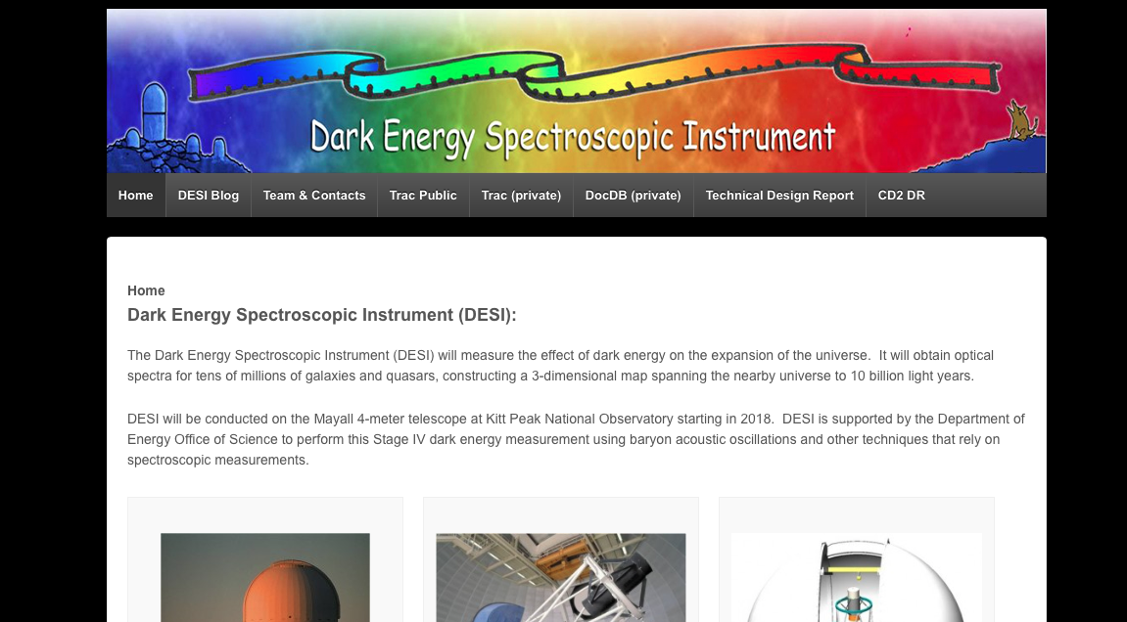
http://desi.lbl.gov

Slide 16
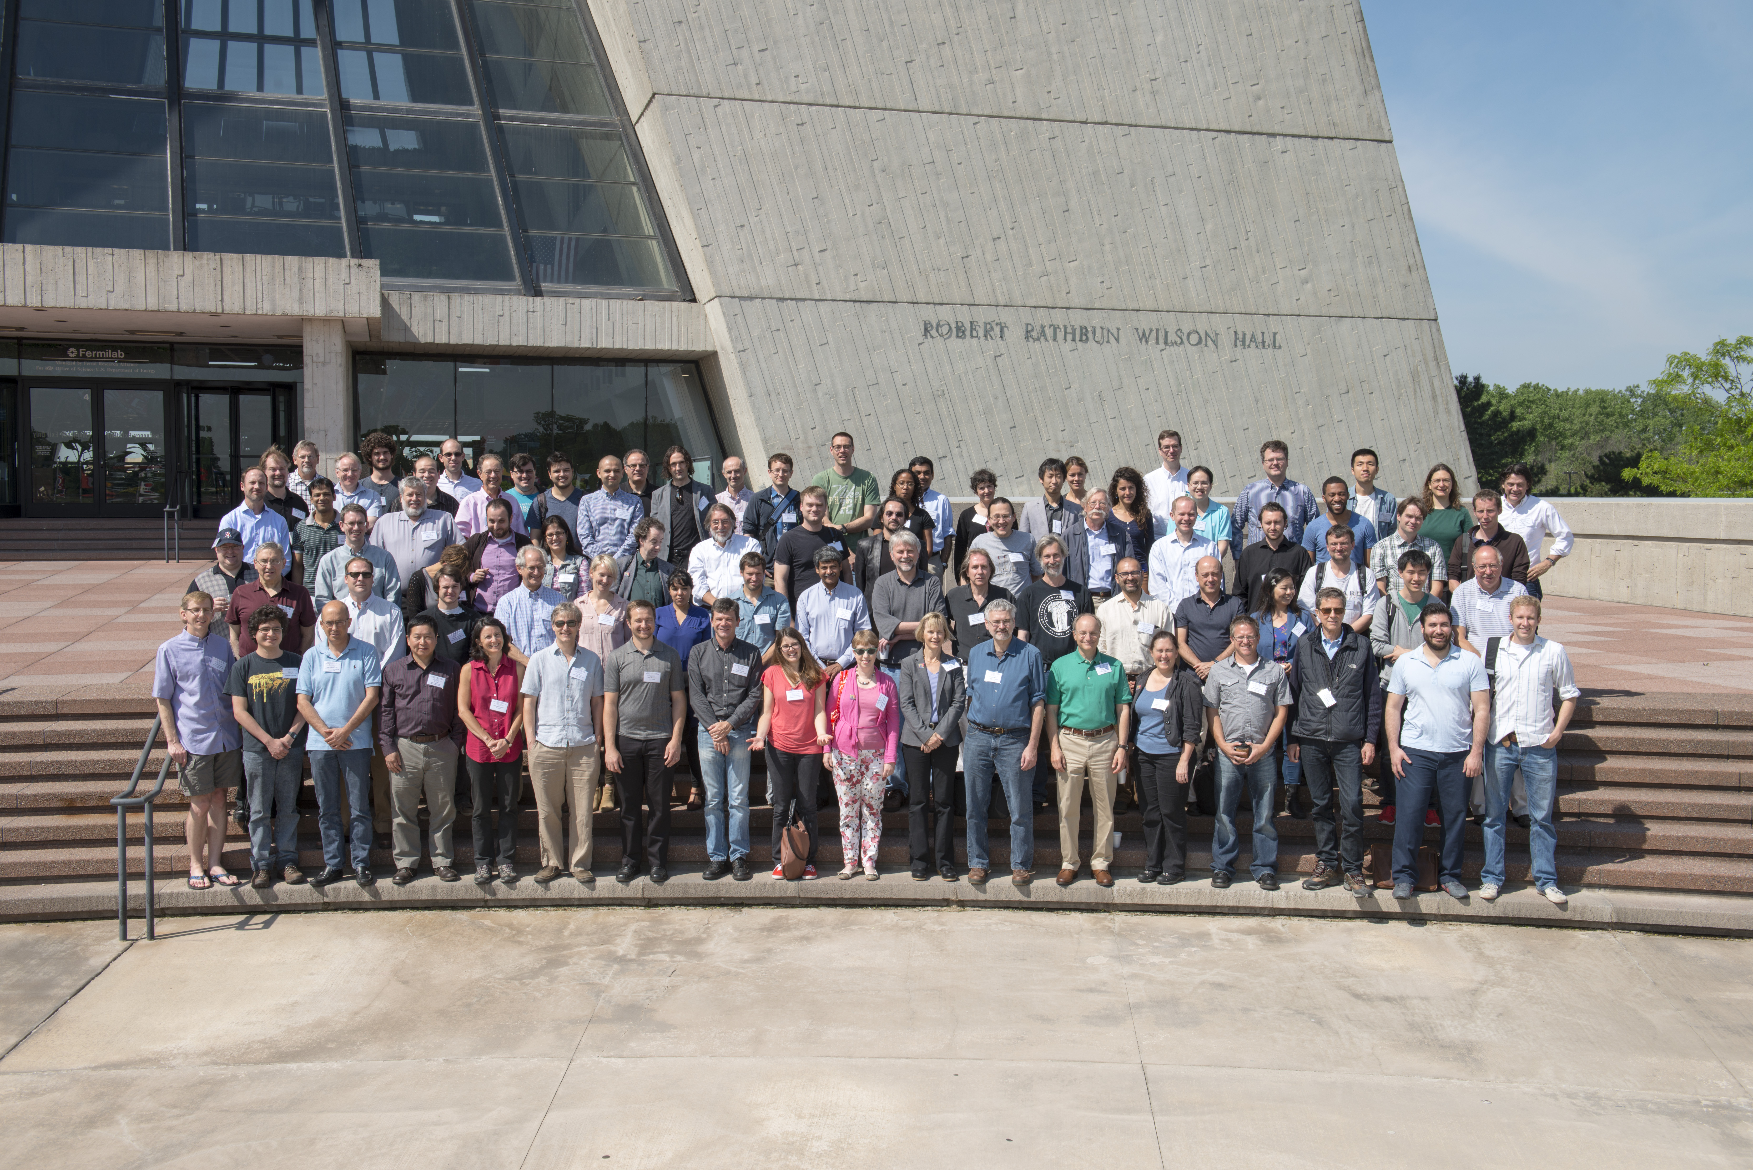
Thank you!

Slide 17
Back-up

Slide 18
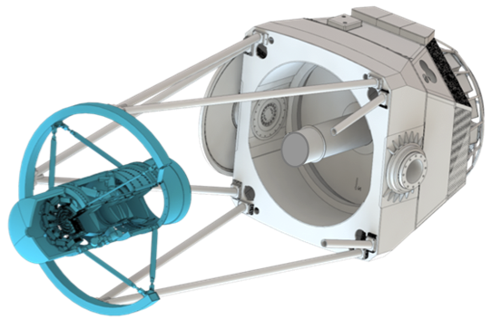
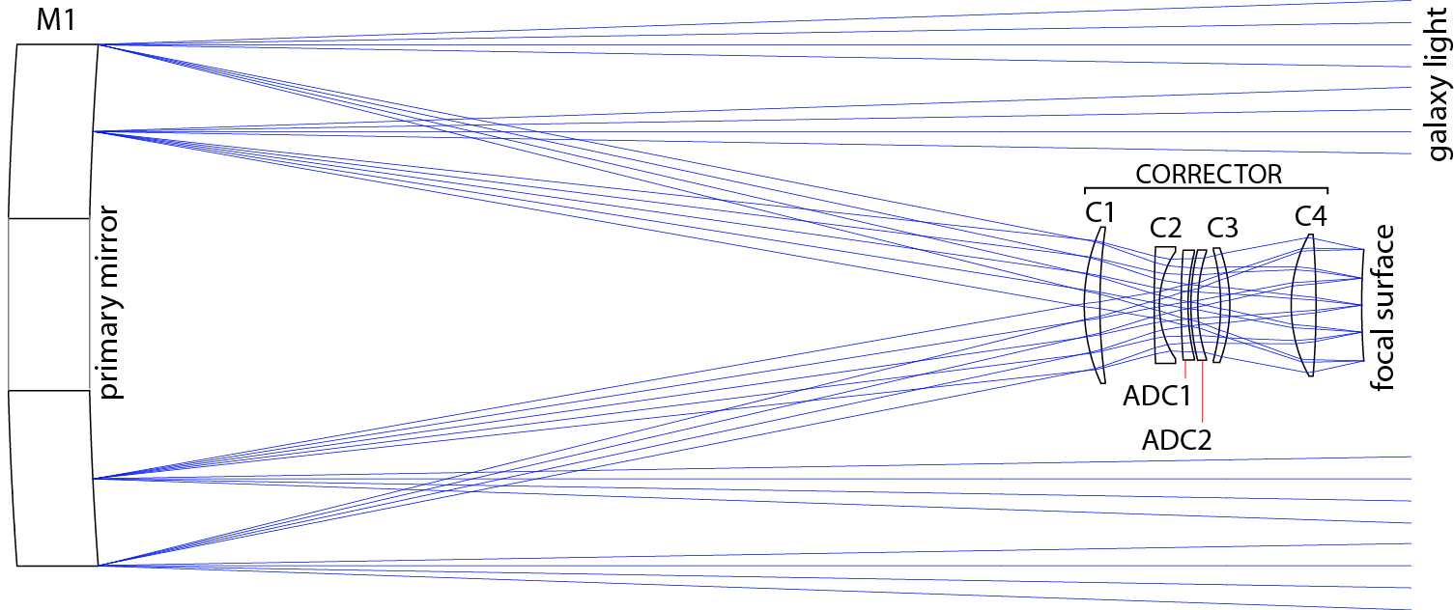
DESI Prime Focus Corrector
Requirements
  Field of view >3˚ linear
  Wavelength bandpass 360 – 980 nm

Slide 19
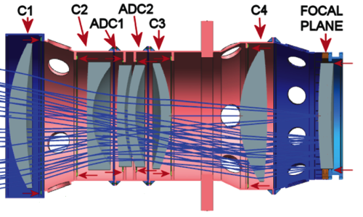
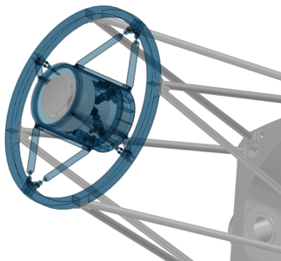
Corrector Mechanical
Lenses are mounted in cells that are in turn mounted in the stiff barrel structure – DECam heritage
Barrel is supported in cage on a hexapod to compensate for temperature, gravity, and misalignment – DECam heritage
Cage is suspended from telescope
trusses by a ring and spiders – Inner Flip ring is eliminated, spiders attach to new outer ring.
Cage
Spiders
Upper Ring

Slide 20
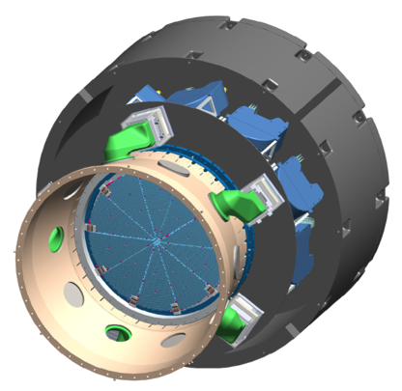
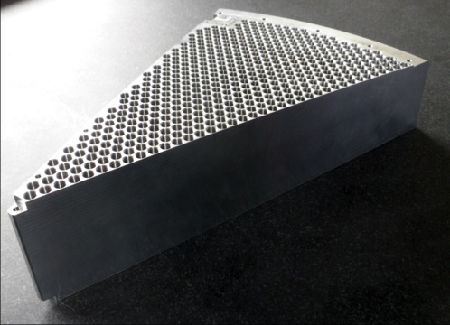
Focal Plane System
Focal plane system
  Attaches to the back of the corrector barrel
  Carries the focal plane, fiber positioners
  and support systems
  Will be assembled and installed as a unit (similar to the DECam CCD imager)
Petals
  10 standalone wedge systems
  Each holds 500 positioners
  All electronics and fiber supports fit in shadow of each petal
10 copies

Slide 21
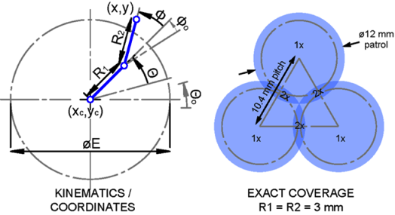
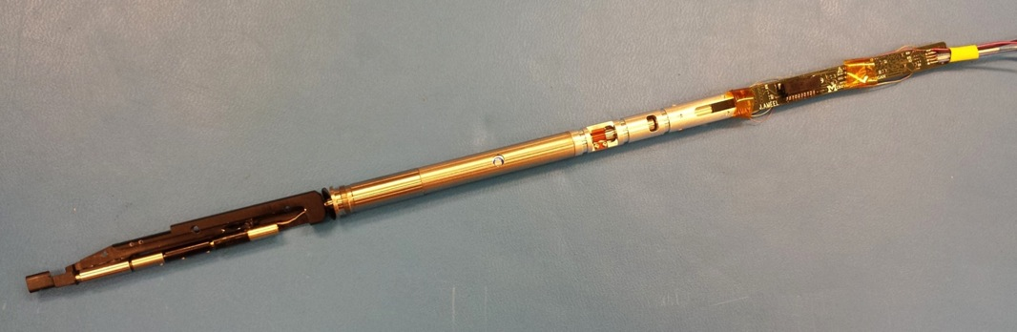
Fiber Positioners
  Position a fiber tip on a galaxy
    5 μm RMS accuracy in <45sec
  500 per petal 10.4 mm
  center-to-center, 12 mm patrol disk
  10 petals (5000 positioners) in the focal plane
  Finished part, final design, with prototype electronics, based on high-speed miniature DC motors.

Slide 22
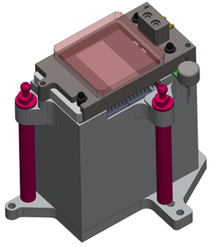
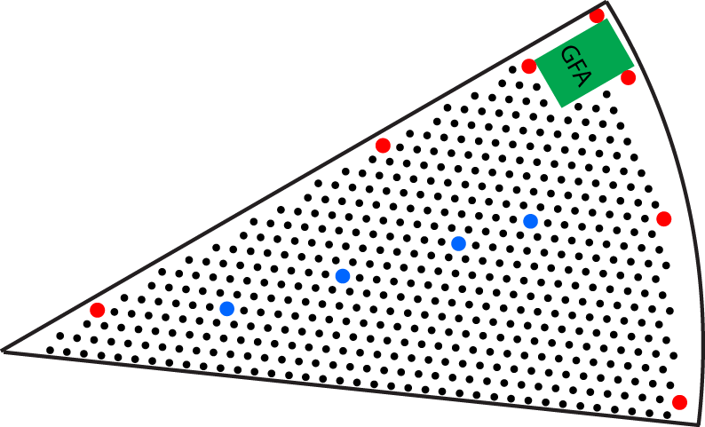
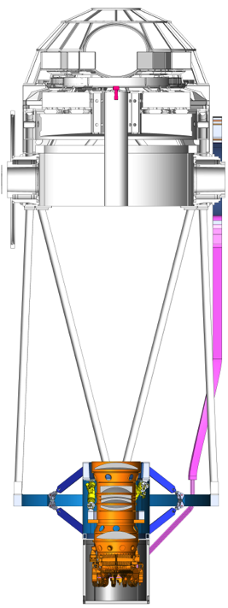
Focal Plane System
Guide / Focus / Alignment sensors – 1 per petal
  Guide star tracking feedback to telescope – 6 units
    Guide star catalog study to optimize guider area
  Focus and alignment data for hexapod – 4 units
Illuminated fiducials – 11 per petal
  Precisely surveyed to GFA sensors
  When viewed from near primary mirror through the corrector, provides optical distortion and mechanical deformations data
Fiber view camera (FVC)
  Observes illuminated fiducials …
  … and backlit fiber positioners
  Provides feedback to positioners to
  align fibers to guide stars
Fiducials are the
blue and red dots

Slide 23
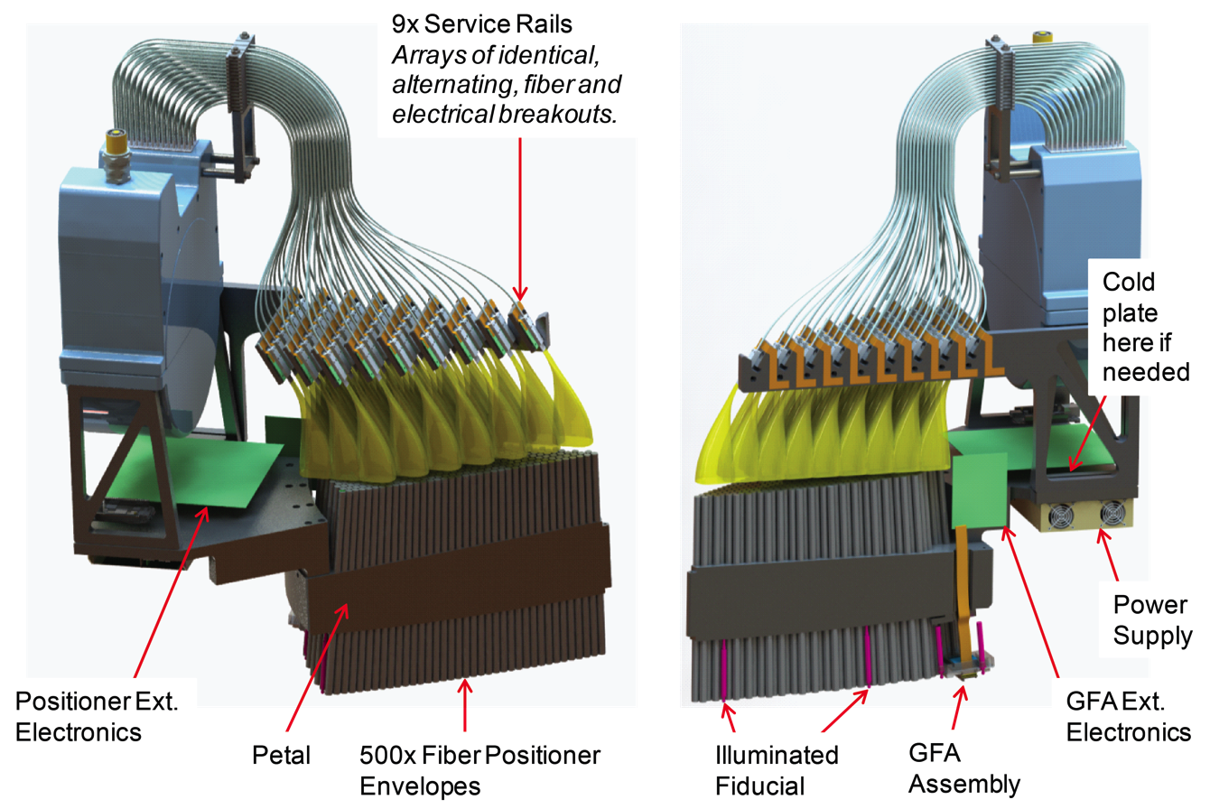
Focal Plane Petal System

Slide 24
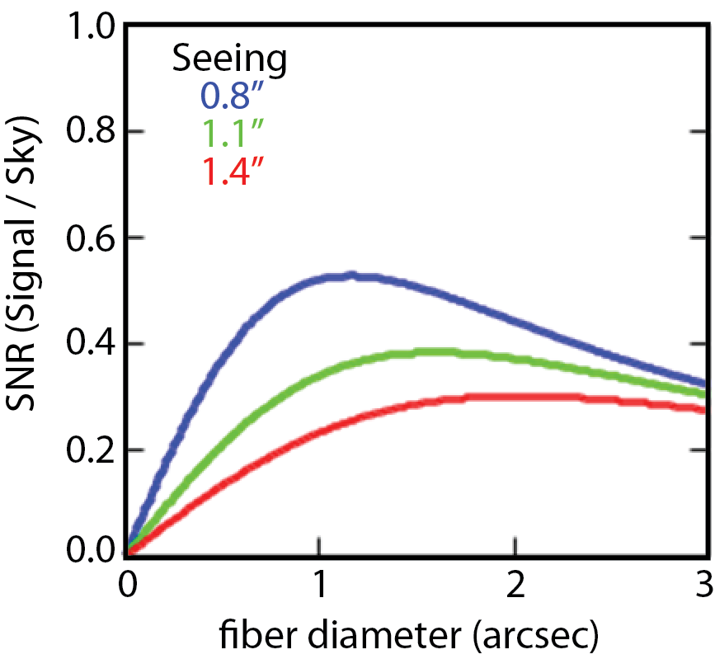

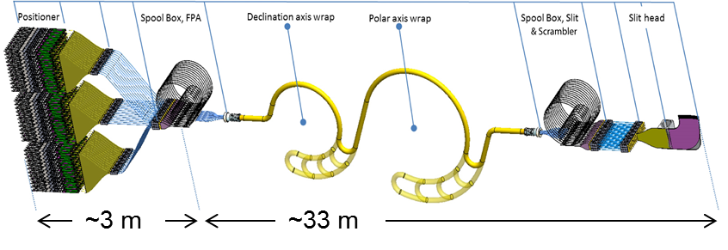
Fiber System
Requirements
  Maximize throughput
    Fiber core size –Φ107 μm (1.47 arcsec)
    Optimize fiber transmission and FRD
  90% of the output light within f/# > 3.57
Convolution of seeing
(Moffatt profile) and
galaxy shape (Sersic)
~35 m
5000 Positioners, 20 Spool Boxes, 10 Cables, 2 Wraps, 10 Slits

Slide 25
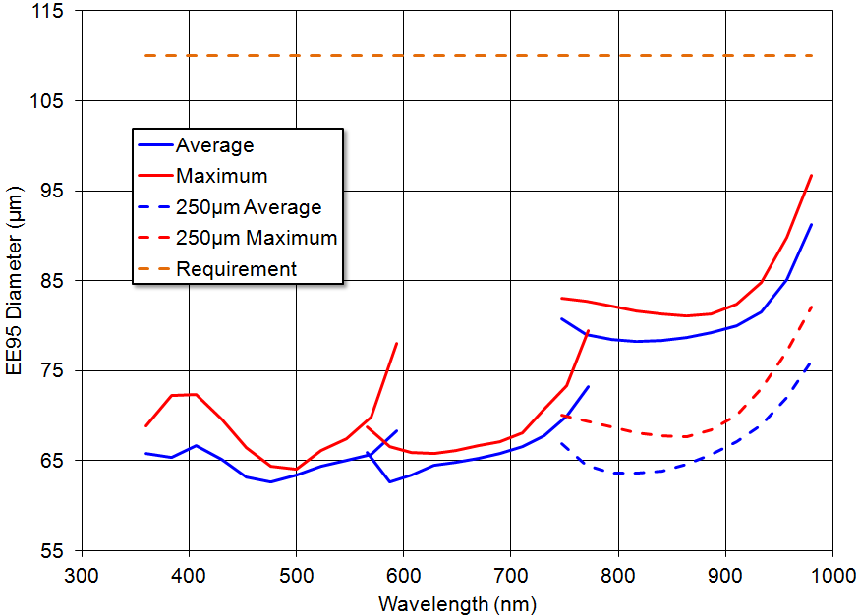
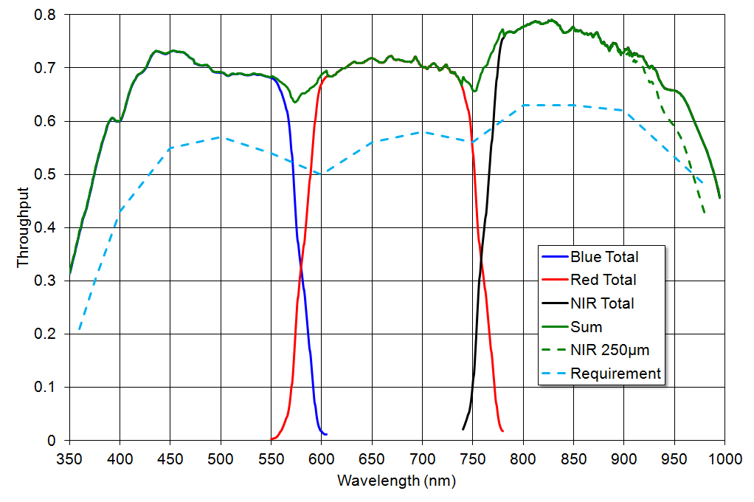
Spectrograph Requirements and Design
Spectral Resolution
Analysis includes:
geometric blur
fiber size
diffraction
CCD effects
requirement
Throughput
requirement
Spot Size
requirement

Slide 26
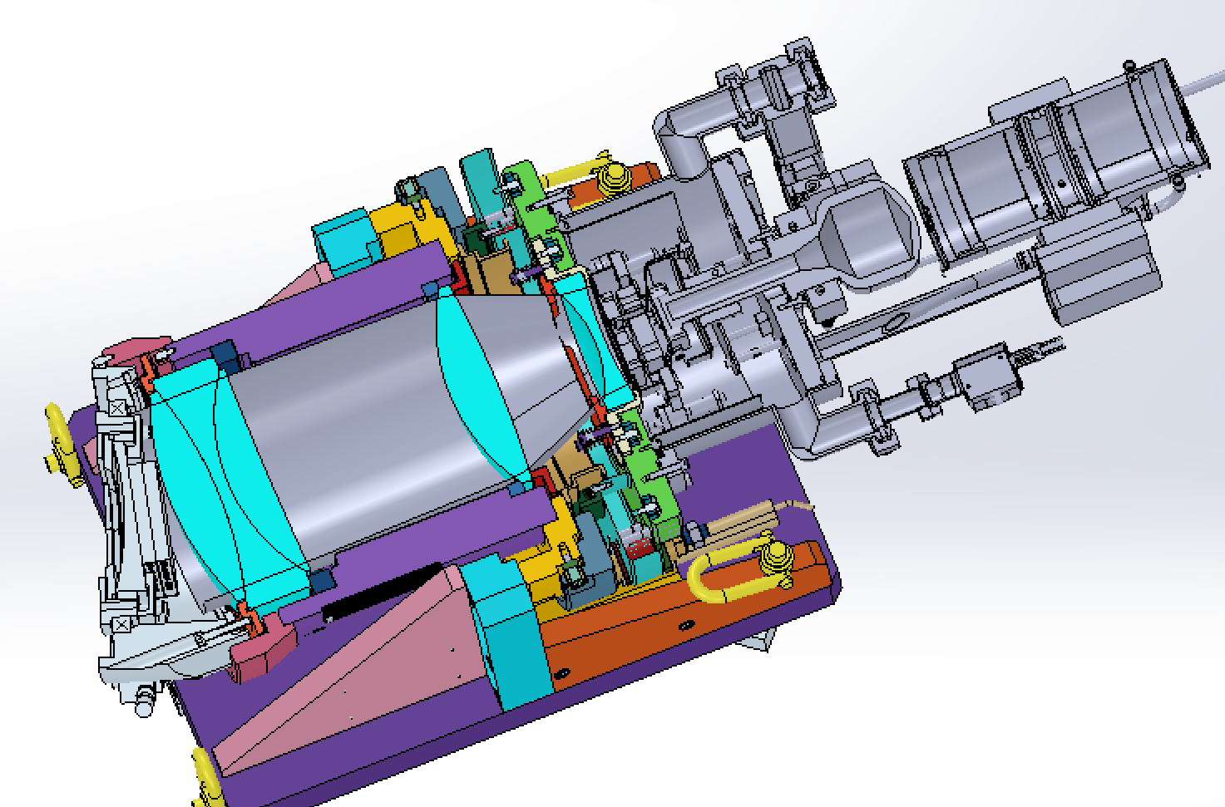
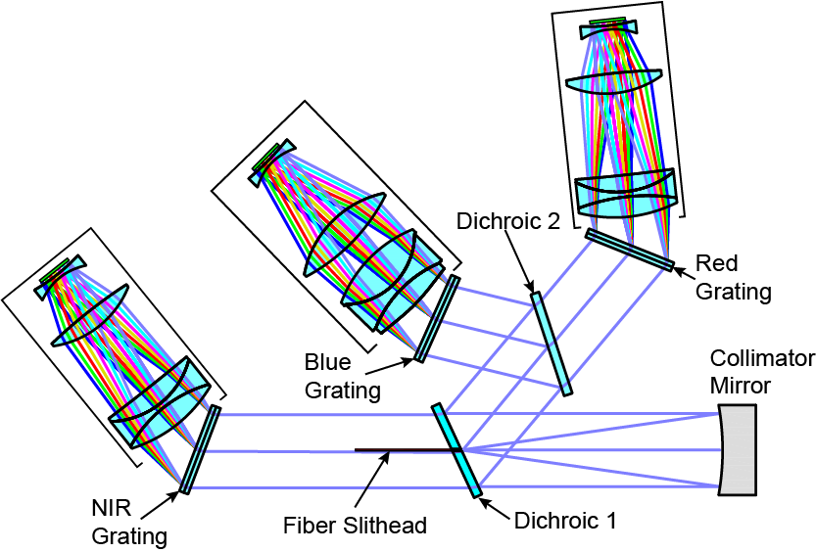
Spectrographs
Red Camera &
Cryostat / CCD
Prototype spectrograph currently under
construction, evaluation this summer
Red Camera
Blue Camera
  CCDs: 4096 x 4096, 15 μm pixel, 500 spectra
NIR Camera
~140 mm
26

Slide 27
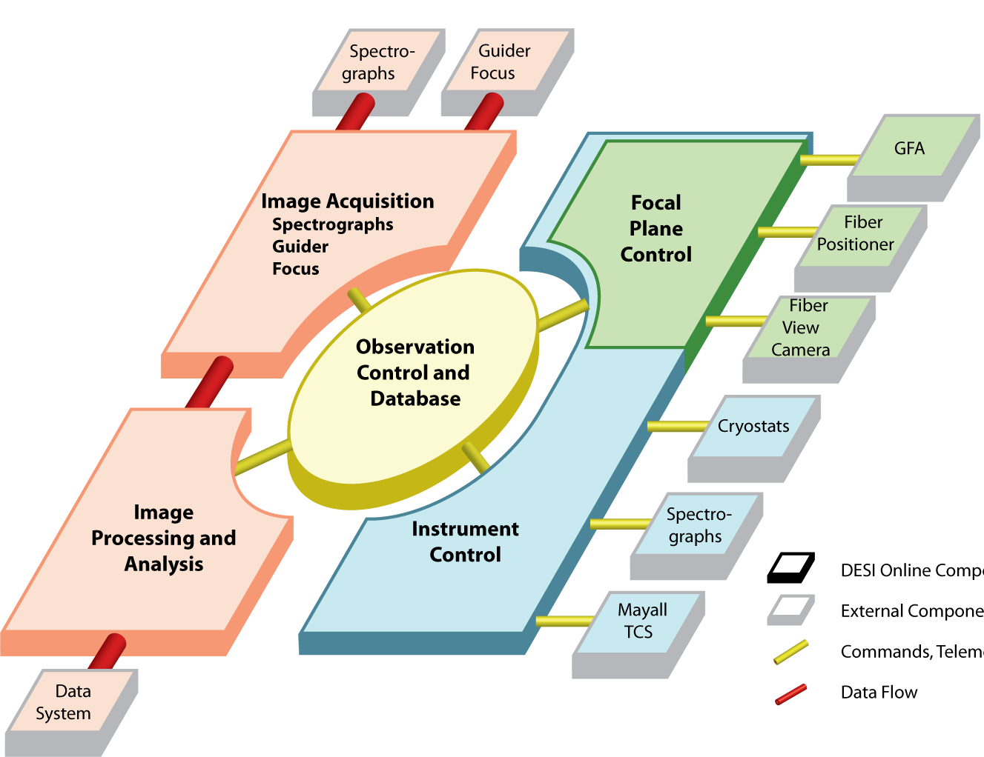
Instrument Readout and Control
Instrument and observation control, and telescope interface
Builds on DECam – same people, same components
Spectrograph and
GFA Data Modules
Hardware
Software
Modules
Online Data
Analysis
Mayall
Interface

Slide 28

Project Status
The project is making great progress. Main focus – keep the optics off the critical path with foundation grants (non-DOE funding)
Procurement of C1-C4 blanks is complete. Grinding and polishing is in progress (AOS and L3-Brashear).
Procurement of ADC blanks is in progress (Schott and Ohara) Polishing contract is being placed.
Expect all lenses to be complete by end of 2016.
C4
C1
C3
C2
Element | Diameter (mm) | Mass (kg) | Material | Aspheric surfaces
C1 | 1140 | 201 | Silica | 0
C2 | 850 | 151 | Silica | 1
ADC1 | 800 | 102 | N-BK7 | 0
ADC2 | 804 | 89 | N-BK7 | 0
C3 | 834 | 84 | Silica | 1
C4 | 1034 | 237 | Silica | 0
ADC2
ADC1

Slide 29
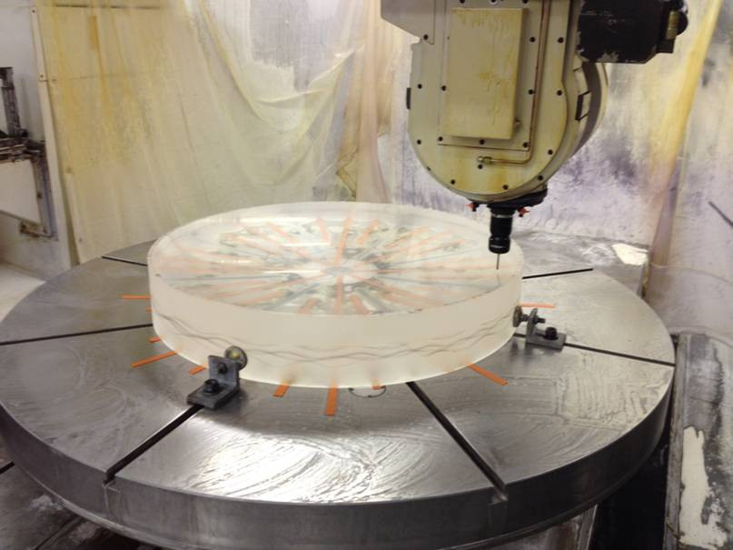
C1 Lens
C1 (1.15 m diameter) on the coordinate measuring machine at L3-Brashear immediately after completion of the concave surface machining.
C1 is well ahead of schedule

Slide 30
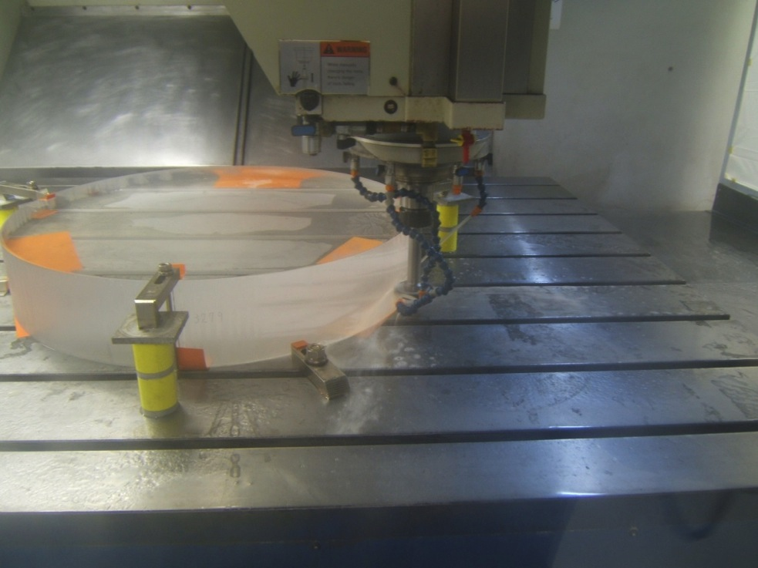
C3 Lens
C3 is in process on edging machine at Inventex. Is being ground to near net shape.

Slide 31
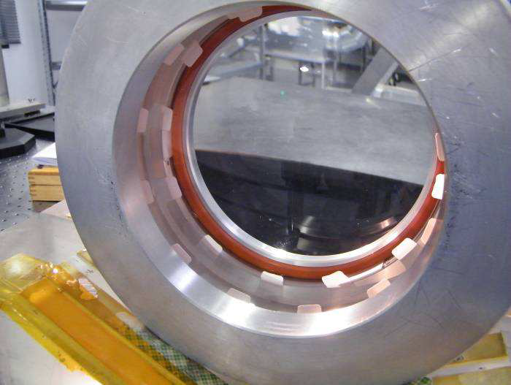
Spectrograph Oil Filled Lens
Blue Camera triplet lens test. Test structure with lenses to test oil seal. The oil interface between lenses provides exceptionally high throughput:

Slide 32
Project Status
Sept. 2014: Successful CD-1 review. DOE Funding profile negotiations nearly settled. Expect “advanced procurement authority” in Mid March 2015.
DOE CD-2/3a review scheduled for July 28-30, 2015 – this is the big one (~ Critical Design Review) - nails down the design, cost and schedule.
Spectrographs are the critical path (funding limited). Fabrication of a prototype will be complete and tested this summer.
DESI installation begins Jan. 2018. Start moving the telescope with DESI installed in Oct. 2018
On-sky commissioning will start in Jan. 2019 with 6 spectrographs, the rest arriving by July. DESI is the only instrument on the telescope
5 year DESI survey will start in Jan. 2020 (after a 6m science verification period)

Slide 33
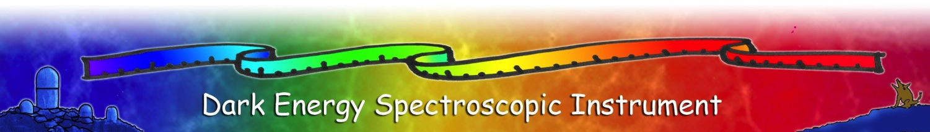
Conclusion
DESI builds on the long and successful experience of multiple collaborations in defining, building and executing wide area surveys to study the formation of our universe and the mystery of Dark Energy
  SDSS, BOSS, DES
DESI will essentially complete BAO measurements in the northern sky out to redshift of 1.5, plus RSD and limits on neutrino masses
Technical design of DESI is mature, Private/non-DOE funding being used for lenses and prototype spectrograph
Strong support from DOE: CD-2/3a baseline review scheduled for July 2015.
On track for on-sky commissioning <4 years from now in 2019!

Slide 34
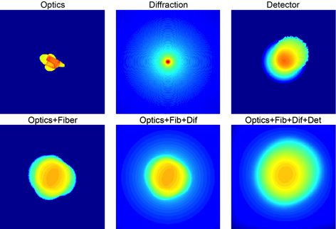
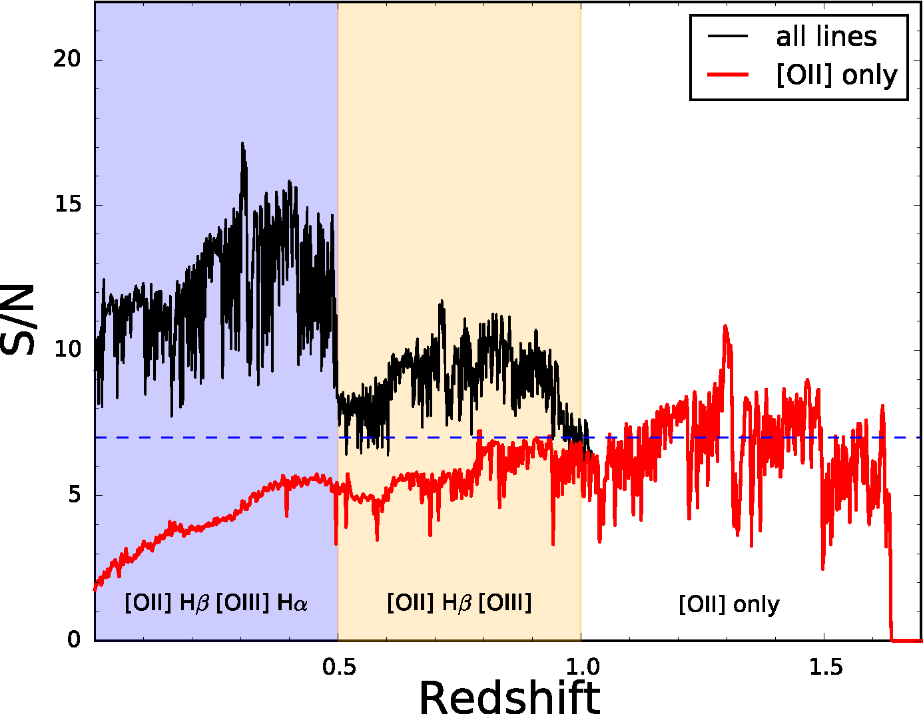
Design Concept Validation
Event generation – creates emission line galaxies
Corrector PSF across the focal plane
  Measured Mayall seeing, PSF, and Moffat profiles
  Zemax transport galaxies to fiber input
Spectrograph – pixel level simulation
  Zemax transport from fiber output to CCD
  Detector response – incident angle, depth of
  conversion, diffusion
1D spectrum fitter – feature S/N extraction
Uses for instrument design
  CCD read noise
  Exposure time
  [OII] resolution
  ELG SNR >7 on [OII] for 8,9,10x10⁻¹⁷ erg/….

