Slide 1
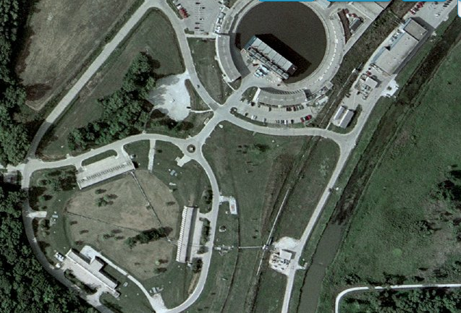
P1, P2 and AP-1 Aperture Improvements
February 5, 2015
J. Morgan

Slide 2
Beam Transport AIP
BT1 Beam Transport AIP ($5,402k)
  BT1.01 Management ($380k)
  BT1.02 RR Extraction system ($2,200k)
  BT1.03 RR to P1 Beamline Connection ($1,170k)
  BT1.04 Beam Transport to Delivery Ring ($1,652k)
  BT1.04.01 Beam Line Aperture Improvements ($875k)
  BT1.04.02 Beam Transport Electrical Infrastructure ($183k)
  BT1.04.03 Beam Line Instrumentation and Controls ($594k)

Slide 3
Beam Transport AIP
BT1.04.01 Beam Line Aperture Improvements
  BT1.04.01.01 Beam Line Magnets
  BT1.04.01.02 Beam Line Power Supplies
  BT1.04.01.03 Beam Line Installation and Mechanical
  BT1.04.01.04 RR to AP0 Target Station and RR to M3 Line Optics

Slide 4
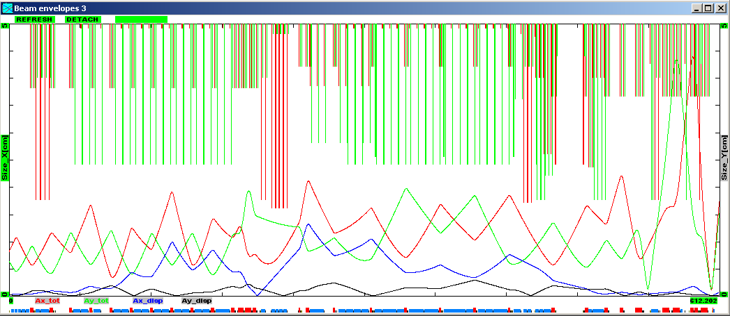
Aperture Improvements
MI-52 Lam. / V701 C-magnets
Replace by new RR to P1 Line
V714 C-magnet
Replace with B2
Tev. F0 Lambertsons
Remove
F-17 C-Magnets
Replace with CDA
HV102 dipoles
Replace with MDC’s
Final Focus
SQx triplet
HV100 dipoles
Replace with MDC’s

Slide 5
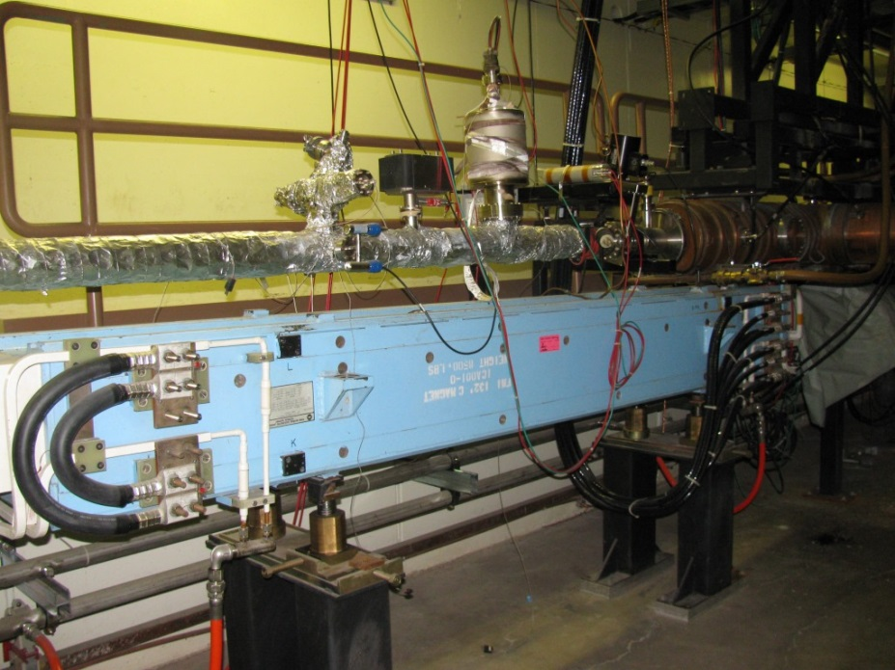
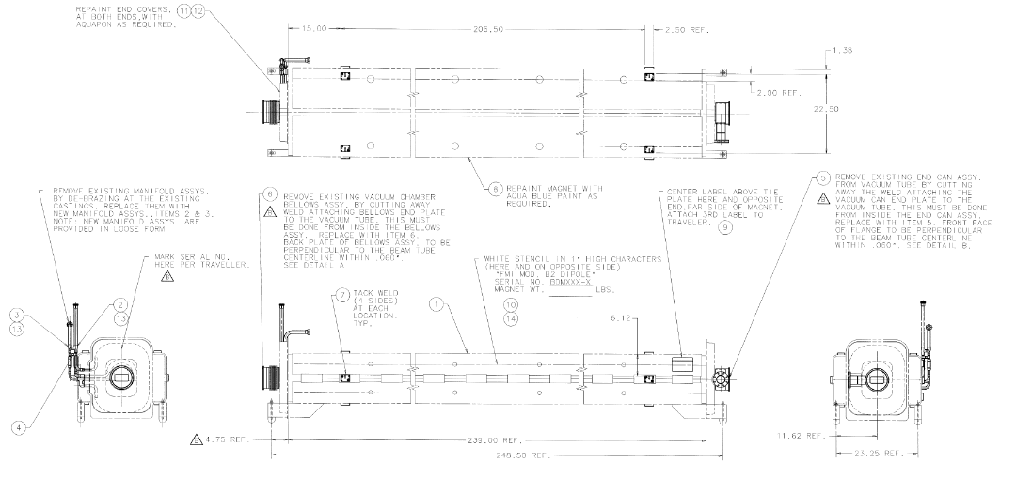
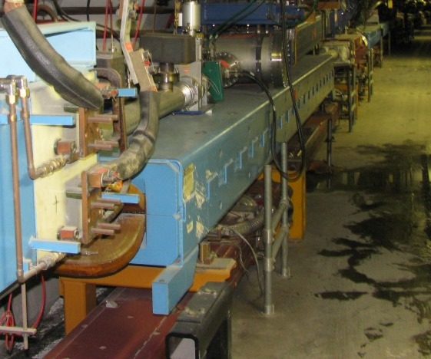
V714 C-Magnet
No longer needs to be C-Magnet due to end of Tevatron operation
  1.5 inch pole gap, tight physical aperture
  C-Magnet probably still has enough aperture, based on historical optics.
B2 magnet currently planned as replacement
  2 inch pole gap
  Relatively inexpensive to refurbish
  20 feet instead of 11 feet long, similar operating current
  May be challenging to squeeze in

Slide 6
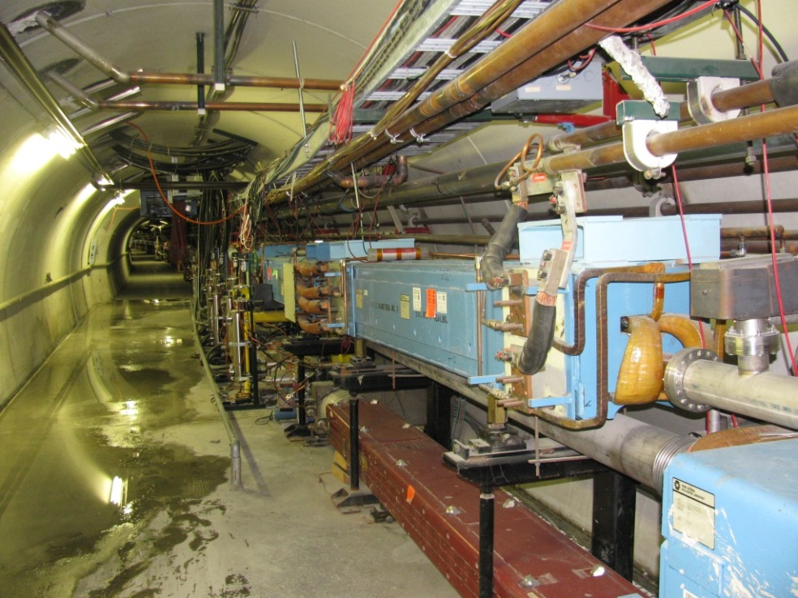
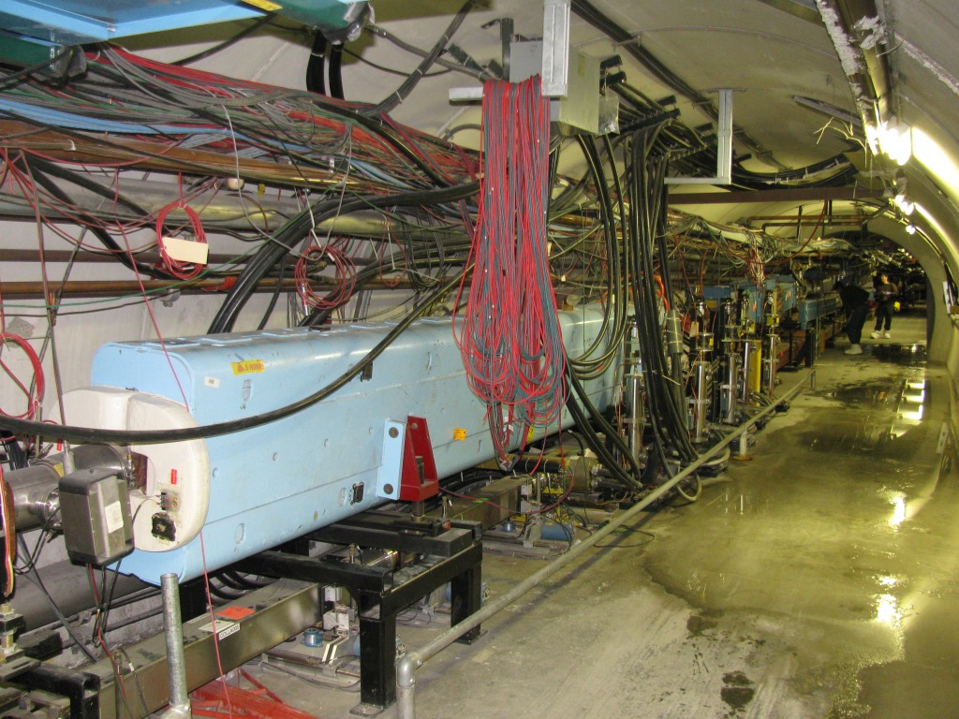
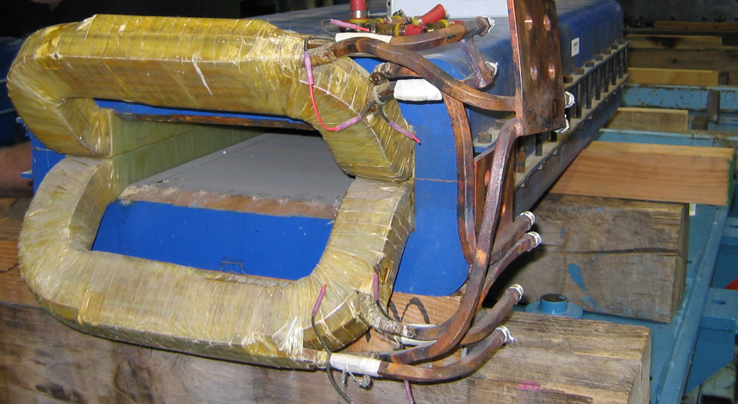
F-17 C-Magnets
C-Magnets required to clear P3 Line
  1.5 inch pole gap, tight physical aperture
  Historical loss point
CDA (Cooling Ring dipole) and new geometry
  3.25 inch pole gap, 12 inch pole width
  Can be located after F17 B3 dipole, allows C-Magnets to be eliminated (limits energy to <40 GeV)
  With proper placement, can be bused with F17B3

Slide 7
Progression of upstream AP-1/M1
Extraction from Main Ring (8/120 GeV)
P2 to AP-1 Line (8/120 GeV)
P2 to M1 Line (8 GeV)

Slide 8
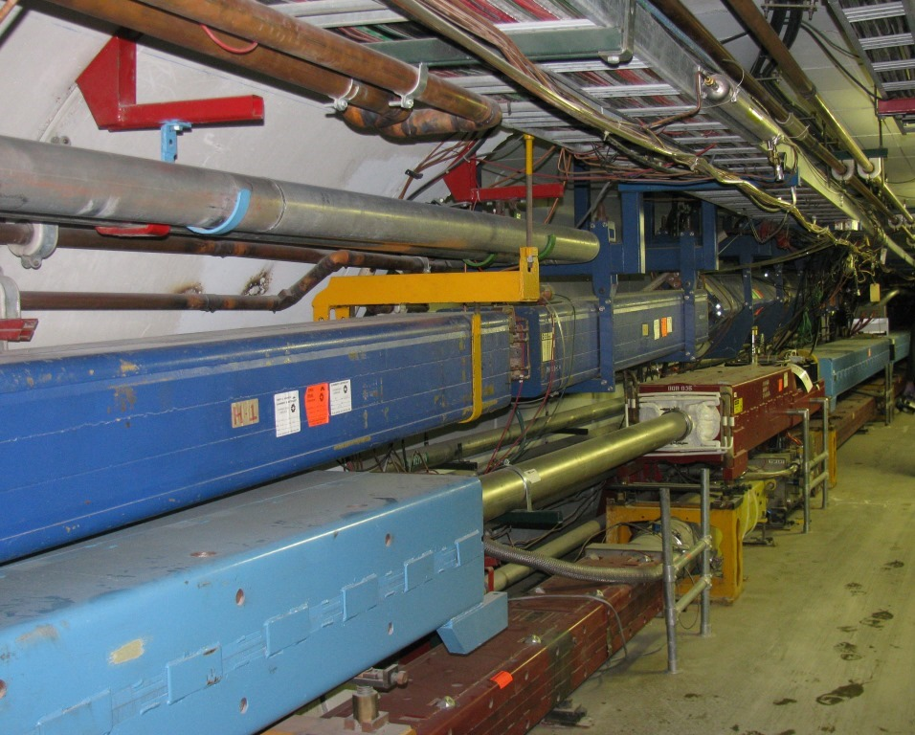
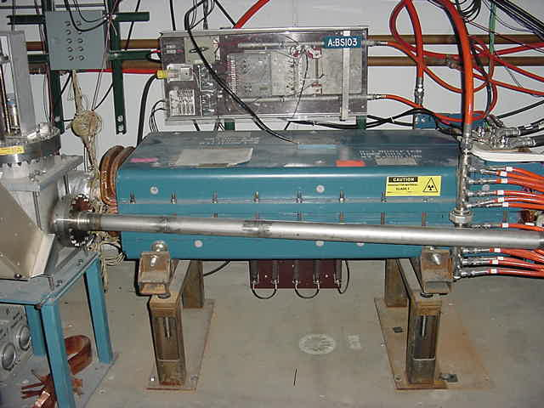
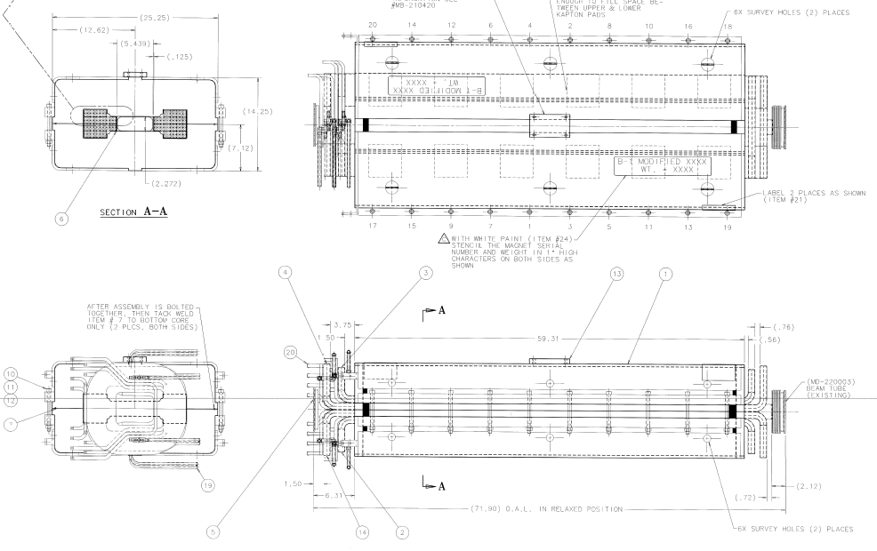
HV100 4-EPB dipole string
Strong magnets required to run 120 GeV
  1.5 inch pole gap, tight physical aperture
  Historical loss point
  10 feet long
Two MDC dipoles used as replacements
  2.25 inch pole gap, 5.25 inch pole width
  Limits energy to <40 GeV
  Located at PB1/2 and PBR1/2 junctions

Slide 9
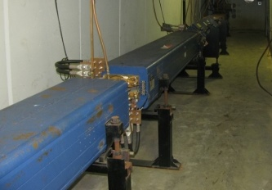
HV100 4-EPB dipole string
Strong magnets required to run 120 GeV
  1.5 inch pole gap, tight physical aperture
  Historical loss point
  10 feet long
Two MDC dipoles used as replacements
  2.25 inch pole gap, 5.25 inch pole width
  Limits energy to <40 GeV
  Located at PB1/2 and PBR1/2 junctions

Slide 10
Beam Transport AIP
BT1.04.02 Beam Transport Electrical Infrastructure
  F-23 power panel upgrades
  F-27 power panel upgrades
  F-27 cable tray extension
  Transport cable tray modifications
  Work completed in December and January !

Slide 11
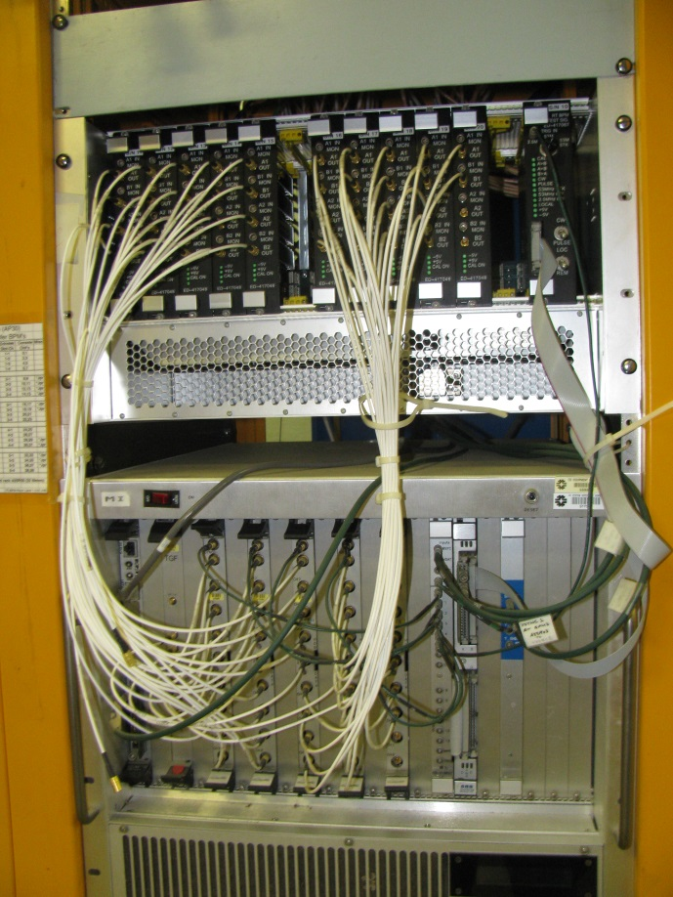
AIP Controls and Instrumentation Work
Echotek BPMs
Controls
  Hardware in place. RRBS configuration complete.
Toroids
  Repurpose P1 & P2 Toroids
  Repurpose existing 3.5” toroids, plus purchase three new 6” toroids (M1, M2 and M3).
BPMs
  Repurpose P1, P2, M1
  Fully populate Echotek BPM electronics at F23, F27 and AP30 to provide coverage for 53 M3 line BPMs.
  Repurpose spare Echotek digitizers and transition boards.
  Build additional transition cards.
  New cable pulls for M3 (F23, F27, AP30).
BLMs
  Upgrade P1, P2, M1 and M3 to Tev-style VME electronics (unexpected free parts!).
  New cable pulls for M3 (AP0 and AP30).
SEMs
  Repurpose P1 and P2 Multiwires.
  Remove failing M1 SEMs and refurbish at NWA.

