Slide 1
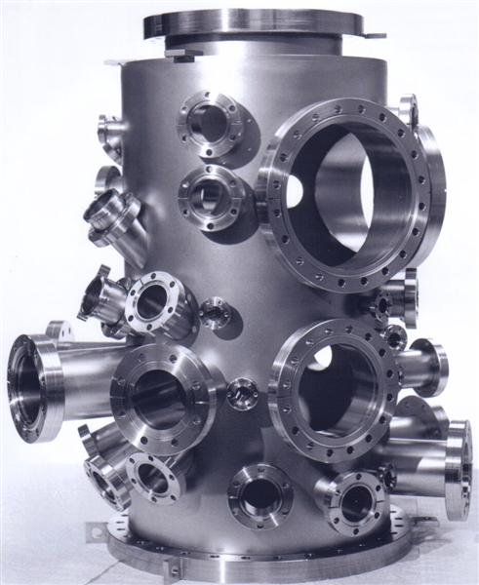
Changes to the D10 Vacuum System in the Delivery Ring

Slide 2
Problems in he straight …
The D10 vacuum was modified to work with the old stochastic cooling systems.
More vacuum valves than we need and arranged so there are parts of the straight we cannot vent or pump down independently of the rest of the straight.
Over pumped – more ion pumps than necessary in some places.
Under pumped – one section with no ion pumps, only a roughing port.
Can’t use the old coasting beam valve safety system. We need a new two valve (redundant) system.
Cryo pressure relief vents that may end up as vacuum leaks in the Mu2e era (rubber O-rings).

Slide 3
Other things we need to do …
DEKIK needs to be removed and replaced with a spool piece.
The old ESEP D-Chamber through D6Q6 needs to be replaced with a spool piece and the old BPM on the upstream end reinstalled.
Old horizontal and vertical schottky’s need removal.
Other misc. parts to remove

Slide 4
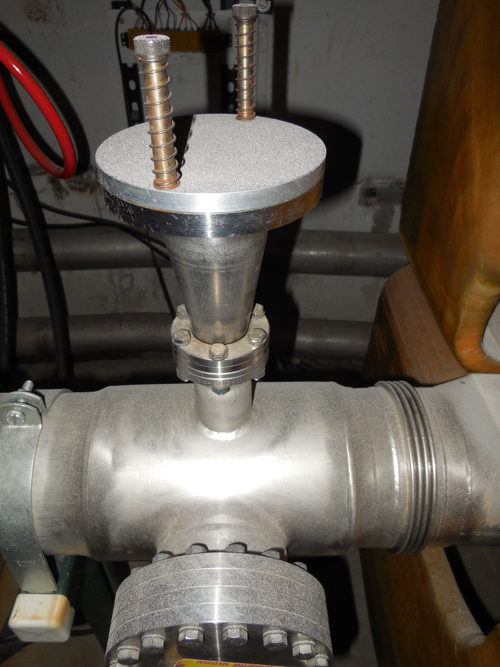

Slide 5
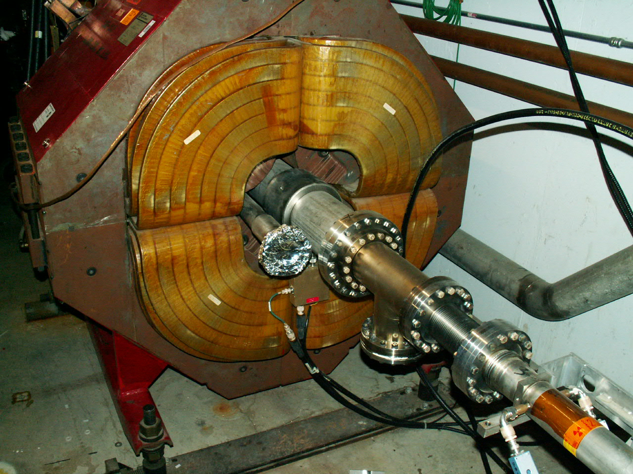

Slide 6
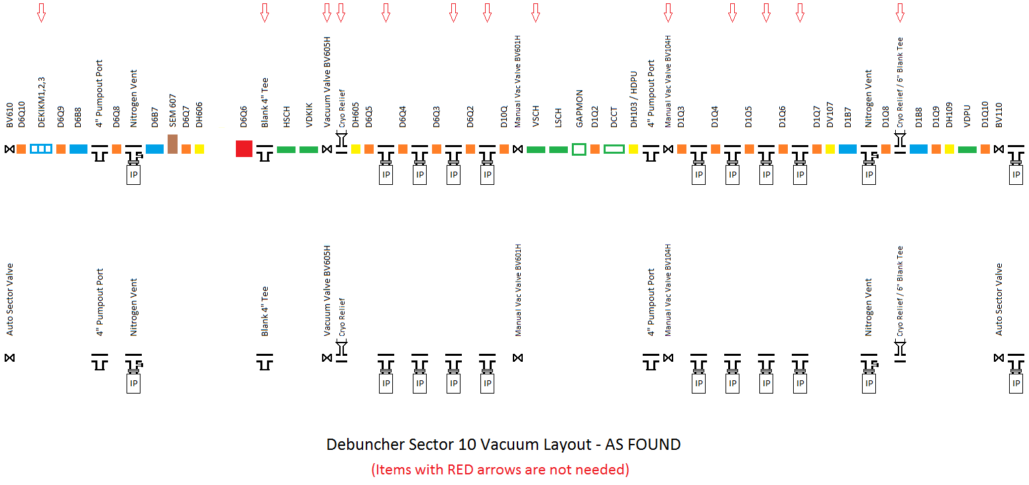

Slide 7
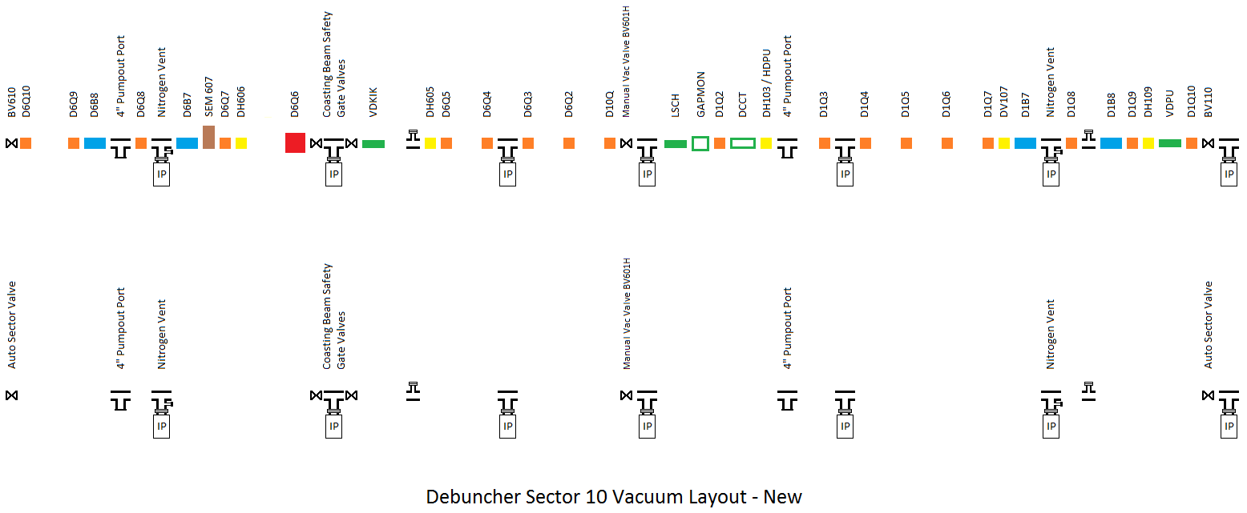

Slide 8
Afterword …
Four fewer ion pumps in the D10 straight for use elsewhere.
On average, better pumping than we have in the arcs.
Better apertures.
No isolated areas were we have to let up or pump back down an adjoining section to recover the vacuum.

