Slide 1
Delivery Ring AIP Update
Jerry Annala
Muon Dept Meeting
5 February 2015

Slide 2
Scope and Status
$9.1M in Accelerator Improvements
Collider equipment removal (95% complete)
Controls-new links to campus (95% complete)
Electrical Infrastructure (50% complete)
Instrumentation (0% complete)
Power supplies
2 pulse septa ( % complete)
2 kickers ( % complete)
Shunts and trims ( 0% complete)
Magnets (< 1% complete)
Installation(5% complete)
Total of project (25% complete)

Slide 3
Current Project Activity
Installing electrical infrastructure in AP30
Will move to AP50 infrastructure next month
Magnetic Septum Power supplies
Design is complete
Procuring parts
Assembly will begin in the next couple of months
Kicker Power supplies
Various stages of design, procurement, and assembly of various subsystems.
Controls will soon pull fiber and safety system cables from AP30 to AP0, F27, F23.
Installation – AP2 line is down and the abort steel will be placed soon. Trying to make arrangements for installing abort line magnets.

Slide 4
Operations update
Beginning Software development
Estimated 5.5 man years of software effort
We have met with Jim Patrick and Bill Marsh to arrange support
Have met with John DeVoy about implementing Auto-tune for the Muon Campus beam lines.
Abandoned Cable Remediation
Al Sondgeroth and Bernie Wisner coordinating
Estimated just over 2 man years of effort
80% removal of Accumulator instrumentation cable
??% removal of abandoned cable in transport.
Needs to be complete by September 2016.

Slide 5
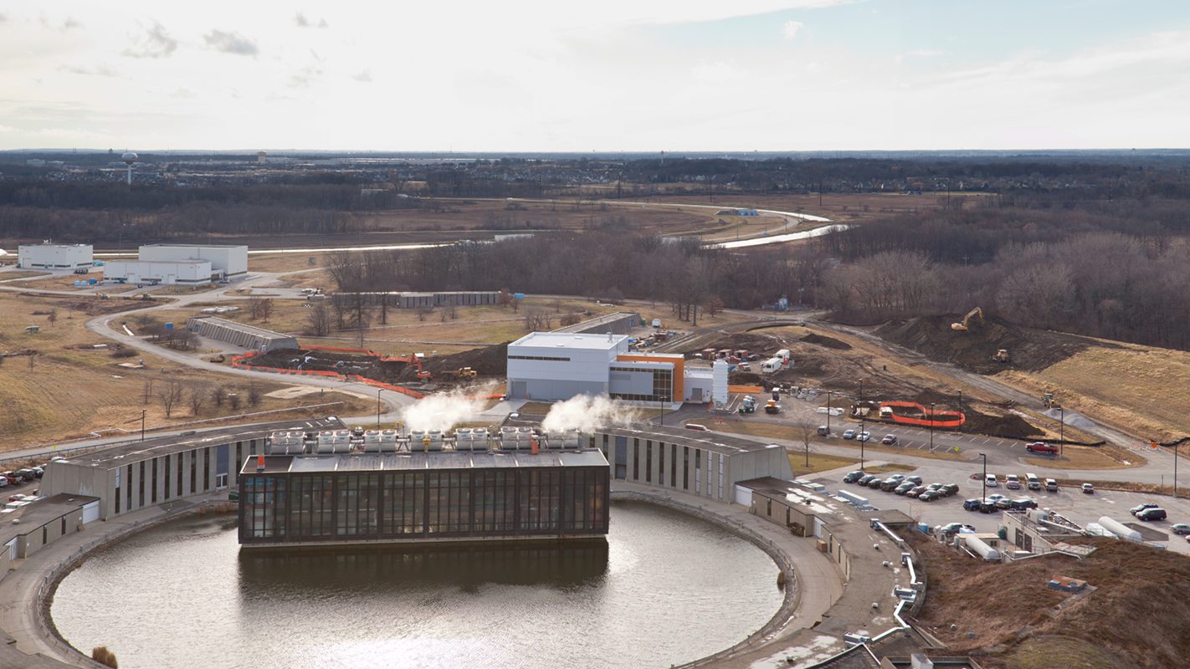
Tunnel GPP update
BO estimated in about 1 year
24% complete as of this date.

Slide 6
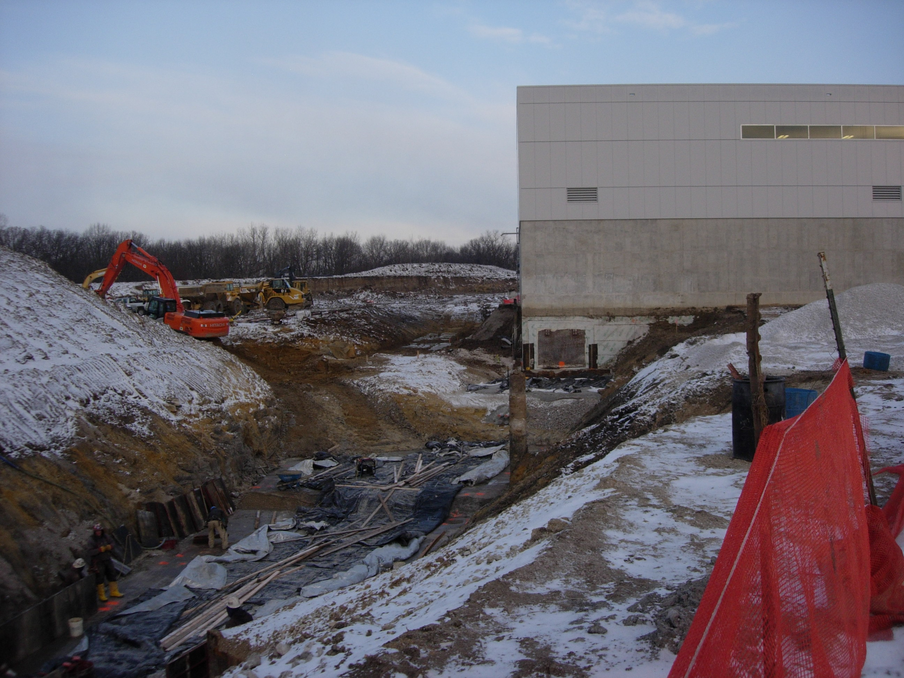

Slide 8
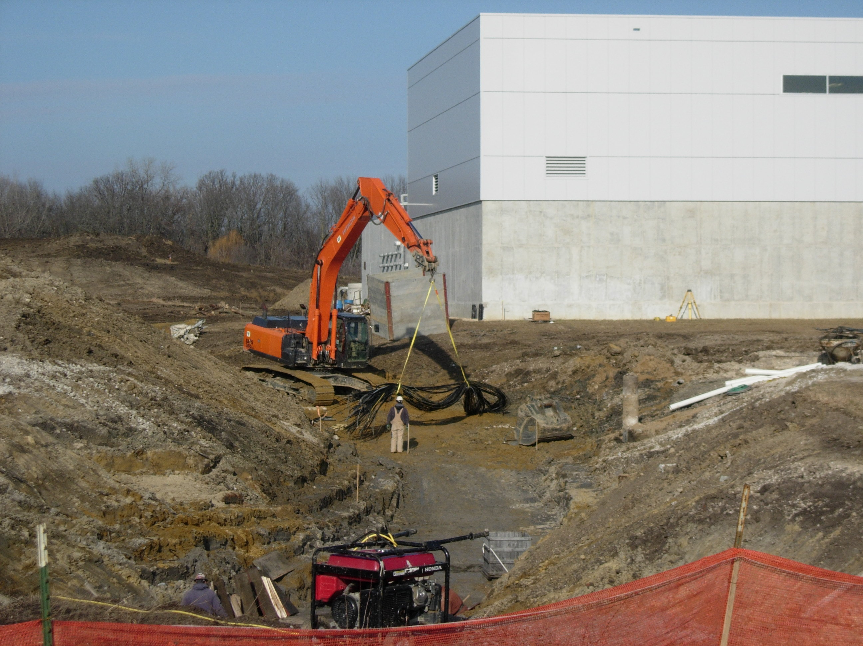

Slide 10
