Slide 1
Superconducting RF:
Resonance Control
Warren Schappert
PIP-II Machine Advisory Committee
10 March 2015

Slide 2
SRF Cavity Detuning
SRF cavity cells often formed from thin (2-4mm) sheets of pure niobium to allow them to be cooled below superconducting transition temperature
  Thin walls make cavities susceptible to detuning from vibration
  Detuned cavities require more RF power to maintain accelerating gradient
  Providing sufficient RF reserve power to overcome cavity detuning increases both capital and operational cost of machine
Controlling cavity detuning critical for current generation of machines, (LCLS-II, PIP-II, ERLs, etc.) that employ very narrow bandwidth cavities
  For machines with very narrow bandwidth cavities, e.g. ERLs, detuning can be the major cost driver for the entire machine

Slide 3
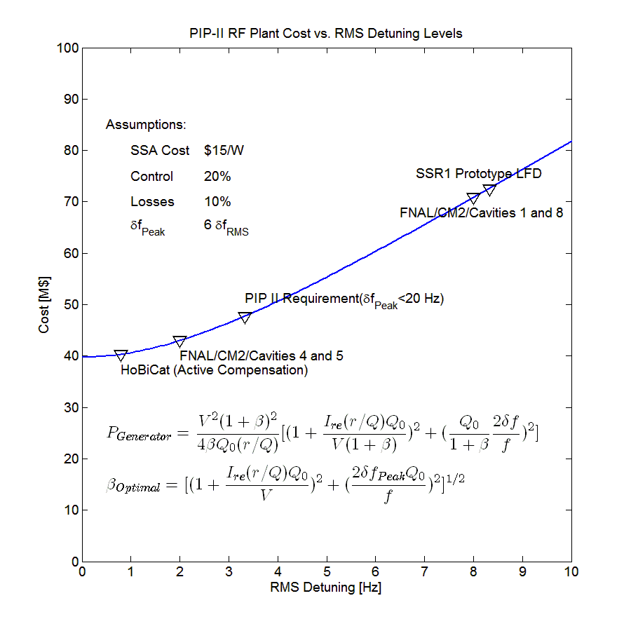
Cost of Cavity Detuning
Detuned cavities require more RF power to maintain constant gradient
PEAK detuning drives the RF costs
    Beam will be lost if RF reserve is insufficient to overcome PEAK detuning
  Providing sufficient reserve increases both the capital cost of the RF plant and the operating cost of the machine

Slide 4
Controlling Cavity Detuning
Cavities may be detuned by either deterministic sources or non-deterministic sources
  Deterministic sources include
    Radiation pressure on cavity walls (Lorentz Force)
  Non-deterministic sources include
    Cavity vibrations driven by external noise sources
    Helium pressure fluctuations
Cavity detuning can be controlled using either passive or active measures
  Passive measures include
    Suppressing external vibration sources
    Reducing cavity sensitivity to sources of detuning, e.g. df/dP, LFD,…
  Active measures include
    Sensing cavity detuning in real-time and using piezo or other actuators to actively cancel detuning
      Deterministic sources may be cancelled using feed-forward
      Non-deterministic sources require feed-back

Slide 5
Controlling Detuning in the PIP-II Cavities
PIP-II design calls for narrow bandwidth (f_{1/2} ≅30 Hz) cavities operating in pulsed mode
  Narrow bandwidth makes cavities susceptible to vibration induced detuning
  Pulsed mode LFD can excite vibrations
PEAK detuning of PIP-II cavities must be limited to 20 Hz or less
  PIP-II cavities will require active detuning compensation of both LFD and microphonics during routine operation
    Will require combination of
      best LFD compensation achieved to date
      AND best active microphonics compensation achieved to date
      AND 24/7 operation over hundreds of cavities for several tens of years
No examples of large machines that require active detuning control during routine operation currently exist
 | N | f | Q₀ | r/Q | E | L _{Effective} | Voltage | Current | Control | Losses | P_{Beam}
 |  | MHz | 10⁹ | Ω | MV/m | m | MV | mA | % | % | kW
HWR | 8 | 162.5 | 5.0 | 275 | 9.7 | 0.21 | 2.01 | 2 | 20 | 10 | 4.02
SSR1 | 16 | 325 | 6.0 | 242 | 10.0 | 0.21 | 2.05 | 2 | 20 | 10 | 4.10
SSR2 | 35 | 325 | 8.0 | 296 | 11.4 | 0.44 | 4.99 | 2 | 20 | 10 | 9.99
LB650 | 33 | 650 | 15.0 | 375 | 15.9 | 0.75 | 11.86 | 2 | 20 | 10 | 23.72
HB650 | 24 | 650 | 20.0 | 609 | 17.8 | 1.12 | 19.92 | 2 | 20 | 10 | 39.84

Slide 6
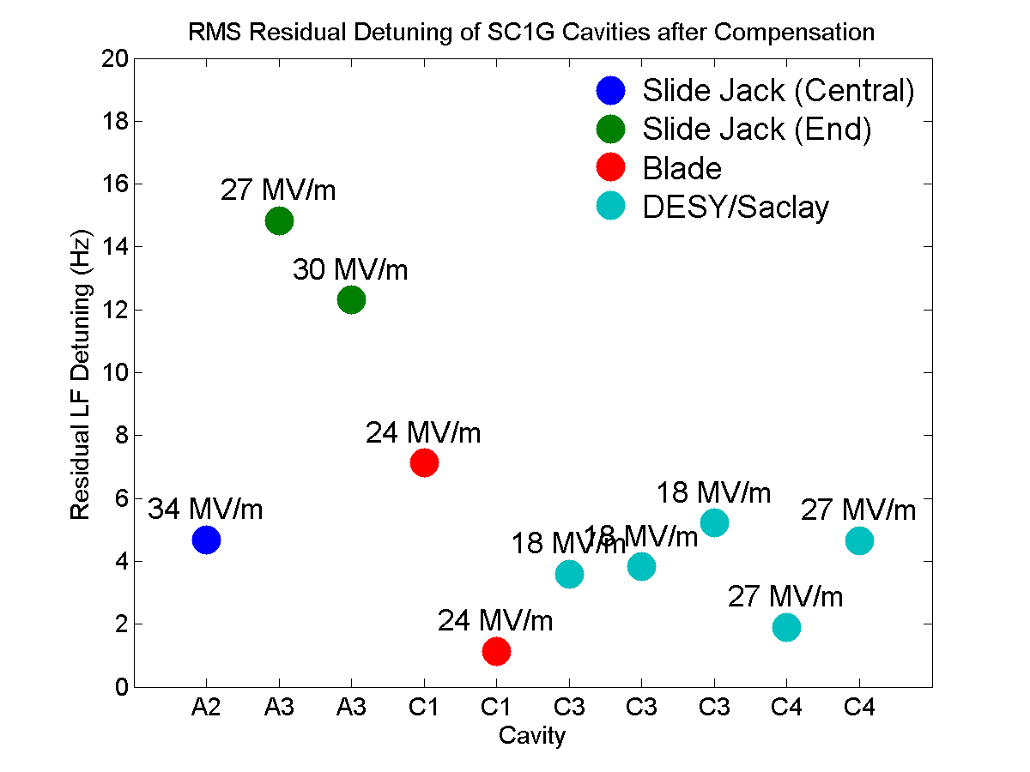
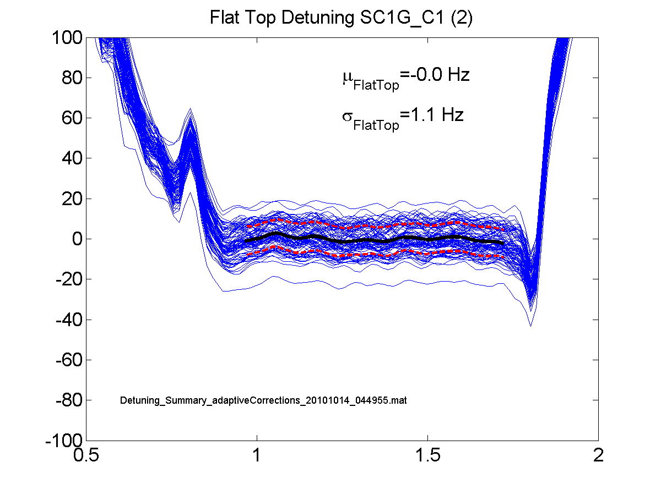
LFD Compensation at FNAL
Adaptive feed-forward LFD compensation system developed at FNAL for ILC cavities
System tested with four distinctly different cavity designs during S1G tests at KEK in 2010
  Uncompensated detuning ranged between several tens to several hundreds of Hz depending on the design
  Compensated detuning limited to <20 Hz in all four cavity types
System is in routine use in NML/CM2 and HTS

Slide 7
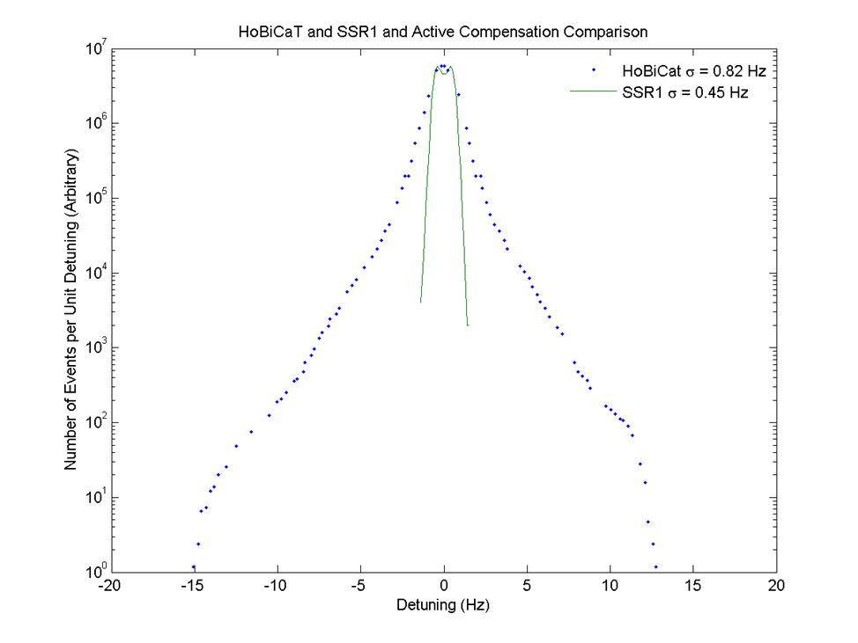
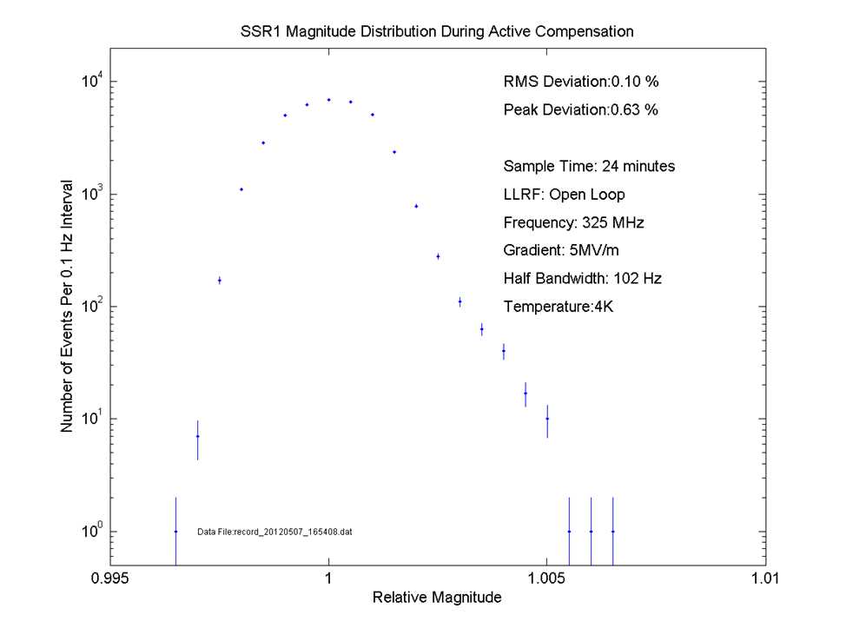
Microphonics Compensation at FNAL
1.3 GHz elliptical cavities
    Damp individual mechanical resonance lines by 15 dB
1st SSR1 prototype
  Fixed frequency/ fixed amplitude RF with piezo feedback
  Frequency stability
    0.45 Hz RMS
  Magnitude stable to
    0.10% RMS
    0.63% Peak over 20 minutes

Slide 8
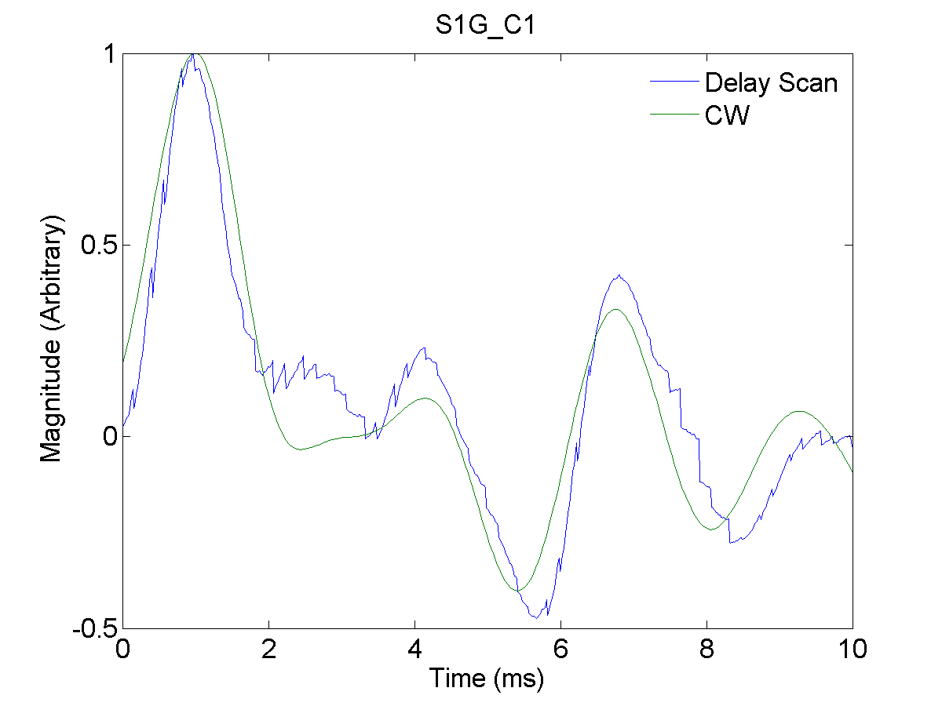
Adaptive Feedforward LFD Compensation
Learning phase
  Apply a series of short stimulus pulses to the piezo at different delays with respect to the RF Pulse,S(t_{Piezo},n_{Pulse})
  Measure the detuning response of the cavity during the flattop, R(t_{Flattop},n_{Pulse})
  Calculate the transfer function, T = (S^{T}S⁾⁻¹(S^{T}R)
    Equivalent to CW measurement of piezo impulse response
Compensation Phase
  Measure the detuning during the flattop, D(t_{Flattop})
  Determine piezo pulse required to cancel out detuning,
    P = -(T^{T}T⁾⁻¹(T^{T}D)
  Iterate to suppress any residual detuning

Slide 9
Detuning Control Program for PIP-II
Demonstrate CW Microphonics Compensation
Demonstration of feasibility is current focus
Focus must shift at some point to engineering a robust integrated electro-mechanical control system
Reliable operation can only be ensured by extensive program of testing of both components and integrated system
Demonstrate Pulsed LFD Compensation
Prototype Integrated Electro-mechanical Controller Development
System Engineering
System Validation and Testing

Slide 10
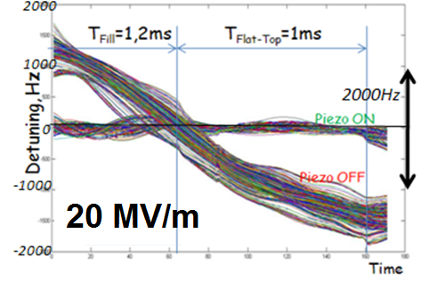
Feasibility of LFD Compensation for PIP-II
LFD compensation measurements using previous SSR1 prototype
  Short test
  Good results but do not meet PIP-II specs
SSR1 Pulsed mode studies with prototype tuner and prototype coupler will commence shortly
  Slower fill
  Improved understanding
 | Detuning
 | Uncompensated |  | Compensated
Gradient | Flattop | Full Pulse | Flattop
MV/m | Hz | Hz | Hz
13 | 450 | 900 | 30
22 | 1450 | 2500 | 75

Slide 11
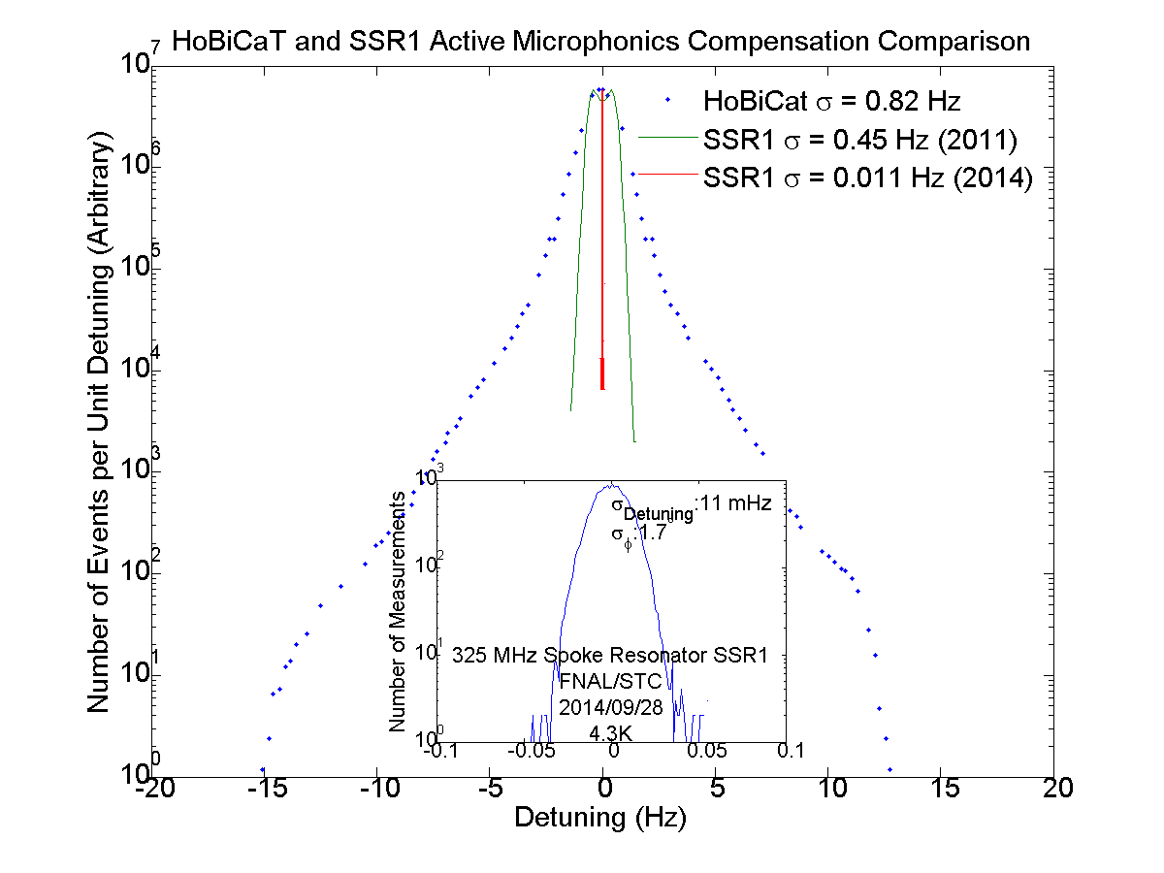
Feasibility of Microphonics Compensation for PIP-II
Very encouraging results from recent test of SSR1 prototype in STC provide reason for CAUTIOUS optimism
  σ_{Detuning}=11 mHz in open loop RF over 2 hour period
    Piezo but no slow tuner
    Narrow bandwidth power coupler
    Resonance frequency stabilized using a combination of
      Feed-forward LFD compensation
      Fast feed-back on forward/probe phase
      Slow feedback on detuning
      Synchronous down-conversion
  Almost two orders of magnitude improvement compared with best previously published results (HoBiCaT)
  More than an order of magnitude compared to best previous results at FNAL
More tests in immediate future using prototype tuner and power coupler

Slide 12
Integrated Electro-Mechanical Controller
  Measure SSR1 mechanical transfer functions
  Detuning response to mechanical and LFD excitations as a function of frequency
Extract low order approximation to transfer mechanical functions
  Minimal State Space Realization (MSSR) algorithm of Kalman and Ho
Construct optimal coupled electro-mechanical filters and controllers from low-order transfer functions
  Kalman filter
  Linear Quadratic Gaussian Regulator
    Recursive, weighted, least-squares fit at each point in time minimizes quadratic cost function that depends on transfer-functions and noise covariance

Slide 13
System Engineering for PIP-II
Detuning control crosses boundaries between divisions and between disciplines
  Robust system required for machine operation
Focus must shift need to shift towards engineering high-reliability system
  Integration of algorithms with LLRF control system
  Will require extensive testing of all hardware, firmware, software
Cryogenic
Fluctuations
External
Vibrations
Compensation Algorithms
RF Signals
Piezo
Tuner

Slide 14
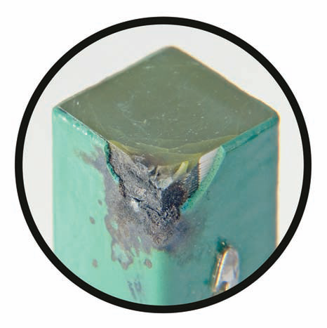
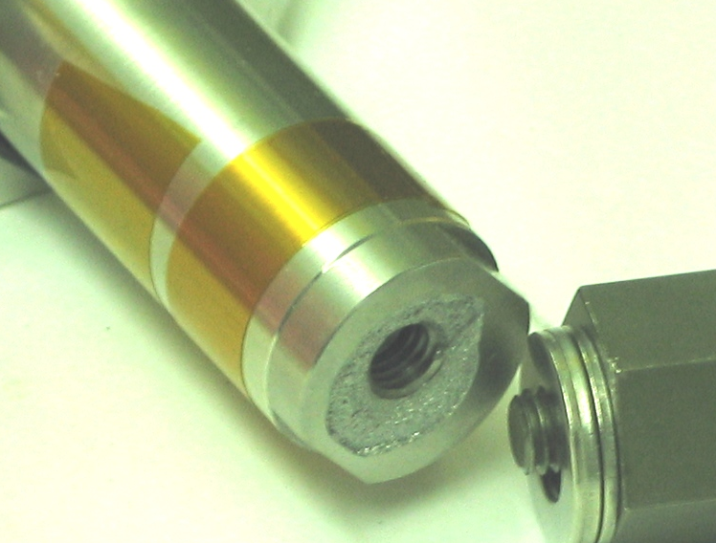
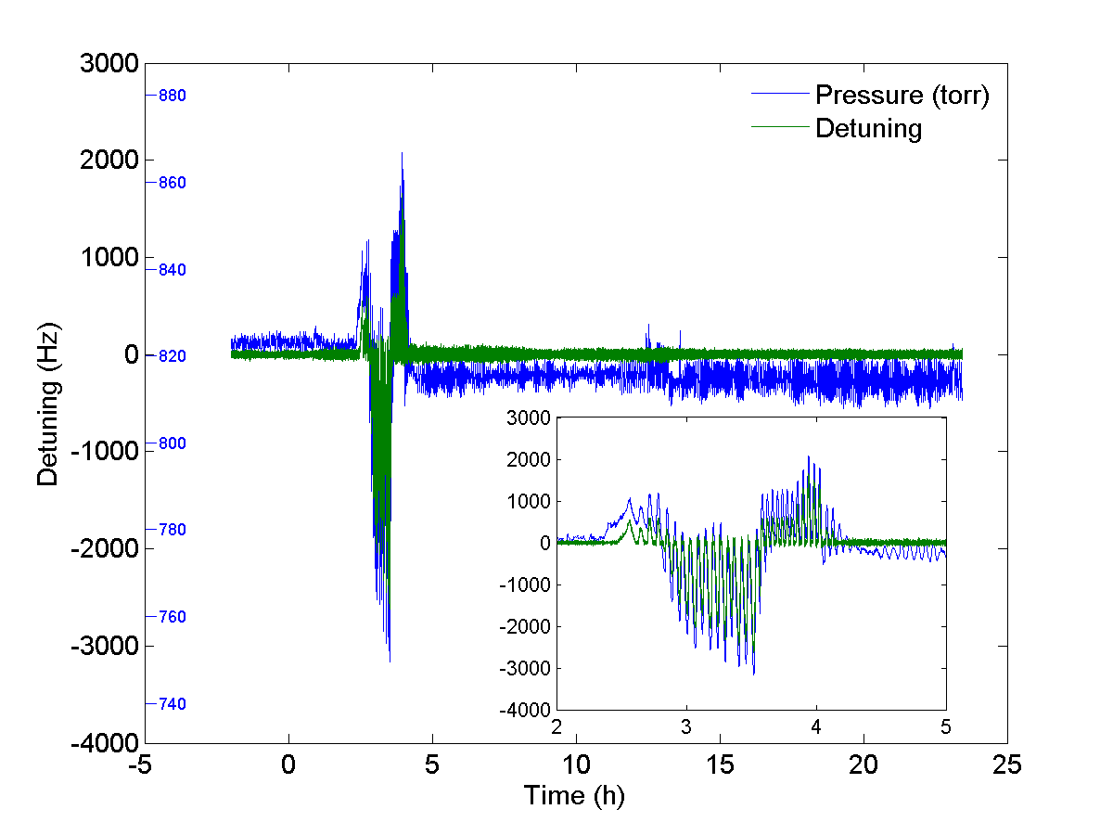
Component and Integration Testing
Extensive component and integration testing required for reliable operation
Experience at FNAL with blade tuner for ILC cavities
  Everything that can go wrong will go wrong
Experience at other labs
  MSU
  JLab
  SNS
  Cornell
  HoBiCaT

Slide 15
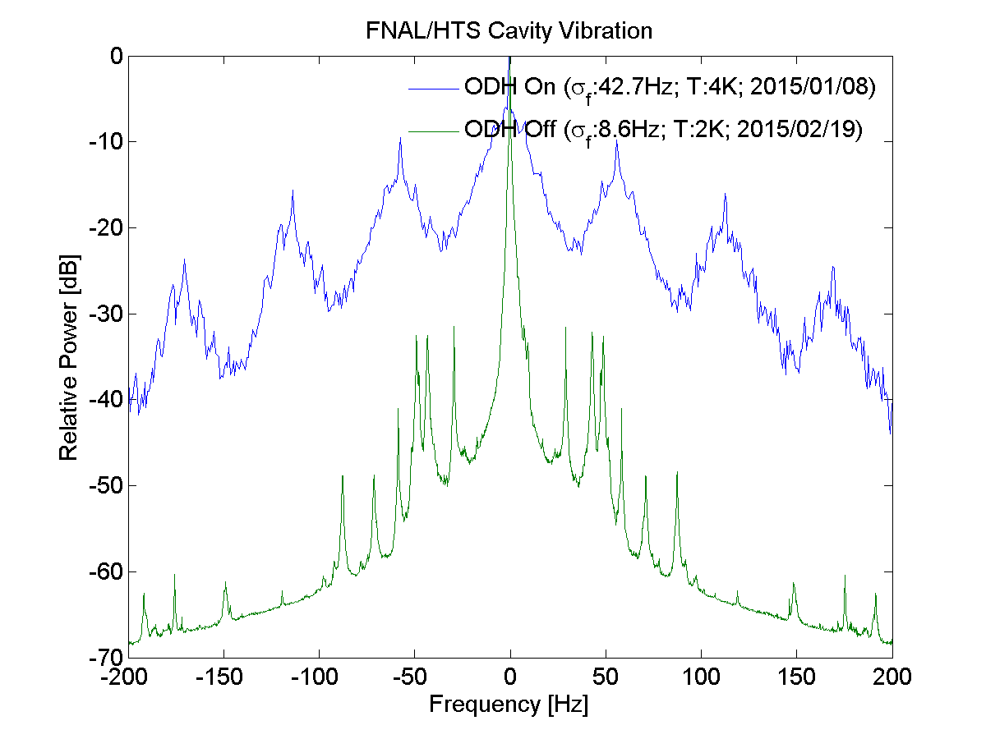
Cross-disciplinary Challenges
Minimizing cavity detuning requires careful optimization across entire machine
  Cavity design, cryomodule design, RF plant, cryogenic system design, civil engineering
    Cross-disciplinary challenges may be more daunting than technical challenges
Large potential costs if any aspect ignored
  Small design changes may have large impact on cavity detuning
  Cost of fixing microphonics afterwards could be very high
Some structure within PIP-II organization will be required to coordinate effort amongst groups and disciplines
  Education and communication
  Vibration related reviews

Slide 16
Looking Forward
Upcoming tests of SSR1 offer opportunity to
  Finalize CW algorithms
  Investigate pulsed mode operation
  Measure expected RF and performance parameters
Focus must then shift to integration of algorithms into an integrated electro-mechanical control system
  Will require close collaboration between TD/RC and AD/LLRF groups
Robust system will require careful system engineering and extensive testing of all hardware, firmware and software
Need to arrive at consensus on mechanism(s) within PIP-II organization to coordinate detuning control efforts

Slide 17
Conclusions
Controlling cavity detuning will be critical for successful operation of PIP-II because of narrow cavity bandwidths (f_{1/2}~ 30 Hz)
  Narrow bandwidths would be challenging even with CW operation alone
  Pulsed mode operation brings significant additional complications
All possible passive measures must be exploited but active control will still be required
  Will require both best LFD and best microphonics compensation achieved to date operating reliably over many cavities and many years
    Early test results provide reason for CAUTIOUS optimism
  There are no existing examples of large machines that require active control of detuning during routine operation
  Cross-disciplinary challenges may be more difficult to solve than technical challenges (which are still considerable)
    Minimizing cavity detuning requires optimization of entire machine
    Will require active coordination across divisions and across disciplines

